Slide 1
Mindful Change Leadership Development Program
Week 4 (of 8)
May 20, 2024
Notes:
Casey-Marie:
J’aimerais vous rappeler que vous pouvez utiliser la langue de votre choix pour exprimer vos commentaires ou vos questions au courant de la session.
By now, you know you can use the language of your choice to express your comments or questions

Slide 2
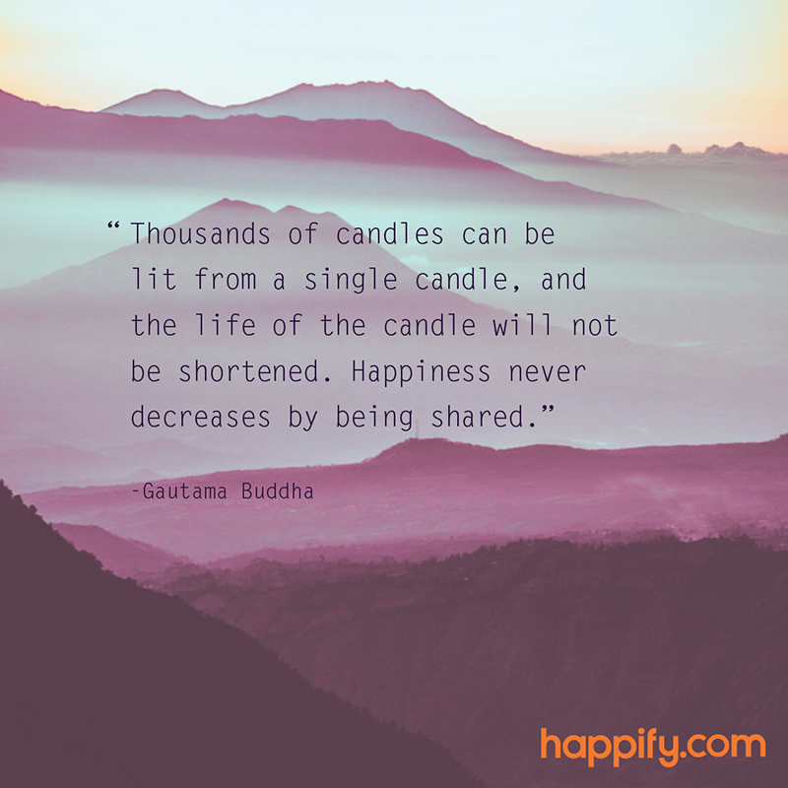
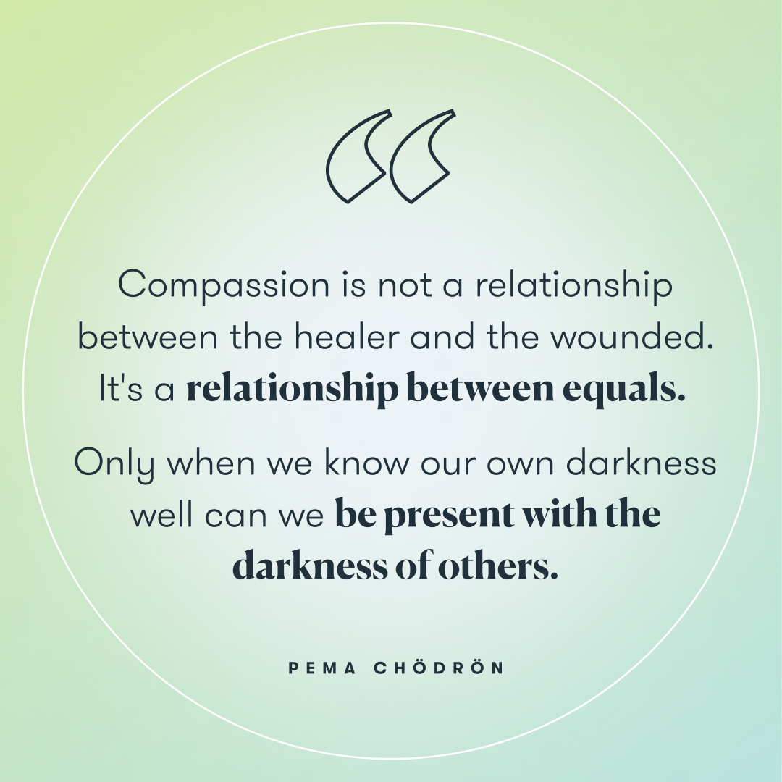

Today we will do a Mindfulness Water drinking exercise, please go grab a small glass of water
Notes:
Casey-Marie:
Prep… (Friendly reminder: prep for sharing audio & video, including English CC and 100% font size)
3 mins - What is Self-Compassion - Part 1: https://www.youtube.com/watch?v=Tyl6YXp1Y6M
(optional) 5 mins - Self-compassion Break: https://self-compassion.org/wp-content/uploads/2020/08/self-compassion.break__01-cleanedbydan.mp3
2 mins - How to Practice Mindful Emailing: https://www.youtube.com/watch?v=qBBy5Jx_xrQ
3 mins - Updated the Monkey and Panda story: https://www.youtube.com/watch?v=5nsySCMH36s

Slide 3


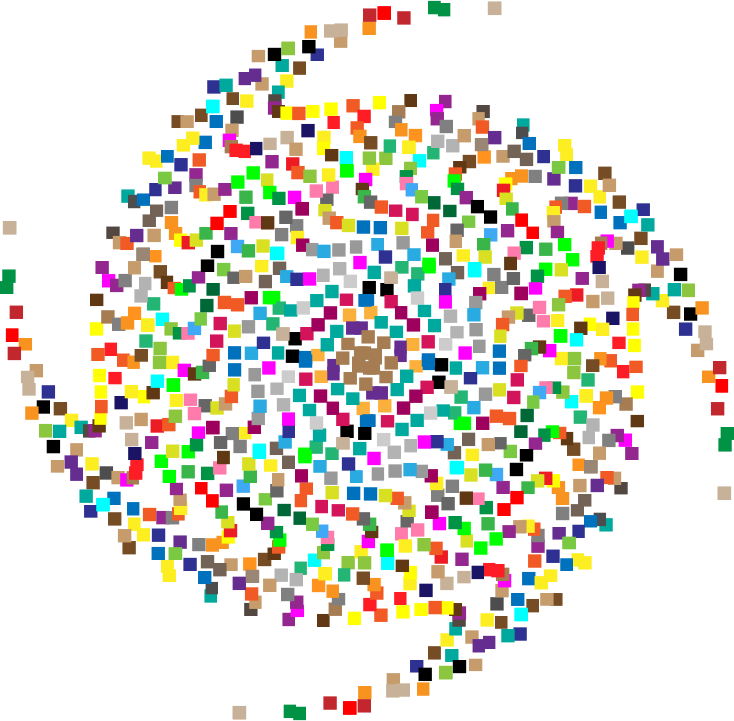
Mindful Breathing Exercise – Centering
Notes:
Casey-Marie:
Let's start by doing a mindfulness breathing exercise.
Sit as comfortably as possible in a position that allows you to be awake, attentive or attentive and at ease at the same time.
You can put your feet flat on the floor; and rest your hands on your knees, palms up or down, whichever is more comfortable for you.
Feel free to close your eyes or close them halfway.
Follow my voice, which will guide you during the exercise.
Gently pay attention to your breathing. No need to change the way you breathe; just notice your breathing.
Don't worry about time.
Just pay attention:
On inspiration
At expiration
If at any point your mind wanders, be kind to your reason, acknowledge that thought, let it go, and bring your attention back to the object of your attention, which is your breath. .
Inspiration
Expiry
Now we are going to take a full minute of self-awareness breathing.
I'll have you sign when the moment has passed.
Just keep focusing on your breathing.

Slide 4






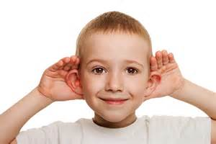


Debrief from last week (3)
Any Insights you’d like to share
Your Buddy Sytem
Your practice
anyone need re-pairing?
Notes:
Casey-Marie:
Please raise your hand to speak, or type in the chat… let’s have about 3 people sharing any insights you experienced or noticed from last week’s practice
Including
the gratitude journaling.
the Mindfulness Breathing or Body Scan,
The Mindful Listening
The mindful decision making/taking
I wish you happiness
(clic)
And ayone who may need re-pairing, either because you haven’t been able to agree on when to meet, or someone abandonned the program?
Just consider, you have the list of people involved, email them if you see need. And don’t need to cc us in the discussion except to confirm the change, so we can update the Buddy System file.

Slide 5

Agenda – week 4
Centering breathing exercise
Debrief from last week 3
Today’s intentions: Compassion & Clarity
Mindfulness – Water drinking
Mindful Cleaning Your Environment
Mindful Self-Compassion
Self-Compassion theory
Compassionate Leader: I wish you happiness
Your take away assignment
Notes:
Casey-Marie:

Slide 6
Mindfulness – Water drinking
With your back straight, sit as comfortable as possible
Gently bring attention to your breath
Let’s take a moment to think about the origins of this water
As you continue breathing...
Think about the time it took for this water to come to you...
Notes:
Casey-Marie:
(while guiding this exercise, take the time needed, go slow, pause… we should take good 5 minutes to do this)
With your water glass in your hand think about the origins of water continue your breathing and focus or the water
Let’s travel a bit back in time to the origins on how this water you’re about to drink came to be
Many billions of years back, there was the big bang, and the universe started to form
Another many millions of years passed by and our galaxy and our solar system formed
After many other millions of years our planet earth cooled down and was able to produce water, life, animals and us, the humans
Now, think about the journey the water made to come to you, about its source, and its natural cycle,
it evaporates, turns into a cloud, it rains, it’s captured in lakes and rivers,
it is then collected by the water service of your region, it may go through a treatment plant, and taken and brought home, and arrive with us either via the tap water or bought in a plastic bottle for us to drink
And now, appreciating how lucky we are, to have clean water to drink at will,
Hold the container in your hand, sense its temperature,
Although water is said not to have odor, try to smell (particularly if you have at hand something other than water), and appreciate it
Now take a sip, take the extra time to savor it, feel in your mouth its temperature,
and now pass it through your throat, enjoy absorbing it, how it hydrates your body
Take another sip, and repeat the savoring and then pass it… and stay there for a couple of seconds enjoying the feelings
And when you’re ready, I invite you to open your eyes and come back

Slide 7


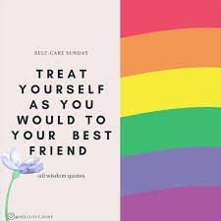
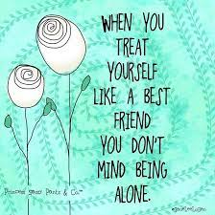
What about “Self-Compassion”?
Become your own best friend
be kind to yourself, as you’d be to others
Quand tu te traites comme un(e) meilleur(e) ami(e), tu n’as pas peur d’être seul(e)
Traite-toi comme tu traiterais ton meilleur ami
Notes:
Casey-Marie:
And then, what we understand by self-compassion?
(have 2/3 answer, then)
Simply said
(click and read x4)
« Become your own best friend »
« be kind to yourself, as you’d be to others »
« Treat yourself as you would to your best friend »
« When you treat yourself like a best friend, you don’t mind being alone »

Slide 8
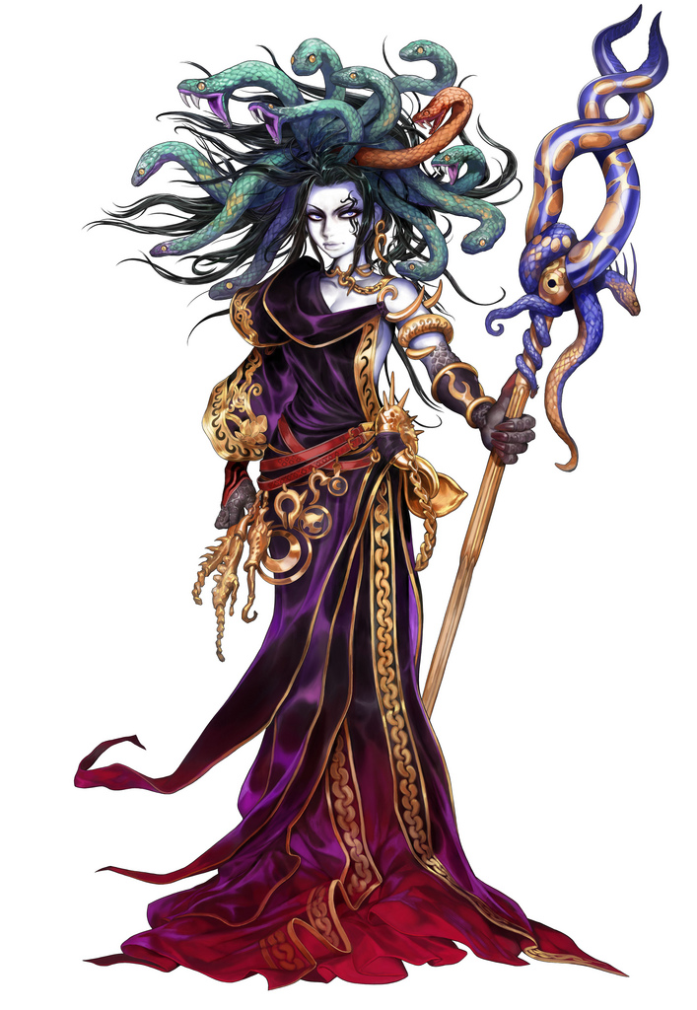
The Five Myths of Self-Compassion
For most people, compassion is a most laudable quality.
Conversely, self-compassion has a negative connotation for many people.
The Five Myths of Self-Compassion – article, addresses these legends:
Self-compassion is a form of self-pity
Self-compassion means weakness
Self-compassion will make me complacent
Self-compassion is narcissistic
Self-compassion is selfish
Greater Good Science Center - Kristin Neff’s article: http://greatergood.berkeley.edu/article/item/the_five_myths_of_self_compassion
Notes:
Casey-Marie:
People do not see any problem seeing compassion as a thoroughly commendable quality particularly unto others.
Compassion refers to good qualities, like kindness, understanding, empathy, with an impulse to help
However, self-compassion may be seen as bad, like self-pity, or selfish… even to the point that if we aren’t blaming and punishing ourselves for something, we risk moral complacency, and the sin of false pride.
According to Dr. Kristin Neff there are 5 myths of self compassion
(read the 5 myths of self-compassion)
Ressources en anglais :
The Five Myths of Self-Compassion - http://greatergood.berkeley.edu/article/item/the_five_myths_of_self_compassion
Ressources :
Article de Kristin Neff* « La physiologie de l'auto-compassion » - https://meditation-pleine-conscience-la-rochelle.fr/content/article-de-kristin-neff-%C2%AB%C2%A0la-physiologie-de-lauto-compassion%C2%A0%C2%BB

Slide 9
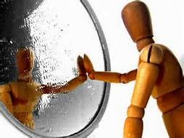

A definition
Self-compassion is extending compassion to one's self in instances of perceived inadequacy, failure, or general suffering.
(Dr. Kristin Neff has defined) Self-compassion as being composed of three main components:
Self-kindness
Common humanity
Mindfulness
Dr. Kristin Neff’s https://www.youtube.com/watch?v=Tyl6YXp1Y6M
Notes:
Casey-Marie:
The “happily ever after” I believed when I was a kid does not really exists, we all need to face challenges daily and personal failure is part of the human existence. We all are complex human being, and we face challenges day and night, human experience is hard and by definition we fail. What can make the difference is how we respond to those failures.
Here a more formal definition:
Self-compassion is extending compassion to one's self in instances of perceived inadequacy, failure, or general suffering.
Dr. Kristin Neff has defined self-compassion as being composed of three main components
Self-kindness: being kind and warm to oneself;
Common humanity: understanding that suffering and personal failure is part of the shared human experience; and
Mindfulness: being mindful of your negative thoughts and emotions to be observed with openness, so that they are held in mindful awareness, with no judgment.
Here, Kristin Neff’s video on Self-Compassion - Part 1: https://www.youtube.com/watch?v=Tyl6YXp1Y6M (soutitres en français)
Ressources en anglais :
From WikiPedia https://en.wikipedia.org/wiki/Self-compassion
Kristin Neff’s What is Self-Compassion - Part 1: https://www.youtube.com/watch?v=Tyl6YXp1Y6M (soutitres en français)
I can’t give what I don’t have… book: https://www.amazon.ca/Cant-Give-What-Dont-Have-ebook/dp/B07CYC32WT
Ressources :
compassion - https://fr.wikipedia.org/wiki/Compassion
suffering - https://fr.wikipedia.org/wiki/Souffrance
Kristin Neff - https://fr.wikipedia.org/wiki/Kristin_Neff
Mindfulness - https://fr.wikipedia.org/wiki/Pleine_conscience

Slide 10
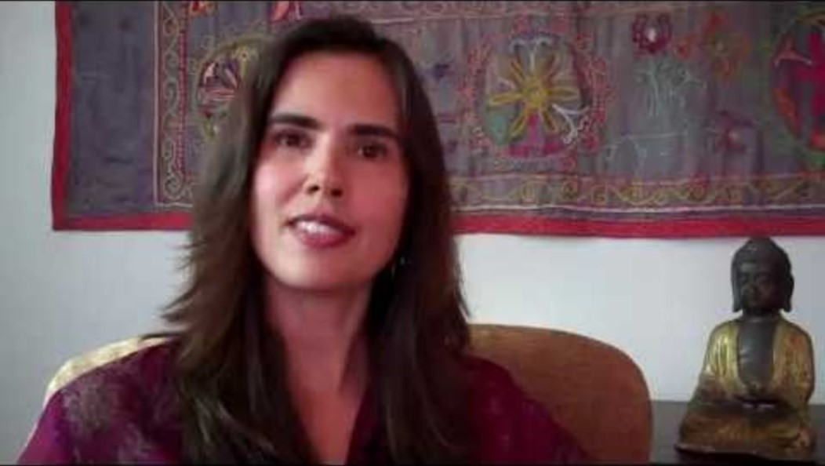
Self Compassion Part 1 Kristin Neff
https://www.youtube.com/watch?v=Tyl6YXp1Y6M
Notes:
Casey-Marie:
((We don’t use “insert video” as some Deparments don’t allow youtube
Instead, we share the screen (audio & video) directly from youtube using a web browser.))
Video link: https://www.youtube.com/watch?v=Tyl6YXp1Y6M

Slide 11
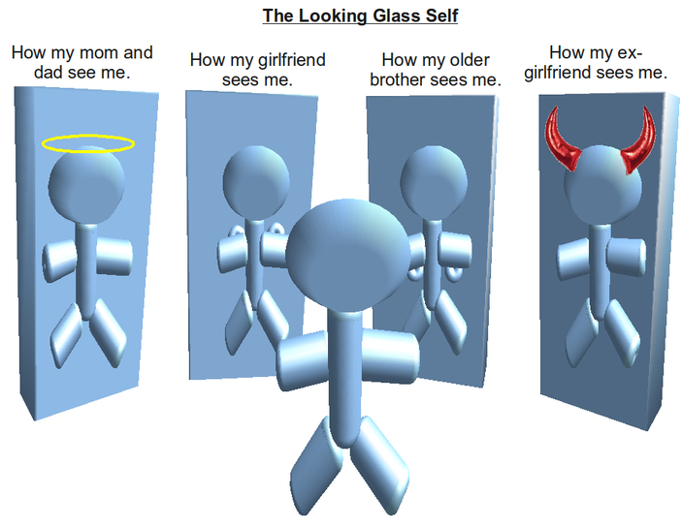
How are we seen?
:
Or how I see myself
Notes:
Dani:
I hope what I'll say resonates with you, the idea is about perspectives on how we perceive and are perceived.
We may constantly think about what image we give to others. How they see us... and chances are that others may not see us the same way we see ourselves.
In this example:
(click)
How my mom and dad see me – especially when young, as an angel, extremely good kid
(click)
How my girlfriend/wife sees me – particularly during the “honeymoon phase”, as strong, brilliant, cute, funny, smart
(click)
How my older brother sees me – typically my older brother used to see me as weak
(click)
How I see myself – usually I’m the hardest person to judge my own self, maybe because from my perspective I see outside usually seeing others… if this is also your case, it is time fix that and start seeing ourselves for who we really are
A person with a negative self-image sees obstacles, insurmountable problems, doubts his abilities, finds excuses not to move forward or convinces himself that there is no hope! She is a person who has difficulty trusting others because she does not trust herself!
While a person with a positive image will send back positive information; these interactions with others will be easier. This person will be able to maintain good relationships. This is a person who will see opportunities everywhere and in everything! She will approach situations from different angles to find solutions! In short, she is a strong and positive person, who inspires confidence!
Furthermore, wanting to get the most out of your image is not narcissism but a way of telling yourself that you love yourself, that you want to take care of yourself.
Ressources:
Greater Good Science Center - Kristin Neff’s article: http://greatergood.berkeley.edu/article/item/the_five_myths_of_self_compassion

Slide 12


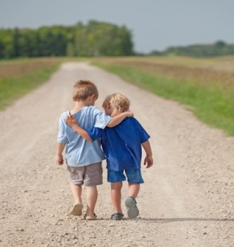
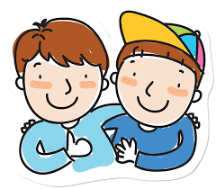
Mindful – self-compassion
If you want to hear it from Kristin Neff: Self-compassion Break: https://self-compassion.org/wp-content/uploads/2020/08/self-compassion.break__01-cleanedbydan.mp3 Time required – 5 minutes
Notes:
Dani:
(Choose one of these)
Kristin Neff’s recording on Self-compassion break, 5 mins: https://self-compassion.org/wp-content/uploads/2020/08/self-compassion.break__01-cleanedbydan.mp3 OR
Or, you can guide participants through a self-compassion exercise, as follows…
I’ll guide us doing a similar loving-kindness meditation
First, think of something that hooked you, something that bugs you and keeps repeating in yourself, in your mind, ideally try this with something light…
Remember, We all are in the same boat (pausing between phrases, do 2 in the personal form “I”, then 2 in the plural form “we”)
My I (we all) be safe
May I (we all) be peaceful
May I (we) be kind to myself (ourselves)
May I accept myself as I am (may we accept ourselves as we are)
Ressuorces en anglais :
From: https://centerformsc.org/practice-msc/guided-meditations-and-exercises/
Self-compassion break, 5 mins: https://self-compassion.org/wp-content/uploads/2020/08/self-compassion.break__01-cleanedbydan.mp3
Self-compassion, 20 minutes - http://self-compassion.org/wp-content/uploads/meditations/LKM.self-compassion.MP3
Ressources en français :
5 mins - Une pause d’autocompassion - https://vimeo.com/470384287
8 mins - La pause d'auto-compassion : https://www.youtube.com/watch?v=Fevw8ahkeeU
Méditation guidée: votre moment d’auto-compassion (17 mins) - https://www.youtube.com/watch?v=nQSAcY-7Xic

Slide 13
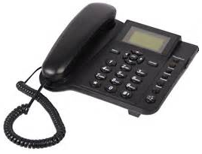



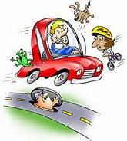



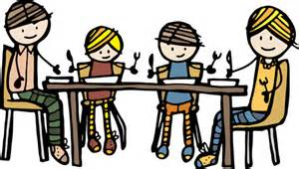
Mindful Cleaning Your Environment
Take on the mini-challenge to be mindful around the distractions
Day 17/21 days challenge - KindSpring - Make A Mindful Phone Call
Practice Digital Mindfulness
How to Practice Mindful Emailing and How to Manage Emails Mindfully
Check the story of the Monkey and the Panda, use it as for inspiration: https://www.youtube.com/watch?v=5nsySCMH36s
Notes:
Dani:
Now I would like to switch topics to cleaning our environments
(click)
When taking calls phone calls - get rid of distractions when speaking to people, also when using MSTeams, try smiling when you are on camera it makes a difference. make a phone call today with a determination to stay as mindful and present as you can through all of it. Maybe this means you resist the temptation of the so called “multitasking” while you’re talking. Maybe it means you take a few moments to genuinely inquire about the other person’s day. And if it’s a particularly challenging phone call, maybe you practice holding back your sharp retorts, and try to respond with empathy while still being true to yourself.
(click)
Practicing digital mindfulness – some of the articles state that you should get rid of your screens one to two hours before going to bed, and even a few minutes before going to bed is a good idea to help with mindfulness sleep. Sometimes I am guilty of this to be on my screen while in bed. Who can relate to this? Also be mindful of the notifications, now I unsubscribed from those automatic notifications that don’t add value to my life.
(click)
Be mindful about emailing – when I was working in an IT shop where I emailed that I would take away the rights to a certain site. I practice having a colleague review the email before sending. I keep it in draft for a day or two if I can to make sure that I am being mindful towards the recipients. Here a video on « How to Practice Mindful Emailing » - https://www.youtube.com/watch?v=qBBy5Jx_xrQ
(click)
When eating, turn off the TV, don’t read, and take the time to be present.
(click)
While driving be mindful of the present moment, avoid distractions
Let’s look at the following video « The Monkey and Panda story » with hopes that it will inspire us - https://www.youtube.com/watch?v=5nsySCMH36s
Resources en anglais :
Phone call: https://gcconnex.gc.ca/blog/view/14813318/day-1721-days-challenge-kindspring-make-a-mindful-phone-call
Digital Mindfulness: https://learn.rumie.org/jR/bytes/practice-digital-mindfulness-for-wellbeing How to Manage Emails Mindfully: https://www.mindspacewellbeing.com/fr/communiquer-en-pleine-conscience/
Ressources en français :
La pleine conscience numérique, étape ultime de la transformation - https://www.sysk.fr/2018/11/13/pleine-conscience-numerique-transformation/
Plus de conscience dans nos emails ? - https://positiveleadership.fr/plus-de-conscience-dans-nos-emails

Slide 14


Mindful Compassion exercise - I wish you happiness
I WISH YOU HAPPINESS!
Try it and see everything change in your life. ~ Richard Gere
Notes:
Dani:
(read from the slide, provide an example if you have one)
There is a powerful exercise, a very simple one, I started using a few years ago.
Who or what am I focusing on or coming across, either an individual or an insect, your first thought is simply "I wish you happiness."
This completely transforms what is going to happen between you and the other party.
At this point, you create the opportunity to make more space around you ... You see how any negative emotion disappears and gives you time to transform ... You see things as they are, as simply ignorance, anger, fear, sadness … don’t blame the other party, but see it as ignorance on your part … you don’t know their history or how their day has been … you remove your interpretation or reaction. You transform this, you let go, you become love.
I WISH YOU HAPPINESS!
Try it and see everything change in your life. ~ Richard Gere
Resources in English:
https://www.dalailamafilm.com/actor-richard-gere-on-happiness-3031
https://alvinalexander.com/photos/i-wish-you-happiness-richard-gere/
Summary: When times are tough and you’re faced with hard decisions, it’s easy to get paralyzed by self-doubt and fear. To move to clarity and action, leaders need self-compassion. Research shows that it increases your levels of emotional intelligence, resilience, integrity, and makes you more compassionate toward others, all of which improves your effectiveness as a leader. The authors offer several exercises for cultivating this skill, from short daily practices to tactics that help you shift your mindset. - https://hbr.org/2020/11/self-compassion-will-make-you-a-better-leader

Slide 15
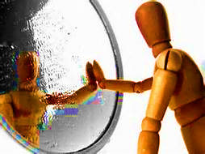

Reflect about today
Notes:
Dani:
Now let’s do a debrief on what we saw today, including:
Self-compassion
The five myths of self-compassion
Exercises
Mindfully water drink
Mindful self-compassion
Mindfully cleaning your environment
I will give the floor to 2 or 3 people who would like to share in plenary how today’s session has gone for you. If you're first, just open your mic and speak, if you're second or third, please raise your hand.
Excellent!
((prepare for chat rooms)
And now, we’ll open the breakout rooms so you can do a debrief in small groups, say 5 or 6 people, you will be assigned randomly. Just be aware and share the time available among you.
(opens chat rooms for about X minutes, send reminder 2 minutes before end)

Slide 16
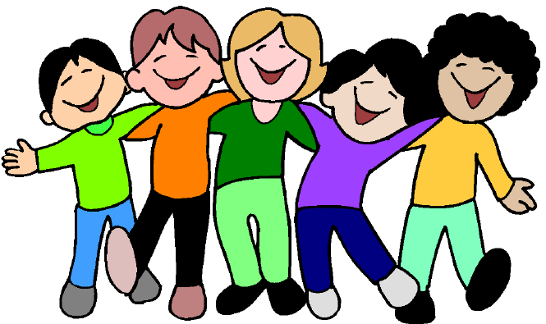
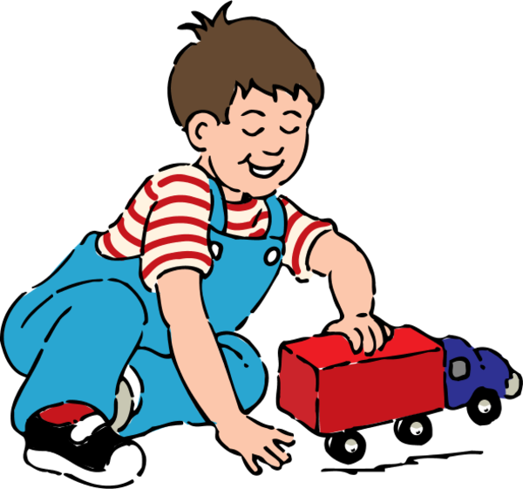
Your take away practice for week 4
Connecting – once a week with you buddy
Gratitude Journaling – daily
Practice up to 10 mins… chose one of the following and keep doing it for the whole week - daily
Body scan or Breathing
Self-compassion
As possible, apply:
Mindful Cleaning Your Environment
Mindfully water drink
Mindful self-compassion
Notes:
Dani:
(read/paraphase from the slide)
Try to practice for longer period of time every day if possible, if you feel comfortable or challenged enough – if you feel that’s not possible, try to practice as much as you can, it is always better to practice say 2 minutes every day than nothing at all. It is also better to practice 2 mintues mindfulness exercises throughout the day. As you can tell, here the idea is to practice.
Resources in English:
- Body scan or Breathing 10 mins - https://www.youtube.com/watch?v=avnwKOIOXFM
10 mins – (bottom-up) https://www.mindful.org/a-10-minute-body-scan-practice/
10 mins - https://www.youtube.com/watch?v=nnVCadMo3qI 15 mins – https://www.rightlifeproject.com/meditate (may need to scroll down) 15 mins – https://soundcloud.com/dharma-gus/15-min-body-scan-augusta-mbsr
- Self-compassion 10 mins – https://soundcloud.com/breathworks-mindfulness/mindfulness-for-women-track-5-self-compassion-meditation 10 mins – https://soundcloud.com/user-640851605/self-compassion-giving-and-receiving-meditation-10-minutes 15 mins – https://soundcloud.com/mindfullivingcoach/self-compassion-meditation 15 mins – https://soundcloud.com/awakeningcompassion/awakening-compassion-class-4 20 mins – http://self-compassion.org/wp-content/uploads/meditations/LKM.self-compassion.MP3
Ressources en français :
Scan corporel ou respiration 10 min – Pleine Conscience Débutant : https://www.youtube.com/watch?v=PLyuSZhyBV4 10 min – Pleine conscience pour débutants 🎧🎙 Cédric Michel : https://www.youtube.com/watch?v=PTsk8VHCZjM 20 min – (1) Méditation Guidée Pleine Conscience (Scan Corporel) : https://www.youtube.com/watch?v=UnK47wWTVZk 20 min – (1) Méditation bodyscan : https://www.youtube.com/watch?v=gN5_D4xeo9c
Autocompassion 5 min – Une pause d’autocompassion : https://vimeo.com/470384287 8 min – La pause d’autocompassion : https://www.youtube.com/watch?v=Fevw8ahkeeU 10 min – Viens méditer avec Mon équilibre UL | Carmen Pedneault – Autocompassion: https://www.youtube.com/watch?v=DQQniKP5GHI 15 min – Pratique d’autocompassion : https://vimeo.com/466742570 17 min – Méditation guidée : votre moment d’autocompassion : https://www.youtube.com/watch?v=nQSAcY-7Xic 18 min – Pleine Conscience pour Bien Démarrer la Journée ☀️ : https://www.youtube.com/watch?v=spFKZfWn07k 20 min – Pleine Conscience Paix Intérieure : https://www.youtube.com/watch?v=aH7Yfzf8-kk 30 min – Développer l’autocompassion : https://www.youtube.com/watch?v=umZpaiLuqCM

Slide 17
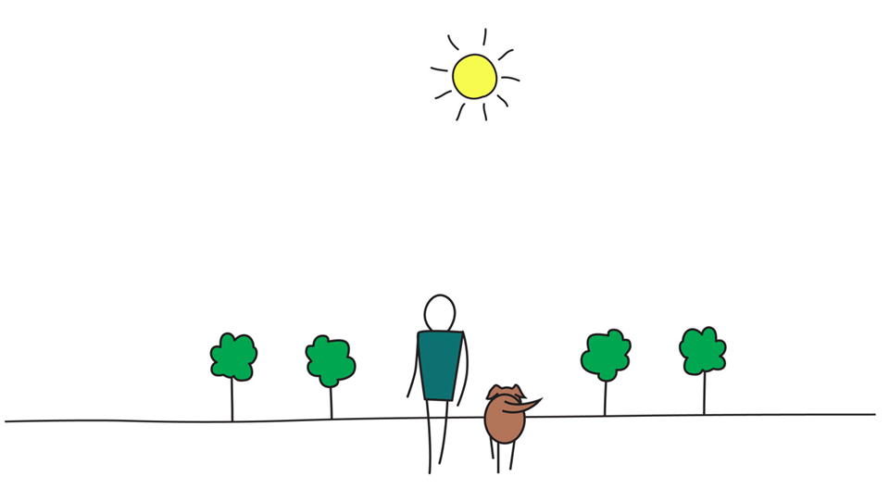

Be Mindful, Be Happy
Notes:
Dani:

