Slide 1
A DAY IN MY ACTIVITY-BASED WORKPLACE
[PROJECT LOCATION]
A presentation to help you define your own journey
DATE

Slide 2
How to use this document
Instructions – Remove this page before using
This presentation is to be used to provide senior leaders, people managers and employees an example of a workday in an activity-based workplace (ABW). It can be used as a complement to other activities such as the Employee Townhall, the “A day in the life” presentation and as a reminder during the Preopening Q&A session.
Please note that the presentation shows the journey of an employee who is very active and is taking full advantage of what an ABW has to offer so it is not necessarily representative of a typical employee’s journey in their new workplace.
* It is essential to emphasize to all participants that everyone’s journey will be different and that they are encouraged to explore the various possibilities their new workplace has to offer.
Optional: If you have access to Slido, Microsoft Forms, Survey Monkey, etc., you could also lead an interactive activity by offering a series of work activities where employees map their own journey using the said activities based on their schedule, their daily tasks and personal preferences. Of course, there is no right or wrong journey, but just different ways to work and use the available tools!
* The French version of this document is available here : FR version

Slide 3
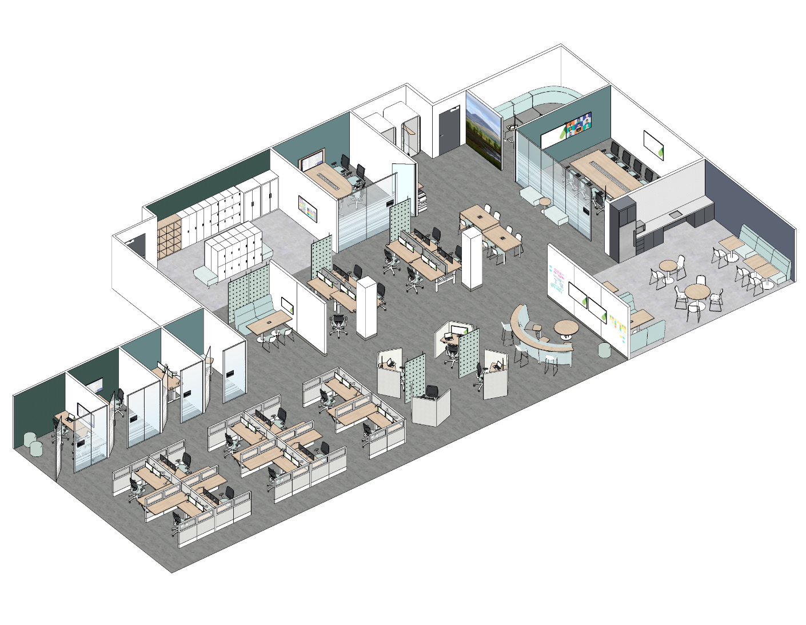
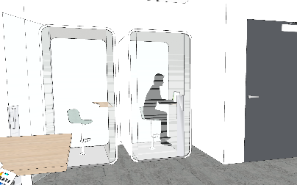
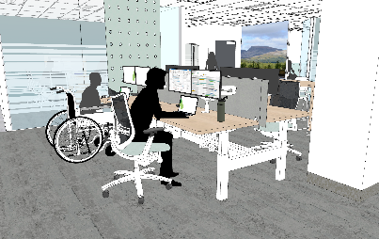
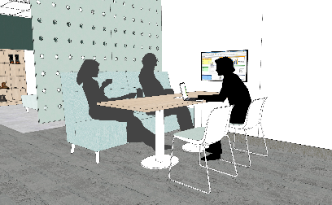
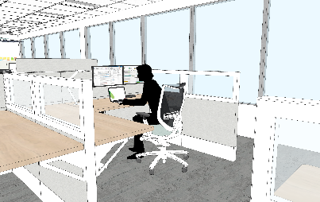
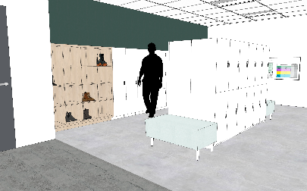
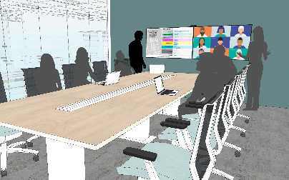
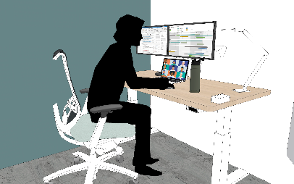
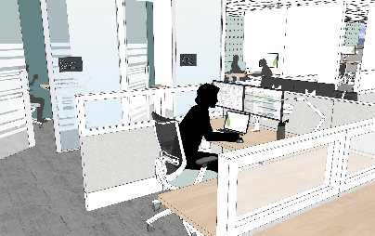
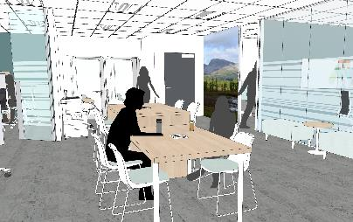
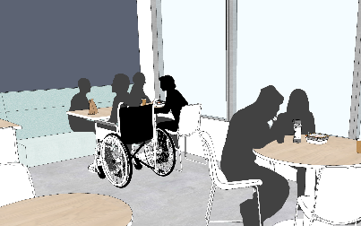
A DAY IN MY ACTIVITY-BASED WORKPLACE
Here is an example of what your day could look like when you come into our new workspace! Everyone’s journey will be different, we encourage you to explore the various possibilities our new workplace has to offer.
3:55 pm – 4:00 pm
LEAVE THE WORKPLACE
You pack up your equipment, make your way to the locker area to collect your personal belongings and leave the office for the day.
8:00 am - 8:05 am
ARRIVAL IN THE WORKPLACE
You arrive at the office and make your way over to the Locker area near the entrance. You lock up any non-needed personal belongings in a locker.
8:05 am - 10:00 am
USE A WORKSTATION FOR FOCUS WORK
You set yourself up at an available workstation in the Quiet area and spend some time doing focus work.
3:00 pm – 3:10 pm
MAKE A PHONE CALL
You need to make a quick phone call and use an available Phonebooth.
3:10 pm – 3:25 pm
HAVE A QUICK CHAT
You run into a colleague and have a quick conversation at a chat point about an upcoming project.
10:00 am – 11:00 am
PARTICIPATE IN A VIRTUAL MEETING
You head to a focus room and participate in a virtual meeting with your colleagues who are working remotely.
11:00 am – 12:00 pm
ATTEND AN IN-PERSON MEETING
You meet with two coworkers at a Huddle in the Interactive Area, where you connect your laptop to the monitor via a wireless connection and have a conversation about some deliverables you have been working on.
3:25 pm – 3:55 pm
USE A WORKSTATION TO ANSWER EMAILS
You head to a nearby open workstation to answer a few emails before the end of your work day.
12:00 pm – 12:30 pm
HAVE LUNCH WITH COLLEAGUES
You have lunch with some colleagues in the Lounge Area.
12:30 pm – 2:00 pm
USE A WORKSTATION FOR FOCUS WORK
You spend some time at an available workstation in the Quiet Area doing some focus work before your next meeting.
2:00 pm – 3:00 pm
PARTICIPATE IN A MEETING
You facilitate a presentation with your colleague in a Meeting room.
Let’s have a look at a typical day in the office.
Notes:
ADD ANIMATION: Have each section come in individually

