Slide 1
Quasi-judicial design
Background, design parameters and considerations
Digital Transformation Office • January 2023
Notes:
Opening slide

Slide 2
Agenda
Background
Who are the quasi-judicials?
Policy requirements
Trust and the Canada.ca brand
Current state of quasi-judicial designs
Design parameters
Discussion
Next steps
Notes:
Content example slide #1b

Slide 3
Background
Since 2018, the TBS Digital Transformation Office has been working with institutions to move them to the Canada.ca design system
Some institutions, including quasi-judicial organizations were not part of the first phase of institutions that were required to adopt the design
The intent was to work with those institutions to develop a variation on the design, but that work was put on hold due to other priorities during the pandemic
We are now ready to work with quasi-judicials on developing a design that respects policy requirements and meets the needs of quasi-judicials and their users
Notes:
Content example slide #1b

Slide 4
Who are the quasi-judicials?
Canada Agricultural Review Tribunal
Canada Energy Regulator
Canada Industrial Relations Board
Canadian Cultural Export Review Board
Canadian Human Rights Commission
Canadian International Trade Tribunal
Canadian Radio-television and Telecommunications Commission
Canadian Transportation Agency
Civilian Review and Complaints Commission for the RCMP
Competition Bureau Canada
Competition Tribunal
Copyright Board Canada
Courts Administration Service
Environmental Protection Tribunal of Canada
Human Rights Tribunal of Canada
Immigration and Refugee Board of Canada
Military Grievances External Review Committee
Military Police Complaints Commission of Canada
National Security and Intelligence Review Agency
Office of the Commissioner for Federal Judicial Affairs Canada
Office of the Intelligence Commissioner
Parole Board of Canada
Patented Medicine Prices Review Board Canada
Public Prosecution Service of Canada
Public Servants Disclosure Protection Tribunal Canada
Public Service Labour Relations and Employment Board
RCMP External Review Committee
Social Security Tribunal of Canada
The Correctional Investigator Canada
Transportation Appeal Tribunal of Canada
Transportation Safety Board of Canada
Veterans Review and Appeal Board
Quasi-judicials are government organizations that are not courts, but whose primary function is to render decisions (often rendering decisions on actions taken by other parts of the government)
Some are institutions recognized in the schedules of the FAA, while others are organizations recognized in the FIP Registry Part 2 - Other Registered Applied Titles
Notes:
Content example slide #1b

Slide 5
Policy requirements
Policy on Communications and Federal Identity
Policy on Communications and Federal Identity
This policy and its supporting instruments apply to departments and other portions of the federal public administration as set out in Schedules I, I.1 and II of the Financial Administration Act, unless excluded by specific acts, regulations or orders in council
This includes organizations on the FIP Registry Part 2 that report to an institution that is on the Schedules
Requirements under Federal identity include:
Apply the Government of Canada’s official symbols in all media, platforms, products, material, equipment and real property in Canada and abroad, in accordance with the Design Standard for the Federal Identity Program
Notes:
Design standard has relevant info
FIP manual does not?

Slide 6
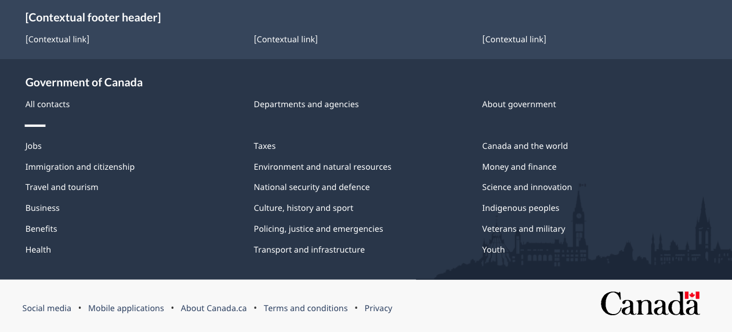
Design Standard for the Federal Identity Program
Standards for Government of Canada websites
The Design Standard provides specific standards for Government of Canada websites
The Canada wordmark and the corporate signature must be applied to all public-facing Government of Canada websites as follows:
the Government of Canada signature appears in the top left corner of the header
the Canada wordmark appears in the bottom right corner of the footer
the Canada wordmark and the Government of Canada signature appear in:
black type with a FIP red flag symbol on a white background
Helvetica medium weight

Slide 7
Directive on the Management of Communications
The Directive on the Management of Communications also articulates the requirements for federal identity, including Appendix D which sets out the Mandatory Procedures for Social Media and Web Communications, including:
Management of web communications
When publishing to the Government of Canada’s web presence, public service employees must consult with their web managers, functional specialists, web content owners or equivalents who will undertake the following:
D.2.1 Prepare web content in accordance with the Canada.ca Content and Information Architecture Specification and the Canada.ca Content Style Guide;
D.2.2 Ensure that equivalent information posted on digital channels and platforms about policies, programs and services is available on the Government of Canada’s web presence; and
D.2.3 Follow the mobile application processes as outlined by the principal publisher.
Notes:
Content example slide #1b

Slide 8
Content and Information Architecture Specification
Mandatory design requirements for the government’s web presence
Its requirements apply to departments and other portions of the federal public administration listed in Schedules I, I.1 and II of the Financial Administration Act
Mandatory elements:
The Canada.ca domain
Styles (typography, colours, layouts)
Header and footer (global header, global footer)
Institutional landing page (variation for quasi-judicials)
Ministerial profile (variation for heads of quasi-judicial institutions)
Notes:
Content example slide #1b

Slide 9
The Canada.ca brand identity
Consistent designs improve trust
Measured and compared trust of elements of the Canada.ca brand (see trust study)
Element | Findings
Government of Canada Signature (FIP flag symbol with Government of Canada in both languages ) | Essential Highly trusted Must be in colour Not replaceable
Canada.ca URL (vs. urls with gc.ca) | Important to essential to some who trust it more than design
Menu button | Not essential
Sign-in | Consistency in sign-in approach is important
Notes:
Content example slide #1b

Slide 10
Current state of quasi-judicial designs
Most are using some version of the Government of Canada design
Design adoption as of November 2022:
17% use current Canada.ca design
32% are use an older version of the Government of Canada design
7% use an older version of the Government of Canada design but with the coat of arms instead of the signature
17% use some elements of the Government of Canada design
25% have a unique design (no current or past GC design elements)
Other findings
Most websites are quite small, but there are some large ones (such as CRTC, Canadian Human Rights Commission, Competition Bureau, Social Security Tribunal) There are some commonalities in the content across quasi-judicial organizations that could lead to some recommendations for common information architecture elements
Notes:
Content example slide #1b

Slide 11
Design parameters for quasi-judicials
The design needs to concurrently:
Convey that the organization is an arm’s length organization with independent decision-making powers
Clearly demonstrate that the website belongs to a trusted, authoritative institution of the Government of Canada
Convey that the organization is an arm’s length organization with independent decision making powers
Notes:
Content example slide #1b

Slide 12
Discussion
What are you looking for in a common design for quasi-judicials?
Are you interested in participating in co-design sessions?
What do you need from TBS to help you adopt a new design?
Notes:
Content example slide #1b

Slide 13
Next steps
Conversations with selection of quasi-judicials to better understand needs and issues
Co-design sessions with quasi-judicials (looking for volunteers) to create and iterate the design
Preparation of guidance, templates and other onboarding materials
Notes:
Content example slide #1b

