Slide 1
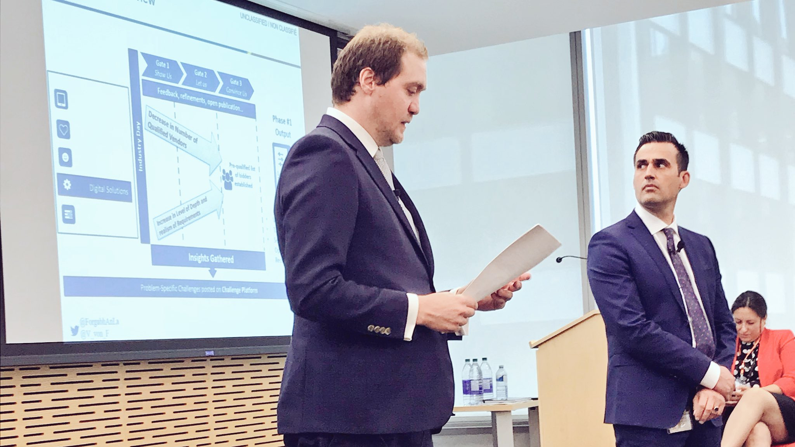
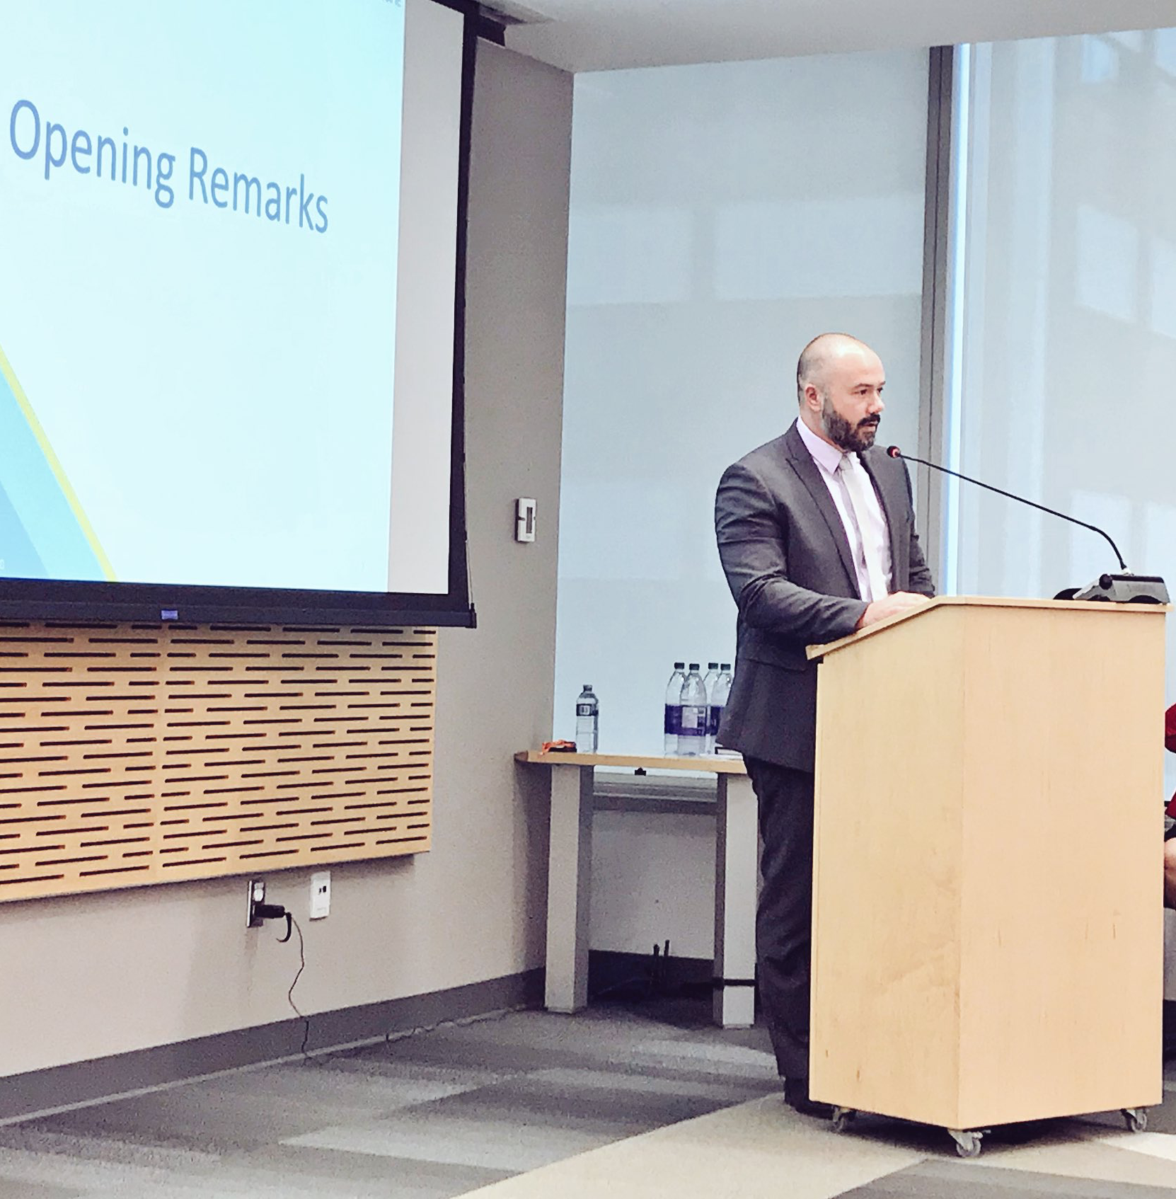
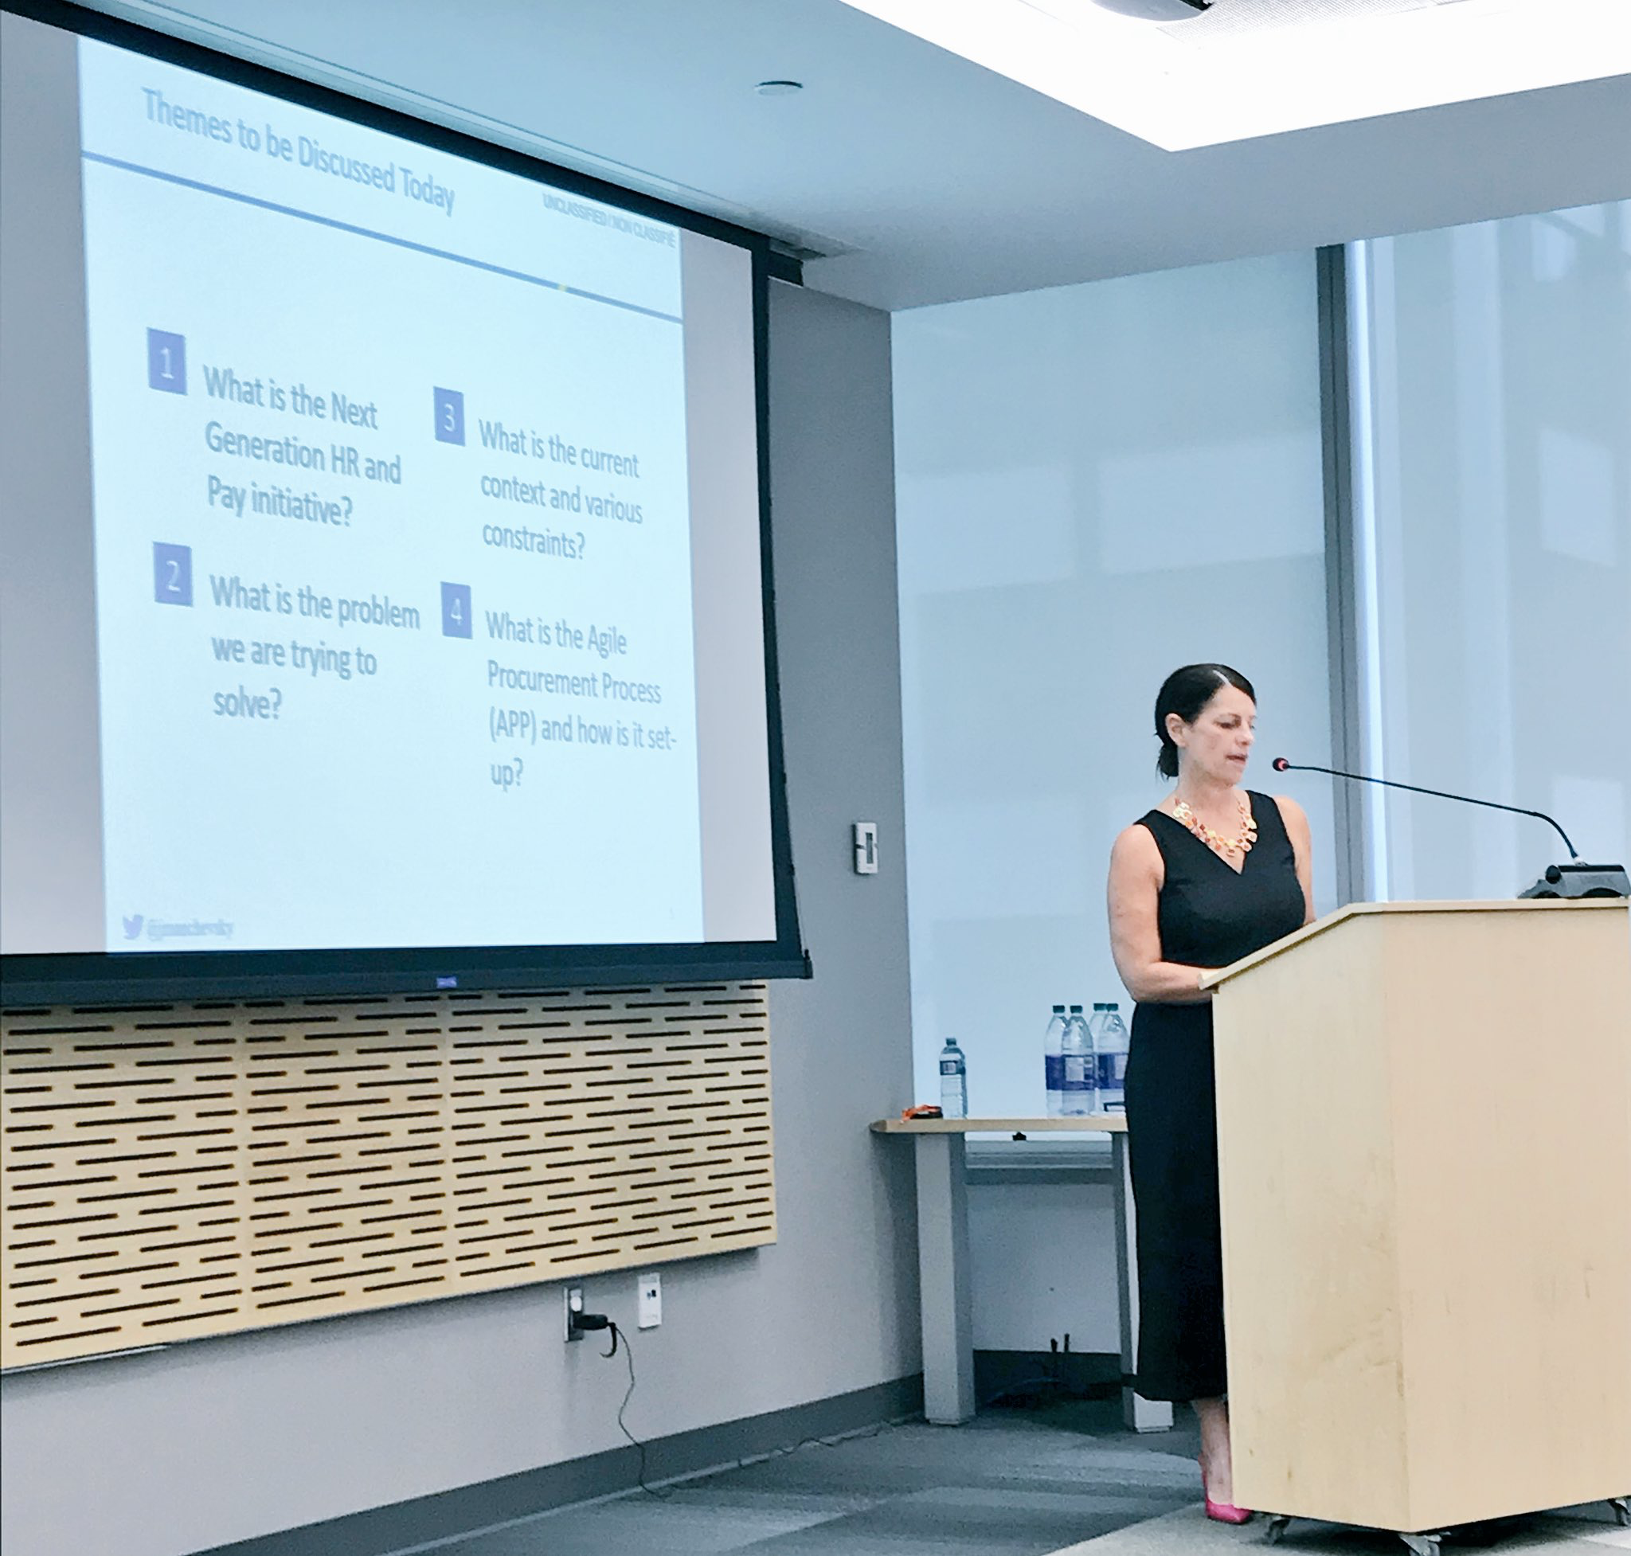
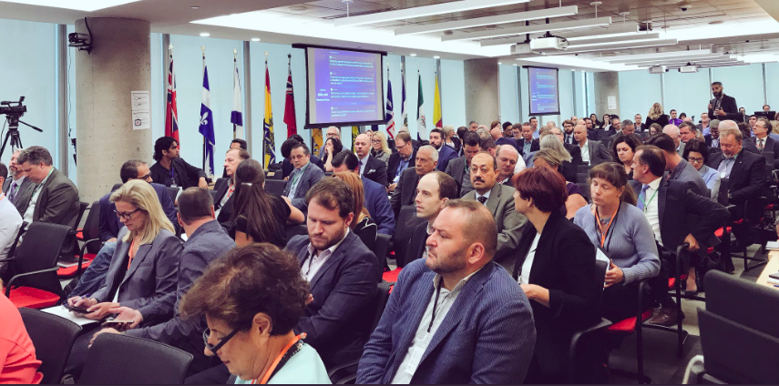
NextGen All Staff Update October 4, 2018
#NextGen

Slide 2
If you Google NextGen, you might think we’re these guys ...

Slide 3
Truth is, NextGen is made up of…
Our team manages and coordinates HR; finance and contracting; briefing materials; public relations; governance; project management; and, initiative-wide priorities.
Jacquie Manchevsky Corporate Secretary
@jmanchevsky
... and her team
Isabelle Leblanc | Claudia Levac | Cassandra Nagy | Amanda Bernardo | Kishanna Kesavan | Lee Traill

Slide 4
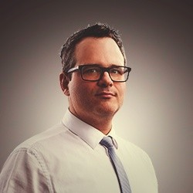
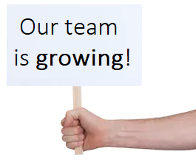
... and these guys ...
Our team is responsible for delivering digital capabilities and practices.
Vernon von Finckenstein Executive Director, Digital Delivery
@V_Von_F
... and his team
Anthony Sheehan | Troy MacFarlane | Marc-Antoine Raby
… with support from PSPC staff: Kristine Ouellette, Mario Godard, Marco Pelchat

Slide 5
... and OCHRO, the business owner
Our team is responsible for putting the user at the centre of the HR transformation.
Dominic Rochon ADM, Human Resources
@Dominic_Rochon
... and his team
Fiona Long | Karyn Kant | Andrew Cunningham | Amanda Stringer

Slide 6
We may not be on Netflix ... but some say we are just as cool!

Slide 7
A lot of people like to ask us about Phoenix...
Do you believe Phoenix can be stabilized?
What are the main lessons learned from Phoenix that you can apply to NextGen?
Would you agree that the problem with Phoenix is not technology but the business processes and complex pay rules?
Some tend to stay away from Phoenix, how do you plan on attracting and retaining top talent to NextGen and holding them accountable to make this a success?
Questions extracted from Industry Day

Slide 8
… but our work is focused on the future not the past
A plan was approved to establish a dedicated team to put forward options on managing the future HR and Pay in the public service.
The NextGen team is currently working on the discovery and analysis phase of this initiative to better understand the problem, the users and the context, which will help to set a vision and identify options.
Our Goals
Pay our People accurately and on time
Establish digital enterprise-wide services for HR and Pay
Identify user-focused alternative HR and Pay options

Slide 9
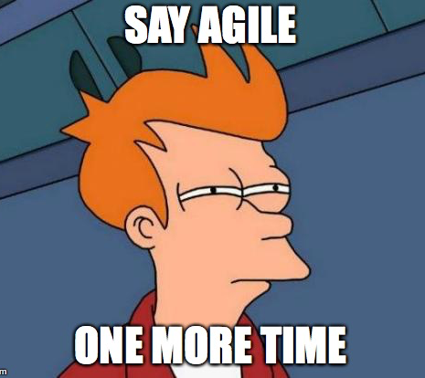
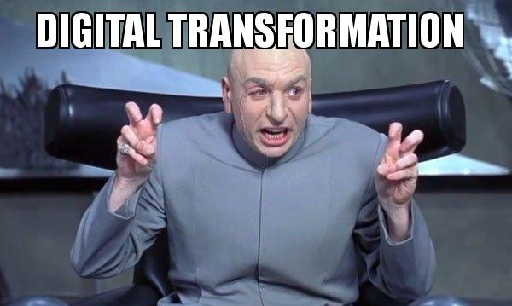
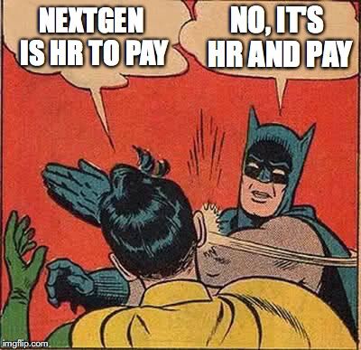
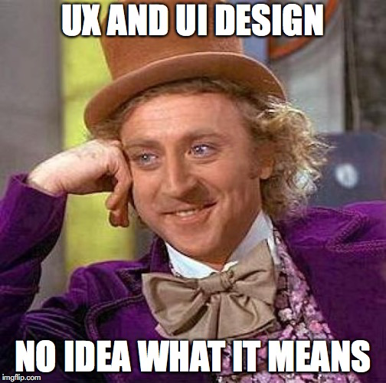
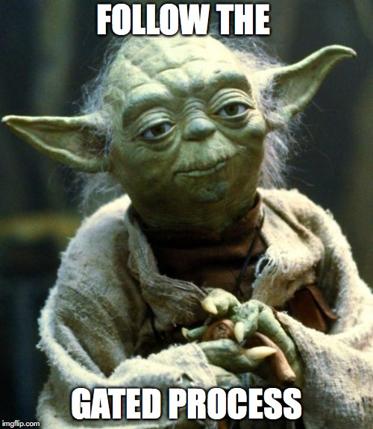
People also like to associate us with buzzwords ...

Slide 10
Please don’t be one of those people.

Slide 11
We’ve been quite busy to date…
Joint partnership
Scope is flexible and adaptable
Working through a gated process
Smaller/faster sprints
200 participants
Launched the APP
Provided information to vendors on the current HR/Pay landscape
Agile Procurement
Industry Day
Open by Default
HR Engagement
Find us online:
HRandPayNextGen-ProGenRHetPaye
Series of workshops that serve as an
initial engagement with users to get early feedback
Open.Canada.ca
Notes:
Agile Procurement Process
TBS has worked closely with PSPC to design a new, gated agile procurement process to align with the government’s commitment to modernize the procurement process.
Industry Day marked the launch of this process and provided a high-level draft of requirements for each gate.
Industry Day
Focused on providing industry: information on the Agile Procurement Process; a view on the current HR/Pay landscape; and, an opportunity for questions/feedback
Over 120 participants in-person and 80 online via WebEx
HR Engagement Sessions
Engagement sessions are being held with public servants through a series of workshops and serve as an initial engagement with users to get early feedback.
NextGen Wiki
We’ve committed to posting our materials online, which are now available here: https://wiki.gccollab.ca/HRandPayNextGen-ProGenRHetPaye

Slide 12
But there is still a lot to do
Launch of Gate One
Cabinet Update
HR Strategy
Digital Solution
October 2018
December 2018
Winter 2019
Spring 2019
Notes:
Launch of Gate One
Gate One of the Agile Procurement Process will be launched October 1, 2018
Cabinet (December 2018)
Presentation planned to update Cabinet
HR Strategy (Winter 2019)
Outline the NextGen HR and Pay vision, engagement and change management strategies; and, options for a service delivery and operating model
Digital Solution (Spring 2019)
Define the target enterprise architecture; find technical requirements; and demonstrate viable technical options

Slide 13
So, are you ready for NextGen?

