Slide 1
PPMG Repository Configurations

Slide 2
The Challenge
Processes that interface with the new repository require baseline definitions: process diagrams, process documentation, process re-design with process owners.
By reviewing the design of each process, opportunities to use the repository will be explored.
New processes will be defined leveraging on those opportunities.
Improvements will be quantified and documented.

Slide 3
As Is
Report Support Functions
BOP
BCP Update
CCDIC HR Staffing Support
Departmental Plan
HAI R&R Report
HIA Stakeholder Engagement Plan
DRF, DRR, Supplementary Information tables X2
Corporate Risk Reporting
Reporting Requirements Inventory
Reports
G’s & C’s reporting
Annual FI Report
Close Out Report
PMR, BOP, PIP, PMT Functions
Build
Drop-down Menu item management (allowed values)
Instruction and guidance comments creation for input scenario Back-Office functions (DBS administration, database loading, creating reports)
Data cleaning, feedback to users
PPD Stakeholder Database Management
G’s & C’s Functions
Database Build
Data management
Instruction and guidance comments creation for input scenario Back-Office functions (DBS administration, database loading, creating reports)
Data cleaning, feedback to users
G’s & C’s Support
Annual FI Report
Close Out Report
PPMG
Voxco Functions
PPMG Voxco advisor, negotiator
MRAP Tracker
Annual FI Report
Close Out Report
Data Systems Lead
Metrics Mapping
UI support
PMT
Design, issue resolution, advisories
Voxco, contract management, negotiations
G’s & C’s Non-Reserve Project fund
PM Tutorial update
PPMG Budget forecast
Audit and Evaluation Advisor
MVR Resolution

Slide 4
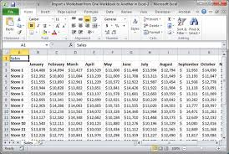
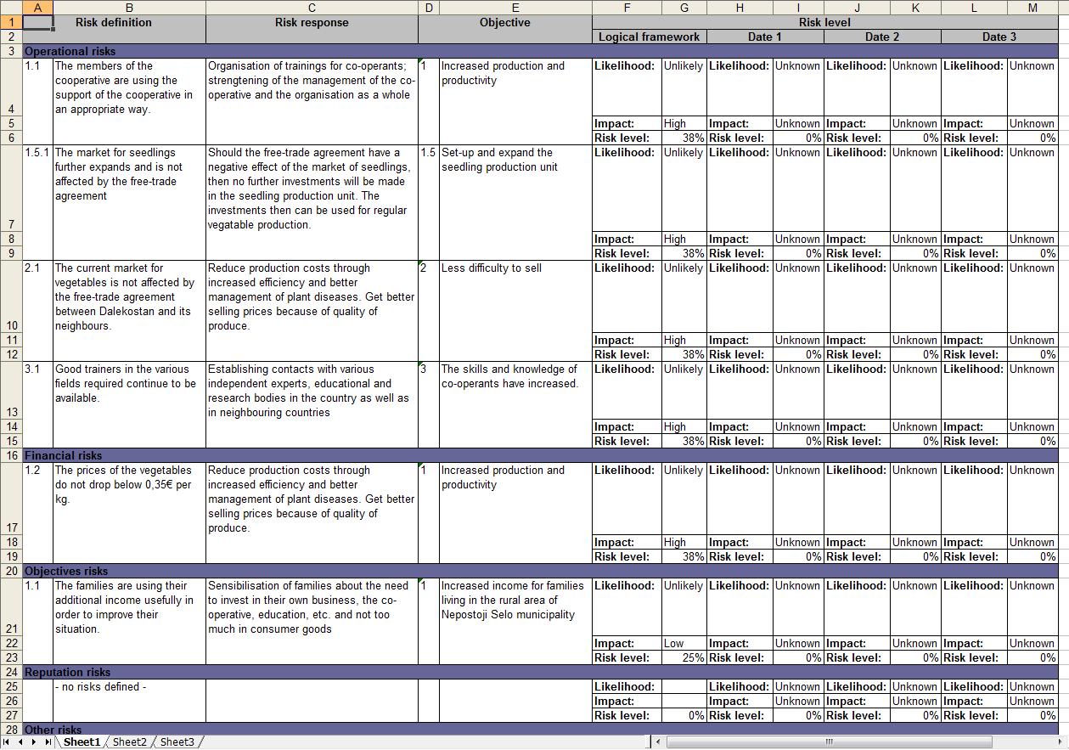
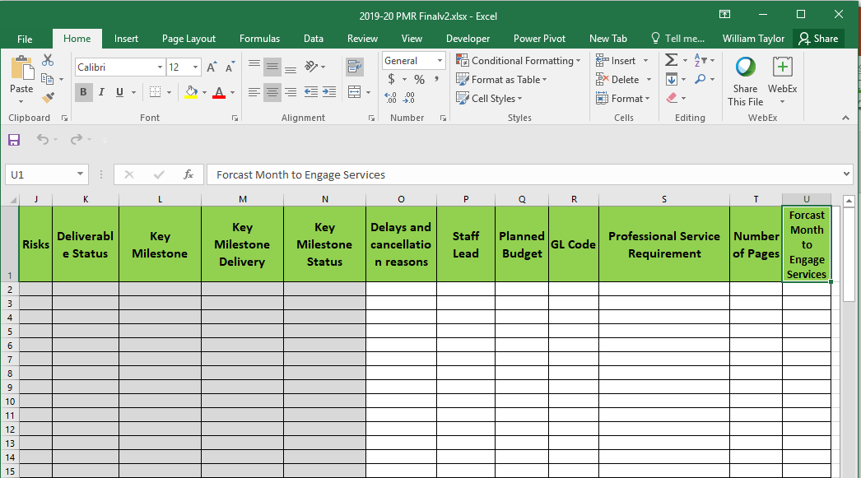
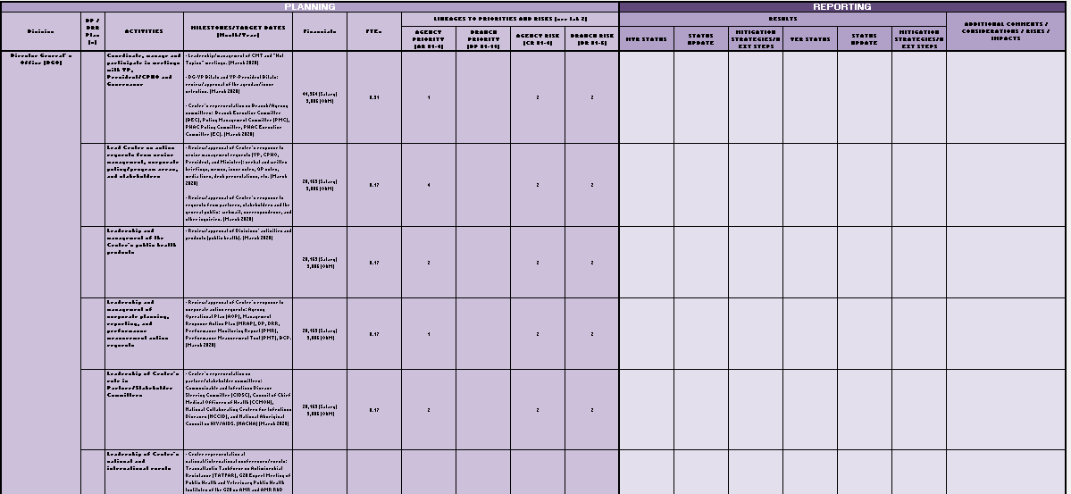
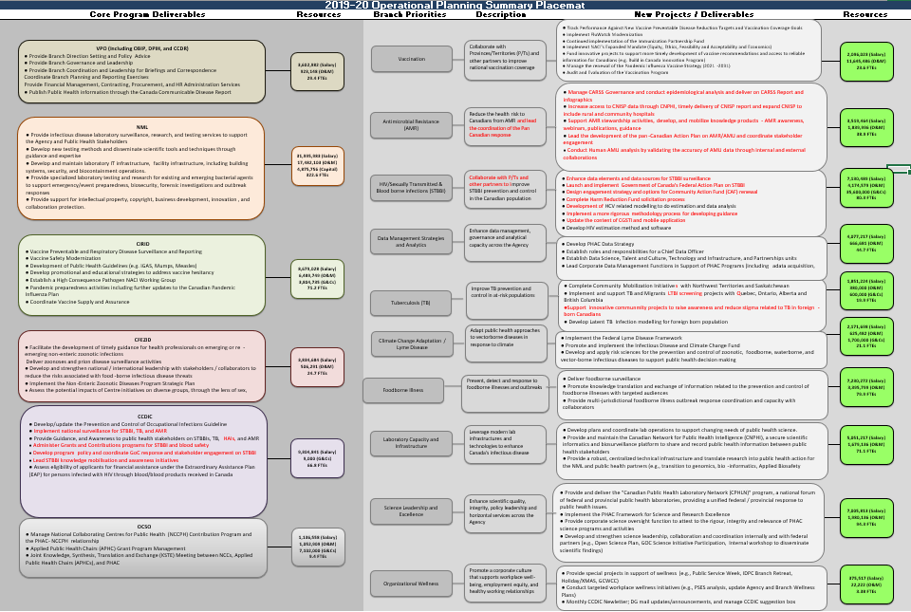
Interim
MVRs
Repository
Work area
Questions
Answers
PPMG
PPMG Planning
Data
PMR
BOP
BOP Placemat
Workbook
Reports

Slide 5
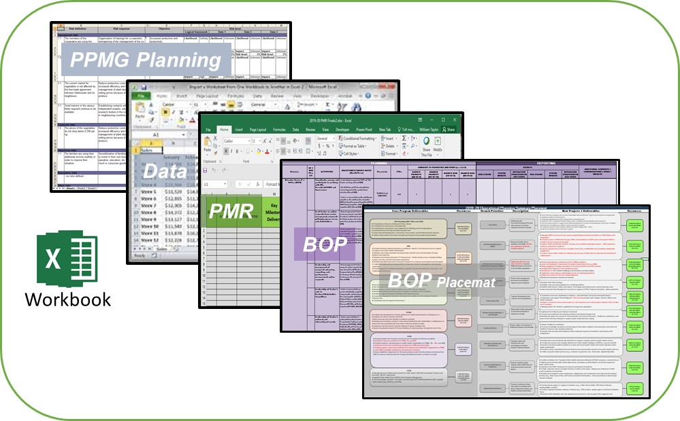
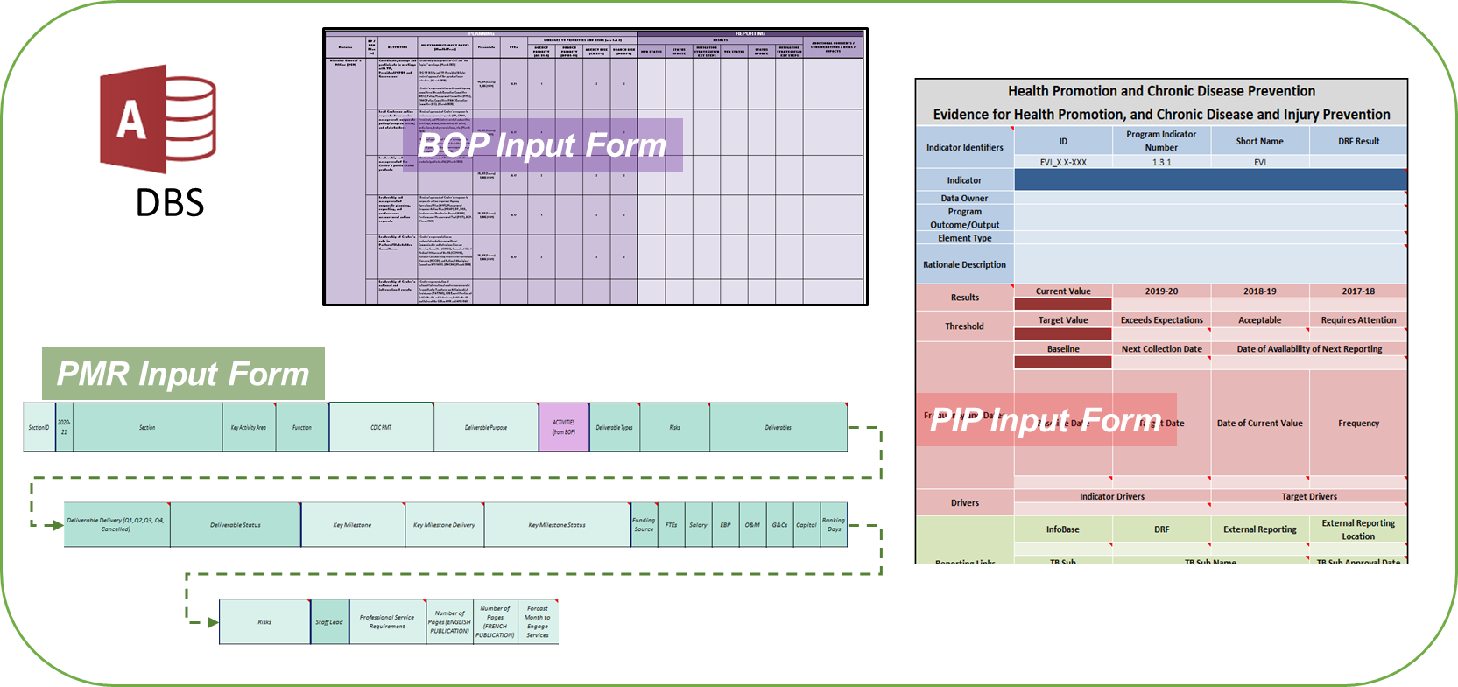
To Be
CCDIC
Repository
Work area & Report Input Area
PPMG
AMR
PPHPD
SED
PPD
Data Warehouse

Slide 6
SectionID
2020-21
Section
Key Activity Area
Function
CDIC PMT
Deliverable Purpose
"ACTIVITIES(from BOP)"
Deliverable Types Risks
Deliverables
Deliverable Delivery (Q1,Q2,Q3, Q4, Cancelled)
Deliverable Status
Key Milestone
Key Milestone Delivery
Key Milestone Status
Funding Source
FTEs
Salary
EBP
O&M
G&Cs
Capital
"Banking Days"
Risks
Staff Lead
Professional Service Requirement
Number of Pages (ENGLISH PUBLICATION)
Number of Pages (FRENCH PUBLICATION)
Forecast Month to Engage Services

Slide 7
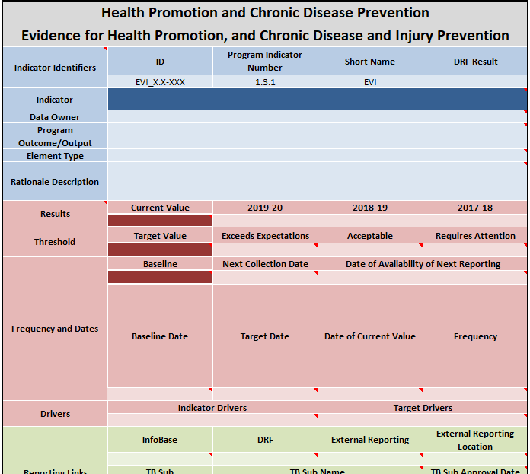
BOP Input Form
DBS
PMR Input Form
PIP Input Form

Slide 8
SectionID
2020-21
Section
Key Activity Area
Function
CDIC PMT
Deliverable Purpose
"ACTIVITIES (from BOP)"
Deliverable Types
Risks
Deliverables
Deliverable Delivery (Q1,Q2,Q3, Q4, Cancelled)
Deliverable Status
Key Milestone
Key Milestone Delivery
Key Milestone Status
Funding Source
FTEs
Salary
EBP
O&M
G&Cs
Capital
"Banking Days"
Risks
Staff Lead
Professional Service Requirement
Number of Pages (ENGLISH PUBLICATION)
Number of Pages (FRENCH PUBLICATION)
Forcast Month to Engage Services
\\Ncr-a-irbv1s\irbv1\PHAC\IDPCB\CCDIC\PPMG\X_ADMIN\SECTION WORK PLANNING\PMR\CCDIC 2019-20

