Slide 1
GC Task Success Survey Update
Results for 2022-23, Planning for 2023-24
Digital Transformation Office • #CanadaDotCa • May 2023

Slide 2
Today’s presentation
Background on the GC TSS
Summary of 2022-23 results
Discussion on 2023-24 and beyond
Outline

Slide 3
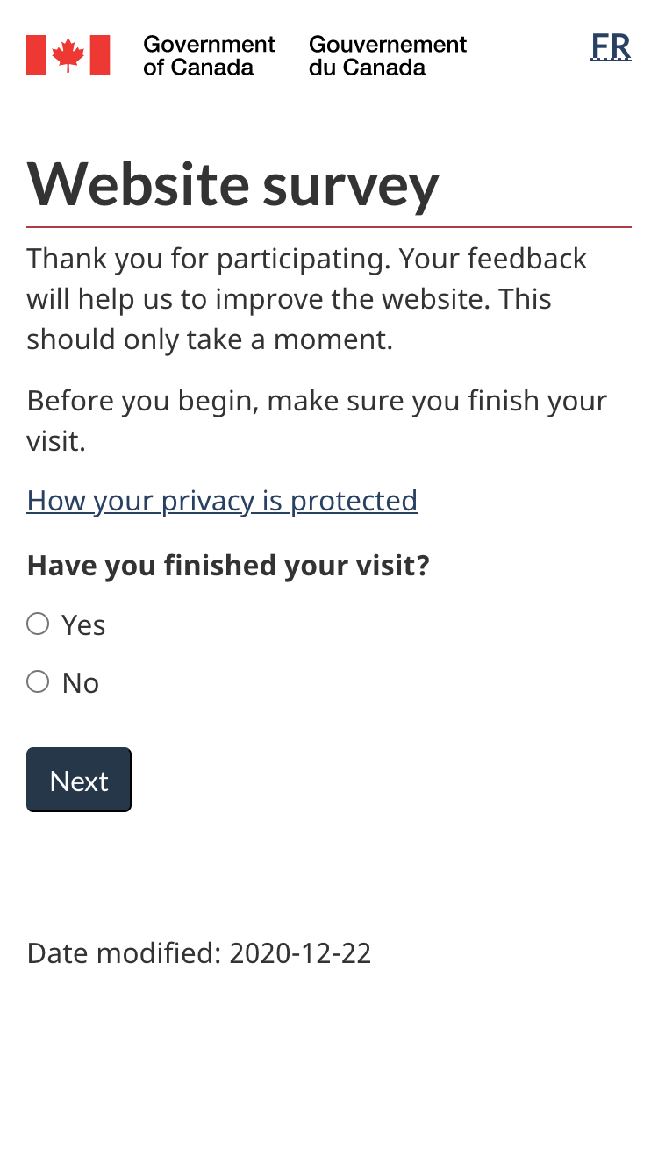
In a nutshell
Website exit survey to identify and measure top tasks:
Runs continuously
Self-reported by site visitors
Over 40,000 participants monthly
Evaluates task completion, ease of use and satisfaction
Survey launched in January 2021
Partnership between Principal Publisher and Digital Transformation Office

Slide 4
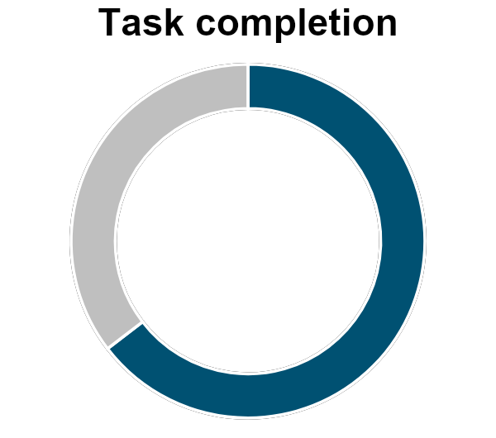
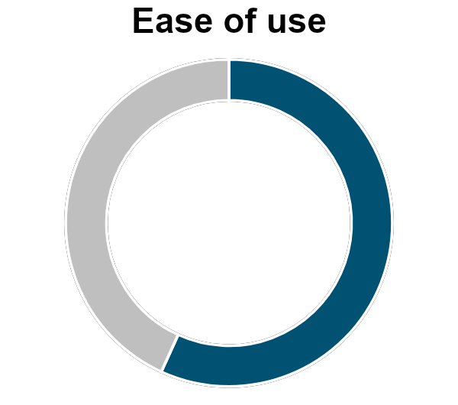
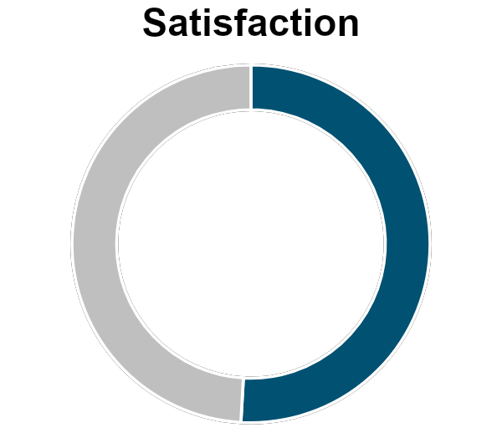
2022-23 overall results
Performance across GC web presence
66.3%
56.3%
52.6%
Source: GC Task Success Survey data, April 2022- March 2023. Total responses: 527,796

Slide 5
Top 100 tasks
Improvements across the board
 | 2021-22 | 2022-23
Top 100 task completion average | 65.80% | 66.87%
Top 100 tasks in the green (over 70%) | 36 | 48
Top 100 tasks in the orange (50%-70%) | 55 | 42
Top 100 tasks in the red (below 50%) | 10 | 8
27 new tasks in the top 100 in 2022-23

Slide 6
Top 100 tasks
2022-2023 Breakdown
11 | Tasks increased success by at least 5 % pts
4 | Tasks decreased success by at least 5 % pts
7 | Tasks went from orange to green
2 | Tasks went from red to orange
0 | Tasks dropped into the red

Slide 7
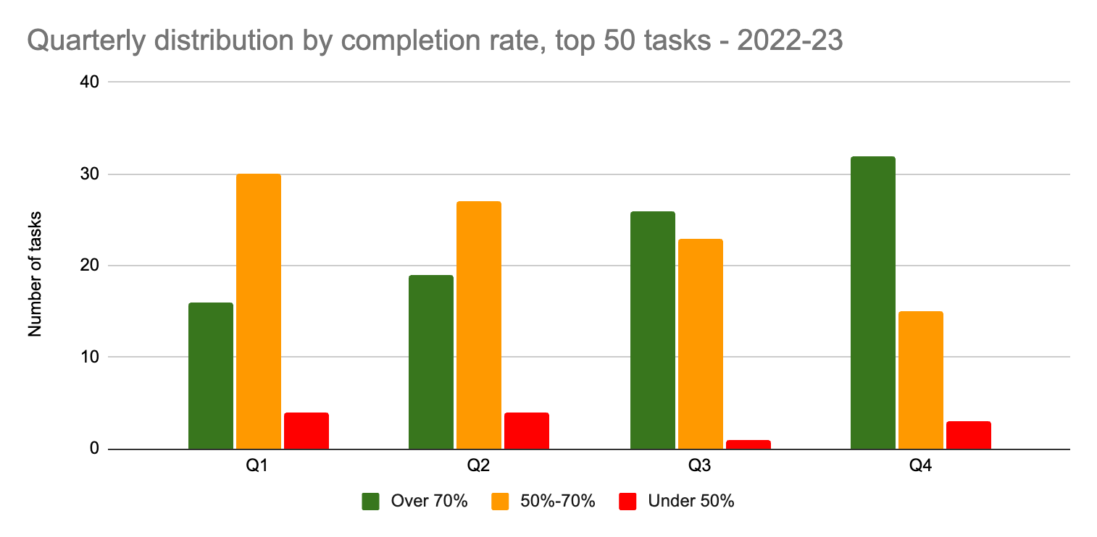
Quarterly comparison
Top 50 tasks

Slide 8
Top performers
Find a term or abbreviation in another language (PSPC) |  | 91.6%
Find a pension payment date (ESDC) |  | 91.4%
Get current and forecasted weather for your location (ECCC) |  | 89.1%
Calculate payroll deductions (CRA) |  | 88.4%
Employment Insurance (EI) - Submit an Employment Insurance Report (ESDC) |  | 87.0%
Find language information (PSPC) |  | 87.0%
Find out the symptoms or risks for a disease or condition (HC) |  | 84.6%
Travel advice and advisories (GAC) |  | 82.9%
Find your National Occupational Classification (NOC) (IRCC) |  | 82.6%
Find the next benefit payment date (CRA) |  | 82.2%
Top 100 tasks in 2022-23 with the highest completion percentage

Slide 9
Biggest improvements
My Service Canada Account (MSCA) - Sign in (ESDC) |  | +21.3 % pts
Access My Account (CRA) |  | +16.5 % pts
Symptoms of COVID-19 (HC) |  | +13.2 % pts
Access your pay (MyGCPay, CWA, Phoenix) (PSPC) |  | +10.2 % pts
ArriveCAN - Make a customs and immigration declaration before flying into Canada (CBSA) |  | +9.0 % pts
Top 100 tasks in 2022-23 with the greatest improvement in completion percentage over 2021-22

Slide 10
Quarterly comparison - passport tasks
Completion rate per quarter, 2022-23
Q2: Impacts of the backlog were apparent in survey feedback.
“There were no appointments available online.” - July 11, 2022
“I wanted to know the status of the passport I applied for, in person, 12 weeks ago.” - July 13, 2022
 | Q1 | Q2 | Q3 | Q4
Apply for a new passport | 45.8% | 52.5% | 64.6% | 71.9%
Renew a passport | 42.8% | 48.0% | 61.8% | 73.1%
Check the status of a passport application | -- | -- | -- | 63.7* (6.8% margin of error)
Q4: Tone of the survey feedback was more positive.
“I did my passport today. 20 minutes. Bravo.” - March 28, 2023
“great experience…very simple & very well laid out. thank you” - March 31, 2023
Sustained effort by ESDC and IRCC on improving these tasks during 2022-23 - it shows in the quarter-by-quarter improvement!

Slide 11
What we need from you
We need a commitment from institutions to take action on improving top task performance.
To that end:
TBS is considering an official tasking to institutions on top task improvement, issued in the fall of 2023
We all have a stake in improving top task performance across the system

Slide 12
How we can help
Support with research and design:
Improving your GC TSS data
Identifying tasks to improve
Analyzing data for insights
Measuring and reporting improvements
Additional research and design activities
Help with change management:
Socializing top task management
Bridging silos within and between organizations
Escalating issues that need attention
DTO and PP can support your teams

Slide 13
Discussion
What would make it possible for you to achieve top task improvements?
Some dimensions to consider:
Tasks - how many? which ones?
Targets - relative? absolute?
Effort - how much time and space can you commit?
What else would like like to see from TBS?
How can we create the conditions for success?

Slide 14
Thank you for your time
Peter Smith
Chief, Canada.ca Product Design
Digital Transformation Office Treasury Board of Canada Secretariat
Peter.Smith@tbs-sct.gc.ca
613-979-0525
Nicolas Pjontek
Manager, Analytics Services
Principal Publisher Service Canada
Nicolas.Pjontek@servicecanada.gc.ca
613-915-6425
GC Task Success Survey on GCpedia

