Slide 1
Business Architecture Course Highlights
BizBok – Business Architecture Guild
November 2020

Slide 2
Agenda
Recap:
Business Architecture Value Proposition
Business Architecture Framework and Domains
Setting up a Business Architecture Practice
Business Architecture and Strategy Execution

Slide 4
Notes:
Core domains: business capabilities, value streams, organization, and information

Slide 5
Notes:
Slide 17 - Introduced the Business architecture framework which consists of the knowledgebase composed of each business architecture domain. The knowledge base and the domains within the knowledge base helps us to deliver architectural blueprints for specific business scenarios and each business scenario helps us to populate and build our knowledgebase

Slide 10
Notes:
Understanding business capabilities delivered by each business unit is powerful:
Shows potential redundancy, same business units engaged in same activities, exposes opportunities for improved collaboration and communication

Slide 11
Notes:
Mapping business capabilities and information to value streams lets us see easily what information is needed to support the value stream and to deliver value to stakeholder

Slide 12
Notes:
For non core domains, Some interesting analysis that can come from looking at these non core domains, Strategy, Initiative and stakeholder domains

Slide 14
Notes:
Another deliverable that shows how business architecture can help, this analysis enables us to see the impact changes in objectives/strategies has on business capabilities

Slide 15
Notes:
Stakeholder is at the center
Mapping stakeholders to business units allows us to business units enables us to re-organize to be customer centric

Slide 16
Notes:
This cross mapping shows us which business capabilities are supported by initiatives, are we investing in the right capabilities, do they support the objectives and therefore strategic objectives we want to?
We have mapped our business capabilities to initiatives, but be have not mapped initiatives to objectives… Strategic planning is interested in this!

Slide 17
Notes:
You can see case file management is enabled by 3 initiatives, so we need to make sure aligned and not 3 different ways of doing case file management
Also performed by 3 different business units, BA needs to make people aware of this

Slide 18
How to Set up a Business Architecture Practice

Slide 20
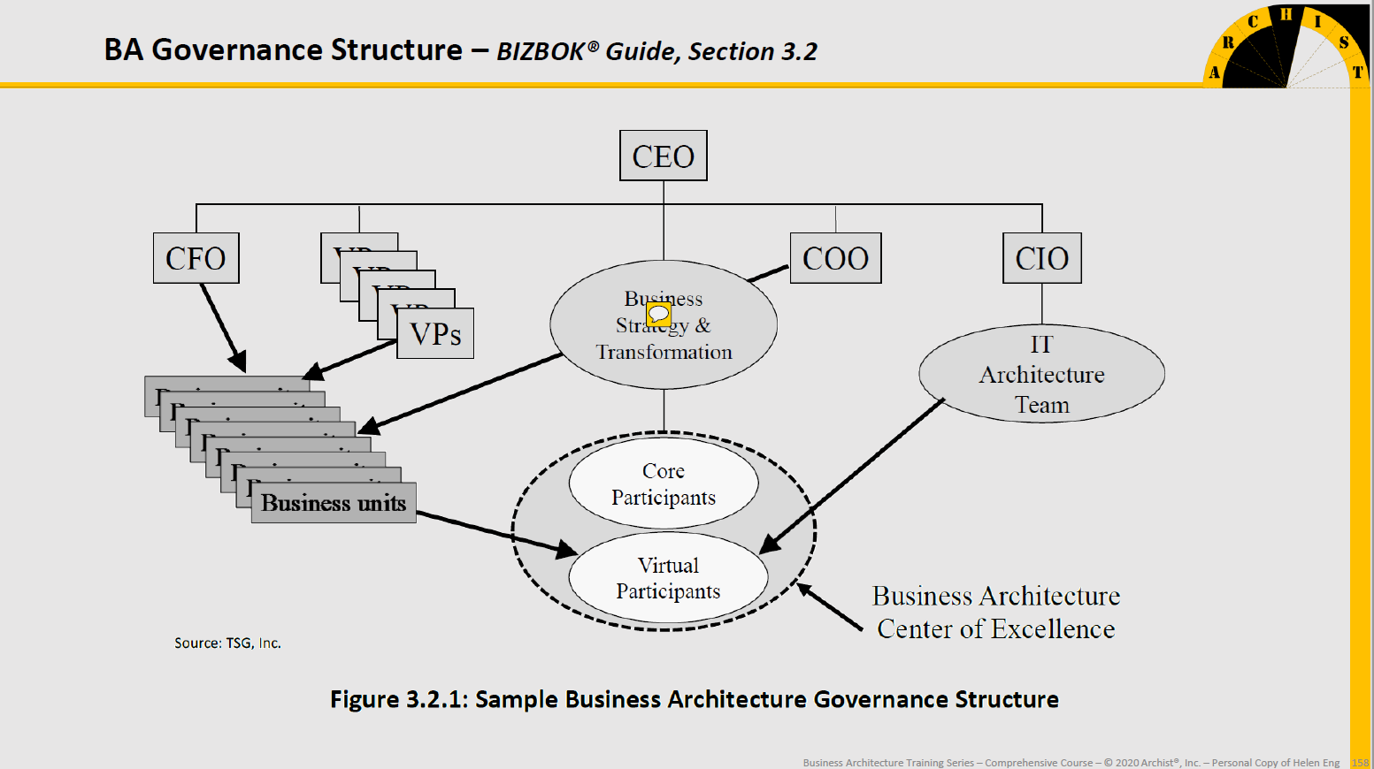
Notes:
Sample BA Organization:
Business architecture is center of excellence, with a small core team and virtual participants from other business areas. - to manage knowledge base, centralize blueprints
virtual participants - a federated model, they provide the context and the business sme's and engaged as needed for the initiative
Any person making decisions and making decisions affecting the business is a business architect, may not be using the tools as the business architect but they are designing their business!
Should not be under IT (CIO), and must educate each time in our engagements, we are about business, not IT, we know and can liaise with IT but we are about understanding business.
And must define linkages with other EA disciplines, it is easier to do!
Both models exist but depends on how mature and the organization structure as a whole.
Critical, being able to show the value fast, being able to position the practice is important!

Slide 21
Notes:
Roles within the Business Architecture team

Slide 22
Business Architecture and other Disciplines
Business Modelling(e.g. Business Model Canvas)
Business Process Modeling and Management
Case Management
Lean Sigma Six
Business Performance Management
Requirements alignment
IT Architecture: EA, SDLC, Application Portfolio Management, SOA, Data Architecture alignment, Solution Architecture, IT Architecture Transformation

Slide 23
Notes:
What do we see? Many applications support the same business capability, - this can mean that the end user must re-enter their information into multiple systems, learn new interfaces etc
Many business units have the same capabilities, are they doing things the same way or differently?
We can do this today analysis today, but there has to be the motivation to transform

Slide 24
Business Architecture and other Disciplines (cont’d)
Business Architecture and Strategy Execution
Notes:
Business Architecture and Strategy Execution
This slide highlights where BA can help in Strategy Execution
Value stream to execute a business strategy includes: Strategy realization, strategy to execution planning, strategy execution, strategy deployment and then strategy implementation
Business architecture can help to:
Avoid organizations from identifying what they want to do and immediately establish and fund projects without understanding the scope and impacts of their projects and if there are any inter-related business objectives or projects
Ensures that planning and deployment teams understand the overall impacts of stated objectives, architect appropriate solutions and scope and fund programs accordingly
Next slides show role of Business architects in strategy formulation, business impact analysis, solution definitions, initiative scoping and definition and solution specification and deployment
Stakeholders of this value stream are business architects, business leaders, business strategists, product and program managers, IT architects and portfolio managers

Slide 25
Notes:
Digital Convergence, I created a matrix that outlined strategy, objectives, goals, and then business requirements. This helped:
To understand the business scenario, ask questions, get a better picture of where we are heading, and have everyone on the same page
Build better Business requirement, ensuring there is traceability back to high level objectives and strategy

Slide 30
Other Reference Slides

Slide 32
Notes:
difference between value stream versus business process mapping

Slide 34
Notes:
*Slide 174 –
Establish practice first, and bring in tool once have a more mature practice!
Better to wait, use excel etc... Because otherwise may not be able to leverage the tool properly, you don't know what you need yet.
The objectives of the practice is important to know e.g. strategic planning? if yes, then a different tool than a downstream alignment requirement
Slide 176 – maturity level of our business architecture practice?

