Slide 1
Explore Immigration Programs
Web UX Research and Design
IRCC
February 28, 2024

Slide 2
Who is WURD?
We’re a small (but mighty) team of designers in the Web directorate at IRCC.
David Pepin, Assistant Director
Eric Hutt, Research lead
Project lead for the Explore Immigration Programs tool
Led the user testing and research, monitoring
Yael Santo, Content lead
Content writer, editor
Karine Bédard, Technical lead
Developed the tool
Catalina Perez
Marianne Couture-Benitez
Inioluwa Oluyemi
Ramanpreet Brar
2
Notes:
Catalina: user research and review
Marianne: Analytics dashboard, review
Ini: monitoring, environmental scans
Ramanpreet: result updates

Slide 3
What we were trying to fix and achieve
Task Success Survey and user feedback showed difficulties finding information on immigration programs
2020 usability testing showed users
want a tool with less questions
explore various programs
The Come to Canada tool limits general exploration
Clients want a high-level exploration tool to “program-shop”
3
Notes:
Our team was asked to create a tool to help users find more information on immigration programs. The main tool we had on the site at the time was the Come to Canada tool. The C2C has a number of issues for users who want to explore different programs;
A lot of questions, limited results, some programs required instructions on how to get the correct result
Internally, hard to maintain
A 2020 usability test report highlighted these issues with the C2C, combined with poor TSS scores for needing help with finding immigration program information, the new tool should be something that allows clients to “program shop”

Slide 4
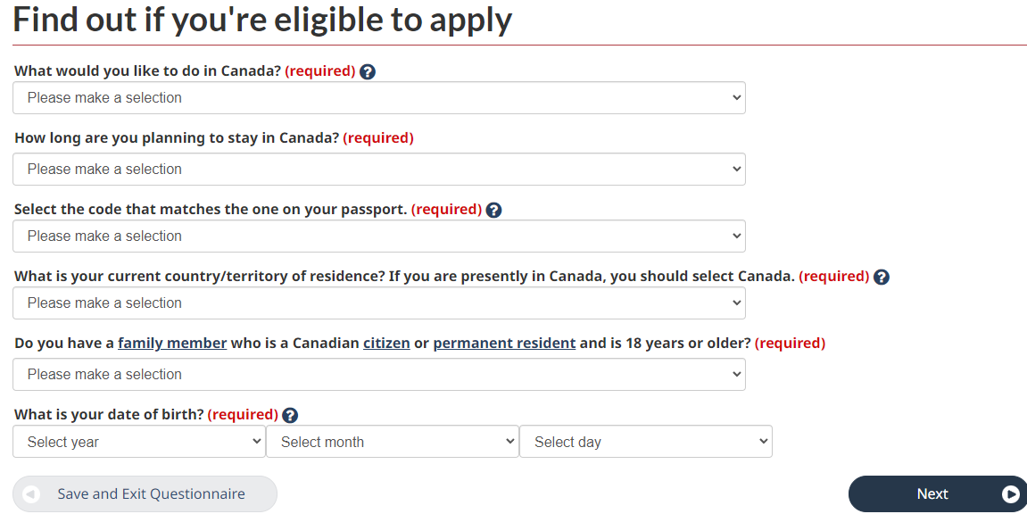
Come to Canada tool (C2C)
Notes:
Because this is an eligibility tool, there’s a lot more information required from the user - but that can limit their results. IT may not show them a program that requires 1 more year of work experience that they need.

Slide 5
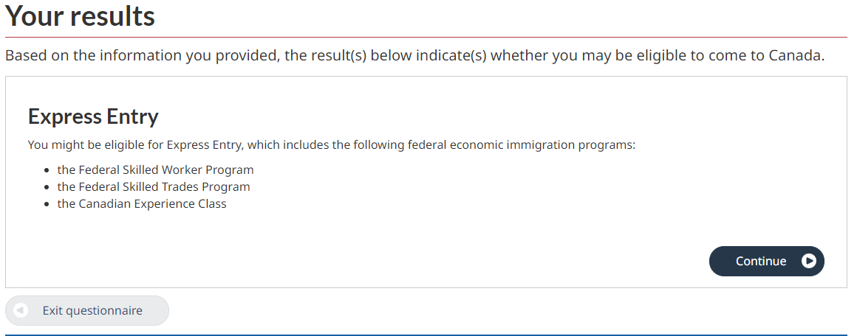

Slide 6
How can we make it easier to find that information
Ask simple, intuitive questions
Present a list of potential programs based on user responses
Provide key information on each program (fees, processing time, basic eligibility) with links to detailed program pages
6
Notes:
Our main objects were to have this tool ask simple, intuitive questions. Present the user with a list of potential programs based on their responses. Give them just enough information to provide a good overview (like the fees, processing times, basic requirements, but send them to the service initiation pages for those programs for more information.
Just enough eligibility requirements, we don’t want to list every thing - essentially duplicating the content. Enough that a user can self-filter - but still need to go through the how to apply pages.

Slide 9
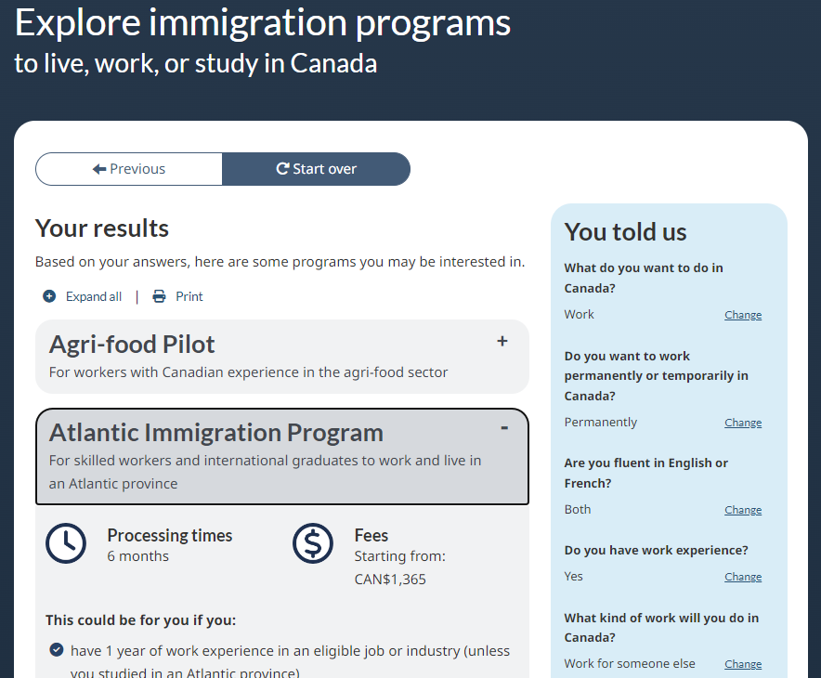
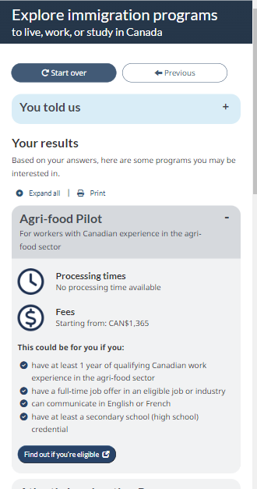

Slide 10
What was our approach?
Iteration and simplicity
10

Slide 11
We followed User-Centred Design principles
Research
Design
Evaluation
Implementation
Phase 1:
Initial MVP, mobile-first
Improved design from testing results
Usability testing to improve proto
Data from monitoring used to tweak once live
Launched tested, validated MVP
Improved tool while live, using data
Deep understanding of user needs
11
Notes:
We followed user-centered design principles
User centered design process:
- do some research to understand needs
- iteratively design a prototype
- do some usability testing
- get something live as soon as it's good
- have a robust monitoring in place
- do continuous improvement

Slide 12
Phase 1 - What was needed for launch
What is our MVP?
Minimum number of simple, intuitive questions to get to programs
Key eligibility requirements
Easy to maintain
Design that’s different from the rest of the web, a separate tool
User centered design
Mobile first, 50% of our users are on mobile
12
Notes:
We worked and are working in multiple phases. We just closed out Phase 1 and into Phase 2.
When starting the development we identified what should be our MVP.
Limited amount of questions, we want users to get to a result quickly. The questions should be intuitive.
We tested many different lines of questions, what made more sense, where were users getting lost..
All requirements? Just a few? What is the right amount
Important that it’s easy to maintain. Something that can keep up with changing policies.
It can’t look like a normal tool, it also needed to look nice and attractive.
From early development, we followed user centered design principles. And we kept a mobile first approach. Overall 65% of our users are on mobile, it needs to perform well. But 50/50 on the tool

Slide 13
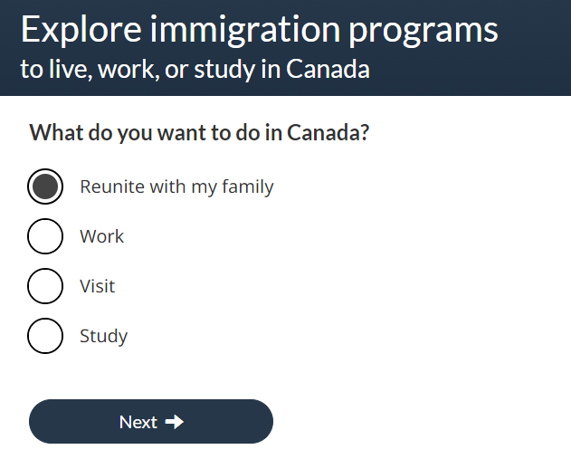
Mobile first
No images on mobile, reduce space
13
Notes:
One of the things we did for mobile first is to simply remove the images, and reduce some of the font sizes, spacing to increase the real estate

Slide 14
Phase 1 - Iterative design
What are some nice to haves?
Prototypes and more prototypes
What can we change in time for launch based on review and testing
Various rounds of review with stakeholders
Tested early with global users
14
Notes:
We wanted to be realistic with what we could achieve for phase 1 - but what were some nice to have ideas that we could possibly implement time permitting.
It was important to test early - how well is it actually doing before we get too far into it.
But also, what can we improve on - that aren’t major issues - found in user testing? From testing we noticed that the first question wasn’t performing well, we made that our focus. With the MVP more or less finalized, we could continue to improve on the design, finess the writing and get stakeholders involved early for feedback and update the content as needed.

Slide 15
Usability testing
8 sessions, mix of desktop and mobile
Most participants had prior experience with IRCC applications
Overall, participants understood the purpose of the tool
15
Notes:
Overall, participants understood the purpose of the tool well and found it to be useful when they were able to populate relevant programs to their situation. Though, participants had particular difficulty in answering the first question - “What do you want to do in Canada?”, due to the ambiguity of the options such as “Come to live permanently”. On the results page, participants were able to use the information presented to determine initial eligibility while still understanding that the tool was not comprehensive with all requirements. Participants continued to the links provided for further eligibility information and to start applications. Other areas where participants faced difficulties included filtering, and using on-page navigation to start over.

Slide 16
Usability testing - Strengths and issues
Questions
No navigation issues with the radio buttons or next button
No issues with understanding the text
No issues with the flow except for the first question
Results:
Most clicked on on exit link to the service initiation page.
Filters weren’t obvious
Mixed results for the eligibility requirements
Controls:
Users not finding start over
16
Notes:
There was no issues with navigation but there was confusion around the first question. We originally had the work permanently question flow under “Come to live permanently”. It was unclear if work would be under that branch.
We originally had filters on the result screen, but they weren’t obvious for the users, we ultimately decided to remove that feature.
Users stated that it wasn’t all eligibility requirements, but some did think that the few items would determine eligibility. Changed the wording of requirement heading and button leading to H2A.
For the controls, users weren’t finding the start over button. Easily fixed by changing the colour.

Slide 17
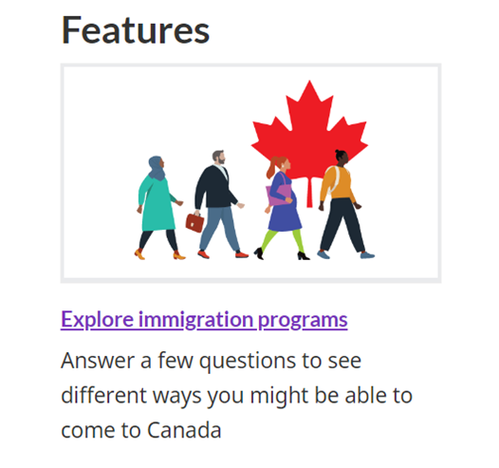
Phase 1 - Full gradual launch
Identify which pages to promote on
Approvals
Gradual increase of traffic until full launch
17
Notes:
So with the tool ready to go, we prepared for a soft launch.
We identified the key pages the tool should be promoted on, the main line of business topic pages. Immigrate to Canada, Visit canada, Work in Canada, Study, Sponsorship..
Then the approvals - which is really what took the most time in order to launch - but not because of required changes, just the nature of a busy directorate.
Which would get us enough traffic to start measuring and monitoring how it’s doing. We did weekly monitoring, and every week add it to another page, and another until we were in full launch.
This allowed us time to pause should there be any major issues. Thankfully we got overwhelming positive feedback.

Slide 18
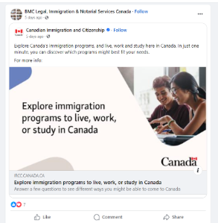
Monitoring plan
Validated UX survey. 500 participants completed the survey, with a score of 3.7/5
Page Feedback tool data
“Excellent, fast, clear, and not complicated!”
“I think you should add more questions so the results are more tailored…”
“When I went through this tool for PR opportunities, the final page provided a long list of PR programs. It would be nice to narrow the search further through a filter system.”
“How can I apply for Canada Humanitarian Visa”
Adobe Analytics dashboard
Weekly environmental scan
18
Notes:
All quantitative measures suggest a smooth experience: about 500 clients filled out our survey (the SUPR-Q validated UX questionnaire) and reported an overall score of 3.7/5, where 5 is “Completely agree”. This score is quite high for a user feedback mechanism - negative experiences greatly impact feedback. Therefore, if there were significant issues with the tool, we would expect a much lower score on this survey.
PFT = Praise, constructive feedback, personal situation, looking for other pathways not inthe tool
We have an analytics dashboard tracking visits, participation rates, # of users getting to a result and to the detail program page. As well as indicators of confusion, drop-off points.
Every week since launch, we performed a scan of social media sites and key immigration discussion forums online to observe any mention or reaction to the tool. For the first few weeks of the Live Beta (tool promoted on low-traffic pages), the Explore tool received no significant online attention.
However, once the Live Beta ended, and wider promotion began, we noticed an uptick of posts involving the tool. Notably, many immigration organizations began sharing the tool once it was formally posted by IRCC social media accounts.

Slide 19
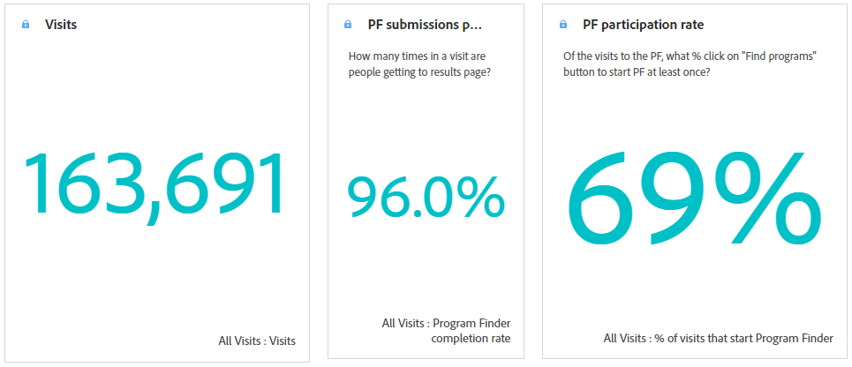
Data monitoring
Data confirms what we saw in testing, users are getting to various programs
19
Notes:
Since the gradual launch, it’s been viewed almost 164k times, a high percentage of users getting to a result, and going to a program page.

Slide 20
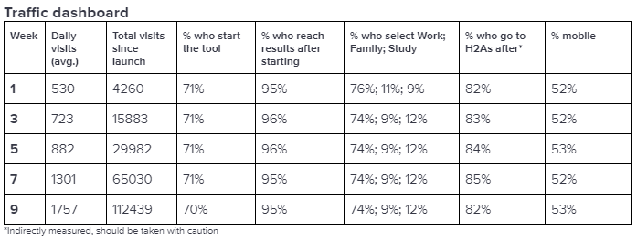
Data monitoring
Data confirms what we saw in testing, users are getting to various programs
20
Notes:
From our monitoring reports, we can see the increase in visits since launch and how it’s keeping a steady pace in performance.

Slide 21
Phase 2
What were some of the some nice to haves?
Do we still need or want them based on testing and feedback?
What do we improve based on user feedback
Decision tree, minimize number of results
Tweak parts of the layout to gain space on mobile
21
Notes:
With Phase 1 behind us, we are now in Phase 2.
For this phase, we looked back at what would have been some nice to haves that we identified at the start of the process. Were they still needed? Are users mentioning anything about it? Looking for that kind of feature?
And what can we do to improve based on the the user feedback.
We identified early on that there was one flow that came to quite a lot of results, 19. We are now reviewing the logic, which is just a simple decision tree, and how we can add 1 question to bring it down to 5 results or less.
We are also looking at features that aren’t being used as much, what can we do to improve it? Analytics is showing users not really using the “You told us” section, would modify it help users, or not? Is it relevant for such a short tool?
And what can we do to gain more real-estate on mobile.

Slide 22
Key to our success - Simplicity
Small, empowered, multidisciplinary team of in-house experts in design, content and tech
Having a developer on the team who can work in tandem with the designers and content writers eliminated a lot of workflow steps.
Early collaboration with stakeholders
Simple design, HTML and Javascript
User centered design process: research, iterative prototypes, testing, production and monitoring
22
Notes:
For us, the key to our success was how we kept everything simple.
We’re a relatively small team of in-house experts in design, content writing and tech. It was invaluable to the success of the tool to have access to experts within the team. Especially someone more technical who could develop alongside the design process.
We collaborated early on with advisors, business clients, to get their input and feedback and ensure accuracy. Not just the result but are their programs well situated within the logic?
We used a simple design, in just HTML or Javascript, utilizing JSON for information that is updated regularly (fees and PT), so it is easy and quick to maintain.
User centered design process:
- do some research to understand needs
- iteratively design a prototype
- do some usability testing
- get something live as soon as it's good
- have a robust monitoring in place
- do continuous improvement

Slide 23
Next steps
23

Slide 24
Continue with Phase 2
Informed updates based on feedback and data
Identified what we want to improve
One update at a time
Continue to monitor with every update
24
Notes:
For now our next steps is to continue with Phase 2. Identify what needs to be improved, one update at a time with continuous monitoring.

Slide 25
Questions?
25

