Slide 1
Employment Equity in Workforce Adjustment & SERLO Process
Understanding systemic risks, legal obligations, and safeguards in
Workforce Adjustment (WFA) and SERLO
Notes:
Nadia: welcome

Slide 2
Objectives
Explore how Workforce Adjustment (WFA) and Selection of Employees for Retention or Lay Off (SERLO) decisions shape careers and organizational culture for racialized and Indigenous employees.
Clarify legal obligations under the PSEA, PSER, Employment Equity Act and Canadian Human Rights Act and Common Law.
Identify practical safeguards for managers, HR advisors, executives, employee networks and unions.
Notes:
Nadia
WAE : Workforce Availability.

Slide 3
Agenda
Welcome and introduction
Why this matters and context
Key definitions
Legal Obligations and systemic risk
Data challenge: representation, attainment rates and projections
Other WFA considerations to support equity for racialized and Indigenous employees
Questions
Key Takeaways
Notes:
Nadia

Slide 4
WHY THIS MATTERS AND CONTEXT

Slide 5
Why This Matters
WFA and SERLO decisions are career-defining and affect psychological safety and trust.
In the federal public service, these decisions must uphold Employment Equity obligations under the PSEA.
If employment equity is not properly integrated, the result is systemic discrimination, not neutrality/impartiality.

Slide 6
Risks if Employment Equity is Ignored
Systemic discrimination, especially for Indigenous and racialized employees
Abuse of Authority complaints, human rights complaints and grievances.
Reputational harm and erosion of trust in leadership, HR and WFA processes.
Further under-representation of designated EE groups, particularly at senior levels.

Slide 7
WFA/SERLO are Employment Equity Processes
WFA and SERLO sit at the intersection of the WFA obligations, the Directive on Employment Equity, Diversity and Inclusion (EEDI), the Employment Equity Act and anti-racism and equity commitments.
Equity obligations do not disappear when budgets are cut; they are most important when jobs and psychological safety are at stake.
Core principle: WFA and SERLO must be designed and implemented as employment equity processes, not handled in parallel to equity.
Notes:
WAE: workforce availability estimate

Slide 8
KEY DEFINITIONS

Slide 9
Workforce Adjustment and SERLO
Workforce Adjustment (WFA): Structured process to manage workforce reductions due to restructuring or program changes
SERLO/ETP (Selection of Employees for Retention or Lay-Off/Employee Transition Plan):
Step within WFA where managers select employees who are retained or laid off.
Workforce Availability: (WAE) Workforce Availability Estimates
Attainment Rate: (Representation ÷ Workforce Availability) × 100
Notes:
WAE: Workforce availability

Slide 10
Substantive equality
Section 15 of Canadian Charter of Rights and Freedoms (and Canadian Human Rights Act, Employment Equity Act)
Substantive equality means ensuring that policies and practices lead to equitable outcomes, not merely equal treatment for employees.
Notes:
Substantive equality prohibits you from treating everyone the same when it comes to policies and practices. This what the EE act is based in.
Focuses on outcomes (*Data)/
Acknowledges and responds to difference
Addresses systemic discrimination/
Requires differential treatment/
Considers historical context/

Slide 11
Requirements for SERLO (PSER)
The 2025 Selection of employees for retention or lay-off: Guide for managers and HR specialists has a dedicated subsection titled: “Organizational need for employment equity, diversity, and inclusion” Canada
“When a gap in the representation of members of one or more of the employment equity designated groups has been identified, delegated managers can include belonging to one or more of the employment equity groups as a relevant current or future organizational need for a SERLO.”
Notes:
It also broadens to diversity and inclusion, saying these can be used “to address documented underrepresentation in other groups or within subgroups of the 4 designated groups (for example, persons with an intellectual disability or members of the Black community).” Canada Separately, the PSC self-declaration form reinforces that EE can be used specifically as an organizational needs merit criterion: “Please note that information regarding the fact that EE has been used as merit criterion (organizational needs) may be shared during the selection process.” Canada
So, yes: using EE as an organizational need in SERLO is explicitly contemplated and documented.
And then a second line to make the EE link explicit, grounded in the PSC guide: Organizational needs and Employment Equity
The PSC’s SERLO guide confirms that when workforce analysis shows gaps in representation, belonging to one or more designated Employment Equity groups can be included as a relevant organizational need in a SERLO, to increase or maintain representation of those groups. A short footnote for the slide: Source: PSC, “Selection of employees for retention or lay-off: Guide for managers and HR specialists” (2025), Step 7; and “Guide on the selection of employees for retention or lay-off” (Merit).

Slide 12
LEGAL OBLIGATIONS

Slide 13
TBS Guidance
Selection of employees for retention or lay-off: Guide for managers and human resources specialists
Organizational need for employment equity, diversity, and inclusion
When a gap in the representation of members of one or more of the employment equity designated groups has been identified, delegated managers can include belonging to one or more of the employment equity groups as a relevant current or future organizational need for a SERLO.
Diversity and inclusion have a broader scope that includes supporting and making improvements for a diverse, inclusive, and culturally competent workplace. Diversity may be used to address documented underrepresentation in other groups or within subgroups of the 4 designated groups (for example, persons with an intellectual disability or members of the Black community).
Notes:
When a gap in the representation of members of one or more of the employment equity designated groups has been identified, delegated managers can include belonging to one or more of the employment equity groups as a relevant current or future organizational need for a SERLO.
Selection of employees for retention or lay-off: Guide for managers and human resources specialists - Canada.ca
Organizational need for employment equity, diversity, and inclusion
When a gap in the representation of members of one or more of the employment equity designated groups has been identified, delegated managers can include belonging to one or more of the employment equity groups as a relevant current or future organizational need for a SERLO.
Diversity and inclusion have a broader scope that includes supporting and making improvements for a diverse, inclusive, and culturally competent workplace. Diversity may be used to address documented underrepresentation in other groups or within subgroups of the 4 designated groups (for example, persons with an intellectual disability or members of the Black community).

Slide 14
Policy Obligations
Public Service Employment Regulations (PSER), including section 22: requires bias assessment of selection methods before SERLO begins.
Employment Equity Act: requires proactive measures to maintain and improve representation of women, Indigenous Peoples, Persons with Disabilities and racialized employees.
Canadian Human Rights Act: prohibits discrimination, including adverse effect discrimination where neutral rules have unequal impact.
Directive on Employment Equity, Diversity and Inclusion (EEDI): requires collaboration with EE representatives when changing plans, policies and processes that impact them.

Slide 15
FETTERING OF DISCRETION

Slide 16
What is Fettering of Discretion?
A legal concept: decision-makers improperly limit or “chain” their discretion by rigidly applying a rule, formula or external source instead of using current evidence and judgment.
In this context, refusing to adjust AR or WAE values for racialized and Indigenous groups, despite clear evidence of growth, fetters discretion.
Result: decision-makers would rely on outdated numbers that hide discrimination and risk undermining compliance with the law.
Notes:
Result: decision-makers rely on outdated numbers that hide discrimination and undermine compliance with the law.

Slide 17
Fettering, Discrimination and Compliance Spectrum
When discretion is fettered, WFA and SERLO processes can drift from “conforming to the law” into zones of discrimination, high discrimination or even abuse of authority.
Women’s WAE values sit closer to legal compliance; racialized and Indigenous groups need projections to meet similar standards.
Using unadjusted 2016 or 2021 data for racialized and Indigenous groups understates under-representation and overstates attainment.
Projection to 2025 for these groups is required to avoid discriminatory effects.

Slide 18
Non-Compliance Risks
Complaints of Abuse of Authority to the Federal Public Sector Labour Relations and Employment Board (FPSLREB).
Human rights complaints and potential findings of systemic discrimination.
Loss of confidence in GOC as an employer that honours employment equity and anti-racism commitments.
Increased potential for legal, financial and reputational risk for the departments

Slide 19
THE DATA CHALLENGE AND ATTAINMENT RATES

Slide 20
Outdated Benchmarks = Built-In Bias
Current representation benchmarks are largely based on 2016/2021 Census Workforce Availability (WAE) tables.
By 2025, these benchmarks understate real labour market availability for racialized and Indigenous employees.
Using only 2016 or 2021 values makes under-representation look smaller than it is and overstates progress.
Notes:
Elaborate

Slide 21
Example of the Data Gap
Static 2021 target for a group: 15%.
Real 2025 availability, based on growth: closer to 22% for racialized and Indigenous groups.
If we treat 16–17% as “good enough” because it exceeds 15%, we mask real under-representation.
Result: systemic bias embedded into SERLO planning and decisions.
Notes:
Dr. Martin: Elaborate

Slide 22
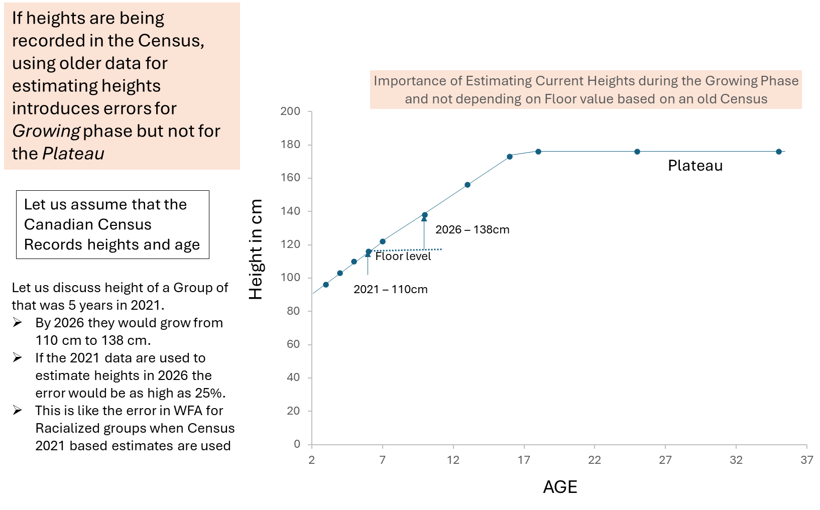
Why we are focusing on
racialized and Indigenous employees?
Notes:
Dr. Martin

Slide 23
Why we are focusing on
racialized and Indigenous employees?
If heights are being recorded in the Census, using older data for estimating heights introduces errors for the growing phase but not for the plateau.
Let us assume that the Canadian Census records heights and age.
Notes:
Dr. Martin
Let us discuss the height of a group that was 5 years old in 2021
By 2026, they would grow from 110 cm to 138 cm.
If the 2021 data are used to estimate heights in 2026, the error would be as high as 25%
This is like the error in WAE for racialized groups when Census 2021 based values are used.

Slide 24
Attainment Rate vs. Gap

Slide 25
Why Use Attainment Rates?
Underrepresentation is a fundamental measure to consider in SERLO for any work unit.
Attainment Rates (AR), not raw representation gaps, should be used to compare EE groups.
Attainment Rate = (Representation ÷ Workforce Availability) × 100.
AR values provide a true measure of proportional representation, account for labour market differences and highlight systemic barriers more accurately.
Notes:
The Attainment Rate (see About the Employment Equity Act ) Employment Equity Act: Annual Report 2024 only discusses the Attainment Rates (AR values) as a measure of compliance with the EE Act. Representation Gaps are not mentioned or reported. What is discussed is whether the AR values are less than or greater than 100%. The attainment rate offers a normalized and relative benchmark that is essential for a data-driven approach to employment equity planning and targeted action, as required by Canadian federal policy. A key performance measure for employment equity is the attainment rate,^{Footnote3} which is a designated group's representation rate^{Footnote4} divided by their labour market availability^{Footnote5} (LMA). When the attainment rate is 100%, it suggests that a group’s representation among the sector’s employees is the same as their representation among potential hires. An attainment rate below 100% shows that there is a shortfall between a group's level of employment and their availability. Progress is considered to have been made when a designated group's attainment rate approaches 100%; that is, when a designated group's representation rate grows closer to their LMA.
Here is a breakdown of why the attainment rate is a superior metric for triaging priorities:
1. Provides a True Measure of Proportional Representation
2. Accounts for Labour Market or Workplace Availability Differences
3. Highlights Systemic Barriers More Accurately
4. Ensures Efficient and Targeted Resource Allocation

Slide 26

“When comparing EE groups, focus on how full the theatre is (attainment rate), not on how many empty seats remain (gap). This ensures fairness for smaller groups.”
Group 1
Seat Capacity = 10; Occupied seats = 0
Empty seats = Gap = 10
Occupancy rate = Attainment Rate
Attainment Rate = (Occupied /Capacity) x 100%
Attainment Rate = 0%
First Group
Capacity: 8
Occupied: 0
Empty Seats (gap): 8
Attainment Rate: 0%
Gap = Empty seats (how far from full).
Attainment Rate = Percentage of seats filled (how close to full).
Notes:
Calculate attainment rate for each employment equity group
Attainment rate (AR) is a key performance measure that is proportional to the group’s availability in the labour market (WAE).
Formula: AR = (Representation Rate / Worforce Availability) * 100%
Attainment rate indicates the extent to which the representation of members of a designated group in an employer's workforce approaches, meets, or exceeds their availability in the relevant labour market.
Using only representation gaps may result in errors in decision making as gaps is an absolute measure, not related to the WAE nor the size of the group. Representation gap is what is reported on the HR Data Hub Employment Equity Reports

Slide 27
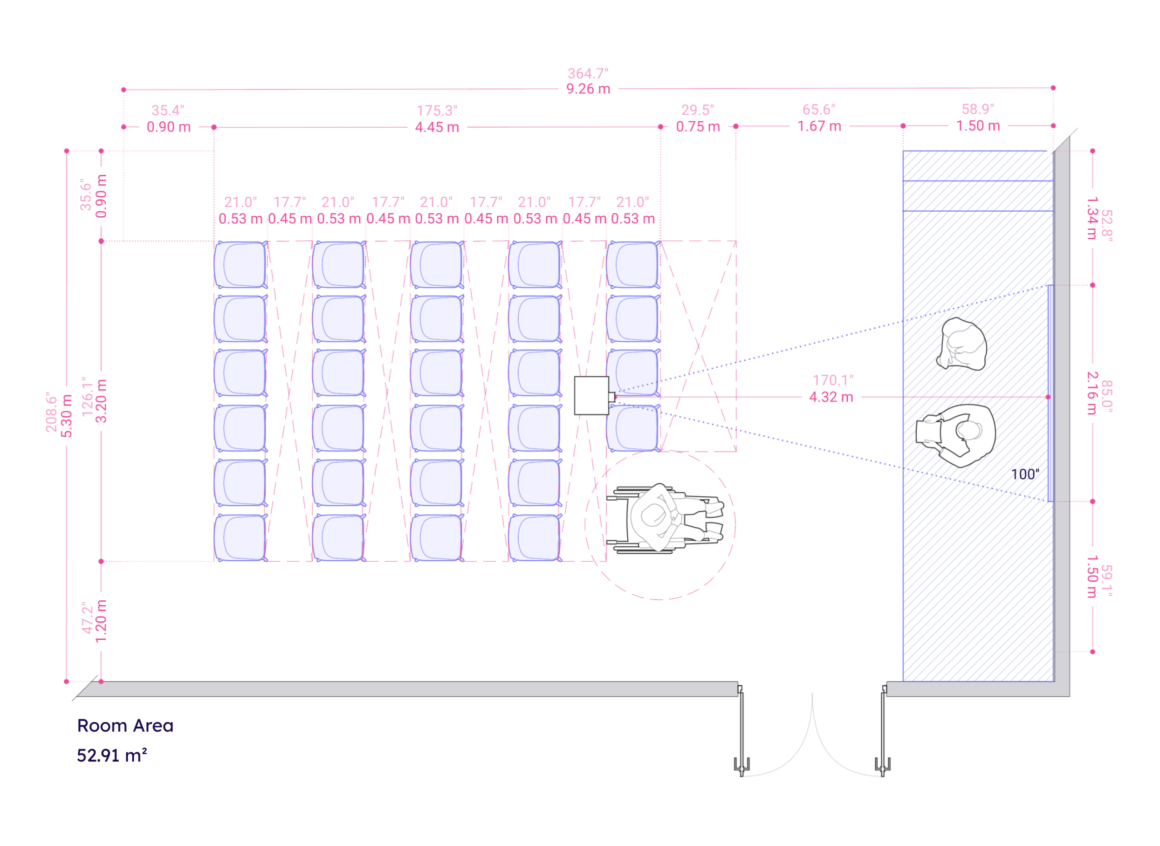
“When comparing EE groups, focus on how full the theatre is (attainment rate), not on how many empty seats remain (gap). This ensures fairness for smaller groups.”
Group 1
Seat Capacity = 10; Occupied seats = 0
Empty seats = Gap = 10
Occupancy rate = Attainment Rate
Attainment Rate = (Occupied /Capacity) x 100%
Attainment Rate = 0%
Group 2
Capacity: 30
Occupied: 20
Empty Seats (gap): 10
Attainment Rate: 67%
Gap = Empty seats (how far from full).
Attainment Rate = Percentage of seats filled (how close to full).

Slide 28
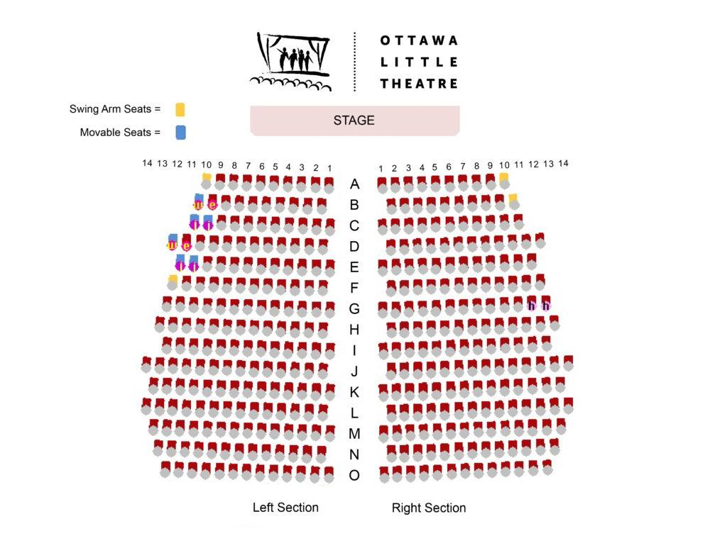
“When comparing EE groups, focus on how full the theatre is (attainment rate), not on how many empty seats remain (gap). This ensures fairness for smaller groups.”
X
Third Group
Capacity: 300
Occupied: 290
Empty Seats (gap): 10
Attainment Rate: 97%
x
x
x
x
X
x
x
X
x
x
The 10 empty seats (Xs) are not very noticeable among 290 attendees.
Gap = Empty seats (how far from full).
Attainment Rate = Percentage of seats filled (how close to full).

Slide 29
Imagine a small theatre with 10 empty seats—there’s no audience at all. Now picture a large theatre with 10 empty seats, but almost every seat is filled. The impact of those 10 empty seats is very different: in the small theatre, it means no engagement; in the big theatre, it means near-full participation and success.
Why use attainment rates?
Gaps penalize smaller groups (e.g., Indigenous, racialized) because their “empty seats” look large even when they are close to proportional representation.
Attainment rates measure progress fairly across groups.
Group | Capacity | Occupied | Empty Seats (Gap) | Attainment Rate
1 | 10 | 0 | 10 | 0%
2 | 30 | 20 | 10 | 67%
3 | 300 | 290 | 10 | 97%
Notes:
In summary,
Imagine a small theatre with 10 empty seats—there’s no audience at all. Now picture a large theatre with 10 empty seats, but almost every seat is filled. The impact of those 10 empty seats is very different: in the small theatre, it means no engagement; in the big theatre, it means near-full participation and success.
This analogy highlights how the same gap can have very different consequences depending on context—just as representation gaps in workforce equity must be understood relative to the size and needs of each group.

Slide 30
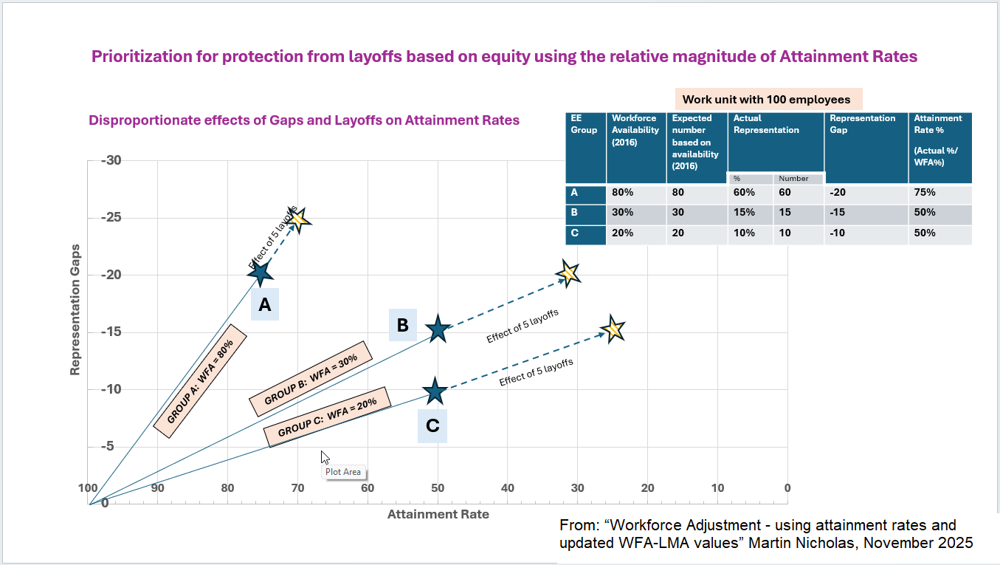

Slide 32
CORRECTING AR AND WORKFORCE AVAILABILITY (WAE) VALUES TO 2025

Slide 33
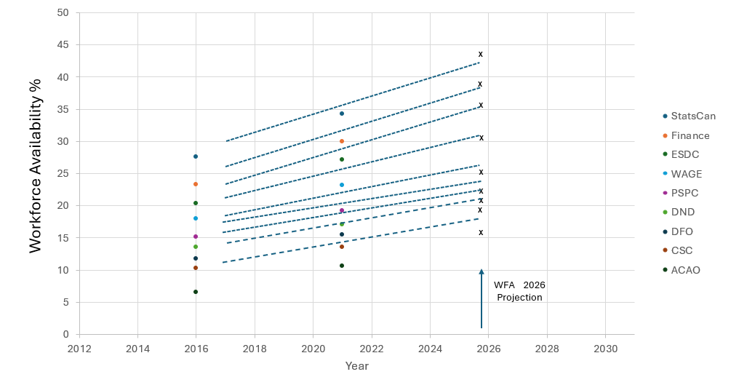
Change in workforce availability for racialized group from 2016 to 2021 and its projection to 2026 for departments - covering a range of values for workforce availability in 2016 (between 5% and 30%)
WAE 2026 projection
Notes:
Workforce availability for 9 departments with data for 2016 and 2021 along with the projection for 2026.

Slide 34
Attainment Rates for racialized and Indigenous groups using 2016 Census
For SERLO purposes:
AR values for racialized groups should be divided by 1.5 to approximate 2025 reality.
AR values for Indigenous groups should be divided by 1.2 to approximate 2025 reality.
Notes:
AR values for racialized and Indigenous groups, if based only on 2021 Census data, are inflated because they do not account for growth between 2021 and 2025.
Attainment Rates for Women and Persons with Disabilities generally do not require adjustment for growth, but PwD representation is underestimated when outdated definitions are used.

Slide 35
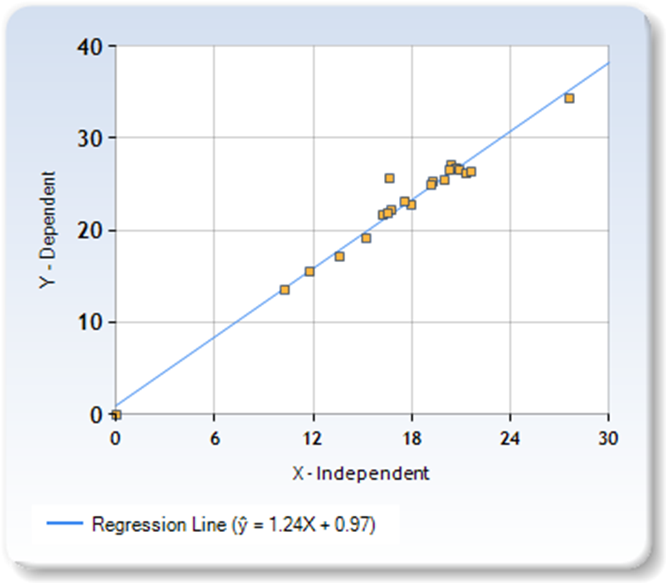
Comparison of WAE 2021 and WAE 2016 for racialized employees in the twenty largest organizations in the
Federal Public Service Core Public Administration
(WAE-2021) = 1.24 x (WAE-2016)
This growth rate of 24% from 2016 to 2021 is expected to continue until 2026 as well.
The WAE for 2026 would be expected to be grow by approximately 25% from 2021.
WAE- 2021
WAE- 2016

Slide 36
Attainment Rates for racialized and Indigenous groups using 2021 Census
For SERLO purposes:
AR values for racialized groups should be divided by 1.25 to approximate 2025 reality.
AR values for Indigenous groups should be divided by 1.10 to approximate 2025 reality.
Notes:
AR values for racialized and Indigenous groups, if based only on 2021 Census data, are inflated because they do not account for growth between 2021 and 2025.
Attainment Rates for Women and Persons with Disabilities generally do not require adjustment for growth, but PwD representation is underestimated when outdated definitions are used.

Slide 37
Two Corrective Options for SERLO
Option 1 (project WFA 2021):
Multiply WFA for racialized groups by 1.25 and for Indigenous groups by 1.10.
Use these projected WFA values to calculate AR and compare with other EE groups.
Option 2 (correct AR directly):
Divide existing AR values for racialized groups by 1.25 and for Indigenous groups by 1.10.
Use these corrected AR values when comparing and prioritizing racialized EE groups in SERLO.

Slide 38
TRACKING OUTCOMES AND SELF-IDENTIFICATION

Slide 39
Track Trends to Catch Patterns Early
Track who is screened in and out of SERLO, and who is retained, by EE group and classification.
Use this information to detect patterns of inequity and adjust processes before decisions are finalized.
Provide concise explanations, on request, about how SERLO criteria, employment equity and accommodation were taken into account.

Slide 40
Modernize Self-Identification
Revise the SERLO employment equity self-identification form to include updated terminology and under-represented groups.
Ensure at least the following options are captured:
Indigenous
Black
Racialized
Person with Disability
2SLGBTQI+
Notes:
Ensure the updated form is provided to all SERLO candidates to support accurate, up-to-date analysis for the department.

Slide 41
Other WFA considerations:
Legal minimum ≠ organizational safety
Notes:
Hi All, this section is from RESN based on the experiences we have heard from members and different practices and concepts to think about: Option 1: “I want to start this part by being honest about the box we’re in – legally and structurally – and how we got here in the first place. Most of us in this room didn’t design the WFA regime, the PSER, the language rules, or the data tables. But we’re the ones living with the impacts, especially if you’re racialized or Indigenous. On paper, it all looks neutral: follow the WFA Directive, follow the SERLO guide, apply the 2021 workforce availability tables, apply the language profiles. In reality, those ‘neutral’ tools sit on top of a history where racialized and Indigenous employees had less access to acting roles, stretch assignments and full-time language training, and where the 2021 data already understates where those groups are in 2025. Add rigid language profiles on top of that, and they become an easy cut-off for who stays and who goes. So yes, there are real legal and structural constraints. But if we stop only at looking at the bare minimum requirements, we’re basically telling people to wait years for change. The question for this section is: how do we use the discretion we do have inside this legal framework to actually reduce harm, instead of repeating the same patterns?”
Option 2: I want to start this part by being really transparent about the environment we’re all working in. Most of us in this room did not create the WFA regime, the WAE tables, the SERLO rules, or the language system. But we are the ones trying to make these tools work in a way that is fair and humane, especially for racialized and Indigenous employees. WFA sits inside a very structured stack of rules: the Public Service Employment Act and Regulations, the Official Languages Act, the Employment Equity Act, and the Workforce Adjustment Directive. All of this is meant to create consistency and predictability. Managers are expected to follow these frameworks closely, and that can make the whole exercise feel like there’s no room to move.
On paper, a lot of this looks neutral: use the approved WAE tables, apply the language profiles, apply the merit criteria. But the lived experience behind those tools is not neutral. racialized and Indigenous employees have often had fewer chances at stretch assignments, acting roles, and full-time language training. Then those same advantages and disadvantages get carried straight into SERLO decisions. So the gap that existed before WFA gets carried straight into WFA. Even inside these structured frameworks, there is still judgment. The rules give direction, but they also leave room for contextual decisions and interpretation. When teams feel locked into a single reading—for example, treating WAE tables as frozen in time even when we know they lag behind current demographics—that doesn’t usually come from bad intent. It comes from how high-stakes and risk-averse these processes feel.
Language is a good example of a known pressure point. Language requirements matter in the Government of Canada, and at the same time, access to language training has not been equal across groups. When language becomes a deciding factor during WFA, it can amplify inequities that were already there. The question isn’t “Does language matter?” The question is “How do we support people equitably when language is part of a SERLO decision?”
So yes, there are real limits. Some changes can only come from central agencies or legislative updates. But if all we do is name the limits, what Racialized and Indigenous employees hear is: “Wait 5–10 years for Ottawa to fix it.” That’s not good enough. Our goal today is to ask: within the rules we have right now, where can we use judgment, discretion, and supportive interpretation to reduce harm?
We also have influence through the questions we ask. Not just “Did we comply?” but “How did we consider equity impacts?” “How did we account for unequal access to training and acting roles?” “What supports exist for people coming back from leave?” “Where is there flexibility that helps level the playing field rather than tilt it further?” Those kinds of questions nudge the process toward equity without breaking any rules.
And this is not about blaming individual managers or HR. Most people are navigating incredibly complex rules while genuinely trying to be fair. What we’re saying is: within that complexity, there are choices. If we surface those choices, use the grey zones wisely, and bring equity into the conversation at the front end of WFA and SERLO, we can get better outcomes now, while we keep pushing for the structural reform that still needs to happen.

Slide 42
Structural Barriers and Equity
Neutral rules, including seniority, language profiles (racialized employees have historically had less access to full-time, employer-funded language training) that is a textbook systemic barrier), or historical availability tables, can have inequitable impacts if applied without updated evidence. SERLO Step 9 explicitly requires leaders to detect and correct these systemic barriers.
Using outdated EE data and applying only the minimum legal bar increases the likelihood of errors, grievances, RWO files, investigations, privacy breaches, workplace assessments, sick leave, turnover, and re-hiring costs. This is the opposite of CER efficiency.
Notes:
This model is already used in other departments and can be adapted. What does Employment Equity becoming as an essential qualification contribute to issues like language requirements, who have been impacting from an equity lens? EE should always be Essential before Language as essential in SERLO…this is something we need to work towards….
c. SERLO already requires you to identify and remove systemic barriers: The 2025 PSC SERLO Guide (reflecting the amended PSER) builds in an explicit bias/ barrier check:
Step 7: managers must determine qualifications, requirements and organizational needs (which include EE objectives) for the SERLO. Canada
Step 9 – Identification of biases and barriers: under PSER s.22(5), managers must evaluate assessment methods and how they’ll be applied to identify and remove biases or barriers that disadvantage equity-seeking groups or mitigate their impact. Canada
d. Employment Equity and human rights law require barrier removal: The Employment Equity Act and union EE toolkits describe employment equity as a proactive program to increase representation of designated groups and to identify and eliminate “artificial barriers” in policies and practices that prevent access to jobs, promotion or training. Public Service Alliance of Cana
The SERLO framework and the updated PSER already encourage managers to look at potential biases or barriers when they define requirements and apply assessment tools. Similarly, the system already uses transitional language pathways in some contexts – hiring someone with a 2-year window to meet their language level is not a new concept. the opportunity is to bring those existing tools together with employment equity in a more deliberate way. For example, in WFA situations where positions are designated as EE-essential, departments could make more systematic use of transitional arrangements and non-imperative language profiles so strong EE candidates are not screened out at the front end by language alone. it would simply use the flexibility that already exists in a way that better reflects employment equity objectives.
I don’t think the value in raising this is to claim non-compliance. The value is to show that, even staying fully within the current legal framework, leaders have more room than they may realize to go beyond the minimum and align SERLO decisions with both equity and organizational needs.

Slide 43
Example of current WFA/SERLO
Management: “EE is not required in this SERLO because overall agency representation meets targets.” (ie. for a particular EE group)
SERLO is a process-level obligation.
Aggregate departmental representation ≠ compliance in an individual SERLO decision. PSER s.21 requires a bias assessment of each selection process.
You cannot skip EE considerations because the agency “looks fine overall.”
This interpretation fetters discretion, because managers are applying a rigid “department-level attainment” rule instead of reviewing the real workforce composition of their unit.
There is no ceiling for EE groups.
Notes:
In a recent WFA affecting about 100 EC staff, around 70% of those affected were VM employees, most of whom were unilingual. When the SERLO stage began, 50 positions were identified — but only two were English-essential. Because bilingual employees can also apply to English-essential roles, the number of real opportunities for unilingual employees was essentially zero. The process met the letter of policy, but it did not meet the spirit of substantive fairness. It created avoidable inefficiency, heightened psychological stress, and reduced trust — the opposite of what CER requires right now.
This illustrates why CER planning must look beyond the minimum bar and ensure that the decision frameworks we use reflect current workforce realities and equity commitments.
Objectively it is a legally weak interpretation and a high-risk one. Why?
SERLO is a process-level obligation.
Aggregate departmental representation ≠ compliance in an individual SERLO decision.
PSER s.21 requires a bias assessment of each selection process.
You cannot skip EE considerations because the agency “looks fine overall.”
This interpretation fetters discretion, because managers are applying a rigid “department-level attainment” rule instead of reviewing the real workforce composition of their unit.
It contradicts the DM’s stated principles because it:
hides inequity behind outdated numbers (not transparent),
avoids accountability for actual impacts, and
shows little respect for affected employees.

Slide 44
Alternation – Access and Fairness
Make alternation processes transparent and accessible to all affected employees, not just those with strong informal networks.
Track alternation opportunities and outcomes by EE group and classification and adjust if patterns of inequity appear.
Notes:
Implement a proactive, transparent alternation process by making opportunities visible and understandable to all employees, rather than circulated informally among managers.
Define clear criteria for viable alternation matches
Provide targeted information and support to EE employees so they are not disadvantaged by weaker informal networks.
Maintain central HR oversight of employees seeking alternation and potential matches.
Track alternation outcomes by EE group and classification to detect inequitable patterns and adjust processes.

Slide 45
Data Analysis – Key Actions
Ensure data analysis is equitable to racialized EE groups by using projections to 2025 levels of Workforce Availability Estimates (WAE).
Use projected attainment Rates rather than raw gaps to make employment equity decisions.
Notes:
correction factors shown on slides 34 and 35 depending on whether your EE data is based on 2016 or 2021 Census data

Slide 46
Assess – Transparent, Bias-Resistant Grids
Apply documented, bias-resistant assessment grids that align with SERLO criteria and can be explained and reviewed.
Safeguard racialized and Indigenous employees affected by systemic barriers to acting roles, language training, informal “visibility” and access to stretch assignments.
Notes:
Transparent assessment grids: Bias-resistant assessment and tracking in SERLO
Ensure there is no penalty for past exclusion or accommodations:
acting experience, informal “visibility” and access to stretch assignments are not over-weighted;
Ensure that lack of those opportunities (often due to bias and systemic barriers) is not held against candidates;
Ensure that accommodations; leave for illness/injury (medical), and modified duties are not factored in decisions;
Duty to accommodate principles were respected in how performance and experience are interpreted.
Audit AI-assisted assessment tools for bias.
Decision-making: Use employment equity as an organizational need in SERLO processes
Use employment equity as an organizational need where under-representation is demonstrated by attainment rates; for example, belonging to racialized, Black, Indigenous, persons with disabilities and 2SLGBTQI+, as directed in the Selection of employees for retention or lay-off: Guide for managers and human resources specialists Employment equity/ tie-breaking where candidates are relatively equivalent:
allow employment equity tie-breaking that supports maintaining or improving representation for under-represented EE groups;
make sure subjective criteria like “fit,” “breadth,” or “visibility” are not used as proxies for bias or informal networks
Employment equity-focused flexibility/exemption for language requirements.
Introduce a process to adapt language profiles for EE employees where:
evidence shows systemic barriers to accessing language training; and
rigid application of profiles would effectively bar them from retention despite meeting other requirements.
The goal is not to abandon bilingualism but to avoid using it as a structural barrier in WFA/SERLO.
Non-imperative and transitional language pathways for EE groups.
Designate a portion of positions affecting EE employees as non-imperative bilingual, with funded, time-bound language training built into work plans and monitoring so that employees are supported to meet profiles, not set up to fail.
This model is already used in other departments (IRCC, PSPC) and should be adapted for PHAC. Clear rationales for non-selection (upon request).
Provide concise explanations, when requested, on:

Slide 47
Decision-Making: Equity in Practice
Use employment equity as an Organizational Need in SERLO where under-representation exists for Indigenous, Black, Racialized employees with intersecting identities of disability and 2SLGBTQI+.
Ensure subjective criteria like “fit”, “breadth” or “visibility” are not used as proxies for bias or informal networks.

Slide 48
KEY TAKEAWAYS AND
YOUR ROLE

Slide 49
Employee Networks and Bargaining Agents
Provide insight on how WFA/SERLO processes impact EE communities and equity-denied employees.
Highlight systemic patterns (e.g., exclusion from development opportunities).
Monitor impacts of WFA/SERLO and advocate for trauma-informed, department-fit process changes.

Slide 50
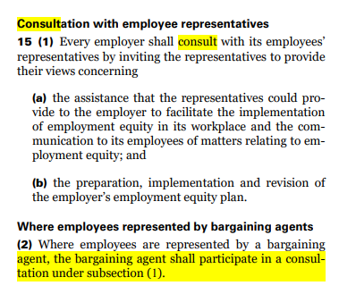
HR/LR
Ensure SERLO plans comply with legal and policy obligations, including PSER s.21 bias assessments.
Support managers to design and document bias-resistant criteria, tools and grids.
Flag systemic risks early and document how employment equity considerations were applied.
Apply merit criteria fairly and consistently, without penalizing employees who lacked access to acting roles or training.
Use Organizational Needs (EE representation) as a legitimate and documented factor where under-representation exists.
Executives: provide oversight, approve SERLO plans and insist on equity safeguards before decisions are finalized.

Slide 51
Next Steps for Leaders and HR
Review current WFA/SERLO plans, tools and data for equity risks and documentation gaps.
Identify where further engagement with EE reps/ networks and unions is needed before decisions proceed.
Confirm how projected WFA and corrected Attainment Rates will be used in upcoming SERLO exercises.
Clarify guidance on language pathways, employees on leave and alternation in your branch or directorate.

Slide 52
KEY QUESTIONS

Slide 53
SERLO Step 1: What HR and managers are supposed to do and what you can ask about.
How are you doing the workforce analysis for our area? Can you show how Black, other racialized and Indigenous employees are represented now, compared to where we should be?
When you did the environmental scan, did you look specifically at representation of Employment Equity groups, or just overall numbers and FTEs?
What did you find when you identified workforce gaps – especially gaps in representation for racialized and Indigenous employees?
Have you done a skills gap analysis that looks at current and future skills, not just who already had acting roles or “visibility”?
How are these findings being used before deciding who is “excess” – for example, are you using them to protect or improve representation for racialized and Indigenous staff?

Slide 54
SERLO Step 1: What HR and managers can do and what you can ask about.
How will representation and under-representation by EE group and classification be examined using projected WFA and Attainment Rates?
What steps will be taken to avoid fettering of discretion by relying solely on unadjusted 2016/2021 data for racialized and Indigenous groups?
What department-wide guidance will protect employees on leave and ensure any participation in SERLO is voluntary and informed?
How will non-imperative and transitional language pathways be used to prevent language profiles from becoming structural barriers?
How will SERLO tie-breaking avoid penalizing employees who were shut out of acting roles and stretch assignments because of systemic barriers?
How will alternation be made transparent and accessible across the department, including for EE employees with weaker informal networks?
In concrete terms, how will membership in under-represented racialized EE groups and subgroups be used as an Organizational Need in SERLO?

Slide 55
Key Takeaways
Outdated data creates systemic risk; projected availability and Attainment Rates should inform WFA and SERLO decisions.
Bias checks, documentation and early consultation with EE networks and unions reduce harm and legal exposure.
SERLO decisions must reflect Employment Equity obligations – this is a legal and ethical requirement, not an option.

Slide 56
REFERENCES

Slide 57
Representation by department or agency
These tables provide representation of one specific employment equity group by department and agency along with the workforce availability estimates and the gap between the actual number of employees and the expected number of employees based on the benchmark.
Women
Indigenous Peoples
Persons with disabilities
Members of visible minorities

Slide 58
Public service hiring guides
Public service hiring guides
Step 1: Determine the desired current and future state of the organization
Delegated managers, with the assistance of their human resources specialist, should consult their departmental plan and HR plan to clearly understand the organization’s current and future programs, services, and priorities. An environmental scan, which can include a workforce analysis (including the representation rate of Employment Equity designated groups) and a skills gap analysis, will assist delegated managers in making decisions that serve the interests of the organization, now and in the future.
Consult departmental and HR plans and Conduct an environmental scan.
Identify workforce gaps, including the representation rate of Employment Equity designated groups. Identify gaps in skills required now or in the future.
For additional information and support related to this step, please refer to the following:
Departmental Plans
Risk Management Essentials: How to Conduct an Environmental Scan
Representation of employment equity groups and subgroups by federal department or agency
Diversity and Inclusion Compass (accessible only on the Government of Canada network)

Slide 59
Report 5—Inclusion in the Workplace for Racialized Employees
Report 5—Inclusion in the Workplace for Racialized Employees - See Articles 5.20 and 5.21

Slide 60
References
Public Service Commission – SERLO Guide for Managers and HR specialists.
National Joint Council – Workforce Adjustment Directive.
Employment Equity Act and associated regulations.
Public Service Employment Act and Public Service Employment Regulations (including section 21).
Statistics Canada – Labour Force Survey and Census-based Workforce Availability tables.
Internal PHAC/HC EE dashboards, WMB guidance and input from EE networks and unions.

