Slide 1
Foundational Geospatial Data
GIS Day – Statistics Canada
November 2019

Slide 2
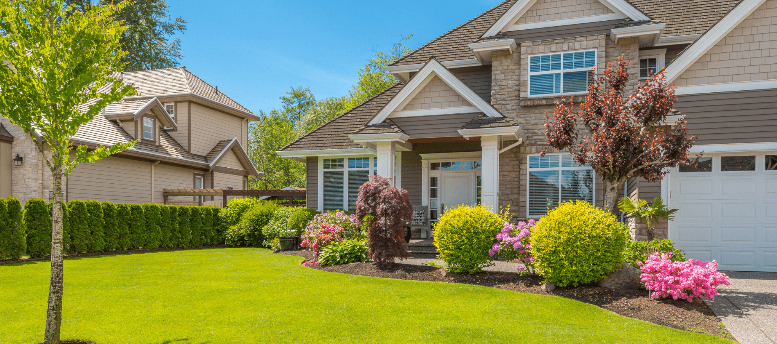
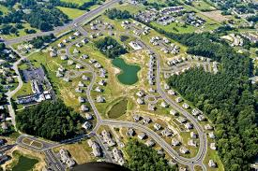
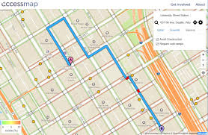
Buying a house
When shopping for a house, what makes you want to visit the house? Make an offer?
Curb Appeal
Landscaping
Large windows
Freshly painted
Brand recognition
Open House
Good neighbourhood
Easy to find/get to
Updated interior
Clean
Easy access
Good lighting

Slide 3
But, what if?
Upon inspection you find a large crack in the foundation?
Erosion of confidence
Walk away
Decide to fix the foundation

Slide 4
Poll
What word(s) come to mind when I say the following two terms:
Confidence
Geospatial data
Text scotttweedy181 to 780-800-5606

Slide 5
Foundational Geospatial Data
CCMEO is identifying authoritative, national scale Foundational Geospatial Layers:
Accountability
National standard
Make them easily discoverable trough FGP/Open Maps
Source, Currency, Coverage, Accuracy
Documented Revision cycle
Will provide an easy to find, easy to use, well-curated national core of geospatial data
Text scotttweedy181 to 780-800-5606 – Confidence, Geospatial Data

Slide 6
High Resolution Elevation Data
Increase high resolution elevation data coverage
Optimize past and future investments
Pooled collection/liberation of source data
Standardization of source data collection
Improve accessibility
Text scotttweedy181 to 780-800-5606 – Confidence, Geospatial Data

Slide 7
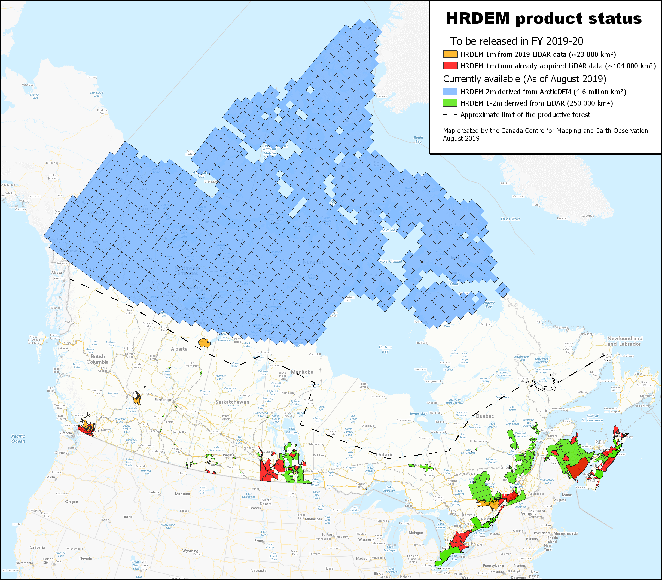
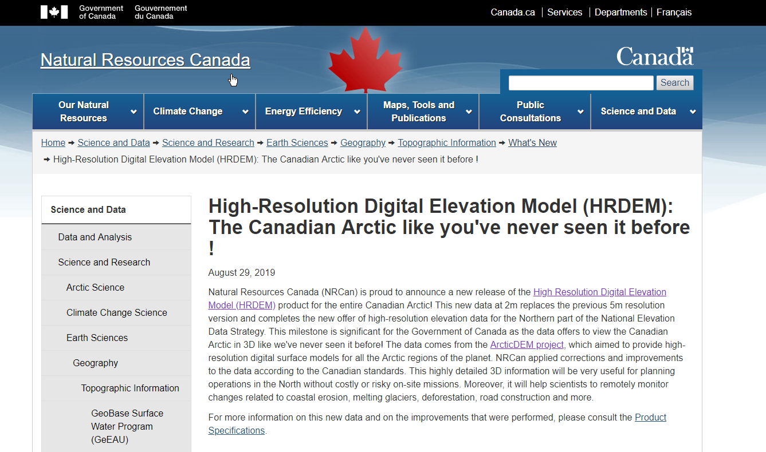
HRDEM release plan
for FY2019-20
August release:
Entire Canadian Arctic at
2m resolution (4.6 million km²)!
To come:
More than 100 000 km²
of DEMs derived from
LiDAR in the south.

Slide 8
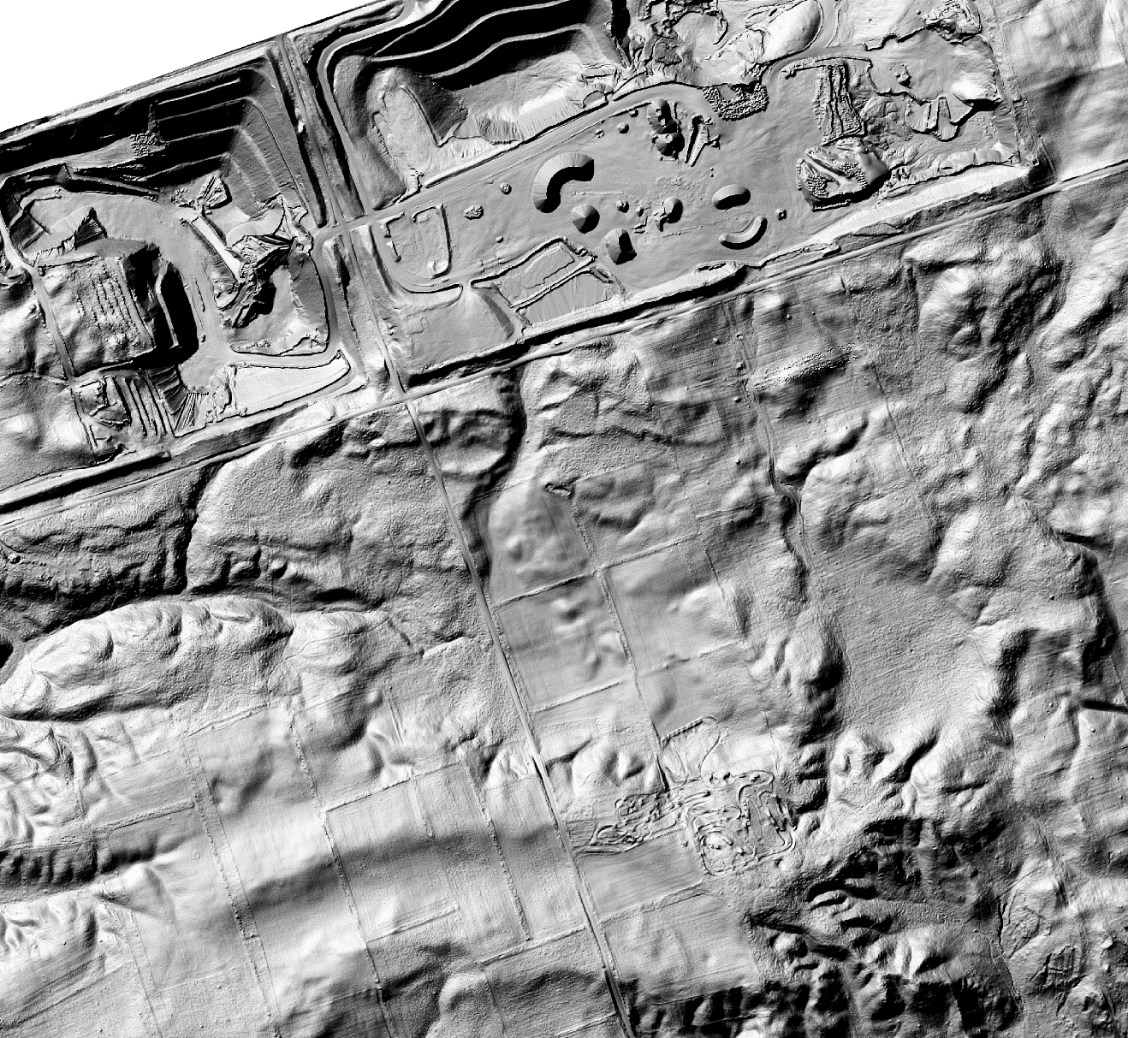
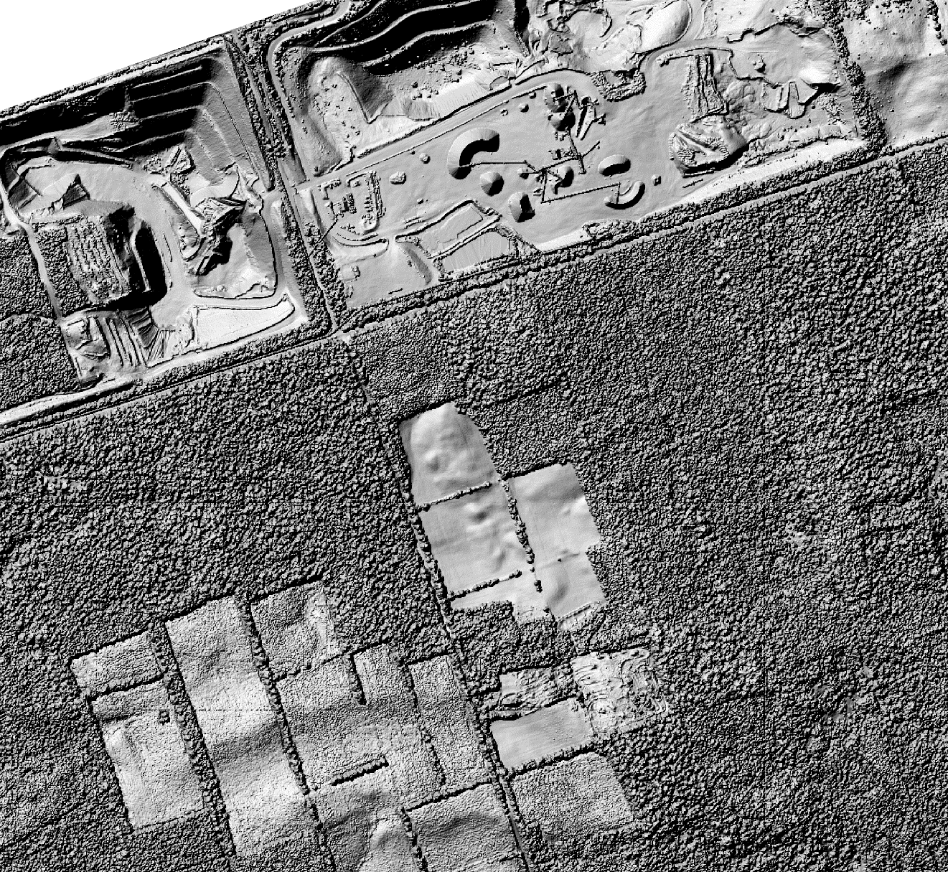
Canada in 3D like we’ve never seen it before!
DTM 1m
CDSM 20m (old)
DSM 1m
HRDEM 1m: South of Peterborough ON / Surface Mining
Notes:
David

Slide 9
Automatic Extraction of Buildings
Using LiDAR as a data source
Building extraction coincident with LiDAR collection
Very high rate of discreet building detection
95% detection rate, 80% representation rate
Text scotttweedy181 to 780-800-5606 – Confidence, Geospatial Data

Slide 10
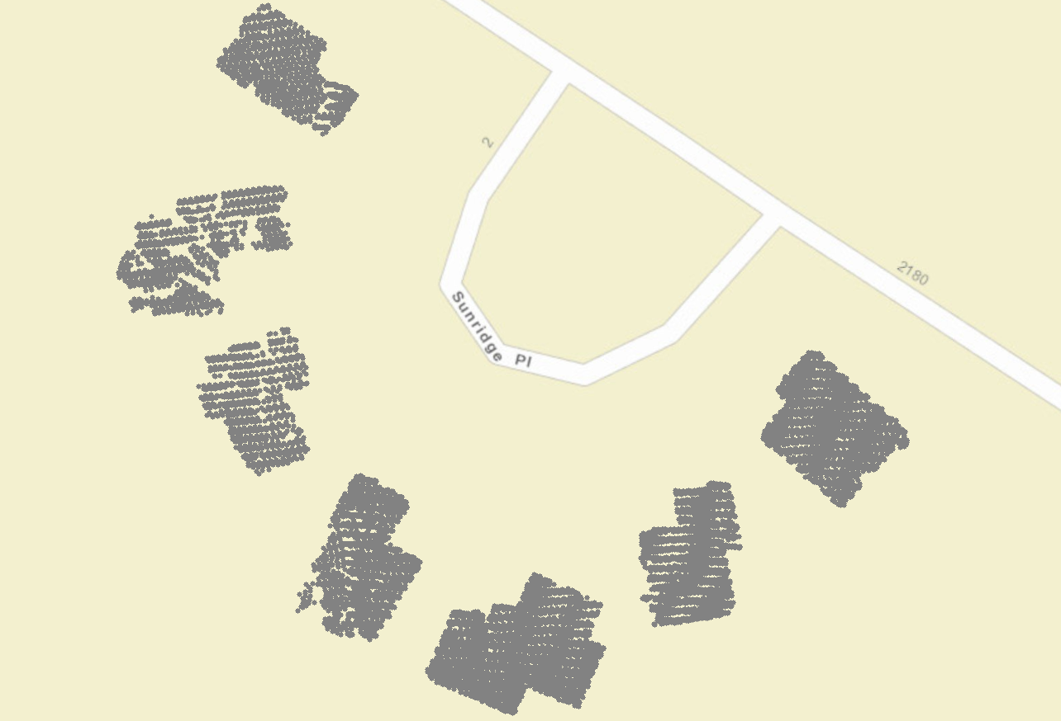
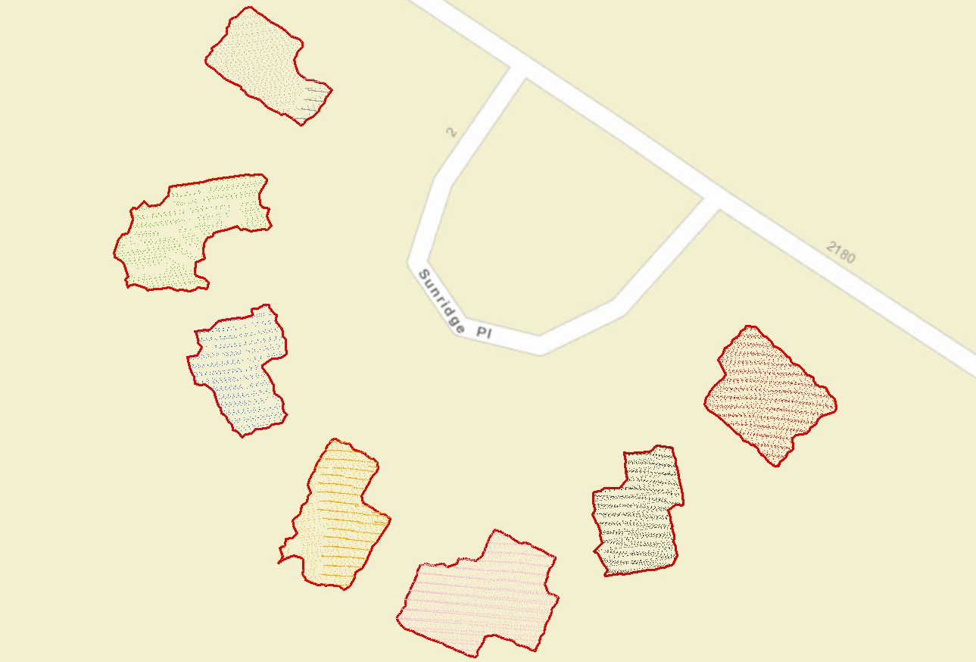
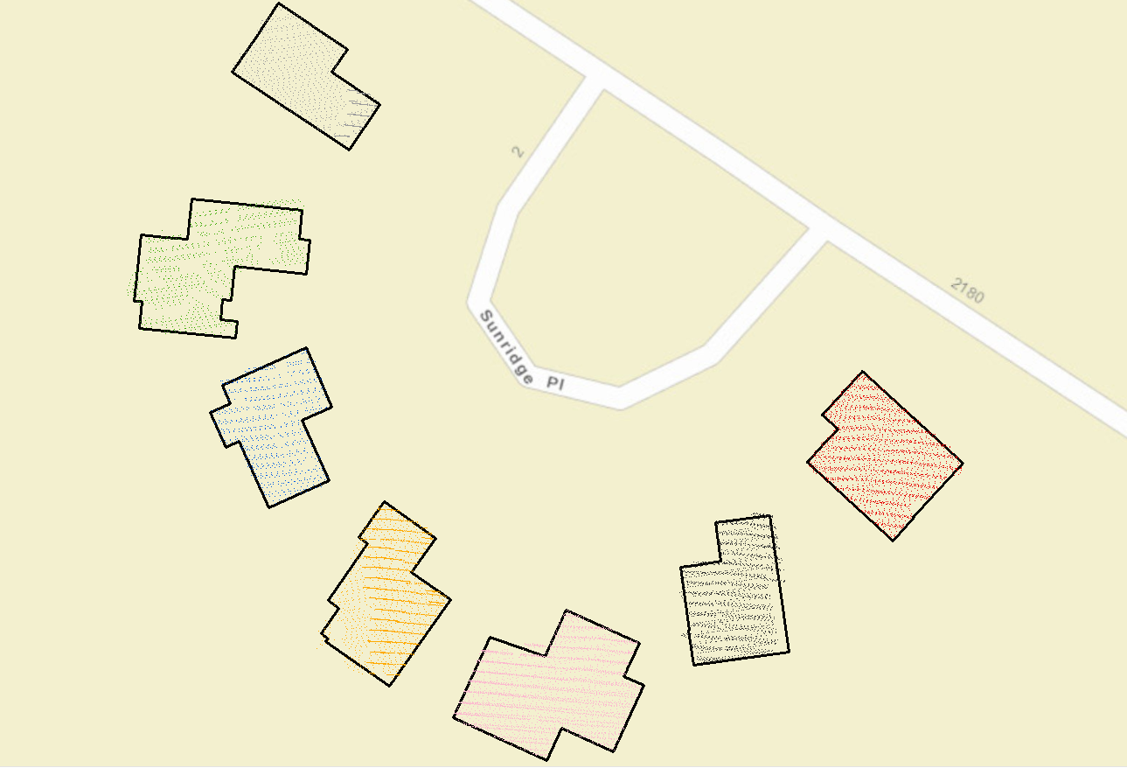
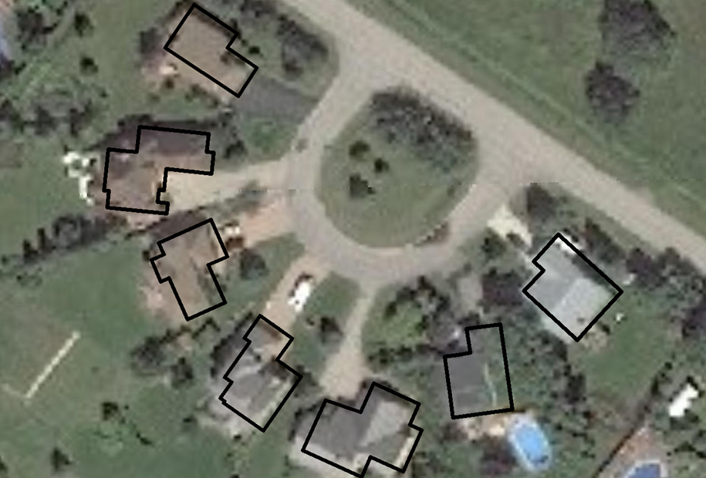
Building feature extraction process from LiDAR
CLASSIFICATION
EXTRACTION
SQUARING
VALIDATION
ATTRIBUTING
Step 1: Classify and keep only the LiDAR points that are related to building.
Step 2: Extract the boundary containing the set of points for each building.
Step 3: Square the polygons to present right angles.
Step 4: Compare polygons with an image to confirm presence and shape.
Step 5: Add following attributes
Minimal and maximal height of the building relative to mean sea level.
Minimal and maximal elevation at the base of the building relative to mean sea level.
Area of the building.
Metadata (Provider, Year)
Text scotttweedy181 to 780-800-5606 – Confidence, Geospatial Data

Slide 11
Automatic extraction of additional features
The potential of using high resolution data sources to improve our foundational datasets
Airports
Lakes, rivers
Transmission lines
Pipelines
Text scotttweedy181 to 780-800-5606 – Confidence, Geospatial Data

Slide 12
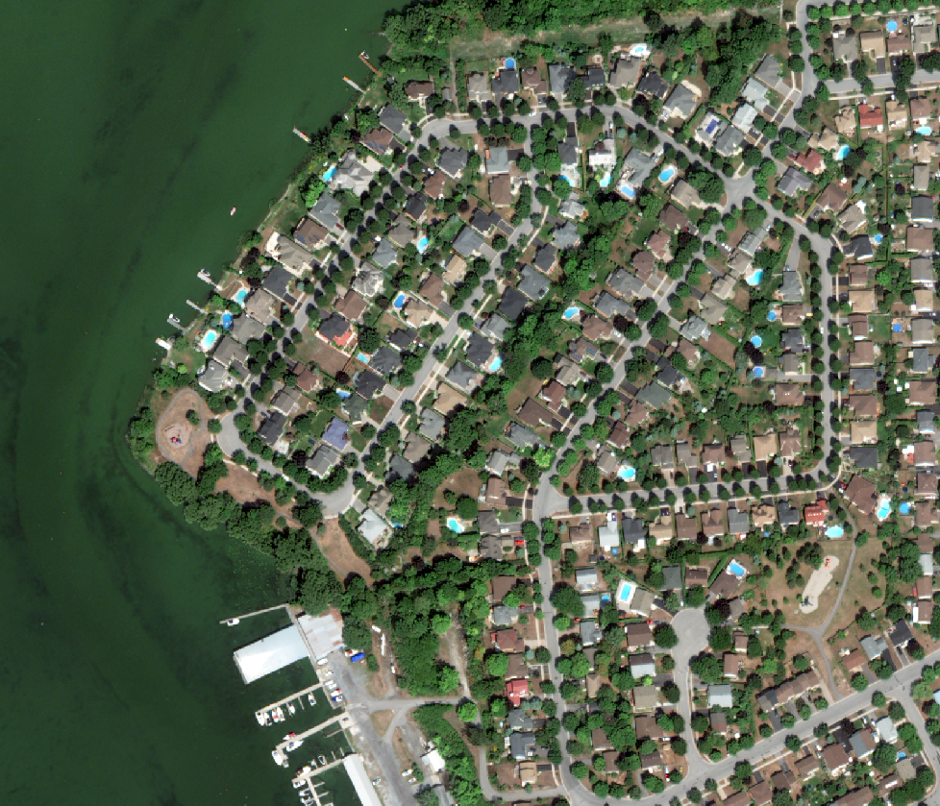
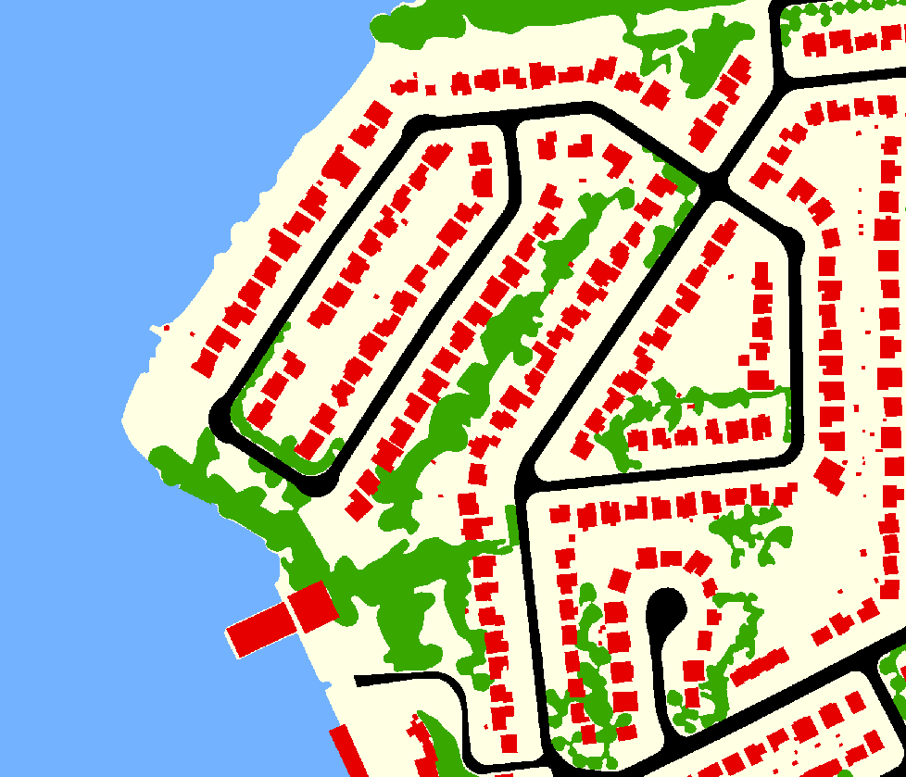
Automatic Extraction with AI
CCMEO has developed a Deep Learning application – geo-deep-learning (GDL)
GDL is used to train models that allow automatic feature extraction
+ GDL =
Background
Vegetation
Waterbodies
Roads
Buildings
Text scotttweedy181 to 780-800-5606 – Confidence, Geospatial Data

Slide 13
National Railway Network
Released in 2016
Updated geometries, attributes
Collaborators:
Natural Resources Canada
Railway Association of Canada
Transport Canada
VIA Rail, CN
Provinces
Text scotttweedy181 to 780-800-5606 – Confidence, Geospatial Data

Slide 14
Improved National Hydro Network
Provide a water information core providing ready to use, easy to access services, data and apps for specialists and non-specialists:
Based on latest technologies
Based on international standards
Scalable
Sharable
Driven by NRCan and communities priorities
Text scotttweedy181 to 780-800-5606 – Confidence, Geospatial Data

Slide 15
National Hydro Network (NHN)
Modernization
National Hydro Network (NHN) V1 (current) | National Hydro Network (NHN) V.2 (CHyF)
CCOG Standard | OGC’s Hy_Feature standard implementation
Downloadable dataset | Service oriented
2D | Elevation based
Complex model | Light core + personalized extensions
In-house software | Open, shared software
Centralised | Community driven

Slide 16
Discover our data and tools
On Open Maps:
High resolution elevation data
Search: HRDEM
Automatically extracted buildings
Search: LiDAR buildings
National Railway Network
Search: NRWN GeoBase
National Hydrographic Network
Search: NHN GeoBase
On GitHub:
Geo Deep Learning
Search: geo-deep-learning

Slide 17
Thank you very much
Any Questions?
scott.tweedy@Canada.ca
Text scotttweedy181 to 780-800-5606 – Confidence, Geospatial Data

