Slide 1
Renewing the Data Strategy for the Federal Public Service What We Heard Report
Winter 2023

Slide 2
Purpose
To summarize feedback received on the data strategy renewal between October 2022 – January 2023 and provide an overview of how the feedback has been addressed. Feedback was received from:
October event
Senior level committees and other working groups

Slide 3
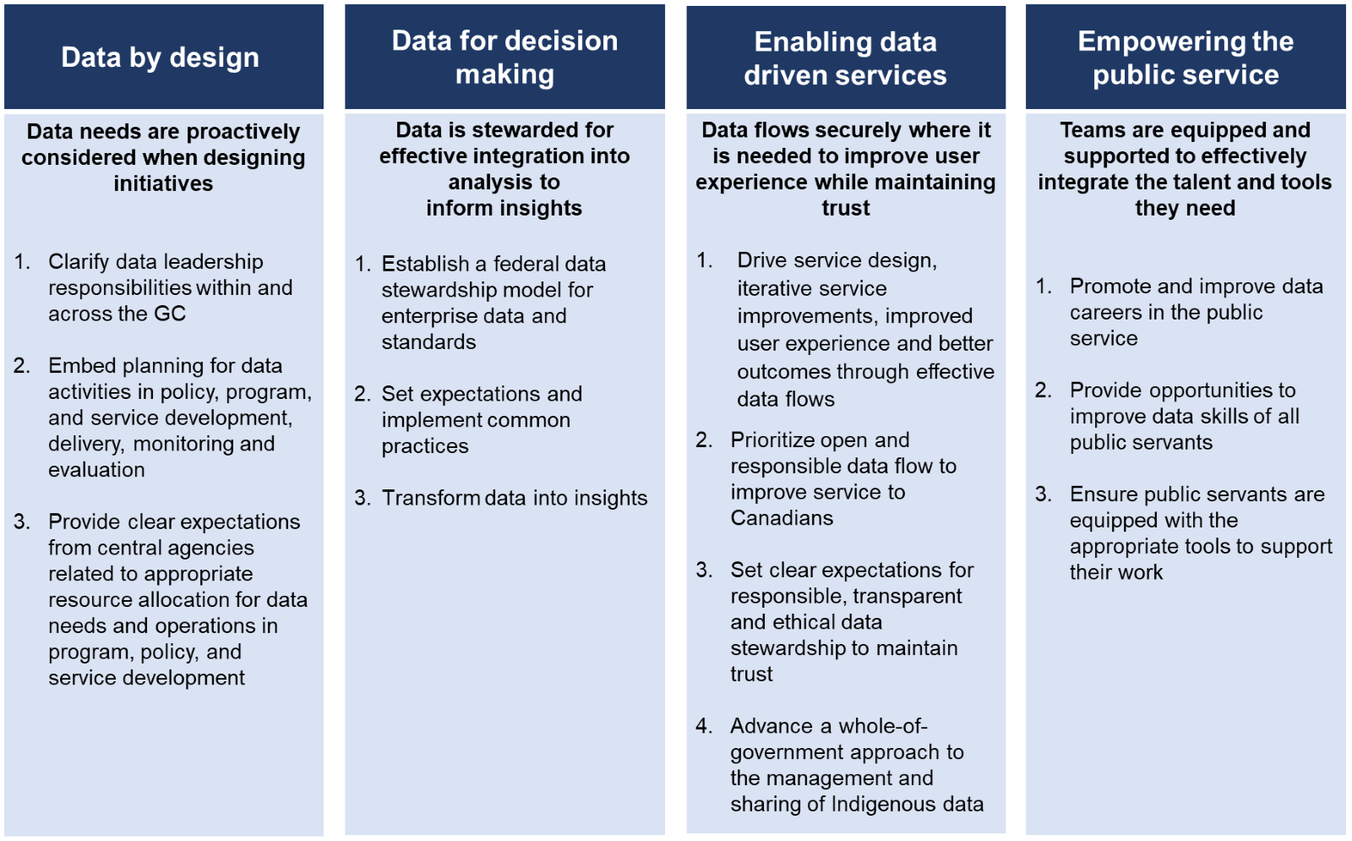
Overview of missions
The data strategy is oriented around missions, supported by actions
Missions are statements of how we will implement "Data as an Asset"
Each mission has been framed as to how it impacts people the government serves

Slide 4
October event
Organized by CSPS, the event highlighted priorities and actions to be included in the renewed strategy
1,100+ attendees
30+ federal departments provided asynchronous feedback on the missions through Departmental Data Leads
Analysis of input:
Individual comments from departments were organized by mission and response type

Slide 5
Senior level committees and other working groups
Groups consulted to raise awareness and gain feedback include:
Public Service Management Advisory Committee (PSMAC)
DM Committee on Enterprise Priorities and Planning (CEPP)
ADM Committee on Data and Information (CDI)
ADM Service and Enterprise Priorities (SEP)
Chief Data Officers Council
Departmental Data Leads
Office of the Privacy Commissioner (OPC)

Slide 6
Feedback
Respondents provided detailed feedback, identified areas in need of clarification, or proposed ways to strengthen the strategy
Top themes include:
Needing more detailed guidance on strategy content and implementation
Strengthening departmental involvement
Needing tools and infrastructure
Incorporating Indigenous data considerations
Strengthening language around privacy
Funding and data costing
Highlighting outcomes to Canadians

Slide 7
Addressing feedback
Theme | How we responded
More detailed guidance needed on strategy: Content Common definitions and terminology, roles and responsibilities within departments, relationship with other horizontal initiatives, other large scale and complex challenges, lessons learned from 2018 roadmap Implementation Performance metrics, training, change management, communication, prioritization and sequencing of actions | Link to Glossary of terms included in the strategy annex Roles and responsibilities within and across departments addressed in Mission 1 Relationship map of select planned and ongoing initiatives included in the strategy annex Scope section developed which includes clarification that several of the horizontal challenges are outside the scope of the strategy, and although not discussed in detail, will be monitored to ensure continued alignment Implementation plan to be published in Spring 2023, which will include timelines, key performance indicators, and communications approach to support change management

Slide 8
Addressing feedback (part 2)
Theme | How we responded
Strengthen role of departments in strategy: Heavy focus on central agencies' role in implementation Flexibility with departmental operating environments, resources, data maturity levels | Edits to clarify existing actions and addition of a new department-specific action Implementation Prioritization section identifies list of actions for departments to advance, and indicates that the ability to advance specific initiatives will vary among organizations Additional detail on departmental responsibilities to be included in the implementation plan
Need for tools and infrastructure Digital credentials, "Tell Us Once" approach Protected B and Secret/Top Secret data exchange | Addition of actions to Mission 3: Promotion of data standardization across a digital credentials ecosystem SSC to pilot data storage and collaboration solutions to improve data sharing between departments

Slide 9
Addressing feedback (part 3)
Theme | How we responded
Incorporation of Indigenous data considerations | Developed in consultation with ISC and CIRNAC: New actions to support Indigenous data sovereignty Addition of outcome statement to framework visual New text box providing details on support for Indigenous data sovereignty
Strengthening the narrative on: Privacy and security Diversity, inclusion and equity Science data representation | Changes made across the strategy to strengthen privacy considerations Updated action in Mission 3 to include security Updated vignettes to strengthen privacy references Clarification of language throughout to better reflect diversity, inclusion and equity Scope edited to clarify "domains" in the strategy, including noting science domains (e.g., health) as a specific area in which complementary strategies are being developed

Slide 10
Addressing feedback (part 4)
Theme | How we responded
Need for funding Support for data costing Resource allocation to sustain and advance key initiatives | Actions in Mission 1 are intended to support future resourcing of initiatives Scope identifies that funding and procurement to achieve the actions will be pursued at the project or department level
Highlight relevance and impact to people and organizations served by the government | Edits made across the strategy to strengthen focus on benefits to those served by the government Plain language review to add clarity Re-orientation of vignettes to lead with outcomes

Slide 11
Summary
Good participation across the consultations
General positive feedback with actionable comments
Clarification of actions and strengthened language throughout
Support of strategy from senior engagement

Slide 12
Next Steps
Publication is anticipated in April 2023
Following publication, focus will shift from strategy to delivery
Detailed implementation plan to follow publication of the renewed strategy
Coordination and collaboration with federal delivery partners
Clear direction and communication of priorities

Slide 13
Questions?
EnterpriseDataDonneesIntegrees@tbs-sct.gc.ca

