Slide 1
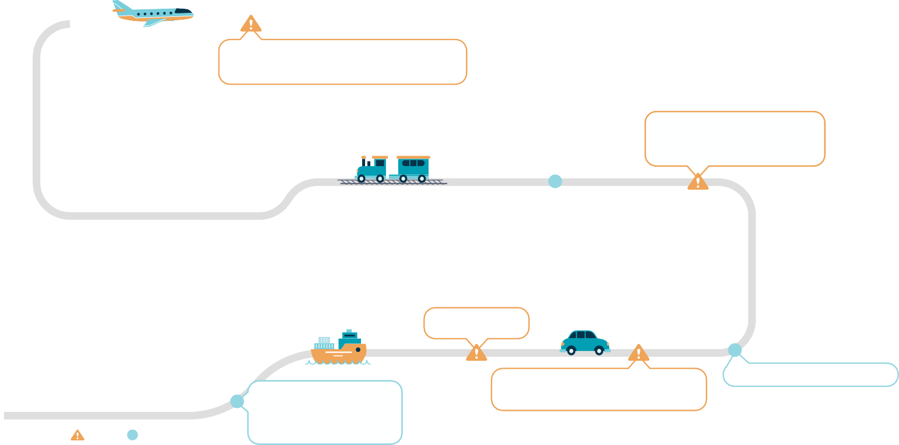
JOURNEY TO THE CLOUD
Modernizing the delivery of digitally-enabled business solutions by leveraging Cloud technology
WHERE WE ARE GOING
Use more, build less..
Cloud First!
Cloud for all new workloads
Software as a Service (SaaS)
Platform as a Service (PaaS)
Infrastructure as a Service (IaaS)
Migrate Workloads to Cloud
Modern, resilient infrastructure
Benefits:
Agility and Time to market
Savings in time and money
Security and reliability
Rapid innovation
Elasticity
Q1 19/20 (ON-GOING)
Prot-B workloads in cloud
Application Portfolio Assessment ✔
Q2 19/20
Workload migration, multi-cloud, Disaster Recovery/Business Continuity (DR/BC) considerations in applications
WHAT WE NEED
Modernized IT Security Risk Management (Digital Services Enablement)
Guidelines for Secure Cloud Applications (Digital Services Enablement)
SSC Protected-B Cloud Services
</> DEVELOPERS
Cloud native developers
Q4 18/19 (ON-GOING)
Unclass production workloads in cloud ; Software as a Service (SaaS)/Platform as a Service (PaaS) workloads
SECURITY
IT Security Risk Management modernizing Information Management and data management policies
Oct-18: SSC to provide Active Directory and Cloud Identity management✘
Oct-18: Modernize IT Security Risk Management (Digital Services Enablement) ✔
Training for Cloud-native developers
INTEGRATION
Change Management integrating/ evolving current IT Service Management processes
Q1 18/19 ✔
Developing expertise, proof of concepts, play-pen/sandbox, start small, test out the art of the possible.
Train our staff to build internal Cloud expertise
Identify candidate applications for proof of concepts
Q2 18/19 (ON-GOING) ✔
Start development testing and user acceptance in Cloud
RISKS
Limited Cloud expertise; lack of mature modern, processes will slow adoption
Prot-B services may not be available when required
Network bandwidth and latency limitations may affect the user experience
Slow pace of culture change may slow down Cloud adoption
WHERE WE ARE
Dedicated Cloud Centre of Excellence established
Exploration of Microsoft Azure and Amazon AWS Cloud services: 3 Prod ; 29 Dev
Dept. committed to Cloud-first in IM/IT plan 2018-2021
Updated Cyber Security processes (SA&A) for Cloud
Workload Assessment completed ; Foundations set-up
Dept’s Cloud Working Group developing legacy application impacts
Jul-18: SSC to provide secure, dedicated network to Cloud
✘
Cloud development framework (Enterprise Architecture)
Core foundational services (Digital Services)
Cloud-Native developer Centre of Expertise (Solution Centre)
Target State Architecture (Enterprise Architecture)
Two four-day training sessions for 20+ employees
Cloud Roadshow Sessions (ongoing)
Proof of concept projects
OpenData (OpenGov)
Small Vessel Compliance Program (SVCP)
publish static web pages
MyTC Talent Network Search service
Legend:
Blocker
Enabler

Slide 2
Transport Canada’s Cloud Adoption Plan
Ultimate goal is : leverage Cloud for ALL Business Applications (in the order: SaaS, PaaS, IaaS)
TC has an urgent requirement for Disaster Recovery for critical business applications.
TC has a requirement for agility, elasticity, and resilience to respond to the Department’s rapidly evolving requirements to support “Going Digital”
TC has 400 legacy applications of various security classifications
3 Key elements: 1) Cloud environment for new business applications/projects 2) Migration/modernization of existing workloads 3) Modernization of desktop tools (Microsoft 365 suite)
Application Assessment work shows all apps are candidates for Cloud
However, legacy apps, limited cloud native expertise, and immaturity of the SaaS market, are limiting factors to the speed at which we can reach the goal. As such, a phased iterative approach is being adopted
Majority of TC’s apps are rated as Protected-B and have a tight coupling/dependence on TC’s Directory Services.
Plan:
Set-up foundational Cloud services environments (AWS and Azure) to support up to Protected-B apps: This will allow NEW applications to be hosted directly in the Cloud
Divvy up the legacy applications into migration sprints (starting with Mission Critical/Business critical apps) and migrate to Cloud (as-is)
For apps that are identified as candidates for refactoring/rebuilding, work with industry to rebuild or optimize for Cloud
Continue to Cloud-optimize legacy applications that were migrated as-is
Work with Microsoft to integrate the Microsoft 365 suite of tools with the Cloud-optimized applications
To achieve this, we need:
Secure high-speed connectivity to the Cloud [SSC]
Cloud expertise (Staff / professional services)
Funding for migration and operation of workloads in Cloud (including licenses)
Detailed Plan/Business case: Business Case – RDIMS# 15170815
GC EARB slides – RDIMS#15181552

