Slide 1
Alert styling study on Canada.ca
Research report
March 2024
Version française
Digital Transformation Office - Canada.ca

Slide 2
Inconsistent styling and overuse of alerts on Canada.ca
Study goal: measure alert styling decisions to create clearer guidance
Context: Recent AB tests suggest people respond differently to the alert styles
Alerts appear to distract from key content, especially on mobile
WCAG accessibility emphasizes reducing distractions to help people focus
Screenreader users hear the words “Danger” and “Warning”
Scan of Canada.ca revealed inconsistent alert styles & usage - overuse and misuse cause alerts to lose their value, people won’t look
Results from 130 respondents from the GC Web Communications community
Low agreement - majority agreed with live styling for only 3 of 8 questions
Guidance does help - 2 of 3 majority agreement questions are from Alert guidance
Avoid danger alerts - very low agreement on styling as danger for all questions
Disagree about instructions styled as alerts, style as page content instead
Use guidance and training to improve low agreement & consistency across Canada.ca
Notes:
Making Content Usable for People with Cognitive and Learning Disabilities

Slide 3
Study began a refresher on current guidance
First, a refresher on current guidance for contextual alerts on Canada.ca
Use the danger alert to draw attention to:
a situation that could place someone in danger
a technical issue that could cause a person to be unable to complete their task, such as an error message
Use the warning alert to draw attention to:
a possible consequence of an action or inaction
the date of an upcoming change to a policy or process that will affect a significant number of people
Use the info alert to draw attention to a temporary clarification of surrounding content or helpful advice.

Slide 4
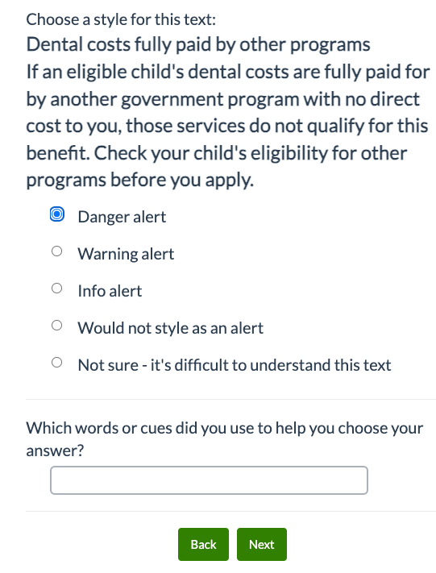
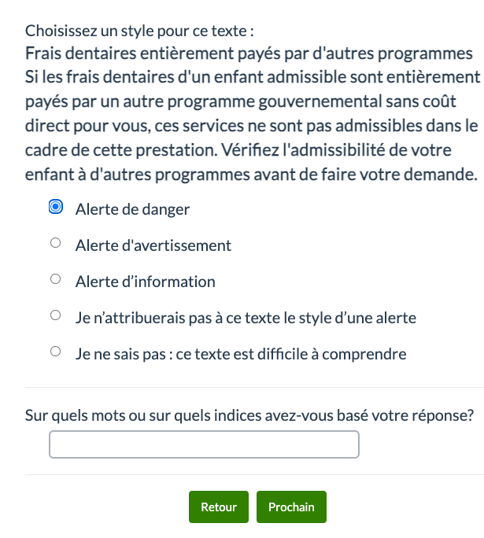
Method - behavioural survey for web comms community
Invite posted on GC Web Comms slack and in GC web managers email - positioned as a game, intro reminded people of alert guidance
For 8 questions, chose style for text from live alert text on Canada.ca & could explain why. At the end, people could view demo page with real alerts
130 respondents completed most or all questions - 125 in EN, 5 in FR - responses are aggregated
Notes:
DEMO Page
https://test.canada.ca/wayfinding-orientation-2023/alerts/examples.html
DEMO FR
https://test.canada.ca/wayfinding-orientation-2023/alerts/exemples.html
EN Survey link
https://survey.alchemer-ca.com/s3/50242626/Which-alert-when
FR Survey link
https://survey.alchemer-ca.com/s3/50242626/1c57096e29f8

Slide 5
Low agreement on styling of most alerts
Results explain why alert styling varies so much across the site - low agreement
Lowest agreement on instructions styled as an alert
Subjective decisions have impacts beyond helping users grasp alert styles
Boxes signal styles of live alerts - green fill signals majority choice by respondents
Question & live style | Danger alert | Warning alert | Info alert | Would not style as an alert
Q1 Guidance for info - status | 5% | 9% | 68% | 16%
Q2 System maintenance | 8% | 65% | 28% | 0%
Q4 Job bank update | 0% | 5% | 60% | 30%
Q3 How update (instructions) | 0% | 2% | 15% | 84%
Q5 Dental costs (instructions) | 1% | 13% | 25% | 56%
Q6 Guidance for danger - travel | 51% | 42% | 2% | 4%
Q7 Older browser | 10% | 58% | 16% | 14%
Q8 2023 Taxes (instructions) | 0% | 5% | 53% | 41%
Majority agree
Majority agree
Majority agree

Slide 6
Q1. Info alert from guidance
This appears on Contextual alert guidance
Alertes contextuelles
68% majority of respondents agreed with info alert style
30% spread across other styles
The 30% is concerning since this example is in the guidance
Danger alert/Alerte de danger |  | 5%
Warning alert/Alerte d’avertissement |  | 9%
Keywords used for the decision:
Closed
Status
Info alert/Alerte d’information | 89/130 | 68%
Would not style as an alert/Pas une alerte |  | 16%
Notes:
Current status of the call for applications:
Closed Thank you for your interest in Canada Summer Jobs. Applications are now closed.

Slide 7
Q2. System maintenance CRA
CRA My business account
Mon dossier d'entreprise
Only 28% agreed with Info styling
Majority chose warning style because it’s about an outage
Majority agree with guidance - it says use warning for upcoming change
Danger alert/Alerte de danger |  | 8%
Keywords used for the decision:
Temporarily unavailable
System maintenance
Warning alert/Alerte d’avertissement | 84/130 | 65%
Info alert/Alerte d’information |  | 28%
Notes:
Q2 System maintenance - Info alert/Alerte d’information on CRA My Account
Routine system maintenanceDue to system maintenance, some services will be temporarily unavailable starting 10:00 pm on Friday February 2, 2024until 6:00 am on Monday February 5, 2024 ET.

Slide 8
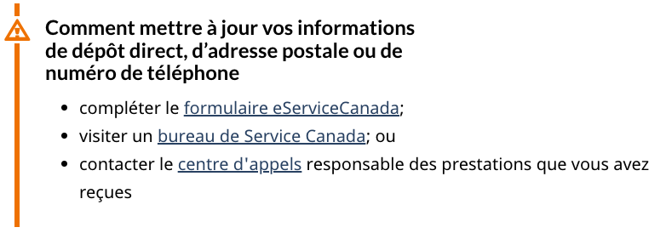
Q3 How to update MSCA - only 2% agree with styling as warning
My Service Canada account
Mon dossier Service Canada
Only 2% agreed with warning styling
84% wouldn’t style as an alert - perceived as instructions
Guidance is to use warning for changes & possible consequences
Warning alert/Alerte d’avertissement |  | 2%
Keywords used for the decision:
How to
Info alert/Alerte d’information |  | 15%
Would not style as an alert/Pas une alerte | 109/130 | 84
Notes:
: How to update your direct deposit, mailing address or telephone number• complete the eServiceCanada form• visit a Service Canada Office, or• contact the call centre responsible for the benefits you have received

Slide 9
Q4 Job bank update - majority agree with info style
ESDC Hire a temporary foreign worker
Embaucher un travailleur étranger temporaire
Majority 60% agree with Info styling
30% wouldn’t style as an alert due to old date, eg. remove alert style in 2024
Warning alert/Alerte d’avertissement |  | 5%
Info alert/Alerte d’information | 77/128 | 60%
Keywords used for the decision:
Update
Every year
Would not style as an alert/Pas une alerte |  | 30%
Notes:
Q4 Job bank update - Info alert/Alerte d’information on ESDC Foreign Worker: Job Bank wage updateJob Bank wages are updated every year in the fall. The 2023 update took place on November 29, 2023.

Slide 10
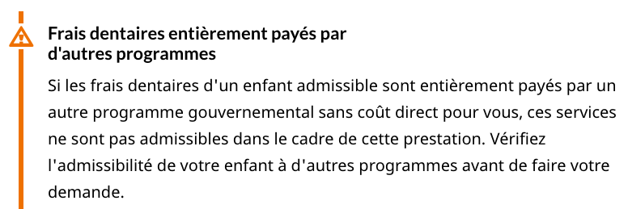
Q5 Dental costs SC - Majority wouldn’t style as an alert
ESDC Canada dental benefit
Only 13% agree with styling as Warning
Majority 56% wouldn’t style as an alert
Instructions aren’t temporary, aren’t time-related
Prestation dentaire canadienne
Warning alert/Alerte d’avertissement |  | 13%
Info alert/Alerte d’information |  | 25%
Keywords used for the decision:
Before you apply
Check, verifiez, helpful
Would not style as an alert/Pas une alerte | 72/129 | 56%
Not sure - it's difficult to understand this text |  | 5%
Notes:
Q5 Dental costs - Warning alert/Alerte d’avertissement on Canada Dental Benefit: Dental costs fully paid by other programsIf an eligible child's dental costs are fully paid for by another government program with no direct cost to you, those services do not qualify for this benefit. Check your child's eligibility for other programs before you apply.

Slide 11
Q6 Avoid travel Alert Guidance example - only 51% agree
This appears on Contextual alert guidance
Alertes contextuelles
Majority 51% agree with styling as Danger
But 42% would style as warning since it’s not immediate danger
Choose a more-agreed upon example for guidance
Danger alert/Alerte de danger | 66/130 | 51%
Keywords used for the decision:
Avoid travel
“It’s advice vs immediate danger”
Warning alert/Alerte d’avertissement |  | 42%
Info alert/Alerte d’information |  | 2%
Would not style as an alert/Pas une alerte |  | 4%
Notes:
If pregnant or considering pregnancy - Notice regarding both partnersAvoid travel to Costa Rica if you are pregnant or planning to conceive a child in the next 3 months.

Slide 12
Q7 Older browser CRA - only 10% agree with danger styling
CRA My account for individuals
Mon dossier pour les particuliers
Only 10% agree with styling as Danger
Majority 58% would style as Warning
Not a physical danger, applies to few
Danger alert/Alerte de danger |  | 10%
Keywords used for the decision:
You will not be able to access
It’s not a danger
Warning alert/Alerte d’avertissement | 76/130 | 58%
Info alert/Alerte d’information |  | 16%
Would not style as an alert/Pas une alerte |  | 14%
Notes:
Q7 Older browser - Danger alert on CRA My Account: If you are using an older browser that does not support the latest security standard, you will not be able to access this secure online service.

Slide 13
Q8 Taxes content isn’t an alert and many agreed
CRA Get ready to do your taxes
Préparez-vous à faire vos impôts
41% agree with not styling as alert
53% would style as info - but within context of alert study, it’s a twist of a question
Most perceived as instructions not an alert
Warning alert/Alerte d’avertissement |  | 5%
Keywords used for choosing alert:
New
Learn
Info alert/Alerte d’information |  | 53%
Would not style as an alert/Pas une alerte | 53/129 | 41%
Notes:
Q8 2023 Taxes - Not styled as an alert/Pas une alerte on CRA: Learn what's new for 2023 taxesChanges to benefits, credits, and expenses for individuals and families, and updates to the 2023 income tax package.

Slide 14
Next steps
Update Alert guidance with more examples from this study
Add keywords to each style that advisors can use as an easier signal
Add ideas for alternatives to alert styles - misuse and overuse cause alerts to lose their value, people won’t look at them their ‘temporary - important’ value
Ideas to help teams be more consistent with their styling
Build an Alert Game with survey software that helps people learn how to style consistently - like this but with the answers (e.g. most advisors chose x)
Build an AI Styler tool - enter the text, styler provides style advice
Use AB testing or natural experiments to better understand impact
Advisors need to be able to warn programs & others about negative effects
“If everything is important, then nothing is important”

Slide 15
Ideas for alternatives to alerts
Alerts lose their value if overused and misused for permanent content
Ensure they are temporary by assigning a default period of 1 month
When an alert is requested, always advise of the 1 month period and set a reminder to remove the alert & notify the requestor
If the content is an instruction, advise the requestor of alternatives
Alternatives to alerts for important content
Bands are preferred over wells - people often don’t look at content in wells
AB tests showed that the Alert band on IRCC performed as well as alert styles for content important to specific groups of visitors
Interactive questions attract high usage - people like to personalize
Use headings, lists & expand collapse instead of paragraphs of text

Slide 16
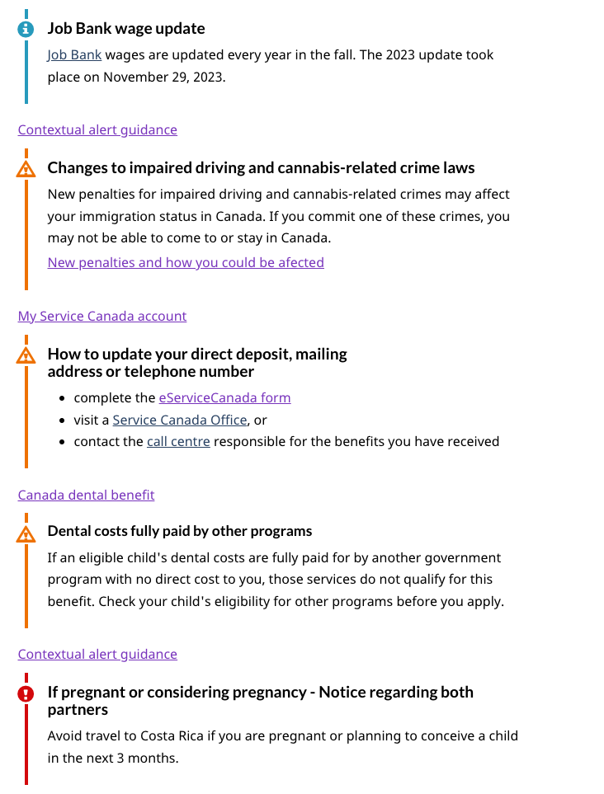
Details
DEMO Page of all alerts in the study with links to live pages
https://test.canada.ca/wayfinding-orientation-2023/alerts/examples.html
DEMO FR
https://test.canada.ca/wayfinding-orientation-2023/alerts/exemples.html

Slide 17
The process
Instructions: For this question and the following questions, you'll see some text with style option choices below. If you're familiar with the text, that's ok. Choose how you would style it, which may not be how it's currently styled on the live site. Answer fairly quickly, as if it's a game.
On completion:
Link was given to demo pages to see how each alert appears on live site Supporting links:
Demo page: https://test.canada.ca/wayfinding-orientation-2023/alerts/examples.html
Demo page in French: https://test.canada.ca/wayfinding-orientation-2023/alerts/exemples.html

