Slide 1
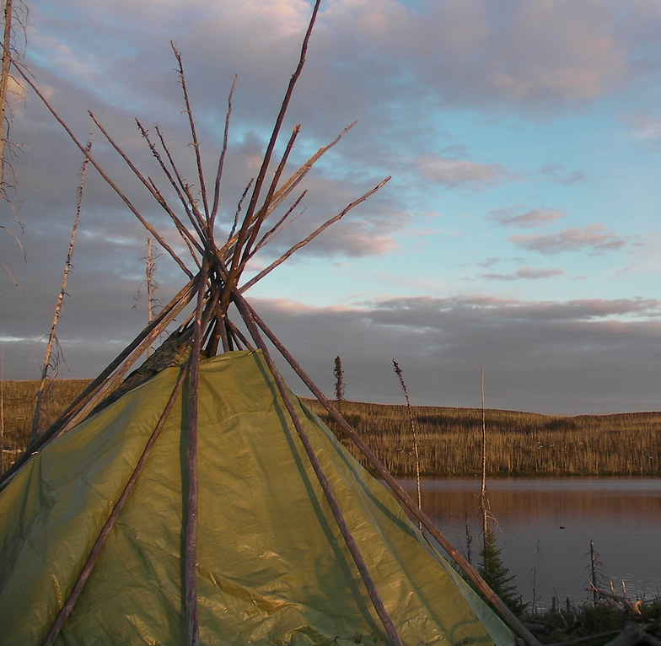
Deconstructing Colonial Practices in the Federal Public Service
Jolene Head
This Photo by Unknown Author is licensed under CC BY-SA
Notes:
Personal introduction here – what lead to writing this thesis, experiences in the public service, etc.

Slide 2
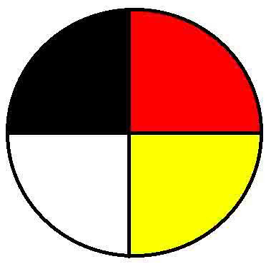
Reconciliation
This Photo by Unknown Author is licensed under CC BY
Reconciliation is a process, not a result
The definition of Reconciliation will differ between Indigenous Peoples
Truth and Reconciliation definition: “Establishing and maintaining a mutually respectful relationship between Aboriginal and non-Aboriginal peoples in this country. In order for that to happen, there has to be awareness of the past, acknowledgement of the harm that has been inflicted, atonement for the causes, and action to change behaviour.”
Notes:
Jalopy analogy as segue to next slide

Slide 3
The Federal Public Service and Reconciliation
Historical relationship between the Federal Public Service and Indigenous Peoples
Current role of the Federal Public Service
Perception that Reconciliation has been co-opted
Assimilation under contemporary colonialism
Quick wins prioritized over effective change
Colonial power sets the terms of Reconciliation
Upholding legacy of colonialism
Barriers to effectively serving Indigenous Peoples

Slide 4
Issues with Reconciliation
Government's current actions still aimed at legitimizing colonial structures of control through diversity/inclusion, anti-racism, and Reconciliation initiatives
Reconciliation without meaningful restitution and transformation results in further colonial injustice and assimilation
Especially if Reconciliation is driven by politicians instead of Indigenous communities
Risk in including Indigenous Peoples in general antiracism initiatives instead of creating specific initiatives to address concerns
Dominant group gets to define and frame Indigeneity to suit its own needs

Slide 5
Decolonization
Dynamic, chaotic process of identifying and shifting away from colonial remnants
Multi-level
Need to identify and address how colonialism has influenced our individual thinking processes
Need to dismantle colonial characteristics in the systems we interact with
Cannot happen without recognizing the political, cultural, and social power and autonomy of Indigenous Peoples
Notes:
Could also talk about Indigenizing here if you wanted

Slide 6
Systems Thinking
Systems are complex entities that involve an interconnected set of elements and relationships
Reconciliation within the federal public service requires complex systems change
Systems thinking allows users to understand the purpose a system is accomplishing and the patterns it uses to accomplish them

Slide 7
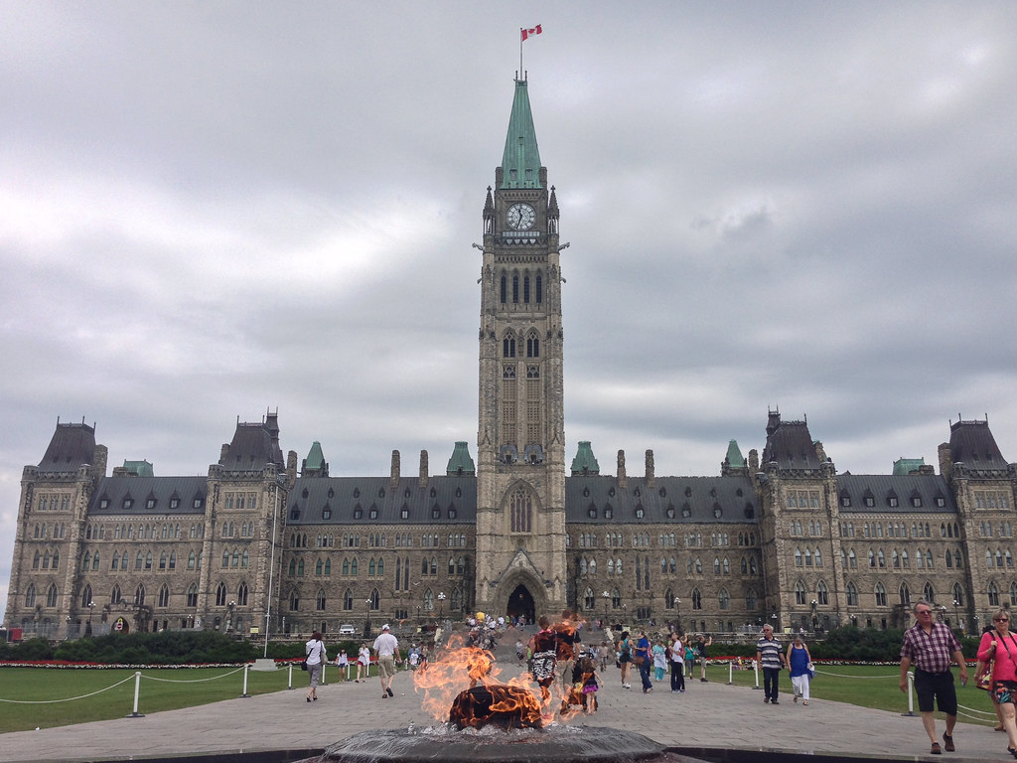
The Public Service System
Westminster model
Representative democracy
Ministerial accountability
Hierarchy and loyalty
PCO and TBS function to cement a culture of command and control
Accountability needs to become more transparent to advance Reconciliation
This requires that Public servants have the latitude to innovate
This Photo by Unknown Author is licensed under CC BY

Slide 8
Systems thinking and the Westminster model
The Westminster model privileges linear thinking, control and predictability
This is an antiquated approach that no longer meets the complex needs of today’s world
Canada’s public service currently prioritizes loyal implementation over fearless advice
To achieve the transformational change required for Reconciliation, a holistic approach is needed
Notes:
Westminster model is deeply hierarchical (yada yada)…
These characteristics make the Public Service ill-suited/unable to genuinely engage in Reconciliation without fundamental changes to the operational norms of the system (yada yada)…
Not only does the current system preclude the type of innovative approach needed to address the public service’s role in furthering the colonial project, but these values are themselves colonial artefacts that are incommensurable with Indigenous worldviews, knowledges, and value systems.

Slide 9
Indigenous ways of Knowing and Researching
Significant overlap between systems thinking and Indigenous ways of knowing
Indigenous worldviews prioritize relationships, responsibility and consent
Wâkôtowin is a Cree concept that describes an expansive definition of kinship by recognizing relationships of mutual responsibility between all human and non-human entities
Storytelling is a way of sharing experiences and knowledge that emphasizes the relationships within the story and between the teller and the listener
Heshook-ish-tsawalk is a worldview that recognizes that everything is one and that this oneness is comprised of individual parts
This Photo by Unknown Author is licensed under CC BY-NC
Notes:
Could use the research process for this thesis as an example (e.g. how your approach reflected Indigenous research methodologies; reiterate meaning of Niwakomakanak/wakatowin etc.)
Would love an explanation of why it was important to use Cree in the paper and more information on why/how Cree names were chosen for Niwakomakanak who participated.

Slide 10
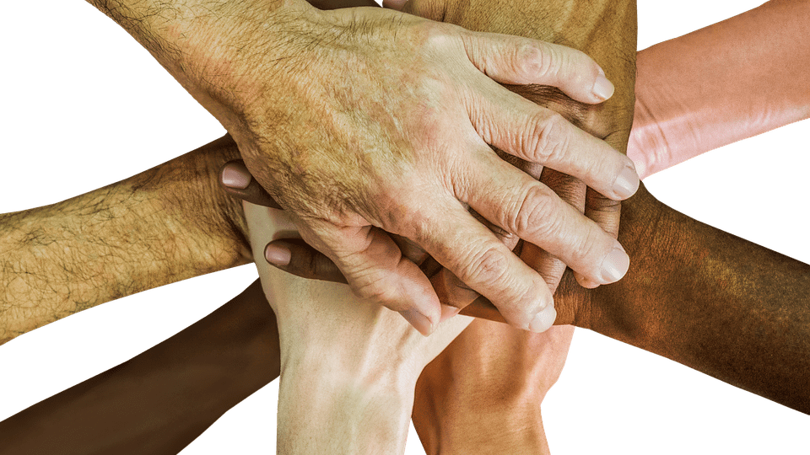
Reconciliation within the Federal Public Service
The Federal Public Service continues to be deeply entrenched in a colonial mindset
Reconciliation depends on a foundation of trust and mutual respect
Indigenous Peoples need to be involved in Reconciliation initiatives as partners
Need to embrace flexibility, experimentation, collaboration, and chaos
Executives need to be effective change leaders
This Photo by Unknown Author is licensed under CC BY-SA

Slide 11
Leadership for effective Transformation
Transformation is only possible with effective, committed, and innovative leadership
Traditional command and control leadership does not make transformative change possible
Transformational leadership
Changes basic values, beliefs and attitudes through communication of a shared vision and individual support
Change leadership
Paradoxical leadership
Human-centered, communicative, relational
Fluctuating levels of command and control
Trauma-informed leadership
Attuning, wondering, following, holding
This Photo by Unknown Author is licensed under CC BY-NC-ND
Notes:
Segue to next slide: Most of the new leadership theories are heavily based on societal values based on Western worldview. so those values may change in a different cultural context (e.g. Indigenous)

Slide 12
Indigenous Leadership
Indigenous leadership models have much in common with cutting-edge Western leadership models
Embracing Indigenous leadership values is an act of Reconciliation and will make transformative change possible
Dynamic cultural and personal process
High personal ethics, wisdom, concern for others
Foundation built on culture and ceremony

Slide 13
Findings, Conclusions and Recommendations

Slide 14
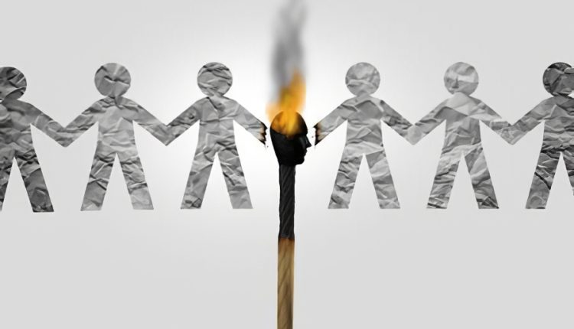
Reconciliation - Findings
Indigenous Peoples have become an industry both internal and external to the Public service which acts as a Reconciliation disincentive
The political arm of government hinders large-scale and long-term change in the Public Service
The Public Service has difficulties building trust and relationships with Indigenous Peoples
This Photo by Unknown Author is licensed under CC BY
Notes:
Industry
-Work on Indigenous files being done to pad resumes, not out of a genuine interest
-erodes relationship
-acceptable Indigeneity/impact on indigenous Public servants
Political arm
-Long-term goal that extends beyond election cycles
-Stability of the Public Service should make this possible
-Political promises vs capacity of the Public Service
-Agenda for the public service is determined by the elected party
-Not all public servants will support all initiatives
-Political priorities dictate public service priorities
-Which party is in power impacts relationship with Indigenous People
Relationship
-ineffective actions/slow pace of change
-paternalism
-ignorance
-expectations that Indigenous Peoples and communities will conform to Public Service norms
-Public Service doesn’t prioritize long-term relationship building
-Public Service oriented towards maintaining control
-

Slide 15
Reconciliation - Conclusions
The meaning of decolonization is static and is a non-politicized process
Reconciliation has been politicized
This Photo by Unknown Author is licensed under CC BY-SA
Notes:
Decolonization
-used more frequently among grassroots Indigenous organizers than the Public Service
-lots of definitions that share similar foundations
-needs to happen before Reconciliation can begin
-Reconciliation without decolonization is symbolic/performative
-antiracist and diversity initiatives in a colonial environment legitimize/entrench these colonial structures
Politicization
-Politicians drive Reconciliation narrative
-Reconciliation needs to extend beyond election cycles and ploys for votes
-Needs to be undertaken in partnership with Indigenous Peoples

Slide 16
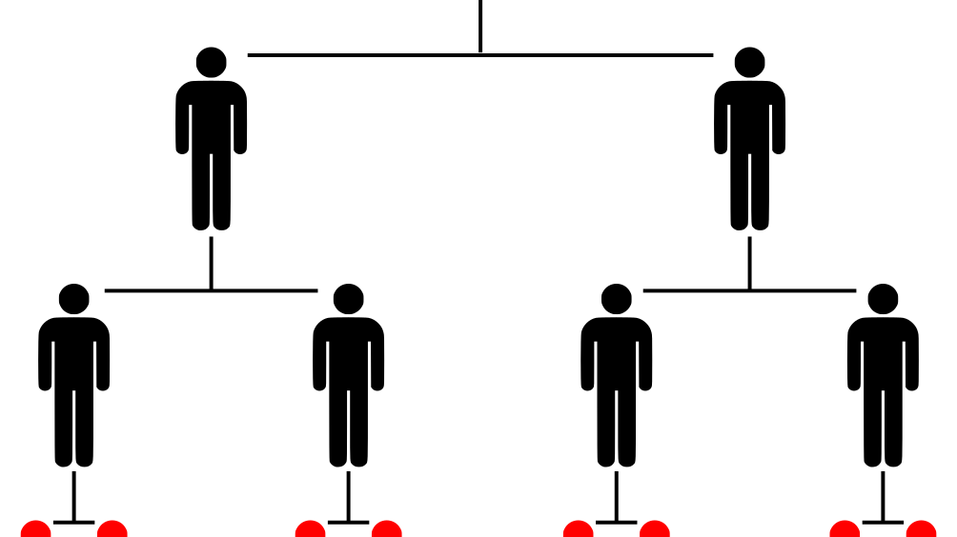
Executives and Central Agencies - Findings
People in key positions can create barriers and hinder progress in the Public Service
Executive culture hinders Reconciliation efforts
Executive lack true understanding of Indigenous history and culture
Central Agencies maintain the status quo and make transformational change challenging
This Photo by Unknown Author is licensed under CC BY
Notes:
Key Positions
-hierarchical structure means that those higher up the chain have lots of influence
-challenging status quo can impact promotion opportunities
-few Indigenous voices at the Executive table
Culture
-Doing things differently is not rewarded
-Executives generally come from privileged backgrounds
-Focused on career progression
-Culture of overworking, overtasking makes it difficult to prioritize Reconciliation

Slide 17
Executives and Central Agencies - Conclusions
Executives set the tone and culture of the Public Service and therefore play a crucial role in prioritizing meaningful Reconciliation actions
Clear direction is needed by the Center, especially the Clerk of the Privy Council, to Deputy Ministers across departments for a consistent prioritization of Reconciliation
Culture change requires utilizing change management strategies, new leadership skills, and becoming comfortable with experimenting and taking risks
This Photo by Unknown Author is licensed under CC BY-SA-NC
Notes:
Tone and culture
-Executives set the behavioral standard
-Non-executives look to Executives when allocating resources
-Clerk of the Privy Council and DMs have the most influence
-leadership/direction must flow from these people
Clear direction
-coordination is difficult, needs to come from the center
-no Call to Action on Reconciliation to date
-de-politicize Reconciliation
Culture change
-current culture supports the status quo and colonial foundations of the Public Service
-culture leads with fear
-leadership does not currently support emerging leadership models
-traditional forms of leadership currently in use do not support transformational change

Slide 18
Executives and Central Agencies – Recommendations
The education of Executives on Indigenous culture and history requires a more robust strategy that also includes experiential learning
Release a Reconciliation Call to Action by the Clerk of the Privy Council that includes Executive accountability to Indigenous Peoples, including Indigenous employees
Executives need to action a culture shift that encourages the disruption of the status quo, colonialism in the Public Service
Public Service Executives need to develop and utilize new leadership skills, which include both non-Western and Western theory which support long-term and complex change such as Reconciliation
This Photo by Unknown Author is licensed under CC BY-NC
Notes:
Education of Executives
-Executives need a higher level of cultural competency than current training provides
-This learning needs to be experiential
-Improves trust between the Public service and Indigenous Peoples
-improve understandings of Canada’s legal obligations to Indigenous Peoples
Reconciliation Call to Action
-makes Executive accountable to Indigenous Peoples
-Department heads required to report on Reconciliation actions and commitments
-Create an Ombudsperson and COE on Reconciliation
-incorporate accountability measures and key leadership competencies into Executive performance agreements
Culture Shift
-move away from traditional fear-based, command and control culture towards a culture of learning, experimentation and flexibility
-develop culturally appropriate support services for Indigenous employees with an Elder Advisory Circle in each department and agency
Leadership
-combine Western and non-Western leadership theories
-lead by example
-Embrace Indigenous leadership qualities
-improves cultural competency, decolonizes, and better supports Indigenous employees

Slide 19
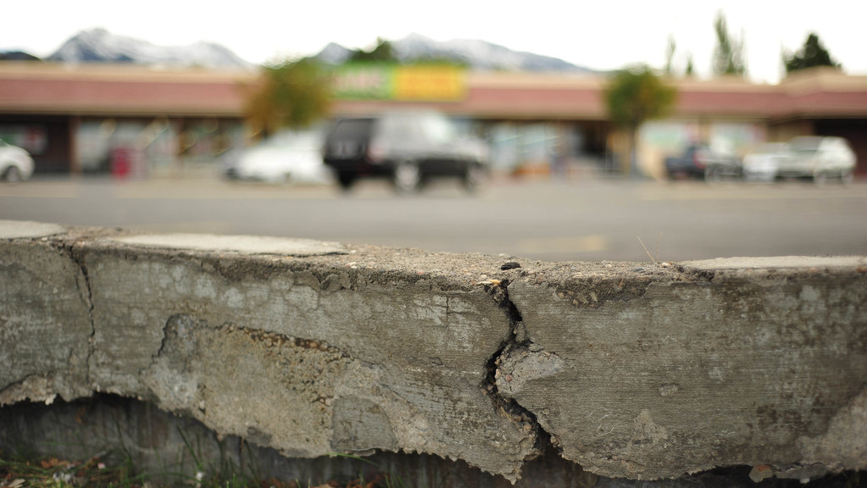
Public Service System- Findings
Meeting the TRC’s Call to Action #57 has been insufficient
The Public Service is a colonial system that hinders Reconciliation efforts
The Public service culture hinders Reconciliation efforts
The Public Service is a challenging work environment for Indigenous Executives and employees
This Photo by Unknown Author is licensed under CC BY-NC
Notes:
TRC Call to Action
-education is inconsistent across the Public Service
-areas of government that do not interact directly with Indigenous Peoples have no incentives to learn and lower levels of knowledge
-Internal and external Indigenous People feel burdened to educate public servants – impacts relationship
Colonial System
-no room for other worldviews
-concentration of control in NCR limits influence of regional/Indigenous perspectives
-system is not accountable to Indigenous People
-high levels of scrutiny, oversight and control for Indigenous projects and funding
-system gravitates towards incremental changes, rather than large-scale transformation
Culture
-Public Service culture is risk-averse
-No space or incentive for innovation – can’t do proper policy analysis
-Perpetuates colonial value systems/ways of thinking
Challenging Work Environment
-impacts recruitment/retention and relationship with Indigenous Peoples
-education burden
-exposure to ignorance and racism
-Conflicting roles of Indigenous public servants
Public servants expected to be loyal to a colonial system
Indigenous experts
Community members
-Expectations of sharing personal/cultural knowledge and experiences - May also be interesting to note how expecting Indigenous public servants to be Indigenous subject-matter experts is doubly cruel because may of use don’t have access to those teachings or experiences, in large part because of things carried out by the public service – when we don’t know, it’s embarrassing/may not feel “Indigenous enough”

Slide 20
Public Service System - Conclusions
The Public Service system cannot effectively address large-scale complex problems such as Reconciliation due to its current structure
Decolonization of the 150-year-old plus system is a necessary step towards meaningful and true Reconciliation
Normalizing using two-eyed seeing will create a shift in the perception of public servants at all levels regarding Indigenous Peoples
This Photo by Unknown Author is licensed under CC BY-NC
Notes:
Complex problems
-system is antiquated, geared towards incremental change
-Glassco Commission recommendations have not been implemented
-need to adapt to meet current needs
-can look to private sector organizational structures for guidance
Two-eyed seeing
-normalizing non-Western knowledges is part of decolonizing
-two-eyed seeing: co-existence of Western and Indigenous knowledges
-shifting culture requires a shift in individual thinking
Decolonization
-Decolonize thinking, especially among Executives
-system change is long overdue

Slide 21
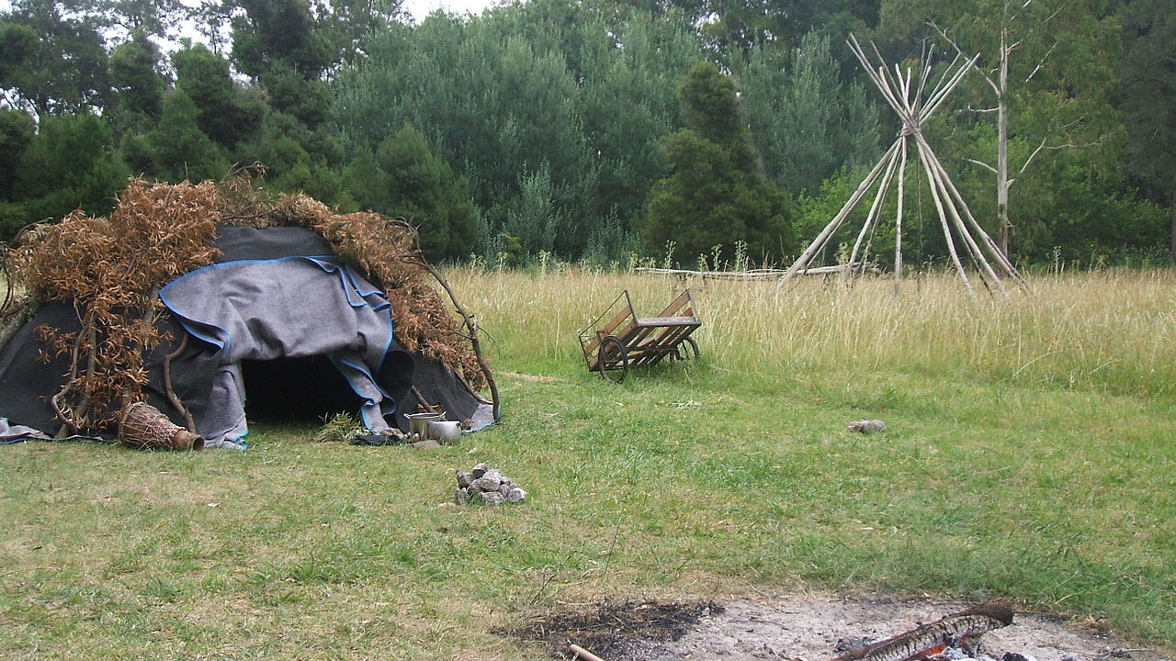
Public Service System – Recommendations
A Public Service system reform to the hierarchical and colonial structure is needed to address today’s complex issues such as Reconciliation
The Public Service needs to begin the process of decolonization to create a truly inclusive working environment for Indigenous executives and employees starting with antiracism and diversity and inclusion initiatives for the Public Service
Build trust and improve the relationship with Indigenous Peoples, including Indigenous employees, by implementing recommendations
Separate Reconciliation from the political arm of government to ensure its non-partisanship, long-term investment, and commitment in the Public Service
This Photo by Unknown Author is licensed under CC BY-SA
Notes:
System reform
-Focus change on Central Agencies/Departments of Finance and Justice, which have been most resistant to change and those which are key to change throughout the Public Service
Decolonization
-decolonization lens to implementing UNDRIP, TRC
-center Indigenous voices as partners
Build trust
-rebuilding relationship key to Reconciliation
-normalize co-development
-decolonizing will help with this
-Focus more on relationship than outcomes
Separate political arm
-Reconciliation should be non-partisan
-political support is needed, but it should not be the driver
-
-

