Slide 1
Access to Information and Privacy 101
Presented by: [insert text]
Date: [insert date]
Notes:
[This guidance is meant for ATIP offices to provide training to their institution’s employees, as per the Appendices B in both directives on requests. This training should be tailored to reflect institution-specific structures, policies and procedures]
Speaking points:
► Hello everyone. Thank you for joining us today to learn more about Access to Information and Privacy
► My name is [name] and my pronouns are [pronouns]. I am a [describe role].
► For accessibility purposes, I am [describe visual appearance]
► This training session is two parts, each 90 minutes of instruction and time for questions.
► Today’s session is English, but please feel free to use the official language of your choice when commenting or asking questions.
► Before I get going, I would like to [insert land acknowledgement of institution].

Slide 2
Objective
To underscore the importance of access to information and privacy (ATIP)
To help you understand your obligations under the Access to Information Act, the Privacy Act and the related Treasury Board policy instruments
This training is mandatory for all employees as required in:
Appendix B of the Directive on Access to Information Requests
Appendix B of the Directive on Personal Information Requests and Correction of Personal Information

Slide 3
Table of contents
The Access to Information Act and the Privacy Act
Treasury Board of Canada Secretariat policies and employee responsibilities
Key players
Information management fundamentals
Responding to ATIP requests
Proactive publication and transparency
Applying privacy practices
Managing privacy breaches
Quiz
Appendix A: Examples of personal information

Slide 4
Section 1: Overview of the Access to Information Act and the Privacy Act
Notes:
[institution might want to add slides on their legislative framework (Income Tax Act, ESDC Act, SSC Act)]
Speaking points:
► I would like to get a sense of who is participating in today’s session. Can you please use the raise hand function in Teams if:
► you are familiar with the Access to Information Act or the Privacy Act
► you have previously completed training on either Act or their underlying policy requirements
► Excellent! Well let’s get into the topic at hand.

Slide 5
Access to Information Act (ATIA)
Enhances accountability and transparency of federal institutions
Part 1 – Gives individuals the right of access to information in records under the control of a federal institution based on the principles that:
government information should be available to the public
exceptions should be limited and specific
decisions on the disclosure of government information should be reviewed independently of government
Part 2 – proactive publication requirements
Notes:
► Democracy, Transparency - ATIA
► Trust in government – Privacy Act
Section 2 of the ATIA sets out the purpose of the act. It reads as follows:
2 (1) The purpose of this Act is to enhance the accountability and transparency of federal institutions in order to promote an open and democratic society and to enable public debate on the conduct of those institutions.
(2) In furtherance of that purpose,
(a) Part 1 extends the present laws of Canada to provide a right of access to information in records under the control of a government institution in accordance with the principles that government information should be available to the public, that necessary exceptions to the right of access should be limited and specific and that decisions on the disclosure of government information should be reviewed independently of government; and
(b) Part 2 sets out requirements for the proactive publication of information.
(3) This Act is also intended to complement and not replace existing procedures for access to government information and is not intended to limit in any way access to the type of government information that is normally available to the general public.

Slide 6
Privacy Act
Protects the privacy of individuals with respect to personal information about themselves held by a government institution
Governs how government institutions collect, use, disclose and retain personal information
Gives individuals a right of access to the personal information that government institutions have about themselves
Allows individuals to request corrections to their personal information

Slide 7


Definition of personal information
The Privacy Act defines personal information as information about an identifiable individual that is recorded in any form
Information can be personal if it can identify a person on its own or in combination with other information
De-identified information can be considered personal information if there is a serious possibility that the individual can be re-identified
See Appendix A: Non-exhaustive list of examples of personal information
Mosaic Effect
Information on its own may not appear identifiable, but when aggregated with other data, it can expose personal details
Notes:
Section 3 of the Privacy Act provides the following definition of personal information
personal information means information about an identifiable individual that is recorded in any form including, without restricting the generality of the foregoing,
(a) information relating to the race, national or ethnic origin, colour, religion, age or marital status of the individual,
(b) information relating to the education or the medical, criminal or employment history of the individual or information relating to financial transactions in which the individual has been involved,
(c) any identifying number, symbol or other particular assigned to the individual,
(d) the address, fingerprints or blood type of the individual,
(e) the personal opinions or views of the individual except where they are about another individual or about a proposal for a grant, an award or a prize to be made to another individual by a government institution or a part of a government institution specified in the regulations,
(f) correspondence sent to a government institution by the individual that is implicitly or explicitly of a private or confidential nature, and replies to such correspondence that would reveal the contents of the original correspondence,
(g) the views or opinions of another individual about the individual,
(h) the views or opinions of another individual about a proposal for a grant, an award or a prize to be made to the individual by an institution or a part of an institution referred to in paragraph (e), but excluding the name of the other individual where it appears with the views or opinions of the other individual, and
(i) the name of the individual where it appears with other personal information relating to the individual or where the disclosure of the name itself would reveal information about the individual,
but, for the purposes of sections 7, 8 and 26 of the Privacy Act and section 19 of the Access to Information Act, does not include
(j) information about an individual who is or was an officer or employee of a government institution that relates to the position or functions of the individual including,
(i) the fact that the individual is or was an officer or employee of the government institution,
(ii) the title, business address and telephone number of the individual,
(iii) the classification, salary range and responsibilities of the position held by the individual,
(iv) the name of the individual on a document prepared by the individual in the course of employment, and
(v) the personal opinions or views of the individual given in the course of employment,
(j.1) the fact that an individual is or was a ministerial adviser or a member of a ministerial staff, as those terms are defined in subsection 2(1) of the Conflict of Interest Act, as well as the individual’s name and title,
(k) information about an individual who is or was performing services under contract for a government institution that relates to the services performed, including the terms of the contract, the name of the individual and the opinions or views of the individual given in the course of the performance of those services,
(l) information relating to any discretionary benefit of a financial nature, including the granting of a licence or permit, conferred on an individual, including the name of the individual and the exact nature of the benefit, and
(m) information about an individual who has been dead for more than twenty years;
The “serious possibility” test is defined in Gordon v. Canada (Health), 2008 FC 258. In it the Federal Court accepted the following test:
Information will be about an identifiable individual where there is a serious possibility that an individual could be identified through the use of that information, alone or in combination with other available information.
The mosaic effect in privacy refers to the idea that individual pieces of seemingly harmless or anonymous information, when combined, can create a detailed and revealing picture of a person’s private life. Even if each piece of information on its own does not seem to be sensitive or identifiable, when aggregated with other data, it can expose personal details, behaviours, or patterns that may have been otherwise private. If, because of the mosaic effect, an individual is identifiable, the information becomes “personal information” for the purpose of the Privacy Act. A “serious possibility” means something more than a frivolous chance, but less than a balance of probabilities. “Other available information” can include information that is publicly available – for example, on the Internet or in other publicly accessible media.

Slide 8
Exceptions to the definition of personal information
The following information is not considered personal information for the use and disclosure by government institutions:
information about a public servant’s position, duties and functions
the fact that someone is or was a member of a ministerial staff
certain contractor information, or information about an individual who received a discretionary benefit of a financial nature
information about those who have been dead for more than 20 years
For the purpose of accountability and transparency,
some of your work-related information can be made public
Notes:
Generally speaking, information not considered personal for use and disclosure means that a government institution can use or disclose it without obtaining the consent of the individuals involved.
Current or past federal employees
Information about an individual who is or was employed by a federal institution that pertains to their position and duties, such as:
title
address and phone number of the workplace
classification (PM-03, CR-02, AS-04 )
salary scale (but not the exact salary)
personal opinions or views given in the course of employment
the fact that an individual is or was a ministerial adviser or a member of a ministerial staff, as well as that individual’s name and title
Financial information
Information relating to any discretionary benefit of a financial nature, such as:
hours of duty and overtime
travel costs
courses and training paid for by the employer
Deceased persons
Information about an individual who has been dead for more than 20 years.
These exceptions should be interpreted narrowly because they are exceptions to the general principle of mandatory protection of personal information recognized under both the Privacy Act and under subsection 19(1) of the ATIA.
For example, paragraphs (j) and (k) should be interpreted as applying to work or function-related information of a factual nature only. Whereas, personnel assessments, for example, a job appraisal, and other assessments of personal competence or characteristics of an individual are included in the definition of personal information. Conflict of interest declarations and reports of disciplinary action taken against an employee or a person under contract should also be treated as personal.
The information excluded by these paragraphs may nevertheless constitute personal information for other purposes. These purposes include sections 4 to 6 of the Privacy Act that relate to the collection, retention and disposal of personal information and the right of access under section 12.

Slide 9
Access to Information and Privacy (ATIP)
Together, the ATIA and the Privacy Act are referred to as ATIP
Both Acts are quasi-constitutional laws and are intended to complement and not replace existing procedures for access
Why is ATIP important?
Ensures transparency and accountability by granting individuals the right to access certain government information
Helps hold institutions accountable for their actions and decisions
Protects sensitive and personal information
Maintains public trust and confidence
Notes:
Quasi-constitutional acts express fundamental values and generally override other inconsistent laws. As recognized in Lavigne v. Canada (Office of the Commissioner of Official Languages), 2002 SCC 53, the Privacy Act is of a quasi-constitutional nature.
Other laws that are quasi-constitutional include: human rights acts; official languages legislation, such as the Official Languages Act; and statutory bills of rights, such as the Canadian Bill of Rights and the Quebec Charter of Human Rights and Freedoms.

Slide 10
Institution’s legislative framework
[This slide is place holder - insert information on your institution's legislative framework as needed]

Slide 11
Section 2:
Treasury Board of Canada Secretariat policy instruments and employee responsibilities
Notes:
[institution might want to add slides on their internal policy framework]
Speaking points:
► Can you please use the raise hand function in Teams if:
► you are familiar with the TBS policy suite and how to find it online?
► you have looked at either the Policy on ATI, the Policy on Privacy Protections or any of their underlying directives or guides?
► Thank you! Ok, let’s get into this.

Slide 12


Treasury Board of Canada Secretariat policy suite
Policy on Access to Information
Directive on Access to Information Requests
Directive on Proactive Publication under the Access to Information Act
Policy on Privacy Protection
Directive on Privacy Practices
Mandatory Procedures for Privacy Breaches
Standard on Privacy Impact Assessment
Standard on Privacy in Web Analytics
Directive on Personal Information Requests and Correction of Personal Information
Directive on Social Insurance Number

Slide 13
The two directives on ATIP requests
Establish principles in support of the institution’s duty to assist, such as:
providing assistance to the requester
responding to requests accurately & completely
providing timely access in the format requested
Assign responsibility to employees for:
recommending informal disclosures of information, when appropriate
taking the necessary steps to ensure complete, accurate, and timely responses
providing recommendations and context on sensitive information that cannot be disclosed in an ATIP request
establishing measures to support public access to information in contracts, arrangements, and agreements
reporting suspected obstruction of access (Directive on ATI Requests only)
Notes:
The Directive on Access to Information Requests and the Directive on Personal Information Requests and Correction of Personal Information establish how to process access to information requests.
The two directives assign the same responsibilities to employees, with the exception of the obstruction of access:
With respect to obstruction of access, the Directive on Access to Information Requests establishes what institutions should do to address alleged or suspected obstructions related to the right of access.
Subsection 4(2.1) of the ATIA states that institutions have a duty to assist requesters. While the duty to assist falls on those with delegated authority, employees play a key role in supporting these principles.

Slide 14
Directive on Proactive Publication
Assigns responsibility to employees for:
providing information to be proactively published
providing recommendations and context on sensitive information that cannot be published
contributing to the development of web resource discovery metadata for information resources available to the public in accordance with the Standard for Managing Metadata
Notes:
Establishes how to meet the proactive publication requirements in Part 2 of the ATIA
Proactive publication does not mean that institutions can publish information that would normally be withheld in response to an access to information request under Part 1 of the ATIA
Canadians can still request the underlying documents through the request-based system (Part 1)
Appendix B of the directive provides a Table of Proactive Publication Requirements including publication timelines

Slide 15
Directive on Privacy Practices
Assigns responsibility to employees for:
following mandatory procedures for privacy breaches as outlined in its Appendix B
preparing and updating personal information banks (PIB), privacy impact assessments (PIA) and privacy protocols in accordance with its Appendix C
performing web analytics (if authorized) in compliance with its Appendix E
Notes:
Establishes consistent and sound management practices
Provides requirement for the creation, collection, accuracy, retention, use, disclosure and disposal of personal information, as well as privacy breaches, personal information banks, privacy protocols and privacy impact assessments
Personal information bank (fichier de renseignements personnels): a description of personal information that is organized and retrievable by a person's name or by an identifying number, symbol or other particular assigned only to that person. The personal information described in the personal information bank has been used, is being used, or is available for an administrative purpose and is under the control of a government institution. Source: Privacy Protection, Policy on
Privacy impact assessment (évaluation des facteurs relatifs à la vie privée): a policy process for identifying, assessing and mitigating privacy risks. Government institutions are to develop and maintain privacy impact assessments for all new or modified programs and activities that involve the use of personal information for an administrative purpose. Source: s.10, Privacy Act, Privacy Protection, Policy on
Privacy protocol (protocol relatif à la protection des renseignements personnels): a set of documented procedures to be followed when using personal information for non-administrative purposes including research, statistical, audit and evaluation purposes. These procedures are to ensure that the individual's personal information is handled in a manner that is consistent with the principles of the Act. Source: Privacy Protection, Policy on
administrative purpose (fins administratives)
The use of personal information about an individual “in a decision-making process that directly affects that individual” (section 3). This includes all uses of personal information for confirming identity (that is, authentication and verification purposes) and for determining eligibility of individuals for government programs.
non-administrative purpose (fins non-administratives)
The use of personal information for a purpose that is not related to any decision-making process that directly affects the individual. This includes the use of personal information for research, statistical, audit and evaluation purposes.

Slide 16

Directive on Social Insurance Number
Provides direction to institutions on how the social insurance number (SIN) can be collected, used and disclosed
The SIN can only be collected or used for purposes expressly authorized under specific Acts and Regulations, or under programs or activities authorized by Parliament and approved by Treasury Board
A list of authorized collections and uses is outlined in Appendix A
Also outlines the process to obtain policy approval for new collections and uses of the SIN
Notes:
The SIN is a sensitive element of personal information that is issued by the federal government.
Given the SIN’s use for administration of financial benefits, a breach of the SIN raises the real risk of significant harm.
For these reasons, there is a specific directive on its use.

Slide 17
Institution’s policy framework
[This slide is place holder - insert information on your institution’s internal policy framework as needed]

Slide 18
Section 3:
Key players
Notes:
[institutions should adjust slides 17 (ATIP office), 18 (Privacy Management Team), 19 (Chief Privacy Officer/ATIP coordinator), 20 (head of the institution), or add any other key players, as appropriate]
Speaking Points:
► Now that we know what each employee is responsible for, please know that you are not alone in delivering on the requirements
► In this section we will describe the important people within our institution who are here to support you and the administration of the two Acts
► Among us today, please raise your hand if:
► you have ever reached out to the ATIP shop for help on proactive publication?
► you have reached out to the privacy team for help on a privacy impact assessment?
► you have sought either team’s help for something else?

Slide 19
Key players (1 of 6)
Head of the institution
[insert name], [insert title] is the head of our institution
Ultimately accountable for proper administration of the Acts, Regulations and policies in the institution
Can delegate responsibilities to Chief Privacy Officer, ATIP coordinators or other officers and employees of the institution through a delegation order
Delegation order
Powers, duties and functions are delegated to positions identified by title, not to individuals identified by name
Persons with delegated authorities must be well informed of their responsibilities
Powers, duties and functions that have been delegated cannot be further delegated
Notes:
[Institutions should tailor this slide to their institution’s structure]
For more information on delegation orders refer to the guidance on Delegation under the Access to Information Act and the Privacy Act (https://www.canada.ca/en/treasury-board-secretariat/services/access-information-privacy/access-information/delegation-under-access-information-act-privacy-act.html)

Slide 20
Key players (2 of 6)
Chief privacy officer (CPO) and Access to Information and Privacy (ATIP) coordinator
Our CPO is [insert name], [insert title]
Our ATIP coordinator is [insert name], [insert title]
Heads of institutions delegate some or all their powers, duties and functions under the Acts and policy suite to the CPO or ATIP coordinator
The CPO and ATIP Coordinator are responsible, on behalf of the head of the institution, for ensuring compliance with the Acts, their Regulations and related policy instruments
Notes:
[Institutions should tailor this slide to their institution’s structure. If the institution does not have a CPO, but rather a Privacy Manager or other title under the ATIP Coordinator, please adjust the slide accordingly.]

Slide 21
Key players (3 of 6)
ATIP Office
Team of analysts in the ATIP Division that processes access to information, personal information and correction requests including:
assisting requesters
gathering records
reviewing and redacting sensitive information
resolving complaints
tracking and reporting
proactive publication of information
providing advice and training
Contact: [insert contact info]
Branch
Directorate
ATIP Division
ATIP Office
Notes:
[Institutions should tailor this slide to their institution’s structure]
The main responsibilities of the ATIP Office for access to information, personal information and correction requests are as follows.
Processing access to information, personal information and correction requests : The ATIP Office responds to all requests received under the Acts in accordance with the provisions of the Acts and the Regulations, jurisprudence, and the policies and directives issued by the President of the Treasury Board. This processing requires the following:
exercising discretion in a fair, reasonable and impartial manner with respect to decisions made in the processing of requests and resolution of complaints
assisting requesters, including protecting their identity and only disclosing the name of the requester to those who need to know; clarifying requests as needed; and providing access in the format and language requested when it enables the requesters to exercise their right of access
establishing a procedure to confirm the identity of the requester, the authority of an individual to make a request on behalf of another, and the right of access under the Acts (see the Privacy Implementation Notice 2022-02: Identity Verification for Personal Information Requests and Access to Information Implementation Notice 2023-01: Amendments to Access to Information Regulations for more guidance)
establishing a procedure for providing complete, accurate and timely responses to requests
communicating with requesters to acknowledge receipt of requests, to advise them of their right to complain to the Commissioners and to clarify requests, as needed
developing and implementing institutional procedures and practices for applying the Acts
determining whether information is under the control of the government institution and therefore subject to a request for access
consulting program managers, senior management, legal advisors, TBS, the Department of Justice Canada (as applicable), the Privy Council Office, third parties and other government institutions as needed
making decisions about requests when this authority has been delegated to the ATIP coordinator or other employees of the ATIP Office
Performing related duties: The ATIP Office performs other duties related to requests, including the following:
determining whether to treat a request informally and seeking the consent of the requester to treat it accordingly
responding to consultations from other government institutions
ensuring compliance with the requirements of the Acts, the Regulations and any other ATIP policy instrument issued by TBS
drafting reports and other documents required by central agencies
ensuring the training and development of ATIP staff; the ATIP Office must document the completed training of employees who have a functional or delegated responsibility for the administration of the Acts or Regulations
ensuring and documenting the training of all the institution’s employees on their obligations under the Acts and policy suites
proactively taking steps to resolve concerns of Canadians before they engage with the formal complaint process, and taking responsibility and steps for corrective action
participating in the resolution of complaints filed with the Commissioners and court reviews, which requires explaining the institution’s decisions concerning the application of the Acts
contributing, with TBS, to the review of policy instruments related to the Acts
Providing facilities to examine information, in accordance with the Regulations.
Providing advice and expertise to employees of the institution, including training and awareness sessions on the Acts and employees’ responsibilities under appendices B of the request directives.
Ensuring that contracts and agreements with private and public sector entities include measures to ensure that the institution meets the requirements of the Acts, and the policy suites. They require measures to support the rights of access. Institutions typically maintain control of information disclosed.
Considering other means of making government information available by reviewing the nature of requests received and assessing the feasibility of making frequently requested types of information available by other means.
Contributing to Info Source: The ATIP Office must prepare, publish or review as required at least once a year the institution’s chapter in Info Source, in accordance with the guidance document Info Source Online Publishing Requirements.
Preparing the annual report to Parliament on the administration of the Acts in the government institution and providing a copy in each official language to TBS and the Commissioners’ Offices once it has been tabled.
Collecting statistics on institutional activities related to the administration of the Acts and submitting annually a statistical report to TBS, in accordance with established requirements.

Slide 22
Key players (4 of 6)
Privacy Management Team (PMT)
Team of analysts in the ATIP Division dedicated to helping the institution protect and manage personal information
Provides internal services to colleagues:
advisory services
privacy risk management
privacy breach management
tracking and reporting
training and awareness
Contact: [insert contact info]
Directorate
ATIP Division
Branch
PMT
Notes:
[Institutions should tailor this slide to their institution’s structure]
Advisory services: Provide advice and guidance to programs on the management and protection of personal information to ensure compliance with the Privacy Act and policy requirements.
(Respond to general inquiries; advise on privacy checklists, privacy notice statements, consent forms, contracts, information sharing agreements, disclosure requests, etc.)
Privacy risk management: Work with programs to identify and reduce the impacts their activities will have on individuals’ privacy through PIAs and privacy protocols.
Privacy breach management: Guide programs through the privacy breach management process, including containment, risk assessment and mitigation, notification and reporting.
Tracking and reporting: Meet Privacy Act and policy reporting requirements for the OPC and TBS (e.g., annual reports, Info Source, privacy breaches, PIAs, etc.).
Training and awareness: Educate employees on proper management of personal information and privacy to help prevent privacy breaches and better protect personal information under the institution’s control.

Slide 23
Key players (5 of 6)
Office of primary interest (OPI) Liaison Officer
OPI refers to the branch, division or program that holds the records requested under an ATIP request
An OPI liaison officer acts as the main point of contact between the branch, division, or program and the ATIP Office
Liaison officer plays an essential role in ensuring that all records or personal information are located and supplied to the ATIP Office on time
Requesters
Individuals that submit ATIP requests
Request needs sufficient detail to enable experienced employees to identify and retrieve relevant records with a reasonable effort
Notes:
[Institutions should tailor this slide to their institution’s structure]
Office of primary interest (OPI): An office in a department or federal agency that holds the records requested under the ATIA or the Privacy Act.

Slide 24
Key players (6 of 6)
Employees
Ensure compliance with
proper record keeping
proper handling of personal information
proper security practices
Make every reasonable effort to locate and retrieve all corresponding records or personal information according to the letter and the spirit of the request within legislative timelines
Responding to ATIP requests is a legislated duty that requires timely attention alongside your other key responsibilities!
Notes:
It is the duty of all employees to ensure compliance with proper record-keeping, handling of personal information and security practices.
Good record-keeping makes it easier to find and provide records when ATIP requests are made. Storing records properly helps speed up the search process. Records should be kept only as long as needed and disposed of according to their disposition authority. This helps reduce the amount of information that needs to be reviewed, redacted and shared in response to a request. For more information on record-keeping practices, consult the department’s information management policies and Information Management Team.
Security practices, such as properly labelling records with the correct security classification, help prevent information from being accidentally released in an ATIP request. Additionally, it’s important to protect personal information from unauthorized access or disclosure to ensure that privacy is maintained. If a privacy breach is identified, report it immediately contain it and notify your privacy officials. If a privacy breach is also a security incident, notify your security officials and vice versa. For more details on security practices, consult the department’s security policies, the Directive on Security Management and the Security Team.
In accordance with its duty to assist, the institution must:
provide assistance to the requester
respond to requests accurately and completely
provide timely access in the format requested
As such, in response to an access to information request, employees must make every reasonable effort to locate and retrieve all corresponding records according to the letter and the spirit of the request within legislative timelines. And, in response to a personal information request, employees must make every reasonable effort to locate and retrieve all personal information under the control of the government institution within legislative timelines.

Slide 25

Other key players (1 of 2)
Information Commissioner of Canada
Agent of Parliament with order-making powers
Investigates complaints related ATI requests
Privacy Commissioner of Canada
Agent of Parliament
Investigates complaints under the Privacy Act and the Personal Information Protection and Electronic Documents Act (private sector–focused legislation)
Protects and promotes privacy rights by overseeing privacy compliance
This Photo by Unknown Author is licensed under CC BY-SA
Notes:
Information Commissioner
The Information Commissioner is an agent of Parliament who receives and independently investigates complaints from requesters who believe that government institutions have not respected their rights under the Act. The Information Commissioner may also initiate complaints when they are satisfied that there are reasonable grounds to investigate a matter relating to requesting or obtaining access to records under the Act. The Commissioner issues reports of the findings of investigations to complainants and institutions and also publishes these reports through their website and on the Canadian Legal Information Institute's website (canlii.org). Once the Commissioner issues their final report, the complainant, institutions and other parties may apply to the Federal Court for a review.
The Information Commissioner of Canada also has order-making powers, meaning they can issue binding orders that have the same effect as an order by a court of law. These orders can require government institutions to disclose records, adjust time extensions, or modify the format of disclosed information. The Commissioner may also make non-binding recommendations. The Commissioner can initiate or intervene in court proceedings or appear before the court on behalf of any person who has applied for a review under the Act.
In addition, the Information Commissioner reports to Parliament on the activities of the Office of the Information Commissioner after each financial year and may make special reports to Parliament referring to and commenting on any matter within the scope of the powers, duties and functions of the Commissioner.
Privacy Commissioner
The Privacy Commissioner is an agent of Parliament who receives and independently investigates complaints from individuals regarding the handling of their personal information by federal government institutions and from requesters who believe that government institutions have not respected their rights of access under the Act. In addition, the Commissioner has the authority to conduct compliance reviews of the privacy practices of government institutions related to the collection, creation, retention, accuracy, use, disclosure and disposal of personal information by government institutions subject to the Act. The Commissioner advises on, and reviews, privacy impact assessments (PIAs) of new and existing government initiatives and receives reports from institutions on material privacy breaches and may also request further information from institutions regarding these breaches.
The Commissioner may initiate complaints when they are satisfied that there are reasonable grounds to investigate a matter under the Act. The Commissioner reports findings and may make recommendations on any matter that has been investigated or reviewed. The Commissioner can also initiate or intervene in court proceedings.
The Commissioner reports to Parliament on the activities of the OPC after each financial year. They may also make special reports to Parliament referring to and commenting on any matter within the scope of the powers, duties and functions of the Commissioner. The Commissioner is subject to strict confidentiality obligations. As such, they may speak publicly about a complaint and the findings from an investigation only after tabling the related report in Parliament.

Slide 26
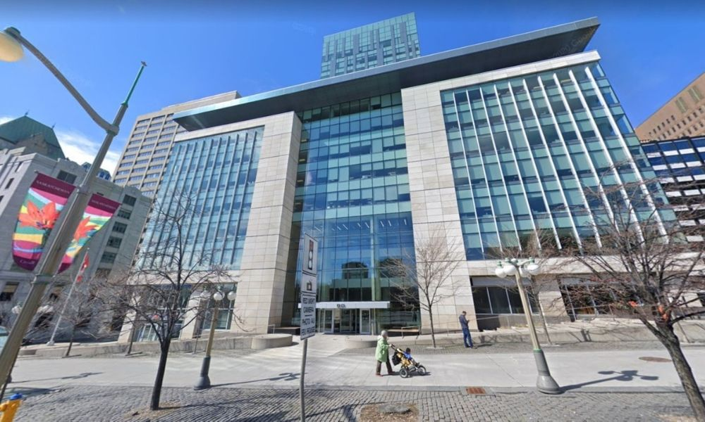
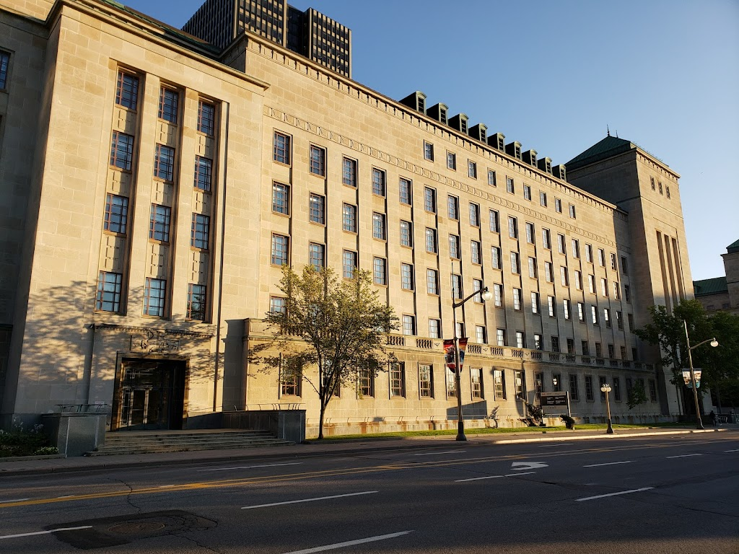
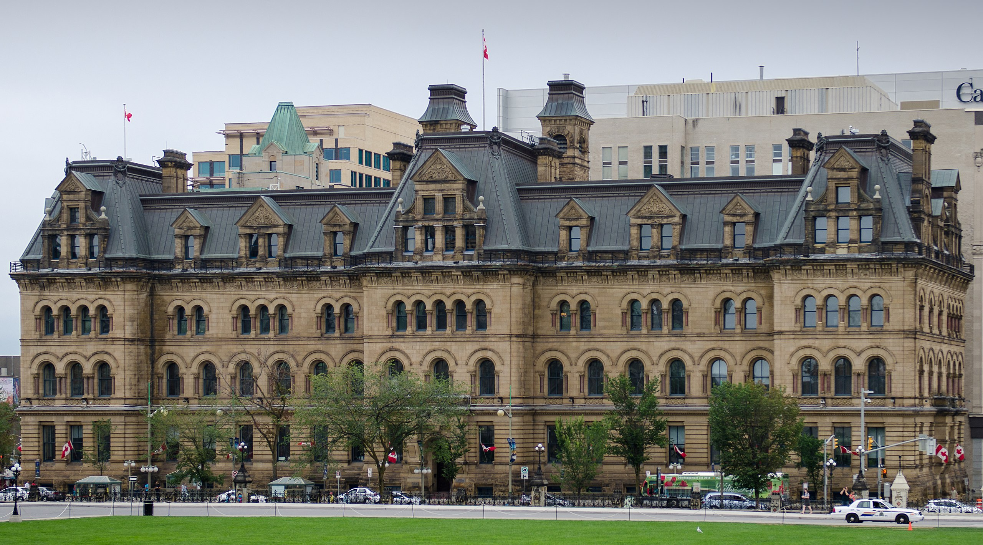
Other key players (2 of 2)
Treasury Board of Canada Secretariat (TBS)
The President of the Treasury Board is the designated minister for overall administration of the Acts
Develops and issues regulations, policies, directives, guidance, tools and advice
Supports ATIP community learning and development
Department of Justice Canada
Provides legal advice and services to the government and client departments and agencies
Represents the Crown in judicial reviews
Must be consulted to determine what constitutes a Cabinet confidence
Privy Council Office
Ensures the integrity of the Cabinet process and the stewardship of related documents
Custodian of confidences of the King’s Privy Council for Canada
Responsible for policies on the administration of Cabinet confidences
Notes:
Treasury Board of Canada Secretariat (TBS)
Access to Information and Open Government Division supports institutions in the administration of the ATIA and its related policies
Privacy and Responsible Data Division supports institutions in the administration of the Privacy Act and its related policies
If there is any doubt as to whether a record is a Cabinet confidence:
Justice legal counsel must first consult the Counsel, Information and Privacy Law Division (CIPL) at the Department of Justice Headquarters.
If the matter cannot be resolved following this consultation, CIPL legal counsel must then consult with the Office of the Counsel to the Clerk of the Privy Council Office (PCO).

Slide 27
Section 4:
ATIP starts with good information management (IM)
Notes:
Speaking points:
► We all have a role to play in maintaining the information resources at this institution
► Please raise your hand if you
► know where we are supposed to save our working files
► have made an effort to clean up your email inbox in the last month
► have ever reached out to our IM team to ask questions

Slide 28
What is information management (IM)?
“A discipline that directs and supports effective and efficient management of information in an organization, from planning and systems development to disposal or long-term preservation”
Information life cycle
Dispose and transfer
Plan
Maintain and protect
Collect and create
Share and use
Organize and store
Notes:
Life cycle steps:
Plan what information you need to accomplish your objectives and to make sound decisions, and how you will manage it
Create and collect information, identify its value to the department and manage it accordingly
Organize information using naming conventions, metadata, filing structure
Use, reuse and share information to make work life easier for you and colleagues while complying with privacy, security and legal restrictions
Maintain accuracy and authenticity of information while guarding against unauthorized access, disclosure or destruction
Dispose of information that is no longer needed, or information of business value that is after its retention period, and transfer information of enduring value to Library and Archives Canada
See the Guidance for Employees of the Government of Canada: Information Management Basics (https://www.tbs-sct.canada.ca/pol/doc-eng.aspx?id=16557) for more information on the information life cycle.

Slide 29
Employee IM responsibilities
We all create, collect, use and share information as part of our day-to-day work, so we are all responsible for effectively managing information that is under our control.
Employees are responsible for:
following IM policies, directives, standards and procedures
using approved systems and repositories
sharing and reusing information to support collaboration and facilitate business operations, respecting all privacy, security and other legal and policy requirements
protecting sensitive and personal information
being informed of and applying retention periods for information
supporting access to information and access to personal information requests
Notes:
See the Guidance for Employees of the Government of Canada: Information Management Basics (https://www.tbs-sct.canada.ca/pol/doc-eng.aspx?id=16557) for more information on employees’ IM responsibilities or the IM office at … [how to contact the institution’s IM resources].

Slide 30

How good IM practices support better ATIP
On-time disposal = fewer transitory records to provide!
Ensures that information is accurate, accessible, and secure
When ATIP requests come in, well-managed information means:
faster and easier retrievals – unmanaged information causes delays
more complete and accurate responses – less risk of missing information and providing incomplete ATIP responses
Reduces the risk of privacy and security breaches, and legal issues under the ATIA and Privacy Act
If you retain transitory records longer than needed, you will need to provide these to ATIP upon request. Caution: do not destroy or alter information after it is requested – this is obstruction!
The penalty for obstruction is up to a $10,000 and 2 years of imprisonment!
Notes:
quicker processing time, better service to requesters, more transparency
clean up their emails before saving – that way we only have the latest with all the information saved and we don't have to go through them and delete duplicates

Slide 31
Section 5:
Responding to ATIP requests
Notes:
[institutions should adjust slides to reflect their ATIP request process – especially slide 35 (how you want records to be provided), slide 41 (process timelines)]
Speaking Points:
► This section is probably the one that most of you are familiar with.
► Please raise your hand if you:
► have ever been tasked with providing records in response to an access to information request?
► have been tasked while at this institution?
► have been tasked with responding to a personal information request?
► have been tasked here at this institution?
► have been tasked with making a correction to personal information?
► are aware when there was a complaint made to a commissioner regarding a request you worked on?

Slide 32
Making a request
 | ATIA | Privacy Act
Who can request? | Individuals or companies in Canada, or citizens regardless of location | Any individual, regardless of location
How to request? | Written ATIP Online is encouraged List of ATIP Coordinators | Written ATIP Online is encouraged List of ATIP Coordinators
What can be requested? | Any Government of Canada record, in any format | Individual’s own recorded personal information
Is there a fee? | $5 | None
How long to get a response? | 30 calendar days, with possible extensions if justified | 30 calendar days, plus maximum 30-day extension
How to correct information? | n/a | Individuals may request correction of their personal information if they believe there is an error or omission
30 calendar days including weekends and holidays!
Notes:
If it will be difficult to respond to a request within the original deadline, note that extensions must be taken in the first 30 days after receiving the access request. This is especially important when employees are providing the time estimation for retrieval and review of records.
Please be prompt
Extension of time limits under the ATIA
The head of a government institution or their delegate can extend the initial time limit under the following three circumstances:
the request is for a large number of records or requires a search through a large number of records and meeting the original time limit, under either of these circumstances, would interfere unreasonably with the institution’s operations;
consultation is necessary and it cannot be completed within the 30-day statutory deadline;
notice is given to a third party under subsection 27(1) of the ATIA.
The institution is not required to consult or obtain the requester’s consent when deciding whether or not to extend the statutory deadline. The institution is required to examine the circumstances and context of each request. More than one extension may be taken, provided each extension is taken within the initial 30-day period.
Extension of time limits under the Privacy Act
The head of a government institution or their delegate can extend the original time limit by a maximum of 30 days under the following circumstances:
meeting the original time limit would unreasonably interfere with the operations of the government institution, or
consultations are necessary to comply with the request that cannot reasonably be completed within the original time limit
In addition, the head can extend the time limit for such a period of time as is reasonable if additional time is necessary to translate the information or convert the information into an accessible format.

Slide 33


Records vs. personal information
Records
Any documentary material regardless of medium or form
Includes documents (paper copies and electronic copies), personal notes and notebooks, emails, sticky notes, text messages, audio and video recordings, etc.
Can also includes personal records if stored on a work account or device
Upon request under the ATIA, all relevant records must be provided to the ATIP Office in their entirety (regardless of classification e.g., protected, secret, solicitor-client privilege)
Personal information
Information about an identifiable individual such as name, contact details, social insurance number, etc.
Can be sensitive, like health data or financial information
Upon request under the Privacy Act, only the records that contain the requested personal information must be provided to the ATIP Office

Slide 34
Step 1. Receive, evaluate and validate request
The ATIP Office will:
receive the request and check that all requirements are met
open a file in their systems
identify which branch, division or program, also known as the office of primary interest (OPI), holds the records requested
send a tasking email to the OPI liaison officer, who forwards the request to any employees who may have relevant records
the ATIP office may send the tasking of a personal information request directly to employees who may have relevant records
The ATIP Office may assist the requester, as needed,
throughout the process
Notes:
[Institutions should tailor this slide to their institution’s process]
The ATIP Office will check whether all requirements are met. They look for the following.
If it is an access to information request:
the requester must be a Canadian citizen, permanent resident, individual present in Canada or a corporation present in Canada
the request must be made in writing (online or by mail)
the request must be sufficiently detailed and specific
a $5 fee must be paid
If it is a personal information request:
the requester must provide adequate documents and/or information to confirm their identity
the request must be made in writing or online
the request must be sufficiently detailed and specific
no fees are associated with personal information requests
Duty to assist
Sections 4.1.8 through 4.1.14 of the Directive on Personal Information Requests and Correction of Personal Information and subsection 4(2.1) of the ATIA assign the head of the government institution or their delegate the duty to assist requesters. These requirements align with the Principles for Assisting Requesters, which are as follows.
In processing a personal information request or correction request under the Privacy Act, institutions will:
offer reasonable assistance throughout the request process
provide information on the Privacy Act, including information on processing requests and requesters’ right to complain to the Privacy Commissioner of Canada
inform requesters as appropriate and without undue delay when requests need to be clarified
make every reasonable effort to locate and retrieve the requested personal information
apply limited and specific exemptions to the requested personal information
provide accurate and complete responses
provide timely access to the requested personal information
provide personal information in the format and official language requested, as appropriate
provide an appropriate location in the government institution to examine the requested personal information
Examples of the types of assistance an ATIP officer may provide are:
helping to clarify a request
working with the requester to narrow the scope of their request so that they receive more timely access to the records or personal information they seek
explaining access and complaint resolution processes under the Acts
directing requesters to other means of obtaining information
when an extension is required, providing the requester a written explanation for the delay
informing the requester of the progress of the request
providing interim disclosures

Slide 35
Step 1. Continued – Consideration for the identity of a requester
For personal information requests, you need the identity of the requester to locate their records. For ATIA requests, the identity of the requester is not necessary and the ATIP office will not share this information.
A requester's identity is personal information!
Do not share the identity of the requester or the wording of a personal information request with colleagues. Even your OPI liaison officer may not need to know the personal information.
Always consult the ATIP analyst that sent you the personal information request if you believe someone else may have relevant records.
Sharing the identity of the requester or the wording of a personal information request could be a privacy breach
Notes:
ATIP Offices may send personal information requests directly to implicated employees, instead of going through the OPI liaison officer. This approach limits the sharing of information to those who have a need to know about the request and protects the requester’s privacy.

Slide 36
Step 2. Clarify the request
Read the request text thoroughly and note the due date – you will only have a few days to respond
Consider whether the request can be responded to informally, that is through another quicker and less formal method to share the information. If so, advise the ATIP Office of the other process
Contact your OPI liaison officer (for ATIA request only) or your ATIP Office if:
you know another section or region that holds relevant records
you believe that the request was tasked to your section in error
you feel that the request is not clear enough
you believe the request is vexatious, made in bad faith or abuses the right of access
If the request isn’t clear, your ATIP Office will follow up with the requester to clarify. Look out for a new tasking and due date
Timelines are tight because of legislative 30-day deadlines!
Notes:
[Institutions should tailor this slide to their institution’s process]
Informal requests
Individuals may also choose to submit an informal request for information or for their personal information. To make an informal request, individuals can contact the government program they have been dealing with or the institution’s ATIP coordinator. When possible, institutions should provide individuals with informal access, as long as it does not contain sensitive information that could be exempted or excluded. However, requesters who submit informal requests to the ATIP Office must be informed that there is no time limit for responding and that they are not entitled to complain to the Information Commissioner or the Privacy Commissioner about the processing of their request.
Acts are meant to complement not replace other sources of information
Consider if the information is available through another process in government (client information hub, information for purchase, etc.)
if so, advise the ATIP Office of the other process
ATIP Office will liaise with the requester to see if they want to proceed informally
Provide a recommendation to the ATIP Office if the request should be disclosed informally
Need clarification?
If you think that the request is unclear or incomprehensible, or that the scope of the request is too general:
Contact your OPI's liaison officer or your ATIP Office (depending on the process established by your department) right away
Provide some idea of the number of records that would need to be found if the request were processed as is
Suggest ways to narrow down the scope of the request, keeping in mind the requester’s right to access
Your ATIP Office will clarify the request with requester
Once the request has been clarified, you should receive a new tasking with the reworded request
Section 6.1 of the ATIA provides that an institution may seek the Information Commissioner’s approval to decline an access request if, in the opinion of the head of the institution, the request is:
vexatious,
made in bad faith, or
otherwise an abuse of the right to make a request for access to records.
The term vexatious is not defined in the Act. In the context of an access request, the term is generally understood to mean a request filed primarily to embarrass, to harass, or to cause annoyance or trouble.
Bad faith generally means with an ulterior motive: for example, motivated by ill will, hostility, malice, personal animosity, lack of fairness or impartiality, lack of total honesty such as withholding information. It includes serious carelessness, recklessness and intentional fault. It can be established by direct or circumstantial evidence.
An abuse of the right to make an access request occurs when a requester uses their right of access in an abusive or inappropriate manner, such as when:
a request’s purpose is other than obtaining documents or information
a request is contrary to the public interest in that it overburdens an institution, hinders other requesters’ rights of access, and/or unnecessarily increases the costs and time spent by institutions to meet their statutory obligations

Slide 37


Step 3. Find the records
Search, locate and retrieve the requested information under the control of the institution
Ensure that searches are comprehensive and consider both the letter and the spirit of the request
Document your search terms and parameters in case of a complaint
Advise ATIP officials as soon as possible if a request cannot be responded to within the timeline, for example if you have a large number of documents (1,000+ pages)
Ask ATIP officials if you are unsure whether certain records are under the control of the government institution
You must find and provide all relevant records that are the subject of a request. You cannot intentionally destroy, mutilate, alter, falsify, or conceal a record with the intent to deny a right of access
Don’t forget to retrieve and provide:
Transitory Records
Email Chains &
Attachments
Notes:
[Institutions should tailor this slide to their institution’s process]
When responding to an Access to Information (ATI) request, employees must make sure their search for records is thorough and complete. This means checking all possible places where the records might be stored—even if they’re not in the usual location or are not well organized. It is good practice to keep a record of how the search was conducted, such as documenting:
what search terms or keywords were used
where they looked (e.g., shared drives, email, document management systems, etc.)
how they conducted the search, especially if records are stored in various or unexpected locations
By documenting this, employees can prove that they made a genuine, diligent effort to find everything relevant. This protects both the employee and the organization by demonstrating accountability and transparency in the search process.
If you expect a delay, notify your ATIP Office as soon as possible; an extension can only be taken in the first 30 days.
The ATIP Office may be able to:
obtain an extension if you justify it with a clear number of records to be found and the scope of the task
narrow the scope of the request
Control is determined by such factors as whether the information is:
held by the institution, electronically on servers or in the cloud, and hard copies at headquarters or at a regional, satellite or other office, either within or outside Canada, or at an off-site location such as a private storage facility or a federal records center (records storage facility administered by Library and Archives Canada containing records that contain personal information that remain under the control of institutions); or
held elsewhere on behalf of the institution (for example, personal information maintained by agents, consultants or other contracted service providers); or
the institution is authorized to grant or deny access to the personal information, to govern its use and, subject to the approval of the Librarian and Archivist of Canada, to dispose of it.
You must justify a time extension. Give your ATIP Office a clear idea of the number of records to be found and the scope of the task. For an extension to be valid and effective, the requester must be notified within 30 calendar days following receipt of their request. You must therefore notify your ATIP Office right away if you need more time to retrieve relevant records and/or if the records meet the other grounds for extension
For access to information requests, there is no maximum extension, but they should be kept as short as possible. Time limits can be extended if it is justified
For personal information requests: The extension cannot exceed an additional 30 days, for a maximum time limit of 60 days total
According to subsection 67.1 (1) of the Access to Information Act, no person shall intentionally destroy, mutilate, alter, falsify, or conceal a record, or order another person to do so, when an access to information request has been made. If you are found guilty of doing so, the maximum penalty is two years in prison, a $10,000 fine, or both.

Slide 38
Step 4. Draft recommendations (1 of 4)
When providing records, provide context to the ATIP office, suggest recommendations on whether requested information should be disclosed and explain why
Indicate whether other institutions should be consulted on the information that is proposed for release
The ATIP Office will consider your recommendations to apply exemptions and exclusions, provided in the ATIA and Privacy Act, and redact the responsive records
Only the ATIP Office officials with delegated authority can make decisions on redactions on the records – you can only make recommendations
Notes:
[Institutions should tailor this slide to their institution’s process]
ATIP Offices are experts in the application of the laws, but are not always familiar with your subject matter. You are responsible for outlining the context and sensitivities surrounding the records and explaining why you are concerned about the release of the information, or why there are no concerns.
Clearly indicate what information is sensitive,
Provide a rationale for any information you recommend not be disclosed to the requester, and/or
Provide a rationale as to why information that may appear sensitive may be disclosed to the requester, and
Send everything to your ATIP Office.

Slide 39
Step 4. Draft recommendations (2 of 4)
The only way to refuse access to information is through an exemption or exclusion
Exemptions: Provisions in the ATIA and Privacy Act allow institutions to refuse to release certain kinds of information
Exclusions: Information that the ATIA and Privacy Act does not apply to
Guidance on exemptions and exclusions
Access to Information Act: Plain Language Guide to Exemptions and Exclusions
Privacy Act: Plain Language Guide to Exemptions and Exclusions
Notes:
Exemptions
An individual's right of access to information is limited by a number of exceptions specified in the legislation (sections 18 – 28 of the Privacy Act, and sections 13 – 26 of the ATIA)
Under section 12 of the Privacy Act, an individual is entitled to request access to only their own personal information
These exceptions to the right of access are known as exemptions
Exemptions involve the content of a record
Each exemption is intended to protect information relating to a particular public or private interest
Exemptions to the public right to access must be:
specific
limited
When an exemption is applied by the ATIP Office, one or more words are redacted from the document
Exclusions
Exclusions relate to categories of documents that the Acts do not apply to
The ATIA and Privacy Act do not apply to certain information. Examples of information that is excluded are published information and Cabinet confidences (outlined in sections 69 and 70 of the Privacy Act, and sections 68 and 69 of the ATIA)
Cabinet confidences are excluded because Ministers must be able to engage in full and frank discussions for the effective functioning of a Cabinet system. This upholds the principle of collective responsibility. PCO is responsible for the policies related to Cabinet confidences and will be consulted when you flag that a record has a Cabinet confidence

Slide 40
Step 4. Draft recommendations (3 of 4)
There are two types of exemptions
Mandatory: “… the head of a government institution shall refuse to disclose …,” which means that there is no option but to refuse access to the information
However, there are some “shall” provisions where information can be disclosed if certain conditions are met
Discretionary: “… the head of a government institution may refuse to disclose…,” which means that institutions have the option to disclose or to protect the information
There are two tests for exemptions
Injury test: determine whether the disclosure of information could reasonably be expected to be injurious to a specific interest
Class test: exemptions require heads of institutions to determine whether information fits within certain categories of information that can be exempted
Notes:
Mandatory exemptions
an exemption provision that is introduced by the phrase “shall refuse to disclose”
institutions are required to refuse to disclose the information. ATIP must not release the information
Examples:
Information received in confidence from another government like a foreign government or provincial government (subsection 13(1) of the ATIA)
Personal information like medical history and banking information (subsection 19(1) of the ATIA)
Trade secrets like a secret recipe (paragraph 20(1)(a) of the ATIA)
Information that is protected by another law like tax information protected by the Income Tax Act (section 24 of the ATIA)
Some exemptions in the Act are mandatory but allow disclosure if certain conditions are met. For example, with consent, institutions may release information under sections 13(2)(a), 19(2)(a), or 20(5) of the ATIA and 19(2)(a) of the Privacy Act. When these conditions are satisfied and no other exemptions apply, institutions have discretion to disclose after weighing factors for and against release.
Discretionary exemptions
an exemption provision that contains the phrase “may refuse to disclose”
permits the head of a government institution, or their delegate/ATIP officials, to refuse to disclose information if it meets the class or injury test involved. In other words, ATIP can choose whether or not to release the information.
Examples:
Federal-provincial affairs, if releasing the information could hurt relations between governments (section 14 of the ATIA)
Advice or recommendations developed for government decision-making (section 21 of the ATIA)
Legal advice (solicitor-client privilege), institution can choose to waive their privilege (section 23 of the ATIA)
Injury test
Exemptions apply only if releasing the information could reasonably be expected to cause harm (injury) to someone or to interests. ATIP officials are required to demonstrate how disclosure could result in a risk of harm.
Examples:
National security, defence, or international relations—only if disclosure could reasonably be expected to cause harm. (subsection 15(1) of the ATIA)
Law enforcement and investigations—if releasing the information could reasonably be expected to interfere with an investigation or endanger someone (section 16 of the ATIA)
Third-party information—if releasing it could reasonably be expected to harm a business’s competitive position (paragraph 20(1)(c) of the ATIA)
Class test
Exemptions apply when the information belongs to a specific category (or class). Parliament has deemed classes of information inherently sensitive and therefore in and of themselves worthy of protection. If released, it is known that this type of information will cause harm.
Examples:
Information received in confidence from another government like a foreign government or provincial government (subsection 13(1) of the ATIA)
Personal information is automatically protected (subsection 19(1) of the ATIA)
Legal advice – automatically protected because of its nature (section 23 of the ATIA)
Appendix C: Classification of Exemptions in the Directive on Access to Information Requests and Appendix C: Classification of Exemptions in the Directive on Personal Information Requests and Correction of Personal Information provide tables that list all exemptions under the ATIA and Privacy Act

Slide 41
Step 4 – Draft recommendations (4 of 4)
When identifying potential redactions and drafting recommendations, consider the context and provide this information to your ATIP office:
Where did the information come from? Who created it? How was it obtained? Were any stipulations attached to the information? Does it include cabinet confidences?
Why was it created/obtained? What purpose does the information serve: internally to the institution, externally to partners, externally to the public / the individual?
What harm or impact could come from releasing the information? Internally? Externally? Publicly?
Would releasing information give certain individuals or third parties an unfair advantage over others?
When was it created? Consider the passage of time and the status of files: active vs closed. Is the sensitivity of the information affected by these factors?
Notes:
[Institutions should tailor this slide to their institution’s process]
Provide context that may not be evident in the records and which is relevant to each specific request.
Explain what the harm will be.
Explain how and when the disclosure could cause harm.
Explain the reasonable grounds that suggest that the disclosure would bring about the injury (i.e. what is the logical link?).
Consider the following:
Use of the information could lead to the specific harm
Availability of the information (i.e. Can it be obtained by observation or independent study by a member of the public acting on their own?)
Press coverage (i.e. If similar information has already been disclosed and received press coverage, could additional harm be expected from this additional release?)
Time (i.e. In some cases, the older the record, the less likely an injury could occur.)
Other relevant documents: Each document must be considered on its own merit and in the context of all the documents requested. Does releasing one document among others cause more harm because of a lack of context?
If there is no harm, you may recommend release.
The term “Cabinet Confidences” refers to “Confidences of the King’s Privy Council for Canada,” which includes information that contains or reveals the deliberations of federal Cabinet Ministers. Information on these deliberations is kept strictly confidential to allow for robust and frank discussions amongst Cabinet Ministers. This includes not only documents prepared for or by Cabinet, but documents or information prepared outside of Cabinet that can reveal what may be considered by Cabinet, what was considered by Cabinet, or what was discussed between ministers.
The disclosure of such information would effectively prevent Cabinet and its members from speaking with one voice before Parliament and the public. A deliberate release of Cabinet confidences to an unauthorized individual means the government can no longer claim statutory protection over the disclosed information as a Cabinet confidence. A Cabinet confidence that has been in existence for more than 20 years cannot be excluded under subsection 69(1) of the ATIA and 70(1) of the Privacy Act.
For more information on Cabinet confidences refer to PCO’s Policy on the security of Cabinet Confidences (https://www.canada.ca/en/privy-council/services/publications/policy-security-cabinet-confidences.html)

Slide 42

Step 5. Provide records
[Institutions should tailor this slide to their institution’s process]
Provide records to your OPI liaison officer or your ATIP Office within assigned timelines
All relevant records must be submitted even if you recommend exemptions or exclusions
Provide photocopies of paper records
For personal information requests, hard copies should be provided directly to the ATIP analyst assigned to the file
Do not use staples, paperclips, white-out, sticky notes
Upload digital copies in the assigned location
Provide your recommendations using the ATIP Office’s template
Do not redact, alter or modify the records before submitting them to ATIP
There are severe penalties for intentionally destroying, mutilating, altering, falsifying and concealing a record
Notes:
[Institutions should tailor this slide to their institution’s process]
Your ATIP office will use your recommendations to determine what should be released. They will in turn document their decisions, including noting what factors that were considered when exercising any discretionary decision.
According to subsection 67.1 (1) of the Access to Information Act, no person shall intentionally destroy, mutilate, alter, falsify, or conceal a record, or counsel another person to do so. If you are found guilty of obstructing the right of access, the maximum penalty is two years in prison, a $10,000 fine, or both.

Slide 43
Step 6. Consult
The ATIP Office is responsible for consulting internal and external stakeholders
The ATIP Office may contact you again after the consultations for additional clarifications or may consult you on other ATIP requests where you may have the subject matter expertise to provide recommendations.
A time extension will typically be applied if external consultations are necessary
Notes:
[Institutions should tailor this slide to their institution’s process]
Internal consultations
Your department’s legal services, if the ATIP Office feels there is a need for legal advice in processing the request.
Any other internal stakeholders that could give advice on the release of the records, like another OPI who is identified in the records. Bring the existence of these stakeholders to the attention of your liaison officer or the ATIP Office.
External consultations
The ATIP Office, based on the recommendations you provided in Step 4, will consult other federal institutions, governments, individuals, private companies and organizations involved in the request, as needed.
Institutions must treat consultation requests from other government institutions with the same level of importance as access requests that they receive directly.
Your responsibility is to identify every internal and external stakeholder that should be consulted in order to comply with an access request.

Slide 44

Step 7. Applying exemptions and exclusions
Your ATIP Office is responsible for this step
The ATIP Office will review the records and your recommendations
They will interpret and apply the legislation to determine where exemptions and exclusions are needed
Using specialized tools, ATIP analysts will sever information that can’t be released and prepare a release package
Only ATIP officers with delegated authority can redact exempt information from documents or exclude entire documents
Notes:
[Institutions should tailor this slide to their institution’s process]
The ATIP office will use your recommendations to determine what should be released. They will, in turn, document their decisions, including noting factors that were considered when exercising any discretionary decision.

Slide 45
Step 8. Send response package to the requester
The ATIP Office will send the requested information, with marked exemptions or exclusions, to the requester in the language and format of their choice (paper or electronic)
Accompanying letter
lists all the exemptions and exclusions that have been applied
provides a link to the applicable plain language guide
informs the requester of their right to file a complaint with the Information Commissioner (for an ATIA request) or the Privacy Commissioner (for a Privacy Act request)

Slide 46
Step 9. Handle complaints (1 of 2)
Your ATIP Office usually handles complaints, but may need your assistance
A requester may submit a complaint if they are dissatisfied with your institution’s response to:
the Information Commissioner (for an ATIA request)
the Privacy Commissioner (for a Privacy Act request)
A requester can complain about:
information fully or partially denied
not meeting the legislative time frames
non-compliance with certain aspects of the law
Under the Privacy Act, individuals can also file a complaint on anything relating to how the government handles their personal information, not just requests for personal information
Notes:
Role of the Information and Privacy Commissioners
Conduct investigations into complaints and may make recommendations to institutions, such as releasing the information that had been excluded or exempted
The Information Commissioner has order-making powers to compel institutions to comply with investigation findings
Investigators from either Commissioner’s offices have the authority to:
require you to meet with them
search your office and computer
administer oaths
meet with you in private without your supervisor being present
require you to provide the documents

Slide 47

Step 9. Handle complaints (2 of 2)
During an investigation from the OIC or the OPC, it is important that you cooperate
You can be fined $1,000 if you obstruct the work of investigators
Notify your ATIP Office if an investigator contacts you
Take notes and document your meetings with the investigator – complaints can be subject of review in Federal Court and you may be called to produce affidavit evidence
Notes:
Making representations during investigations
The Commissioners must give parties to a complaint a reasonable opportunity to make representations during investigations pursuant to subsections 35(2) of the ATIA and 33(2) of the Privacy Act.
The parties are generally considered to be the complainant and the institution that is the subject of the complaint. Third parties and the Privacy Commissioner may also be parties to an OIC complaint in some instances.
Representations include:
documents,
information and facts the Commissioner’s Office gathers during investigations from complainants, institutions and other parties,
all parties’ views on the matters under investigation.
For example, an institution might explain in its representations why a record is exempt from disclosure under a provision of the Act, while a complainant might list reasons why the record is not exempt.
Beyond the representations they make in response to queries from investigators, complainants and institutions may also provide representations of their own accord at any time before the Commissioner releases their findings on the complaint.

Slide 48
Summary of ATIP requests process
Day 1–2: Receive the request | Day 3–9: Retrieve the records | Day 10–30: ATIP review and final approvals | Day 30 and on: Handle complaints
ATIP Office receives and tasks the request (Step 1) | Clarify the wording or scope of the request (Step 2) Search for all relevant records (Step 3) Draft recommendations on information that should potentially be withheld (Step 4) Provide records and recommendations to your OPI liaison or the ATIP Office (Step 5) | ATIP Office conducts necessary consultations (Step 6) ATIP Office reviews all responsive records & recommendations, applies exemptions & exclusions, redacts information and obtains final approvals (Step 7) ATIP Office provides response package to the requester (Step 8) | Requesters can submit a complaint to the OIC (within 60 days of receiving the response package or in the absence of a response) or to the OPC, as appropriate Institution cooperates with investigations (Step 9)
Notes:
[Institutions should tailor this slide to their institution’s process]

Slide 49

Correction requests
Following a personal information request, individuals may request a correction to their personal information if that information is being used to make a decision about them
Information for non-administrative uses, such as statistics, evaluation, sentiment analysis, is not eligible for corrections
The ATIP Office will receive these requests and forward them on to the OPI liaison in your division
If the correction is not made, a notation must be added to the record to advise that a correction was requested
All copies of the personal information will need correction or a notation
Partners and contractors with whom the personal information has been shared will need to be notified so they can also correct or annotate their copies

Slide 50
Section 6:
Proactive publication and transparency
Notes:
Speaking Points:
► Proactive publication requirements were added to the Access to Information Act in 2019.
► Before then they were recommended as a transparency mechanisms
► Please raise your hand if you have:
► Ensured that documents, like briefing notes, had titles that could be released under proactive publication
► Prepared documents, like travel expenses and contract summaries, for proactive publication
► Looked up on the open government website the list of documents that are available.

Slide 51
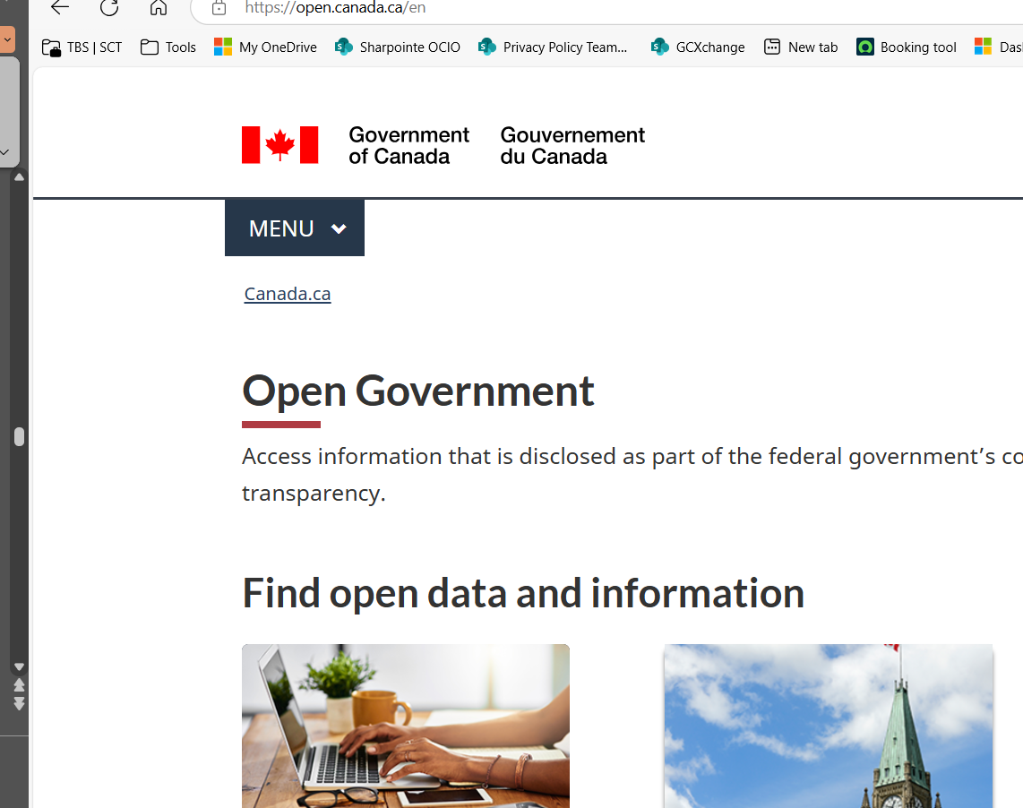
Proactive publication (1 of 2)
Publishing information of public interest is a great way to enhance transparency and enable requesters to ask for more specific information
The ATIA requires institutions to proactively publish specific information known to be of interest to the public. Most of these publications relate to the use of public funds and contract information, including:
travel & hospitality expenses
contracts over $10,000
briefing material prepared for new or incoming ministers
titles of memoranda for ministers
For the full list and publishing timelines see Appendix B of the Directive on Proactive Publication
The Directive on Access to Information Requests requires institutions to publish summaries of completed ATI requests on the Open Government Portal: https://open.canada.ca/en/search/ati

Slide 52
Proactive publication (2 of 2)
Proactive publication does not mean that institutions publish information that would normally be withheld in response to an access to information request under Part 1 of the ATIA
Material must be reviewed before publishing. Contact your ATIP Office for help
Canadians can still request underlying documents through an access request. Therefore, published information should match the redacted records when formally requested
When producing information that will be proactively published, consider:
giving briefing notes releasable but still meaningful titles (e.g. don’t include personal or protected/classified information in the title)
separating releasable and non-releasable information when developing documents
marking or highlighting information that is not releasable to make reviews easier

Slide 53
Transparency mechanisms in the Privacy Act
Under the Privacy Act and related policy instruments, institutions are required to proactively publish their Info Source, personal information banks (PIBs), classes of personal information and classes or records (CoRs)
Info Source is a web page published by each institution. Institutions publish their PIBs, classes of personal information, classes of records, and program summaries in their Info Source chapters.
PIBs describe personal information held by an institution that is used or intended for use in decisions that affect individuals, or organized to be retrievable by name or another form of identification. They inform individuals of what personal information the institution collects and how it is used, shared, retained, and disposed.
Classes of personal information describe information held by an institution that is not used in decision-making processes and is not organized in a retrievable manner
CoRs describe the types of records an institution creates, captures and maintains
These publications promote transparency by helping the public understand what information each institution holds and by enabling individuals to request access to the information
Notes:
Info Source:
The Treasury Board of Canada Secretariat–directed web page published by each government institution in which the institution describes their program responsibilities and information holdings, including personal information banks and classes of personal information. The descriptions are to contain sufficient clarity and detail to facilitate the exercise of the right of access under the Act. Data-matching activities, use of the Social Insurance Number and all activities for which privacy impact assessments were conducted must be cited in personal information banks, as applicable. The web page also provides contact information for government institutions as well as summaries of court cases and statistics on access requests. This web page must be updated at least once per year.
Source: para 71(1)(d), Privacy Act; Privacy Protection, Policy on
Personal information banks (PIBs) describe a program’s personal information holdings and how the information is handled. PIBs are published online in an institution’s Info Source chapter.
It is defined as a description of personal information under the control of a government institution that is organized and retrievable by an individual's name or by a number, symbol or other element that identifies that individual. The personal information described in the bank has been used, is being used or is available for an administrative purpose. The bank describes how personal information is collected, used, disclosed, retained and/or disposed of in the administration of a government institution's program or activity.
Standard PIBs are created by the Treasury Board of Canada Secretariat. They are published here: https://www.canada.ca/en/treasury-board-secretariat/services/access-information-privacy/access-information/info-source/standard-personal-information-banks.html
Individuals seeking access to the institution-specific Personal Information Banks of a particular government institution should consult the institution’s Info Source chapter (https://www.canada.ca/en/treasury-board-secretariat/services/access-information-privacy/access-information/info-source/list-institutions.html).
Sources: s.10, Privacy Act; Privacy Protection, Policy on
A class of records (CoRs) is a description of records and information created, captured and maintained by a government institution as evidence of the administration of a particular program or activity specific to the institution.
Standard classes of records are descriptions of records maintained by most government institutions in support of common internal services. These include records relating to human resources management, materiel management, corporate communications and other administrative services. Standard classes of records are created by the Treasury Board of Canada Secretariat. They are published here: Standard classes of records - Canada.ca
Individuals seeking access to the institution-specific classes of records of a particular government institution should consult the institution’s Info Source chapter (https://www.canada.ca/en/treasury-board-secretariat/services/access-information-privacy/access-information/info-source/list-institutions.html).
administrative purpose (fins administratives)
The use of personal information about an individual “in a decision-making process that directly affects that individual” (section 3). This includes all uses of personal information for confirming identity (that is, authentication and verification purposes) and for determining eligibility of individuals for government programs.
non-administrative purpose (fins non-administratives)
The use of personal information for a purpose that is not related to any decision-making process that directly affects the individual. This includes the use of personal information for research, statistical, audit and evaluation purposes.

Slide 54
Section 7:
Privacy practices
Notes:
Speaking points:
► The personal information held by the Government of Canada is an important asset that we must all manage responsibly
► The public has entrusted the information to us, and we each have a duty to use and safeguard it responsibly
► We also have significant holdings of personal information of fellow public servants that deserve good stewardship
► As managers and colleagues, our inboxes, performance management software and leave systems contain personal details that need protection
► Please raise your hand if the following applies to you:
► My inbox contains praise, opinions and other personal details of my colleagues
► My job involves handling personal information of public servants for human resources and labour relations matters
► My job involves handling personal information of program applicants or users of a service
► My job is to help establish programs, activities, contracts or sharing agreements that involve personal information
► I have been involved in the development of a Privacy Impact Assessment or privacy protocol

Slide 55
Privacy practices
Properly handling and protecting personal information is essential in promoting trust in government institutions
Institutions, and thus employees, must comply with privacy obligations
Obligations are established in sections 4 through 8 of the Privacy Act, the Privacy Regulations, the Policy on Privacy Protection and its supporting instruments
Failure to meet obligations can result in privacy breaches and expose the individual and the institution to potential harm
All employees are responsible for effectively managing and protecting personal information in their care!

Slide 56
Fair information principles
The 10 fair information principles provide the foundation for properly handling personal information
Accountability
Identifying purpose
Limiting collection
Limiting use, disclosure and retention
Consent
Accuracy
Safeguards
Openness
Individual access
Challenging compliance
Notes:
Underlying privacy regulations are fundamental privacy principles. There are several versions of these principles.
The principles flow from a recognition that privacy is recognized as fundamental human right, particularly in the digital age. It is also recognized as a Constitutional right under section 8 of the Charter.
The set of principles most commonly accepted in Canada is the Canadian Standards Association (CSA) Model Code for the Protection of Personal Information, which consists of 10 Fair Information Principles (FIPs). The Organization for Economic Cooperation and Development (OECD) established FIPs that were the precursor to the CSAs.
These principles are incorporated as a schedule to Canada’s private-sector privacy law, the Personal Information Protection and Electronic Documents Act (PIPEDA).
The Privacy Act includes many of the concepts involved in the FIPs (e.g. s. 4–12 , 29) but does not enumerate them like PIPEDA.
The principles also establish the foundation for privacy impact assessment (PIA) in accordance with the TBS Directive on Privacy Practices and the TBS PIA Template.

Slide 57
Accountability
Government institutions are responsible for the personal information under their control, including information collected by or transferred to a third party. Someone needs to be accountable for the institution’s compliance with privacy requirements.
The head of an institution is ultimately accountable but can delegate their powers, duties and functions under the Privacy Act and related policy instruments to:
the CPO
the ATIP coordinator
other officers and employees of the institution (usually in the ATIP Office or the PMT)
Delegates are responsible for fostering good privacy practices and ensuring compliance with privacy requirements
Accountability should be established by:
defining clear roles and responsibilities for the care and control of personal information in policies and procedures
including appropriate privacy clauses in contracts and information sharing arrangements
Notes:
The Privacy Act and supporting TBS privacy policy instruments have accountability requirements.
The Privacy Act states the law’s purpose is “to protect…personal information” (s.2) and stipulates rules about collection, use, disclosure, retention, disposal, and access (s.4–9).
In addition to the core compliance sections 4–17, the Privacy Act contains a right to complain (s.29), and publication/reporting requirements (e.g. sections 10, 72)
Section 73 permits delegation of accountability from the head of the institution to Privacy Officials – e.g. Chief Privacy Officer, ATIP Coordinator, other officers
Delegates are responsible for the institution’s privacy management practices, policies, procedures and ensuring compliance
Refer to Guidance on Preparing Information Sharing Agreements Involving Personal Information and Taking Privacy into Account Before Making Contracting Decisions for more information on accountability

Slide 58

Identifying purpose​
The institution must identify why personal information is being collected before or at the time of collection.
Provide a privacy notice when collecting information through forms or other mechanisms (except in limited circumstances)
The notice should:
inform individuals why their personal information is needed
communicate all uses, disclosures and consistent uses of their personal information
inform individuals of their rights to access and correct the information
refer to your program’s PIB
meet the requirements of the Directive on Privacy Practices
Consult your Privacy Management Team when developing or updating a privacy notice
Notes:
Individuals should be informed why their personal information is collected unless:
notice would result in the collection of inaccurate information or,
notice would defeat the purpose of the collection or,
notice would prejudice the use for which information is collected.
Notices must include:
the purpose of and the authority for the collection
any use or disclosure consistent with the original purpose
any legal or administrative consequences for refusing to provide the personal information
rights of access, correction and protection of personal information under the Act
the right to file a complaint with the Privacy Commissioner about the handling of personal information by institution staff.
Source: Privacy Practices, Directive on
Consistent use: A use of personal information that has a reasonable and direct connection to the original purpose for which the information described in a personal information bank was obtained or compiled. The original purpose and this use are so closely related that the individual would expect that their information could be used for such a purpose, even if the use was not spelled out at the time the information was originally collected.
Sources: s. 7, 8 of the Privacy Act; Privacy Protection, Policy on

Slide 59
Limiting collection
The collection of personal information must be limited to what is needed for the institution’s activities or programs.
Only collect personal information if:
you have legal authority for the program or activity that needs to collect the personal information
the personal information to be collected relates directly to the institution's program or activity
the personal information is demonstrably necessary for the program or activity
An individual’s consent cannot replace legal authority to collect.
Notes:
Legal authority to collect the information means that there must be an enabling legislation, regulation, or order-in-council allowing the institution to establish the program or activity and the collection of personal information must be directly related to it.
The personal information collected relates directly to the institution’s program or activity means that the program or activity has a clear and specific reason that justifies the collection.
Demonstrably necessary means that each piece of information you collect is essential to achieving the purpose of the collection.

Slide 60
Limiting use
Personal information can be used only for the purpose it was collected for or obtained, or under specific circumstances
The use of personal information must be limited to:
the purpose it was originally collected for and any consistent use
uses stemming from sharing permitted by one of the 13 grounds provided in subsection 8(2) of the Privacy Act
any other purposes with the consent of the individual
Let your PMT know if you are thinking of using personal information for a new purpose. They may need to:
confirm the new use is consistent with the original purpose of collection
help develop the consent form
notify the Privacy Commissioner of Canada of new consistent use
update or create a new privacy impact assessment
include the new use in the relevant PIB
Notes:
Use: an example includes accessing the information because you have been given a mandate to carry out a task directly related to the reason for which the information was collected.
Consistent use: A use of personal information that has a reasonable and direct connection to the original purpose for which the information described in a personal information bank was obtained or compiled. The original purpose and this use are so closely related that the individual would expect that their information could be used for such a purpose, even if the use was not spelled out at the time the information was originally collected. Per section 4.1.16.3 of the Directive on Privacy Practices, the Privacy Commissioner of Canada must be notified of all new consistent uses.
13 grounds under Section 8(2) of the Privacy Act where personal information may be disclosed:
“Subject to any other Act of Parliament, personal information under the control of a government institution may be disclosed
(a) for the purpose for which the information was obtained or compiled by the institution or for a use consistent with that purpose;
(b) for any purpose in accordance with any Act of Parliament or any regulation made thereunder that authorizes its disclosure;
(c) for the purpose of complying with a subpoena or warrant issued or order made by a court, person or body with jurisdiction to compel the production of information or for the purpose of complying with rules of court relating to the production of information;
(d) to the Attorney General of Canada for use in legal proceedings involving the Crown in right of Canada or the Government of Canada;
(e) to an investigative body specified in the regulations, on the written request of the body, for the purpose of enforcing any law of Canada or a province or carrying out a lawful investigation, if the request specifies the purpose and describes the information to be disclosed;
(f) for the purpose of administering or enforcing any law or carrying out a lawful investigation, under an agreement or arrangement between the Government of Canada or any of its institutions and any of the following entities or any of their institutions:
(i) the government of a foreign state,
(ii) an international organization of states or an international organization established by the governments of states,
(iii) the government of a province,
(iv) the council of the Westbank First Nation,
(v) the council of a participating First Nation as defined in subsection 2(1) of the First Nations Jurisdiction over Education in British Columbia Act,
(vi) the council of a participating First Nation as defined in section 2 of the Anishinabek Nation Education Agreement Act,
(vii) a First Nation Government or the Anishinabek Nation Government, as defined in section 2 of the Anishinabek Nation Governance Agreement Act, or an Anishinaabe Institution, within the meaning of section 1.1 of the Agreement, as defined in section 2 of that Act,
(vii.1) the Whitecap Dakota Government, as defined in section 2 of the Self-Government Treaty Recognizing the Whitecap Dakota Nation / Wapaha Ska Dakota Oyate Act;
(g) to a member of Parliament for the purpose of assisting the individual to whom the information relates in resolving a problem;
(h) to officers or employees of the institution for internal audit purposes, or to the office of the Comptroller General or any other person or body specified in the regulations for audit purposes;
(i) to the Library and Archives of Canada for archival purposes;
(j) to any person or body for research or statistical purposes if the head of the government institution
(i) is satisfied that the purpose for which the information is disclosed cannot reasonably be accomplished unless the information is provided in a form that would identify the individual to whom it relates, and
(ii) obtains from the person or body a written undertaking that no subsequent disclosure of the information will be made in a form that could reasonably be expected to identify the individual to whom it relates;
(k) to any aboriginal government, association of aboriginal people, Indian band, government institution or part thereof, or to any person acting on behalf of such government, association, band, institution or part thereof, for the purpose of researching or validating the claims, disputes or grievances of any of the aboriginal peoples of Canada;
(l) to any government institution for the purpose of locating an individual in order to collect a debt owing to Her Majesty in right of Canada by that individual or make a payment owing to that individual by Her Majesty in right of Canada; and
(m) for any purpose where, in the opinion of the head of the institution,
(i) the public interest in disclosure clearly outweighs any invasion of privacy that could result from the disclosure, or
(ii) disclosure would clearly benefit the individual to whom the information relates.”

Slide 61

Limiting disclosure
Institutions can only disclose personal information if the Privacy Act permits it
Subsection 8(2) of the Privacy Act outlines 13 grounds where the disclosure of personal information is permitted. If none of these 13 grounds apply, institutions must get consent from the individual the information is about before disclosing it.
Note: Disclosure of personal information may be authorized in accordance with 19(2)(c) of the ATIA if the information is publicly available
Consider alternatives to sharing identifiable personal information (e.g. sharing anonymized or de-identified information​)
Always limit the disclosure of personal information to what is necessary
Ensure disclosures are approved by the appropriate person with authority before sharing
Develop information sharing agreements and include privacy clauses in contracts (where applicable)
Let your PMT know if you are thinking of disclosing personal information; they may:
confirm the new disclosure is permissible
help develop the consent form
need to notify the Privacy Commissioner of Canada of new disclosure
need to include the new disclosure in the relevant PIB
Notes:
Disclosures must be approved by the appropriate person with authority before sharing. Often, this is the individual that is responsible for the program that holds the personal information. For disclosures for research and statistical purpose (in accordance with 8(2)(j) of the Privacy Act) and public interest disclosure (in accordance with 8(2)(m) of the Privacy Act) legally require approval from an ATIP delegate. To determine, who is an ATIP delegate, refer to the ATIP delegation order [Insert institution's delegation order]. For more information on delegation refer to slide 19. If you are unsure who can approve the disclosure of personal information, ask your manager.
Use: an example includes accessing the information because you have been given a mandate to carry out a task directly related to the reason for which the information was collected.
Disclosure: Sharing or sending the personal information outside of your program or activity.
Consistent use: A use of personal information that has a reasonable and direct connection to the original purpose for which the information described in a personal information bank was obtained or compiled. The original purpose and this use are so closely related that the individual would expect that their information could be used for such a purpose, even if the use was not spelled out at the time the information was originally collected.
Anonymized information (renseignements anonymisés): Personal information that has been de‑identified to the point that there is no serious possibility of re‑identification, by any person or body using any additional data or technology at this point in time. Source: Privacy Implementation Notice 2023 01: De identification

Slide 62
Limiting retention and disposal
Only retain personal information for as long as necessary
Follow your institution’s record-keeping and disposal policies and procedures. Consult your Information Management​ (IM) team for more information
Personal information, used for an administrative purpose, should be retained for a minimum of two years after it is last used
This gives individuals enough time to request access to and correction of their information
Earlier disposal requires the individual's consent
There is no minimum retention period for personal information that has not been used for an administrative purpose. Follow IM policies and procedures for its disposal
Destroy personal information in accordance with security requirement and in such a way that it cannot be recovered
Notes:
The retention period is the length of time personal information must be kept before it can be legally disposed of. The Privacy Regulations establish that the minimum retention period for personal information that has been used for an administrative purpose is two years after its last administrative use. The minimum two-year period is to allow individuals the time to make a request for their own personal information and/or to have the information corrected. Last administrative use means the last time personal information was used in a decision-making process that directly affected the individual.
Disposal: Disposal means transferring personal information to Library and Archives or destroying it.
Administrative purpose (fins administratives)
The use of personal information about an individual “in a decision-making process that directly affects that individual” (section 3). This includes all uses of personal information for confirming identity (that is, authentication and verification purposes) and for determining eligibility of individuals for government programs.
Non-administrative purpose (fins non-administratives)
The use of personal information for a purpose that is not related to any decision-making process that directly affects the individual. This includes the use of personal information for research, statistical, audit and evaluation purposes.

Slide 63
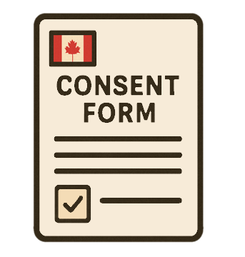
Consent
When the individuals authorizes it, institutions can make:
indirect collections of personal information used for an administrative purpose
Obtain consent for:
new uses or disclosures that are not consistent with the purposes the personal information was originally obtained for
disposals of personal information before the two-year minimum retention standard unless such disposal is expressly authorized by legislation
Consent is not required if the indirect collection, use or disclosure was made under subsection 8(2) of the Privacy Act, such as complying with a subpoena
The Directive on Privacy Practices outlines the mandatory elements for consent
Consult your PMT when developing or updating a consent statement.
Notes:
Indirect collection: The collection of personal information from a source other than the individual to whom the information relates. Source: Privacy Practices, Directive on
Administrative purpose (fins administratives): Is the use of personal information about an individual “in a decision-making process that directly affects that individual” (section 3). This includes all uses of personal information for confirming identity (i.e. authentication and verification purposes) and for determining eligibility of individuals for government programs. Source: Privacy Protection, Policy on

Slide 64
Accuracy
Personal information, used for an administrative purpose, must be as accurate, up to date and complete as possible
When an individual requests a correction to their personal information, institutions must make the correction or add a notation about the request to correct, when that information is used in administrative processes.
Institutions must take reasonable steps to ensure that personal information used in a decision-making process is accurate. Examples of measures include​:
collecting personal information directly from the individual the information belongs to
where appropriate to collect personal information indirectly, collecting from reliable sources
verifying or validating the accuracy of the personal information before it is used
documenting how personal information is verified or validated
using safeguards to prevent data from being compromised by malicious actors or user errors during storage, use and disclosure of personal information
Notes:
Direct collection: The collection of personal information from the individual to whom the information relates. Source: Privacy Practices, Directive on
Personal information is collected directly from the individual that the information relates to unless:
the individual has been notified of the collection and has authorized the indirect collection or,
the information was disclosed to the program in accordance to subsection 8(2) of the Privacy Act or,
direct collection would result in the collection of inaccurate information or,
direct collection would defeat the purpose of the collection or,
direct collection would prejudice the use for which information is collected.

Slide 65

Safeguards
Personal information must be protected by safeguards appropriate to the sensitivity of the information.
If you handle personal information, you must protect it from inappropriate access, use or disclosure:
use administrative, physical and technical safeguards to protect personal information at all times, including when you store it, when you share it and when you transport it.
consult IT and Security officials for guidance and necessary assessments ​
safeguards should be proportionate to the level of sensitivity of the personal information ​
ensure that methods to monitor, detect and respond to breaches are in place​
Limit access to personal information to individuals with the required level of security screening and who have a need to know to perform their functions or duties for the program or activity​:
use permission settings or create role-based user profiles to limit access​ in electronic repositories
Notes:
Administrative safeguards: Policies, directives, rules, procedures and processes that aim to protect personal information throughout the life cycle of both the information and the program or activity (e.g., institutional security policy, security provisions in a service contract for the destruction of records). Source: Privacy Practices, Directive on
Physical safeguards: The facilities and equipment that are used to protect personal information (e.g., locked storage rooms, locked filing cabinets). Source: Privacy Practices, Directive on
Technical safeguards: Information technology measures that are used to protect the facility, the equipment, and the support system where personal information is recorded and stored (e.g., electronic access control devices, audit controls). Source: Privacy Practices, Directive on
Need to know: A criterion used by the custodian(s) of sensitive information, assets or facilities to establish, prior to disclosure or providing access, that the intended recipient must have access to perform their official duties. Source: Policy on Government Security
It is also important to ensure that information is categorized appropriately for information management security control, according to the Directive on Security Management.

Slide 66
Openness
An institution should make detailed information about its policies and practices relating to the management of personal information publicly and readily available.
Be open, clear and transparent​:
consider informal means of providing access when responding to personal information requests
respond to personal information requests completely, accurately and on time
provide privacy notices ​and seek consent where applicable
support the publication and maintenance of your institution’s Info Source chapter and PIBs
support the development and publication of summaries​ of privacy impact assessments, contracts and information sharing agreements where applicable
Notes:
Privacy impact assessment (évaluation des facteurs relatifs à la vie privée) A process prescribed in policy for identifying, assessing and mitigating privacy risks. Government institutions are to develop and maintain privacy impact assessments for all new or modified programs and activities that involve the use of personal information for an administrative purpose.
Information-sharing agreement (accord d’échange de renseignements) A written record of understanding that outlines the terms and conditions under which personal information is disclosed between parties. An information-sharing agreement is usually employed to facilitate the disclosure of personal information from a federal institution to a public sector entity external to the Crown. An information-sharing agreement may or may not be legally binding.

Slide 67
Individual access and challenging compliance​
Individuals have the right to access and to request a correction of their personal information. Individuals also have the right to complain when an institution does not handle personal information appropriately
Inform individuals of their rights in privacy notices
Upon request, provide individuals with access to their personal information and make corrections to inaccurate information:
organize personal information used for an administrative purpose so that it’s retrievable​
have tools and processes in place to retrieve or correct personal information used for administrative purposes
Resolve informal complaints and comply with investigations from the Office of the Privacy Commissioner (OPC)
Notes:
The Privacy Commissioner of Canada is an agent of Parliament who has the power to investigate complaints, summon witnesses, administer oaths and compel the production of evidence.
The OPC oversees compliance with the Privacy Act .

Slide 68

Privacy by design​
An approach that builds privacy and the protection of personal information into the development of programs and activities from the very beginning
Ensures that privacy is considered throughout the entire life cycle, from design to deployment and beyond
Consult privacy experts as early as possible to integrate privacy early in the planning phase. Waiting can result in redesigns that impact project deadlines and costs
Conduct PIAs and privacy protocols before starting projects to assess privacy risks and to establish mitigation strategies
Notes:
Privacy by design is a principle that promotes proactively embedding privacy into programs and activities, helping institutions meet their obligations under the Privacy Act. Requirements such as PIAs and privacy protocols support and put in practice this principle.

Slide 69

Privacy assessments
Identify, assess, and mitigate potential privacy risks before they happen
Develop or update a PIA when:
an initiative uses or intends to use personal information in a decision-making process that will affect an individual
changing how personal information is, or will be, handled by an initiative that makes decisions that affect individuals, including when contracting out or transferring any part of this initiative
Institutions need to establish and maintain a privacy protocol when initiatives don’t make decisions that impact individuals but still handle personal information
Appendix C of the Directive on Privacy Practices contains the Standard on Privacy Impact Assessment
Consult your PMT to determine whether you need to
conduct a PIA or a privacy protocol
Notes:
Privacy impact assessments (PIA)
A PIA is a policy process to identify, assess, and mitigate potential privacy risks before they happen.
When you need one
Institutions need to develop and update a PIA any time that:
an initiative uses or intends to use personal information to make a decision about an individual, or
there is a substantial change to the way personal information is, or will be, used to make a decision about an individual. This can include your initiative contracting out or transferring any part of the initiative
Privacy tip: Your privacy expert may ask you to answer a few short questions to determine whether you need a PIA.
If your initiative doesn’t make decisions about an individual, but does collect and/or use personal information, consult your privacy experts to determine whether any privacy assessment, such as a privacy protocol, or other deliverables are needed.
[Institutions should tailor this slide to their institution’s process]
General process
reach out to your privacy experts
complete the Privacy Checklist to determine if a PIA is needed
complete the PIA template
your privacy expert will help determine if you need a personal information bank (PIB)
your privacy experts can review your PIA, determine any risks in your plan, and help develop mitigation strategies
if you need a PIB, you should send it for approval with the PIA
get the PIA approved and signed off, as appropriate in your institution, and send a copy to the OPC and TBS
review and implement recommendations from the OPC and TBS
all these steps need to be completed before the launch of the initiative
When to update and review
Your PIA should be continually reviewed and updated any time there are changes to your initiative. Always contact our departmental privacy experts to help you determine which parts of the PIA need updating.

Slide 70
Section 8:
Privacy breaches
Notes:
[Institutions should adapt slide 64 with examples of common breaches and slide 66 – what to do when there is a privacy breach]
Speaking Points:
► Privacy breaches can occur to anyone. The most important thing to do is to report it so that it can be contained and mitigated.
► Please raise your hand if you have:
► been the subject of a private sector privacy breach (credit cards, company mailing lists, etc.)
► been the subject of a breach that occurred in another level of government (school board, hospital, etc.)
► been the subject of a breach at a federal institution (tax records, passports, relocation services, etc.)
► reported a breach at work

Slide 71

Privacy breaches
Improper or unauthorized access to, creation, collection, use, disclosure, retention or disposal of personal information
A violation of sections 4 through 8 of the Privacy Act
Material privacy breaches involve sensitive personal information and could reasonably be expected to cause serious injury or harm to the affected individuals
PMT is required to notify the OPC and TBS within 7 days of determining that a breach is material
Mandatory Procedures for Privacy Breaches are provided in Appendix B of the Directive on Privacy Practices
Refer to the Privacy Breach Management Toolkit and the OPC's Real Risk of Significant Harm Tool

Slide 72

Privacy breach examples
Most commonly reported breaches are accidental disclosures, loss or theft of equipment:
an employee who sends a letter or email containing personal information to the wrong address
the loss or theft of laptops or USB keys containing personal information
resumés included in Outlook calendar invitations that are open to all
phishing or the use of deceptive tactics to trick someone into providing their personal information either directly or by going to a fake website
Some privacy breaches are just as common, but much less visible:
a department collecting personal information without the authority to do so
records containing personal information destroyed before the end of the legal two-year period
employees who consult files containing personal information without having a mandate to do so, even when they have system authorization or a password
forms that do not include a privacy statement
public servants who disclose personal information without appropriate approval from an official with authority

Slide 73
Potential consequences
Employee
Employer loses trust in employee
Affected individual
For the department
Loss of public trust
Repeated incidents can impact employee performance evaluations
could lead to disciplinary measures and/or security investigations
loss of security status or clearance
loss of employment
If a breach was intentional:
Distress
Loss of standing or reputation
Financial loss
Identity theft / fraud
Physical / psychological harm
Loss of reputation
Administrative burden
Financial loss
Media scrutiny
Impact to national interest
Investigation(s) by the OPC
Litigation/lawsuits
Notes:
Breaches happen every day. Most breaches are a result of human error. It’s ok to make mistakes; we’re all human. However, reporting the breach as soon as possible will reduce the potential harm to the affected individuals and to the institution. The privacy policy unit’s role is to help guide you through the privacy breach process and to help make sure that similar breaches don't happen again.
What matters is what you do about it:
What can you do to reduce the risk of harm to affected individuals?
What can you do to prevent a breach from happening again?
What can you do to be proactive and prevent breaches from happening in the first place?

Slide 74
Take action
Immediately contain the breach and protect affected records, systems, emails and websites
Notify your Privacy Management Team (PMT) and your Departmental Security Team if you suspect that a security incident has also occurred
Notify your supervisor as they may need to
notify third parties and affected individuals
assign a program official to coordinate with the PMT throughout the breach management process
Brief your senior management of the situation
Provide the PMT, or assigned coordinator, with all information needed to assess the breach and complete the breach report
The PMT will provide advice and guidance on next steps
Implement mitigation measures recommended by the PMT
Your PMT will finalize the breach report and notify the OPC and TBS in the event of a material breach
Implement prevention measures
Notes:
[Institutions should tailor this slide to their institution’s process, including Directive on Security Management, Appendix I: Standard on Security Event Reporting for reporting requirements]
Containment – The purpose of containment is to stop the dissemination of personal information and to minimize the potential damage of the breach. Examples of measures that could be used to contain the privacy breach:
Remove, move or isolate vulnerable information or records i.e. take all necessary measures to prevent any other unauthorized access or disclosure
Retrieve documents or copies of documents wrongly disclosed or taken by an unauthorized person
Attempt to find lost records or devices
Return documents to their origin or intended recipient
Advise the employee to stop sending emails and correspondence to the wrong address
Ask the recipient to delete any email, correspondence, or related documents received in error

Slide 75
Preventing privacy breaches
Mistakes happen, what matters is learning from them. Each privacy breach is an opportunity to strengthen our practices to prevent them from happening again.
There are two forms of measures to prevent a breach from reoccurring:
Corrective actions to support individuals in understanding what went wrong and how to prevent it in the future. For example:
education, training and awareness
coaching or mentoring
occasionally, disciplinary measures
Changes to internal processes or safeguards to fix gaps identified during the privacy breach. For example:
review guidance, procedures and tools to ensure appropriate privacy practices are included and easily understood
conduct or review PIAs and security assessments
review or terminate contracts or agreements if the breach occurred at a third party
Notes:
[Institutions should tailor this slide to their institution’s process]
Situations that may warrant administrative or disciplinary action include:
failure to implement and maintain security controls for personal information that an individual is responsible for, regardless of whether such action results in a privacy breach
exceeding authorized access to personal information or intentional disclosure of personal information to unauthorized persons
failure to report any known or suspected loss of control or unauthorized disclosure of personal information
for managers and supervisors:
failure to adequately instruct, train or supervise individuals in their responsibilities
failure to take appropriate action pursuant to personal information handling requirements upon discovering a breach
failure to implement and maintain required security controls
failure to prevent a breach from occurring
Examples of corrective actions
disciplinary reprimand (oral or written)
training and education
coaching and/or mentoring
revocation of certain privileges and/or user access to system or records
revocation of security status or clearance
reassignment (transfer or deployment)
suspension
termination
Changes to internal processes and safeguards
Changes to internal processes or safeguards may be required to address shortcomings that put the institution at risk of further privacy breaches.
Such changes are important, particularly when:
the breach assessment uncovers weak points in the OPI’s or institution’s plans and practices
multiple breaches share a similar cause
These may align with the Directive on Security Management, Appendix G: Mandatory Procedures for Security Event Management Control for post-event analysis requirements.
Examples of changes to internal processes and safeguards
reviewing how information is collected
ensuring that employees receive education and training
conducting or reviewing PIAs or security assessments and authorizations
reviewing or terminating contracts or agreements if the breach occurred in a third party
strengthening engagement with privacy officials on the collection, use, disclosure, retention and disposal of personal information
conducting a security audit for both physical and information technology security
implementing encryption
putting in place monitoring and audit trails
conducting an inventory of records that contain personal information
ensuring that records are disposed of in accordance with records disposition authorities and with internal information management policies and procedures
privacy officials considering actions such as:
updating policies and guidance to address legal and policy requirements
reviewing and updating the institution’s plans for addressing privacy breaches
reviewing employee training practices

Slide 76

Questions?
For questions, advice and guidance, please do not hesitate to contact us​ [ENTER CONTACT INFORMATION]
Notes:
Relevant sources from TBS
Access to information and privacy policy, guidance and tools: https://www.canada.ca/en/treasury-board-secretariat/services/access-information-privacy.html

Slide 77
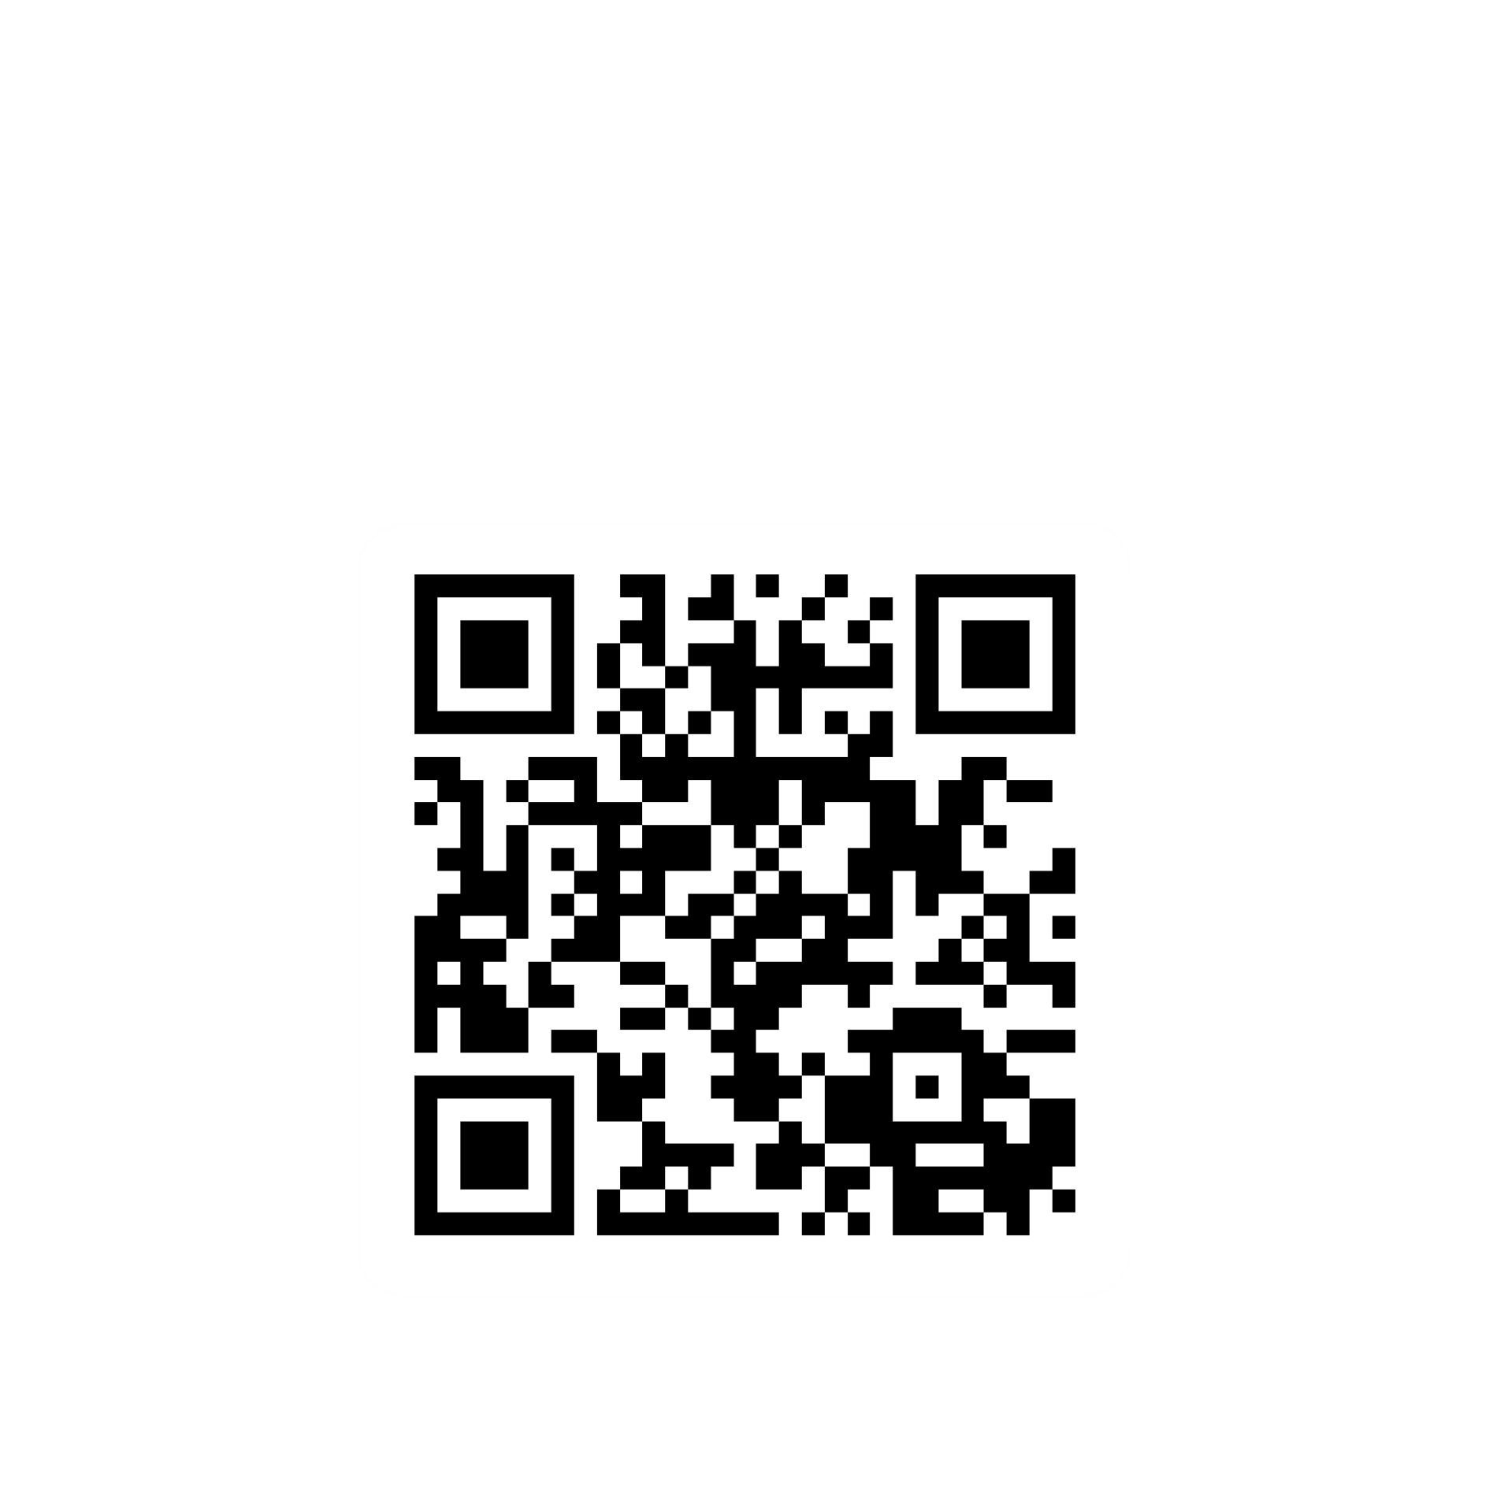
Quiz
This quiz is designed to test your understanding of key ATIP practices. To successfully complete the training, you need to answer at least 80% of the questions correctly.
Take your time, read each question carefully, and select the best answer.
Good luck!
Click here!
[Insert LINK to shape]
Scan code!
[INSERT your QR Code]
Type in browser!
https:// forms…
[Type in your LINK]
Notes:
[Institutions should tailor this slide. The test can be completed using MS Forms or other testing platforms. Use the questions provided in the following slides to create your test]

Slide 78
Quiz (1 of 9)
1. Requirements for the handling of personal information are established in which of the following instruments?
Privacy Act
Policy on Privacy Protection
Directive on Privacy Practices
All of the above
2. Both the ATIA and the Privacy Act are considered what type of laws?
Administrative laws
Criminal laws
Quasi-constitutional laws, which are acts that express fundamental values and generally override other inconsistent laws
Contract laws
Notes:
Answers:
Question 1 – d) All of the above
Question 2 – c) Quasi-constitutional laws, which are acts that express fundamental values and generally override other inconsistent laws.

Slide 79
Quiz (2 of 9)
3. What is the purpose of the ATIA?
To protect the privacy of individuals and their personal information held by government institutions
To enhance the accountability and transparency of government institutions in order to promote an open and democratic society and to enable public debate on the conduct of those institutions
To establish practices and procedures for processing personal information requests
To limit the use of social insurance numbers (SINs) by government institutions
4. If an employee believes that a request for information under the ATIA or the Privacy Act is unclear, what is their initial responsibility?
To make their best interpretation of the request and proceed with locating records
To contact the requester directly to seek clarification without involving the ATIP Office
To contact their OPI's liaison officer or their ATIP Office right away to indicate the lack of clarity
To wait until the deadline approaches before raising concerns about the clarity of the request
Notes:
Answers:
Question 3 – b) To enhance the accountability and transparency of government institutions in order to promote an open and democratic society and to enable public debate on the conduct of those institutions
Question 4 – c) To contact their OPI's liaison officer or their ATIP Office right away to indicate the lack of clarity

Slide 80
Quiz (3 of 9)
5. How long does a government institution generally have to respond to a personal information request?
15 calendar days
30 calendar days
30 business days
90 calendar days
6. True or false: In response to an access to information request, employees are responsible for making every reasonable effort to locate and retrieve all corresponding records according to the letter and the spirit of the request within legislative timelines.
True
False
Notes:
Answers:
Question 5 – b) 30 calendar days
Question 6 – a) True

Slide 81
Quiz (4 of 9)
7. Monica, a manager, received a request under the Access to Information Act (ATIA) asking for records about her program. Which of the following records can be requested under this Act? Select all that apply.
Emails and their attachments
Secret briefing notes
Presentations to the deputy head
Budgets
Text messages
Post-it notes
Handwritten notes and notebooks
Video recordings of meetings
Data exported from a database
An investigation report with personal information
Notes:
Answers:
Question 7 – All the of the above

Slide 82
Quiz (5 of 9)
8. Jonathan is coaching George, a new employee, on how to recognize personal information according to the Privacy Act. He has prepared a list to test George. Can you help him identify what is considered personal information? Select all that apply.
Someone's age
A colleague’s phone number at work
The name and date of birth of a client
The opinion of a colleague on a draft briefing note
The record of decisions of the latest ministerial committee meeting
The salary range of your manager
The Personal Record Identifier (PRI) of an employee
The IP address unique to an individual
The identity of the requester of a personal information request
Aggregated statistical data that is no longer identifiable
Notes:
Answers:
Question 8 – a, c, g, h and i

Slide 83
Quiz (6 of 9)
9. An institution can collect personal information only if:
The institution has legal authority for the program or activity that collects the information
The information relates directly to the institution's programs or activities
The information is demonstrably necessary for the program or activity
All of the above
10. When can personal information be disclosed to third parties without the individual’s consent?
Upon written request from a third party regardless of the purpose
When the information is shared for marketing purposes
When the disclosure is permitted under one of the 13 grounds provided in subsection 8(2) of the Privacy Act
When the information is sold for commercial purposes
Notes:
Answers:
Question 9 - d) All of the above
Question 10 - c) When the disclosure is permitted under one of the 13 grounds provided in subsection 8(2) of the Privacy Act

Slide 84
Quiz (7 of 9)
11. How long must personal information be kept after it has been used for an administrative purpose, that is used to make a decision about an individual?
For a period of 1 year
For a minimum of 2 years, ensuring that the individual has had a reasonable opportunity to exercise their rights under the Privacy Act
No more than 1 month to protect the information from inappropriate access
The information should be kept for ever in case it is ever needed for other purposes
12. What is the purpose of a privacy notice?
To inform individuals why their personal information is being collected
To track data for marketing purposes
To prevent the sharing of information with third parties
To inform individuals of their right to delete their personal information
Notes:
Answers:
Question 11 - b) For a minimum of 2 years, ensuring that the individual has had a reasonable opportunity to exercise their rights under the Privacy Act
Question 12 - a) To inform individuals why their personal information is being collected

Slide 85
Quiz (8 of 9)
13. What safeguards should be used to protect personal information?
Only physical safeguards
Administrative, physical, and technical safeguards
No safeguards are necessary
Only technical safeguards
14. What is “privacy by design”?
Incorporating privacy measures during the implementation phase of a project
Privacy should be considered only after a project has been deployed
A principle that means building privacy and the protection of personal information into the development of programs and activities from the very beginning
Design programs to collect all available data regardless of privacy risks
Notes:
Answers:
Question 13 - b) Administrative, physical, and technical safeguards
Question 14 - c) A principle that means building privacy and the protection of personal information into the development of programs and systems from the very beginning

Slide 86
Quiz (9 of 9)
15. What is the first thing you should do in the event of a privacy breach?
Immediately contain the breach and notify privacy officials
Ignore the breach as nothing will come from it
Pretend it didn’t happen and dispose of any evidence of a mistake
Panic and alert the media
Notes:
Answers:
Question 15 - a) Immediately contain the breach and notify privacy officials

Slide 87
Appendix A: Examples of personal information (1 of 8)
Identifying information
Information that uniquely identifies or can be used to uniquely identify an individual.
Name (full name, nickname)
Usernames & online identifiers (social media handles, profile IDs)
Identification (social insurance number, passport number, driver’s licence, etc.)
Biometric data (fingerprints, retinal scans, facial recognition data)
Picture (photographs, video footage)
Physical characteristics (height, weight, eye colour, skin tone, hair colour, etc.)
Contact information
Details that provide a mechanism for contacting an individual.
Email address
Phone number (mobile, home)
Physical address (home, billing address)
Notes:
[Institutions should tailor this appendix to the personal information it commonly handles – refer to Standard PIBs and Institution specific PIBs]
This list is not exhaustive.

Slide 88
Appendix A (2 of 8)
Demographic information
General information that provides context about an individual’s group affiliation.
Age or age range
Gender identity
Sexual orientation
Ethnicity or race
Nationality or citizenship
Languages spoken
Marital status
Family structure (siblings, children)
Occupation & employment status (except information about a public servant’s position, duties and functions which is not considered personal information for the use and disclosure by government institutions)
Behavioural information
Information that describes an individual’s habits, actions, or behaviours, both online and offline.
Browsing behaviour (web history, search behaviour)
Social media activity (posts, likes, shares, comments)
In-app behaviour (app usage, in-app purchases, interaction patterns)
Purchasing behaviour (shopping habits, frequency, interests)
Location history and geofencing data (when and where a person has been, GPS data)
Interaction data (how and when they engage with content, services, or people)
Behavioural analysis (e.g., tendencies, cognitive patterns)
Notes:
This list is not exhaustive

Slide 89
Appendix A (3 of 8)
Social Information
Information about an individual’s social connections, relationships and social networks.
Friends and social connections (associates, acquaintances, group memberships)
Social network memberships (Facebook, LinkedIn, etc.)
Public life (social status, reputation, and public persona)
Family relationships (spouse, children, parents, extended family)
Family guardianship or caretaker details (who is responsible for their care)
Political affiliations (voting history, political party affiliation)
Professional and educational information
Data related to an individual’s career, education, and professional life.
Employment history (job titles, companies, tenure)
Educational background (schools attended, degrees, certifications)
Professional certifications and licences
Job performance and evaluations (employee reviews, promotions)
References and recommendations
Public professional information (publications, patents, professional projects)
Psychometric profiles (e.g., assessments done for career counselling or personal development)
Notes:
This list is not exhaustive.

Slide 90
Appendix A (4 of 8)
Psychological assessments
Information derived from tests and evaluations designed to measure an individual’s psychological attributes.
Intelligence tests (IQ tests)
Personality assessments (e.g., Myers-Briggs, Big Five, enneagram)
Aptitude tests (e.g., skills and abilities assessments)
Emotional intelligence assessments (e.g., EQ tests)
Life history & family information
Data related to significant life events, personal milestones, family structure, and experiences.
Life milestones (births, deaths, marriages, divorces)
Career changes or achievements (job promotions, starting a business, retirement)
Significant personal events (graduations, relocations, personal decisions)
Family structure (parents, children, siblings, extended family members)
Genealogy and ancestry (family trees, historical family background)
Major family events (e.g., family reunions, inheritance, family-owned businesses)
Cultural or historical events that had an impact on the individual or their family (e.g., wars, migrations)
Family-related milestones (e.g., the birth of a child, marriage, or divorce in the family)
Notes:
This list is not exhaustive.

Slide 91
Appendix A (5 of 8)
Health and medical information
Sensitive data related to an individual’s physical or mental well-being.
Physical health conditions (illnesses, diagnoses)
Mental health evaluations (e.g., emotional stability, stress levels, coping mechanisms)
Mental health conditions (disorders, therapy records)
Medications and prescriptions
Health history (family health history, genetic data)
Test results
Disabilities (physical, intellectual, or sensory)
Financial information
Details about an individual’s economic status, transactions, and financial history.
Bank account information (account numbers, balance)
Credit and debit card numbers
Loan and mortgage information
Transaction history (purchases, sales, withdrawals)
Income and salary
Tax records
Credit score and credit history
Investment data (stocks, bonds, real estate investments)
Notes:
This list is not exhaustive.

Slide 92
Appendix A (6 of 8)
Cultural and religious information
Details about an individual’s cultural background or religious beliefs.
Cultural identity (traditions, heritage)
Religious beliefs and practices (affiliation, rituals, religious observances)
Participation in religious or cultural groups (church, temple, clubs)
Preferences and interests
Information about what an individual likes or dislikes.
Hobbies and leisure activities (sports, reading, arts)
Favourite things (foods, music, books, films)
Travel preferences (preferred destinations, frequency of travel)
Communication preferences (preferred methods and times of contact)
Notes:
This list is not exhaustive.

Slide 93
Appendix A (7 of 8)
Monitoring & tracking information
Data gathered specifically for monitoring an individual’s activities or tracking their whereabouts.
Digital identifiers (IP address, MAC address, browser fingerprint)
Communication logs (emails, messages, voicemails)
Geolocation tracking (GPS data, real-time tracking, geofencing)
Social media tracking (advertising preferences, engagement tracking)
Device and browser fingerprinting
Web behaviour data (clicks, time spent on pages)
Digital footprint
Data collected through an individual’s interactions with digital platforms.
Cookies and web tracking data (site visits, behaviour tracking)
Social media activity (posts, likes, interactions)
Public online records (articles, blogs, professional profiles)
Digital content ownership (content shared, videos, images, blogs)
Search engine activity (search queries, search history)
Notes:
This list is not exhaustive.

Slide 94
Appendix A (8 of 8)
Security and access information
Data related to access control, security measures and systems access.
Login credentials (username, password, PIN)
Security credentials (two-factor authentication, biometric login, access tokens)
Surveillance data (video footage, security camera data)
Access logs (logins, device used, timestamp, locations)
Notes:
This list is not exhaustive.

