Slide 1
Using data to optimize performance Project collaboration between CRA, TBS and Service Canada
FOR DISCUSSION

Slide 2
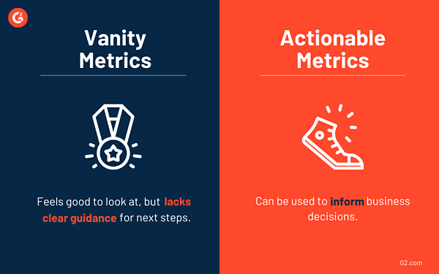
Vanity versus actionable metrics
Number of visits
% of visitors who report success or failure

Slide 3
Performance considerations for web optimization
Over reliance on vanity metrics because they are easy to gather and understand
Vanity metrics do little to help improve information and services
Better integration of data from other channels (call centres and in-person)
Moving to actionable metrics means addressing the following issues:
Developing a more complete picture of user behaviours and points of failure
Increasing the level of automation for unstructured feedback
Increasing awareness and understanding of performance metrics eg. Click-through rates (CTRs) on top search terms

Slide 4
Data driven optimization of digital content and services
Help product owners continually improve information and services by providing actionable insights
Significant changes in behaviour
Self-service failures
Evolving mental models
Reported issues and failures
Build richer insights by continuously integrating data from additional sources:
Adobe, Google or other analytics platforms
Page success widget
Google Search Console
Task success exit survey
Call centres
Task performance testing (Moderated and unmoderated)
Streamline performance reporting
Reduce performance reporting overhead and effort
Improve access for product teams across the GC

Slide 5
Building a more complete picture of user behaviour
Web analytics (navigation)
Relevance of key links
Failures through off-ramps - next page click to contact or search
Search (navigation)
Relevancy - relevant result appears in first 3 results on SERP page
Intent - Words or phrases used
Failures - Low click-through rates
Reported problems
Couldn’t find
Content gaps
Content not understandable
Reported task success or failure
Unmoderated and moderated task performance testing
Basic
Insights
Rich

Slide 6
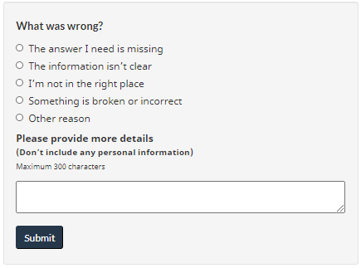
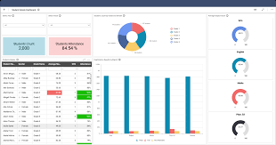
Performance measurement concept
Page and search analytics
Page feedback - widget and survey
Open source front-end and project
Common code base for shared elements of solution
Data store
Performance front-end
Google search data
or
Call centre data
Departmental data
Larger departments can implement:
Reporting customizations
Additional departmental data
Task performance data

Slide 7
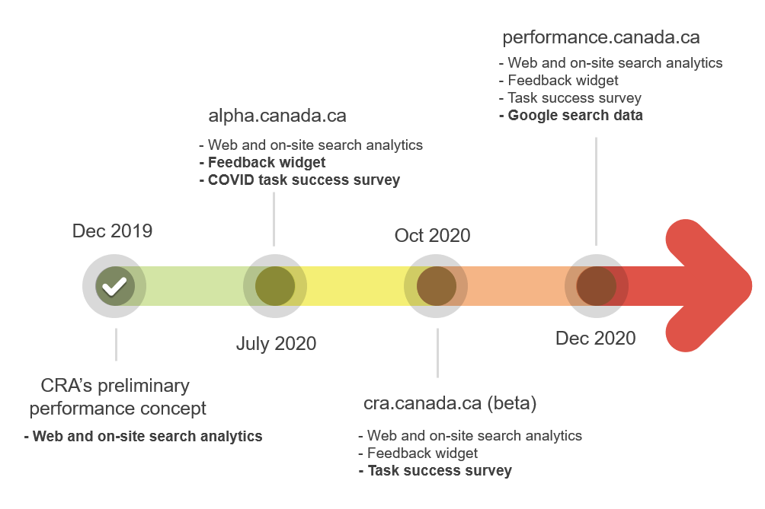
Proposed plan and timeline

Slide 8
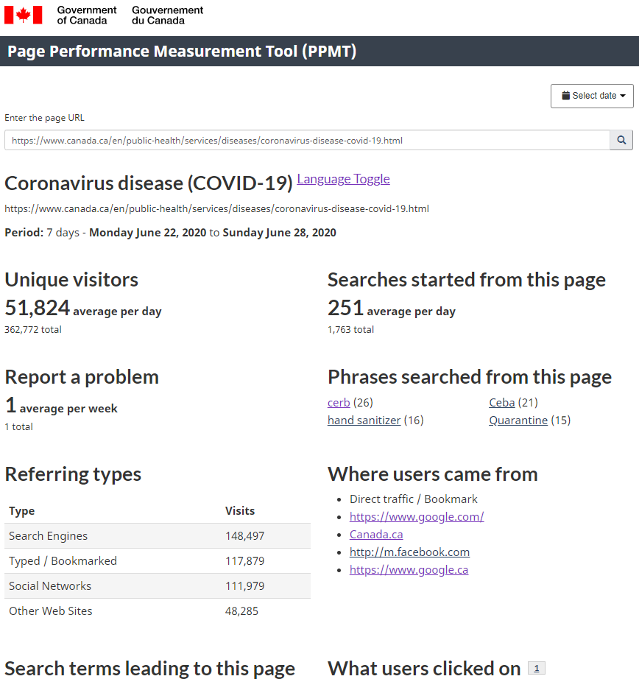
CRA’s web and search analytic concept
Focused on data that helps improve digital self-service: - Is there significant off-ramping to contact pages or to search? - Do searches phrases suggest poor information scent? - Is this page receiving a higher % of mobile usage

Slide 9
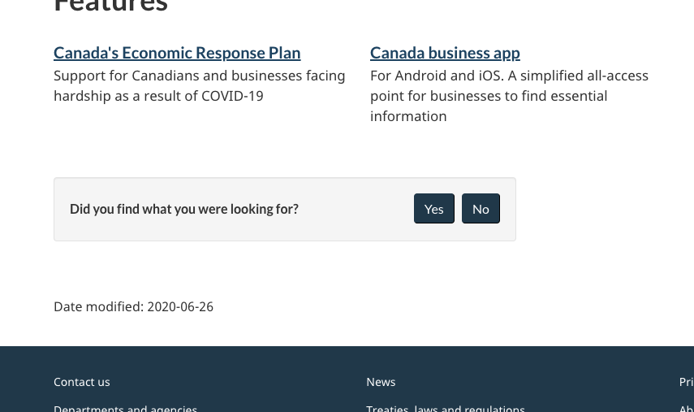
Page feedback widget
Added to key pages in partnership with responsible departments
Asks: “Did you find what you were looking for” Answers: Yes, No - and why not
Metrics trackable across time and pages
“Why not” comment data processed manually and automatically (PII, sentiment, category)
Working on easier processing for web teams and programs

Slide 10
Notional plan 1-4 months
Complete alpha (performance.tbs.alpha.canada.ca) to support COVID
Objective: Validate preliminary concept
Date scope: Adobe Analytics (AA), page feedback data, COVID task success survey
Page scope: Top COVID pages
Users: Available to health, business, travel and tracking leads for COVID
Beta (performance.cra.alpha.canada.ca or cra.canada.ca)
Objective: Confirm that the solution can scale
Data scope: AA, page feedback & Google
Reporting scope: Service lines
Page scope: All CRA pages
Users: CRA

Slide 11
Questions?

