Slide 1
COVID-19 Communication in 11 Official Languages
August 17th, 2020

Slide 2
Regional Context – Northwest Territories
33 communities spread over 1.3 million kms
12 communities are fly-in only
Digital infrastructure: speed + cost vary
Literacy levels: 70% of indigenous adults are below IALSS level 3 (international functional literacy standard) in English

Slide 3
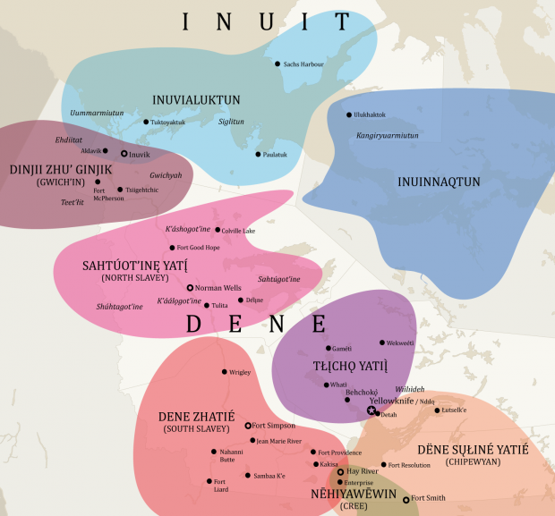
Languages
11 Official Languages
  English
  French
  Chipewyan/Dené
  Cree
  Gwich’in
  North Slavey
  South Slavey
  Tłįchǫ
  Inuktitut
  Inuinnaqtun
  Inuvialuktun

Slide 4
Language challenges
Oral vs. Written/Read
  Most who speak Indigenous languages cannot read/write them
Glyphs/Unicode Support
  Our websites do not support Inuktitut/ Tłįchǫ Unicode fonts
Digital Literacy/Limitations
  Elders/Communities have limited access to digital hardware/platforms
Translation Timing/Access
  Access to translators is limited, turn around time varies

Slide 5
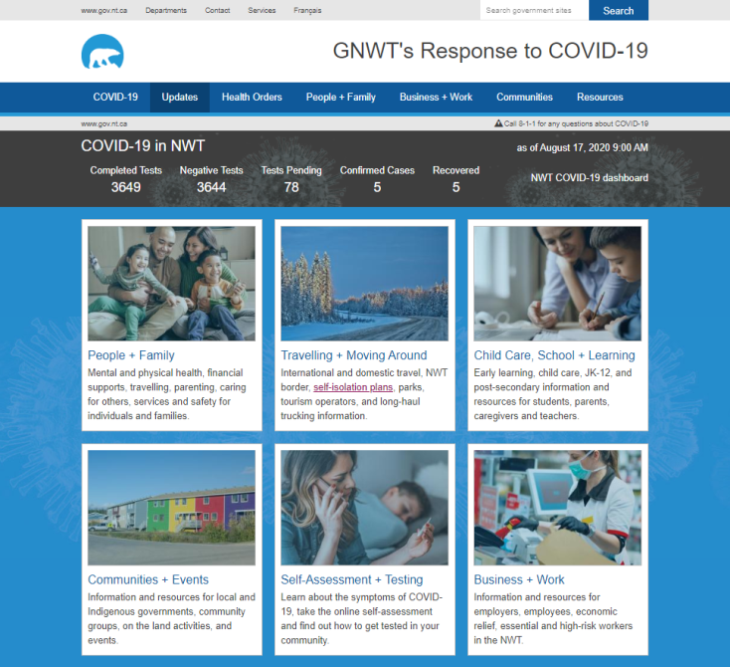
Distribution Channels
Leveraging existing structures
  Government Services Officers (GSO’s)
  Community Health Representatives (CHR’s)
  Community + Indigenous Governments
  Community Radio
  Social Media
  Print Media
Building new structures
  COVID-19 Website
  ‘Community Kits’ (Google Drive)

Slide 6
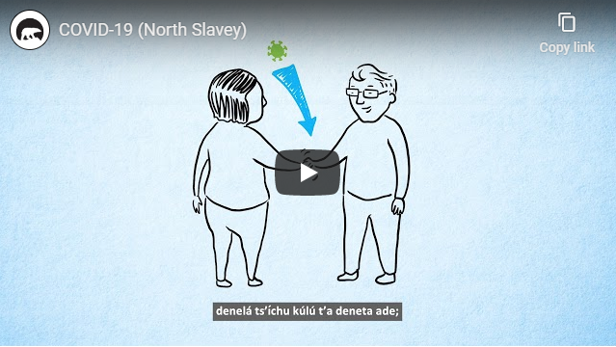
Traditional + New Media
Tactics
  COVID-19 Website (Daily)
  Radio Broadcasts (Daily/Weekly)
  Audio Files (Download/Streaming)
  Shareable PSA Videos (Social/Web)
  CPHO/Premier Video Broadcasts (Social)
  Fact Sheets (Download/Printable/Shareable)
  Paid/Organic Social (Bi-weekly Ad Updates + Engaging Community)

Slide 7
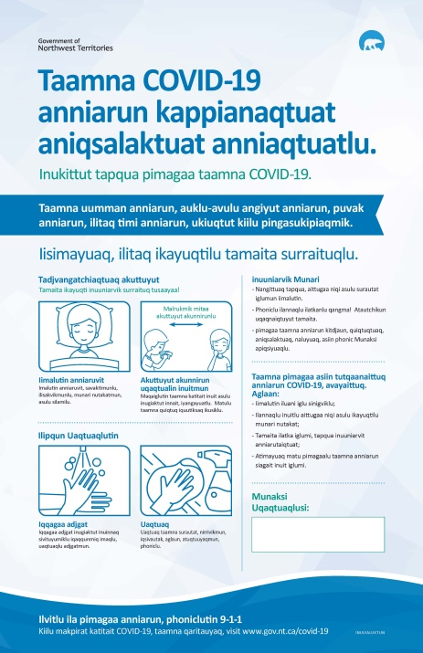
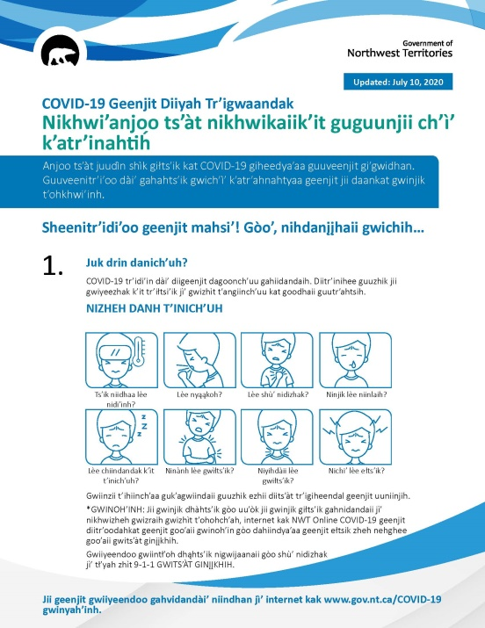
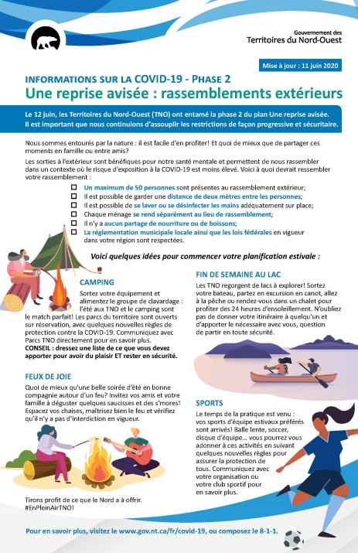
Traditional Media

Slide 8


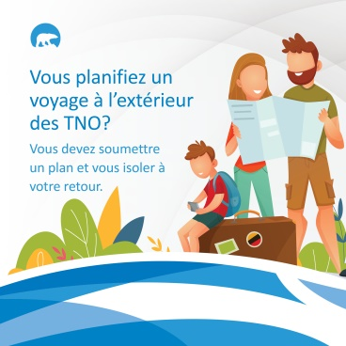
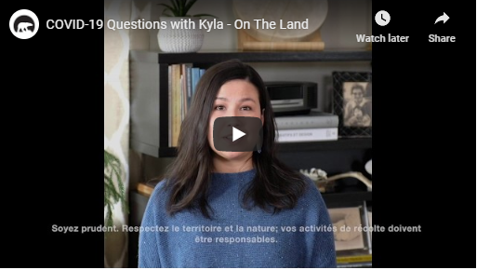
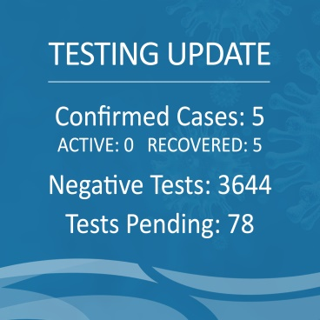
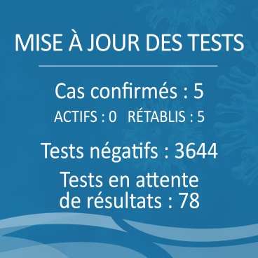
New Media

Slide 9
Lessons Learned
Understanding regional/local context to mitigate assumptions
Leveraging existing platforms and communication structures
Merging traditional and new media : reality of implementation
Active engagement on social platforms

