Slide 1
Workplace Etiquette Posters
A guide for managing change and supporting team members
Date : June 2023

Slide 2
How to use this document
* The French version of this document is available here : FR version
The Workplace Etiquette posters included in the Employee Toolkit are intended to be used in conjunction with the Community Norms for the Workplace included in Activity 2.4
The previously established Community Norms (awareness, respect, courtesy and communication) are the values upon which the Workplace Etiquette posters presented in the CM Program in-a-box are based. The posters were created to provide information to users about the use of certain workpoints offered in the workplace and about the use of the different zones proposed. The elements conveyed on each of the posters influence the adoption of certain habits in order to create a friendly work environment based on community norms. The posters offered in the CM Program in-a-box were largely inspired by etiquettes previously implemented in other organizations. While we encourage employee engagement in the creation of workplace etiquette to support adoption and personalization, we are aware that the very tight timelines of the projects delivered under the Workplace Transformation Program may make such an activity more difficult to organize.
To capitalize on the adoption of workplace etiquette, we recommend the following:
Customize the etiquette posters as needed to reflect some of your organization's unique characteristics
Leverage your existing networks or internal communities to customize the labels
You can use the posters on visual supports such as screens installed throughout your future workplace, as well as on your intranet page. They can also be presented at orientation sessions for new employees.
These posters have been developed for digital use. The colors, format and contrast may not meet accessibility standards if the posters are printed. We recommend that you adapt the posters for print use.

Slide 3
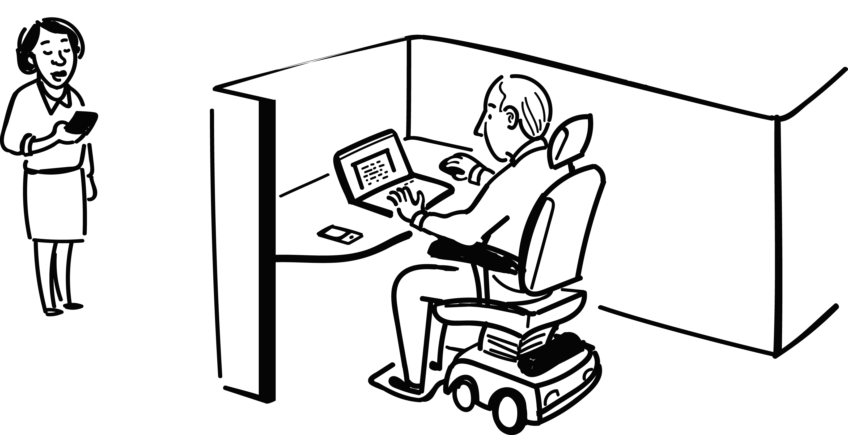
Quiet zone
AWARENESS • RESPECT • COURTESY • COMMUNICATION
*Instant message*
Can I talk to you about the new project?
*Instant message*
Sure, meet you in the lounge in half an hour?
Book your workpoint (if required)
Release your booking if you no longer need it
Help promote focus
Send a chat message to talk to a colleague working in the quiet zone
Mute your devices
Turn off device volume or use vibrate mode
Take it elsewhere
Use appropriate enclosed spaces for discussions, phone calls or virtual meetings
Ask others to tone it down
It is acceptable to politely remind others that this is a quiet zone
Report faulty equipment
If something is not working properly, please report it
Help the planet
Turn off monitors and task lighting when you leave
Tidy up after yourself
Dispose of garbage and clean surfaces with wipes provided

Slide 4
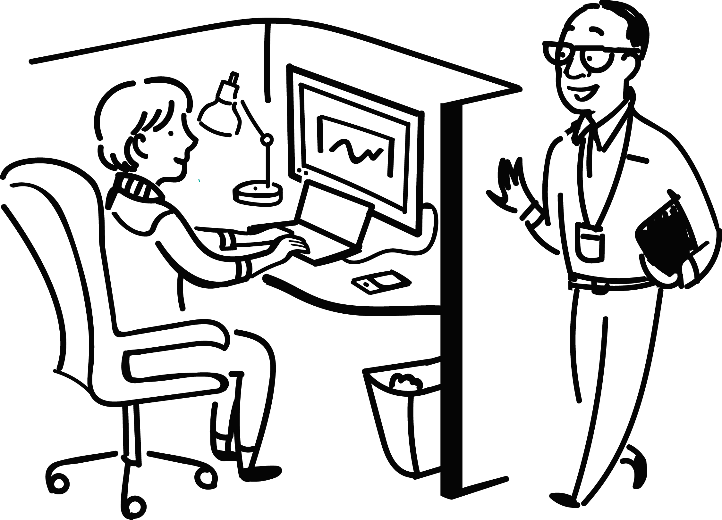
Transition zone
AWARENESS • RESPECT • COURTESY • COMMUNICATION
Book your workpoint (if required)
Release your booking if you no longer need it
Be aware of your noise
Use headphones to listen to music or participate in virtual meetings
Modulate your voice
Be considerate of your colleagues when speaking on the phone or collaborating with a co-worker
Take it elsewhere
Use collaborative spaces or appropriate enclosed spaces when discussions get lengthy
Switch it up
Explore the various workpoints available
Report faulty equipment
If something is not working properly, please report it
Help the planet
Turn off monitors and task lighting when you leave
Tidy up after yourself
Dispose of garbage and clean surfaces with wipes provided

Slide 5
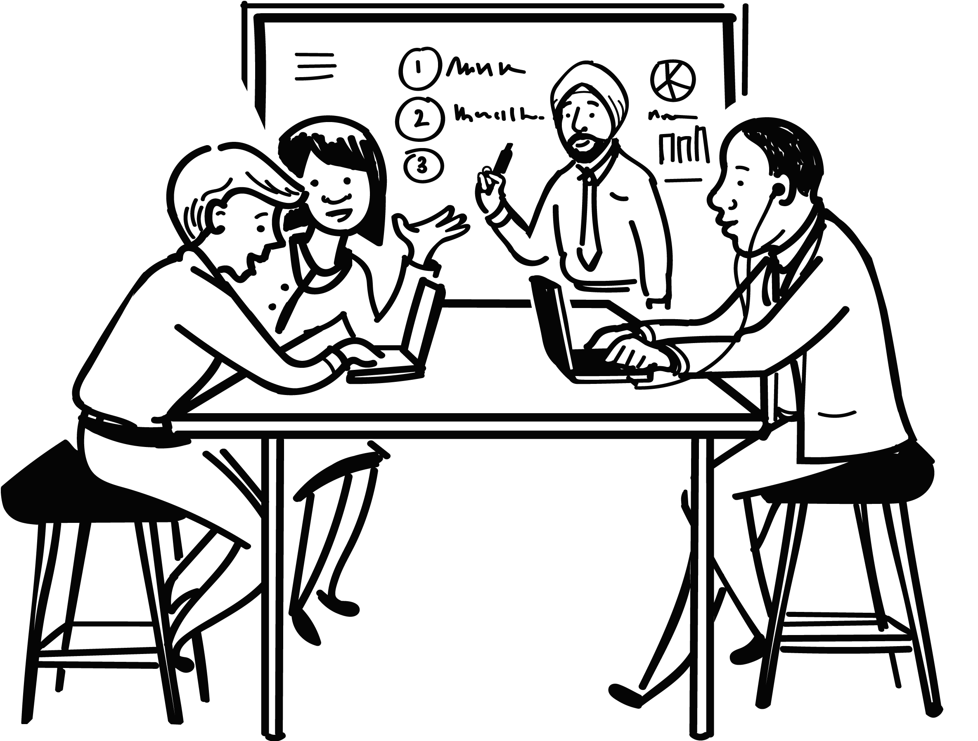
Interactive zone
AWARENESS • RESPECT • COURTESY • COMMUNICATION
Be respectful
Avoid inserting yourself into discussions in open areas near you, unless you are invited to do so
Return to order
Clean white boards and return furniture to original layout
Don’t expect silence
Others around you will be collaborating. If you need to focus, move to a quiet/focus area
Be aware of your noise
Use headphones to listen to music or participate in virtual meetings
Report faulty equipment
If something is not working properly, please report it
Help the planet
Turn off monitors and task lighting when you leave
Tidy up after yourself
Dispose of garbage and clean surfaces with wipes provided

Slide 6
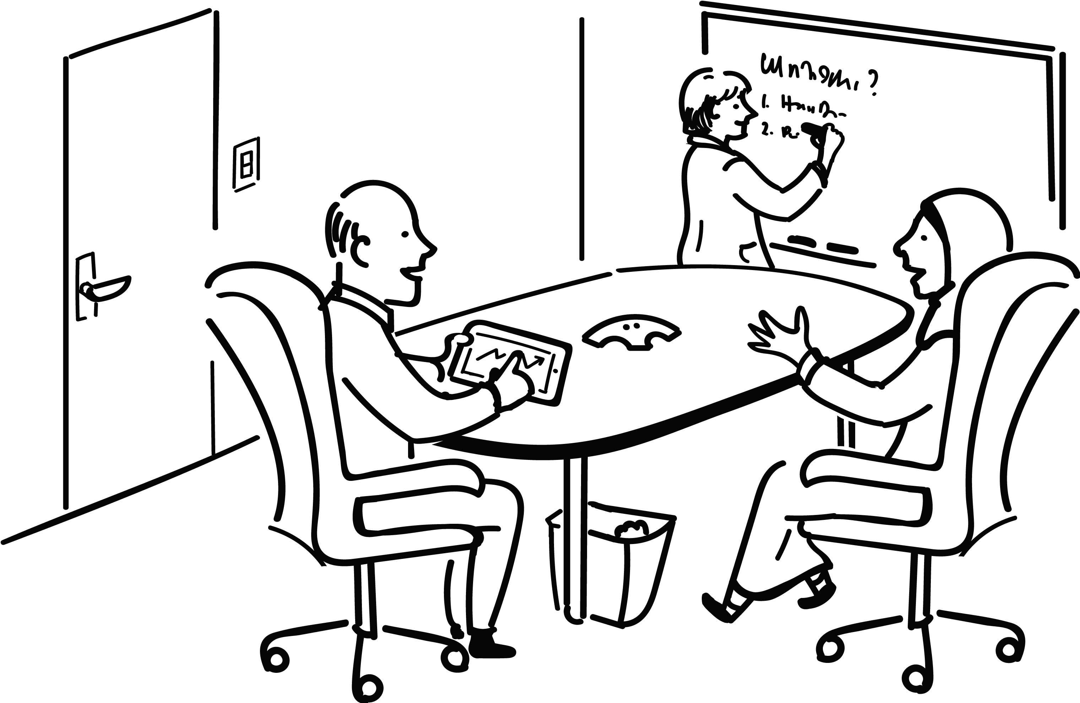
Enclosed spaces
AWARENESS • RESPECT • COURTESY • COMMUNICATION
Book a room (if required)
Release your booking if you no longer need it
Spontaneous use is ok
Check the booking system first
Don’t overstay
Respect scheduled meeting times – wrap it up 5 minutes before the end of your booking
Leave the room ready for others
Clean white boards and return furniture/equipment to original layout
Report faulty equipment
If something is not working properly, please report it
Help the planet
Turn off monitors and task lighting when you leave
Tidy up after yourself
Dispose of garbage and clean surfaces with wipes provided

Slide 7
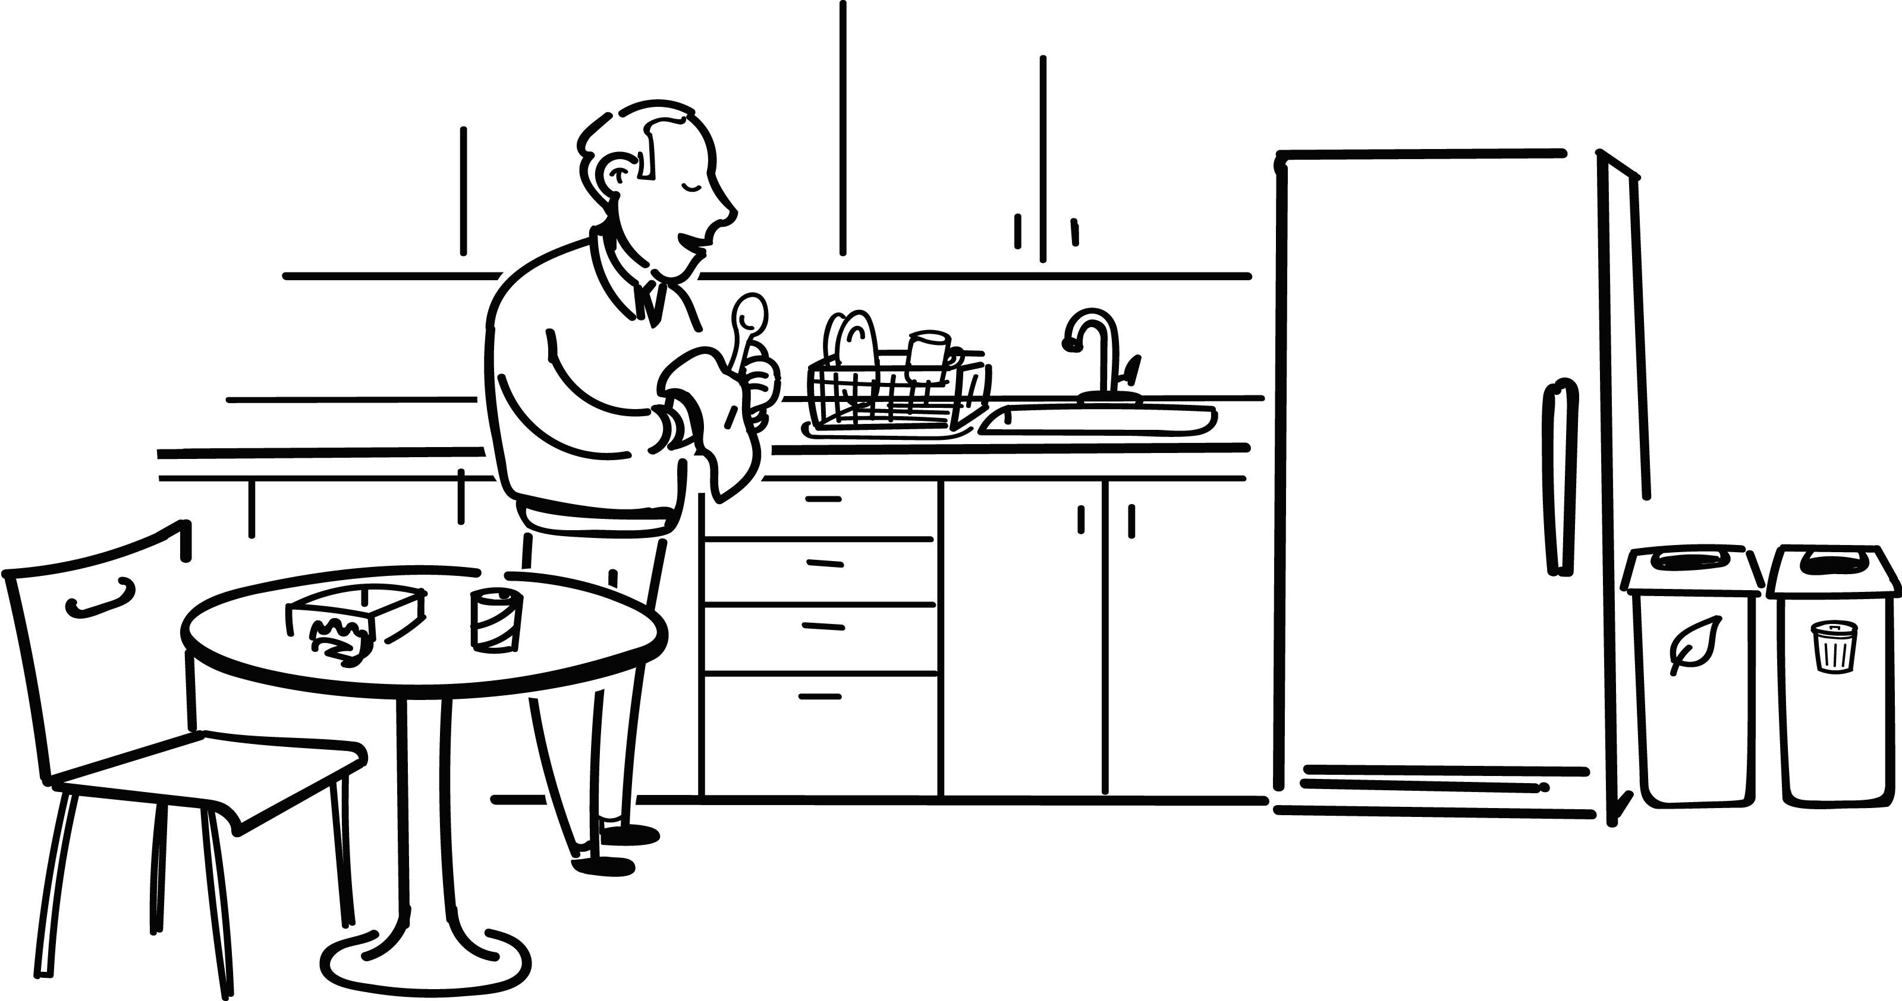
Kitchenette
AWARENESS • RESPECT • COURTESY • COMMUNICATION
Utensils and dishes
Don’t leave dirty utensils and dishes in the sink. Clean and dry what you use and put them back in their place
Shared use of refrigerator
Be mindful of expiry dates of any food you store in the refrigerator
Report faulty equipment
If something is not working properly, please report it
Help the planet
Use recycle and green bins/compost bins where available
Tidy up after yourself
Clean surfaces and appliances after use. Dispose of garbage and take any personal items with you when you leave

Slide 8
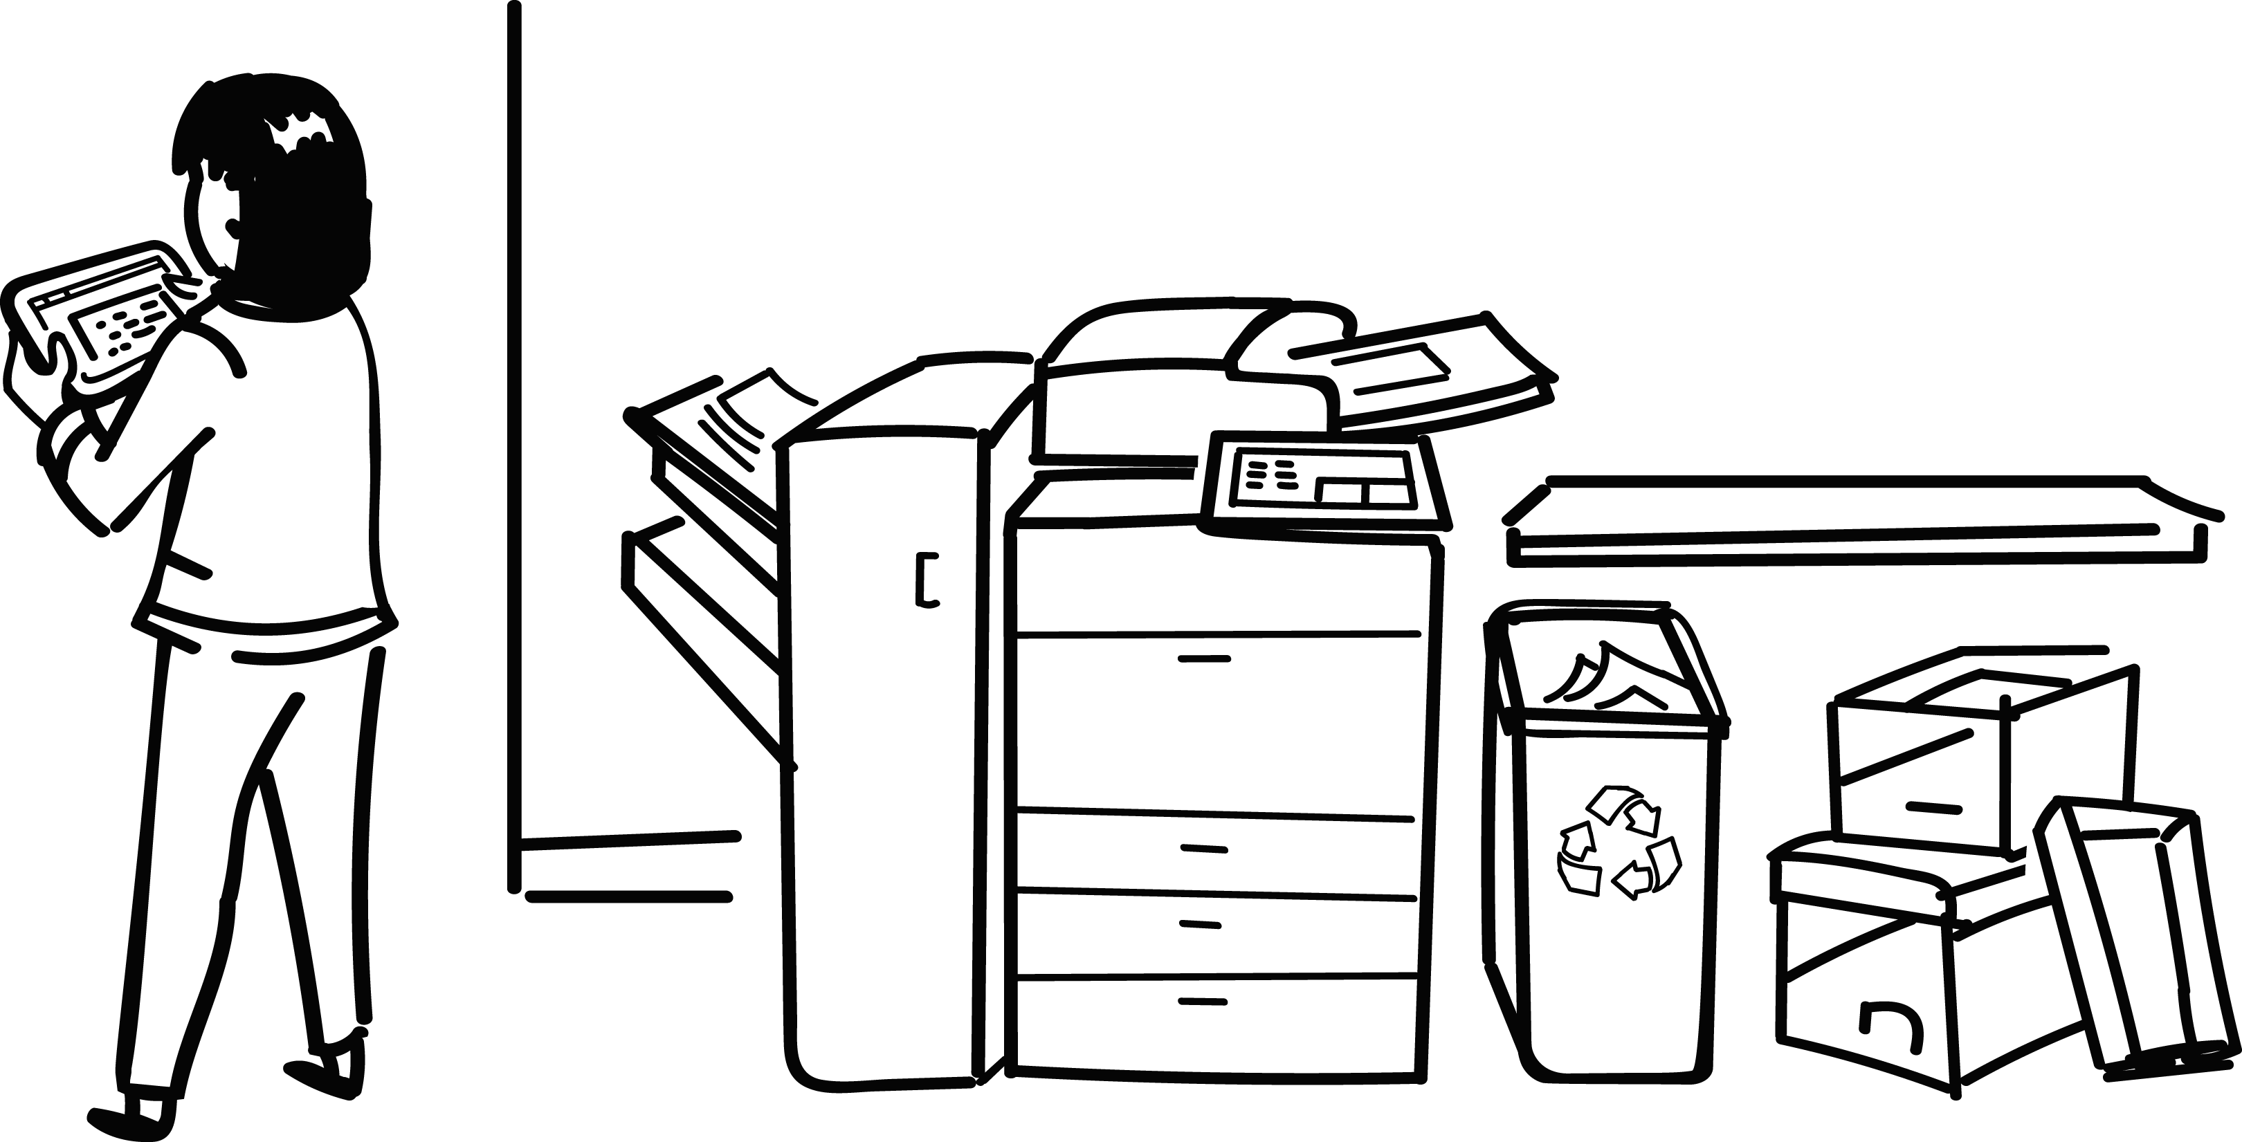
Equipment area
AWARENESS • RESPECT • COURTESY • COMMUNICATION
Think before you print
Try viewing on screen first, print only if necessary
Pick up your documents
Collect documents in a timely fashion
Safety first
Keep area clear of clutter
Think of others
Refill paper trays when empty
Report faulty equipment
If something is not working properly, please report it
Help the planet
Place discarded paper into recycle bins
Tidy up after yourself
Dispose of garbage and clean surfaces with wipes provided

