Slide 1
Best practice Repository (SAP) KPI Catalog (SAP)
Walkthrough – 2023 04 17

Slide 2
Goals & Objectives for Walkthrough
Introduce BPR (SAP) – What it is and How can we use it?
Walkthrough Taxonomy for one example
Introduce KPI Catalog (SAP) – What is it and How can we use it?
Walkthrough one Application Area or Business Line
Can be used outside of SAP
Questions & Answers
Access – Anyone with an OSS ID which is a part of the SAP Maintenance Contract
Tools for Business Blueprinting activities

Slide 3
Best Practice Repository (SAP)
What is it?
A repository of Best Practice Business Process Flows
https://rapid.sap.com/bp/
How can it help us?
General description of process areas
Task Tutorials - Recorded tutorials demonstrating each process
Test Scripts - A procedure for testing (in SAP)
Process Flows – Standard and Editable / Extensible
Integration information
Walkthrough a specific example

Slide 4
SAP’s Best Practice Explorer
This is why to get an
OSS IDs

Slide 5
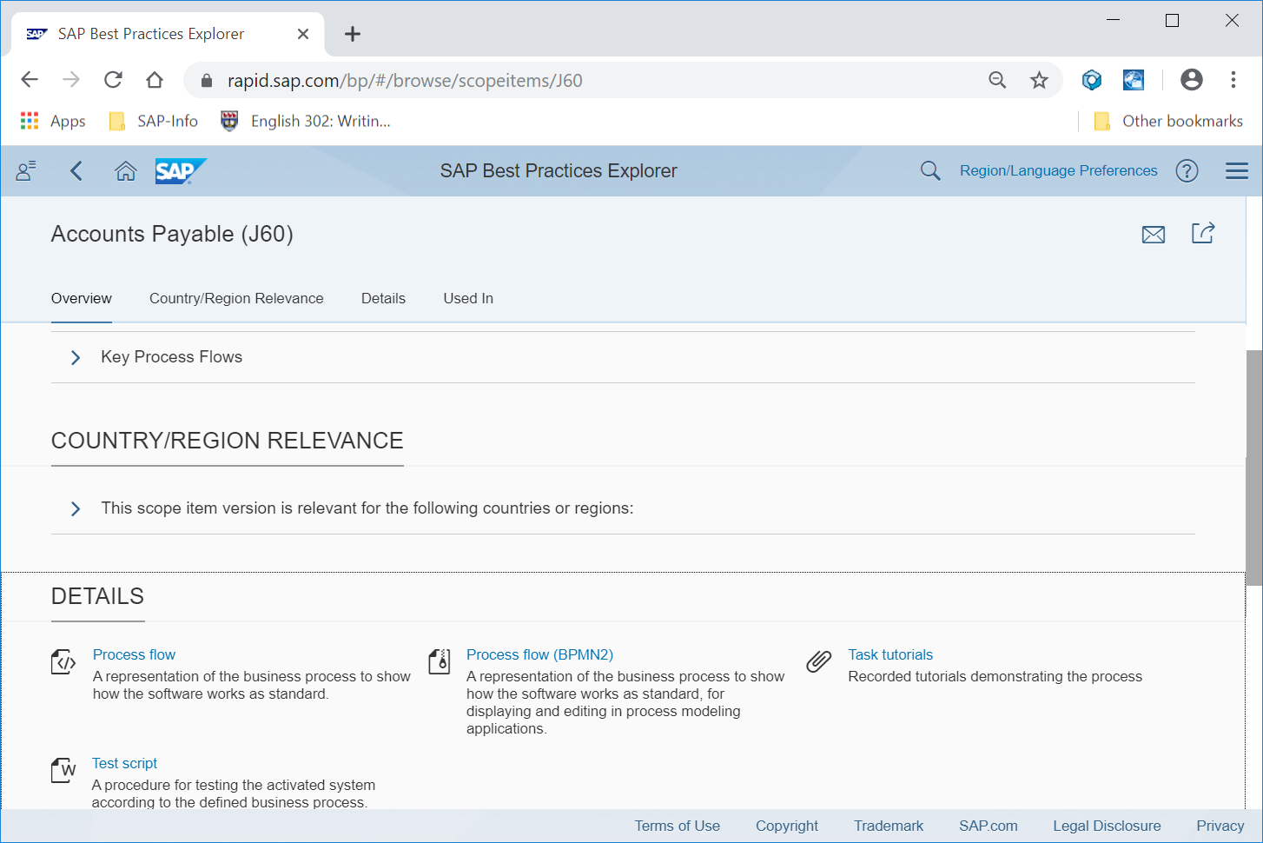
SAP’s Best Practice Explorer Walkthrough – J60

Slide 6
KPI Catalog / Repository
What is it?
A repository of Key Performance Indicators
Welcome to KPI Catalog (sap.com)
How can it help us?
General description of KPIs
Linked to Process Models
Linked to Capabilities
Linked to Roles and Actors
Can be imported / activated in SAP environments
Walkthrough a specific example

Slide 7
What / How of the KPI Catalog

Slide 8
KPI Catalog Walkthrough

Slide 9
Questions & Answers
Access
Anyone with an OSS ID which is a part of the SAP Maintenance Contract
If your organization is using SAP then your email address is the key to an OSS ID
Tools for Business Blueprinting activities inside or outside of SAP

