Slide 1
Cultural Humility: The Great Connector
L’humilité culturelle: le grand connecteur
Nadia Ferrara, PhD
Ombuds
Services aux Autochtones Canada| Indigenous Services Canada

Slide 2
It is through our humility that we experience our humanity.
C'est à travers notre humilité que nous faisons l’expérience de notre humanité.

Slide 3
Humility: Its Origins
Originates from the Latin word humilis (grounded) and humus (earth)
Not about weakness, but about understanding our place in the larger order of things
Involves admitting our shortcomings, and actively seeking to overcome them
A way of being that embraces constant self-correction and self-improvement
Helps us become better learners and problem-solvers, build stronger relationships founded on trust

Slide 4
Ce que l'humilité culturelle n'est pas
Compétence culturelle: suggère que nous pouvons devenir un expert de la culture et des expériences de quelqu'un d'autre, ce qui nous permet de travailler avec eux plus efficacement
Sensibilité culturelle: être conscient des différences culturelles et de la manière dont elles influencent les valeurs, les croyances et les comportements, sans porter de jugement
La sécurité culturelle: repose sur la reconnaissance et la remise en question des déséquilibres et des inégalités de pouvoir. Elle invite à une réflexion critique sur ses croyances, ses préjugés et ses pratiques

Slide 5
Cultural Humility Defined
A lifelong journey of self-reflection, self-evaluation and commitment to understanding and respecting different points of view
Engaging with others humbly, authentically and from a place of learning
A way of being for moving us toward equity
An approach that recognizes the role of power and privilege, as well as the imbalances inherent within systems and organizations

Slide 6
Donner la priorité à l'autoréflexion
Il doit y avoir un processus d'auto-réflexion et d'auto-évaluation continue, en ce qui concerne le travail avec ceux qui sont différents de nous
Il s'agit d'un processus individuel et d'un
processus organisationnel

Slide 7
Self-reflection & evaluation
Self-reflection:
What do I know about…?
Where did that info come from?
What perceptions or beliefs have I attached to my knowledge?
Self-evaluation:
Have I gone to a reliable source for information/insight? What do I believe now?
Have I challenged my source of knowledge? Was any of my information false or ill informed?
Is there new information available? What has changed?

Slide 8
L'humilité culturelle est une voie vers la responsabilité à la fois personnelle et institutionnelle
Cultural humility is a pathway to both personal and institutional accountability

Slide 9
Cultural Humility promotes institutional accountability
We cannot individually commit to self-evaluation and fixing power imbalances without advocating within the larger organizations in which we participate
Our institutions must allow the space to engage in self-reflection and self-evaluation, uncover unconscious biases, and identify and remove structural barriers

Slide 10
Pratiquer l'humilité culturelle via la responsabilité institutionnelle ressemble à…
Engagement envers la diversité et l'inclusion ; identifier les barrières institutionnelles
Reconnaissance des privilèges et des préjugés conscients ou inconscients dans les structures hiérarchiques
Offrir une formation sur les préjugés, l'enquête compatissante, l'empathie, les conversations difficiles et les communications sans jugement
Changement dans les pratiques d'embauche, la composition du personnel
Créer des partenariats avec la communauté locale
Créer des mesures de responsabilisation

Slide 11
Resistance to Practicing Cultural Humility looks like…
Refusal to change/ rigid/ unwilling to learn or connect
Strategic ignorance / upholding biases or myths
Lack of self-reflection, self-awareness or honesty / fear of judgement
Ego or superiority complex/ self-centeredness
Unwillingness to demonstrate vulnerability or admit to a lack of knowledge
Zero consideration for lived experience or specific cultural differences
Refusal to accept accountability / “not my problem” mentality
These views often show up as microaggressions/ bullying/ harassment/ abuse of power

Slide 12
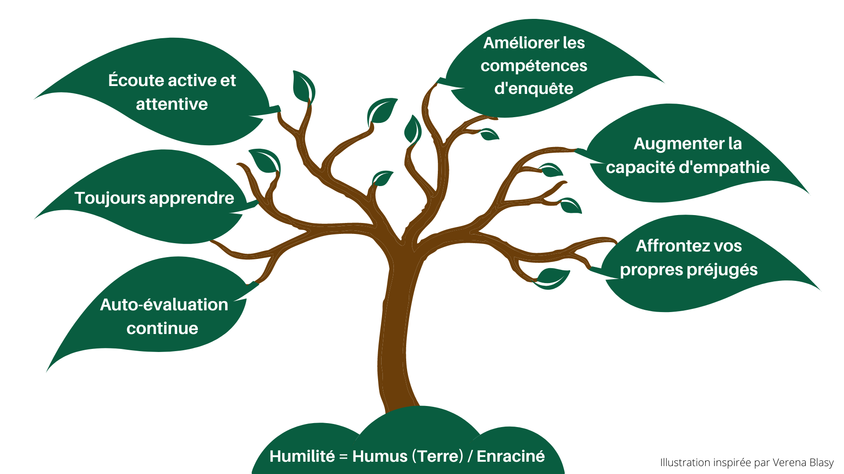
L'humilité culturelle en pratique

Slide 13
Cultural Humility is…
About seeing ourselves, our organizations, the past and the present truthfully, learning from these insights, and using them to do better, and to be better
An ongoing process recognizing the person in front of you is the expert of their lived experiences
The great connector as it leads to meaningful and compassionate change

Slide 14
Les 5 éléments de l’humilité culturelle

Slide 15
The 5 R’s of Cultural Humility

Slide 16
“Embrace your humanity. Employ humility.”
«Embrassez votre humanité. Employez l'humilité.»
- Myrna McCallum

