Slide 1
Subway pattern
Presented by CRA

Slide 2
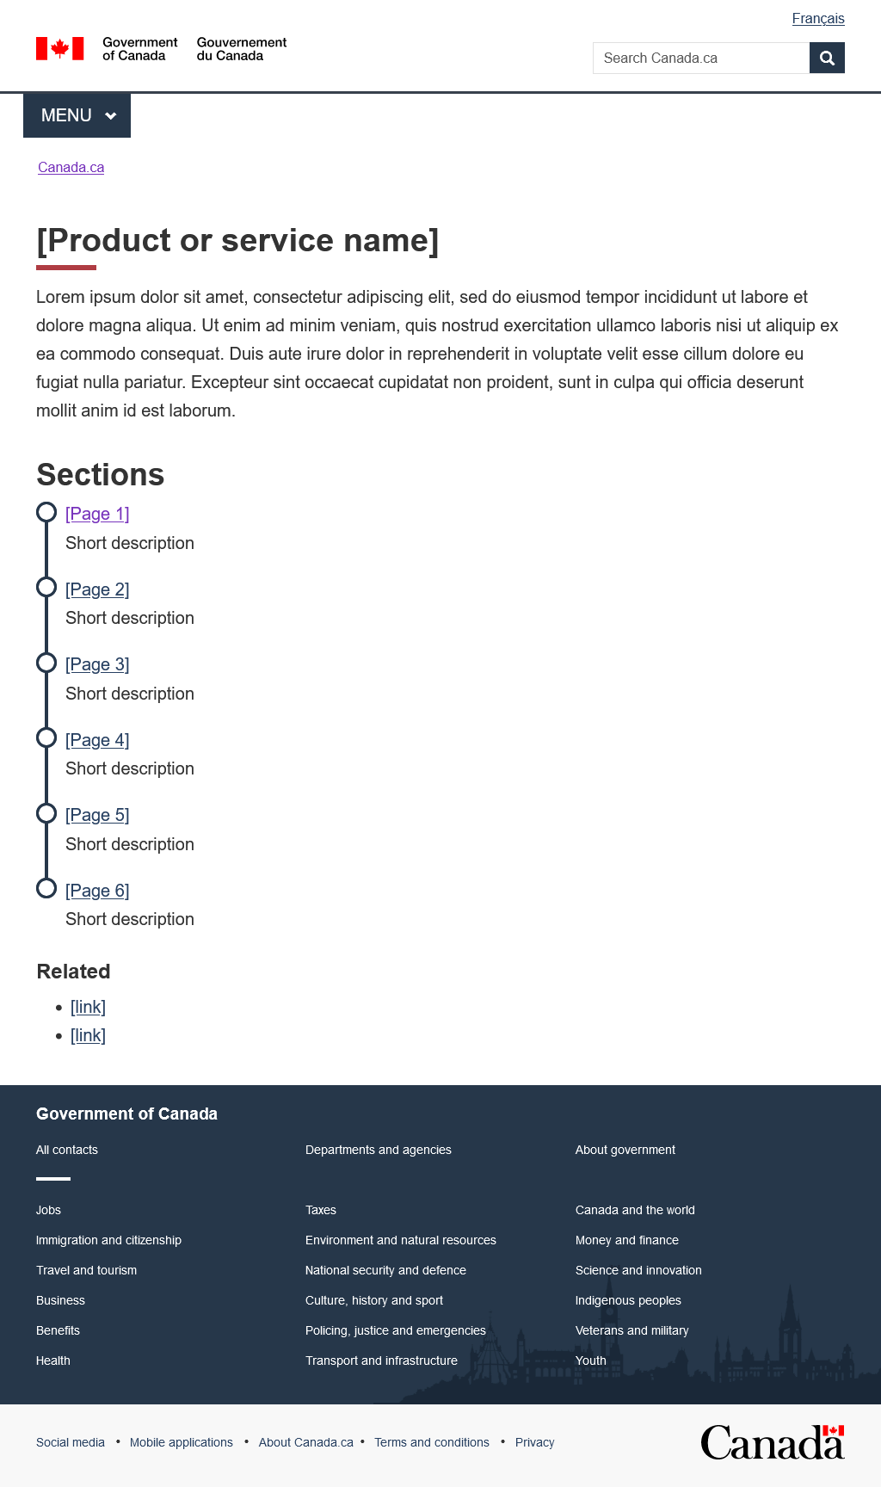
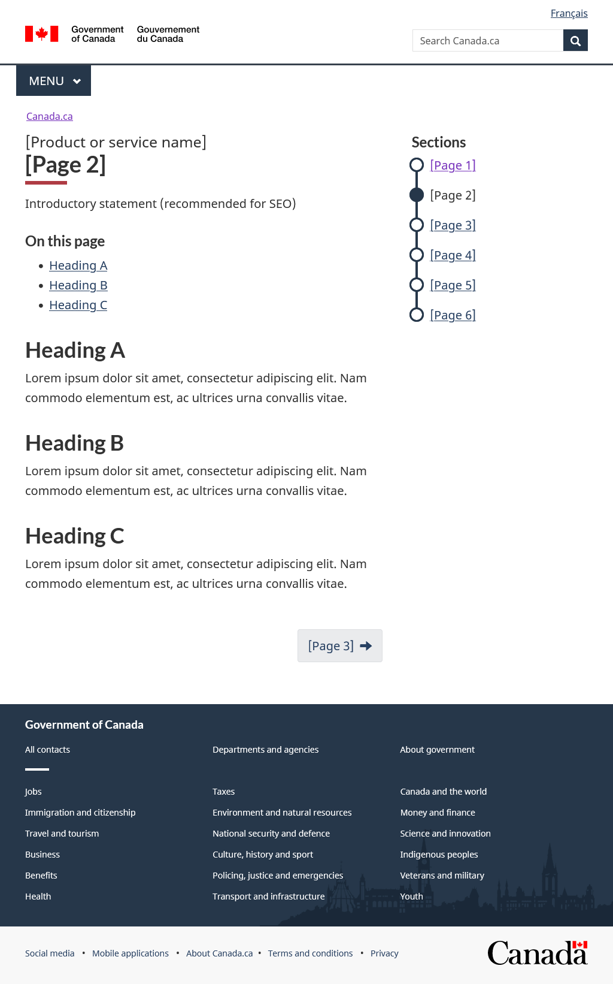
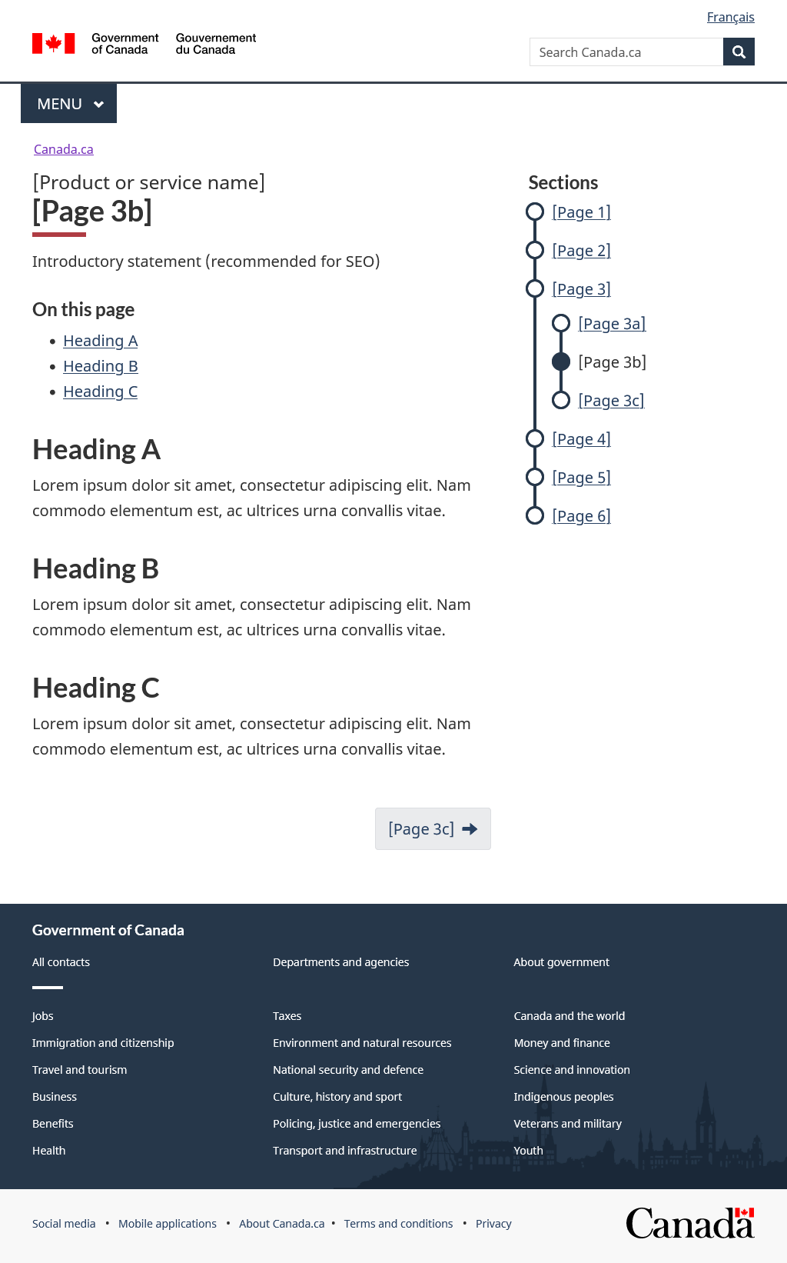
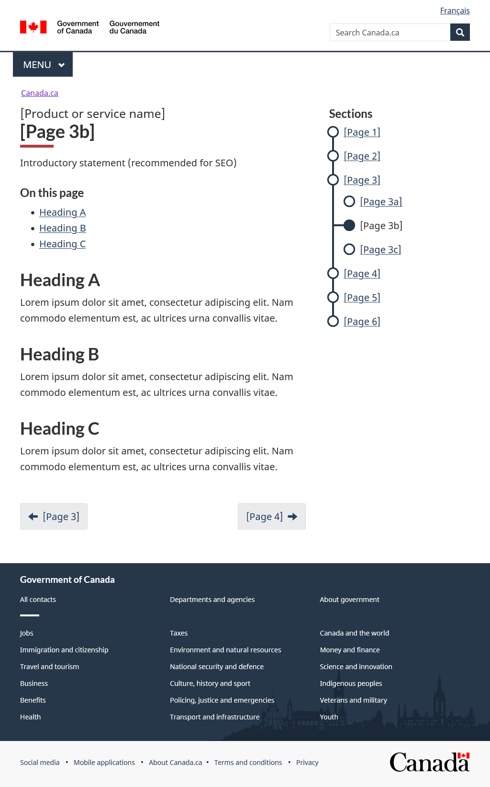
3 page types
Index page (required) Step page (required) Sub-page (experimental)

Slide 3
Mobile-first coding on step page and sub-page
“Sections” appears

Slide 4
The “happy path”
The flow of content should follow a logical progression. It should reflect the user journey and represent a "happy path“
The "happy path" is:
Introduce the product or service
Explain who it's for
Explain what core activity the user has to do
Explain any follow-up activities
Provide contact details (optional)

Slide 5
1. Introduce the product or service
If it's easy to describe
If it's complicated to describe
Introductory statement goes on the index page, above the subway menu
Live examples:
Canada Dental Benefit
Canada Workers Benefit
If the product or service is too complex to reasonably describe on the index page, include a high-level description on the index page and use the first step page in the subway menu to provide more detail.
Recommended wording:
What is the [X]
What are [X]
Live examples:
Disability tax credit (DTC) (index page)
What is the DTC (first step page)
Scientific Research and Experimental Development (SR&ED) tax incentives (index page)
What are SR&ED tax incentives (first step page)

Slide 6
2. Explain who it's for
This is often where eligibility information goes
Recommended wording (choose one):
Who can apply
Who can claim
Who can file
Who is eligible (avoid if possible)
Who must register
Provide extra information. Recommended wording (as needed):
How much you can get
Periods you can apply for
Expenses you can claim
Which of your employees qualify

Slide 7
3. Explain what core activity the user has to do
This page contains the core activity
Prepare for the core activity. Recommended wording (choose one):
Get ready to apply
Get ready to claim
Get ready to file
Get ready to register
Give timelines. Recommended wording (choose one):
When to apply
When to claim
When to file
Provide assistance. Recommended wording:
Calculate your [x]
How to complete the core activity. Recommended wording (choose one):
How to apply
How to claim
How to file
How to register

Slide 8
4. Explain any follow-up activities
Contains the activities that happen after the core activity has been done.
Explain what happens after. Recommended wording (choose one):
After you apply
After you claim
After you file
After you register
Post application tasks or information. Recommended wording (as needed):
Validating your application
Our review and decision
When and how to get your payment
Impact on your [x]
Change or cancel your claim
Change or manage your account
Return a payment
Keep getting your payments

Slide 9
5. Provide contact details (optional)
If there are specific phone numbers or mailing addresses associated with the product or service, it is optional to create a contact page.
Recommended wording:
Contact us

Slide 10
Reminder: 3 page types
Index page (required) Step page (required) Sub-page (experimental)

Slide 11
Index page
H1
Nouns: Likely the name of the product, so already specific
Canada Dental Benefit
Verbs: Huge risk of overlap with other products so be very specific
Vague is bad: Register for an account
Specific is good: Register for a payroll account
Content area
Introduce the product or service
If it’s too big to fit, use the first step page to explain
Navigation menu
Aim for 3-8
Uses doormat desk (link + descriptive text)
Must follow a “happy path”
Breadcrumb
Link to the parent page
Parent page must link back
Supporting links
Ideally avoid
Must link to content that applies to the whole of the product or service
Pagination
None

Slide 12
Index page: Typical mistakes
No index page was created because the content was ported over from a SIP pattern
Vague H1
Missing doormat text
Too many ‘Related’ links

Slide 13
Step page
First H1
Matches index page H1
Second H1
Concise heading
Content area
Adheres to style guide rules and GCWeb styles
Navigation menu
Links only to other pages in the second level of the IA
You can't link to pages outside the subway menu from a subway link
Breadcrumb
Canada.ca > ... > [Parent topic page] > [Index page]
Supporting links
Appear within the content area, in the body of the text at the point of need
Pagination
Forward only
Use the H1 of the landing page as the link text
<title> tag
<title>[Step page] - [Index page] - Canada.ca</title>
You must manually override the default, to include the name of the [Index page]

Slide 14
Step page: Typical mistakes
H1 is too wordy (remember, the index H1 is also there, so there is no need to repeat)
H1 is too action oriented (“Apply” vs “How to apply”)
Links taking the user away from the subway
Showing sub-pages in the IA menu
Displaying a previous pagination button
“Next” button text instead of the name of the landing page

Slide 15
Research
CRA developed with DTO during an optimization project on the Canada Child Benefit, which confirmed it:
Works well on mobile devices
Is an effective way to show the relationship between related pages
Has been further tested on numerous other benefit programs, including the COVID-19 benefits and subsidies
Uses 2 H1headings on the step pages and the sub-pages, as discussed in Service Canada's: Design decision 12 - Double H1 on a single page

