Slide 1
Staffing Redesign Project
Canada Revenue Agency – Human Resources Branch
April 27, 2022

Slide 2
Overview
Our vision
Phase 1 summary – What we heard
Phase 2 summary – 54 ideas
Overview of main implementations and experimentations
Next steps

Slide 3
VISION
“
Making staffing better, together
“
Fast, Fair, Simple
A new approach to staffing that makes people our priority.

Slide 4
Project Summary
PHASE 1 | information gathering
More than
250 internal
and 77 external
consultation sessions across Canada
(2,500+ people were consulted)
Over
1,700 surveys
were completed by employees and managers on client satisfaction and administrative burden
A legislative review determined that 119 of CRA’s 180 staffing rules were self-imposed and not legislatively required
Baseline data was established for time-to-staff, along with staffing process volumetrics
“
What we heard
When asked what the worst thing we could do to staffing would be, managers and employees were unanimous in saying “nothing”
Managers and employees were frustrated as staffing was:
• Too long
• Too complicated
• Too recourse heavy
• Too administrative
”

Slide 5
Project Summary
PHASE 2 | testing and implementing ideas
Research, experiment and implement
Make
recommendations
Project governance
Phase 2
start
Phase 2
end
Implement
first ideas
Measure and
evaluate
Notes:
Project governance
- Set up the governance structure and documents, including an overarching change management strategy.
Implement first ideas
- 9 ideas were implemented in June 2019 with revisions to the Procedures for staffing and Procedures for recourse on staffing.
Research, experiment and implement
- Places the client at the center of solutions, geared towards reducing delays, administrative burden and increasing satisfaction.
Measure and evaluate
- Data was tracked, analyzed and compared to the baseline to measure performance results, success and support evidence based decision making.
Make recommendations
- Based on the results of the SRP, seek approval for recommendations for national implementation of successful experiments.

Slide 6
Implementation
In addition to the changes that took place in June 2019, the SRP implemented other significant changes including:
Reducing the threshold for administrative conversion from five to three years.
Creating a National Mobility Bank to provide employees with greater access to job opportunities and managers with additional staffing methods.
Launching the Non-Advertised Staffing Strategy to promote non-advertised staffing as a valid staffing option for managers when conducted in a consistent and transparent manner.

Slide 7
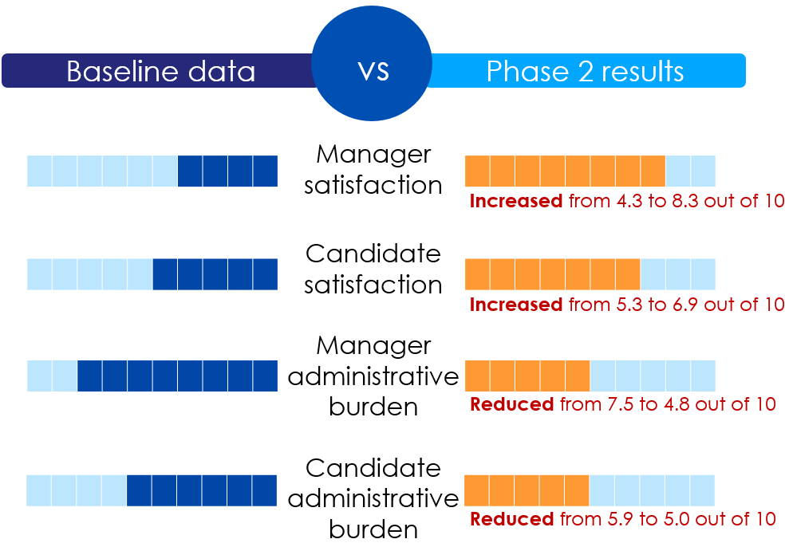
Delivery Model (SDM)
What we achieved
Over 900 hiring managers and 6,000 employees were serviced within four branches and two regions between Nov. 2019 to Sept. 2021.
Compared to the baseline (for external processes), the SDM:
Reduced time to create a pool by 43%
Reduced time to first appointment by 42%
Recommendation:
National implementation

Slide 8
Dedicated Staffing Team (DST)
Level of Satisfaction
What we achieved
29 staffing processes - 19 pools created
Time to create a pool: 82 days (baseline 148 days) 45% reduction
Time to first appointment: 100 days (baseline 199 days) 50% reduction
Manager (with DST)
Baseline
Increased by
81%
Candidate (with DST)
Baseline
Increased by
22%
Administrative Burden
Decreased by
55%
Board members (with DST)
Baseline
Decreased by
15%
Candidate (with DST)
Baseline
Recommendation: National implementation

Slide 9
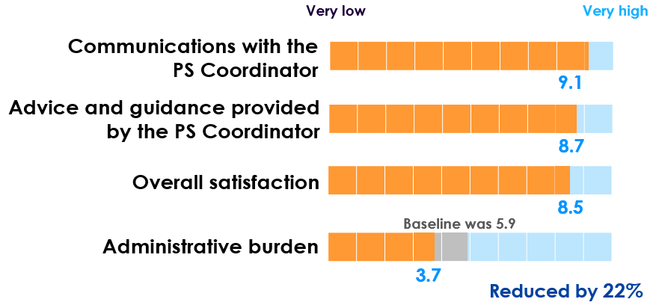
Preferred Status Coordinator
What we achieved
Managers’ level of satisfation with the PSC
The PS Coordinator supported a total of 11 temporary and 30 permanent appointments (compared to 13 placements pre-experiment).
Overall, satisfaction was rated highly at 8.0 out of 10.
Recommendation:
National implementation

Slide 10
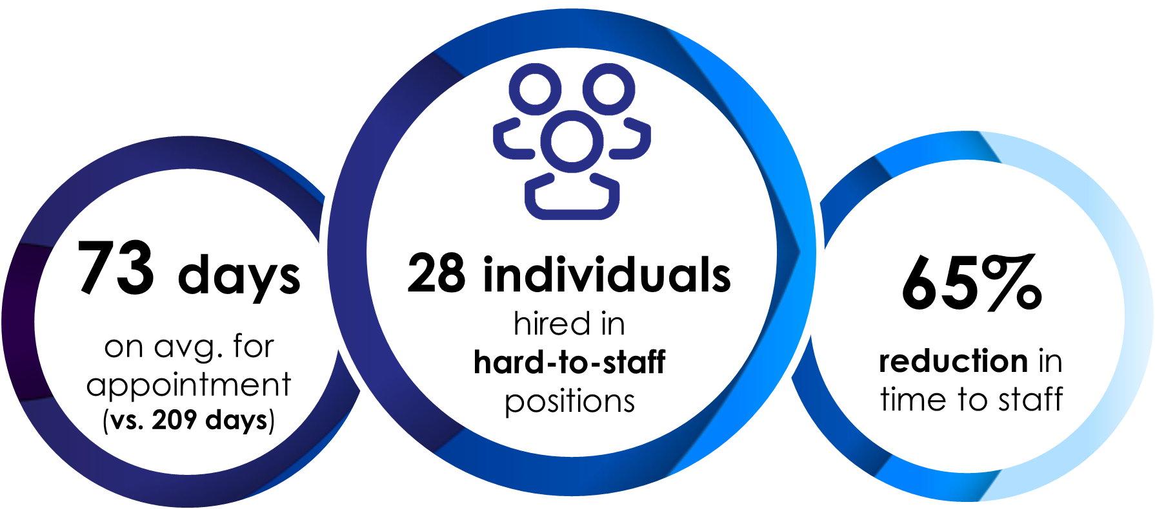
Talent Acquisition Team
What we achieved
One month after appointments
Six months after appointments
Managers reported an extremely high level of satisfaction with the quality of hire: 9.0/10
New employees reported even higher satisfaction with regards to their own suitability and satisfaction with their position at CRA: 9.8/10
Hiring managers and the individuals that were hired rated their level of satisfaction:
Recommendation: National implementation
Notes:
Rework the slide

Slide 11
Other experiments
Strategic Business Partner
Based on the results of a focus group session:
Western Region would like to leverage the SBP for additional regional priorities moving forward.
Atlantic Region SBP was able to bring several HR partners together to work more strategically to service clients and saw improvements in creating more strategic business plans.
Recommendation:
Continue experimentation
Recourse
Recommendation:
Continue experimentation

Slide 12
Conclusion and next steps
This redesign creates economies of scale and efficiencies in delivering quality HR service.
Partner with resourcing CoEs, regions and branches to finalize a 3-year implementation plan
Next steps
Continue offering support towards national implementation, and applying a change management approach

Slide 13
Questions?
STAFFING REDESIGN DIVISION
Making staffing better, together
Fast, fair, simple

