Slide 1



Circle Discussion Guide #5
Confidence: Strengthen Your Mindset for Career and Leadership Success
Notes:
1.7.2013
Welcome everyone to our last Circle session on Self-Compassion and Neuroplasticity.
‹#›

Slide 2
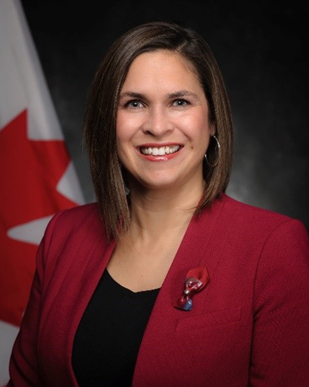



Founders’ Message
“Thank you” doesn’t feel like enough to describe how happy we are, for you to have made the commitment to join the Lifting as you Lead Mentoring Circles program 5th Cohort, organized by the Diversity and Inclusion Office, Materiel Group, National Defence. Open to all Federal Public Service and military members. You're now part of a diverse network of 1500+ inclusive-minded leaders from over 60 Government of Canada departments, Crown corporations and agencies learning together to apply inclusive leadership skills in real time.
What began as a simple idea from our consultations has matured into a thriving network, addressing the desire for meaningful connection and professional growth.
There’s Power in People Coming Together
You have been assigned to a group Mentoring Circle: a small, trusted group for goal achievement in a safe space. By actively engaging with your Circle over the course of the 10-week program, sharing experiences, and fostering connections, you'll unlock personal and professional growth opportunities. This Circle will facilitate learning from others' experiences and diverse perspectives, expanding your knowledge and tactical skills.
LLMC offers a unique opportunity for everyone to feel valued and respected for their contributions. The relationships you build will accelerate progress and drive accountability.
Judith Bennett
Associate Assistant Deputy Minister, Materiel,
National Defence
Samantha Moonsammy
LLMC Founder,
Materiel, National Defence
Notes:
1.7.2013
Here's a message from the program founders if you'd like to take a read through in your Discussion Guide PDFs [first of two slides]
‹#›

Slide 3
Founders’ Message
The Time to Act is Now!
Thank you for answering the call to action, and committing to creating a psychologically safer workplaces for all, especially those from equity-deserving groups. This takes personal accountability for what we do. It is about initiative - and taking that extra step that no one may have asked you to take, but that is often needed to make something a success.
We hope you will feel a real and fundamental shift throughout the program. And together we will celebrate all the hard work you put into this experience. Thank you for showing up for yourself, your family, your organization and the communities you’re called to serve.
Going forward, take advantage of all the networking that will take place, meet new LLMC members in MS Teams and on LinkedIn. Lean into the Masterclasses.
Choose to stay consistent with that next level version of you. We are rooting for you.
Be proud. Proud of the work you do. Proud of serving Canada and Canadians.
Judith Bennett
Associate Assistant Deputy Minister, Materiel,
National Defence
Samantha Moonsammy
LLMC Founder,
Materiel, National Defence
Notes:
1.7.2013
Here's a message from the program founders if you'd like to take a read through in your Discussion Guide PDFs [second of two slides]
‹#›

Slide 4

Circle Ground Rules and Values
Equality: Everyone is an equal member
Substance: Share what's important
Openness: Listen and avoid judgements
Respect: Treat others as they would like to be treated
Notes:
1.7.2013
Let's take a moment to review the Circle Ground Rules and Values:
Equality: Everyone is an equal member
Substance: Share what's important
Openness: Listen and avoid judgements
Respect: Treat others as they would like to be treated
‹#›

Slide 5
Participant Ground Rules and Values
Confidentiality - trust is critical
Bring your full self and beginner’s mindset to each session
Come nourished and stay hydrated
Keep your camera on so everyone feels safe and connected
Be candid and honest - listen with empathy
Be ready to engage with your peers
Remove outside distractions
Keep your audio off, except when asking questions and contributing to the discussion
Be fully present and attend all five weeks - no multitasking
Notes:
1.7.2013
Let's take a moment to review the Participant Ground Rules and Values:
Confidentiality - trust is critical
Bring your full self and beginner’s mindset to each session
Come nourished and stay hydrated
Keep your camera on so everyone feels safe and connected
Be candid and honest - listen with empathy
Be ready to engage with your peers
Remove outside distractions
Keep your audio off, except when asking questions and contributing to the discussion
Be fully present and attend all five weeks - no multitasking
‹#›

Slide 6

Confidence: Strengthen Your Mindset for Career and Leadership Success
"Confidence is not something you build once and then it’s there forever. Confidence is like a muscle: you need to be practicing confidence-building habits every day to keep that muscle strong.” Louisa Jewell, founder of the Canadian Positive Psychology Association and author of Wire Your Brain for Confidence: The Science of Conquering Self-Doubt “Successful people have fear, successful people have doubts, and successful people have worries. They just don’t let these feelings stop them.” T. Harv Eker Author, author of the book Secrets of the Millionaire Mind
Notes:
Here are some quotes on confidence to get us started:
"Confidence is not something you build once and then it’s there forever. Confidence is like a muscle: you need to be practicing confidence-building habits every day to keep that muscle strong.”
Louisa Jewell, founder of the Canadian Positive Psychology Association and author of Wire Your Brain for Confidence: The Science of Conquering Self-Doubt
“Successful people have fear, successful people have doubts, and successful people have worries. They just don’t let these feelings stop them.”
T. Harv Eker Author, author of the book Secrets of the Millionaire Mind

Slide 7



1. Check-In: Warm up and get going
(10 minutes)
1.1 Welcome
(1 minute)
Confidence is strengthened through action, community, and the belief others place in you.
Bonding Moment Share something you’re proud of– big or small. This can be at work or in your personal life (10 seconds each)
Notes:
Welcome, everyone, to our final Circle session. Today, we’ll work on confidence building. Building up your self-confidence is one of the most effective ways to advance your career, achieve your goals, and help you become the person you want to be. As we close out the LLMC program, this topic brings everything full circle. Over the past months, you’ve explored your leadership identity, built meaningful connections, and supported others in their growth. Now, it’s time to focus on how you carry that learning forward—with confidence. This session is about transforming self-doubt into self-assurance, and recognizing that while self-esteem starts from within, confidence is strengthened through action, community, and the belief others place in you. It’s the perfect way to honour your growth and step boldly into what’s next.

Slide 8


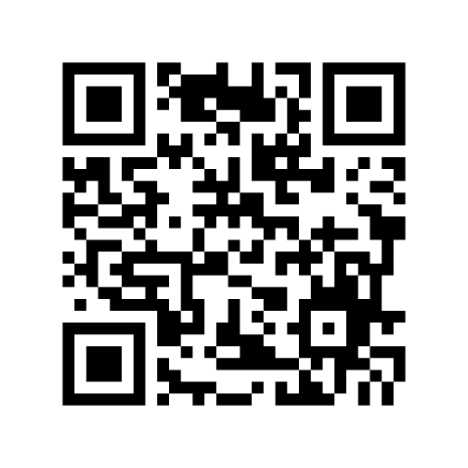
1.2 Your Health Comes First
(1 minute)
Hope for Wellness Helpline
1-855-242-3310
Employee Assistance Program (EAP)
Toll-free: 1-800-268-7708
For persons with hearing impairments:
1-800-567-5803
Notes:
1.7.2013
Before we begin today’s Circle, an important reminder. The intent of these sessions is to have safer conversations about important subjects that will help transform the Federal Public Service by creating diverse and inclusive psychologically safer workplaces. The subjects may be difficult for some people to discuss. If at any point during this session you feel that you need to step away, you may leave the session in order to protect your mental health. There’s also a 5 minute break built in partway through the Circle.
Your health comes first.
If you need to talk to someone, whether before, during, or after a circle, there is support available to you 24/7. Please see the support section at the end of this guide for contact information.
‹#›

Slide 9




1.3 Overview
(2 minutes)
Power Pose
Uses body language to influence how you feel.
Confidence Model
Begins with action—taking a step forward, even when you feel uncertain.
Notes:
Self-esteem comes from within; confidence comes from outside. Confidence is not just about how you speak to others—it’s about how you speak to yourself. Confidence isn’t the same as self-esteem. Self-esteem is your internal foundation: your sense of worth, values, and identity. Confidence is how that inner strength is expressed and reinforced through your actions, your voice, and the recognition you receive from others. It grows when you take risks, speak up, and see the impact of your leadership in real time.
Today, we’ll explore two practical tools to help you continue building confidence in your day-to-day work:
Power Posing
Power posing is a simple yet powerful technique that uses body language to influence how you feel. Open posture—even for just two minutes—can increase feelings of confidence and reduce stress. For example, think of the “super hero” stance: feet grounded, hands on hips, chest lifted. This isn’t about pretending to be someone you’re not: it’s about using your body to send a message to your brain that you are ready, capable, and strong. Power posing is especially helpful before high-stakes conversations, presentations, or moments when you need to project calm and authority.
The Confidence Model
Unlike self-esteem, which is internal, confidence is built from the outside in. The Confidence Model begins with action—taking a step forward, even when you feel uncertain. That action leads to experience, which generates feedback from others and from yourself. Over time, this feedback reinforces your belief in your own abilities, creating a cycle of growth. Confidence doesn’t require perfection: it requires momentum. Each time you speak up, lead a meeting, or support a colleague, you reinforce your own leadership capacity. As the saying goes: “Don’t fake it until you make it—fake it until you become it.”

Slide 10
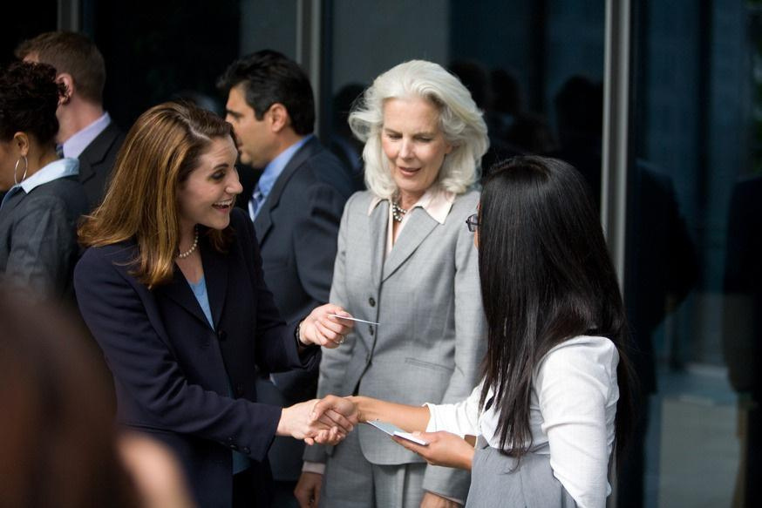
1.5 One Action from the last meeting
(5 minutes)
Instructions: Once you’re warmed up, go around your Circle and have each member share their One Action update from week #4, Diversity, Equity, Inclusion, and Accessibility: A Non-Performative Approach. Your “One Action” is a concrete commitment you made during your previous Circle session. (1 minute per member)
Notes:
Now that we're warmed up, let's go around the Circle and have each of us share our One Action update from week #4: Diversity, Equity, Inclusion, and Accessibility: A Non-Performative Approach. Your One Action is a concrete commitment you made during your previous Circle session.
(1 minute or less per member)

Slide 11
2. Educational Activity: Lean in, get inspired, and add to your toolkit
(30 minutes)
2.1 Everyday Leadership: Leading with Authenticity and Confidence
(20 minutes)
Step 1 – Individual Reflection (3 minutes) Each participant will reflect on the following prompts. They may write brief notes or consider their responses silently: What is one truth you've come to recognize about yourself? What gives me a sense of belonging in my work or community? How do I define confidence in my own words? One intentional way I can create space for my voice—my ideas, values, and perspective—and ensure it is expressed with clarity and confidence in my work or leadership is… | Step 2 – Small Group Discussion (1–2 minutes per person) Invite participants to share any insights they are comfortable discussing. Suggested guiding questions: Which reflection prompt resonated most with you, and why? What does it mean to lead with authenticity in your role? How do you intend to integrate your personal truth and voice into the way you lead each day?
Notes:
Purpose:
This activity invites participants to reflect on what confidence means to them—beyond external expectations—and consider how they can lead with greater authenticity. By identifying a personal truth and exploring how to live in alignment with it, participants strengthen their self-awareness and leadership presence.
Step 1 – Individual Reflection
Each participant will reflect on the following prompts.
They may write brief notes or consider their responses silently:
What is one truth you've come to recognize about yourself?
What gives me a sense of belonging in my work or community?
How do I define confidence in my own words?
One intentional way I can create space for my voice—my ideas, values, and perspective—and ensure it is expressed with clarity and confidence in my work or leadership is…
Step 2 – Small Group Discussion
Invite participants to share any insights they are comfortable discussing.
Suggested guiding questions:
Which reflection prompt resonated most with you, and why?
What does it mean to lead with authenticity in your role?
How do you intend to integrate your personal truth and voice into the way you lead each day?

Slide 12



Your Health Comes First!
Before the next activity, take a 5 minute mind and body
break. Grab some water, use the washroom, stretch—
whatever you need!
Notes:
Before the next activity, take a 5 minute mind & body break. Grab some water, use the washroom, stretch—whatever you need!
We'll be back together in 5 mins.

Slide 13
3. Group Activity: Storytelling and Networking - Share, Learn, and Connect
(40 minutes)
3.1 The Power of Celebration: Compliment Circle
(15 minutes)
Instructions: This is an opportunity for the Circle to practice giving and receiving compliments and celebrating wins. In this exercise, you will celebrate and compliment each other. Begin by writing down something you like or admire about every other person in your Circle. Then, go around the Circle and have everyone compliment a specific person, one by one, until everyone has gotten compliments from everyone else. (5 minutes writing & 10 minute discussion)
Notes:
Welcome back!
Celebrating achievements, no matter how small, plays a huge role in leadership. We acknowledge everyone is a leader at all levels. When we take a leader perspective and create the time to recognize and celebrate accomplishments, it helps to create a positive environment and strengthens resilience in the team.
Everyone at all levels can harness the power of celebration to foster a positive and resilient work environment. For instance, team members can acknowledge each other’s achievements in regular meetings, share a round of applause, or highlight successes during team huddles.
Not only does it acknowledge the hard work and effort of individuals, but it also triggers neuroplasticity—the brain’s ability to adapt and change. This means that when we celebrate, we’re encouraging our brains to reinforce positive patterns and outlooks, helping us to bounce back from setbacks more effectively.
It’s like nurturing a garden where each bloom represents not just a success but a fertile ground for new growth and potential.
A simple ‘thank you’ or a small, informal gathering to celebrate milestones can go a long way in strengthening team bonds and encouraging a growth mindset. By fostering a culture where recognition and celebration are part of the daily routine, everyone contributes to building a positive perspective and enhancing resilience in the workplace.
Instructions: This is an opportunity for the Circle to practice giving and receiving compliments and celebrating wins. In this exercise, you will celebrate and compliment each other.
Begin by writing down something you like or admire about every other person in your Circle. Then, go around the Circle and have everyone compliment a specific person, one by one, until everyone has gotten compliments from everyone else.
(5 minutes writing & 10 minute discussion)

Slide 14
3.2 Self-Reflection & Celebration
(25 minutes)
Instructions: This is an opportunity for the Circle to reflect on and share their learning, gratitude, and celebrations from the LLMC program. Begin by individually reflecting on the prompts below, then share as a group. (5 minutes individual reflection, then 2 minutes per member to share) What are the key lessons you’ve taken from the program? What’s one thing you’ve accomplished in this program? What’s something you’re grateful for as a result of this experience? How should we collectively celebrate our success?
Notes:
As we conclude our journey through the LLMC program, our objective is to celebrate the growth and insights we’ve gained while fostering an inclusive and psychologically safer workplace. By recognizing and appreciating these learnings, we strengthen individual capabilities and reinforce a culture of inclusion, sponsorship, and negotiation. By embracing inclusive leadership, diversity, accessibility, neuroplasticity, and more, we continue to promote a supportive environment where everyone feels valued and empowered.
Instructions: This is an opportunity for the Circle to reflect on and share their learning, gratitude, and celebrations from the LLMC program.
Begin by individually reflecting on the prompts below, then share as a group.
(5 minutes individual reflection, then 2 minutes per member to share)
-What are the key lessons you’ve taken from the program?
-What’s one thing you’ve accomplished in this program?
-What’s something you’re grateful for as a result of this experience?
-How should we collectively celebrate our success?

Slide 15

4. One Action: Apply yourself, pledge to grow, and inspire
others
(10 minutes)
Instructions: Each member declares their One Action commitment for this week. (1 minute per member)
Notes:
Your “One Action” is a concrete commitment you undertake related to the topics discussed during each Circle. The goal of a One Action is to step outside your comfort zone, practise a new skill, or try something new. Examples of one actions for this Circle can be found in the table that follows:
Instructions: Each member declares their One Action commitment for this week.
(1 minute per member)

Slide 16
Confidence | Confidence | One Action
1 | Book a follow-up meeting 1 month from now with your circle. | Check out the Learning Library for some interesting ideas and inspiration.
2 | Share your final thoughts and accomplishments in the LLMC final evaluations. | Check out the Learning Library for some interesting ideas and inspiration.
3 | Continue to implement the new activities from the Intention Plan and LLMC learnings into your everyday life. | Check out the Learning Library for some interesting ideas and inspiration.
4 | Take your learning Beyond the Circle! | Explore the Learning Library Resources at the end of this guide
5 |  | Write down your One Action commitment in the table cell to the left.

Slide 17

5. Wrap-up: What’s next and a few final words
(8 minutes)
LLMC Written Component: Please share your comments by completing the
bi-weekly Written Component forms.
LLMC Lounge: Join this Friday’s LLMC Lounge if you would like to connect and
engage more on this week’s topic. This 60-minute session is facilitated by the LLMC
Program Team at Materiel Group’s Diversity and Inclusion Office (DIO) every Friday.
Notes:
Thank you, everyone, for your active participation in today’s
session on Confidence—and for your commitment throughout the entire Lifting as you Lead Mentoring Circles journey. Over the past 10 weeks, you’ve explored your leadership identity, built
meaningful relationships, and practiced the art of lifting others as you lead. Today’s focus on confidence is a powerful way to close the program, reminding us that leadership is not just about a
title or position—it’s about how you choose to show up, support others, and create impact every day.
Confidence is not a destination; it’s a practice. It grows through action, reflection, and connection. As you move forward, we encourage you to continue applying what you’ve learned—not just for your own growth, but to empower those around you. Share your insights with your colleagues, teams, managers, and networks. Model the tools, language, and mindset you’ve developed. Be the spark that helps others find their voice and step into their own leadership.
Remember: you don’t need to have all the answers to lead with confidence. You simply need to take the next step, speak with intention, and trust in the strength you’ve built. While this program may be coming to a close, the opportunity to lead with purpose, to grow, and to lift others continues—wherever you are in your leadership journey.
Recap: To recap today’s Circle, please review this discussion guide to help you reflect on this Circle session and implement your One Action for navigating change.
LLMC Written Component: Please share your comments by completing the bi-weekly Written Component forms. A link to the form can be found in your calendar. Completion of these forms is one of the commitments you made when you applied. The LLMC Program team relies upon your feedback to continue to grow the program.

Slide 18
This is our final official week of the Lifting as you Lead Mentoring
Circles program. Everyone’s participation in this program is
appreciated and we hope that the experience has been a
positive and motivating one.
As mentioned last week, the conversation should not end with
the conclusion of the official LLMC program. The Diversity and
Inclusion Office (DIO) Team’s vision for all Circle members is to continue
to be inspired by this connection and to continue to grow your network, elevate your knowledge, and inspire others. The DIO team encourages you to continue to use the LLMC program-wide network. The DIO will post some topics and resources for possible future discussions on the LLMC Wiki page, but please feel free to find topics yourselves based upon the interests of the Circle members.
Thank you all for your participation in these Circles!
Be well, and take care.
Notes:
This is our final official week of the Lifting as you Lead Mentoring Circles program. Everyone’s participation in this program is appreciated and we hope that the experience has been a positive and motivating one. As mentioned last week, the conversation should not end with the conclusion of the official LLMC program. The Diversity and Inclusion Office (DIO) Team’s vision for all Circle members is to continue to be inspired by this connection and to continue to grow your network, elevate your knowledge, and inspire others. The DIO team encourages you to continue to use the LLMC program-wide network. The DIO will post some topics and resources for possible future discussions on the LLMC Wiki page, but please feel free to find topics yourselves based upon the interests of the Circle members.
Thank you all for your participation in these Circles! Be well, and take care.

Slide 19


To Do for Next Week & Into the Future
Consult the LLMC Program Overview Wiki
page for all checklist links
Attend the LLMC Lounge at 1:00pm Eastern (optional)
Join the LLMC LinkedIn group
Fill out the Reflection Questions (Discussion Guide PDF)
Check out the LLMC Learning Library
Complete your One Action
Complete your Written Component forms
Make plans to (re)connect with your Circle
Be the change!

Slide 20

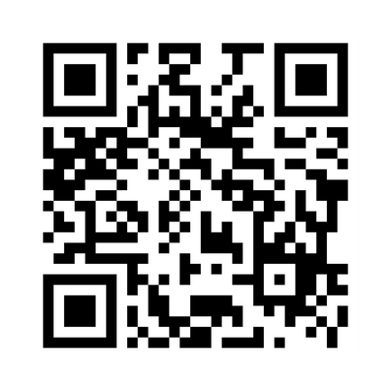
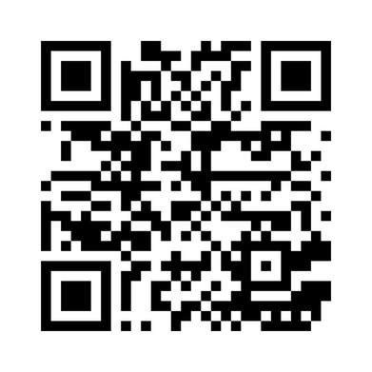
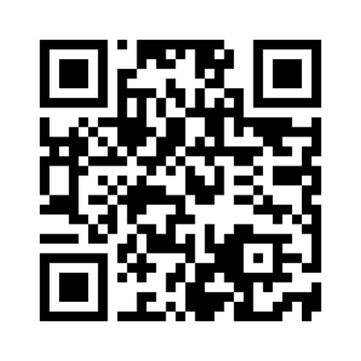
Important Links
Contact us on the LLMC Support Form
Visit the LLMC Learning Library
Join the LLMC LinkedIn Group

Slide 21

Support
Employee Assistance Program (EAP)
EAP provides free short-term counselling for personal or work-related problems as well as crisis
counselling.
Toll-free: 1-800-268-7708
TTY (for people with hearing impairments): 1-800-567-5803
https://www.canada.ca/en/government/publicservice/wellness-inclusion-diversity-public-service/
employee-assistance-program.html#E
Hope for Wellness Helpline
24/7 access to Indigenous Counsellors.
Available in French and English and, upon request, Ojibway, Cree and Inuktituk.
1-855-242-3310
Chat line via: https://www.hopeforwellness.ca/
Member and Family Assistance services (Canadian Armed Forces)
The Member and Family Assistance services is a 24 hour, 7 days a week bilingual telephone and face to face counselling service that is voluntary, confidential, and available to Canadian Armed Forces (CAF) members and their families who have personal concerns that affect their well-being and/or work performance.
https://www.canada.ca/en/department-national-defence/services/benefits-military/health-support/member-family-assistance-services.html

Slide 22

Support
Sexual Misconduct Support and Resource Centre (National Defence)
The Sexual Misconduct Support and Resource Centre (SMSRC) was created by the Department of
National Defence but is independent from the CAF chain of command and is not required to report
incidents of sexual misconduct to the CAF. Support services for CAF members, National Defence public
service employees, Cadets and Junior Canadian Rangers affected by sexual misconduct and their
families, aged 16 and older. Guidance and support for leaders and management on addressing sexual
misconduct.
https://www.canada.ca/en/department-national-defence/services/benefits-military/health-support/sexual-misconduct-response.html
The Canada Suicide Prevention Service
Talk Suicide Canada provides nationwide, 24-hour, bilingual support to anyone who is facing suicide.
Toll-free: 1-833-456-4566.
https://www.crisisservicescanada.ca/en/
Wellness Together Canada
Mental Health and Substance Abuse Support.
Toll free: 1-866-585-0445
https://wellnesstogether.ca

Slide 23
Thank you all for your participation!
Be well, and take care.
Notes:
1.7.2013
‹#›

