Slide 1

GC NewsROOm product updates
Source: created with AI
Digital Communications Coordination Unit, Privy Council Office and Principal Publisher, Service Canada

Slide 2
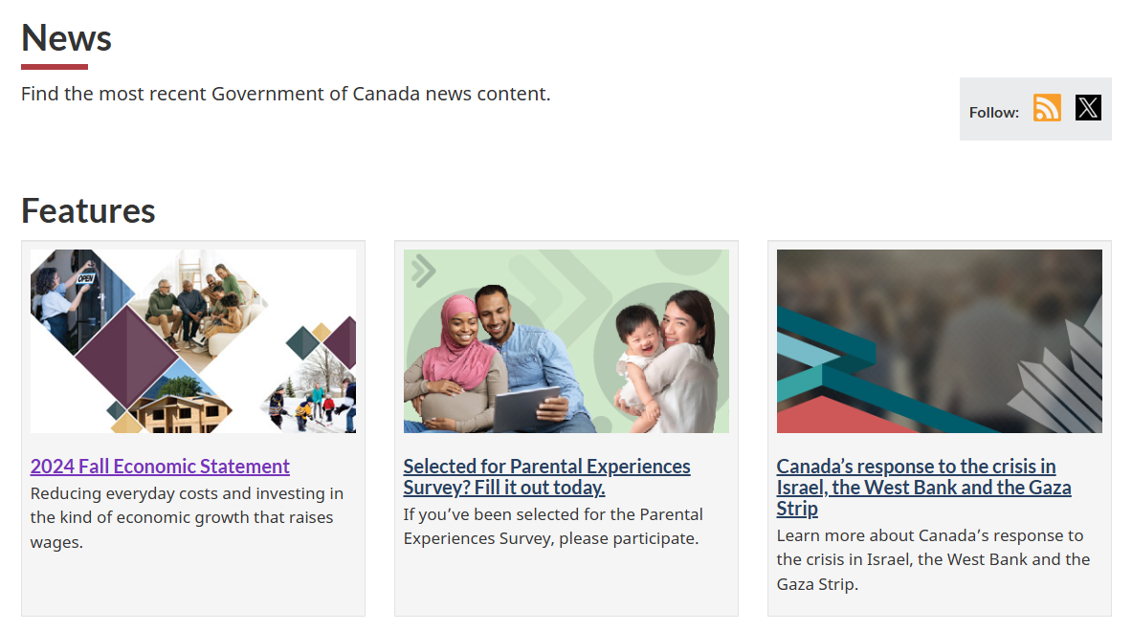
Updates to the Newsroom
Removed large rotating banner
Existing features now refresh on page load

Slide 3

Email pilot
Minimal viable product approach
Emails are sent:
  if there are new products (news releases and statements only)
  Seven days a week, at 9:00 a.m., 2:00 p.m. and 6:00 p.m. ET
Live demo
Prototype

Slide 4

Pilot launch / post-launch
Aiming to launch the week of January 20, 2025 on canada.ca
Canada.ca email notification service future product launch
News from the Government of Canada
Minister Ien and Minister Ng highlight the government’s tax break for all Canadians and new Working Canadians Benefit
Women and Gender Equality Canada | 2024-12-15 11:30 am ET
Statement by Minister Anandasangaree, Minister Vandal, Minister Hajdu, and Minister Virani on the Ninth Anniversary of the Truth and Reconciliation Commission’s Final Report
Crown-Indigenous Relations and Northern Affairs Canada | 2024-12-15 10:13 am ET
Prototype

Slide 5
Questions and feedback
Newsroom product owners – Digital communications coordination unit, PCO
DCCU-UCCN@pco-bcp.gc.ca
Digital Services Directorate – Principal Publisher, Service Canada
simon.cossette@servicecanada.gc.ca

