Slide 1
Canadian Critical Minerals Strategy
Critical Minerals Enabling Infrastructure

Slide 2









The Canadian Critical Minerals Strategy
Goal: Increase the supply of responsibly-sourced critical minerals and support domestic and global value chain development for the green and digital economy
$3.8 billion in support committed to Strategy with implementation, involving 15+ federal departments and agencies
Natural Resources Canada leads five funding initiatives:
Critical Minerals Infrastructure Fund
Critical Minerals Geoscience and Data initiative
Critical Minerals Research, Development & Demonstration program
Indigenous Natural Resource Partnerships program
Global Partnerships Initiative
The Strategy’s Areas of Focus
1. Drive exploration, research and development and innovation
2. Accelerate responsible project development
3. Build sustainable infrastructure
4. Advance reconciliation with Indigenous Peoples
5. Grow a diverse workforce
and prosperous communities
6. Strengthen global leadership and security

Slide 3
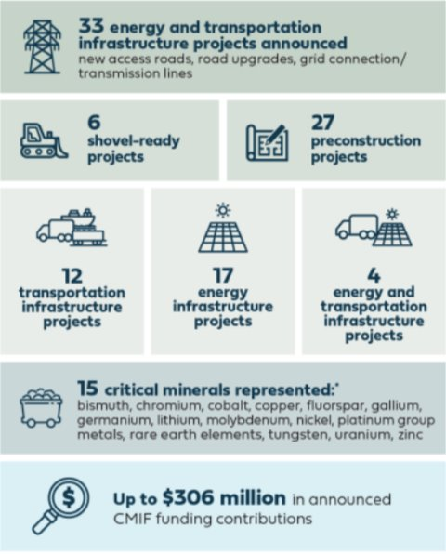
Critical Minerals Infrastructure Fund
CMIF Progress as of October 2025
CMIF is part of the Canadian Critical Minerals Strategy and contributes to focus area #3 building sustainable infrastructure
Purpose: Advance clean energy and transportation projects to address key infrastructure gaps in critical minerals value chains
Support:
Contribution funding for clean energy and transportation infrastructure projects necessary to enable sustainable development and expansion of critical minerals mines in Canada
Grants to support Indigenous engagement, capacity building, and knowledge gathering and sharing activities related to critical minerals infrastructure projects
Expected outcome: increased production of critical minerals
Total available funding: $1.5 billion
Timeframe: 2023–30
Partners: Transport Canada, Canada Infrastructure Bank, and supported by interdepartmental governance that includes 16 federal departments and agencies
Program status: Stream 1 preconstruction applications are now closed. Stream 2 shovel-ready applications will be accepted until March 4, 2026. Indigenous Grants applications will be accepted until December 17, 2025.
*Critical minerals supported by future calls may differ

Slide 4

Budget 2025 Highlights
Infrastructure Announcement
First and Last Mile Fund
Budget 2025 proposes to provide $371.8 million over four years, starting in 2026-27, to Natural Resources Canada to create the First and Last Mile Fund.
The fund will support the development of critical minerals projects and supply chains at the upstream and midstream segments of the value chains.
The First and Last Mile Fund will absorb the Critical Minerals Infrastructure Fund, leveraging its existing envelope to provide a total of up to $1.5 billion from 2026-27 to 2029-30.
Other Announcements
Critical Minerals Sovereign Fund
Budget 2025 proposes to provide $2 billion over five years, on a cash basis, and $50 million/5 years for delivery, starting in 2026-27, to Natural Resources Canada to create the Critical Minerals Sovereign Fund.
The fund will make strategic investments in critical minerals projects and companies, including equity investments, loan guarantees, and offtake agreements.
Exploration and Investment Tax Credits
METC: extended for 2 years until March 31, 2027.
CMETC: expanded to include 12 additional critical minerals.
CTM-ITC:
expanded to include antimony, indium, gallium, germanium, and scandium.
expanded to retroactively support polymetallic extraction and processing.
Defence Industrial Strategy
Budget 2025 proposes $443.0 million over five years, starting in 2025-26, to Natural Resources Canada and ISED to support the development of innovative critical minerals processing technologies, support joint investments with Allies in Canadian critical minerals projects, and develop a critical minerals stockpiling mechanism to strengthen Canadian and Allied national security.

Slide 5
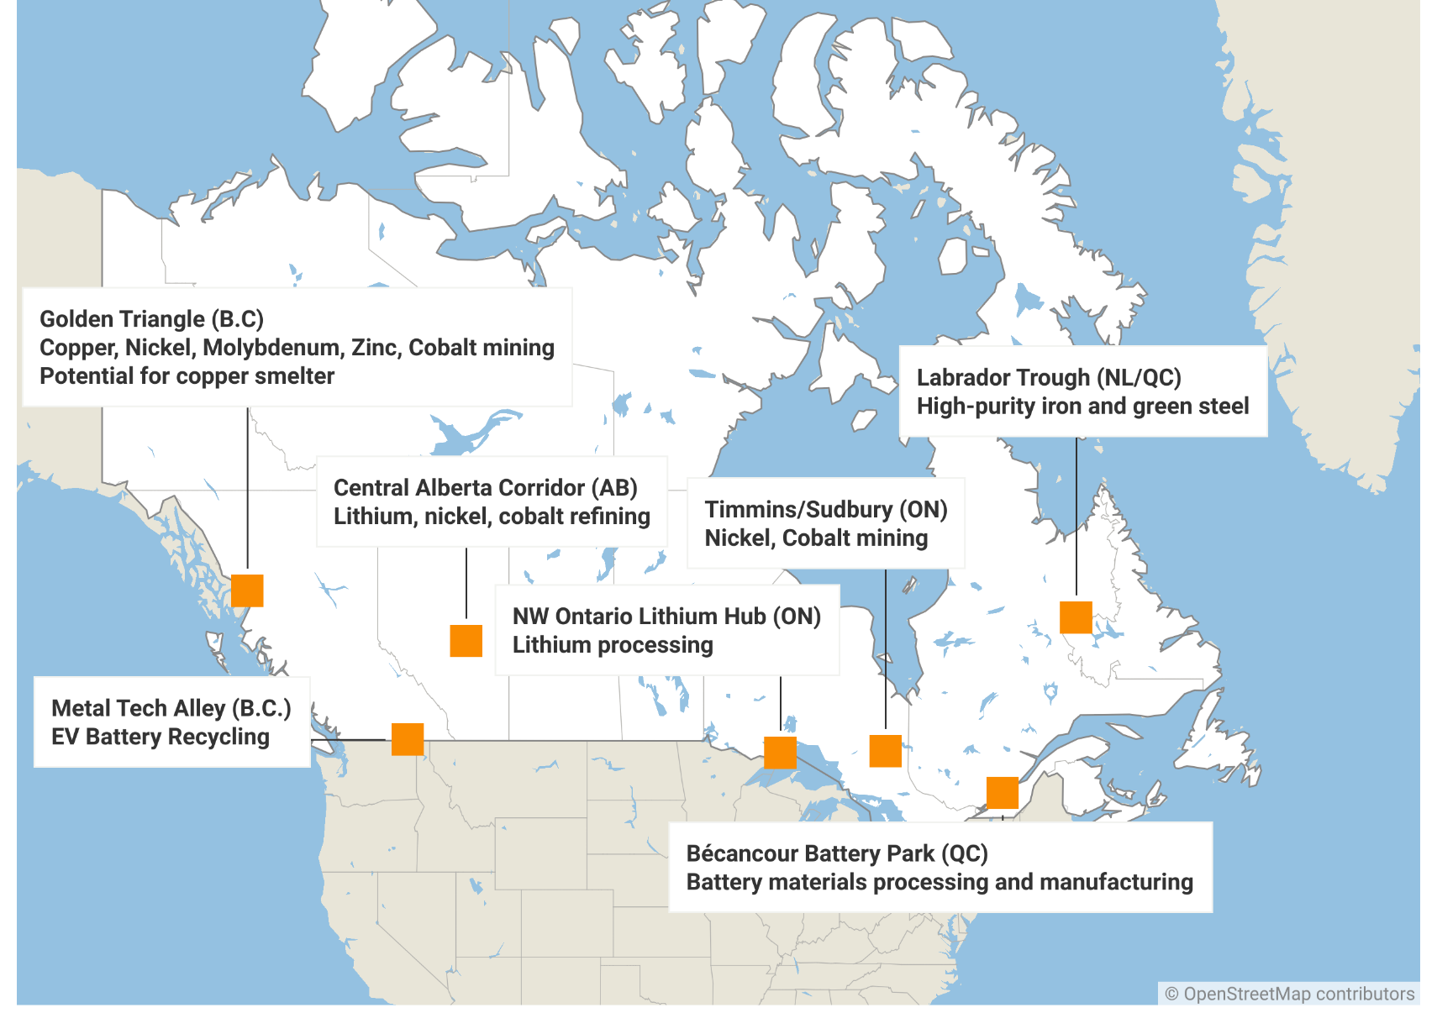
Regional Industrial Zones
Canada's industrial and trade links are heavily geared towards north-south development with U.S., and recent events show need for stronger inter-Canadian links
Priority projects are being identified to maximize interregional cooperation and trade diversification opportunities, with potential links to First and Last Mile Fund
The identified priorities could guide federal investment decisions in major projects

Slide 6
2025

