Slide 1
Microsoft Teams Training Module 1
ACCESSING MICROSOFT TEAMS

Slide 2
In this module you will learn:
How to install Microsoft Teams
How to launch Microsoft Teams

Slide 3
Installing Microsoft Teams
Step 1
Open the Software Center
Step 2
Search for Microsoft Teams

Slide 4
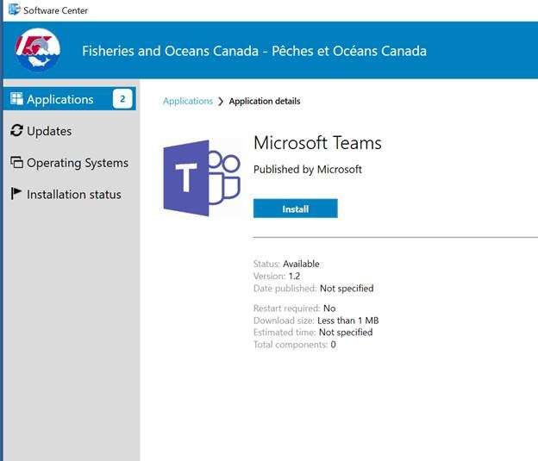
Step 3
Install Microsoft Teams

Slide 5
To Launch Microsoft Teams
Step 1
Open the Microsoft Teams application

Slide 6
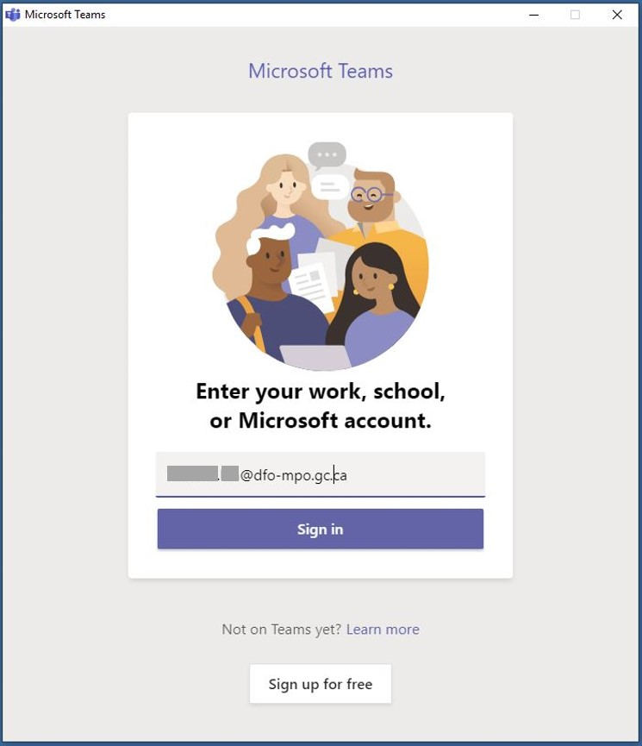
Step 2
You will be prompted to sign in to your account with an automatically populated email address - THIS MUST BE EDITED
Step 3
Enter your email address in the format firstname.lastname@dfo-mpo.gc.ca and Sign in

Slide 7
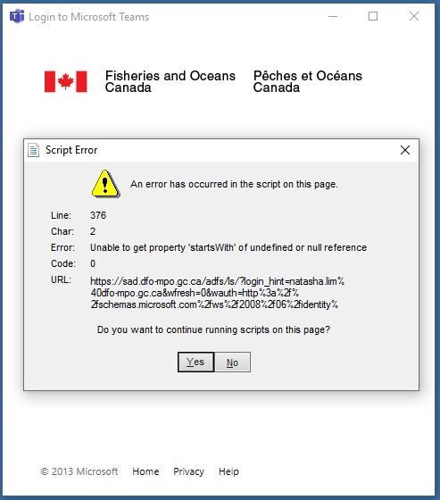
Step 4
You will then receive the following Script Error warning. Click Yes to continue running scripts on this page.

Slide 8
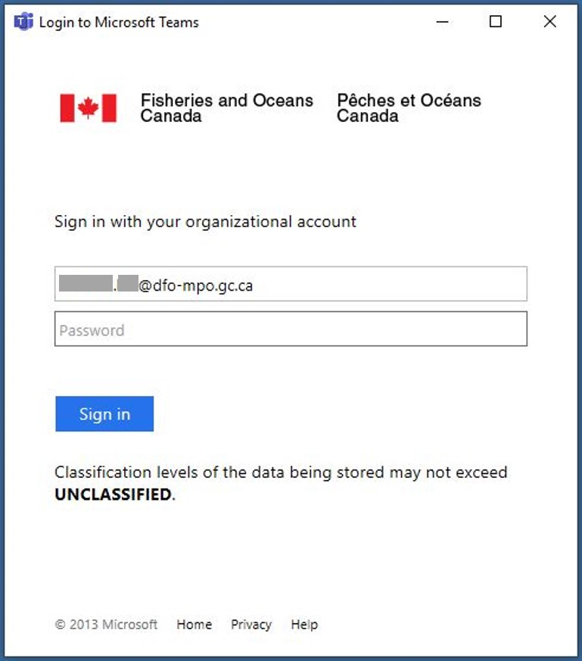
Step 5
Re-enter your credentials to Sign in to your DFO account

Slide 9
Step 6
Select a method to receive your Sign in code
Via Text to your mobile
Via email

Slide 10
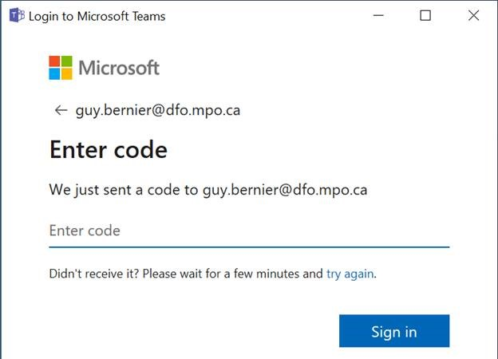
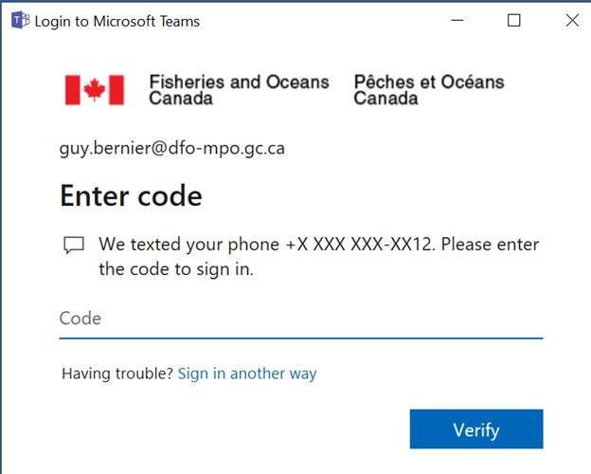
Step 7
Enter your Sign in code to verify your account and Sign in

Slide 11
Congratulations!
You should now have access to Microsoft Teams.
Start exploring!
Join us in the next learning module Navigating Teams
For questions or feedback please contact DFO.IMTS.DWS-SEN.GIST.MPO@dfo-mpo.gc.ca

