Slide 1
Mindful Change Leadership Development Program
Week 6 (of 8)
June 3, 2025
Notes:
Jena:
Welcome participants to session 6
Friendly reminding people about a small fruit or veggie will be needed for one exercise we’ll do today.

Slide 2
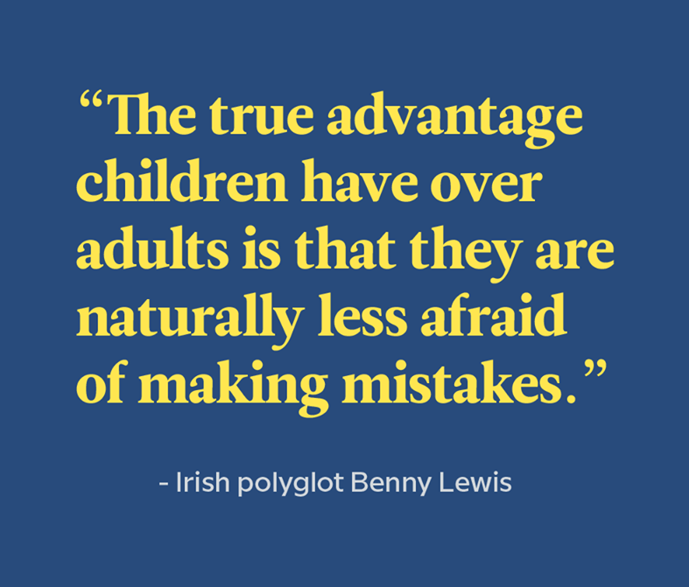
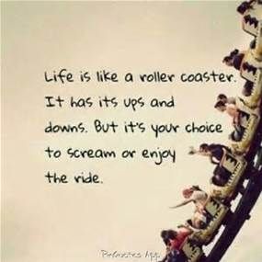
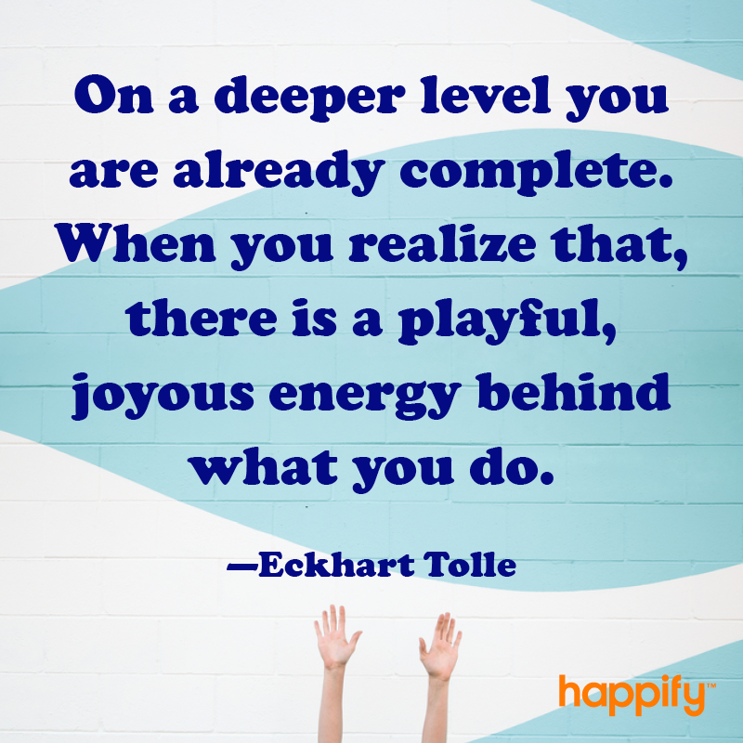

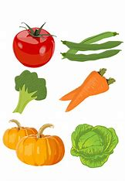
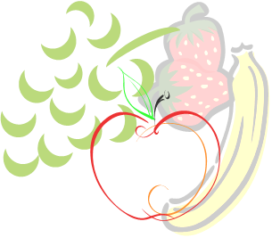
Welcome
Notes:
Jena:
(Friendly reminder: prep for sharing audio & video, including French CC and 100% font size)
Prepping for the session
Space image: Have the file locally saved and turned to show correctly: https://upload.wikimedia.org/wikipedia/commons/4/4a/Location_of_Earth_%283x3-English_Annot-smaller%29.png
Nanometer Image: Have the file locally saved and turned to show correctly: https://upload.wikimedia.org/wikipedia/commons/a/ae/Comparison_of_nanomaterials_sizes.jpg
How Big Is a Nanometer – 1:28 mins: https://www.youtube.com/watch?v=IC3AcItKc3U
SPT 1.5 mins: https://www.youtube.com/watch?v=oNgt_V6sUwY
SPT 2.5 mins: https://www.youtube.com/watch?v=bvecmpMdb3o
Quick sample of SPT 10 seconds: https://www.youtube.com/watch?v=wRou06sb9Is
Win-win-win - Takes about 12 minutes total, we’ll start at minute 4 http://instituteformindfulleadership.org/guided-reflection-finding-win-win-win-solution/

Slide 3
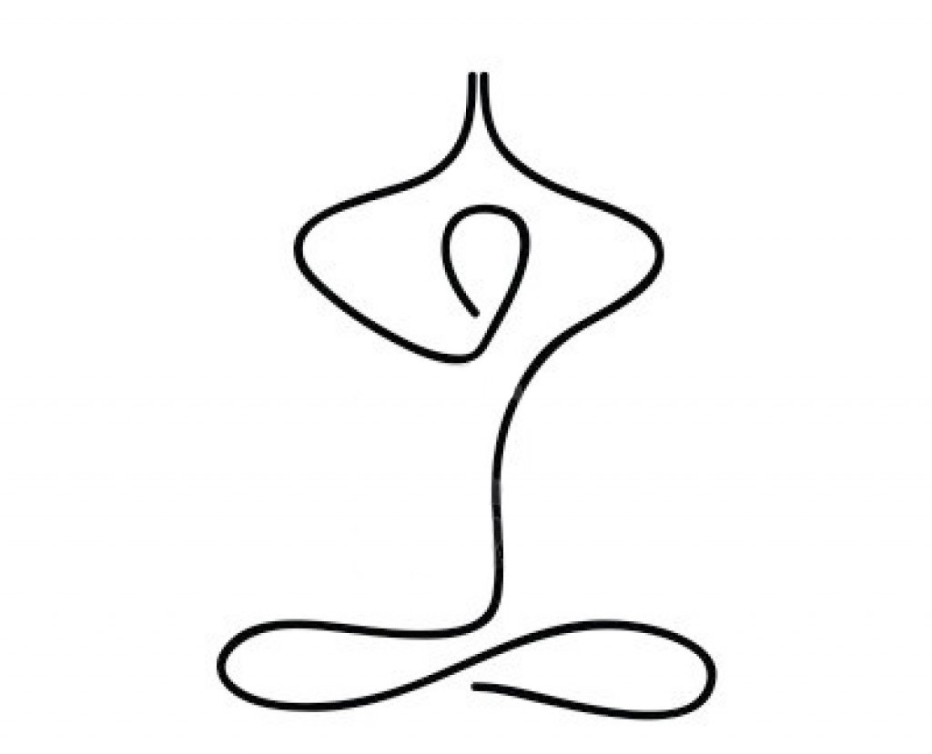

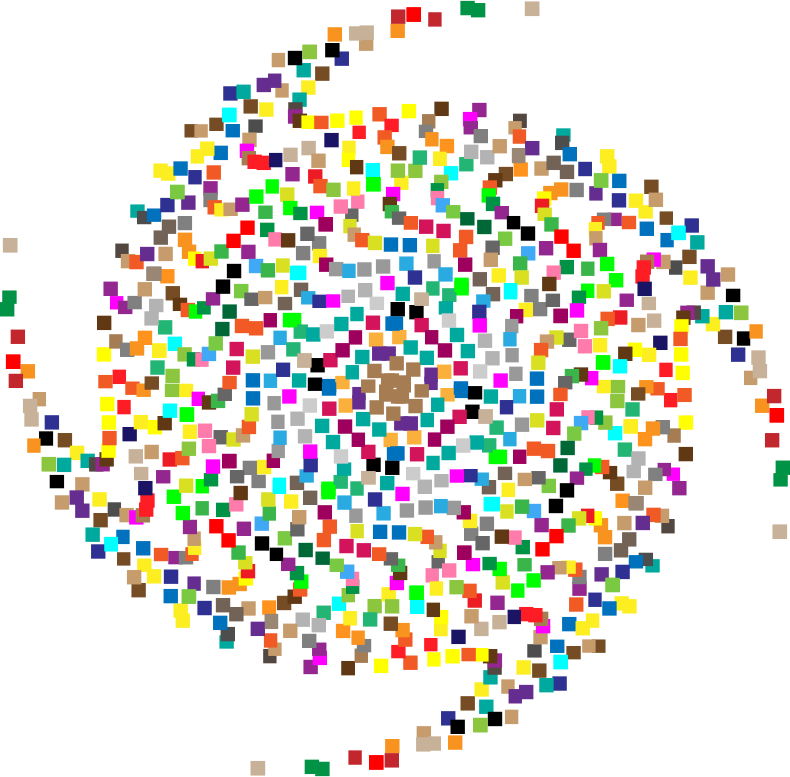
Mindful Self-Compassion Exercise – Centering
Notes:
Jena:
For today’s centering exercise, we’ll use a slight variation…. Similar to previous ones, the trick is to shift from “doing” to “being”
Let’s start by doing the following...
Sit with a straight position, as comfortable as possible
It helps if you close or semi-close your eyes
Focus on your breathing and repeat in your mind the following sentences that feel right to you, in this moment…
Repeat twice or three times, with a pause in between:
May I be safe
(pause)
May I be peaceful
(pause)
May I be kind to myself
(pause)
May I accept myself as I am
(pause)

Slide 4

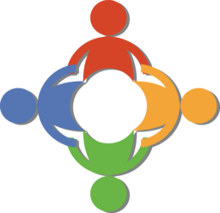
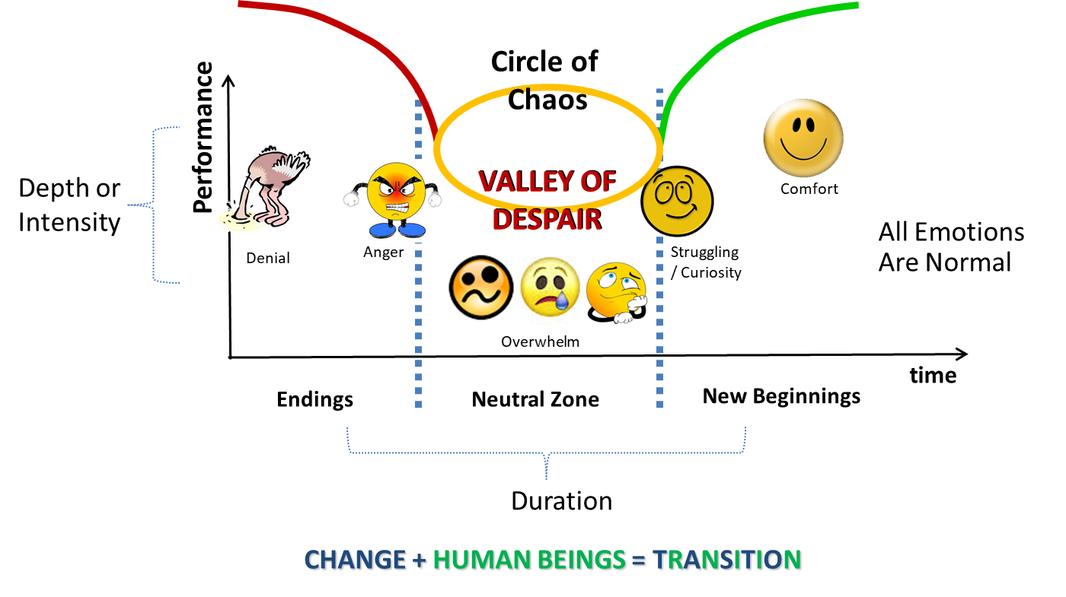

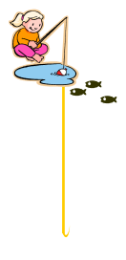



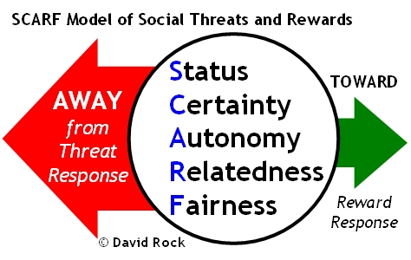
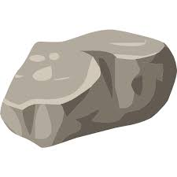
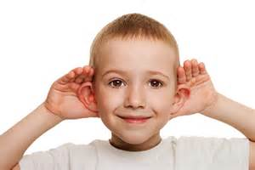

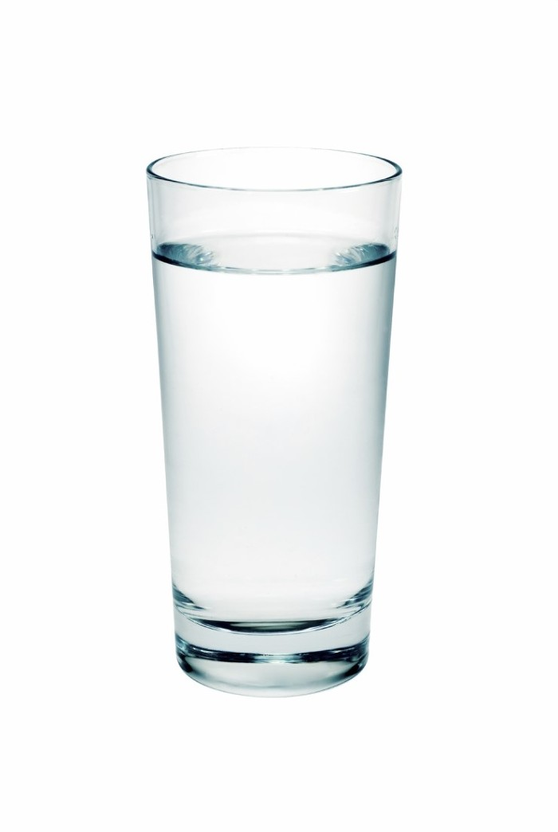
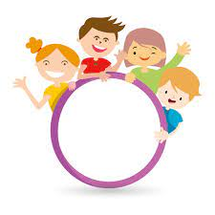
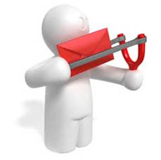
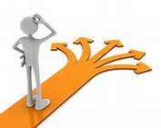

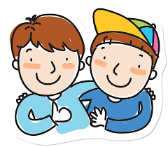
Debrief from last week (5)
Any insights?
SBN-RR
Notes:
Jena:
Let’s open the mic to some people who would like to share your comments, challenges, surprises… particularly would like to hear from someone who hasn’t spoke
Feel free to raise your hand to speak, or type in the chat, let’s hear from 2 or 3 of you about how the week went.
Consider the last week activities and your own experiences, including
the gratitude journaling.
the Mindfulness Breathing or Body Scan,
Change and Transition
Cynefin, Adaptive Action, VUCA models
SCARF Model
SBN RR technique
I love myself
((manage the participation & the comments on the chat))

Slide 5

Agenda – week 6
Centering breathing exercise
Debrief from last week 5
Today’s session intentions:
Focus, Compassion, Clarity, Creativity
Human being is enough
Present – Presence – Presencing
Mindful Win-Win-Win exercise
Mindful Eating exercise
Your takeaway assignment
Notes:
Jena:

Slide 6
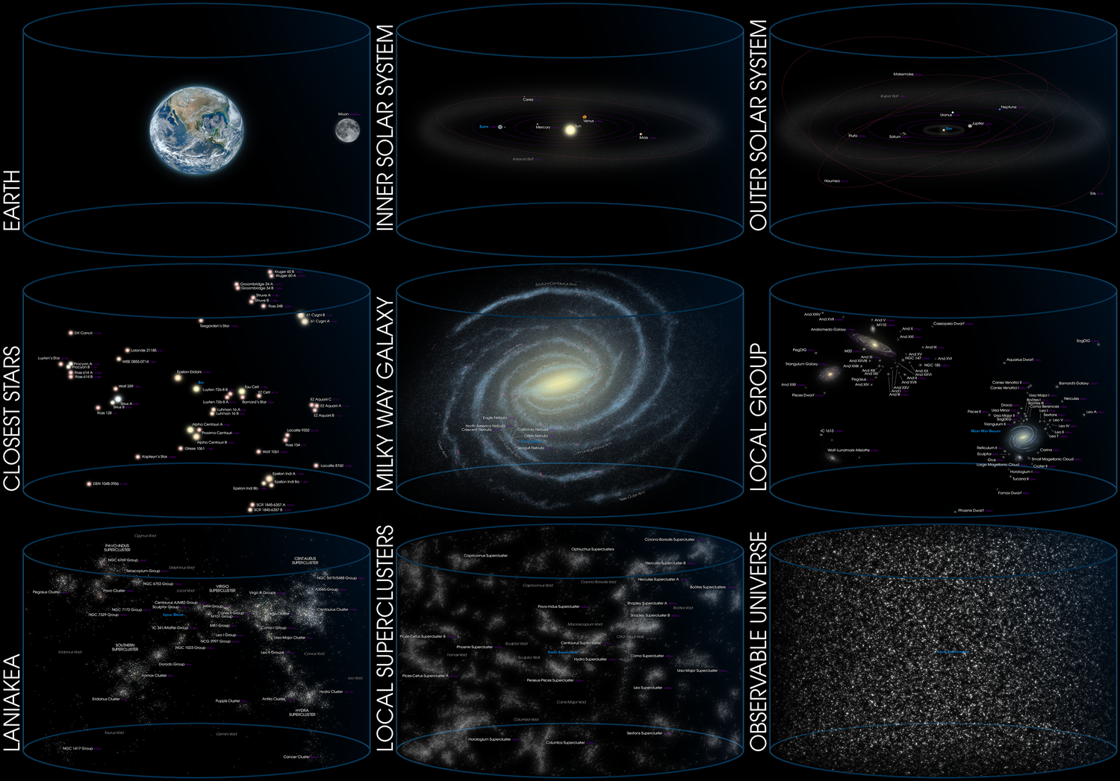
Where is our place in the Universe?
https://en.wikipedia.org/wiki/Universe
Notes:
Jena:
As human beings – Where is our place in the universe
The intent is to offer an overall perspective – Zooming Out From Earth to the Edge of the “Observable Universe”
-----------
Explore the following cosmic map, while mentioning the different titles of structures:
-Local superclusters
-Laniakea
-Local group
-Milky Way Galaxy
-Closest stars
-Outer solar system
-Inner solar system
-Earth
------------
And in the world, we have the continents, North America, Canada, the territory or province, down to your neighborhood and the house/apartment
I’ll let the image there for a few seconds to have it settle with us
(((Space image, have the file locally saved and turned to show correctly: https://upload.wikimedia.org/wikipedia/commons/4/4a/Location_of_Earth_%283x3-English_Annot-smaller%29.png ))
Resources:
The Universe:
https://en.wikipedia.org/wiki/Universe
https://upload.wikimedia.org/wikipedia/commons/4/4a/Location_of_Earth_%283x3-English_Annot-smaller%29.png
Interactive map of the observable universe Charts from where you are to the edge of the observable universe map: http://www.atlasoftheuniverse.com/universe.html
https://en.wikipedia.org/wiki/Universe
https://upload.wikimedia.org/wikipedia/commons/4/4a/Location_of_Earth_%283x3-English_Annot-smaller%29.png
Resources in French:
https://fr.wikipedia.org/wiki/Univers
https://upload.wikimedia.org/wikipedia/commons/3/3a/Observable_Universe_French_Annotations_for_wiki.png

Slide 7
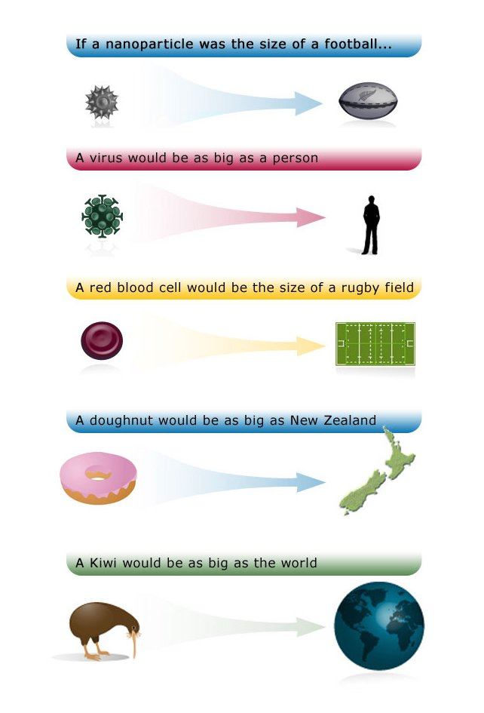
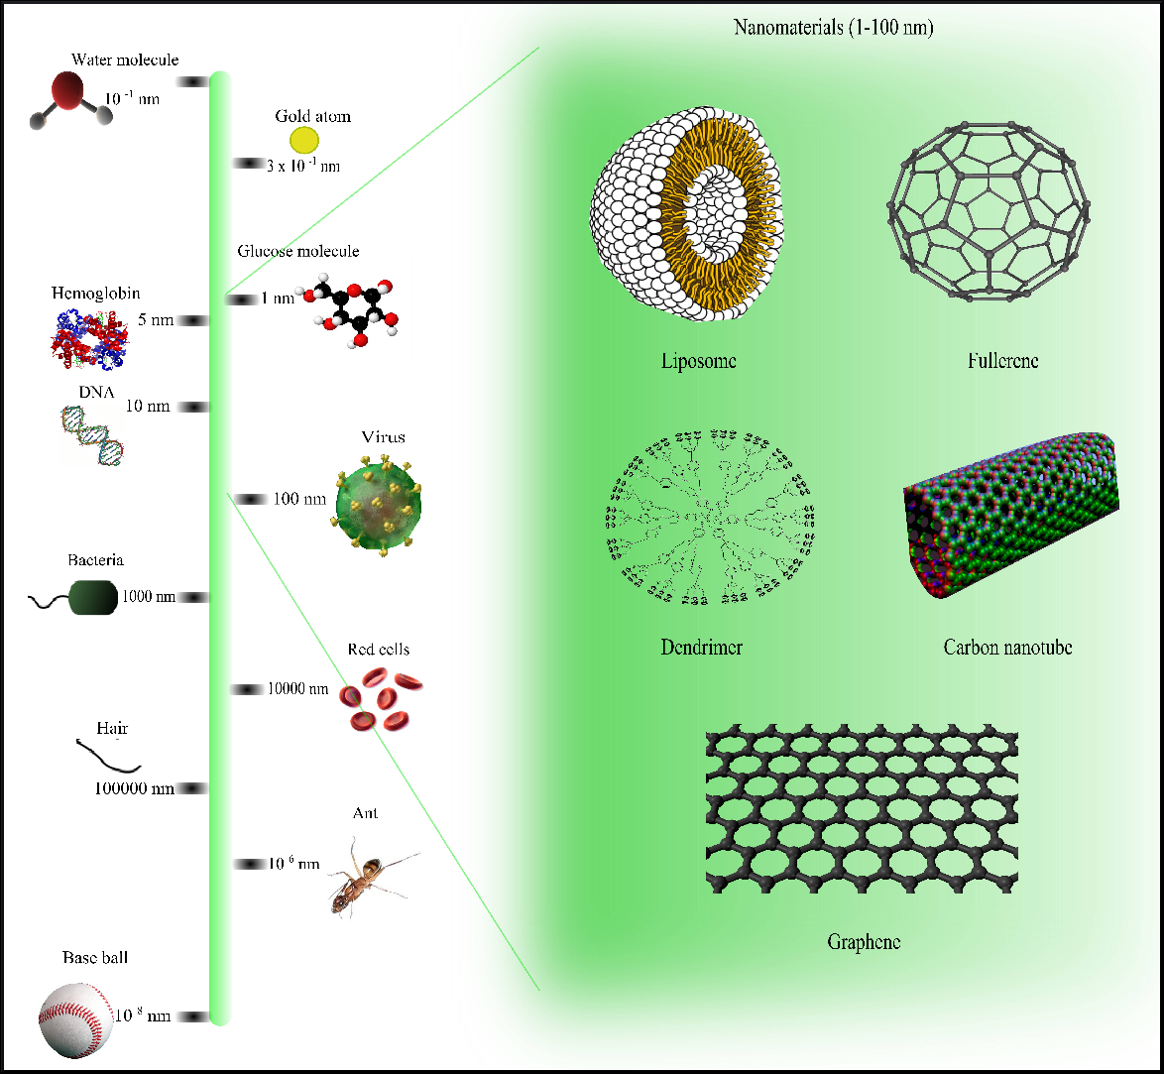
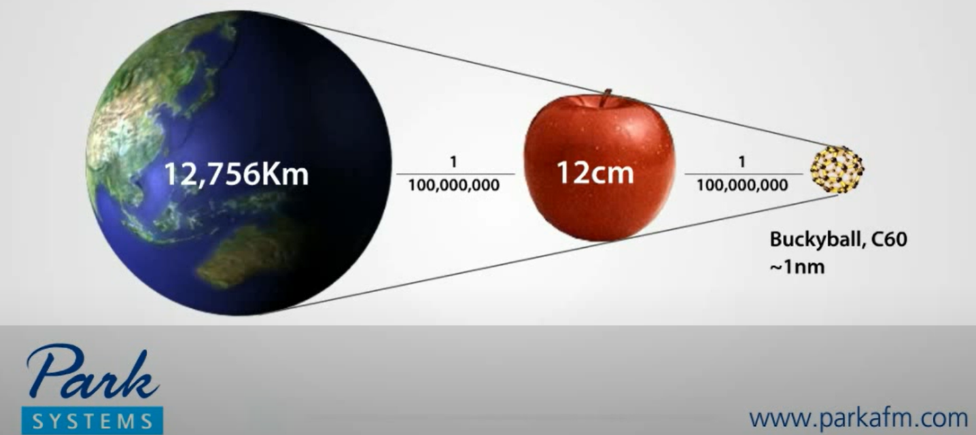

Nano-World
https://en.wikipedia.org/wiki/Nanotechnology
https://www.youtube.com/watch?v=EYzO9OcBxNg
https://upload.wikimedia.org/wikipedia/commons/a/ae/Comparison_of_nanomaterials_sizes.jpg
Notes:
Jena:
Nanometer Image: Have the file locally saved and turned to show correctly: https://upload.wikimedia.org/wikipedia/commons/a/ae/Comparison_of_nanomaterials_sizes.jpg
((explore the image from the “baseball” to the smallest image, mentioning the different titles))
On the following image, explore from the baseball smallest item or element, while mentioning the different titles.
(English – Français)
- Baseball ball - Balle de baseball
- Ant - Fourmi
- Hair – Cheveu
- Red cells - Globules rouges
- Bacteria – Bactéries
- Virus – Virus
- DNA – ADN
- Hemoglobin – Hémoglobine
- Glucose molecule - Molécule de glucose
- Gold atom - Atome d'or
- Water molecule – Molécule d’eau
- Within the Nanomaterials we have: liposome, fullerene, dendrimer, carbon nanotube, graphene
(Et les nanomatériaux sont listes : liposome, fullerène, dendrimère, nanotube de carbone, graphène)
((Then play the video))
How Big Is a Nanometer – 1:28 MINS
https://www.youtube.com/watch?v=IC3AcItKc3U
Nano World – What is NANO – How small is Nano - 2 mins
https://www.youtube.com/watch?v=EYzO9OcBxNg
Resources:
Nanometer Image: Have the file locally saved and turned to show correctly: https://upload.wikimedia.org/wikipedia/commons/a/ae/Comparison_of_nanomaterials_s izes.jpg
Video Nanometer: https://www.youtube.com/watch?v=EYzO9OcBxNg
https://www.britannica.com/technology/nanotechnology
https://www.nanowerk.com/nanotechnology/introduction/introduction_to_nanotechnology_1.php
Resources in French…
https://fr.wikipedia.org/wiki/Nanotechnologie
https://www.futura-sciences.com/tech/definitions/technologie-nanotechnologie-4783/

Slide 8
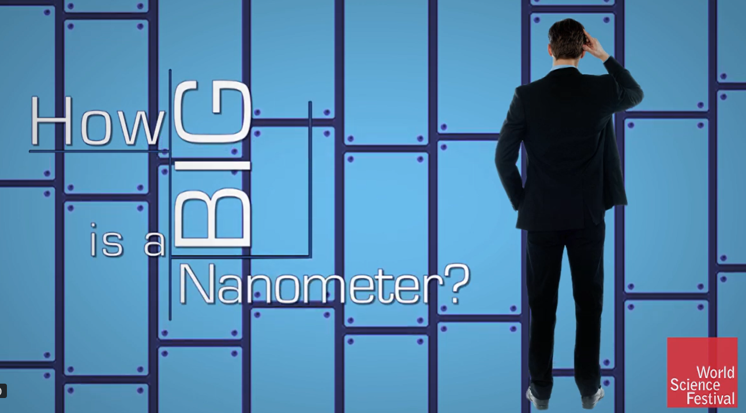
Nano-World
Notes:
Jena:
((Then play the video))
How Big Is a Nanometer – 1:28 MINS
https://www.youtube.com/watch?v=IC3AcItKc3U

Slide 9
Human being – because being is enough
Who I am, that’s the ideal me
Not who others want me to be,
Not who I would prefer to be
I am enough
Space, Time, Beings
Notes:
Jena:
The key message here is, existing as you are, and being who you are is enough.
---------
Some may think, what does the whole universe and the nano world has to do with this program?
Well, it has to do with the being, the human side of us, as opposed to the doing.
(click)
On this slide, at the bottom, you see a horizontal line, representing space, time, and beings
(click)
Now, there is a little dot, representing us, me, you
(click)
And all this space represents all of that we saw in the last two slides, the universe, the nano world and everything in between
(click)
Who I am, that’s the ideal me
Not who others want me to be,
Not who I would prefer to be
I am enough

Slide 10

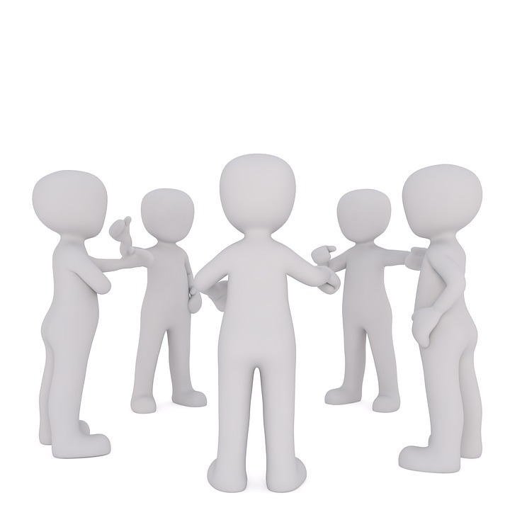
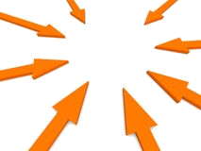
Being Fully Present
“Being fully present means having your focus, your attention, your thoughts and feelings all concentrated on the task at hand”
Feel
Think
Do
Say
Express
Believe
Notes:
Jena:
What does being present means?
(read the slide)
(click)
Or in other words, what you say, what you think, what you express, what you feel, what you do, what you believe, all of these things
(click)
sometimes happens in parts of us, sometimes they are not necessarily aligned;
(click)
and being present, as the ultimate goal of being mindful, means that all of them what I think, what I feel and what I do are being one, aligned and in harmony
In other words, Being Present (or living mindfully) simply means you're focused and engaged in the here and now, not distracted or mentally absent.
Being Present means being fully conscious of the moment and free from the noise of internal dialogue. It's often associated with feelings of stillness and peace. Sensations often seem sharper.
=== Additional Resources ===
--------------------
What is Being Present:
Being present (or living mindfully) simply means you're focused and engaged in the here and now, not distracted or mentally absent.
Being Present means being fully conscious of the moment and free from the noise of internal dialogue. It's often associated with feelings of stillness and peace. Sensations often seem sharper.
What is the act of Being Present
Being present means being fully conscious of, and engaged with our experience, even if that experience is difficult. When we are lost in thought, reliving the past, or going through the motions, it interferes with how we act in the present.
Each moment in your life has meaning, whether you notice that importance immediately or some time down the line. Making the most of life as it happens, rather than wishing for the past or worrying about the future, can improve your quality of life and help you feel more optimistic and prepared to face any challenge, more resilient.
------------
Being present is the foundation of being mindful. When all your 5 senses are aligned and in harmony.
Use your 5 senses for observation
They include the sense of sight, hearing, taste, touch, and smell. Most people pay some level of attention to what they see and hear.
Being more present is often as simple as:
savoring the taste and fragrance of your morning tea or coffee;
relishing the softness of your favorite sweater;
noting distant sounds, like music, your neighbors’ voices, birdsong, and so on;
enjoying the warmth of the water on your skin as you shower or wash your hands.
That old saying “Stop and smell the roses” isn’t bad advice.
The benefits of Being Present:
It can make it easier to manage stress
Many people respond to emotional distress and uncertainty by disengaging from the source. It can certainly seem counterintuitive to stay present when you feel anxious or nervous. Distracting yourself from unwanted or unpleasant thoughts can bring short-term relief. But you can’t permanently hide from reality. Acknowledging fears and stress triggers, and working to mindfully accept them, can have more benefit in the long run.
It may help relieve mental health symptoms
According to research mindfulness practices, including present-moment awareness, may help reduce symptoms of anxiety and depression.
When you focus on the present moment, you’re paying attention to the things currently happening. These events might range from joyous to downright heartbreaking (or anywhere in between).
If you’re going through a tough time, you might understandably wonder how increasing your awareness of these experiences can benefit you.
Mindfulness helps you recognize anxious or depressed thoughts as just that: thoughts. Eventually, you can learn to recognize these thoughts as you notice them and interrupt their patterns before they trap you in a spiral of distress.
It can strengthen your relationships
Ever spent time with a friend or partner who kept looking at their phone or saying, “Sorry, what?” Maybe you’ve been the one to lose the train of a conversation when you had something else on your mind.
Everyone gets distracted from time to time, but when this happens often, it can negatively affect relationships.
------------------
No matter how busy you are, find quiet reflective moments in your life.
--------
“Most humans are never fully present in the now, because unconsciously they believe that the next moment must be more important than this one. But then you miss your whole life, which is never not now.”– Eckhart Tolle
------------
“Wherever You Go, there you are” --Book by mindfulness expert Jon Kabat Zinn. Classic bestselling guide!
--------------
In the midst of movement and chaos, keep stillness inside of you –Deepak Chopra
---------------
“If you are depressed you are living in the past. If you are anxious you are living in the future. If you are at peace you are living in the present.” – Lao Tzu
-------------
Don’t be overheard complaining…not even to yourself. — Marcus Aurelius (So simple, yet so powerful).
-------------
“If you feel lost, disappointed, hesitant, or weak, return to yourself, to who you are, here and now and when you get there, you will discover yourself, like a lotus flower in full bloom, even in a muddy pond, beautiful and strong.“ — Masaru Emoto
---------------
“Do not dwell in the past, do not dream of the future, concentrate the mind on the present moment.” —Buddha
-------------
He said, “There are only two days in the year that nothing can be done. One is called yesterday and the other is called tomorrow, so today is the right day to love, believe, do and mostly live.” – Dalai Lama

Slide 11
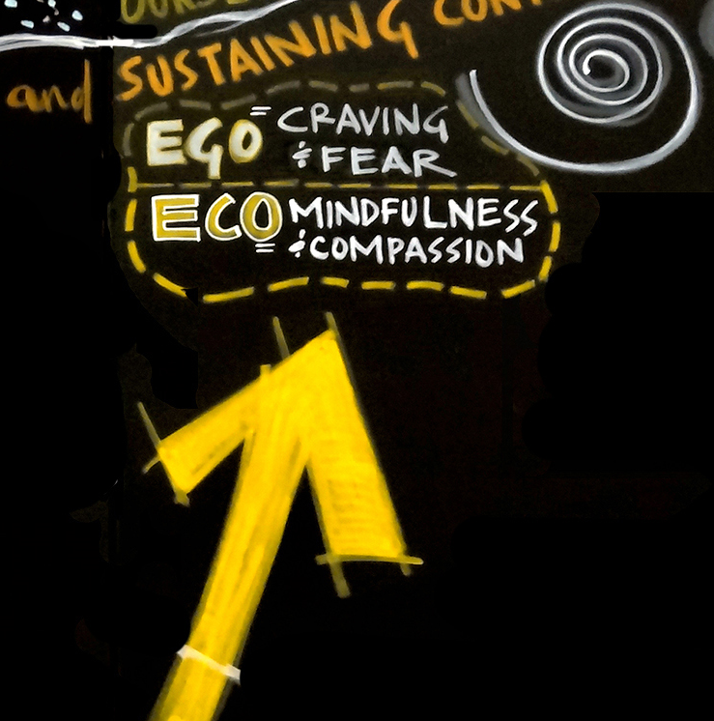
Presencing
… is a blended word combining “sensing” (feeling the future possibility) and “presence” (the state of being in the present moment)
Theory - U
https://www.presencing.com/theoryu
Theory U proposes that the quality of the results that we create in any kind of social system is a function of the quality of awareness, attention, or consciousness that the participants in the system operate from. *
Notes:
Casey-Marie:
Now let’s share about the Presencing Institute. Some of you may already know of it
(read first bullet from the slide)
And the U-Theory makes reference to the Ego, summarized by craving and fear, and the Eco, summarized with mindfulness and compassion
(read second bullet from the slide)
Resources…
https://www.presencing.com/theoryu
https://www.presencing.com/overview
=== Additional Resources ===
"In order to operate in the complexity of this century we have to do some inner work." - Otto Scharmer
We live in a time of massive institutional failure, in which we collectively create results that (almost) nobody wants. The list is well known: Climate change. Hunger. Poverty. Terrorism. Violence. Destruction of communities, nature, life—the foundations of our social, economic, ecological, and spiritual well being. These times call for a new consciousness and a new collective leadership capacity to meet these challenges in a more conscious, intentional, and strategic way. The development of such a capacity would allow us to create a future of greater possibilities.
--------------
The Presencing Institute has developed Theory U as a change framework and set of methodologies that have been used by thousands of organizations and communities worldwide to address our most pressing global challenges: climate change, food systems, inequality and exclusion, finance, healthcare and education.
---------------
Theory U is an awareness-based method for changing systems.
Theory U blends systems thinking, innovation, and leading change -- from the viewpoint of an evolving human consciousness.
Theory U revolves around a core process of co-sensing and co-shaping emerging future possibilities.
-----------------
Theory U offers a method for rethinking the parts and the whole by making it possible for the system to sense and see itself. When that happens, the collective consciousness begins to shift from ego-system awareness to eco-system awareness - from a silo view, to a systems view.
Meeting the challenges of this century requires updating our operating system from an obsolete “ego-system” focused entirely on the well-being of oneself to an eco-system awareness that emphasizes the well-being of the whole.
The Ego to Eco framework applies a Theory U lens to the transformation of the economy and its key social systems.
One of the core ideas of Theory U is that form follows attention or consciousness. We can change reality by changing the inner place from which we operate. The first step in understanding the impact of attention on reality is to look at how we operate on the individual level.
---------------
At its core, Theory U comprises three main elements:
A framework for seeing the blind spot of leadership and systems change: the "interior condition" from which we operate;
A method for implementing awareness-based change: practical methods and tools for change makers. The focus is on building the collective capacity to shift the inner place from which we operate;
A new narrative for evolutionary societal change: updating our mental and institutional operating systems in all of society's sectors. What does it take to redesign societies in ways that address the pressing challenges of our time? What does it take to apply the power of mindfulness and awareness to the transformation of the collective system?
-------------
Leadership essentially is not what a person or an individual does, that's the biggest misunderstanding. The essence of leadership is the capacity of the system, in which everyone is participating, to sense and shape the future, and to be in touch with what is wanting to emerge, and then stepping into that. That really is what leadership is all about. And that's why leadership is a distributive phenomenon.
It needs to include all of us, it's not something we can delegate to the one person at the top. The essential leadership capacities needed to address the root causes of today’s social, environmental, and spiritual challenges.
-----------------
Dr. Dan Siegel is a Clinical Professor of Psychiatry at the UCLA School of Medicine and the founding co-director of the Mindful Awareness Research Center at UCLA.
Dr. Dan Siegel: “Me + We = Mwe” Relates to the “collective consciousness”
-----------------------
I invite you to have a look at their WEBSITE for additional information. The links are available on the last slide, on the resources slide.
--------------------
Resources:
Otto Scharmer: https://ottoscharmer.com/
https://www.u-school.org/presencing
https://www.presencing.com/theoryu
https://www.presencing.com/overview
https://www.presencing.org/aboutus/spt
https://www.presencing.org/#/aboutus/theory-u
Dr. Dan Siegel: https://drdansiegel.com/
Dr. Dan Siegel: “Me + We = Mwe” https://www.youtube.com/watch?v=uo8Yo4UE6g0

Slide 12
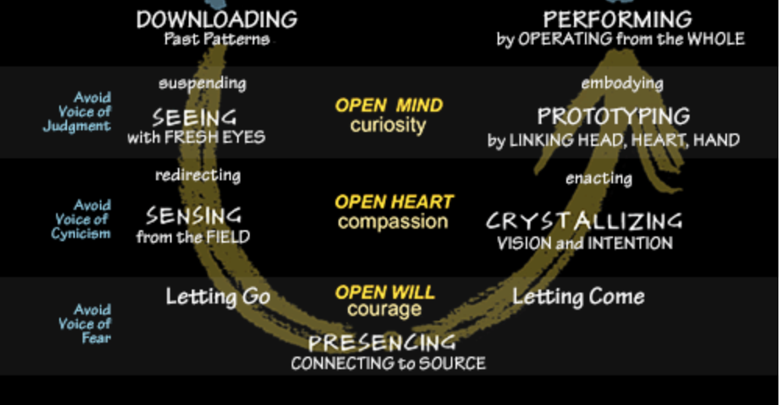
Theory – U by Otto Scharmer
Embodies awareness-based systems change…
You can only change a system when you transform consciousness.
You can only transform consciousness when the system see and sense itself
Theory – U uses "social presencing theatre“, this is not "theater" in the conventional sense, it uses simple body postures and movements to dissolve limiting concepts, to communicate directly, to access intuition, and to make visible both current reality, and the deeper – often invisible – leverage points for creating profound change.
https://www.presencing.org/aboutus/spt
Notes:
Casey-Marie:
(read from slide first 3 bullets)
In other words, what Theory U does is, increases of consciousness, as in self-awareness, and that’s what we aim at this program
(click)
Theory U also uses “social presencing theatre”, which is very simple yet very innovative dynamic… by incorporating theatrical movements and other concepts or elements, accesses the intuition, making visible aspects otherwise overseen, creating profound and transformative change.
I invite you to explore the presencing institute website to get more information
Resources…
https://www.presencing.org/aboutus/spt
https://www.presencing.org/#/aboutus/theory-u
(3.5 mins) U.Lab: Transforming Business, Society, and Self | MITx on edX | About Video (youtube.com) - https://www.youtube.com/watch?v=gF8wV9OlUHc
01 SPT OTTO INTRO (youtube.com) - https://www.youtube.com/watch?v=otinvYTV6iU&list=PLQ6Oz70HpGuSgDnKTwENCo_k1VS05T91a
Social Presencing Theatre 20min dance Part 2 (youtube.com) - https://www.youtube.com/watch?v=bvecmpMdb3o
Introduction Social Presencing Theater with Arawana Hayashi (youtube.com) (6.5 mins) - https://www.youtube.com/watch?v=aVsG_LHw-_c
An Embodiment Practice from Social Presencing Theater - with Arawana Hayashi (youtube.com) - https://www.youtube.com/watch?v=KqoLGlSoiB8
For review/consideration? Meet the winners of the 2024 Dance Your PhD Contest | Ars Technica - https://arstechnica.com/science/2024/02/kangaroo-time-tops-winners-list-for-2024-dance-your-phd-contest/
Ressources en français :
The "I" and the "We" - https://www.youtube.com/watch?v=dIcmpy10PaE
https://www.facebook.com/groups/VoyageGaiaHubFrancophone/?tn-str=*F
https://www.youtube.com/c/PresencingInstitute/search?query=Francophone
https://www.u-school.org/community/hubs/gaia-francophone-hub
=== Additional Resources ===
Have any of you heard of the concept of “Presencing” ?
------------
The concept was co-founded by Otto Scharmer, co-founder of the Presencing Institute, and an american academic author senior lecturer. And action researcher who co-creates pathways of transformation for individuals, institutions, and larger systems.
To create an action research platform at the intersection of science, consciousness, and profound social and organizational change.
------------
The Presencing Institute and The U-school for Transformation
The Presencing Institute is the holding entity that maintains the governance of The U-school and other initiatives supporting awareness-based systems change.
The U-school for Transformation: Our curriculum blends systems thinking, action learning, social arts, awareness-based practices and multi-sector learning and collaboration.
------------------
Presencing, the blending of sensing and presence, means to connect from the Source of the highest future possibility and to bring it into the now. Presencing happens when our perception begins to happen from the source of our emerging future. The boundaries between three types of presence collapse: the presence of the past (current field), the presence of the future (the emerging field of the future), and the presence of one’s authentic Self. When this co-presence, or merging of the three types of presence, begins to resonate, we experience a profound shift, a change of the place from which we operate.
-----------------
We can choose to operate from a closed mind, closed heart, and closed will, or we can choose to operate from an open mind, open heart, and open will. Accordingly, our actions give rise to a social field of self-destruction (absencing) or of collective creativity (presencing).
So, what are the conditions that determine whether a person or community activates the field of absencing or presencing? Whether we collectively enact a social architecture of separation or connection? In essence, the difference is about a shift of the heart on the level of the individual and the collective.
----------------------
There are three different responses to disruption that are playing out in all sectors and systems in the present moment:
Response 1 | Muddling through: downloading (maintaining the status quo), doing nothing.
Response 2 | Moving backward: the system is broken and that we need to orient ourselves backward. It operates on the closing of the mind, heart, and will, i.e., the amplification of prejudice, ignorance, hate, and fear.
Response 3 | Moving forward: leaning into the unknown to co-sense and co-create the future. Byleaning forward into the unknown, by sensing and actualizing the future that wants to emerge. To do that you need three critical capacities: listening and curiosity (an open mind), empathy and compassion (an open heart), as well as confidence and courage (an open will).
-----------
Theory U also uses Social Presencing Theater, which is very simple yet very innovative dynamic, by incorporating theatrical movements and other concepts or elements, accesses the intuition, making visible aspects otherwise overseen, creating profound and transformative change.
Social presencing theatre is not theater in the conventional sense, it uses simple body postures and movements to dissolve limiting concepts, to communicate directly, to access intuition, and to make visible both current reality, and the deeper, often invisible, and leverage points for creating profound change.
Social Presencing Theater where participants can cultivate personal embodied presence through guided practices that include mindfulness, movement and reflection. Social Presencing Theater can provide a strong ground for sensing into ourselves and into our contexts, leading to fresh insights, an ability to prototype creative ways of moving forward, and the courage to extend kindness and compassion to the systems and communities we care so deeply about. intensive training in applying Social Presencing Theater expertise to enable shifts in the social field.
Visual Practice (VP) is a field of work that weaves together the disciplines of presencing, Theory U, systems thinking, and dialogue with “scribing”. It is a 2-dimensional social art that helps systems see and sense their reality and potential.
These methods stand for deeper levels of listening and scribing, shining light on relationships, root causes, and energy that is felt. It is always done in service of a group, to 'presence' what a group or a social system wants to express, and then make it visible. The drawing establishes connections within content, aids with insight, and supports decision making.
-------------
I invite you to have a look at their WEBSITE for additional information..
------------
Resources:
Otto Scharmer: https://ottoscharmer.com/
U.Lab: Transforming Business, Society, and Self | MITx on edX | About Video – YouTube
Presencing | u-school for Transformation
Theory U | u-school for Transformation
u-school for Transformation | u-school for Transformation
Resources | u-school for Transformation
Dr. Dan Siegel: https://drdansiegel.com/
Dr. Dan Siegel: “Me + We = Mwe” https://www.youtube.com/watch?v=uo8Yo4U

Slide 13
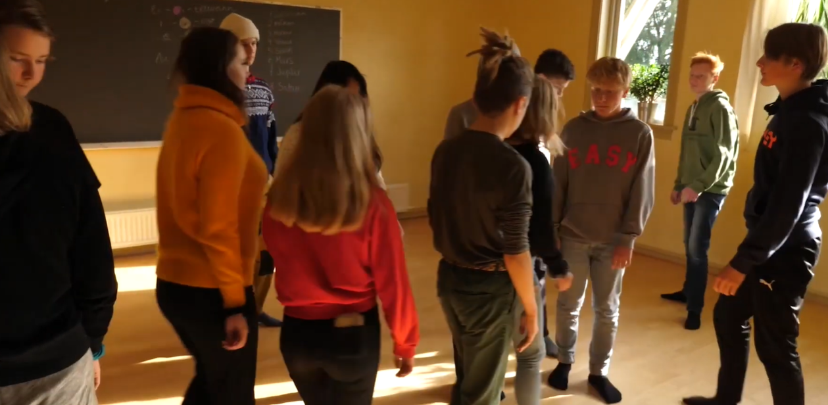
SPT: A new dimension for global learning
Notes:
Casey-Marie:
https://www.youtube.com/watch?v=LeXQd8j1N7E
*** ***
Alternative, in a combination of the following 3 videos about the Social Presencing Teathre is…
(would need to review what sections to show)
https://www.youtube.com/watch?v=oNgt_V6sUwY
https://www.youtube.com/watch?v=bvecmpMdb3o
(quick example of SPT) https://www.youtube.com/watch?v=wRou06sb9Is

Slide 14
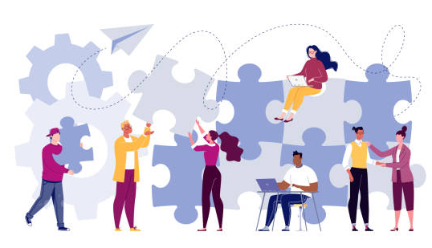
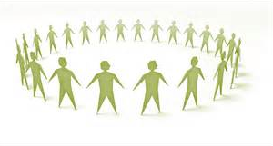

Finding a Win, Win, Win Solution
The benefits of A Win, Win, Win Solution practice
A guided reflection investigating how to solve difficult problems in a way that brings the broadest benefit to all
Notes:
Casey-Marie:
Think about a professional or personal challenge or difficult situation (past or present), where getting to a Win Win outcome, bringing forward a Win Win Solution could be beneficial to those in your organization, your team, to yourself and, also the wider community.
-----------
Senior Instructor Patrick Briody from the “Institute for Mindful Leadership”leads a guided reflection investigating how to solve difficult problems in a way that brings the broadest benefit to all.
Start audio at minute 4 : http://instituteformindfulleadership.org/guided-reflection-finding-win-win-win-solution/
…and I invite you to open your eyes and come back.
Keep in mind, shortly you’ll have time to share your reflections in the debrief

Slide 15
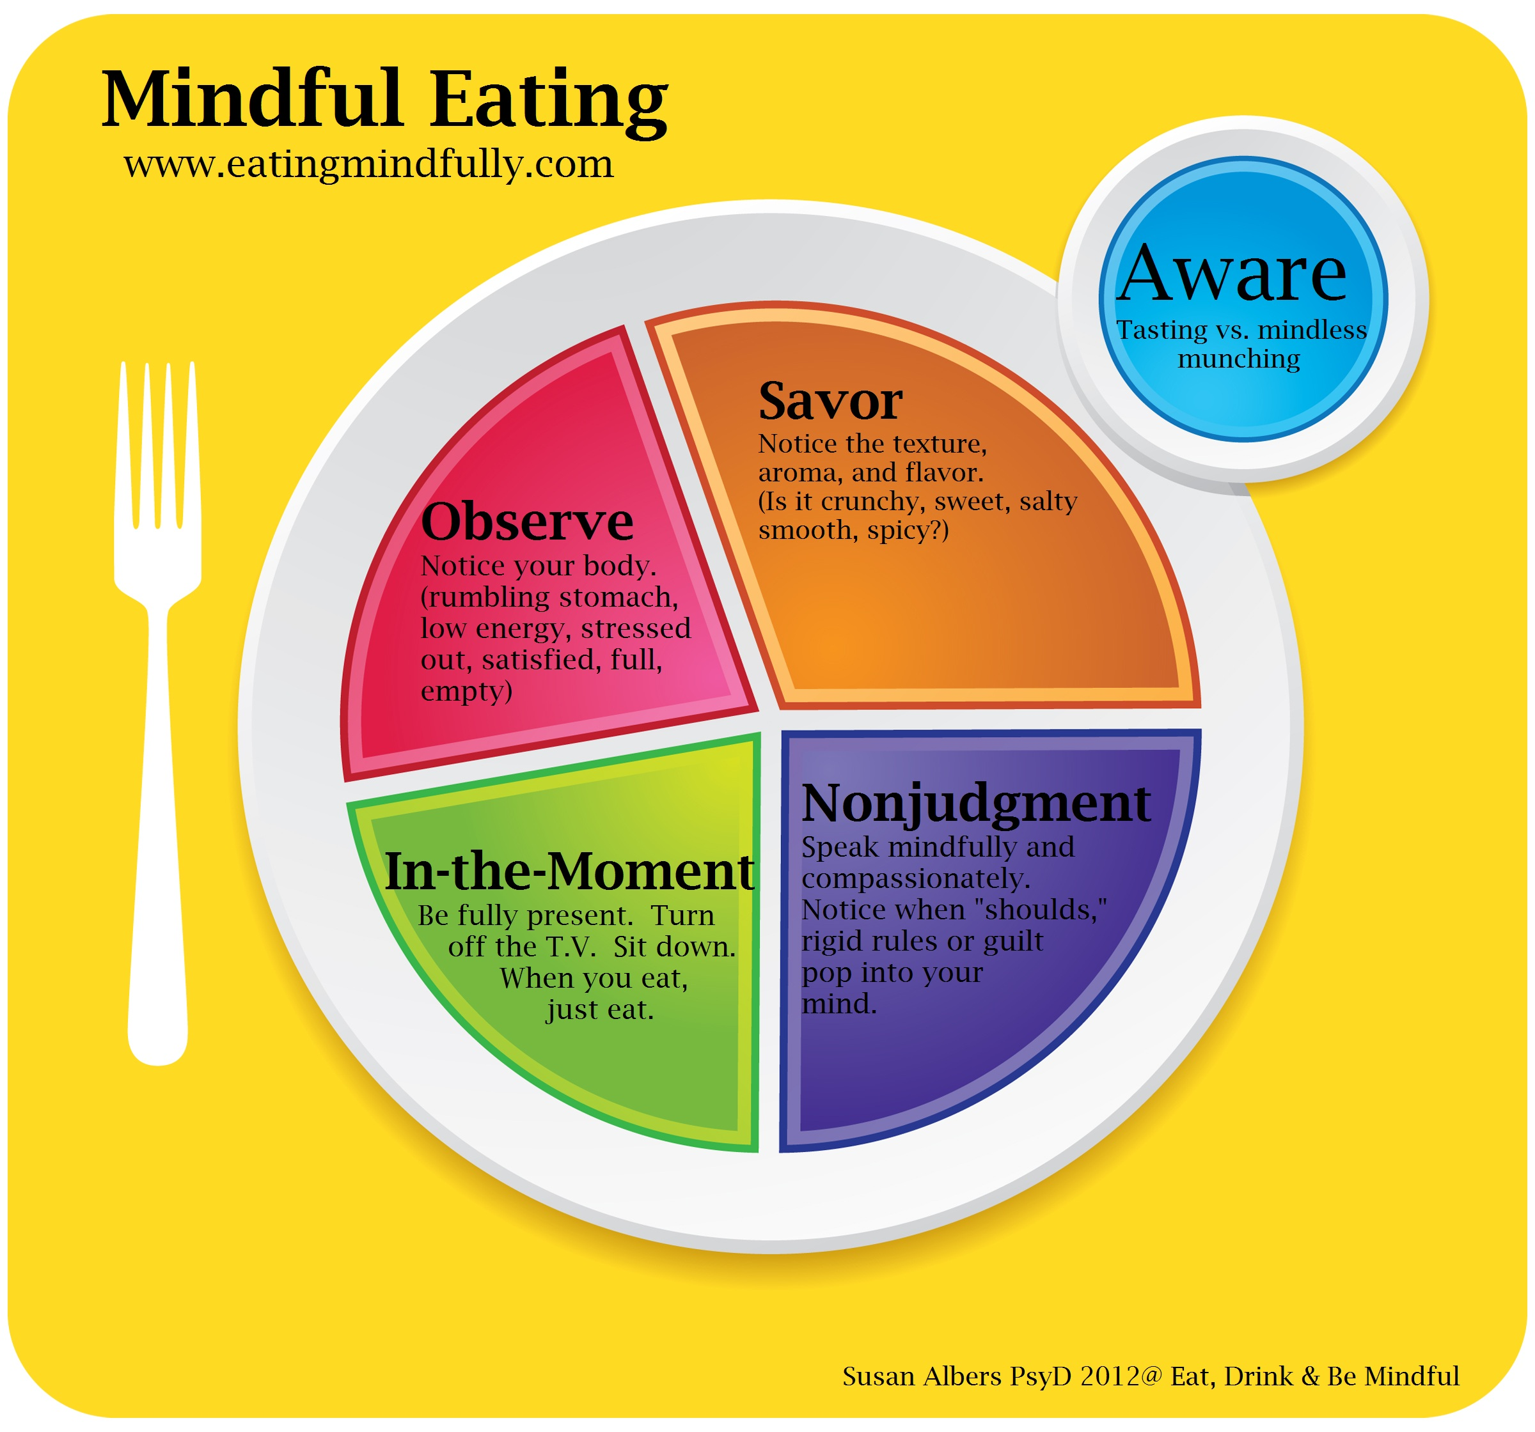
Benefits of Mindful Eating
Increased Awareness of Hunger and Fullness
Stress Reduction
Better Digestion
Healthy Eating Habits
Better Relationship with Food
Decreased Emotional Eating
Sustainability
Connect to your Body and Senses
Improved Health and Consciousness
Notes:
Casey-Marie:
Not to change our diet, just to be more mindful when we eat
=== Additional Resources ===
https://eatingmindfully.com/
Article: https://www.shutterbite.com/blog/mindful-eating-the-complete-beginners-guide
60 minutes interview of Jon Kabat-Zinn w/ Anderson Cooper… 13 mins - https://www.youtube.com/watch?v=ozyr7jVucz0
In it, some interesting people participate including:
Rich Fernandes, ex google Sr People Development Lead, SIY Global/SIYLY CEO
Karen May, google VP People Development
Chad Meng-Tan, Google Jolly Good Fellow, creator of the SIY mindfulness program
Tim Ryan, Ohio democrat, and
Judson Brewer,

Slide 16
Mindful Eating Exercise
Take a couple of deep breaths…
Gently bring attention to your breath
Let’s think about what we are about to eat
As you continue breathing...
Think about the time it took for this food to come to you...
Notes:
Casey-Marie:
For this exercise, try putting distractions away, like your phone and email
Adopt a posture that allows you to be comfortable and with your back straight
Put both feet on the ground
Take a couple of deep breaths…
Gently bring attention to your breath
Let’s think about what we are about to eat
As you continue breathing...
Think about the time it took for this food to come to you...
Chew your food 25 - 30 times before swallowing
Check in with your hunger level and stop eating when full
Smile and be grateful
Article - Why You Should Take a Relaxing Lunch Breakhttp://greatergood.berkeley.edu/article/item/why_you_should_take_a_relaxing_lunch_break
=== Additional Resources ===
It is suggested that for this mindful eating exercise you use a small fruit or veggie, like slices of an orange, it can be slices of an apple, or small chunks of cucumber, or pieces of celery or carrot, or similar.
==Script==
Now think about this fruit or veggie you’re about to eat, let’s think about its origin, let’s imagine where it came from, and to do so, let’s go back in time, to its origins. Let’s go back a few billions years ago, all the way to the big-bang, you may identify with the creation of the universe… and from there, think about all the billions and billions of years that took for the universe to be formed.
Then think about the billions of years for our solar system to form. Now consider the millions of years for the earth to cool down, the air, the water and the soil to form, and give life in our planet.
Now, think about more recent time, the seed that was seeded for the plant that produced what we’re about to eat. The person who took care of it, that watered it, the sun and the air which helped it grow.
Think about the time it took from the plant to your house, perhaps it is something you cultivated in your backyard, or something you bought at the grocery store.
Think about the preparation you took, you may have washed it, peeled it, chopped it, and now it is in front of you.
Now, I invite you to take the piece of food you’re about to eat, pick it up, feel it in your hands, can you tell its temperature, its texture, its form. Be conscious of that.
Now, I invite you to put it in your mouth without biting it, with your tongue, again, feel its temperature, its texture, its form. Be conscious of that.
And now, I invite you to bite on this food, being aware of the explosion of flavour in your mouth, conscious of your chewing, and swallow it when you feel ok to do so.
(give some time for participants to chew and pass the food)
Enjoy the moment
If you have a second piece of food, you’re welcome to eat it
(give participants some time)
… and when you’re done, I invite you to join us and come back

Slide 17
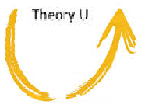
Reflect about today’s exercises
Notes:
Casey-Marie:
Now, before going into small groups debrief, let’s do a plenary debrief, let’s open the microphone for a few of you who would like to share your reflections about today’s exercises
Human Being is enough
Presence
Theory U, Social Presencing Teather
Mindful – Win Win Win
Mindful Eating Exercise
(Give the voice to 2-4 participants, depending on time, likely to start the small groups around 20 minutes before the end of the session)
Now, we’ll do the small breakout rooms, as in previous weeks, you’re going to be randomly assigned to a breakout room so you can do your debriefs in small groups, we’ll see you back in about 12-15 minutes.
(Then create breakout rooms of 4)
(open the breakout rooms while mentioning the following)
Feel free to share:
What you noticed
What you had a hard time with
What you’re reailzing
An intention you have for the week

Slide 18


Your take away practice for week 6
Connecting – Buddy System
Gratitude Journaling – daily
Practice up to 15 mins… chose one - daily
  Body scan or Breathing
  Self-compassion
Be Mindful of your Presence – as much as possible
Apply Mindful Eating
Apply Mindful Win-Win-Win
Notes:
Casey-Marie:
For this week… as usual, if you have any questions, now is the time to ask…
(read from slide until the end)
Homework…
Connecting – once a week with you buddy
Gratitude Journaling – daily
Practice, chose one of the following and
keep doing it for the whole week - daily
Self-compassion
15 mins – https://soundcloud.com/mindfullivingcoach/self-compassion-meditation
15 mins – https://soundcloud.com/awakeningcompassion/awakening-compassion-class-4
20 mins – http://self-compassion.org/wp-content/uploads/meditations/LKM.self-compassion.MP3
Be Mindful of your Presence – as much as possible
20 mins – Loving https://www.tarabrach.com/meditation-loving-presence-2/
5 mins – Arriving - https://www.tarabrach.com/brief-meditation-5-minute/
Apply Mindful Eating – as needed
Apply Mindful Win-Win-Win – as much as possible
http://instituteformindfulleadership.org/guided-reflection-finding-win-win-win-solution/

Slide 19
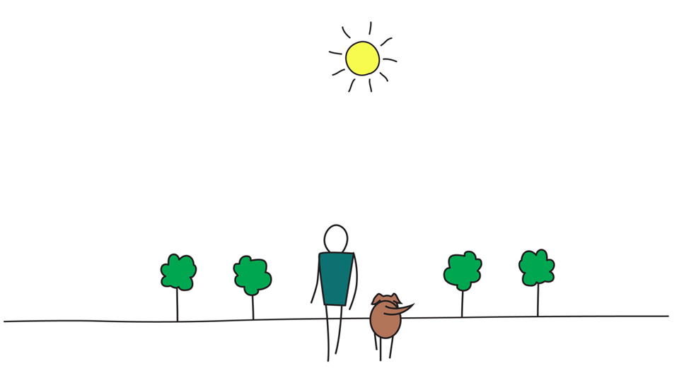

Be Mindful, Be Happy
Notes:
Casey-Marie:

