Slide 1


Community Norms in Action
[PROJECT LOCATION]
DATE

Slide 2
How to use this document
Instructions – Remove this page before using
OBJECTIVE and FOR WHO: For the sponsor and workplace community norms committee to present the norms and have some interaction around hypothetical scenarios. The audience can include any and every employee moving into a space with this new norms.
WHEN: After workplace community norms committee has been established and has identified the community norms .
HOW: If the committee has agreed upon norms that are different than the ones identified here, please adjust the presentation accordingly.
In the scenario portion, allow time for participants to discuss and give suggestions.
* The French version of this document is available here: FR version

Slide 3

Community Norms
Workplace community norms are an agreed upon set of values or principles that help employees share and use the space and collaborate with others.
Workplace community norms contribute to a harmonious and productive work environment, benefiting both individuals and the organization. They provide a framework for interacting with others in a way that promotes harmony and mutual understanding, politeness, courtesy, and sensitivity to others' feelings. In short, they facilitate moving from “me” space to “we” space.
[Describe how the community norms align with your organization’s values. Explain how the committee tackled the development of the community norms.]

Slide 4
Our Community Norms
Awareness: Be aware of others and yourself. It involves being mindful of how our actions and choices affects others, fostering a respectful and collaborative environment.
Respect: Respect people and the environment. It means valuing and considering the well-being of colleagues and our common workspace in every action and decision.
Courtesy: Be mindful and polite in the workplace, considering others’ perspectives and showing respect in all interactions.
Communication: Help create a workplace where there is healthy communication. Encouraging open communication and constructive feedback to ensure understanding, teamwork and collaboration.

Slide 5






Applying the Workplace Community Norms in Every-Day Situations
Notes:
How do we apply these norms in practice? To answer this question, we will now go through a few hypothetical scenarios and look at our community norms can be applied in these situations.

Slide 6


1st Scenario – Awareness and communication
GETTING READY
I must meet the 1 pm deadline for a report. I would like to bring my lunch -an egg salad- at my workstation, hoping to eat it while I put the finishing touch to my report.
Consider the community norms of awareness and communication. What questions should I be asking myself in this situation?
Take a few minutes to reflect and discuss.

Slide 7
1st Scenario – Awareness and communication (cont’d)
GETTING READY
Here are examples of what I should ask myself before proceeding:
Do I see other people having lunch at their workstation or are most people at their workstation just working?
If there are people around me, could they be allergic to eggs or bothered by the smell of my lunch?
Am I ready to accept being told if someone feels bothered?
I can ask around and if it bothers someone or take it to the kitchenette after my deadline is passed.

Slide 8
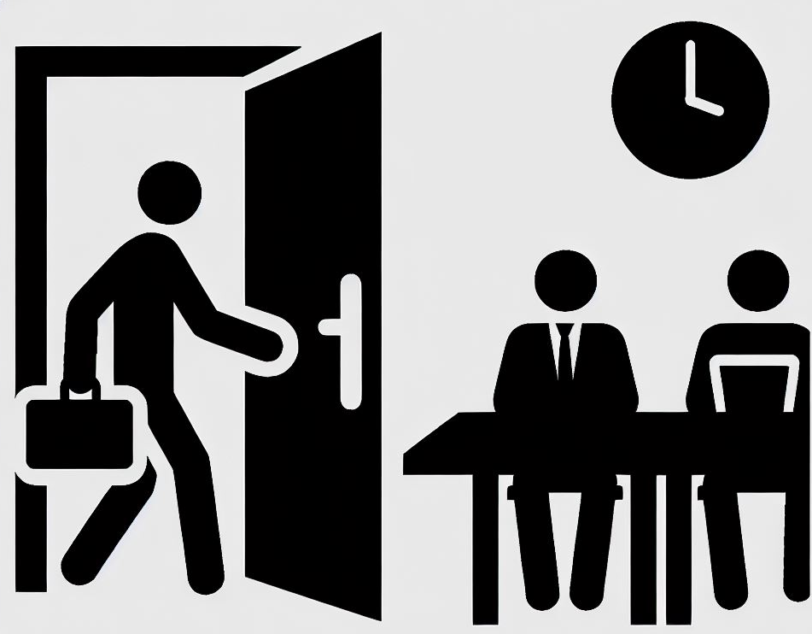

2nd Scenario – Awareness and respect
I booked a meeting room to participate in a conference call with a client. My booking is about to be up, but the conversation is very interesting, and I wish to continue this meaningful exchange.
Consider the community norms of awareness and respect.
What are some different courses of action I could take in this situation?
Take a few minutes to reflect and discuss.

Slide 9
2nd Scenario – Awareness and respect (cont’d)
Here are some different courses of action I could take in the spirit of Community Norms :
Look at the booking system and see if I can extend my reservation.
Contact the person who booked the room after me to verify if they could do me a favour and move their meeting to another room.
Ask for a 5 minutes break with my client and take my meeting somewhere else
Inform my client that I have to respect our initial agenda and book another meeting to continue the conversation.
Have in mind to book an extra 30 minutes next time.

Slide 10


3rd Scenario – Courtesy and communication
I booked a workstation in a quiet zone to do some head down work.
I notice that a group of colleagues near me engage in a casual conversation, talking about their week-ends.
What course of action could I take?
Take a few minutes to discuss and reflect.

Slide 11
3rd Scenario – Courtesy and communication (cont’d)
Here are some ways I could proceed:
Wait 5-10 minutes to see if they wrap-up their conversation.
Evaluate if I should book a closed office given that I require a high level of concentration anyways.
If the noise goes on, politely remind them that this is a quiet zone and ask them to move their conversation to the kitchen or a meeting room.

Slide 12


4th Scenario – Respect and communication
I booked a meeting room for my director who is organizing a brainstorming session with her managers. I notice that she brings coffee and muffins to the group.
When the meeting is over, participants leave very quickly, and coffee cups and muffin crumbs are left on the table. I also note that the white board still has the meeting’s note.
I find it frustrating that the responsibility of cleaning the meeting room falls on me.
How could I proceed?
Take a few minutes to discuss and reflect.

Slide 13
4th Scenario – Respect and communication (cont’d)
Here are a few initiatives I can take :
Ask my director to add a closing agenda item 5 minutes before the end of the meeting where all participants contribute to leave the room as clean as it was when they entered.
Do a reminder at the next team meeting that it’s everyone responsibility to clean the meeting room at the end of their meetings.
Contact the accommodation team to inform them of this recurring issue and ask them to do a reminder to staff in the next internal newsletter.

Slide 14
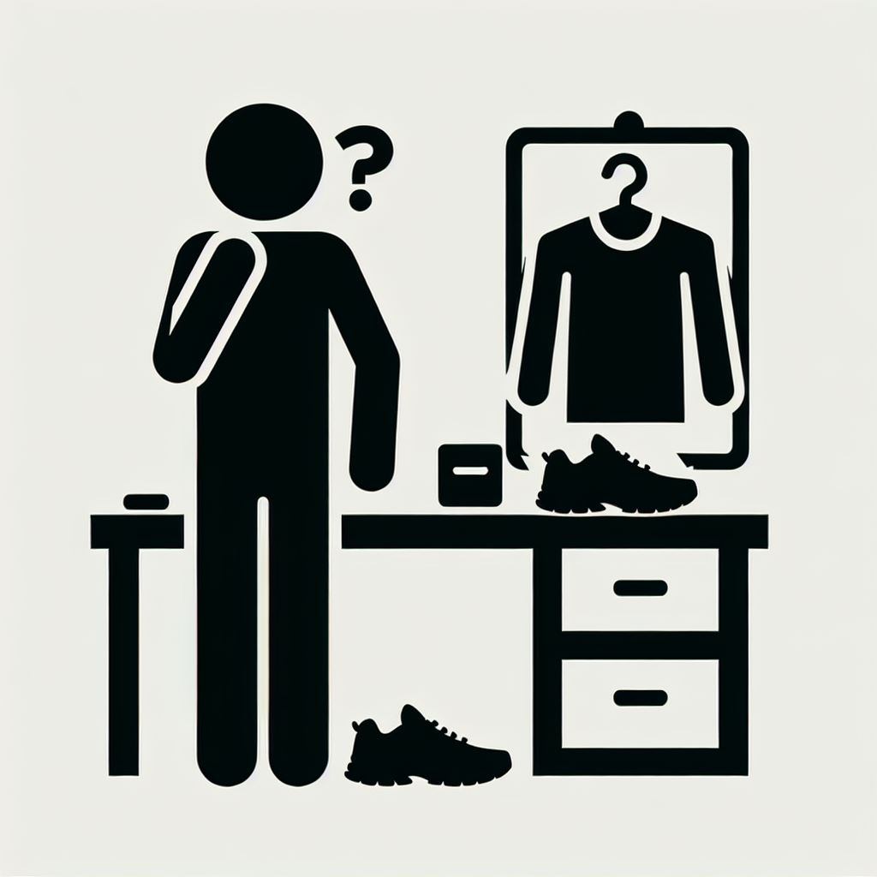

5th Scenario – Respect and Awareness
I am training for a half-marathon race in the fall, and I go for a run at lunch break. For convenience, I would like to leave my training gear at the office for the week and bring it back home on Friday.
I could probably subtly squat a locker, but they are supposed to be for daily use since they are limited, which means someone might not have access to a locker because of me.
What are things I should consider in this scenario?
Take a few minutes to reflect and discuss.

Slide 15
5th Scenario – Respect and Awareness (cont’d)
Here are considerations in this scenario:
Does the building have a locker room for people using alternate transport and offers seasonal assigned lockers?
Could I ask the accommodation team if they could temporarily assign me a locker?
Is there somewhere else where I could leave my things ? Shoes could stay in a closet and water bottle in a cabinet in the kitchen.
I drive to work; I could just leave my gym bag in my car.

Slide 16
A Collective Effort for Our Collective Benefit
GETTING READY
Being mindful of these norms in the workplace will be our collective responsibility and will enable us all to reap the benefits of a healthy work environment.
Being mindful of the norms of awareness, communication, respect, and courtesy, will help us:
Foster Collaboration: By adhering to community norms, we create a supportive environment where collaboration thrives.
Promote Harmony: These norms help us maintain a respectful and harmonious workplace, enhancing overall productivity and job satisfaction.
From “Me” to “We”: Embracing these norms helps us transition from individualistic to collective thinking, fostering a true sense of community.

