Slide 1
Task to service mapping resources
Digital Transformation Office (DTO) November 2022

Slide 2
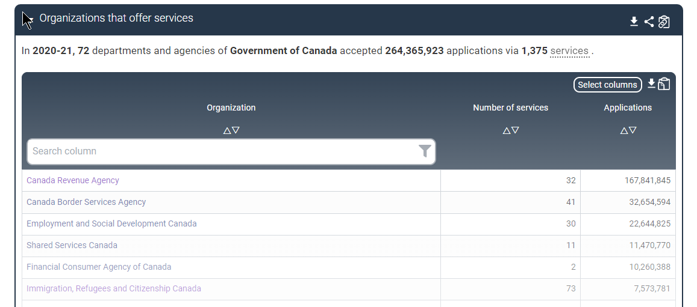
Service inventory data published on GC InfoBase
https://www.tbs-sct.canada.ca/ems-sgd/edb-bdd/index-eng.html#infographic/gov/gov/services

Slide 3
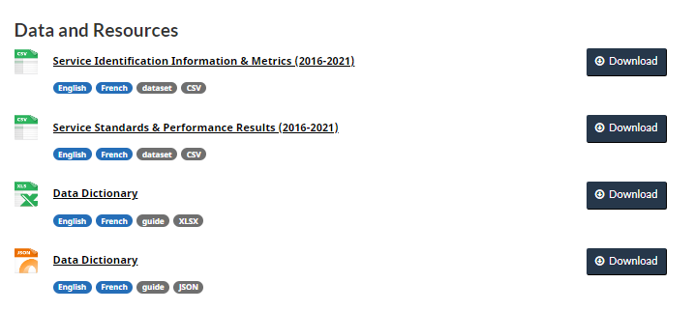
Service inventory downloadable as open data
https://open.canada.ca/data/en/dataset/3ac0d080-6149-499a-8b06-7ce5f00ec56c

Slide 4
Service inventory data
Fiscal Year Service ID Number Service Name Department Name External Service or Internal Enterprise Service Service Type Special Designations Service Description URL to Service Program Name Year of last GBA+ Digital Identity Platform Client/Target Groups Information Service Service Fees Use of CRA Business Number Use of Social Insurance Number | Service Delivery Channels Number of Telephone Enquiries Received Number of Website Visits (Information-Based Services) Number of Applications Submitted Online Number of Applications Submitted by Telephone Number of Applications Submitted In-Person Number of Applications Submitted via Postal Mail Number of Applications Submitted via other channels, such as email or fax E-enabled Services - Registration E-enabled Services - Authentication E-enabled Services - Application E-enabled Services - Decision E-enabled Services - Issuance E-enabled Services - Feedback Client Given Opportunity to Provide Feedback on Level of Satisfaction with this Service by Channel Special Remarks
See downloadable data dictionary for details: https://open.canada.ca/data/en/dataset/3ac0d080-6149-499a-8b06-7ce5f00ec56c

Slide 5
DTO tasks to services mapping
https://docs.google.com/spreadsheets/d/10yUFB27DTMrUpkL5bkhlfaUK2kK0ijMnDnVv7Vyz2L8/edit?usp=sharing

