Slide 1
Robotic Process Automation (RPA)
What can RPA do for you
October 2021

Slide 2
Overview
1
What is Robotic Process Automation (RPA)
What is RPA
Types of Bots
What is Artificial Intelligence
Successes with RPA
How to start your RPA journey
Kick start your journey
Considerations
Questions
2

Slide 3
What is Robotic Process Automation (RPA)
What is RPA
Types of Bots
What is Artificial intelligence (AI)
Successes with RPA

Slide 4
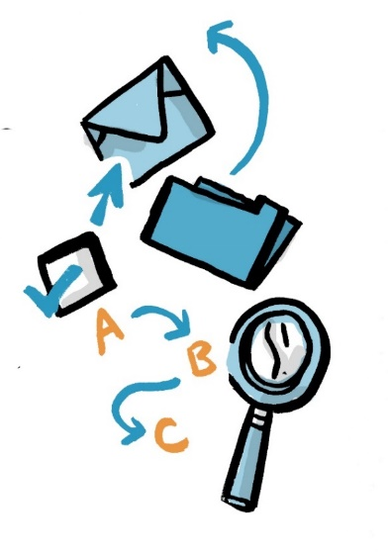
What is RPA
Robotics Process Automation is a technology that helps automate internal processes, and reduces the amount of manual and repetitive tasks. RPA empowers employees to focus on value-added work that requires human judgement and decision-making.
Process Automation can…​
Access and gather data from multiple systems
Move data from one system to another
Check and update data across multiple systems
Consolidate information from different sources
Fill standard forms and pre-populate data
Perform data calculations

Slide 5
Types of Bots
There are two types of bots that can be used for process automation: Attended and Unattended. However, neither can rival the creative capacity and problem-solving abilities of humans.
Attended Bots
Unattended Bots
The user triggers the bot to run for a specific task, right on their desktop. Automations operate as a virtual desktop assistant, streamlining repetitive and manual processes.
For example, tasks that include logging into systems, issuing documents, copying and pasting information, and pre-populating forms.
The bot is not trigged by the user, it is self-triggered and works in the background based on predefined conditions.
For example, bots can validate files for processing.

Slide 6
What is Artificial intelligence
Artificial Intelligence (AI) is digital solutions that exhibit human or higher-level judgement to carry out tasks for the department. It is assumed that AI solutions contain some machine learning elements that enable them to continually improve their ability to carry out the task.
What AI is and what it is not…
A spreadsheet that calculates sums and other pre-defined functions on given data
Why: The user-specified formula determines the outcome with an automated calculator, no AI needed.
A GPS navigation system
Why: The signal processing and geometry used to determine the coordinates is not AI. Nevertheless, if variables such as traffic conditions are taken into account for providing good suggestions for navigation (shortest/fastest routes) then AI can be integrated into the GPS navigation system.
Treasury Board Definition:
Information technology that performs tasks that would ordinarily require biological brainpower to accomplish, such as making sense of spoken language, learning behaviours, or solving problems.

Slide 7
RPA Successes
Since 2018, ESDC has successfully deployed RPA capabilities into our Service Canada processing operations. In the first year, Service Canada leveraged RPA for 183,000 CPP and OAS transactions. In 2020-21 the volumes exceeded 550,000 transactions, and for 2021-22, RPA is forecasting between 600,000 and 650,000 CPP and OAS transactions.
Since then, pensions processing has successfully automated 14 Pensions-related processes and build capability to continue develop RPA to address increased workload pressures.
Since the introduction of RPA:
there have been 14 automations processes implemented nationally with over 1M transactions automated.
another 4 processes will be implemented in the 2021-22 fiscal year;
about 79% reduction in processing time on the Death Notifications automation; and
about 38% reduction in Guaranteed Income Supplement (GIS) Auto Enroll (AE) processing time.
While pensions processing has successfully build capability to continue develop RPA to address increased workload pressures, ESDC just ESDC kicked off EI RPA to support the Department’s response to COVID-19 in April 2020. To date, the EI RPA operations have successfully deployed 8 automations into production to support EI Processing and Call Centres .

Slide 8
How to start your RPA journey
Kick start your journey
Considerations
Questions

Slide 9
Kick start your journey
There are several things to think about before embarking on your RPA journey. Clearly determining your business needs will help you identify whether RPA is a viable solution.
To kick start your journey, you should:
Determine your business needs and the right processes to automate (design thinking)
Consult your IT Innovation Department
Check your available resources (financial, HR, key partners, etc.)
Consult with your senior management
Confirm your need for procurement (consult with your experts!)
Begin plans for project management (governance, gating, change management, communications and engagement, etc.)
Process types that are best suited for RPA are…
Based on structured input data
Involved significant manual work
Prone to discrepancies associated with data entry
Require employees to access a limited number of platforms or applications
Prone to fluctuations in demand and / or backlogs
Mid-to-high transaction volume
Replicated processes

Slide 10
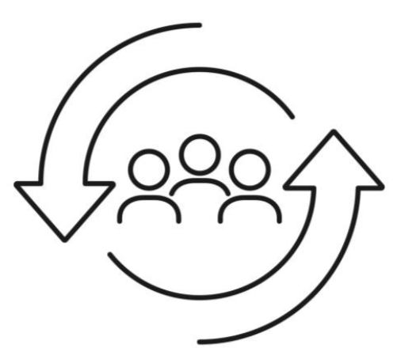
Considerations
As you are implementing RPA in your business processes, there are many elements to consider.
Monitoring and Reporting
RPA Implemented
Continued maintenance & communications
Bot pilots and training
Bot development & testing
Change Management
Enhancements
Securing Resources
Engagement & Communications
Governance
Determining ROI
Determining
PM Approach
RPA Project Begins
Notes:
Elements to consider in your business process:
Understanding the needs of your users
Do your research on RPA
Find the common lessons learned
Consult with other Departments on their experience
Determine a suitable governance structure
Define roles and responsibilities
Change management communication is an essential function of a successful RPA experience

Slide 11
Questions
If you have any questions on RPA, please contact Jonathan Larocque.

