Slide 1
MVRAntO&M
MVRAntG&C
MVRIntExtXfers
MVRAntSalary
MVRCCDICRollup
Disaggregate
Projection: Branch
Grouped by: Fund
Branch
Centres
BOP
Centres
(Divisions grouped by Centre but granularity is at Division – Branch totals )
Total of Divisions = Branch totals but not broken out by Fund (no fund data in BOP)
BOP
Projection: Division
Grouped by: Branch Activity
Division
Total of Sections = CCDIC totals but not broken out by Fund (no fund data in BOP)
PMR
Projection: Section
Grouped by: Key Activity Area
Section
(CCDIC only)
Aggregate

Slide 2
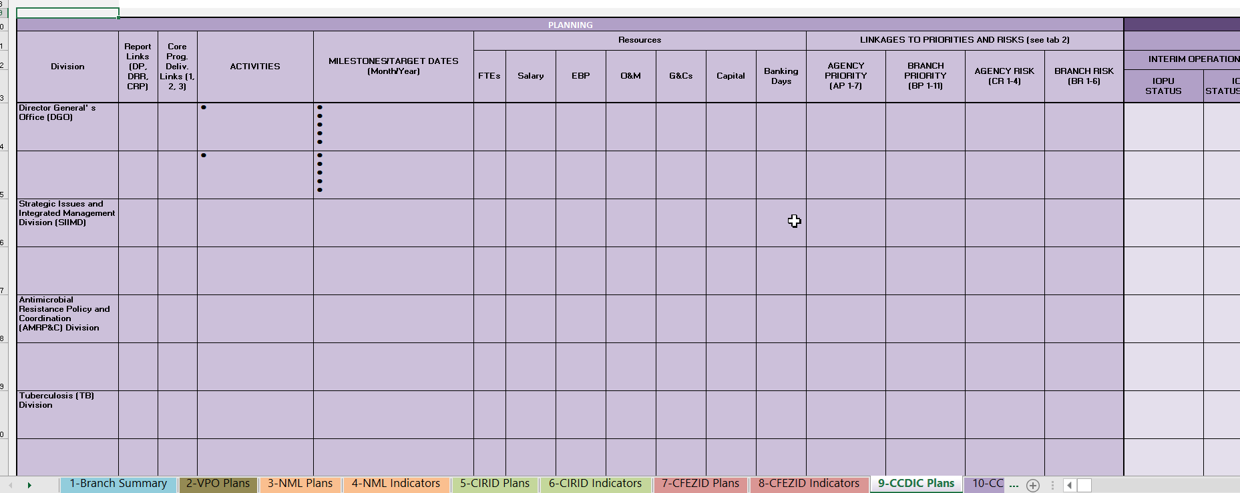
CCDIC Work Planning Tools 2020-21
1. Work planning slides
󠅎∑
󠅎∑
󠅎∑
󠅎∑
󠅎∑
2. BOP
3b) PMR to BOP
3a) PMR

Slide 3
CCDIC Performance Measurement Tool
Report Sections
I Reporting Manager’s Name, coordinates and Date, filling in the 2017-2018 PMT
II Knowledge Creation and analysis outputs
III Knowledge Translation, Transfer and mobilization outputs
IV Policy, Planning/Program development and Performance Measurement/Reporting/Evaluation output(s)
1 1) Planned and 2) Completed this last Fiscal Year
Section’s Outputs
Output Completed
Quarter When completed
Type of output
Funding Source
2 Output Subject Content
Section’s Outputs
Subject content
Description of Subject content
3 Context in Which the Output was Generated
Section’s Outputs
Context in Which the Content was Generated
4 Outputs Addressing the Determinants of Health
Section’s Outputs
Output Addressing the Determinants of Health
Key Determinants of Health
Explanations
5 Outputs Developed in Partnership(s)
Section’s Outputs
Output Developed in Partnership?
Type of Partner
Names of Key Partners
Level of Collaboration
6 Primary Target Audience(s)
Section’s Outputs
Primary Target Audience
7 Output Dissemination
Section’s Outputs
Output Planned To be Disseminated
Output Disseminated as Planned
Output Disseminated in 2017-2018
Date of Dissemination
Level of Dissemination
8 Output Dissemination Mechanism(s)
Section’s Outputs
International Standard Book Number (ISBN)
Mechanisms of Dissemination
Published on PHAC website: Provide URL
If Published on Website provide the number of hits
If distributed by email: Indicate number of copies distributed
If Social Media: Indicate the Metrics (Header)
Tweet and Re-Tweet
Followers
YouTube Visits
Facebook Likes
9 Webinar(s) held for specific stakeholder(s) within a year after completion?
Section’s Outputs
Webinars held within a year after completion
Total Number of Individuals Who Participated in the Webinar
Total Number of Organizations Who Participated in the Webinar
Total Number of Knowledge Translation, Transfer and Mobilization Products Finalized in a given year
10 Education modules / Workshops completed in 2017-2018
Section’s Outputs
Total Number of Individuals who participated in educational module / workshop
Total Number of Organizations who participated in educational module / workshop
Total Number of educational module / workshop held in 2017-2018

Slide 4
CCDIC Performance Monitoring Report
SectionID
2020-21
Section
Key Activity Area
Function
CDIC PMT
Deliverable Purpose
"ACTIVITIES (from BOP)"
Deliverable Types
Risks
Deliverables
Deliverable Delivery (Q1,Q2,Q3, Q4, Cancelled)
Deliverable Status
Key Milestone
Key Milestone Delivery
Key Milestone Status
Funding Source
FTEs
Salary
EBP
O&M
G&Cs
Capital
"Banking Days"
Risks
Staff Lead
Professional Service Requirement
Number of Pages (ENGLISH PUBLICATION)
Number of Pages (FRENCH PUBLICATION)
Forcast Month to Engage Services

Slide 5
Branch Operational Plan
Division
DP / DRR Plan (x)
Activities
Milestones / Target Dates (Month/Year)
Financials
FTEs
AGENCY PRIORITY
(AR #1-4)
BRANCH PRIORITY
(BP #1-11)
AGENCY RISK
(CR #1-4)
BRANCH RISK
(BR #1-6)
MYR STATUS
STATUS UPDATE
MITIGATION STRATEGIES/NEXT STEPS
YER STATUS
STATUS UPDATE
MITIGATION STRATEGIES/NEXT STEPS
ADDITIONAL COMMENTS / CONSIDERATIONS / RISKS / IMPACTS

Slide 6
Multiple Variance Reports
MVR Anticipated O&M
MVR Anticipated G&C
MVR Internal / External Xfers
MVR CCDIC Rollup
MVR Anticipated Salary
Branch
Directorate
Division Name
Division Code
Cost Centre
Fund
FA Code
Internal Order Code
Cost Element Group
G/L Code
Anticipated Expenditure Amount
Description of Anticipated Expenditure
Risk
Status and explanation of risk
Branch
Directorate
Division Name
Division Code
Cost Centre
Fund
FA Code
Internal Order Code
Cost Element Group
G/L Code
Anticipated Expenditure Amount
Description of Anticipated Expenditure
Risk
Status and explanation of risk
Branch
Directorate
Division Name
Division Code
Cost Centre
Fund
FA Code
Adj to Plan Branch Internal
Adj to Plan Branch External
Details of Transfer (indicate where the transfer is going to/coming from and for what reason)
Branch
Directorate
Division Name
Division Coding
Cost Centre
Fund
FA Code
Internal Order
Anticipated Expenditure Type
Group & Level
Step
Position no. (if known)
Position Title
"Planned Tenure"
Scope of Hiring
Estimated Start Date
Estimated End Date
Anticipated Expenditure Amount
Risk
Status and Comments
Fund
Fund Description
Current SAP Plan
Adj. to Plan Branch Internal
Adj. to Plan Branch Ext.
Revised Plan
Actuals
Pending Invoices
Commitments
Anticipated Expenditures
Year End Forecast
Surplus /Deficit

Slide 8
BOP
Planning
Division
DP / DRR Plan (x)
Activities
Milestones / Target Dates (Month/Year)
Financials
FTEs
Linkages To Priorities and Risks
Agency Priority (AR #1-4)
Branch Priority (BP #1-11)
Agency Risk (CR #1-4)
Branch Risk (BR #1-6)
Reporting
Results
MYR Status
Status Update
Migration Strategies / Next Steps
YER Status
Status Update
Mitigation Strategies / Next Steps
Additional Comments / Considerations / Risks / Impacts

