Slide 1
Maintaining Acquired Linguistic Skills through Mini-Talks
Best Practices Forum on Official Languages
Date Presented: 6th February 2024
Hollweg Apollon, Pierre Girard, Julien Thibert-Leduc
Official Languages Centre
Canadian Food Inspection Agency

Slide 2
Who are we?
The Canadian Food Inspection Agency (CFIA) Official Languages Centre Team
Hollweg Apollon – Assistant Director
Pierre Girard – Team Leader
Julien Thibert-Leduc – Official Languages Officer

Slide 3
The problem
Problem we wanted to solve;
We noticed the ever-increasing costs for employees who had to retake their second language assessment (ELS) orally.
Each employee who has not practised their second language since their last assessment (often 5 years) has to undergo training which can cost between $18,000 and $25,000.
The three main objectives of the program are:
To enable every staff member to practise their second official language in order to maintain their language level in a safe and nonjudgmental environment, thereby removing the embarrassment that some staff members feel about using their second language.
Significantly reduce the Agency's training costs associated with refresher courses.
Promote linguistic duality within the Agency.

Slide 4
What are we looking for! A simple, effective and affordable program
The target audience:
All CFIA employees who have achieved at least a “B” level.
Benefits for all:
For employees:
Practise your 2nd language in a social and non-binding context;
Help maintain and/or improve your oral language level.
For the Agency:
Reduction of training costs related to oral exam preparation;
Elimination of absences for oral preparation training.
Features:
Quick and easy enrolment (SharePoint).
Simplified supervisor approval.
Flexible—Allows the learners to choose the time that suits them.
Various topics related to daily and cultural activities outside of work.
Peer facilitation.
Allows for different time zones.

Slide 5
Comparative analysis of similar initiatives in the Agency.
Personalised approach:
It is characterized by its ability to adapt teaching to the individual needs, preferences and learning styles of each learner.
Individualized monitoring and support:
By offering individualized monitoring and support to each learner to help them improve and progress more quickly.
Communicative and practical approach:
Emphasis is placed on real communication skills and practical use of the target language. We offer activities based on everyday situations and role-plays that allow learners to put their language skills into practice in real-life contexts.
Taking culture into account:
It integrates cultural elements related to the target language to help learners better understand the culture, customs and idioms.
Flexibility and accessibility:
It is characterized by its flexibility and accessibility. We offer flexible course schedules and are able to adapt to learners’ constraints and preferences, making language learning more convenient and accessible for everyone.
Experience and expertise:
It is characterized by its teaching team of passionate facilitators, supervised by highly qualified teachers with experience in teaching the target language. Their expertise and passion for teaching contribute to a superior learning experience.

Slide 6
Communication and approval strategy
Present the project to the agency’s official languages ​​champions;
Demonstrate that the program will adds value to the efforts of the regional champions.
Present the project to our Executive Director for approval;
Demonstrate the impact of this program on staff satisfaction and sense of belonging.
Present the project to our Vice-President (Human Resources) for approval;
Demonstrate how it aligns with the HR management objectives.
And finally, present the project to our Senior Management Committee for approval;
Demonstrate the positive impact on our organization.
No cost for the agency;
Significant reduction in training costs;
Promotion of linguistic duality;
Reduction of complaints related to the OLA;
Promote the “Active Offer of Service”;
Possibility of introducing it to executive performance evaluations.

Slide 7
Our approval process A- Launch of a pilot project
Objective:
Demonstrate the need for and feasibility of the program;
The main features of the program.
Practice your second official languages in a professional context without embarrassment;
Organize lunchtime discussion sessions (1 hour per week) led by staff volunteers;
Facilitate the formation of groups and offer varied and topical topics for discussion;
Minimize preparation time for facilitators and participants;
Limit participation to those whose level in the oral test is at least “B”.

Slide 8
Our approval process B- Demonstrate the benefits of practicing a 2nd language
1. Improved language skills:
Allow a higher level of self-control.
2. Strengthening cognitive skills:
Helps improve cognitive functions such as memory, attention and problem solving.
3. Personal development:
Helps develop qualities such as patience, perseverance and creativity. Learning a language requires personal investment and regularity of effort.

Slide 9
Our approval process C – Present our action plan for success
Identify learners' specific language learning objectives and needs;
Provide a progressive curriculum that offers interactive learning opportunities;
Make available our pedagogical and technological resources to support learning, such as manuals and dictionaries;
Recruit motivated and qualified facilitators in the target language;
Conduct regular assessments to identify areas that require particular attention;

Slide 10
Our approval process C – Our action plan for success (continued)
Encourage active learner participation by providing interactive and engaging activities;
Provide ongoing post-training monitoring and support to enable learners to maintain and further improve their language skills;
Regularly evaluate and adjust the program and teaching methods based on learner’s feedback and evaluation results;
Promote a positive learning atmosphere where learners feel comfortable taking risks and practicing the target language without fear of judgment.

Slide 11
Evolution of the du program
2021 – Launch of the pilot project.
2022 – Launch of the program (Levels B, C and E).
2023 – Creation of groups reserved exclusively for members of management (EX) (French only).
2024 - Creation of groups reserved exclusively for members of management (EX) (French and English).
2025 –Introduction of level A group.

Slide 12
Running the mini-talk program with minimal resources
Define our role.
Be the interface between the facilitators and the participants.
Provide the necessary tools for the smooth running of the session.
Promote and ensuring continuity with the client.
Internal communication of the Agency.
Liaise with the OLC through the language training and ELS components.
Participants and facilitators of previous sessions.
Reduced administration.
Synergy between Excel, SharePoint, Teams, and Outlook applications.
Creation of groups in a semi-autonomous way that suits the facilitators as well as the participants.
Be flexible with clients who come from all over Canada.
Look at the gradual adjustment of the program from session to session taking into account client expectations. Understand that this is an iterative process.

Slide 13
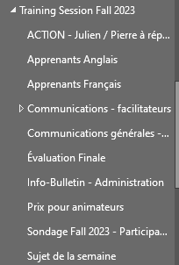
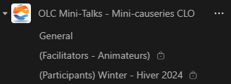
Integration Outlook-Teams-SharePoint-Excel
Interested customers send an email to our generic Outlook mailbox. This is the entry point to the program.
We receive their written commitment to respect the eligibility criteria. They indicate their preference regarding the language and level of the group.
We add them to our Teams group dedicated to mini-chats.

Slide 14
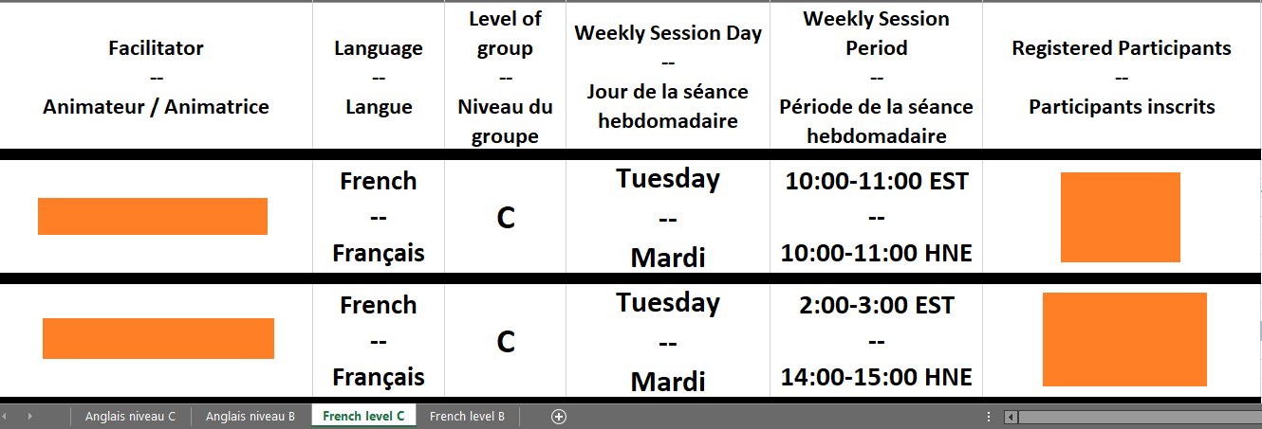
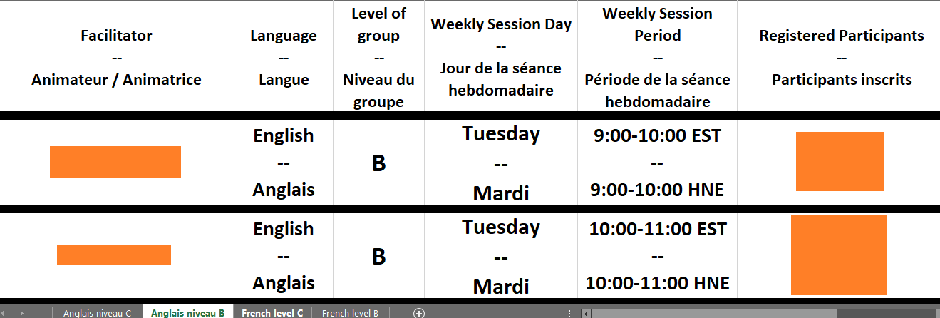
Autonomy at registration
Based on the facilitators' preferences, we create tables in Excel that display the groups.
Participants can register for a suitable group.

Slide 15
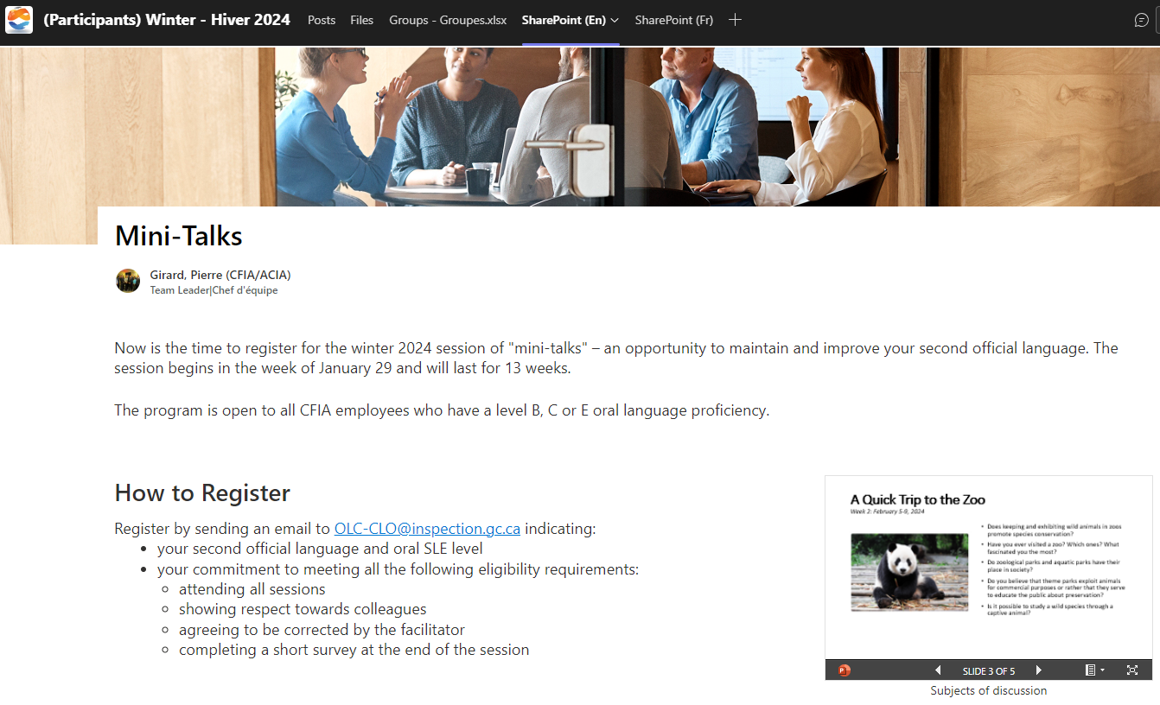
Details on the Program via SharePoint

Slide 16
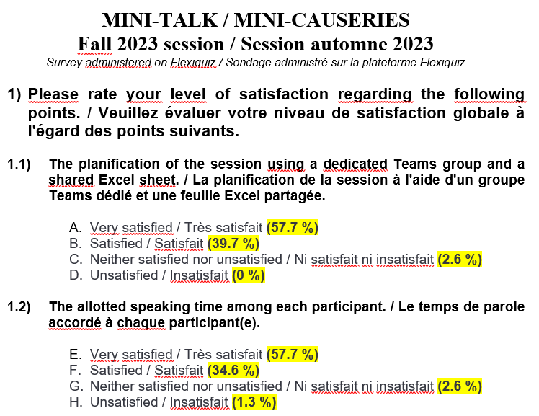
Program evaluation
At the end of the session with our account on the website, we ask the participants to complete a short survey.
www.Flexiquiz.com.

Slide 17
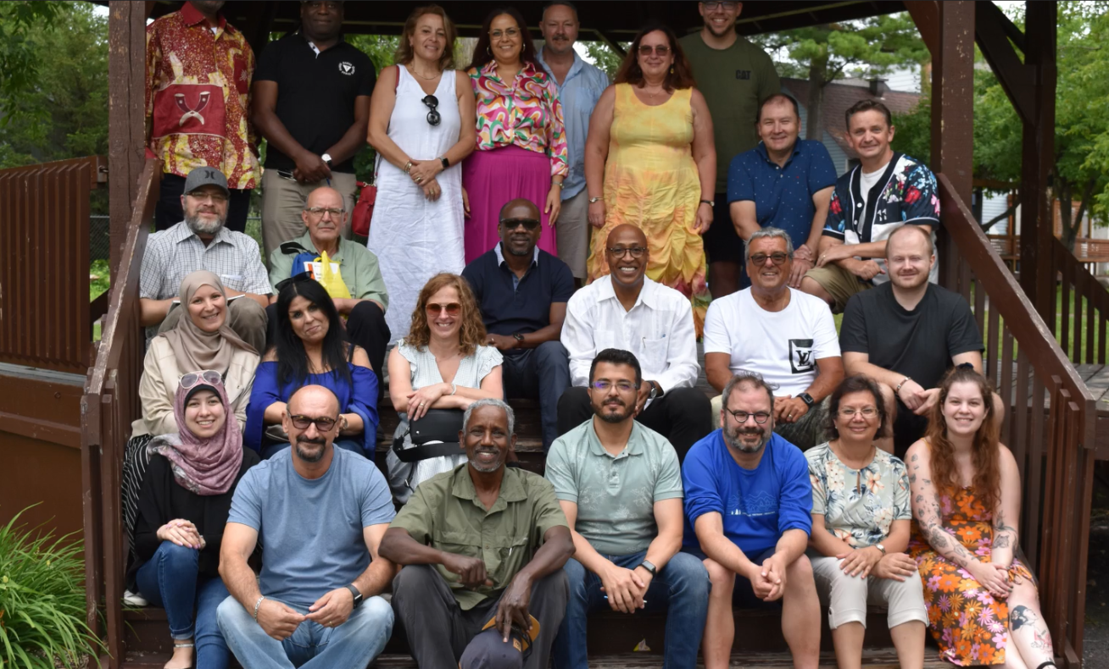
Everyone has an important role to play The OLC’s team that contributed to this success

Slide 18
Questions ?
If you want more information about this program, please contact us by email at:
Pierre.girard@inspection.gc.ca
Julien.thibert-leduc@inspection.gc.ca

