Slide 1
Workplace Transformation Program
INFORMATION SESSION
Prepared by Accommodations Management & Workplace Solutions
Real Property Services
January 2023

Slide 2
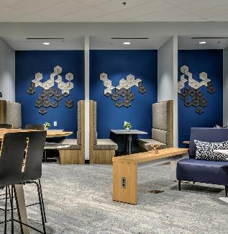
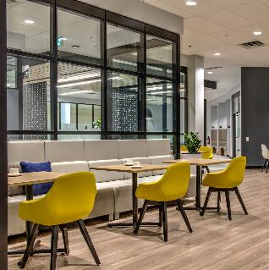
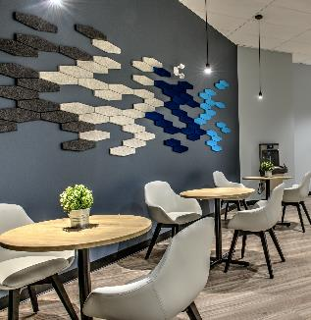
TABLE OF CONTENTS
PART A - PROGRAM DEFINITION & OBJECTIVES
Definition, Objectives & Efficiencies
Scope & Bundle of Goods
Project Admissibility Criteria
PART B - INTERIOR DESIGN PRINCIPLES & METHODOLOGY
What is GCworkplace?
Design Principles & Features
Design Inspiration & Mood Boards
PART C – PROJECT IMPLEMENTATION
Requirements Gathering & Design Methodology
Project Scope
PART D – CLIENT ENGAGEMENT
PSPC Role & Support
Client Role & Responsabilities
Project Process & Next Steps

Slide 3
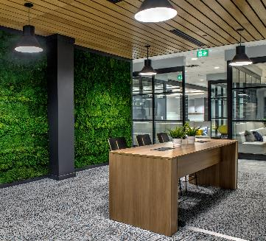
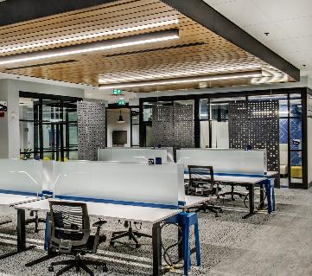
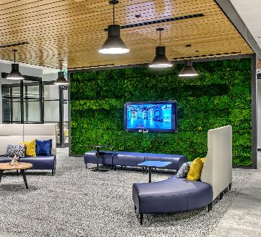
TABLE OF CONTENTS
PART A PROGRAM DEFINITION & OBJECTIVES

Slide 4
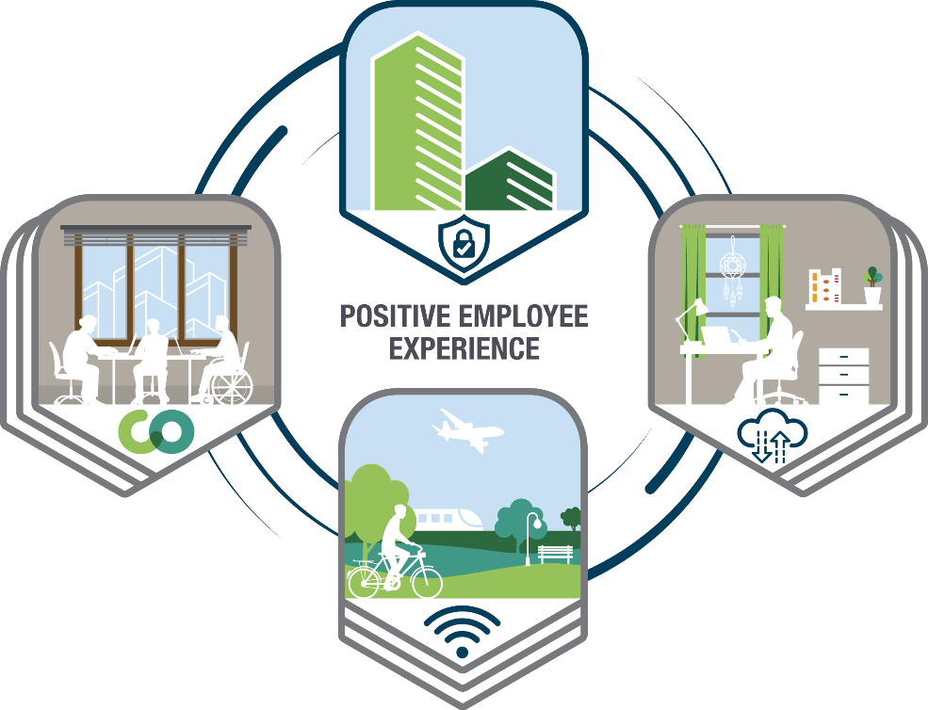
WORKPLACE TRANSFORMATION PROGRAM
The Workplace Transformation Program will efficiently provide organizations with a modernized workplace that supports a hybrid working model.
4
Notes:
Hybrid working is comprised of an ecosystem of workplaces: Home, Office, Shared spaces like Gccoworking and even other locations.
Change management alongside project management can help create a positive employee experience in all these workplaces using a employee-centric approach.
The Workplace Transformation Program will efficiently provide organizations with a modernized workplace that supports a hybrid working model. Providing a workplace that supports flexibility, collaboration and the new ways of working that contribute to a positive employee experience!

Slide 5
WORKPLACE TRANSFORMATION PROGRAM
Definition
A Workplace Transformation Project is an office accommodation project based on GCworkplace standards. Designed to deliver activity-based workplaces via furniture-first solutions and repurposing existing constructed elements. WTP projects follow a specific process to support the speed of delivery.
Projects are delivered in a shorter timeframe and are more cost-effective than full fit-ups.
Objectives
Efficiencies & Innovations
Maintain as much of the existing constructed elements as suitable & limit base-building intervention
Reuse suitable existing furniture
Create modern workpoint solutions
Improve accessibility and inclusivity of the workplace
Focus on sustainability
Deliver a compliant GCworkplace
Standardized, all-in-one bundle of goods
Pre-defined workpoints & furniture components
Condensed process for both for PSPC Governance and client approvals
Condensed functional programming & design
New furniture and IT/AV equipment procurement tools and processes

Slide 6
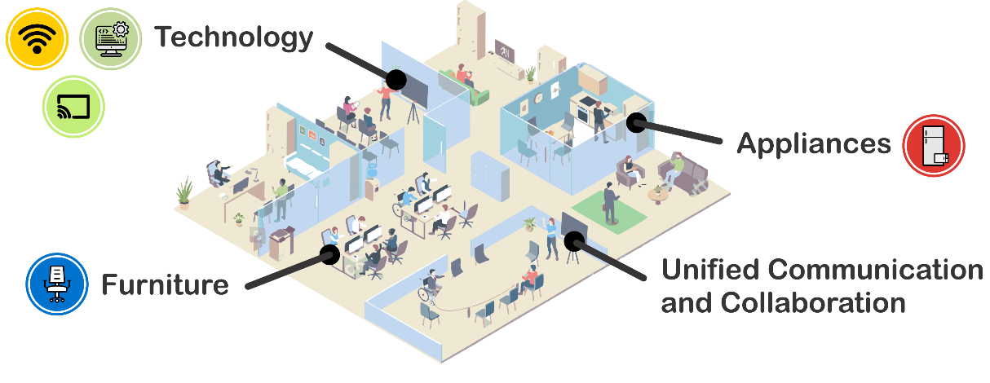
WORKPLACE TRANSFORMATION PROGRAM
TURNKEY SOLUTION
A modern GCworkplace
Complete bundle of goods
Advice and guidance from a PSPC workplace strategist and Change management expert
A Change Management Program in-a-box
Interior Design services to assess your requirements and translate your needs into a design solution

Slide 7
WORKPLACE TRANSFORMATION PROGRAM
SCOPE & BUNDLE OF GOODS
PSPC will assume the initial costs of:
Furniture, fixtures, equipment, AV and IT as per GCworkplace Bundle of Goods
Installation of Wi-Fi and associated IT cabling as required
Mandatory accessibility upgrades to workplace and base-building washrooms
Replacement of finishes as required
New demountable partition assemblies as required for compliant design
Wayfinding and identification signage
Electrical and mechanical changes to support new design
Minimal base building work*
Kitchenette improvements and appliances as required
One-time costs to prepare and load data to Archibus reservation system
*If more extensive base building work is required, specific exemptions will need to be sought through governance and rationale be provided as to why it would not better suited as a traditional fit-up project
Client ongoing costs:
Wi-Fi service & maintenance
Reservation system service
Resources required to meet employer Health and Safety requirements (Workplace Coordinator role)

Slide 8
WORKPLACE TRANSFORMATION PROGRAM
PROJECT ADMISSIBILITY CRITERIA
SCREEN B: SITE SUITABILITY
Existing space must meet specific requirements & new design must comply to GCworkplace
SCREEN A: PORTFOLIO ALIGNMENT
Asset must have medium to long term retention strategy & project must enable net reduction portfolio
SCREEN C: ORGANIZATIONAL READINESS
Ready & willing client with min. 50% mobility, and adoption of activity based working

Slide 9
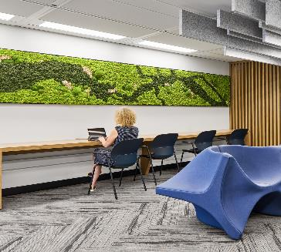
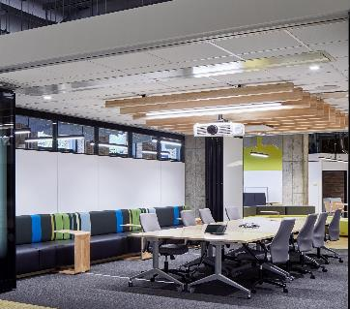
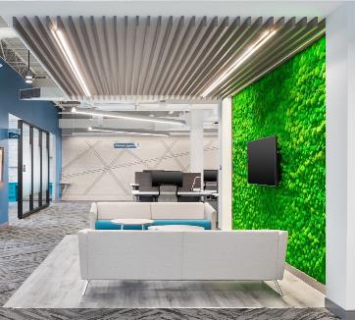
TABLE OF CONTENTS
PART B INTERIOR DESIGN PRINCIPLES & METHODOLOGY

Slide 10
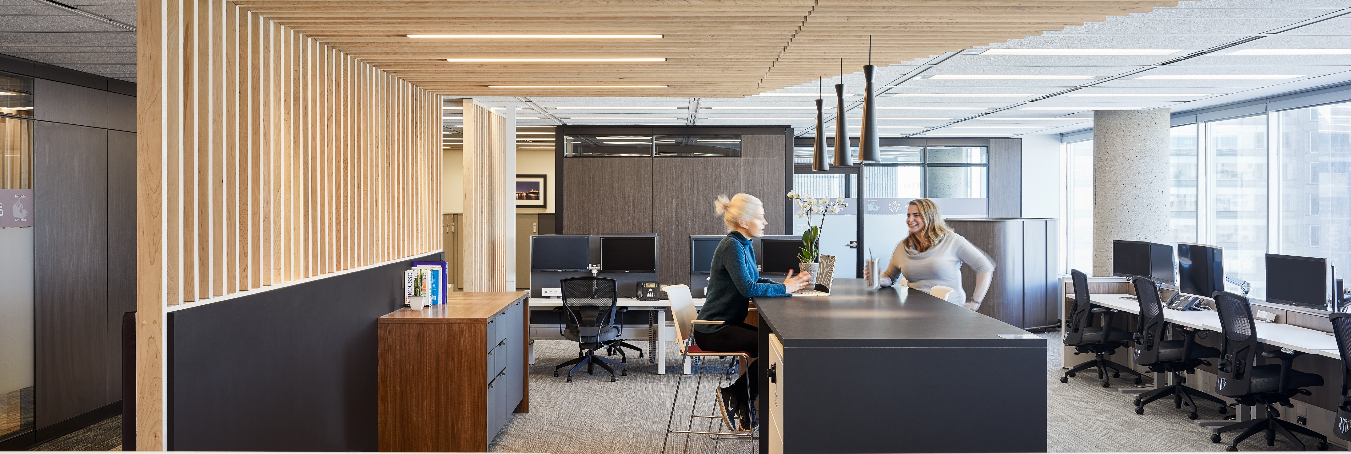
WORKPLACE TRANSFORMATION PROGRAM
Current GoC’s General Purpose Office space design standard
Modern, efficient and inclusive workplace
Variety of functional work settings & acoustical zones
is designed to enable
Activity Based Working
(ABW)
Provides autonomy to self-select the optimal settings that support various activities, needs and preferences throughout the day
For the user:
Choice and flexibility of where & how to work
Adaptable to personal needs & preferences
Access to a wide range of workpoints and amenities
Accessible and inclusive
Asset management:
Flexibility to suit within the design standard
Eliminates many common tenant service requests
Why ABW?
Portfolio:
Optimizes use of space

Slide 11
WORKPLACE TRANSFORMATION PROGRAM
HOW IS A GCWORKPLACE DESIGNED?
ACTIVITY PROFILES
INDIVIDUAL
COLLABORATIVE
AUTONOMOUS PROFILE
INDIVIDUAL
COLLABORATIVE
GCworkplace
Example: 1100m2 = 100 onsite target occupancy
Hybrid working impact on workplace:
NO remote work ▷ serves 100 total population
LOW remote work ▷ serves 120 total population
MED. remote work ▷ serves 150 total population
HIGH remote work ▷ serves 180 total population
BALANCED
PROFILE
INDIVIDUAL
COLLABORATIVE
INTERACTIVE
PROFILE

Slide 12
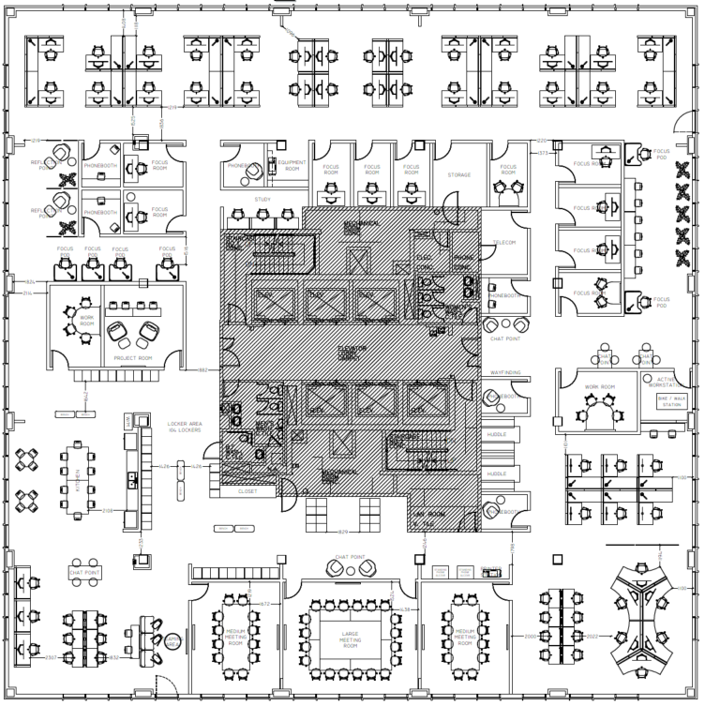
WORKPLACE TRANSFORMATION PROGRAM
HOW IS A GCWORKPLACE DESIGNED?
ZONING
Zoning
is a key element of inclusive design
Activities separated by acoustic levels
Suitable environments to support concentration and collaboration
Choice and autonomy over work setting that best meets functional needs, abilities and preferences
QUIET ZONE
TRANSITIONAL ZONE
INTERACTIVE ZONE

Slide 13
WORKPLACE TRANSFORMATION PROGRAM
DESIGN PRINCIPLES & FEATURES
NATURE
INDIGENOUS DESIGN
INCLUSIVITY
SUSTAINABILITY
STANDARD WORKPOINTS
Natural light
Organic shapes and textures
Natural materials
Connection to nature
Local Indigenous art
Territorial acknowledgement
Equitable
Adaptable
Variety
Choice
Repurposed items
Proper disposal and recycling
Sustainable sourcing
GCworkplace configurations
Complete furniture and equipment solutions (AV/IT)

Slide 14
WORKPLACE TRANSFORMATION PROGRAM
DESIGN INSPIRATION
The design inspiration for the Workplace Transformation Program is Canada’s Natural Landscapes.
The natural world is full of colors that attract attention, that blend beautifully with its background and create extraordinary displays.
The workplaces delivered through this program will strive to highlight the beauty of our country and the inspiration it provides by showcasing the stunning colors found in nature.
The designs will incorporate imagery of Canadian landscapes, natural colors and materials and deliberate emphasis on consideration of Indigenous design elements.

Slide 15
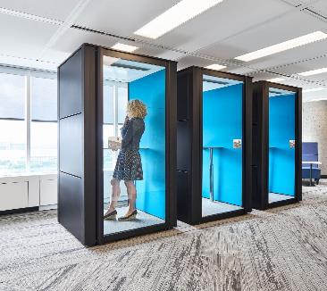
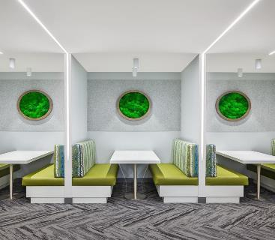
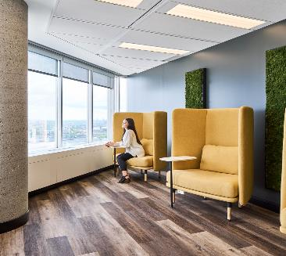
TABLE OF CONTENTS
PART C PROJECT IMPLEMENTATION

Slide 16
WORKPLACE TRANSFORMATION PROGRAM
DESIGN METHODOLOGY
Concept Design Process
PRE-PLANNING
CLIENT CONSULTATION
CONCEPT DESIGN
STEP 1
STEP 2
STEPS 3a & 3b
STEP 4
STEP 5
STEP 6
Site
Assessment
Test Plan
a. Info Session b. Functional Programming Lite
Mini Design Brief
Concept Plan & Presentation
Client Selections and Approvals
Development of generic test plan
a. Info Session or kick-off
Brief report outlining results of functional programing lite
Furniture reuse strategy
For client approval
Reflects work required based on results of Step 1
Development & presentation (workshop) of 1 concept plan
Revised floor plan is issued for client approval
Concept plan may be revised once
Client sign-off of approved plan and mood board
b. Requirements gathering process
Assessment of site for intervention required and furniture inventory
Feedback collected during workshop
Project Charter
Revised Project Charter

Slide 17
WORKPLACE TRANSFORMATION PROGRAM
DESIGN METHODOLOGY REQUIREMENTS GATHERING
3a – Workplace Transformation Info Session – NOW
3b – Functional Programming Lite
Client Requirements Questionnaire
Functional Programming Workshop
Discuss & validate questionnaire findings
Discuss special requirements with functional specialists
View test plans & obtain feedback
Discuss additional requirements
RESULTS
Validation of Activity Profile(s)
Identification of specific workpoint requirements
Identification of specific adjacency requirements
Zoning recommendations
Furniture recommendations

Slide 18
WORKPLACE TRANSFORMATION PROGRAM
DESIGN METHODOLOGY CONCEPT DESIGN
Reuse & repurpose as much suitable furniture & equipment as possible.
Maintain suitable constructed elements in order to be fiscally and environmentally responsible.
Make necessary adjustments to ensure the workplace is accessible & inclusive.
Design to the GCworkplace standard, following compliant workpoint types & ratios, zoning strategies & activity profiles.

Slide 19
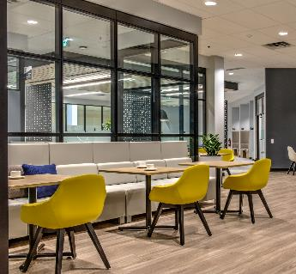
TABLE OF CONTENTS
PART D CLIENT ENGAGEMENT

Slide 20
WORKPLACE TRANSFORMATION PROGRAM
PSPC ROLE & SUPPORT
You’re not in it alone!
to help define a workplace modernization plan for the future of work...
The
STRATEGIC WORKPLACE ADVISORY GROUP
“SWAG”
to ensure a successful workplace project outcome, like all other PSPC-lead real property project…
The
INTERIOR DESIGN & PROJECT
DELIVERY
TEAM
to help create a great employee experience and ensure the adoption of the new modern workplace…
The
CHANGE MANGEMENT NATIONAL CENTRE
OF EXPERTISE

Slide 21
WORKPLACE TRANSFORMATION PROGRAM
CLIENT ROLE & RESPONSIBILITIES
We have a tool for that!
Establish a workplace vision and strategic objectives
Assign required resources & prioritize enabling initiatives
Contribute to functional programming & design activities
Implement CM Program in-a-box in parallel to project delivery
Measure space utilization and performance (with PSPC support)
Fund ongoing costs
We have a tool for that!
We have a tool for that!
We have a tool for that!

Slide 22
WORKPLACE TRANSFORMATION PROGRAM
PROJECT PROCESS
ONCE ADMITTED TO PROGRAM…
Pre-Planning & Planning
Implementation
Post Occupancy
Approx. 1-2 months
Approx. 4-12 months (depending on space)
Approx. 3-12 months
Post-Occupancy adjustments
Project Kick off
Post-Occupancy Workplace Performance Survey
Design process
Renovation and furniture installation
Lessons learned and post-mortem
PSPC Lead
CM Kick off
WORKPLACE
IS DELIVERED
Client Lead
EMPLOYEES ARE READY
Announce project
WTP employee
Townhall
DESIGN IS FINALIZED
Change Management Program in-a-box

Slide 23
WORKPLACE TRANSFORMATION PROGRAM
NEXT STEPS
SCREEN A: Portfolio Alignment
SCREEN B: Site Suitability
SCREEN C: Organizational Readiness
PROJECT KICK-OFF
CHANGE MANAGEMENT KICK-OFF
DESIGN PROCESS
ADMISSION
PROJECT

Slide 24
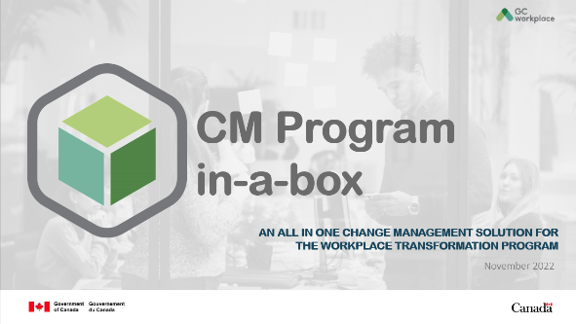
GETTING READY TO MANAGE CHANGE
A key element to a successful transition and implementation of a change management program, and one of the conditions for participation in the program, is the allocation of dedicated resources to this function. Dedicated change management resources for your workplace transformation project will be responsible to:
Familiarize themself with the Change Management Program in-a-box;
Develop and implement a change management program;
Monitor change adoption
PSPC's Change Management National Centre of Expertise will provide advice and guidance to the client-assigned change management resource or team to:
Organize the establishment of the CM team; Understand how to use of the CM Program in-a-box and how best to customize the tools offered; Share best practices on how to sustain the change.

