Slide 1
Landing page redesign
Health Infobase
December 2022

Slide 2
Executive summary
The Infobase Team:
conducted research to understand issues and user needs for the Infobase landing page
prototyped a new design and tested it
launched a new design on December 23
will monitor performance and work on further improvements

Slide 3
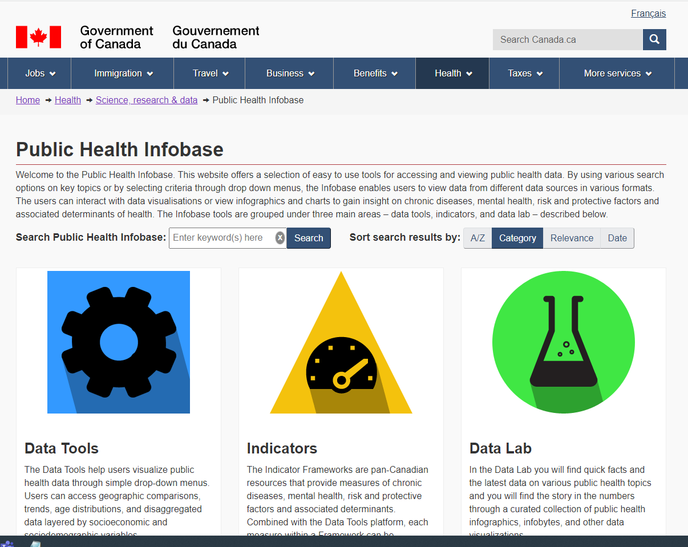
Context and objectives
Why we’re doing this
The current landing page has several issues:
outdated look
hard to use
difficult to find specific products
Desired outcomes:
Improved user experience of the Infobase landing page
Increased awareness of the Infobase

Slide 4
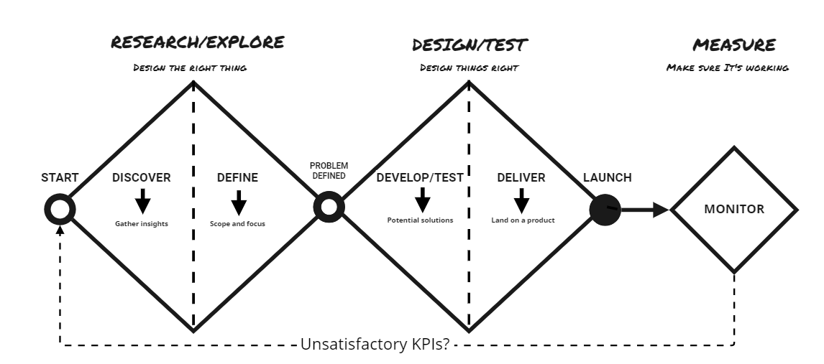
Methodology: How we execute improvements
1
2
3
Understand issues
Identify solutions
Monitor results

Slide 5
Research / Explore
Designing the right thing
data sources
main findings
what we tried to fix

Slide 6
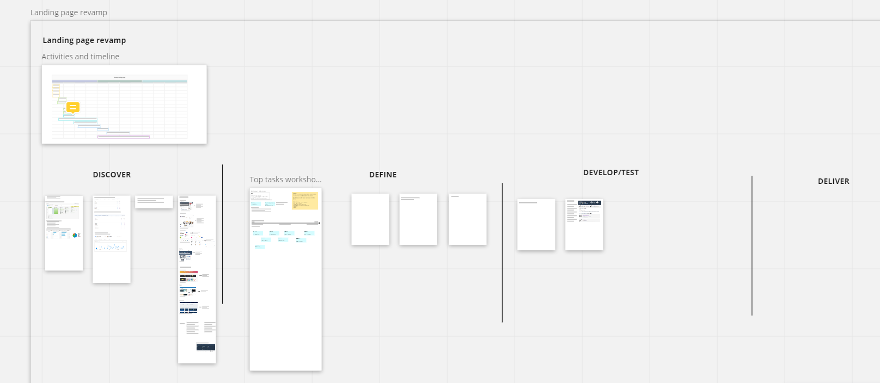
Data sources we looked at
We gathered insights from different sources
Web analytics
Search queries
Environmental scan
Heuristic evaluation
Top task exercise
Miro board

Slide 7
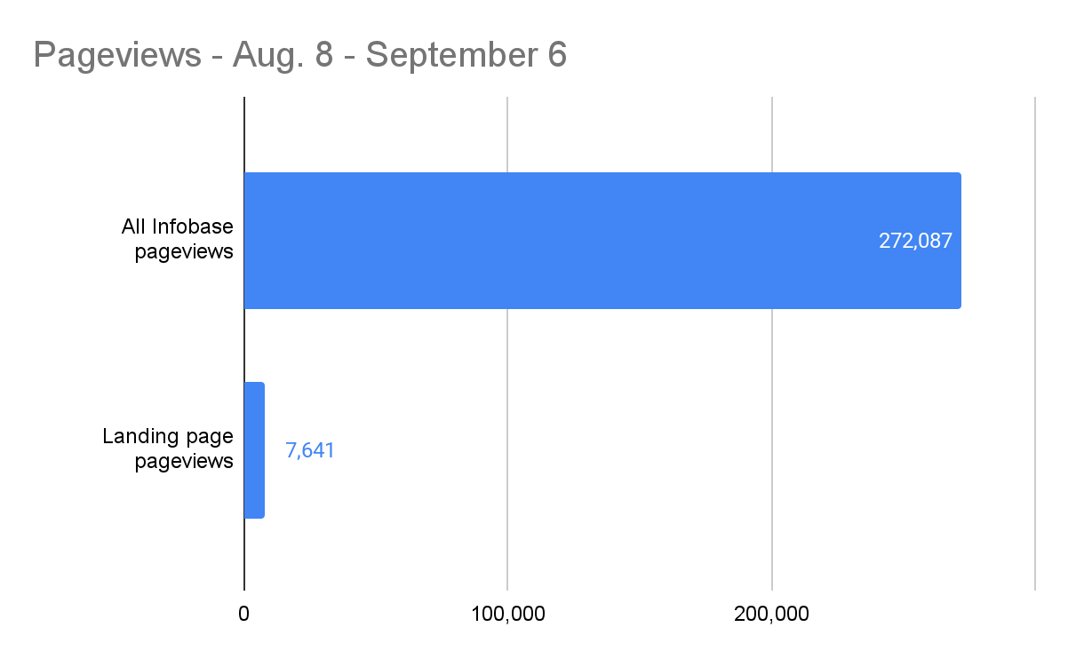
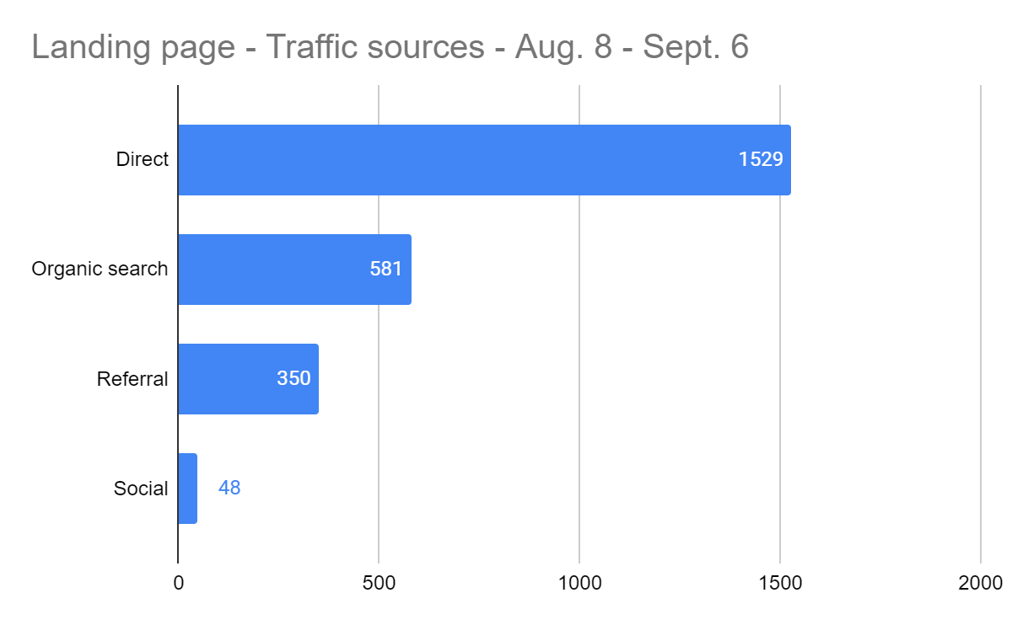
Landing page is hard to find
Most people don’t get to the landing page
Pageviews to the landing page are less than 3% of all Infobase pageviews
Over 30 days, less than 600 people got to the landing page from search engines

Slide 8
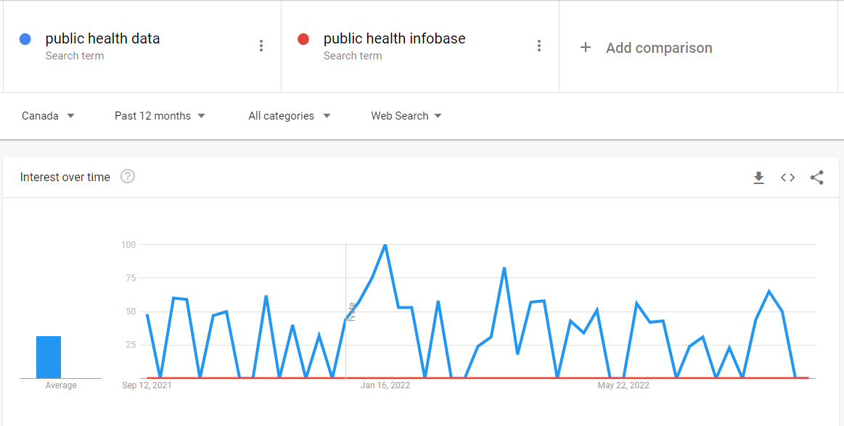
People don’t search for “Infobase”
Infobase is not the word people use
The only way to find the landing page from Google is to search for “Infobase”
But people don’t search for “Infobase”...
Google searches that led to the landing page (last 3 months)
public health infobase | 102
phac infobase | 49
health infobase canada | 48
infobase | 40
infobase canada | 20
health infobase | 17
health-infobase.canada.ca | 7
info base | 5
infobase database | 1
health infobase canada covid | 1

Slide 9
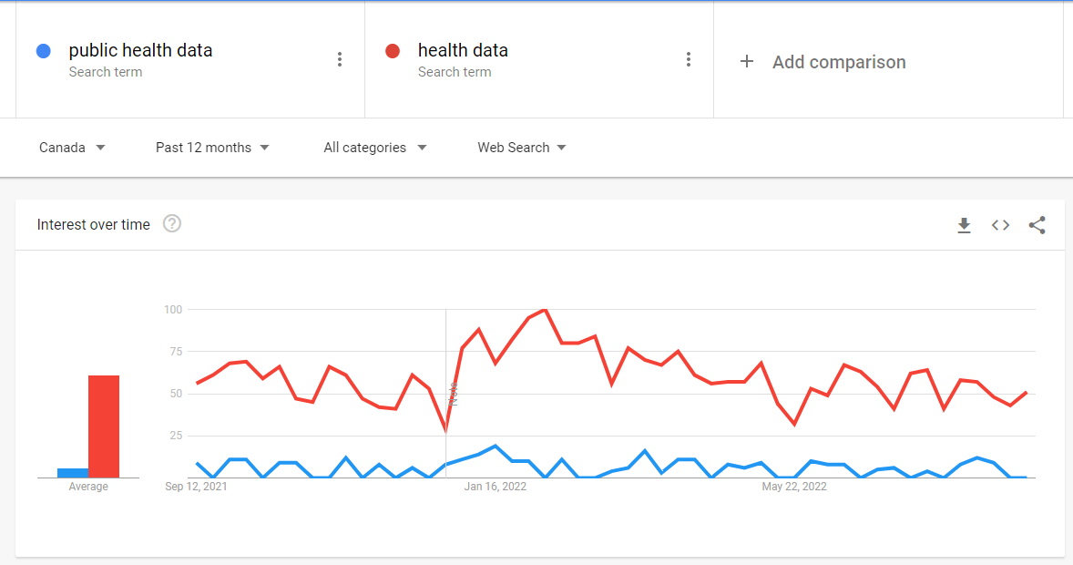
People search for “health data”
Health data is what people are looking for
And our pages don’t show up if you search for “health data”

Slide 10
People look for specific products
Most viewed items are specific products

Slide 11
People look for specific products (2)
Most search queries are for specific products
Top queries | Clicks | Impressions | CTR
canada covid cases | 3463 | 66714 | 5.19%
canada vaccination rate | 2239 | 8210 | 27.27%
covid cases canada | 1743 | 37959 | 4.59%
covid cases | 1049 | 82398 | 1.27%
covid deaths canada | 925 | 15366 | 6.02%
wastewater covid ontario | 840 | 3245 | 25.89%
covid wastewater ontario | 769 | 3714 | 20.71%
canada covid deaths | 648 | 10564 | 6.13%
ontario wastewater covid | 647 | 5905 | 10.96%
canada covid cases vaccinated vs unvaccinated | 626 | 2424 | 25.83%

Slide 12
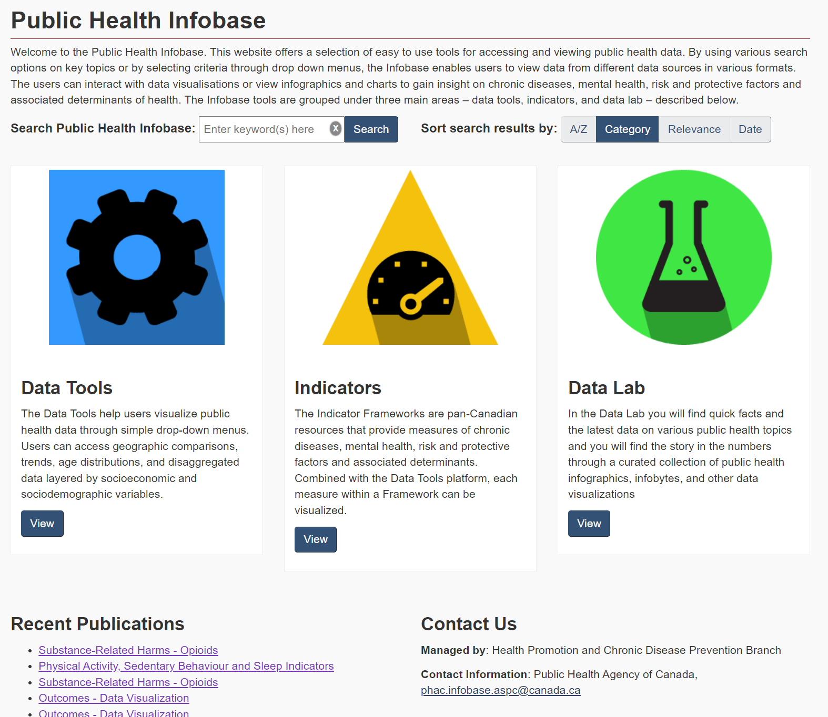
Specific products: hard to find from landing page
Most people don’t get to actual products from the landing page
Products are not immediately visible from the landing page
Landing page has a 85% drop-off rate

Slide 13
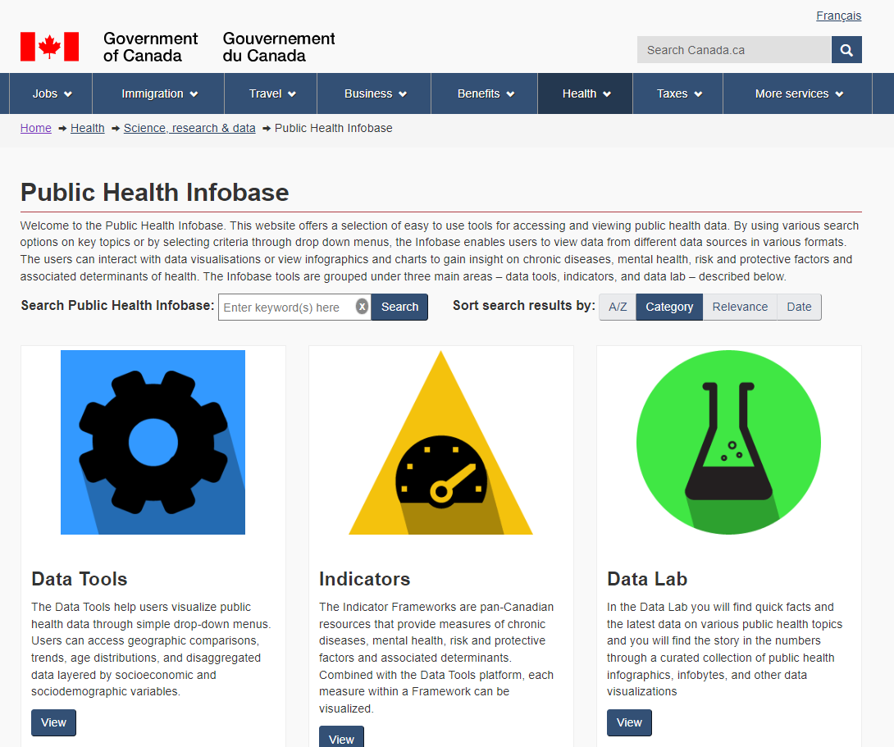
An outdated look and feel
Needs a revamp
Old Canada.ca theme
Icons look dated
Landing page not up to modern standards

Slide 14
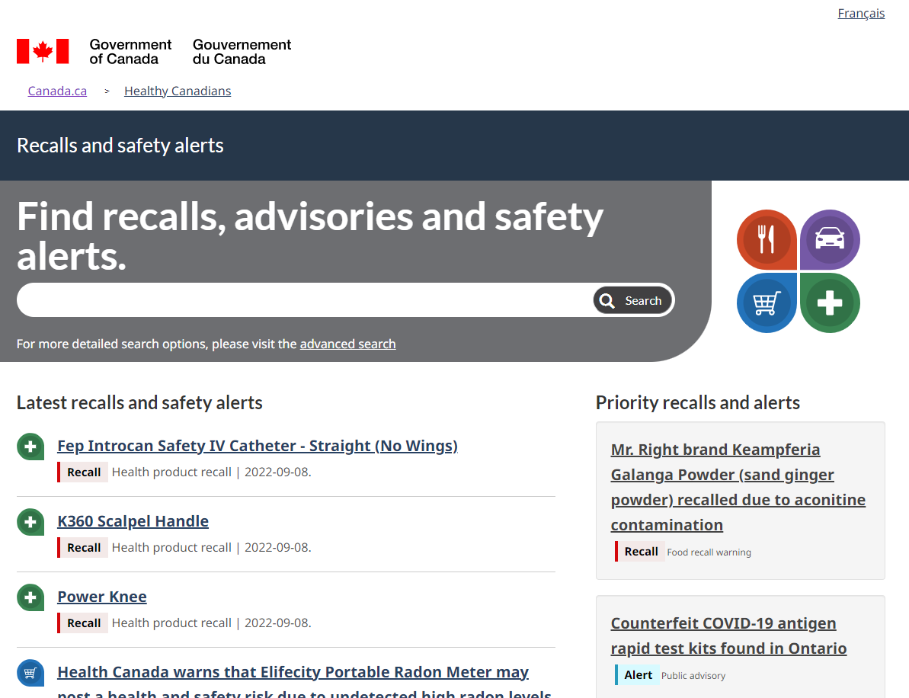
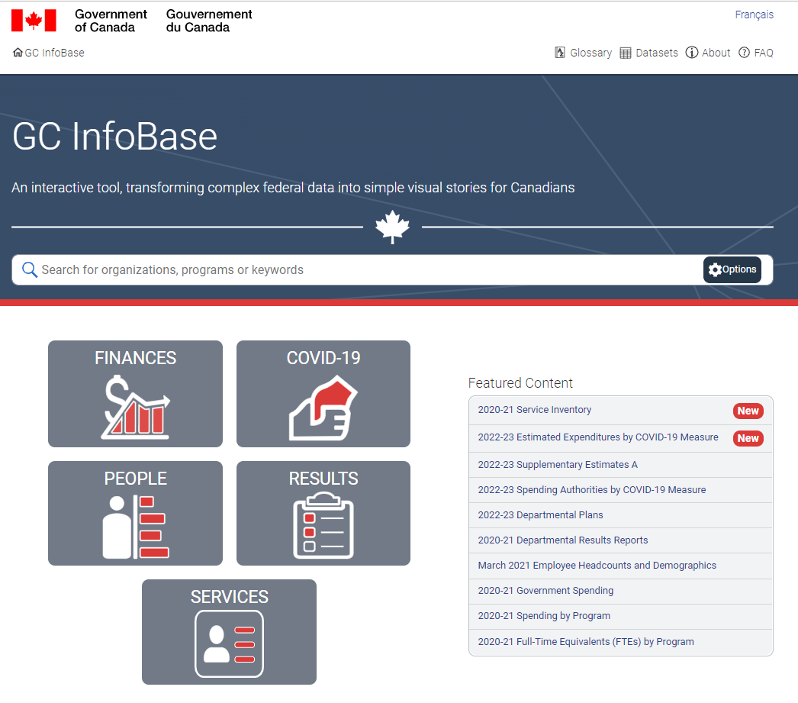
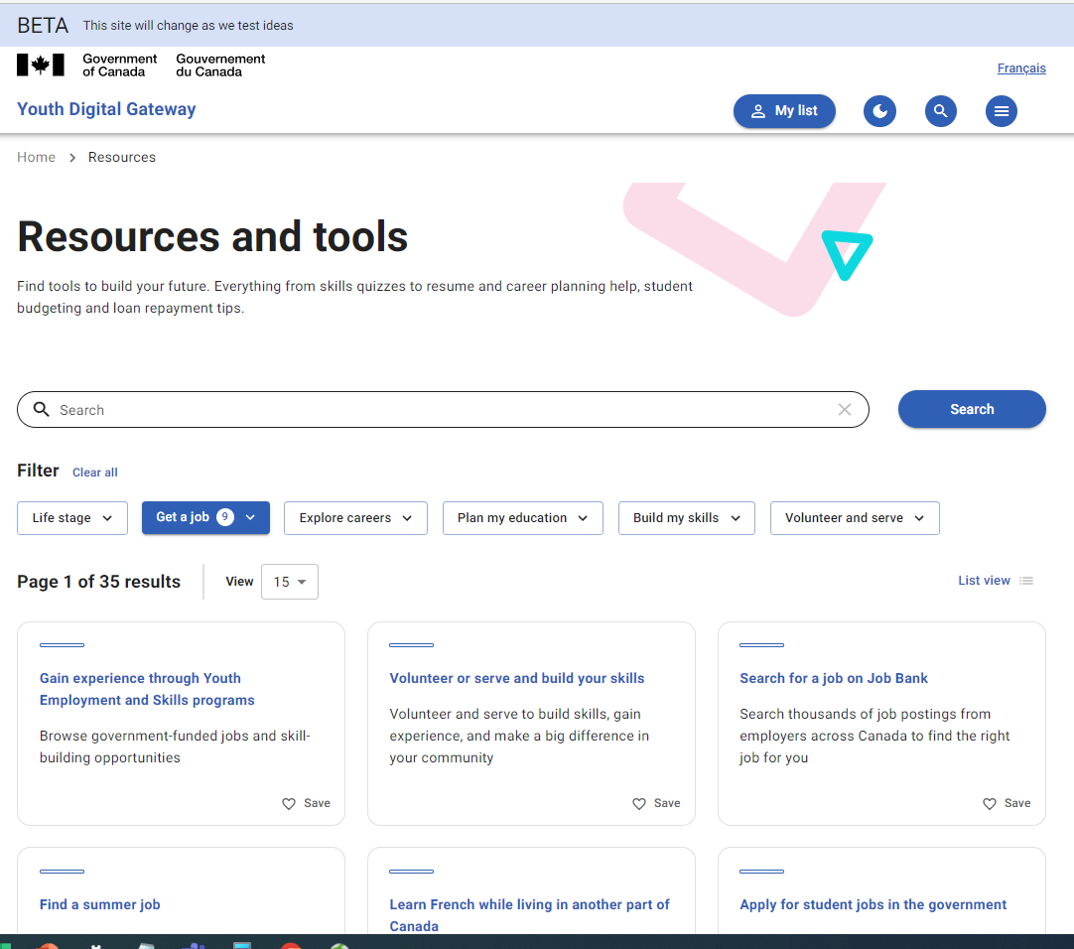
What other libraries do
Search, filters and labels

Slide 15
A range of top tasks
From top-down explanation to self-directed exploration
General public
Simple
Explanatory
Experts
Complex
Exploratory
Key insights
Data storytelling
Infographics and blog
Top-down interpretation
Interactive maps and charts
Self-exploration of data
Complex data viz
Self-interpretation
Raw data
Technical details
Sources
API

Slide 16
Scope of the redesign
What we tried to fix
Make it easier to:
find the landing page from search engines
find a specific product from the landing page
explore what the Infobase has to offer

Slide 17
Design / Test
Designing things right
Look and feel
Findability of the landing page
Usability: filters and labels
Usability testing

Slide 18
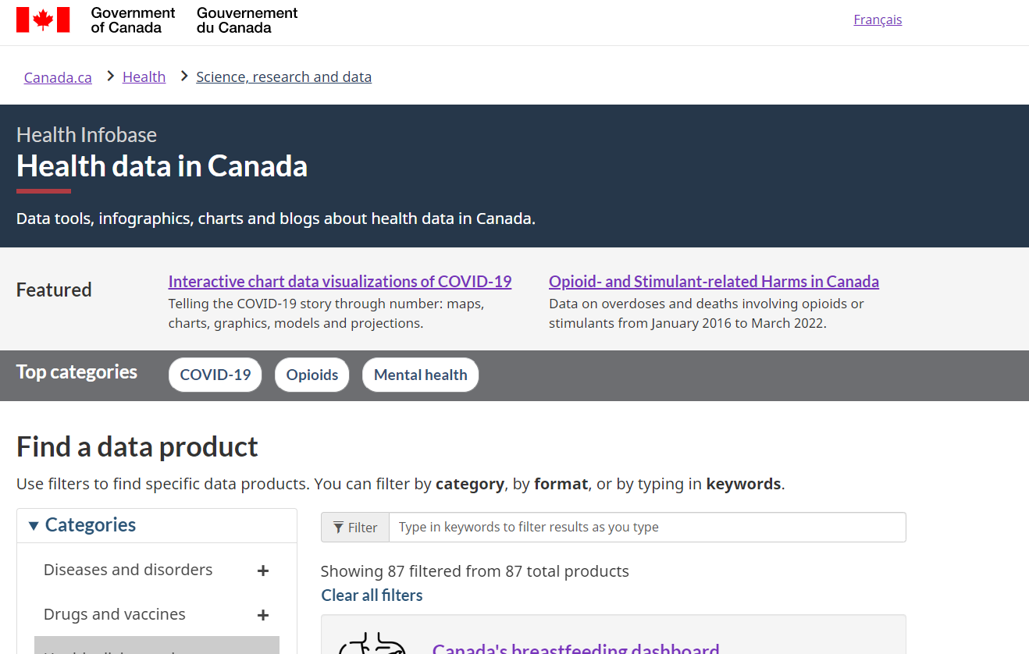
New look and feel
Distinctive, within the Canada.ca brand
Respects the Canada.ca mandatory elements
Modern, flat icons
Familiar enough to be sure it’s from the Government of Canada
Distinctive enough to signal it’s a separate “product”

Slide 19
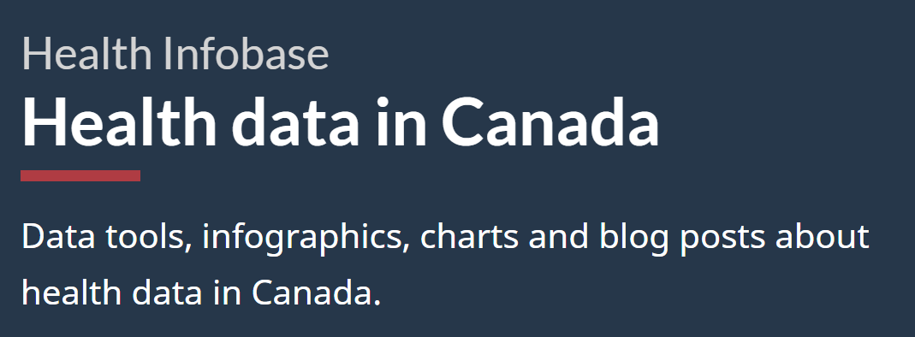
Revised page title and H1
Using the words people use
Uses the keywords “health data” in the H1
Leverages the stacked H1 pattern to connect the name of repository (Health Infobase) with commonly searched terms

Slide 20
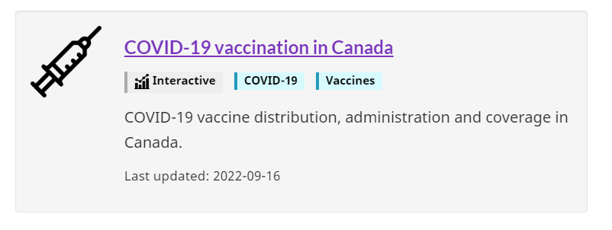
Labels and tags
Simplifying discovery
Added tags to each data product

Slide 21
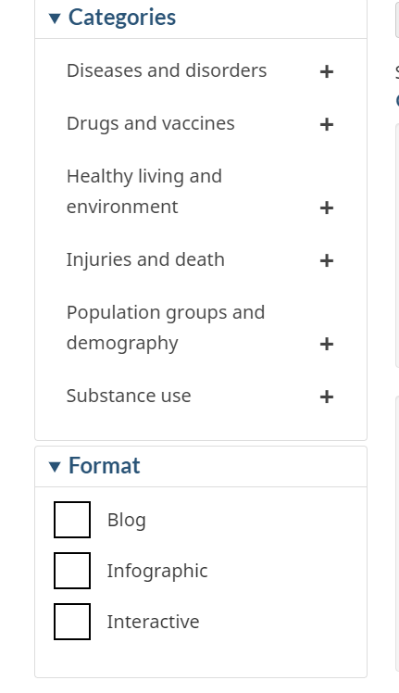
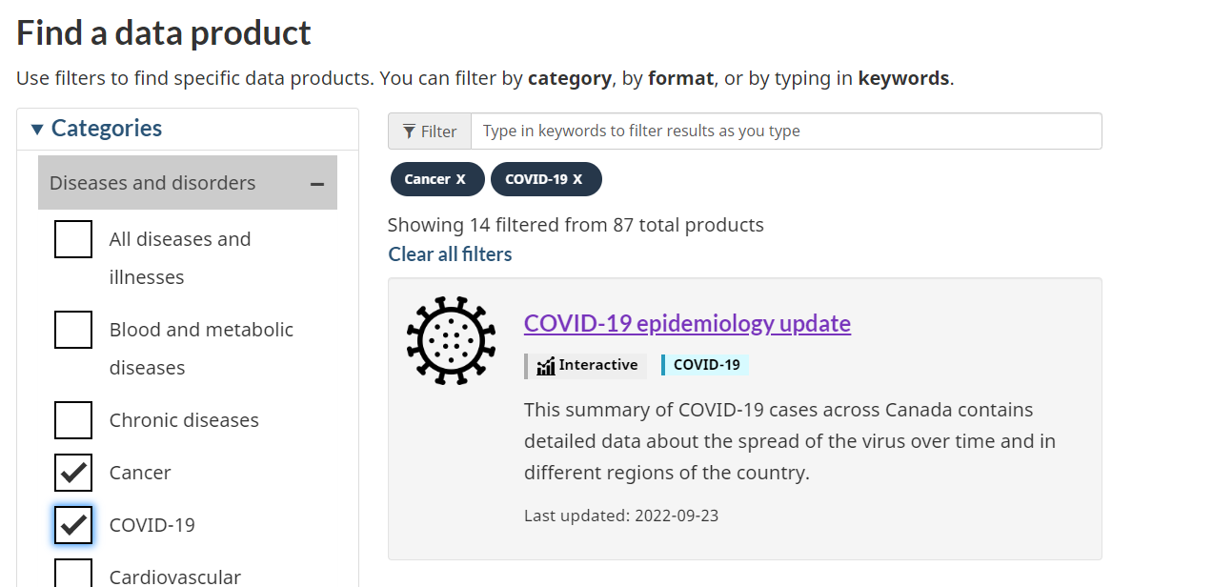
Filters
Exploring a wide range of products
Conducted a card sorting exercise to help group categories
Built a prototype that allowed people to select and unselect multiple categories and formats

Slide 22
Usability testing
Validating the design
Usability testing full presentation
Unmoderated testing through UserZoom
Tested the English prototype
6 participants (4 desktop, 2 mobile)
5 tasks + 3 open-ended questions
Research questions:
does the revamped landing page help people find the right product
are there usability issues to fix before going live
identify potential further improvements
28/30 successful trials
Findings
The prototype does a good job at helping people find data products
We found issues to be fixed before launch
We identified a few things that could be further improved after launch

Slide 23
Going live
Delivering an improved experience
Before going live, we:
Made small improvements from testing
Reviewed the code for accessibility and validity
Added metadata, including FAQ structured data
Added Google Analytics code
Conducted testing to make sure everything worked as intended
Went live
DEC 23

Slide 24
Measure
Making sure it’s working
Performance metrics

Slide 25
Performance metrics
Did it work?
We are monitoring these metrics:
Does the landing page help people get to specific products?
Drop off rate from the landing page
Is the landing page more findable?
Clicks to the landing page from Google

Slide 26
Next steps
Continue improving access to health data
Monitor performance
Start working on further improvements
Work with Health and PHAC web to improve Health and Health data topics, and the PHAC landing page
Review the product template for specific data products

