Slide 1
Sponsor Support Guide
A guide for Change Managers
Date : October 2023

Slide 2
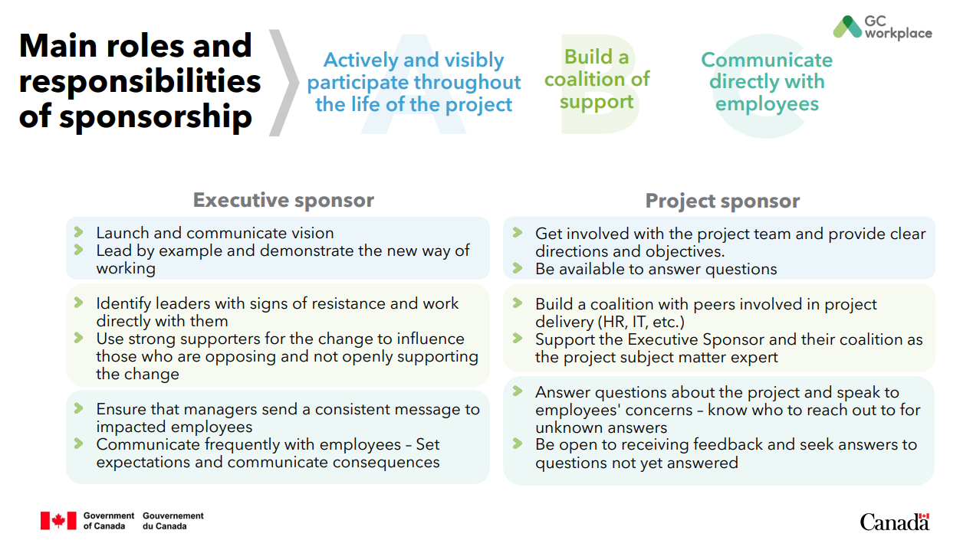
About this Guide
This guide was created to help you prepare for the support role you will play with your Project Sponsor and Executive Sponsor. It includes possible agenda meetings for your first meetings with them, as well as a high–level Sponsorship Plan. There are also ideas on what to do in the event of certain scenarios, such as a change in sponsorship mid-project, or if your sponsor(s) are not embracing or fulfilling their roles.
As a starting point, ensure to review the content of the Sponsorship commitments and responsibilities. This document may already have been provided to your sponsor(s) and/or project team. It is a good place to start your conversations with your sponsor(s).

Slide 3
Contents
Confirming Sponsorship Commitment and Responsibilities
Sponsorship Plan
What to do when…
Annex A - Prosci Research on Sponsor Impact
Annex B - The Sponsorship checklist*
Annex C - Meeting agenda ideas
*adapted from the PROSCI Sponsorship Checklist

Slide 4
Confirming Sponsorship Commitment and Responsibilities (1 of 2)
In your first meetings with the Executive Sponsor and/or Project Sponsor, it is critical to review with them their sponsorship commitment and responsibilities.
Activity | Details | Notes/Resources
Meeting #1 | Review the slides in the Sponsorship Commitment and Responsibilities presentation. Discuss how the sponsor(s) wish(es) to remain visible, what are their preferred methods of communication and how they plan on creating their sponsorship coalition. Ask sponsor(s) for permission to speak candidly with them about the change. Without candid discussions, it can be difficult to move changes forward. Note any questions or comments they may have and evaluate if they are willing and able to perform their role(s) of sponsor(s). Determine the frequency of your meetings. | Sponsorship commitments and responsibilities (gccollab.ca) Questions to consider asking: What questions do you have about your sponsor role? (Check for their understanding of the ABCs and reinforce anything they may have missed.) What questions do you have about my role as the change manager on this project? (Offer up the role headlines as needed.) How would you like to work together on this change? (Encourage your sponsor to share their expectations first.) Do you have any specific role expectations we have not discussed?

Slide 5
Confirming Sponsorship Commitment and Responsibilities (2 of 2)
Activity | Details | Notes/Resources
Meeting #2 | Review any items that raised questions or where your sponsor(s) required additional information. Obtain buy-in from your sponsor(s) on their responsibilities Present a high-level Sponsorship Plan with proposed activities to be carried out by your sponsor(s) throughout the course of the project. | Sponsorship Plan
Meeting #3 + | Refer to Annex C for subsequent meeting agenda ideas. | Annex C

Slide 6
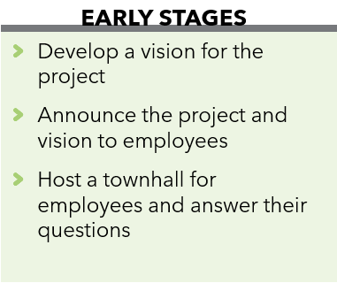
Sponsorship Plan – Early Stages (1 of 2)
Creating a Sponsorship Plan will help outline the key activities and needed to support the change at each phase of the project. In the Early Stages of a project, focus on these 3 main activities for the sponsor(s).
PHASE 1 Pre-planning and Planning | Details | Notes/Resources
Develop a vision for the project (if not already completed) | Successful projects require a clear vision. How can you get there if you don’t know where you are heading? A project vision must align with the organizational vision, it guides decision-making during the project, and it serves as the basis for employee communication. Your project vision is critical to keep the project on track. It needs to be a priority for leadership, in order to begin any change management activities. | The PSPC Strategic Workplace Advisory Group can help in the development of your project vision and facilitate a vision creation session as required. The Project Realization Evaluation Tool (PRET) included in the CM Workbook includes options for a generic project vision and guidance on creating your own.
Announce the project and vision to employees | Employees prefer receiving messages from the executive sponsor, specifically as it relates to why the change is needed. Early communications should be sent from the executive sponsor. | The CM Program in-a-box includes a communication template to announce the project to the leadership team and one to announce the project to employees.

Slide 7
Sponsorship Plan – Early Stages (2 of 2)
PHASE 1 Pre-planning and Planning | Details | Notes/Resources
Host a townhall for employees and answer their questions | The first townhall is an opportunity to build trust with employees by being open and transparent about the change to come, letting them express their concerns and answer their questions. The sponsor(s) should commit to addressing concerns and answering questions as the information becomes available. Having a Commonly Asked Questions document on your intranet that is frequently updated can help achieve this. To help the sponsor(s) prepare for the townhall, you can review the FAQ document with them, work on potential answers to anticipated questions, plan a practice dry-run, review the presentation together, etc. | The CM Program in-a-box includes a presentation template for the townhall, an invitation template for a townhall and communications to send the information package. You can also find guidance on setting up Communication Channels in section 1.C and a template for Commonly Asked Question for Employees

Slide 8
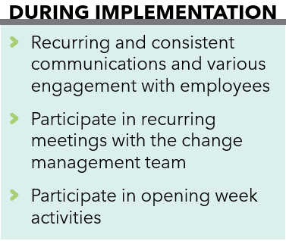
Sponsorship Plan – Implementation (1 of 2)
The length of the Implementation phase can vary; it’s important to maintain momentum with employees throughout the course of this phase with planned communication, engagement and training activities.
PHASE 2 Implementation | Details | Notes/Resources
Ensure recurring and consistent communications and participate in various engagement with employees | After setting the stage with the project announcement and Employee Townhall, it’s important to continue with regular open and transparent communications, even when there is nothing new to announce. Establish a calendar of recurring communications; the sponsor(s) should commit to keeping employees informed on a recurring basis. Consider what employees communication, engagement and training activities where your sponsor(s) should activity participate, or at the very least make an appearance and listen to employee’s questions and concerns. The sponsor(s) also need(s) to solicitate the participation of their collation. | The CM Program in-a-box includes many communications to keep employees informed. A proposed sequence can be found in the Communication Framework. There is also a Training Framework to help identify which training could be required. You can also find many activities in which employees can be engaged and further their knowledge about the change: 1.3 Design Engagement Activities 1.5 Change Agent Network 2.3 Meeting Room Naming 2.5 Team Charters 2.6 ‘A day in a life’ presentation 2.9 Pre-opening Q&A 2.10 Tours of the New Workplace

Slide 9
Sponsorship Plan – Implementation (2 of 2)
PHASE 2 Implementation | Details | Notes/Resources
Participate in recurring meetings with the change manager | As the change manager, you take on the role of coach to the sponsor(s) throughout the project and are responsible for: Maintaining a Sponsorship Plan listing important activities in which the sponsor(s) need to participate Guide the sponsor(s) to be effective Preparing communications for the sponsor(s) and the rest of the sponsorship coalition Ensuring the sponsor(s) has all the material, notes, presentations and documents needed for all their activities | Sponsorship Plan
Participate in opening week activities | Your sponsor(s) should plan on attending as many Opening week activities as possible. This is a great opportunity to demonstrate the new behaviours needed to work in an Activity-based working environment, as well as addressing last-minute concerns from employees to ease their transition to their new workplace. | The CM Program in-a-box includes many activities for 2.11 Opening week with suggestions on how to make this a meaningful and positive transition for employees.

Slide 10
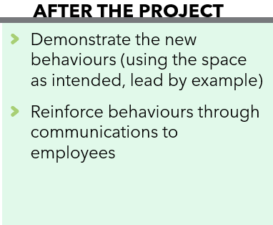
Sponsorship Plan – After the project
Now is not the time to stop the sponsor(s)’ important work! This is a critical time for employees to adopt the new behaviours and transition through the change.
PHASE 3 Post-occupancy | Details | Notes/Resources
Demonstrate the new behaviours (using the space as intended, lead by example) | The sponsor(s) should plan on spending most of their time in the new space for the first weeks post-occupancy. This is a critical time for employee adoption and having the sponsor(s) or any executives use the space as intended will contribute greatly to stopping any lingering resistance. | Workplace etiquette posters
Reinforce behaviours through communications to employees | Just as in the Early Stages, reinforcement communications should be sent by your executive sponsor. | The CM Program in-a-box includes 3.2 Sustainment communications to help reinforce behaviours. These are a starting point, more targeted communications may be required based on the needs of your organization and any resistance that may still be lingering in employees.

Slide 11
What to do when…(1 of 3)
Even with all your efforts and plans, situations may arise that you will need to address. You can also use the Sponsorship checklist in Annex B to help identify possible solutions.
 | Details | Notes/Resources
… your sponsor changes while the project is ongoing | Have a transition plan ready in the event this occurs. At a minimum, a meeting between the current sponsor(s) and new sponsor(s) should be prioritized. Both the Executive Sponsor and Project Sponsor should be present for the handoff. At that meeting, you can also cover the following: Advocate for the need to maintain your recurring meetings Work with the project team to ensure they provide a project briefing including, timeline, budget, project charter, approvals, status to date, etc. Ensure expectations are set upfront about allowing any changes Present the previous decisions that were made by their predecessor: project vision, Screen C commitment, any speaking points or communications to employees where commitments were made from the sponsor, such as providing timely information, holding information sessions Document any expectations the new sponsor has for his role and the project. Work with the project team to review what can/can’t be accommodated | In all scenarios, it’s important to continue with all planned change management activities. Without proper sponsorship, the efficiency and success of the activities may be diminished, but they are still necessary. You may also need more activities to make up for an absent or ineffective sponsor, such as increased engagement with various existing groups within your organization (Young Professionals, Managers, etc.)

Slide 12
What to do when… (2 of 3)
 | How to | Notes/Resources
… your sponsor does not make it a priority to meet with you | Address this with the sponsor(s): Prosci research shows that having solid access to your sponsor(s) correlates with meeting or exceeding objectives from change initiatives. If your sponsor is looking for additional information and data to support the importance of these recurring meetings and your relationship, present them with the Prosci data. If the situation doesn’t change: See if you can find an ally within the sponsor’s direct reports such as a Chief of Staff that could assist you in getting materials across to the sponsor and to schedule their presence at specific events. | Annex A The Symbiotic Relationship Between Sponsors and Practitioners (prosci.com)
… your sponsor does not understand his role | Address this with the sponsor(s): Work with your sponsor(s) to educate them on their role. Prosci research demonstrates that sponsors are so critical to change efforts that they can make or break a project or initiative. Executives and senior leaders are generally willing to be sponsors of change, yet many did not fully understand what that means. If the situation doesn’t change: Work with someone close to the sponsor(s) that can provide you access to them in order to educate them or can pass along the information to them. | Annex A You can provide your sponsor(s) with the following Sponsor guide – roles and responsibilities If your sponsor is looking for data to help them understand: Primary Sponsor's Role and Importance (prosci.com)

Slide 13
What to do when… (3 of 3)
 | Details | Notes/Resources
… your sponsor is not active or visible | Address this with the sponsor: Educate your sponsor(s) on the importance of being active and visible, such as participating in change activities. Their sustained presence is necessary to build and maintain momentum for a change. If the situation doesn’t change: Work with the Communications team to spotlight the project via various channels. Ensure that employees know who the members of the project team are, so they know who to turn to in the absence of a sponsor. Consider other informal allies you could use to fill the void. | Primary Sponsor's Role and Importance (prosci.com)
… your sponsor delegates their responsibilities | Address this with the sponsor: Use the Sponsorship plan in this toolkit as a starting point to plan out specific interventions by your sponsor. Engage your sponsor in the creation of the plan to ensure they are fully on board with the activities planned. If the situation doesn’t change: Some responsibilities may be delegated to other senior executives who have influence and authority in your organization. Carefully consider the impact of delegating certain duties and discuss these with your sponsor. Your sponsor(s) could communicate that they are delegating their responsibilities to someone else, to provide more authority and credibility to the replacement. | Sponsorship Plan

Slide 14
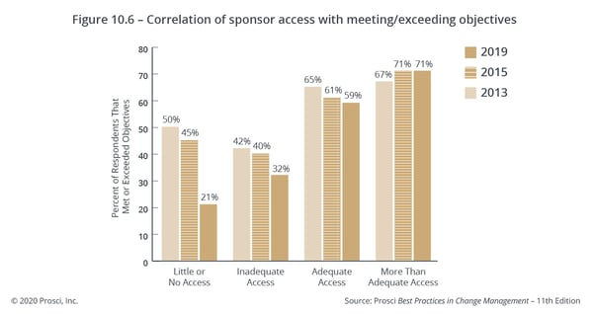
Prosci Research on Sponsor Impact (1 of 3)
Keeping Your Active and Engaged Sponsor on Track During Change (prosci.com)

Slide 15
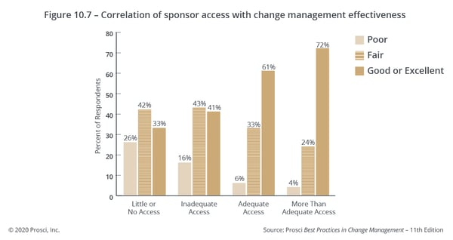
Prosci Research on Sponsor Impact (2 of 3)
Keeping Your Active and Engaged Sponsor on Track During Change (prosci.com)

Slide 16
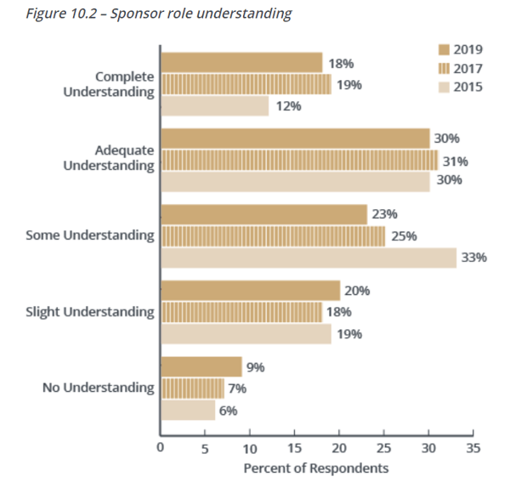
Prosci Research on Sponsor Impact (3 of 3)
Sponsors are often uninformed about their role
Primary Sponsor's Role and Importance (prosci.com)

Slide 17
The Sponsorship checklist* draws upon benchmarking research conducted by PROSCI©
Are your sponsor and champions aware of the importance they play in making change successful? In Prosci benchmarking studies, the number one response by participants when asked what was the greatest overall contributor to project success in each of the studies was active and visible sponsorship.
Do your sponsor and champions know their three biggest roles in supporting organizational change? The three key roles for senior leaders: (1) Participate actively and visibly throughout the project, (2) Build a coalition of sponsorship with managers and peers; and (3) Communicate directly with employees. Nearly 50% of study participants ranked their sponsor as having a moderate to poor understanding of their role.
Are your sponsor and champions active and visible throughout the project? Effective sponsors cannot stand on the side-lines—they must be involved in more than just signing their names on the project charter. They must stay active and visible throughout the project.
Are your sponsor and champions building coalitions that are needed for the change to be successful? Effective sponsors and champions interact with the other leaders necessary to make the change successful. They must build relationships and commitment with these other key leaders.
Are your sponsor and champions communicating directly and effectively with employees? The leaders of change are one of the two preferred sender of communication messages. Your sponsor and champions need to directly communicate with employees about the business reasons for change, risks of not changing and why the change is happening now.
Do your sponsor and champions know that the biggest mistake cited by study participants was failing to personally engage as a leader of change? Failure to engage personally, abdicating their role to lower level managers or the project team and failing to communicate reasons for change with immediate employees are the biggest mistakes cited by study participants. Project teams face tremendous difficulties when they have a sponsor and champions who do not personally engage in the change.
Is your sponsor prepared to manage resistance? Managing resistance is a key role of senior leaders, managers and supervisors. Your sponsor needs to be prepared and ready to deal with resistance in the organization—especially from other senior leaders and managers. Change managers need to coach senior leaders on how to identify root causes of resistance and how to engage and manage resistance when it happens.
Is your sponsor prepared to celebrate success? Celebrating success—even small, short-term success—is an important part of building support and momentum for change. Sponsors play a key role in recognizing employees both publicly and privately.
Is your sponsor setting clear priorities regarding this initiative, other initiatives and day-to-day work? Sponsors influence priorities through their behaviors, actions and the communications they send. Sponsors must show both their own and the organization’s commitment to change if they expect employees throughout the organization to become engaged.
Is your sponsor avoiding the “flavour of the month” syndrome? “Flavour of the month” describes a situation where organizations are constantly introducing and abandoning initiatives. When this occurs, it makes it more difficult to create meaningful change. Sponsors are responsible for launching new initiatives and ensuring new projects are not just the next “flavour”.
*adapted from the PROSCI Sponsorship Checklist

Slide 18
Meeting agenda ideas
Activity | Details | Notes/Resources
Meeting #3 + | Recurring items to cover at each meeting with your sponsor(s): Sponsorship Plan and upcoming CM activities, including what will be expected of them at each activity Update from the Change Agent Network: Highlight any positive feedback received Discuss any resistance that has been observed and if any changes are required to the upcoming activities to address it Upcoming meetings with Manager’s Network: Opportunities to address points of resistance Important announcements

