Slide 1


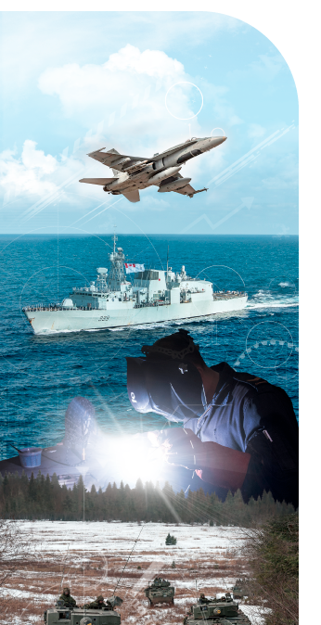

Materiel Group New Employee Orientation 2023

Slide 2

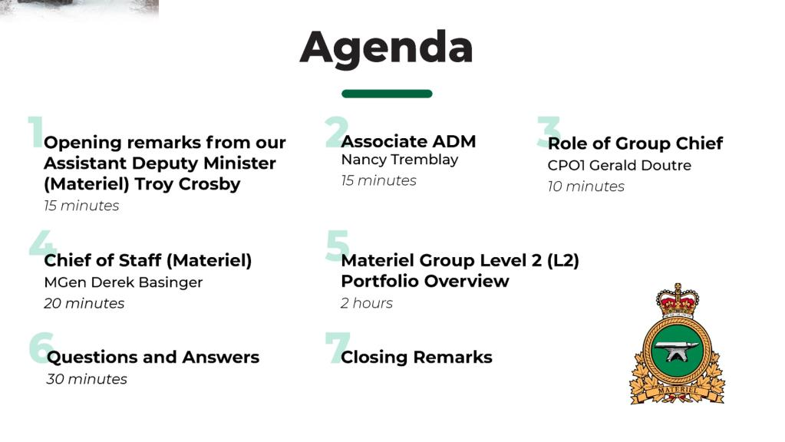
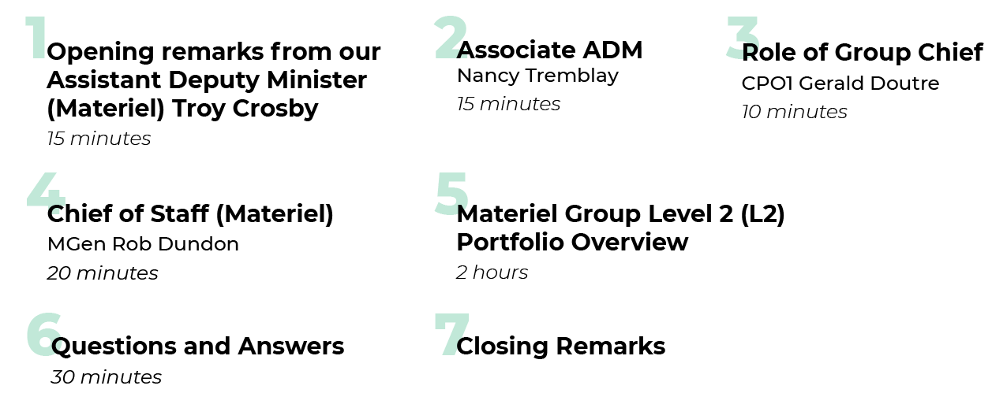

Agenda
MGen Rob Dundon

Slide 3
Welcome to the new employee Materiel Group Orientation
Defence procurement plays a key role in keeping the Canadian
Armed Forces (CAF) strategically relevant, operationally
responsive, tactically decisive and capable of operating within a
dynamic and evolving security spectrum. The Materiel Group is
the organisation within DND/CAF responsible for
defence procurement.

Slide 4
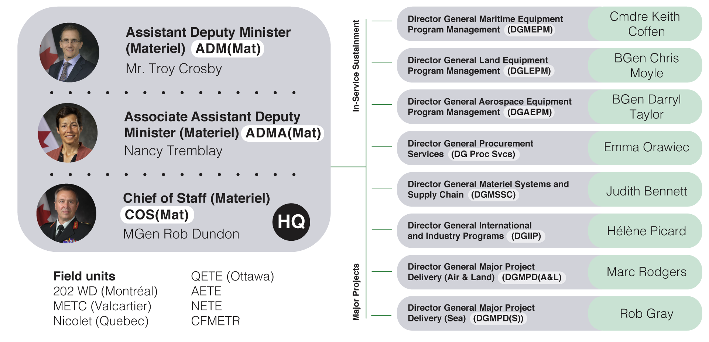
Our Organization

Slide 5

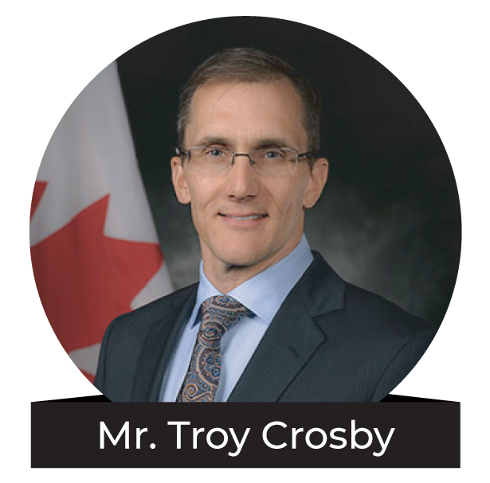
Assistant Deputy
Minister (Materiel)
The Materiel Group, led by the Assistant Deputy Minister (Materiel) (ADM(Mat)), manages equipment commencing with procurement, including maintenance and support throughout its life cycle and ending with disposal. The Group is also responsible for defence materiel liaison and coordination with other departments, governments and interdepartmental organizations.
The anvil is the Materiel Group symbol, featured on our flag and on our crest. It symbolizes the forging of new ideas and the expansion of past successes.

Slide 6

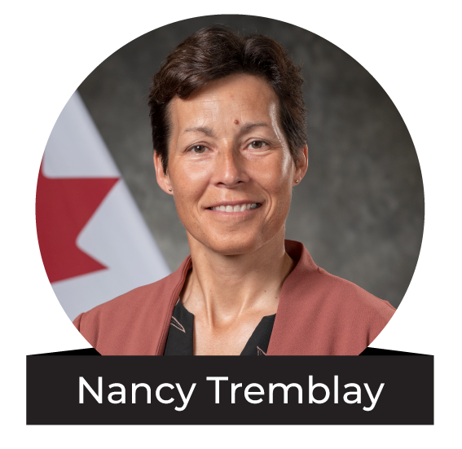
Associate Assistant Deputy Minister (Materiel)
The Associate Assistant Deputy Minister (Materiel) oversees the Maritime, Land and Aerospace Equipment Acquisition Programs which acquire new or modernized equipment required by the Canadian Armed Forces in response to evolving Defence requirements.
The Associate ADM(Mat) also oversees the Materiel Assurance Program implementation by the Equipment Management Program divisions; implementation of horizontal procurement initiatives including Indigenous procurement, greening and Gender Based Analysis Plus (GBA Plus); and the Project Management Competency Development Program.

Slide 7
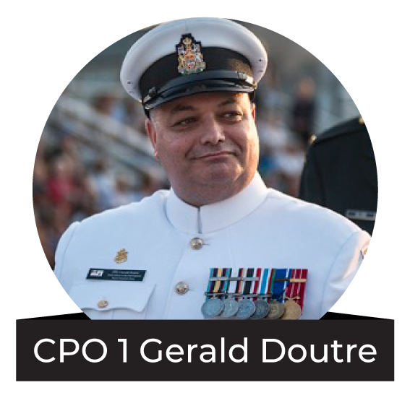
Materiel Group Chief Warrant Officer (GCWO)
The Materiel Group Chief Warrant Officer is Chief Petty Officer 1st Class Gerald Doutre. The Assistant Deputy Minister (Materiel) Group Chief Warrant Officer (ADM(Mat) GCWO) provides the ADM(Mat), as well as the Officer Commanding the Command (OCC), with a personnel perspective on behalf of all military and civilian personnel within the Materiel Group.
As the custodian of the Non Commissioned Members (NCM) Corps, the GCWO advises the ADM and the OCC on issues related to Materiel Group personnel including but are not limited to, dress, discipline, professional development, administration, morale, training, welfare, conditions of service, and quality of life.
The ADM(Mat) GCWO acts as a bridge between the group's military and civilian employees supporting a harmonized working environment that promotes a respectful work place and encourages diversity and unity within the Materiel Group.

Slide 8

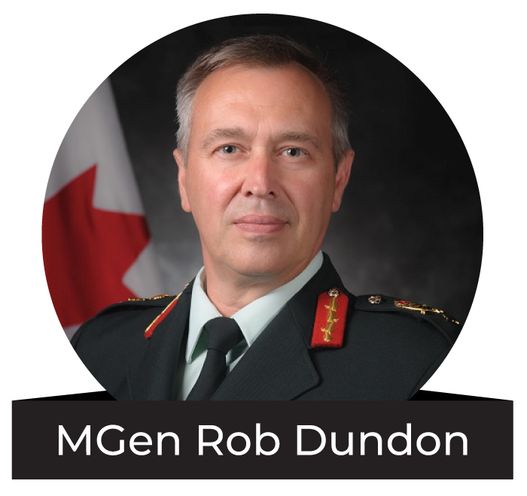
Chief of Staff (Materiel)
The Chief of Staff (Materiel) (COS(Mat)) oversees traditional corporate service functions for the Materiel Group such as strategic human resources management, comptrollership, strategic planning, information services and internal communications.
The COS(Mat) organization also guides sustainable development, provides access to materiel technology and operational research capabilities and is responsible for a selection of safety programs across the Group and supports project management and competency development.

Slide 9

Director General Maritime Equipment
Program Management (DGMEPM)
Cmdre Keith Coffen
DGMEPM is the materiel authority for all naval ships, submarines,
auxiliary vessels and naval equipment for shore establishments. As such, DGMEPM is responsible for the in-service support of these platforms and systems and provides engineering expertise, leadership and advice to the naval engineering community and the Royal Canadian Navy, as well as matrix support to naval Major Capital Projects. DGMEPM also includes the Naval Engineering Test Establishment (NETE) and the Canadian Forces Maritime Experimental and Test Ranges (CFMETR).
In-Service Sustainment
(137 Mil | 545 Civ)

Slide 10

Director General Land Equipment
Program Management (DGLEPM)
BGen Chris Moyle
DGLEPM is the acquisition and maintenance authority for land and common equipment including wheeled and tracked vehicles, arms, camp equipment, and clothing. As well, the Quality Engineering Test Establishment, and 202 Workshop Depot are all part of DGLEPM.
(342 Mil | 1129 Civ)

Slide 11

Director General Aerospace Equipment Program Management (DGAEPM)
BGen Darryl Taylor
DGAEPM is responsible for the sustainment and capability
enhancement of in-service transport, fighters, trainers, helicopters and unmanned aircraft, as well as radar and communications systems. The Aerospace Engineering Test Establishment (AETE) field unit is also part of DGAEPM.
(449 Mil | 455 Civ)

Slide 12

Director General Procurement
Services (DG Proc Svcs)
Emma Orawiec
DG Proc Svcs manages major service delivery programs in support of CAF Operations, Training and Personnel Support. It provides procurement services for information technology, communications and electronic equipment (including Space, Cyber and command and control systems), and joint and common equipment systems. It provides procurement and contracting support to most Level One organizations in the National Capital Region. It manages the Foreign Military Sales (FMS) payment process and provides procurement and contracting support to CAF operations including contracted transportation services.
(5 Mil | 217 Civ)

Slide 13

Director General Materiel Systems
and Supply Chain (DGMSSC)
Judith Bennett
DGMSSC manages the Materiel Acquisition & Support (MA&S) framework on behalf of ADM(Mat) to optimize the delivery of materiel and operational support to CAF operations and departmental activities. The Division establishes policies, standards and procedures in a variety of MA&S areas and is responsible for the defence supply chain information systems and requirements key to doing MA&S business. The Division is also responsible for defining and establishing policy and procedures for disposal of corporate assets, the conduct of Quality Assurance functions for the Department and overseeing Defence supply chain operations.
(79 Mil | 371 Civ)

Slide 14

Director General International
and Industry Programs (DGIIP)
Hélène Picard
DGIIP deals with other government departments and foreign governments on a variety of issues including: bilateral and multilateral engagements (such as NATO, Canada-US engagements), strategic industry issues and events, cooperative programs, and memoranda of understanding. DGIIP also oversees the Munitions Supply Program (MSP) and works with the Canadian defence industry and related associations to ensure they understand the government procurement process and help them to access foreign markets when appropriate.
(1 Mil | 41 Civ)

Slide 15

Director General Major Project
Delivery (Air & Land) (DGMPD(A&L)
Marc Rodgers
DGMPD (A&L) is responsible for Major Capital Projects assigned by the Assistant Deputy Minister (Materiel) to acquire aerospace and land equipment including: The Fixed-Wing Search and Rescue Aircraft Replacement (FWSAR) project, the Remotely Piloted Aircraft Systems (RPAS) project, the Future Fighter Capability Project (FFCP) project, the Strategic Tanker Transport Capability (STTC) project, the Canadian Multi-Mission Aircraft (CMMA) project, the Logistic Vehicle Modernization (LVM) project and the Armoured Combat Support Vehicle (ACSV) project.
Major Projects
(92 Mil | 1241 Civ)

Slide 16

Director General Major Project
Delivery (Sea) (DGMPD(S))
Rob Gray
DGMPD(S) manages the acquisition of naval vessels including the Canadian Surface Combatant (CSC) project, the Joint Support Ship (JSS) project, and the Arctic and Offshore Patrol Ship (AOPS) project.
(116 Mil | 173 Civ)

Slide 17
Personnel Overview
4495 + 718 = 5213
NCR
Regions
Total Staff
Classifications:
Engineering and Land Survey: 24%
Purchasing and Supply: 24%
Administrative Services: 14%
Engineering and Scientific Support: 12%
Electronics: 4%

Slide 18

Questions?
Scan with your smartphone’s camera to ask questions!
Slido.com
Code: #9495970

Slide 19

Thank you for attending.

