Slide 1
FYN Virtual Learning Series
Série d’apprentissage virtuel RJFF
Kimberley Macies, Executive Director, NMC/ Directrice exécutive, CNG

Slide 2
NMC MANDATE
CONNECT, ENGAGE and COLLABORATE
The National Managers’ Community (NMC) is a key horizontal network representing the voice of 40,000+ managers that strives to:
CONNECT managers with peers, senior leaders, resources and tools enabling them to better achieve their objectives;
ENGAGE our network and stakeholders; and
COLLABORATE with central agencies and other partners in support of public service wide priorities.
CONNECT - ENGAGE - COLLABORATE

Slide 3
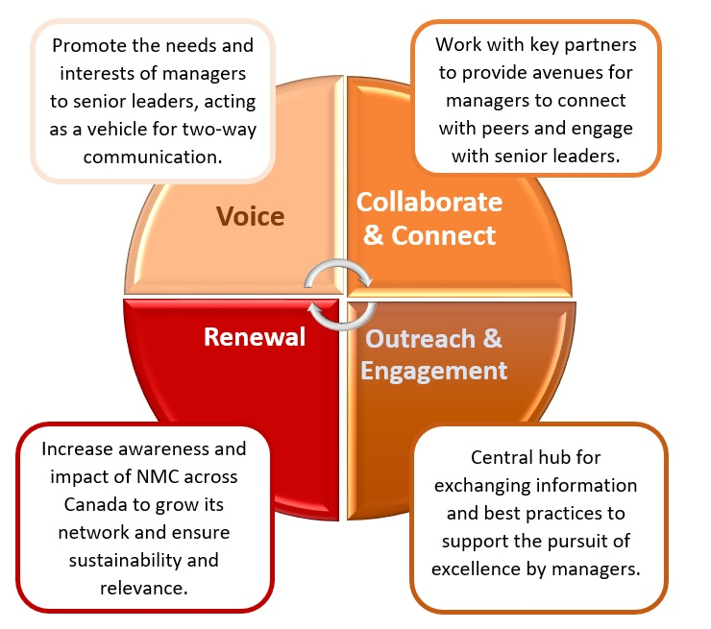
STRATEGIC OBJECTIVES
CONNECT - ENGAGE - COLLABORATE
Notes:
Voice: We are the voice of managers, we need to hear from them to know how we can become more agile, inclusive & equipped.
Collaborate: How PCO had kiosks at all the managers exchanges as well as the lightning talks, participation during the armchair discussions
Outreach & Engagement: We are promoting Boeyond2020 on all our platforms and involved with Innovation Fairs, project up North

Slide 4
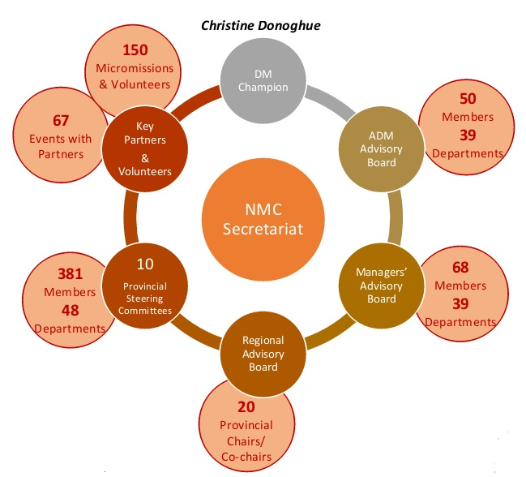
NMC NETWORK
By extending the NMC Network across departments, agencies and regions; more managers are better able to connect, engage and collaborate with public servants at all levels to achieve their objectives and deliver on government-wide priorities.
Did you Know?
Provincial Steering Committee and Advisory Board members spent 3,500 hours on the side of their desks, discussing issues of importance to the managers’ community with the NMC network.
CONNECT - ENGAGE - COLLABORATE
Notes:
# of meetings for steering committees = hours
# of members
# of departments
# of volunteers, hours
# of meetings (in hours)

Slide 5
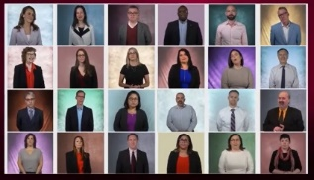
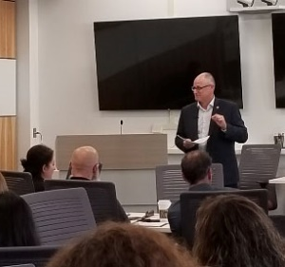
THE VOICE
Bringing the voice, needs and interests of managers to senior leaders and key stakeholders to raise awareness of the barriers to success and allow managers across Canada to be heard.
The NMC represented the voice of managers to over 1,000 senior leaders.
NMC Video: Canada’s Federal Public Service Managers: Mobilizers, Influencers and Innovators
The NMC is a trusted medium to engage managers. The network was consulted 32 times to shape the priorities of the Government of Canada.
The NMC gathered managers from all regions of Canada to record a video providing a glimpse into their day-to-day realities. It was presented to Deputy Ministers at the Public Service Management Advisory Committee (PSMAC) meeting on June 21, 2019.
Did you Know?
The NMC worked with the PSC to enable Patrick Borbey, PSC President to hear directly from 114 managers across the country.
CONNECT - ENGAGE - COLLABORATE
Notes:
Mind-mapping = 6 senior leaders, events, 1 sl per event.
NMC – a trusted medium to engage managers.

Slide 6
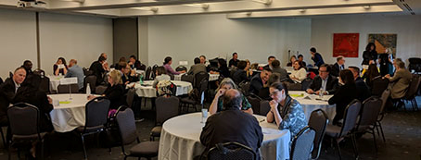
COLLABORATE AND CONNECT
Collaborating with key stakeholders, permits the NMC to deliver/ facilitate opportunities for managers from all departments and regions across Canada to connect with peers and senior leaders, strengthen their network and acquire resources and tools.
Networking
Limits isolation
Face to face
Interdepartmental connections
Engaged discussions
29 senior leaders and 10 managers from every region in Canada participated in the ADM Forum on April 25, 2019 to discuss engaging leadership for the future
Thank you to our key partners and ambassadors who enable us to grow and do more in support of managers!
Public Service Renewal Secretariat, PCO
Office Chief Human Resource Officer
Public Service Commission of Canada
Regional Federal Councils
Canada School of Public Service
Federal Youth Network
Office of Public Service Accessibility
Senior Leaders’ Networks
Did you Know?
140 senior leaders participated in NMC events in 2019.
CONNECT - ENGAGE - COLLABORATE
Notes:
Provided # of opportunities for managers to network
We need our partners to achieve more & be effective

Slide 7
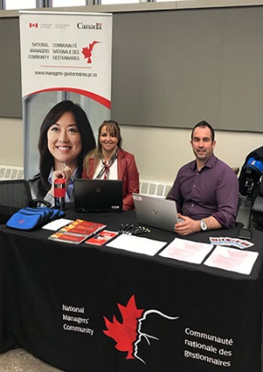
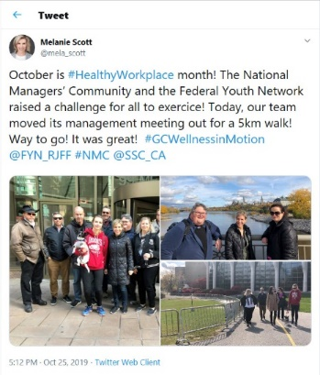
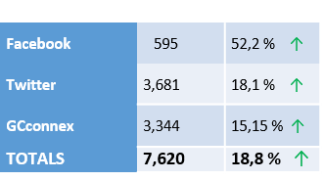
OUTREACH AND ENGAGEMENT
By engaging managers with proactive and targeted interactions, the NMC acts as a central hub for facilitating dialogue and exchanging information and best practices on key and upcoming issues. The NMC experiments with different mediums to reach new managers and expand its network.
32
Kiosks
The NMC relaunched their Website in July. Take a look!
www.managers-gestionnaires.gc.ca
October is Healthy Workplace Month. In 2019, The NMC and the Federal Youth Network launched the #GCWellnessinMotion Challenge, encouraging public servants from across the country to spend time exercising.
Congratulations!
Top three departments:
1 – IRCC = 8,606.5 minutes
2 – IRB = 4,942 minutes
3 – SSC = 4,097 minutes
Individual winner:
David Meloshko with IRCC (Alberta) = 4,310 minutes
Social Media Followers
CONNECT - ENGAGE - COLLABORATE
Notes:
Reaching out to managers
Review workplan & social media posts
How many new steering committee members were recruited this year? New co-chairs?
International learning opportunities - Apolitical

Slide 8
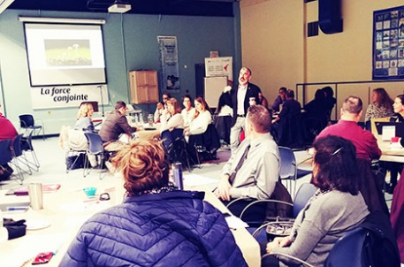
The Learning Day for Managers (LDM) program was developed from consultations with the extended NMC network across Canada - we were told it’s important to create a day for managers to let them network to strengthen their circles; and find tools to support themselves and their teams.
OBJECTIVES
To provide an opportunity for managers and aspiring managers to learn together, and to further strengthen their networks and community.
To examine management and leadership practices that build resiliency, cultivate personal growth, promote inclusion and contribute to safe workspaces and public service excellence.
To understand unconscious bias and learn how it can shape tendencies and decision making.
To explore ways to build team resilience at work and strengthen strategies for increased resilience.
680 participants at 12 LDM
27 departments participated
Robert Armstrong delivered on Resilient Teams at the Halifax LDM on November 13, 2019
A big shout out to CRA, DND, CSPS and the RFCs for their collaboration and support during the LDM this year!!
CONNECT - ENGAGE - COLLABORATE
Notes:
Developped in consultation with networks, thanks the collaborators, CRA, DND, School
Quotes from evaluations
Courtyard Café topics

Slide 9
NMC EVENTS
NMC connected with and equipped 3,000 managers at 88 NMC events in every region of Canada in 2019!
CONNECT - ENGAGE - COLLABORATE

Slide 10
THE NMC IS TAKING ACTION ON…
Report
Inclusive
in developing ideas and decision making
Expand partnerships and remove barriers to collaborate
I-2
Co-create by bringing different perspectives to the table
I-3
CONNECT - ENGAGE - COLLABORATE

Slide 11
Managers who have connected with the NMC have ensured that their voice is heard and that they were aware of events and opportunities that will contribute to the development of a more agile, equipped and inclusive public service.

