Slide 1
COVID-19
Integrating announcements into web content
For discussion
Theme Management Committee
April 3, 2020

Slide 2
Multiple navigation paths
People should be able to get to content they need to complete their tasks, whether they start their journey:
at Canada.ca/coronavirus
at the institutional level
at the theme or topic level

Slide 3
Get people to the tasks
Canada.ca
Departments and agencies
Canada.ca/coronavirus
Navigation
Theme
Institutional landing page
COVID-19 sub-section
Topic
Destination
Program or service
(task)

Slide 4
Priority issues to solve
No info on specific service pages (e.g.: EI regular benefit, CCB, GSTC, Work-sharing program)
Unnecessary duplication of high-level information

Slide 5
Approach: Sequencing the updates
1. Announcement
2. High-level summary
3. Detailed summary
4. Service update
Goal:
Progressively get more detailed and task-oriented content available to people

Slide 6
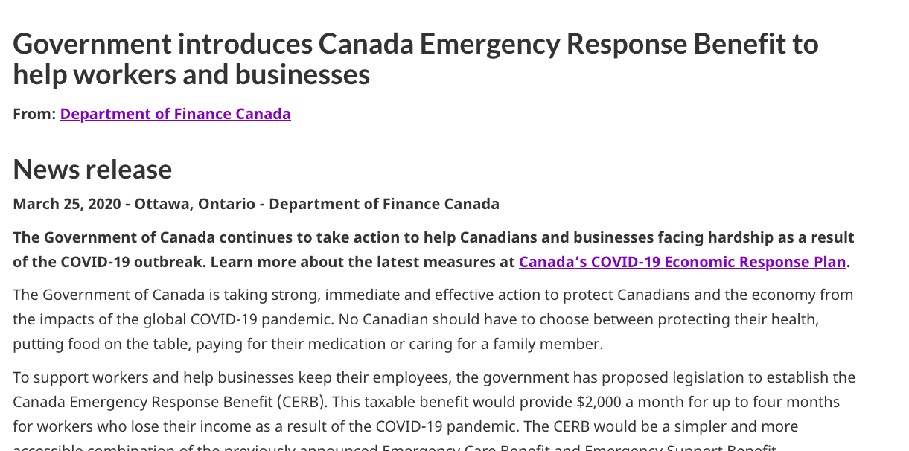
CERB - Step 1 - News release

Slide 7
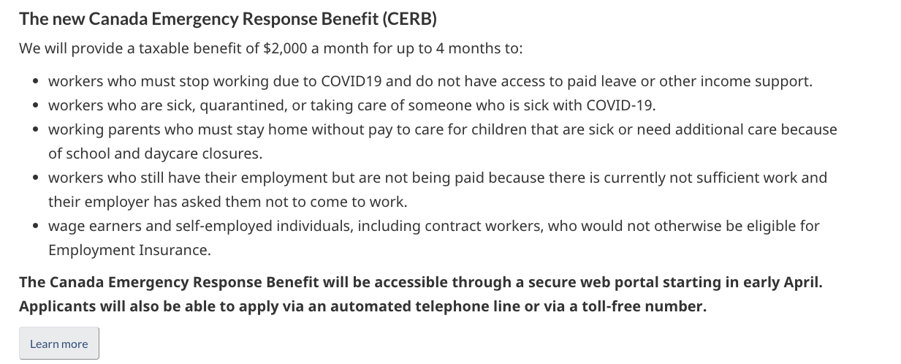
CERB - Step 2 - High-level summary

Slide 8
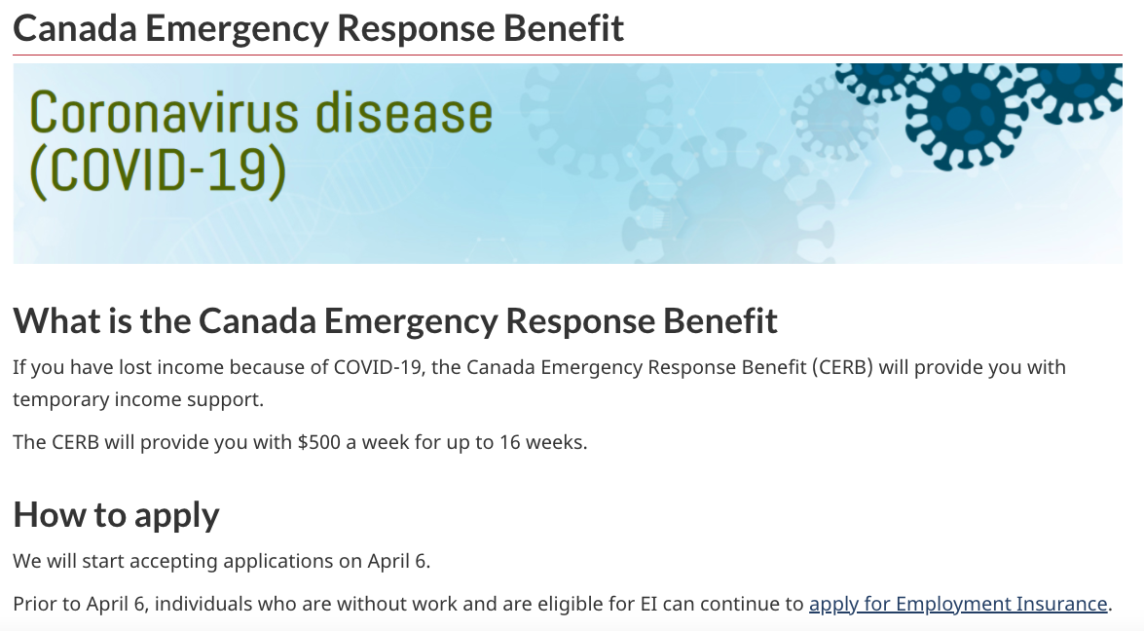
CERB - Step 3 - Detailed summary
Revised high-level summary
Detailed summary

Slide 9
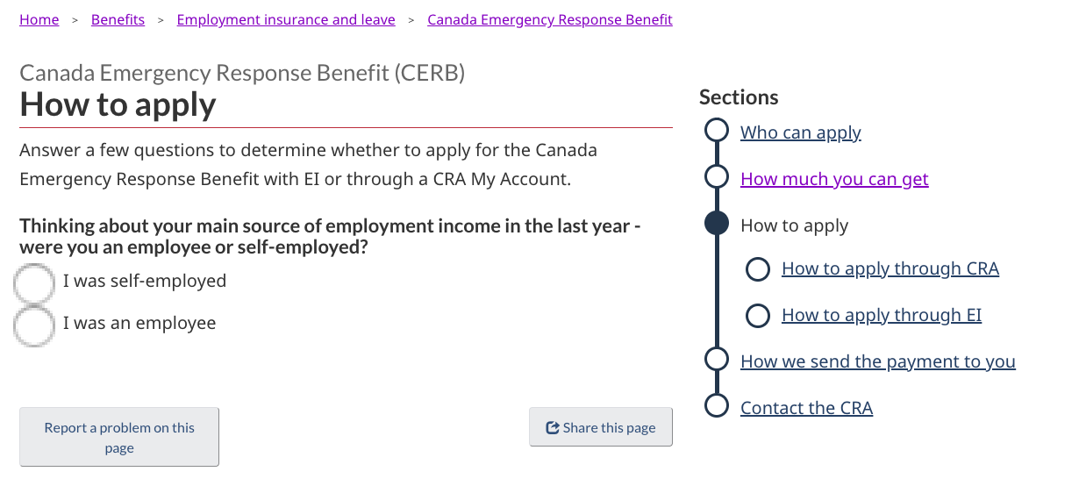
CERB - Step 4 (draft) - Service initiation template

Slide 10
Example: the new CERB
CRA and ESDC launched what constitutes a “detailed summary” yesterday - not yet a fully integrated, task-based content
The high-level summary on the COVID-19 page was reduced, and is now linking to the detailed summary
Next step: integrate the content into a task-based set of pages, ideally using the service initiation template

Slide 11
Step 1 - Announcement
1. Announcement
2. High-level summary
3. Detailed summary
4. Service update
Navigation
Canada.ca
Canada.ca/coronavirus
Departments and agencies
Theme
COVID-19 sub-section
Institutional landing page
Topic
Destination
Task or service
Add alert linking to news release

Slide 12
Step 1: Announcement
News release
Alert added to the service page ASAP, pointing to the news release
Timing: immediately, at announcement
Make the alert contextual, specific and direct - not a general notice about covid
Do: Covid-19: Proposed changes to the Canada Child Benefit
Don’t: Please read our latest notice on Coronavirus
*Only link to the news release if you are unable to get a high level summary in time for the announcement. Direction to heads of comms is to prioritize getting that content developed ahead of time to avoid linking to the news release.

Slide 13
Step 2 - High-level summary
1. Announcement
2. High-level summary
3. Detailed summary
4. Service update
Navigation
Canada.ca
Canada.ca/coronavirus
Departments and agencies
Theme
COVID-19 sub-section
Add high-level summary
Institutional landing page
Topic
Destination
Program or service
Point alert to high level summary

Slide 14
Step 2: High-level summary
High-level summary: added to the covid-19 pages, with a link to the specific service
Replace links in the alerts to point to the high-level summaries (not the news release)
If needed: departments can point to the high-level summaries - Don’t duplicate
If needed: high-level summary can link to News release
Timing: as soon as possible

Slide 15
Step 3 - Detailed summary
1. Announcement
2. High-level summary
3. Detailed summary
4. Service update
Navigation
Canada.ca
Canada.ca/coronavirus
Departments and agencies
Theme
COVID-19 sub-section
Reduce summary
Link to detailed summary
Institutional landing page
Topic
Destination
Program or service
Add detailed summary
Point alert to detailed summary

Slide 16
Step 3: Detailed summary
Detailed summary: added to the service/program pages
Replace links in the alerts to point to the detailed summaries (not the high-level summaries)
Reduce content in the main covid pages to the bare minimum, and point to detailed summaries in the tasks pages
Timing: as soon as enough details are available

Slide 17
Step 4 - Service update or launch
1. Announcement
2. High-level summary
3. Detailed summary
4. Service update
Navigation
Canada.ca
Canada.ca/coronavirus
Departments and agencies
Theme
COVID-19 sub-section
Point to service page
Institutional landing page
Topic
Destination
Program or service
Add/Launch updated content
Remove alert

Slide 18
Step 4: Service update or launch
Stable, task-focused content added to the service/program pages
Use the service initiation template
Remove alerts in service pages
Timing: as soon as the policy details are stable

Slide 19
Responsibilities of departments
Don’t duplicate announcements and high-level information - link to it
Update impacted services ASAP: link to high-level summary until you can flesh out a detailed summary
When details are known: update your service pages with task-based content
* Service disruptions: if service level is impacted, update the relevant service pages - consider a departmental page if there are many service disruptions

Slide 20
Some content doesn’t fit in that model
Some supporting content doesn’t fit in this model, especially when it’s not a “measure” or an announcement
This supporting content may need to be connected to:
the topic tree
the main COVID-19 area, where it makes sense
Work with your theme lead to determine where it belongs
Overall IA diagram

Slide 21
Questions?

