Slide 1



Meet your Circle
2025
Notes:
Welcome everyone to our Meet Your Circle Members session for Lifting as you Lead 2025!

Slide 2


Meet Your Circle
Message from the Lifting as you Lead Mentoring Circles program team: Wanted - Someone to volunteer to be the first Circle Leader and facilitate this Discussion Guide.
Notes:
Welcome to the Lifting as you Lead Menoting Cirlces (LLMC) program! This guide is intended to walk you through the first steps you'll take as a Circle. The Materiel Group Diversity and Inclusion Office hopes this session will give everyone the opportunity to introduce themselves, determine Circle session times, and volunteer to be a Circle Leader or Assistant Circle Leader for one of the five Circle meetings.

Slide 3
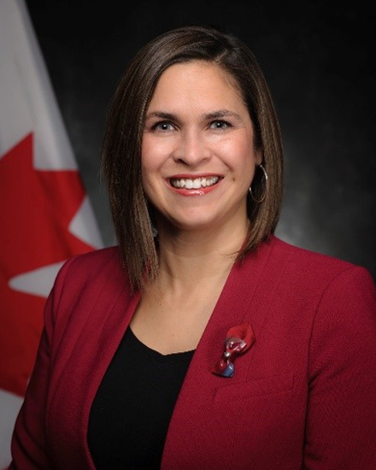

Founders’ Message
“Thank you” doesn’t feel like enough to describe how happy we are, for you to have made the commitment to join the Lifting as you Lead Mentoring Circles program 5th Cohort, organized by the Diversity and Inclusion Office, Materiel Group, National Defence. Open to all Federal Public Service and military members. You're now part of a diverse network of 1500+ inclusive-minded leaders from over 60 Government of Canada departments, Crown corporations and agencies learning together to apply inclusive leadership skills in real time.
What began as a simple idea from our consultations has matured into a thriving network, addressing the desire for meaningful connection and professional growth.
There’s Power in People Coming Together
You have been assigned to a group Mentoring Circle: a small, trusted group for goal achievement in a safe space. By actively engaging with your Circle over the course of the 10-week program, sharing experiences, and fostering connections, you'll unlock personal and professional growth opportunities. This Circle will facilitate learning from others' experiences and diverse perspectives, expanding your knowledge and tactical skills.
LLMC offers a unique opportunity for everyone to feel valued and respected for their contributions. The relationships you build will accelerate progress and drive accountability.
Judith Bennett
Associate Assistant Deputy Minister, Materiel,
National Defence
Samantha Moonsammy
LLMC Founder,
Materiel, National Defence
Notes:
Here's a message from the program founders if you'd like to take a read through in your Discussion Guide PDFs
[first of two slides]

Slide 4
Founders’ Message
The Time to Act is Now!
Thank you for answering the call to action, and committing to creating a psychologically safer workplaces for all, especially those from equity-deserving groups. This takes personal accountability for what we do. It is about initiative - and taking that extra step that no one may have asked you to take, but that is often needed to make something a success.
We hope you will feel a real and fundamental shift throughout the program. And together we will celebrate all the hard work you put into this experience. Thank you for showing up for yourself, your family, your organization and the communities you’re called to serve.
Going forward, take advantage of all the networking that will take place, meet new LLMC members in MS Teams and on LinkedIn. Lean into the Masterclasses.
Choose to stay consistent with that next level version of you. We are rooting for you.
Be proud. Proud of the work you do. Proud of serving Canada and Canadians.
Judith Bennett
Associate Assistant Deputy Minister, Materiel,
National Defence
Samantha Moonsammy
LLMC Founder,
Materiel, National Defence
Notes:
Here's a message from the program founders if you'd like to take a read through in your Discussion Guide PDFs
[second of two slides]

Slide 5
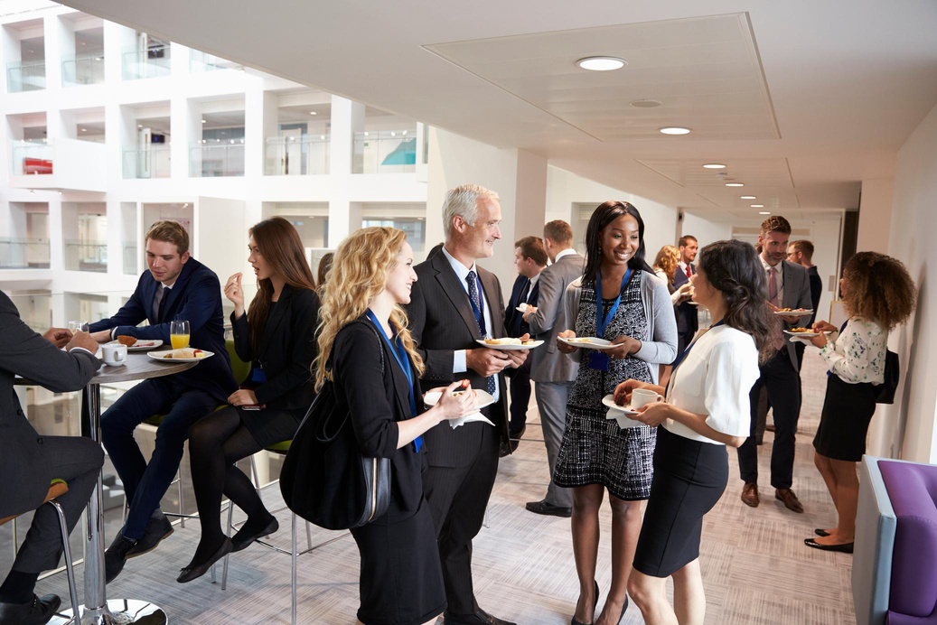


Program Description
Connect
Elevate
Inspire
Networking across the Federal Public Service
The Clerk’s Call to Action
Inclusive Leadership by Design
Notes:
The LLMC program is an initiative grounded in the 2020/2021 Deputy Minister Commitments on Diversity and Inclusion and strives to build on the Clerk’s Call to Action to better support leadership development towards addressing anti-racism, equity, and inclusion in the federal public service. Through this lens, the LLMC program provides you with an innovative space and opportunity to actively partake in making your
workplace inclusive.
This ten-week program, consisting of five Circle sessions and five Masterclasses, provides a platform for members to network with colleagues and leadership across the federal public service while developing interpersonal skills, learning about key leadership and cultural competencies, and finding career building opportunities.
By actively engaging with your Circle members, sharing your story, knowledge, and questions, and fostering connections within the broader LLMC network, you will unlock opportunities for personal and professional growth. The knowledge you acquire through these interactions will empower you to advance in your career.
LLMC is a call to action for you to become a change-maker through sharing what you learned with those in your organisation and by integrating it into your daily actions. By applying for this program, you are committing to use what you learn to create a psychologically safer workplace for everyone, especially those from deserving equity groups.

Slide 6



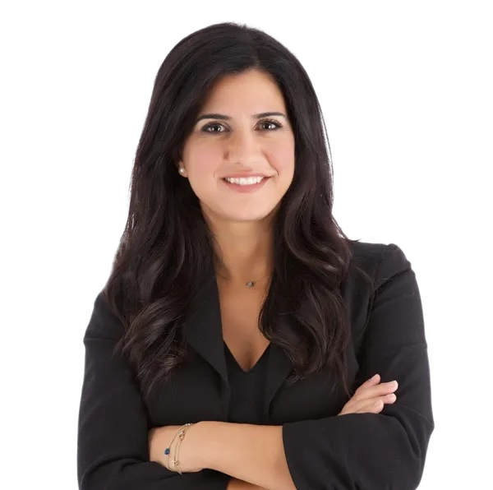
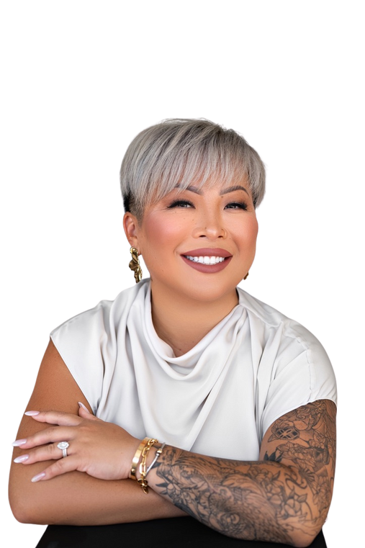
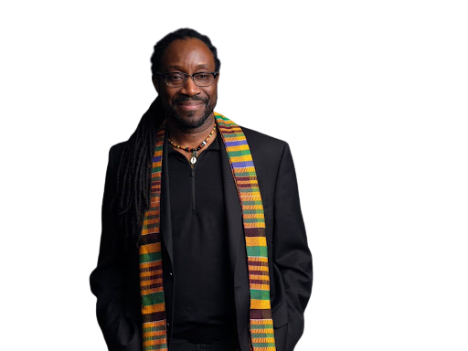
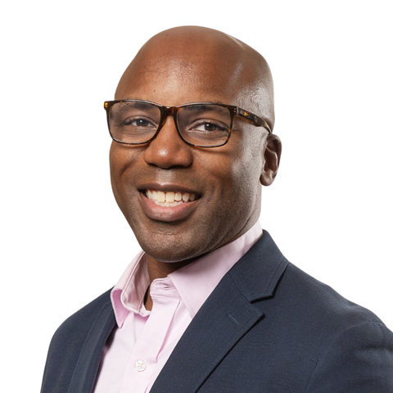
2025 Masterclass Teachers
Dr. Jody Carrington
Fotini Iconomopoulos
Jenny Chen
Richard Sharpe
Charles Achampong
Inclusive Leadership:
Psychological Safety and Belonging as the
Future of Work
Say Less, Get More:
Mastering Effective Negotiation
The Power of Sponsorship:
Turning Connection into Career Momentum
Innies and Outies: Maintaining our Humanity During the Age of AI
Confidence:
Strengthen Your Mindset for Career and Leadership Success
September 22, 2025
1:00 pm - 2:30 pm ET
October 6, 2025
1:00 pm - 2:30 pm ET
October 20, 2025 1:00 pm - 2:30 pm ET
November 3, 2025
1:00 pm - 2:30 pm ET
November 17, 2025
1:00 pm - 2:30 pm ET
Notes:
Let’s take a closer look at the 2025 program outline. This year's Masterclass teachers are:
Inclusive Leadership: Psychological Safety and Belonging as the Future of Work with Dr. Jody Carrington
Say Less, Get More: Mastering Effective Negotiation with Fotini Iconomopoulos
The Power of Sponsorship: Turning Connection into Career Momentum with Jenny Chen
Innies and Outies: Maintaining our Humanity During the Age of AI with Richard Sharpe
Confidence: Strengthen Your Mindset for Career and Leadership Success with Charles Achampong.
Masterclasses are recorded for viewing at a later date if you’re unable to attend live.

Slide 7

Circle Themes
Inclusive Leadership
September 30 or October 1
Mastering the Art of Negotiation
October 14 or 15
Sponsorship and Career Building
October 28 or 29
Diversity, Equity, Inclusion, and Accessibility: A Non-Performative Approach
November 11 or 12
Confidence: Strengthen Your Mindset for Career and Leadership Success
November 25 or 26
Notes:
LLMC Cohort 5 Circle Themes are:
Inclusive Leadership
Mastering the Art of Negotiation
Sponsorship and Career Building
Diversity, Equity, Inclusion, and Accessibility: A Non-Performative Approach
Confidence: Strengthen Your Mindset for Career and Leadership Success

Slide 8

Benefits and Toolkit
Masterclasses with Subject Matter Experts Discussion Guides Networking Best Practices Weekly LLMC Lounge Written Components Emails Online Engagements (i.e., LinkedIn, MS Teams) Local in-person events (optional; hosted by LLMC member volunteers across Canada)
Notes:
The program has several benefits to expand your professional toolkit:
Masterclasses with Subject Matter Experts
Discussion Guides such as this one
A guide for Networking Best Practices found on the LLMC GCWiki page
LLMC Lounges
Written Components
Emails
Online Engagement
Local in-person events - hosted by LLMC member volunteers across Canada

Slide 9
Logistics
Circle time frame | Circle size
90 minutes and 120 minutes for Circle #5 For maximum collaboration and clear expectations | Optimal Circle number is 6-8 members
Notes:
Circle logistics:
each Circle is approximately 90-minutes in length and the 5th Circle is approximately 120-minutes
Ensuring maximum collaboration and clear expectations
The optimal Circle size is 6-8 members

Slide 10

Circle Ground Rules and Values
    Equality: Everyone is an equal member
    Substance: Share what's important
    Openness: Listen and avoid judgements
    Respect: Treat others as they would like to be treated
Notes:
Let's take a moment to review the Circle Ground Rules and Values - and the Participant Ground Rules and Values on the next slide:
Equality: Everyone is an equal member
Substance: Share what's important
Openness: Listen and avoid judgements
Respect: Treat others as they would like to be treated

Slide 11
Participant Ground Rules and Values
    Confidentiality - trust is critical
    Bring your full self and beginner’s mindset to each session
    Come nourished and stay hydrated
    Keep your camera on so everyone feels safe and connected
    Be candid and honest - listen with empathy
    Be ready to engage with your peers
    Remove outside distractions
    Keep your audio off, except when asking questions and contributing to the discussion
    Be fully present and attend all five weeks - no multitasking
Notes:
Let's take a moment to review the Participant Ground Rules and Values:
Confidentiality - trust is critical
Bring your full self and beginner’s mindset to each session
Come nourished and stay hydrated
Keep your camera on so everyone feels safe and connected
Be candid and honest - listen with empathy
Be ready to engage with your peers
Remove outside distractions
Keep your audio off, except when asking questions and contributing to the discussion
Be fully present and attend all five weeks - no multitasking

Slide 12

Zero Tolerance Criteria
We value and champion equality, substance,
openness and respect. Discriminatory feedback,
consistent negative energy and insulting comments
could result in blocked access to the rest of the meetings and other program sessions in the future.
Notes:
We value and champion equality, substance, openness and respect. Discriminatory feedback, consistent negative energy and insulting comments could result in blocked access to the rest of the meetings and other program sessions in the future.

Slide 13

How will we hold each other accountable?
    Commit to the ground rules
    Reflect on how we can support each other
    Practice self-reflection
Reminder
Do what you can in the Circles, you don’t need to get through it all. Use your best judgement!
Notes:
Together, let’s commit to these ground rules:
-Everyone has an equal voice
-Everyone is respectful of others opinions, perspectives and ideas
-Everyone is free to ask for what they need
-No one is wrong
-We will approach our circles from a place of curiosity, without judgement or bias
-We will hold the confidentiality of everyone and everything shared in our Circle
Throughout LLMC let’s ask:
-How can we best support each other on this journey?
-What do you need to succeed on this journey?
-What is our expectations of each other around Circle preparation, attendance, and participation?
-How do we hold each other accountable to be prepared and participate in our Circle?
-What is the expectation if someone must miss a Circle or will be late? (i.e. how much advance notice? Option to reschedule? etc.)
-How do we speak hard truths to each other?
-What do you hope to achieve with this Circle?
-How can we best support each other on this journey?
-What do you need to succeed on this journey?
-What is our expectations of each other around Circle preparation, attendance, and participation?
-How do we hold each other accountable to be prepared and participate in our Circle?
-What is the expectation if someone must miss a Circle or will be late? (i.e. how much advance notice? Option to reschedule? etc.)
-How do we speak hard truths to each other?
-What do you hope to achieve with this Circle?
Practice some self reflection:
-Who do I want to be when participating in our Circle?
What will be the role of my inner critic
-What do I want to create/change in this area of my life?
-Am I open to having my assumptions challenged?
And a reminder for us to do what we can in the Circles, we don’t need to get through it all. We will use our best judgement!

Slide 14

Program Requirements
    Actively Participate in all 5 Circle Sessions
    (scheduled by your Circle Group)
    Attend Masterclasses to enrich your experience and learning
    (invites in your calendars)
    Complete the 6 Written Components
    (reminders in your calendars)
Optional LLMC Perks
    Weekly LLMC Lounge (invites in your calendars)
    Local events (hosted/organized by LLMC member volunteers across Canada)
    Online engagements (LinkedIn, MS Teams)
Notes:
The program requirements are:
to actively participate in all 5 Circle sessions. If you are unable to attend a session please let us, your Circle group know ahead of time
Attend Masterclasses
Complete the 6 program Written Components
Optional LLMC perks:
LLMC Lounges
Local events
Online engagements

Slide 15


Meet your Circle Members
Message from the Lifting as you Lead Mentoring Circles program team: The following slides represent how all Discussion Guides going forward look.
1. Welcome
(1 minute)
Welcome to the Lifting as you Lead Mentoring Circles (LLMC) program! This guide is meant to provide guidance on the first steps you will take as a Circle. The Diversity and Inclusion Office, Materiel Group is hoping that this session gives everyone an opportunity to introduce themselves, determine the time for your Circle sessions, and volunteer to be a Circle Leader or Assistant Circle Leader for any of the five Circle sessions.
Notes:
Welcome to the Lifting as you Lead Mentoring Circles (LLMC) program! This guide is meant to provide guidance on the first steps you will take as a Circle. The Diversity and Inclusion Office, Materiel Group is hoping that this session gives everyone an opportunity to introduce themselves, determine the time for your Circle sessions, and volunteer to be a Circle leader or assistant Circle leader for any of the five Circle sessions.

Slide 16

2. Icebreaker - Sharing Your Layers
(10 minutes)
Instructions: Each member is asked to share one “layer” or “square” from the table on the next slide within your time. Use this creative activity to share your unique story. (1 minute per member)
Notes:
Instructions: Each member is asked to share one “layer” or “square” from the table on the next slide within your time. Use this creative activity to share your unique story.
(1 minute per member)

Slide 17
I am over 49 years of age | I do volunteer work | I belong to an Employment Equity group | I speak a language other than English or French | I am under 30 years of age
I have military experience | I am the first generation of a family who immigrated to Canada | I live/have lived on an island | I attended post-secondary education | I am left handed
I have grey hair | I have lived in another country | Free Space: choose your own layer to share | I immigrated to Canada | I am an Indigenous person in Canada
I live/have lived in a Territory | I have a daily ritual in my life | I am a manager | I have difficulty hearing | I did not attend post-secondary education
I am religious or spiritual | I know American Sign Language (ASL) | I wear glasses or contact lenses | I identify as part of the 2SLGBTQIA+ communities | I am a single parent
Notes:
[1 minute per member]

Slide 18

3. Sharing your ‘Why’
(10 minutes)
Reflecting upon our motivations for partaking in these activities is an
important step for cultivating connectivity within our designated circles.
In the spirit of fostering dialogue, we are encouraged to share our WHY with
this Circle and to explore our aspirations regarding the invaluable insights these
guides offer.
This next activity aims to foster understanding, connection, and a shared sense of
purpose as we explore the significance of our individual and collective endeavours within the LLMC community.
Instructions: Each Circle member will take 1 minute to share their response to either one of the following questions: Why have you joined LLMC? How do you hope LLMC will add to your knowledge and expand your leadership toolkit?
Notes:
Reflecting upon our motivations for partaking in these activities is an important step for cultivating connectivity within our designated circles. In the spirit of fostering dialogue, we are encouraged to share our WHY with this circle and to explore our aspirations regarding the invaluable insights these guides offer. This next activity aims to foster understanding, connection, and a shared sense of purpose as we explore the significance of our individual and collective endeavours within the LLMC community.
Instructions: Each circle member will take 1 minute to share their response to either one of the following questions: Why have you joined LLMC? How do you hope LLMC will add to your knowledge and expand your leadership toolkit?

Slide 19

4. Circle Preparation
(10 minutes)
Each Circle is responsible for:
    Choosing Circle Leaders and Assistant Circle Leaders
    Scheduling all 5 Circle Sessions
    Active engagement in all Circle activities
    Reviewing each Discussion Guide and video (when applicable) ahead of the Circle Session
    Completion of all after Circle activities including bi-weekly Written Components
Notes:
Each Circle is responsible for:
-Choosing Circle Leaders and Assistant Circle Leaders
-Scheduling all 5 Circle sessions
-Active engagement in all Circle activities
-Reviewing each Discussion Guide and video (when applicable) ahead of the Circle session
-Completion of all after Circle activities including bi-weekly Written Components

Slide 20
4.1 Circle Leader and Assistant Circle Leader Selection
(5 minutes)
An integral part of our upcoming Circle sessions are the Circle
Leaders and Assistant Circle Leaders. Volunteering for these
responsibilities goes beyond participation; it's a commitment to
shaping the journey and cultivating leadership. Each Circle session
calls for different members to undertake the responsibilities of leadership.
For this next stage of this Meet Your Circle Members session, we ask you to step into a leadership role by volunteering to be a Circle Leader or Assistant Circle Leader for one of the five Circle sessions.
Notes:
An integral part of our upcoming Circle sessions are the Circle Leaders and Assistant Circle Leaders. Volunteering for these responsibilities goes beyond participation; it's a commitment to shaping the journey and cultivating leadership. Each Circle session calls for different members to undertake the responsibilities of leadership. For this next stage of this Meet Your Circle Members session, we ask you to step into a leadership role by volunteering to be a Circle Leader or Assistant Circle Leader for one of the five Circle sessions.
[go to next slide]

Slide 21

To help you choose a role, here are the responsibilities for the
positions of Circle Leader and Assistant Circle Leader during
the program.
Circle Leader | Assistant Circle Leader
Bring positive energy Reinforce rules and expectations Be aware of your speed of speech Build rapport within the Circle Handle logistics of the session Touch point with Circle members | Keep track of time Provide technical support Bring positive energy Reinforce rules and expectations
Notes:
To help you choose a role, here are the responsibilities for the positions of Circle Leader and Assistant Circle Leader during the program.
Circle Leaders will Bring positive energy; Reinforce rules and expectations; Be aware of your speed of speech; Build rapport within the Circle; Handle logistics of the session; and Touch point with Circle members.
Assistant Circle Leaders will: Keep track of time; Provide technical support; Bring positive energy; and Reinforce rules and expectations.
[as a group, choose leaders & assistant leaders for the 5 circle sessions now. if there isn’t time, make sure to at least choose a leader & assistant leader for the first circle session at minimum]

Slide 22
4.2 Schedule Your Circle Sessions
(5 minutes)
Each Circle has been formed based upon several factors including
the preferred session time block indicated on our application forms. This
is the time to choose a 90-minute period (120 minutes for Circle #5)
within that time block that works for this Circle group.
Instructions: Confirm that all Circle members are available for the time block indicated in the email sent by the LLMC Program team and work together to determine the best time for all members. Ask a member of the Circle to schedule all 5 Circle sessions for the chosen 90-minute Circle (120 minutes for Circle #5) session time and send the invitations out to the other Circle members on the list (including those not present at the session).
Notes:
Each Circle has been formed based upon several factors including the preferred session time block indicated on our application forms. This is the time to choose a 90-minute period (120 minutes for Circle #5) within that time block that works for this Circle group.
Instructions: Confirm that all Circle members are available for the time block indicated in the email sent by the LLMC Program team and work together to determine the best time for all members.
Ask a member of the circle to schedule all 5 Circle sessions for the chosen 90-minute Circle (120 minutes for Circle #5) session time and send the invitations out to the other Circle members on the list (including those not present at the session).

Slide 23

5. Wrap-up: What’s next and a few final words
(4 minutes)
Thank you everyone for your active participation in this Meet Your Circle Members
session. Having shared some of our layers and our “why” for joining the program, the
hope is that we all feel ready to learn and grow as we begin our LLMC journey.
    Launch: The 2024 LLMC program will officially begin with the program launch
taking place on Tuesday, September 9th at 1:00 pm ET! Check your email or calendar
    for more information about this session.
    Masterclass: Our first Masterclass takes place on Monday, September 22, 2025, at 1:00 pm Eastern Time. This 90-minute Masterclass is a hands-on coaching class on Inclusive Leadership: Psychological Safety and Belonging as the Future of Work. Invitations to all 5 Masterclasses have been sent to you prior to the start of this LLMC cohort. Please see your calendar for details.
    Next Circle: The next Circle session will be focused on Inclusive Leadership. We will learn about the characteristics of inclusive leaders and how we can apply this knowledge in the workplace. Please review Discussion Guide #1 and watch Simon Sinek’s TedTalk, “Why Good Leaders Make You Feel Safe” prior to the second Circle session.
Thank you, everyone! Be well, take care and see you at the program launch on Tuesday, September 9th, 1:00–2:30pm.
Notes:
Thank you everyone for your active participation in this Meet Your Circle Members session. Having shared some of our layers and our “why” for joining the program, the hope is that we all feel ready to learn and grow as we begin our LLMC journey.
Launch: The 2025 LLMC program will officially begin with the program launch taking place on Tuesday, September 9th at 1:00 pm! Check your email or calendar for more information about this session.
Masterclass: Our first Masterclass takes place on Monday, September 22, 2025, at 1:00 pm Eastern Time. This 90-minute Masterclass is a hands-on coaching class on Inclusive Leadership: Psychological Safety and Belonging as the Future of Work. Invitations to all 5 Masterclasses have been sent to you prior to the start of this LLMC cohort. Please see your calendar for details.
Next Circle: The next Circle session will be focused on Inclusive Leadership. We will learn about the characteristics of inclusive leaders and how we can apply this knowledge in the workplace. Please review Discussion Guide #1 and watch Simon Sinek’s TedTalk, “Why Good Leaders Make You Feel Safe” prior to the second Circle session.
Thank you, everyone! Be well, take care and see you at the program launch on Tuesday, September 9th, 1:00–2:30pm.

Slide 24

To Do Checklist: First Circle at a Glance
Consult the LLMC Program Overview Wiki
page for all checklist links
Attend the Masterclass on September 22 at 1:00pm Eastern
Fill out the List of Circle Members (Discussion Guide PDF)
Attend the LLMC Lounge (optional)
Review Discussion Guide #1 on Inclusive Leadership
Join the LLMC LinkedIn group
Check out the LLMC Learning Library

Slide 25

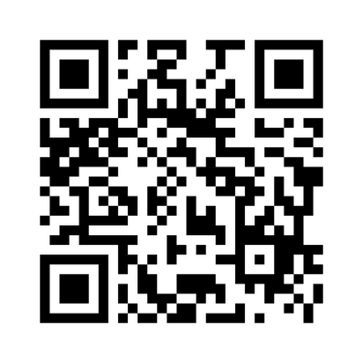
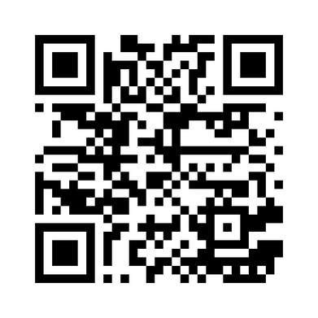
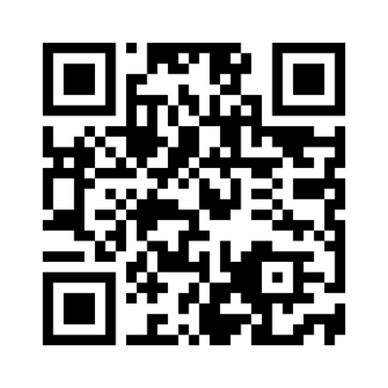
Important Links
Contact us on the LLMC Support Form
Visit the LLMC Learning Library
Join the LLMC LinkedIn Group

Slide 26

Support
Employee Assistance Program (EAP)
EAP provides free short-term counselling for personal or work-related problems as well as crisis
counselling.
Toll-free: 1-800-268-7708
TTY (for people with hearing impairments): 1-800-567-5803
https://www.canada.ca/en/government/publicservice/wellness-inclusion-diversity-public-service/
employee-assistance-program.html#E
Hope for Wellness Helpline
24/7 access to Indigenous Counsellors.
Available in French and English and, upon request, Ojibway, Cree and Inuktituk.
1-855-242-3310
Chat line via: https://www.hopeforwellness.ca/
Member and Family Assistance services (Canadian Armed Forces)
The Member and Family Assistance services is a 24 hour, 7 days a week bilingual telephone and face to face counselling service that is voluntary, confidential, and available to Canadian Armed Forces (CAF) members and their families who have personal concerns that affect their well-being and/or work performance.
https://www.canada.ca/en/department-national-defence/services/benefits-military/health-support/member-family-assistance-services.html

Slide 27

Support
Sexual Misconduct Support and Resource Centre (National Defence)
The Sexual Misconduct Support and Resource Centre (SMSRC) was created by the Department of
National Defence but is independent from the CAF chain of command and is not required to report
incidents of sexual misconduct to the CAF. Support services for CAF members, National Defence public
service employees, Cadets and Junior Canadian Rangers affected by sexual misconduct and their
families, aged 16 and older. Guidance and support for leaders and management on addressing sexual
misconduct.
https://www.canada.ca/en/department-national-defence/services/benefits-military/health-support/sexual-misconduct-response.html
The Canada Suicide Prevention Service
Talk Suicide Canada provides nationwide, 24-hour, bilingual support to anyone who is facing suicide.
Toll-free: 1-833-456-4566.
https://www.crisisservicescanada.ca/en/
Wellness Together Canada
Mental Health and Substance Abuse Support.
Toll free: 1-866-585-0445
https://wellnesstogether.ca

Slide 28
Thank you all for your participation!
Be well, and take care.

