Slide 1
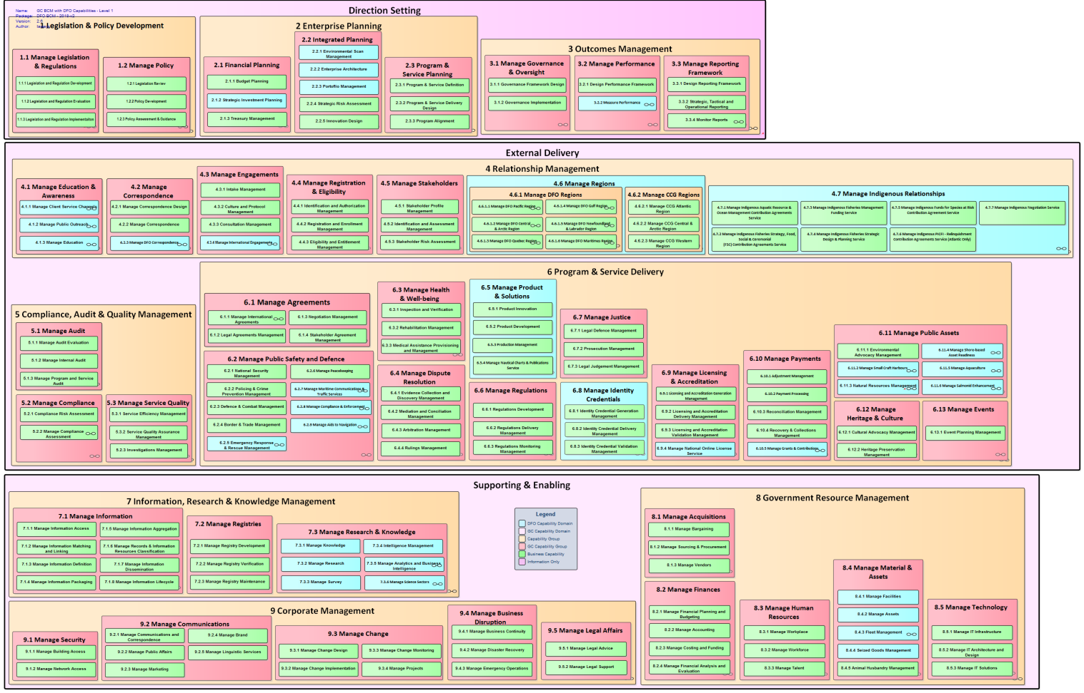
Annex B – DFO BCM (For Highlighting, Expanding DFO Capabilities based on GC BCM)
Notes:
Level 1 starts to show specific capability domains and capability groupings. Pink is GC, light blue is DFO

