Slide 1
GC design system - Testing with Fable
Système de design GC - Tester avec Fable
design-system.alpha.canada.ca
systeme-design.alpha.canada.ca/fr/

Slide 2
Our research plan
Notre plan de recherche
Determine if our users are able to use websites built with GC Design System, without encountering any accessibility barriers that would prevent them from:
Understanding the website goal
Assess if the website and its content meet their needs
Notes:
Our Research Plan: Determine if our users are able to use websites built GC Design System without encountering any accessibility barriers that would prevent them from:
Understanding the website goal
Assess if the website and its content meet their needs

Slide 3
Assistive technology engagement

Slide 4
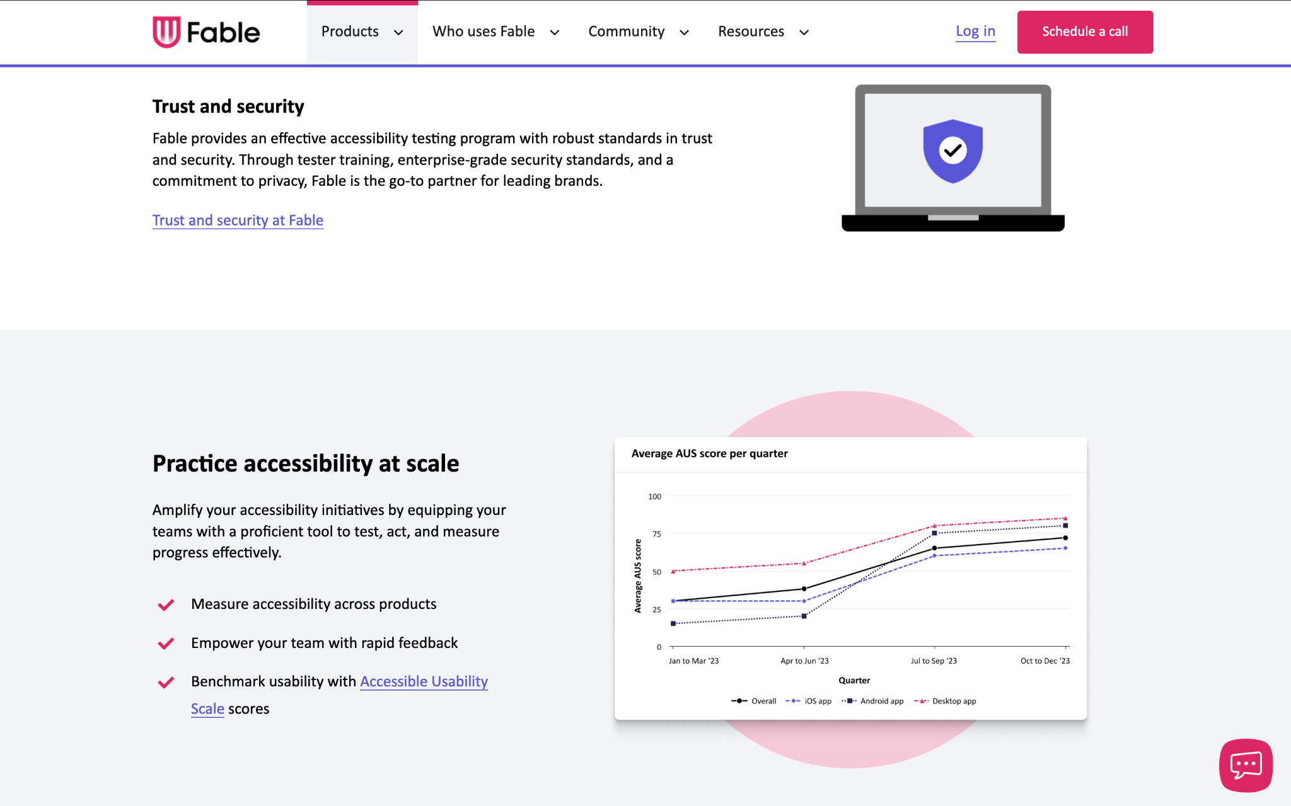
Our assistive technology testing platform:
Notes:
Fable is a platform used for testing assistive technology, for people with disabilities. The team consists of individuals who are uniquely qualified to support our digital team.
Fable testers are a diverse community of individuals, all of whom live with a disability, and each who us assistive technology as part of their daily life.
Testers are located across Canada, and the US, across 5 time zones.
Most testers have experience with multiple types of assistive technology. They are experts in the field.

Slide 5
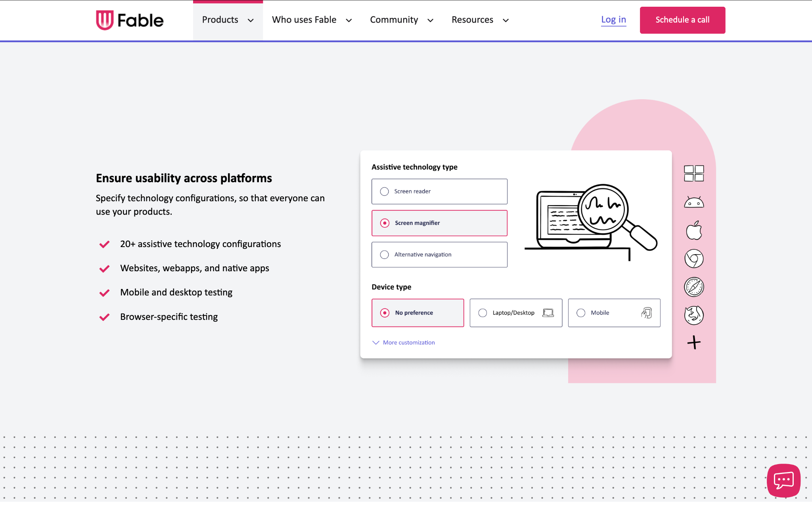
Our assistive technology testing platform:
Notes:
Fable is a platform used for testing assistive technology, for people with disabilities. The team consists of individuals who are uniquely qualified to support our digital team.
Fable testers are a diverse community of individuals, all of whom live with a disability, and each who us assistive technology as part of their daily life.
Testers are located across Canada, and the US, across 5 time zones.
Most testers have experience with multiple types of assistive technology. They are experts in the field.

Slide 6
1/ The GC Design System website
🔬 Methodologies include: compatibility, self-guided, moderated interview
Testing the collective functions, navigation, and accessibility of the contents on the documentation site
https://design-system.alpha.canada.ca/en/
2/ The components through a demo website leveraging our available components
🔬 Methodologies include: compatibility, self-guided, moderated interview
Testing the collective functions, and accessibility of the new, updated, and old components
https://fable-test.d2fzvkr34ak02t.amplifyapp.com/
Methodology : 2 websites used for testing
Notes:
1/ The GC Design System website
🔬 Methodologies include: compatibility, self-guided, moderated interview
Testing the collective functions, navigation, and accessibility of the contents on the documentation site
https://design-system.alpha.canada.ca/en/
2/ The components through a demo website leveraging our available components
🔬 Methodologies include: compatibility, self-guided, moderated interview
Testing the collective functions, and accessibility of the new, updated, and old components
https://fable-test.d2fzvkr34ak02t.amplifyapp.com/

Slide 7
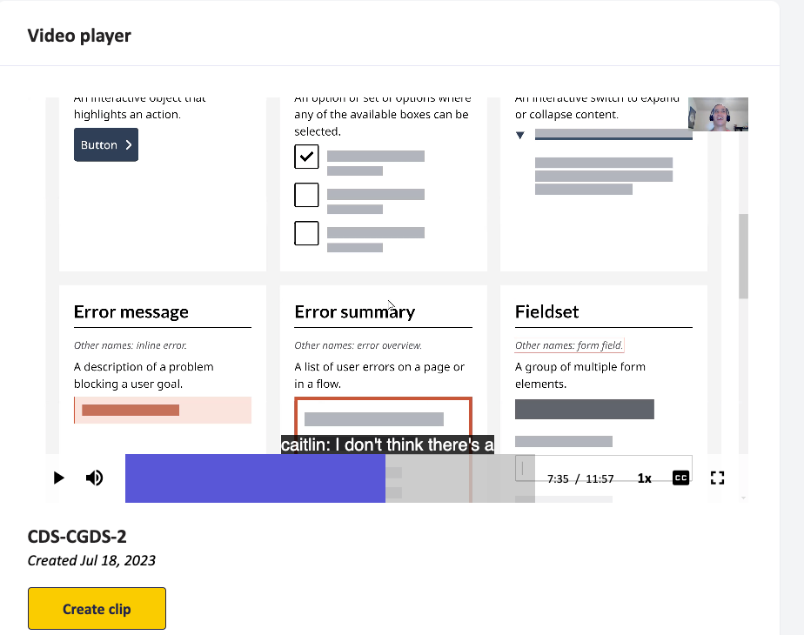
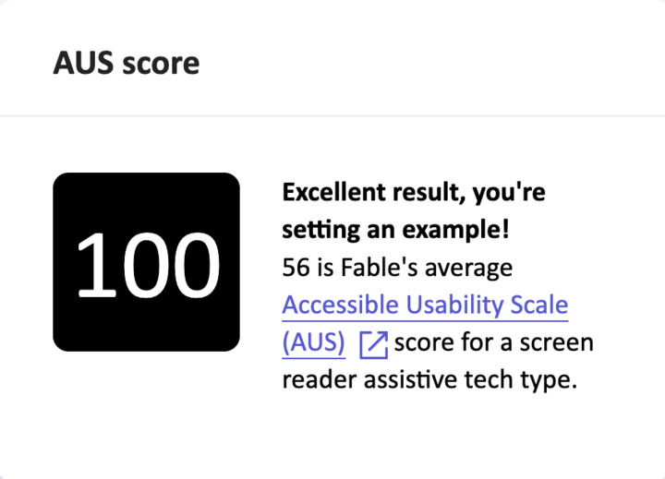
Website test - Self guided
Empower cross-team collaboration by sharing video clips.
Get insights on how a user would try to complete a specific task.
Notes:
Spontaneous observations from testers with assistive technology. We’re not sure exactly where they're going to browse or with which steps they’ll take but we can give an overall context of the goal of the product and observe if they can navigate.
Unmoderated request type, completed by an assistive technology of our choice
Intro to testing, great to unveil potential problem space, provide details about their assistive technology
Results are a recorded video of tester narrating/accessing the accessibility and usability of the product/experience
There is a usability survey accessible usability scale (AUS), which provides results once video has been completed (we had a 100 🎉)

Slide 8
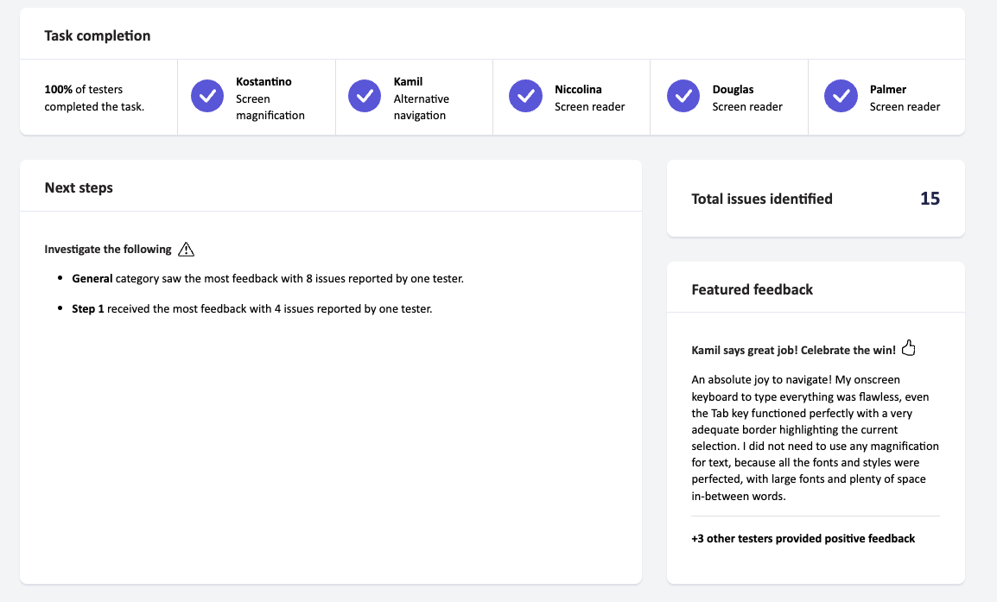
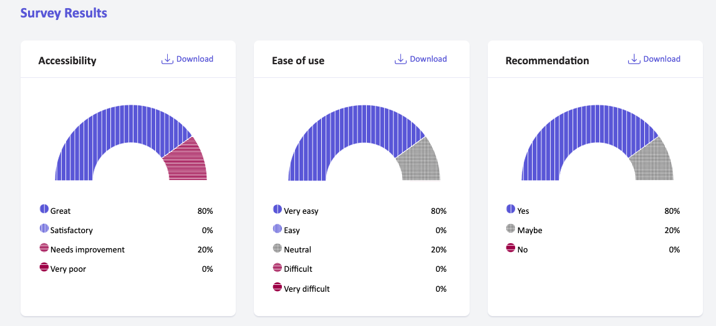
Website test - Compatibility
Task completion rates
High priority issues that prevent completion
Likelihood to recommend
Component level issues by assistive technology
Relevant WCAG criterion per issue
Notes:
Test specific tasks on our website to understand if the flow of component installation is accessible.
Gather detailed feedback from 5 assistive technology users, and get an overall sense of the user experience and if it’s working well for end user
Tests will provide us with a combination of qualitative and quantitative feedback,
Allow to get metrics like Task Completion, number of issues, and Accessibility Rating, to inform our prioritization efforts and observe ongoing a11y performance of our product

Slide 9
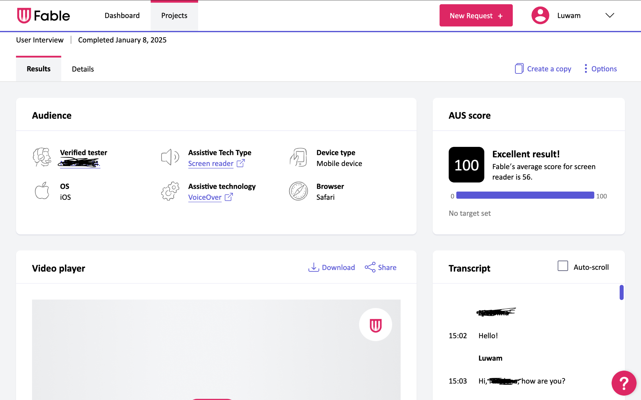
Website test - User interview
User Interview: Conduct a user interview in real time, and receive an Accessibility Usability Scale score
Prototype Review: Guide a user through a prototype
Notes:
Test specific tasks through 1:1 interview between the user and the researcher, on our website/product, to understand if the flow of component installation, and navigation of web page is accessible.
Gain more detailed conversations with the participants and better capture all levels of potential barriers to navigation.
Tests will provide us with a combination of observed user experience, and added insights to the user experience, which would otherwise may not be tracked by unmoderated existing questions.
Allows users to provide more context of their environment, and for researcher to ask follow-up questions to acc

Slide 10
Types of assistive technologies tested
Alternative navigation
Dragon Naturally Speaking
On-screen
Switch system
Head mouse
Voice Control
Keyboard
Eye gaze
Screen magnifier
ZoomText
iOS Zoom
Android Zoom
Browser Zoom
Screen reader
JAWS
NVDA
VoiceOver
TalkBack
Narrato
Notes:
Alternative navigation is a collective term for a group of assistive technologies that replace the standard keyboard, mouse, or touch screen. It is used by people who have physical challenges that would make it difficult or impossible for them to use these devices.
A screen magnifier is a type of assistive technology that magnifies the contents of a screen, increases color contrast, and performs other visual modifications to the screen making it easier to see for people who have low vision.
A screen reader is a type of assistive technology that outputs on-screen text using text-to-speech, primarily used by those who are blind.

Slide 11
Our accessibility standards
The GC Design System meets or exceeds WCAG 2.1 AA, making it fully compliant with Government of Canada accessibility standards.
Our accessibility checklist
Navigation: Including Focus states, Keyboard navigation, Screen Reader compatibility, and Responsive design
Visuals: Including Colour contrast, Non-colour indicators, Screen magnifier compatibility, Browsers and assistive plugins compatibility, Alt text, and ARIA roles and attributes
Clarity: Including clear form fields, and clear and specific error messages
Accessibility in the GC Design System
https://design-system.alpha.canada.ca/en/accessibility/
Notes:
The GC Design System meets or exceeds WCAG 2.1 AA, making it fully compliant with Government of Canada accessibility standards.
Our accessibility checklist
Navigation: Including Focus states, Keyboard navigation, Screen Reader compatibility, and Responsive design
Visuals: Including Colour contrast, Non-colour indicators, Screen magnifier compatibility, Browsers and assistive plugins compatibility, Alt text, and ARIA roles and attributes
Clarity: Including clear form fields, and clear and specific error messages
Accessibility in the GC Design System
https://design-system.alpha.canada.ca/en/accessibility/

Slide 12
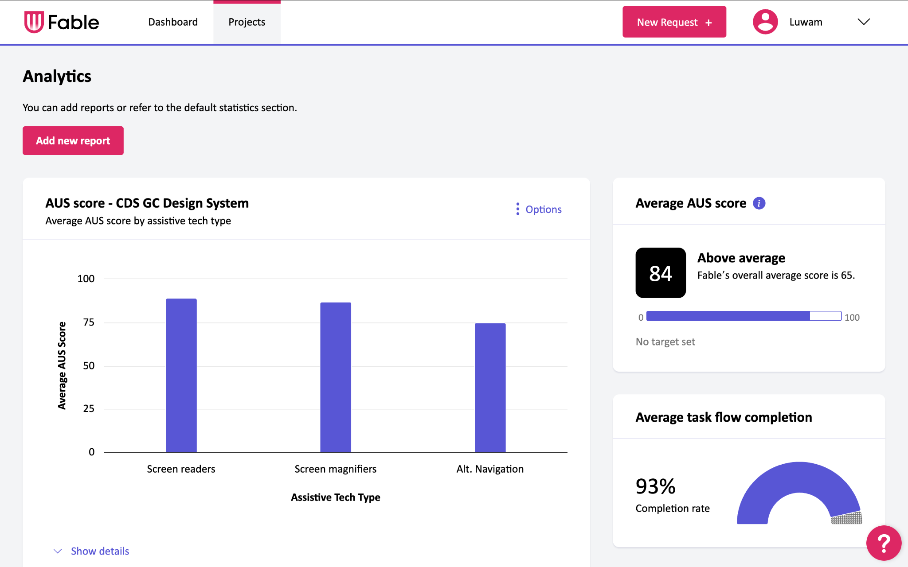
GC Design System metrics, March 2025
We have completed 48 requests (from July 2023-March 2025)
Tested with 98 participants
Averaging 84% score overall
We average out approximately 5 requests per 4-6 weeks
Notes:
We have completed 48 requests (from July 2023-March 2025)
Tested with 98 participants
Averaging 84% score overall (our average AUS score)=accessibility usability scale, which are the overall survey results collected from our participants)
We average out approximately 5 requests per 4-6 weeks

Slide 13
Introducing Accessibility Coverage, Data Tracker
Notes:
Data tracker which allows our team to see which components, assistive technologies, browsers, devices, and operating systems have been tested
More importantly, showcases what has not yet been tested
This tracker is used as a valuable and effective reference tool, when trying to understand where there may be gaps in our testing on accessibility
This holds us accountable for testing across all systems, in order to meet accessibility standards across all platforms
https://docs.google.com/spreadsheets/d/183RKCtgXhn7JE77W37IqrDlMI1H62thUdaO0_APhn3I/edit?gid=0#gid=0

Slide 14
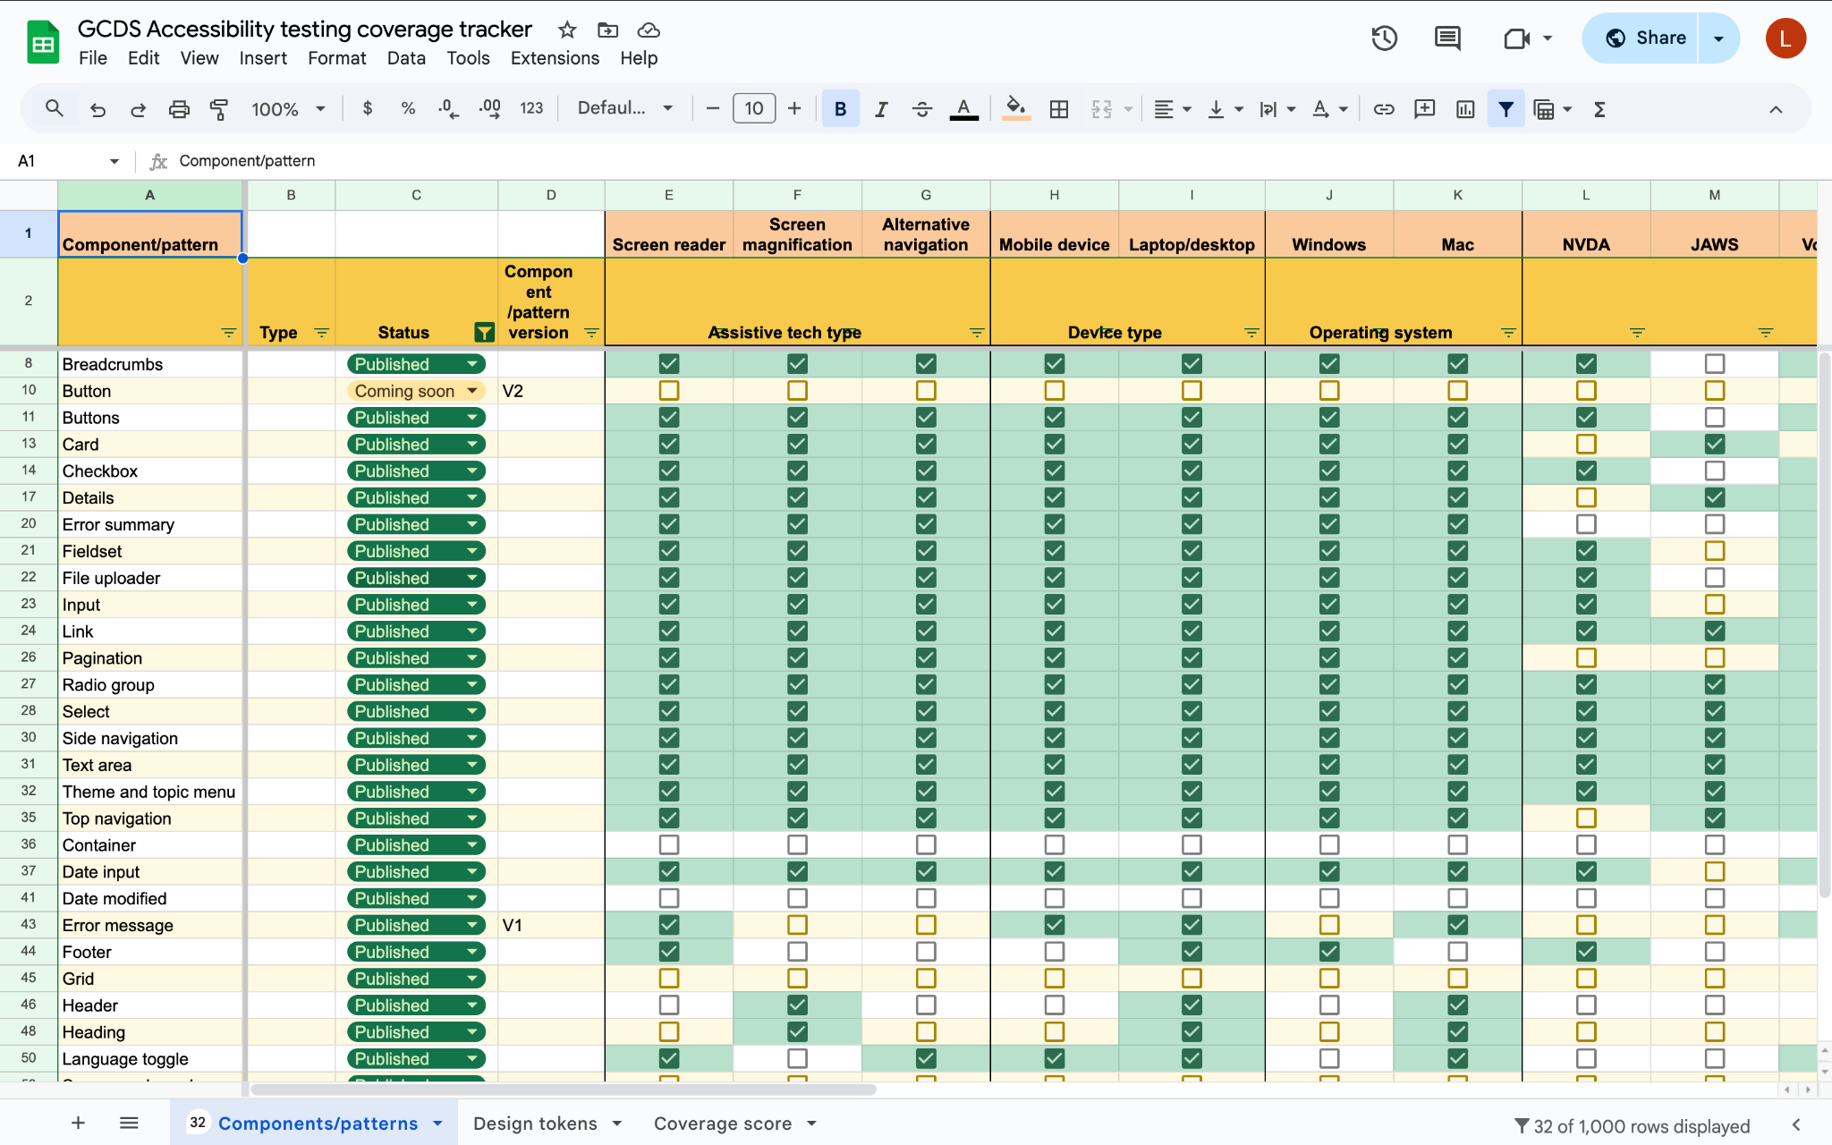
Notes:
https://docs.google.com/spreadsheets/d/183RKCtgXhn7JE77W37IqrDlMI1H62thUdaO0_APhn3I/edit?gid=0#gid=0

Slide 15
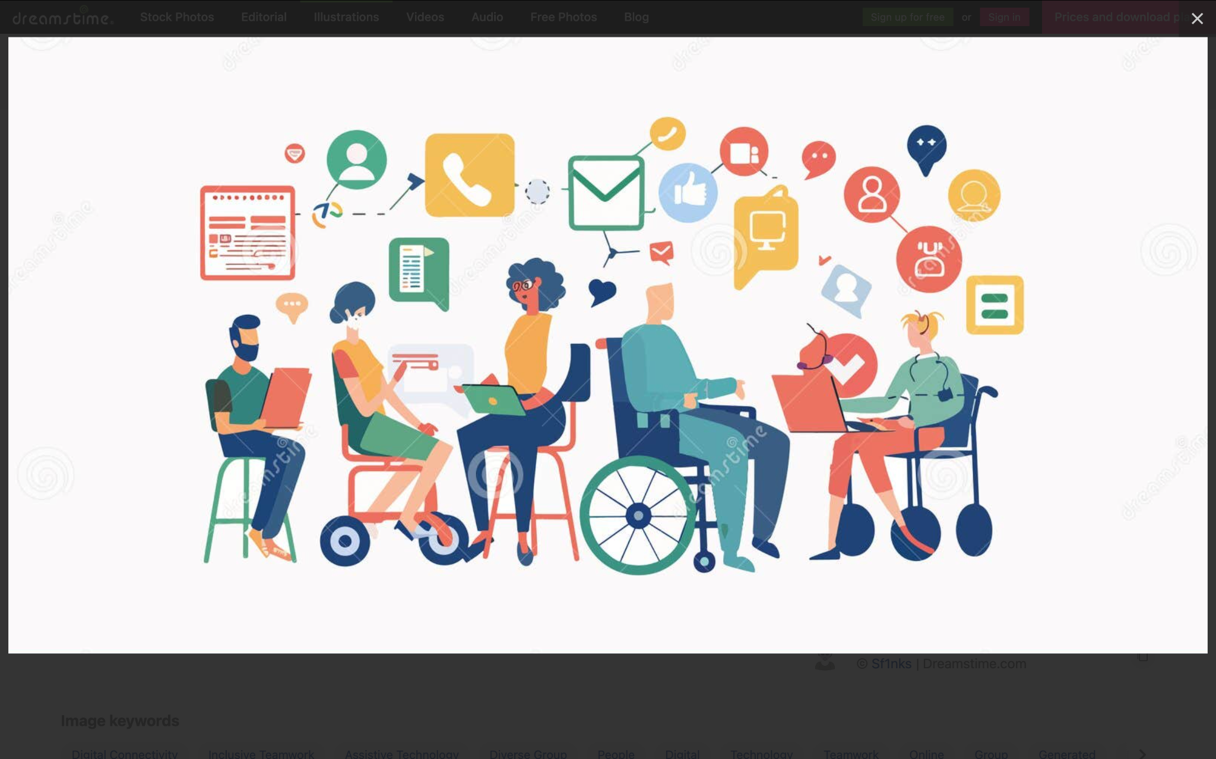
Contact us😁
Get in touch with us:
https://design-system.alpha.canada.ca/en/contact/
Notes:
Contact us: GCDS contact form

