Slide 1

Microsoft Teams Training
Module 4
COLLABORATING IN TEAMS & CHANNELS

Slide 2
In this module you will learn how to:
Add a channel
Add channel tabs
  GCdocs folder
Post in a channel
Reply to a thread
@mention a person/channel/team
Perform more options for posts
  Edit a post
  Like or React to a post
  Save a post
Collaborate on a file

Slide 3
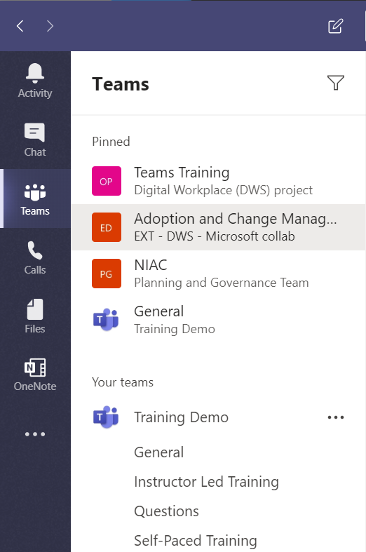
Teams and Channels
A team (ex. Training Demo) is a collection of people brought together for work or projects. Teams are made up of channels and every team automatically comes with a General channel.
Each channel (ex. General/Instructor Led Training) is built around a particular department, project, or topic. Channels are where conversations happen, where files are shared, and where apps are added.

Slide 4
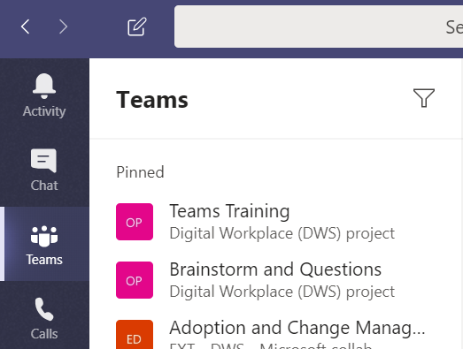
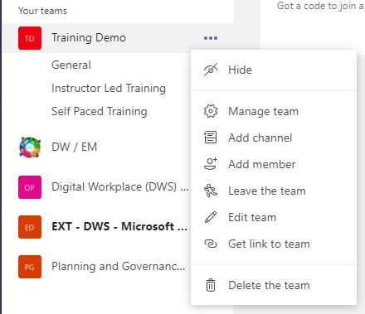
Add a Channel
To Add a Channel
Click Teams
Click the three dots beside the team name for More options
Click Add channel

Slide 5
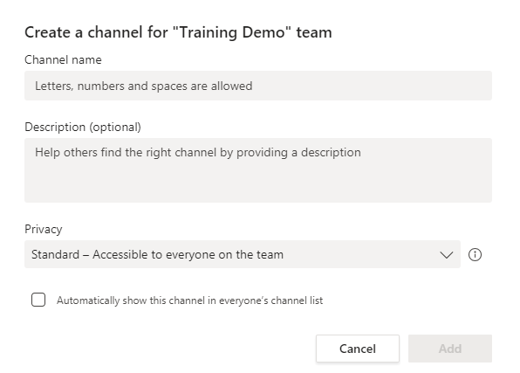
Add a Channel
Enter a Channel name
Enter a Description for the channel
Select the Privacy of the channel
  Standard – accessible to everyone on the team
  Private – only accessible to members you invite
Select whether or not you want the channel to automatically show the channel in everyone’s list
  NOTE: if you do not select this option, the channel will appear as a hidden channel in the team list and users will have to “Unhide” the channel to view it
Click Add to create the channel

Slide 6
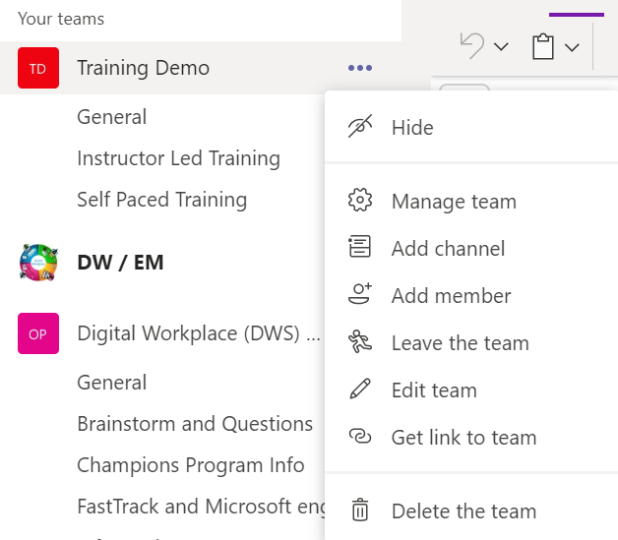
Add a Channel
Add a Channel – Method 2
Click on Teams to access the Teams panel
Click the three dots beside the team name for More Options
Select Manage Team

Slide 7
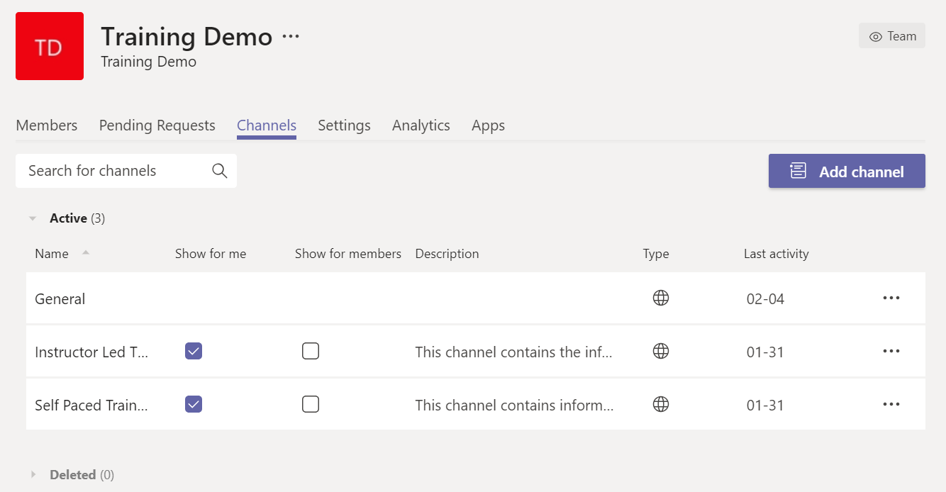
Add a Channel
Add a Channel – Method 2
Select the Channels tab
Click Add channel

Slide 8
Add a Channel
Enter a Channel name
Enter a Description for the channel
Select the Privacy of the channel
  Standard – accessible to everyone on the team
  Private – only accessible to members you invite
Select whether or not you want the channel to automatically show the channel in everyone’s list
  NOTE: if you do not select this option, the channel will appear as a hidden channel in the team list and users will have to “Unhide” the channel to view it
Click Add to create the channel

Slide 9
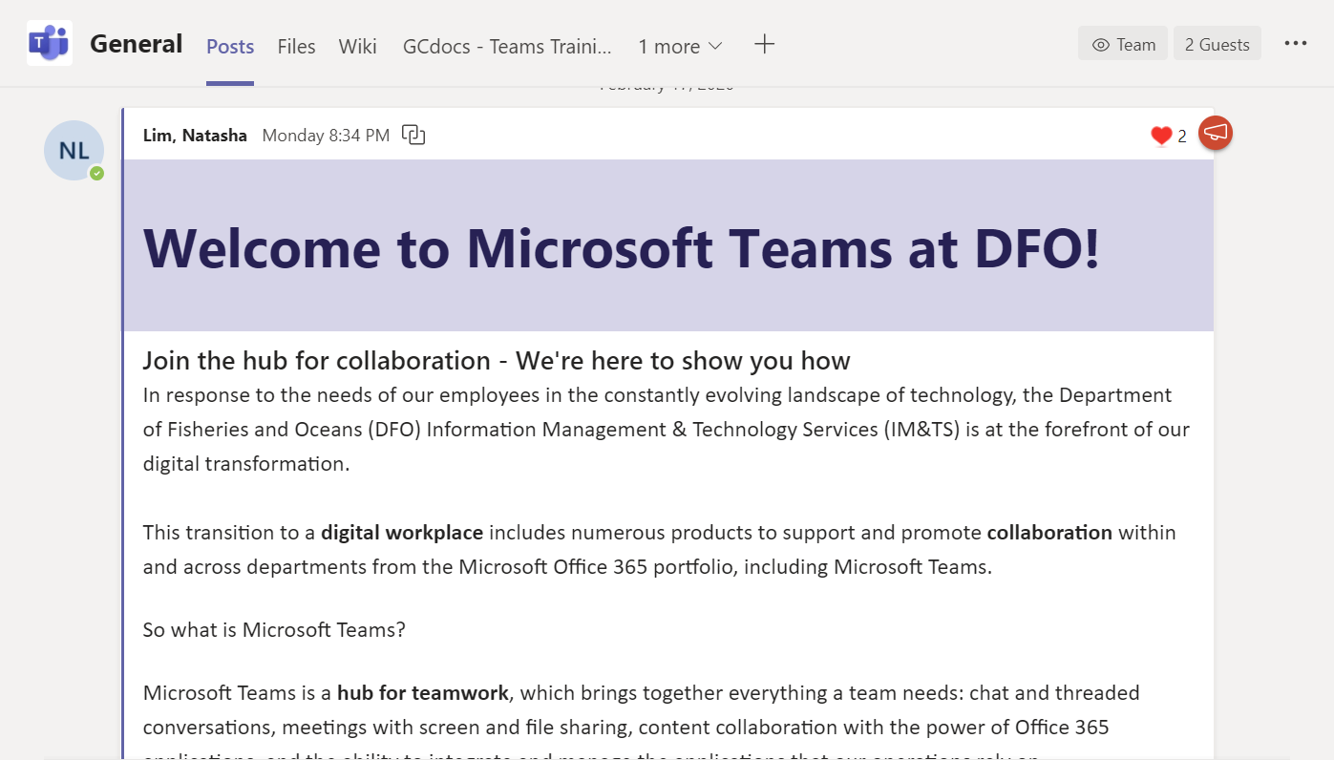
Teams and Channels
At the top of each channel, you’ll find tabs – these are links to the channel’s posts, files, apps, services, and sites. Each channel automatically comes with a
Posts tab
Files tab
Wiki tab

Slide 10
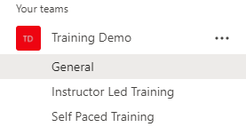
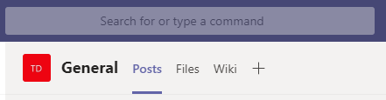
Add a Channel Tab
To Add a New Channel Tab
Click on the channel you want to add the tab to
Click on the + at the top of the channel beside the other tabs

Slide 11
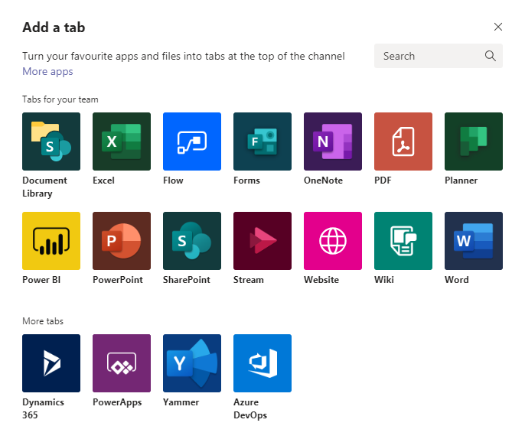
Add a Channel Tab
From here, you can select what type of tab you would like to add:
  An Excel spreadsheet
  A OneNote notebook
  A Planner project plan
  A PowerPoint presentation
  A website
  A Word document
We highly recommend adding the relevant Gcdocs folder to your channel tabs
Click Website

Slide 12
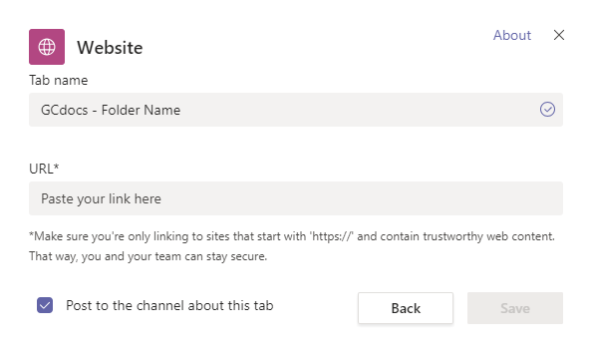
Add a Channel Tab
Go to the relevant GCdocs folder in your web browser and copy the URL
Enter the Tab Name using the naming convention GCdocs – Folder Name
  Ex. GCdocs – Teams Training Documents
Paste the URL in the URL box
Select whether or not you want to Post to the channel about the tab
Click Save

Slide 13

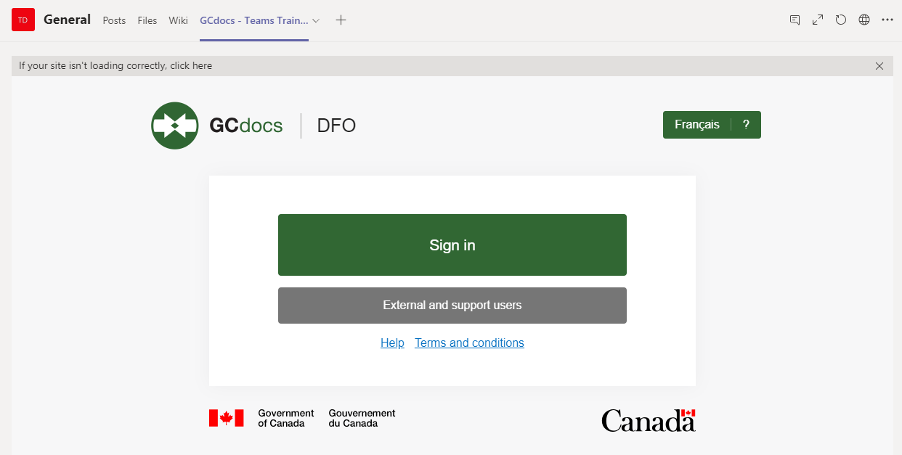
Add a Channel Tab
The tab should now be added at the top of the channel
Click on the tab to access it
You will be prompted to Sign In as usual

Slide 14
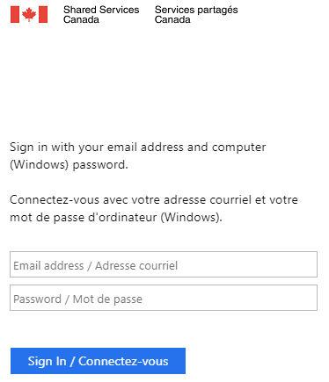
Add a Channel Tab
Sign in with your credentials

Slide 15
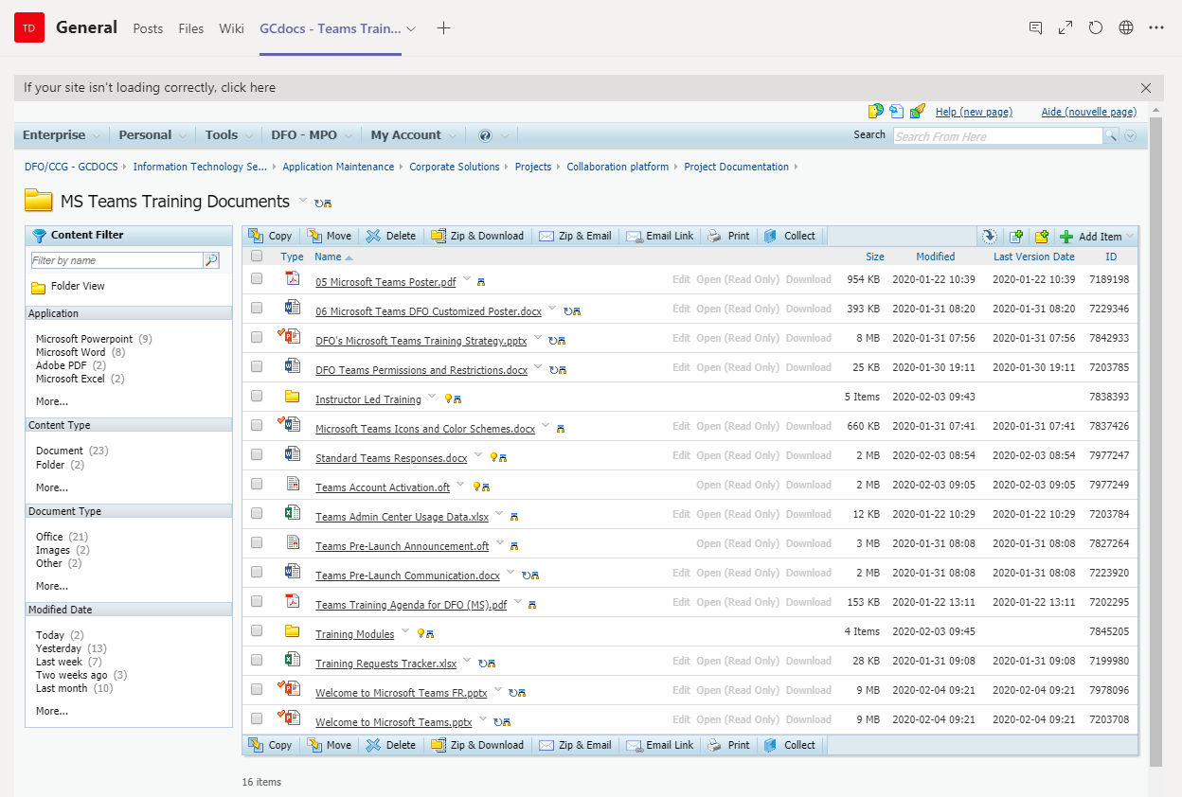
Add a Channel Tab
The GCdocs folder will then open in Teams
You can still drag/drop to add/update files in the folder and should have the full functionalities that the website offers

Slide 16

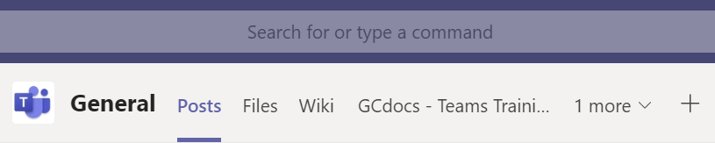
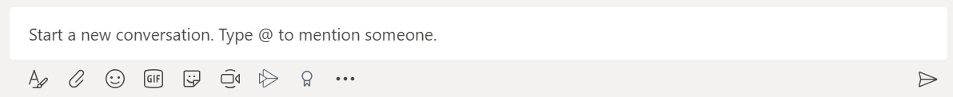
Post in a Channel
Post a New Conversation/Announcement
At the top of the channel, click on the Posts tab
Click in the start a new conversation box at the bottom of the window

Slide 17
Post in a Channel
Post a New Conversation/Announcement
When posting you can select any of the following options (and more):
  Format the message
  Add attachments
  Add emojis
  Add GIFS
  Add stickers

Slide 18
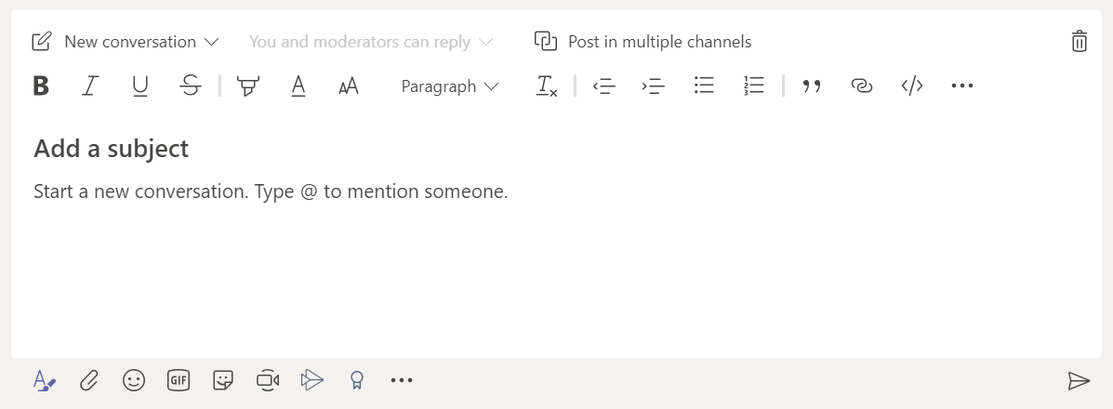
Post in a Channel
Post a New Conversation/Announcement
By clicking Format you have the following options:
  Post as a
    New conversation
    Announcement
  Post in multiple channels
  Add a Subject heading

Slide 19
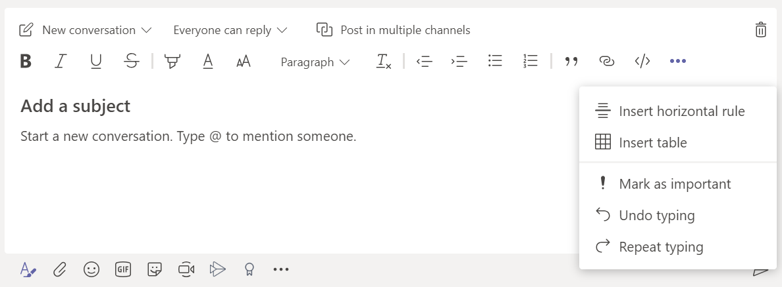
Post in a Channel
Post a New Conversation/Announcement
By clicking Format you have the following options:
  Format the message
    Font formatting
    Bullet points
    Numbered lists
    Insert a horizontal line
    Insert a table
  Mark as Important

Slide 20
Post in a Channel
Post a New Conversation/Announcement
Once you are satisfied with your message click on the Arrow or press Enter to send

Slide 21
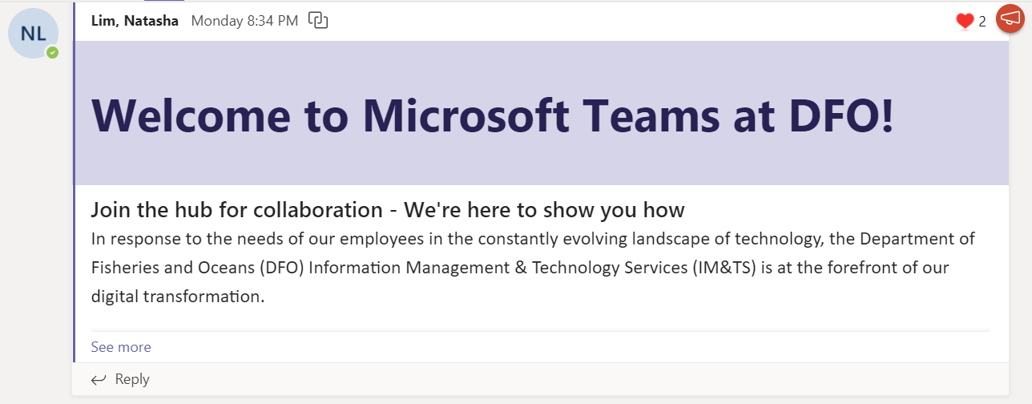
Post in a Channel
Reply to a Thread
To continue a conversation instead of creating a new one, you can reply to a conversation thread:
Find the thread you want to reply to
At the bottom of the post, click on the Reply bar

Slide 22
Post in a Channel
Reply to a Thread
When replying you can select any of the following options (and more):
  Format the message
  Add attachments
  Add emojis
  Add GIFS
  Add stickers

Slide 23
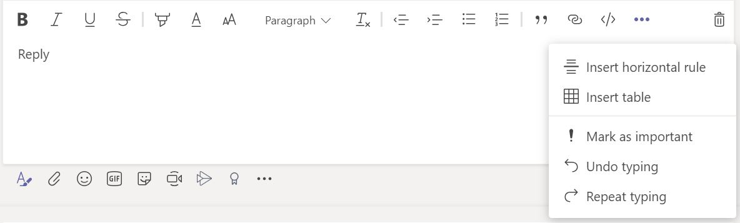
Post in a Channel
Reply to a Thread
By clicking Format you have the following options:
  Format the message
    Font formatting
    Bullet points
    Numbered lists
    Insert a horizontal line
    Insert a table
  Mark as Important

Slide 24
Post in a Channel
Reply to a Thread
Once you are satisfied with your message click on the Arrow or press Enter to send

Slide 25
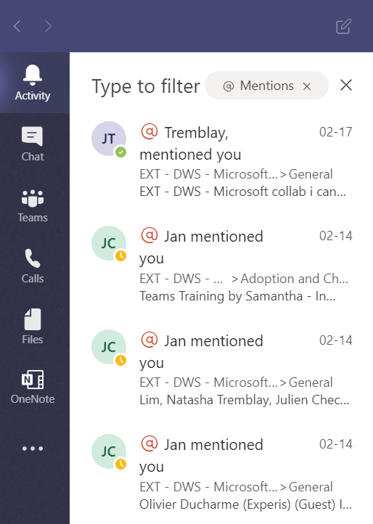
@mention
@mention a Person/Channel/Team
An @mention is a way to get someone’s attention in a channel conversation or a chat.
They can also be used to get the attention of an entire team or channel in a channel conversation (but cannot be done in a chat).
@mention notifications will show up in the recipient’s Activity feed.

Slide 26
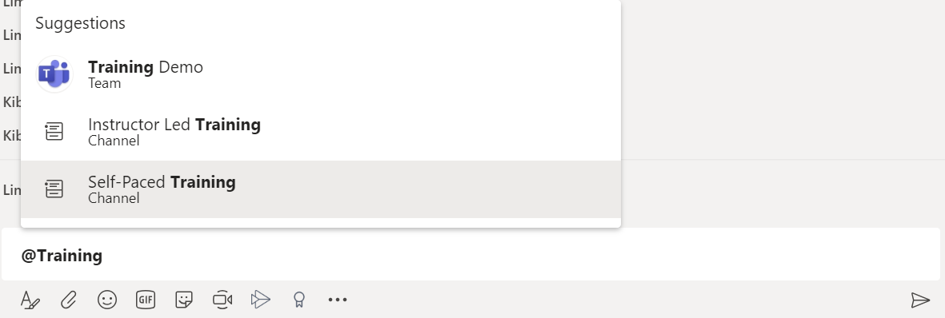
@mention
@mention a Person/Channel/Team
To @mention a person, channel, or team:
In the message box (of a chat or a channel conversation) type @[the name of the person/channel/team you want to @mention]
Select the correct recipient(s) of the @mention
Once you have completed your message click on the Arrow or press Enter to Send
NOTE – you can @mention a person/channel/team in a channel post, but in a chat message you can ONLY @mention people that are in the chat

Slide 27
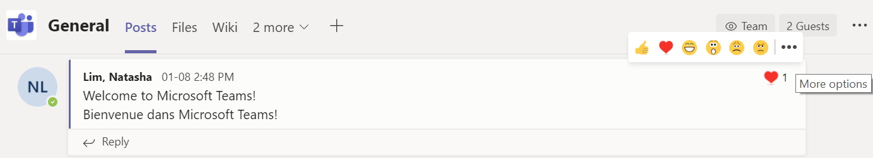
More Options for Posts
Edit your Posts/Messages
If you want to edit one of your posts/messages:
Hover over the top right corner of the post
Click the three dots for More options

Slide 28
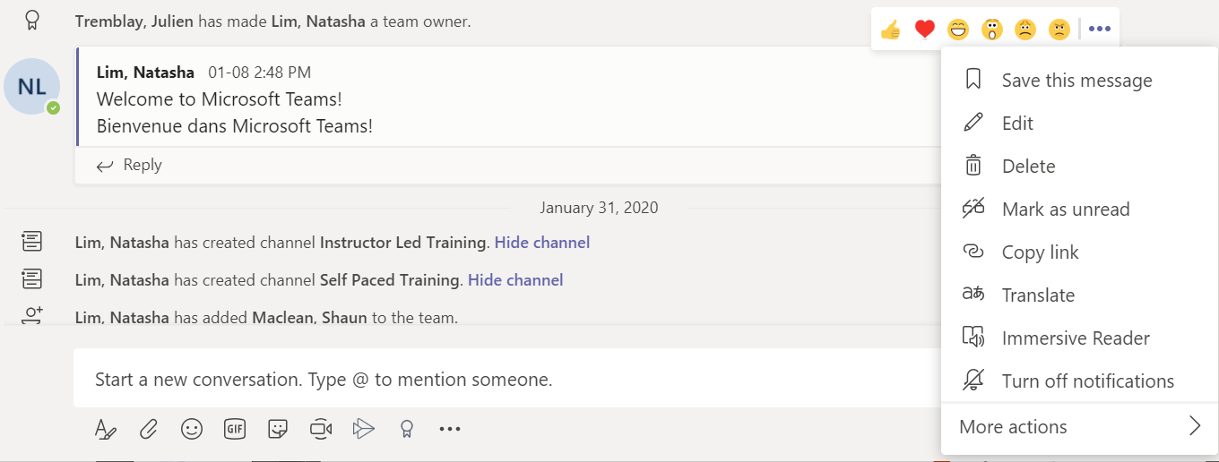
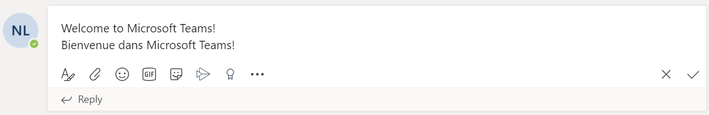
More Options for Posts
Edit your Posts/Messages
Select Edit
Make the desired revisions to the post/message
Click the checkmark to update the post/message

Slide 29
More Options for Posts
Like or React to a Post/Message
Hover over the top right corner of the post/message
Click the reaction you would like to use
  Like
  Heart
  Laugh
  Surprised
  Sad
  Angry

Slide 30
More Options for Posts
Save a Post/Message
Hover over the top right corner of the post/message
Click the three dots for More Options
Select Save this message

Slide 31
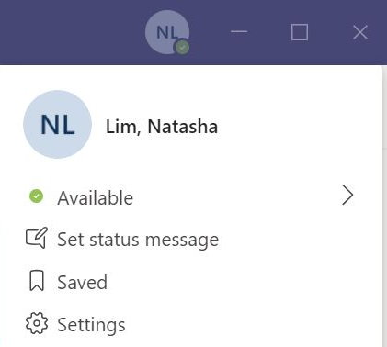
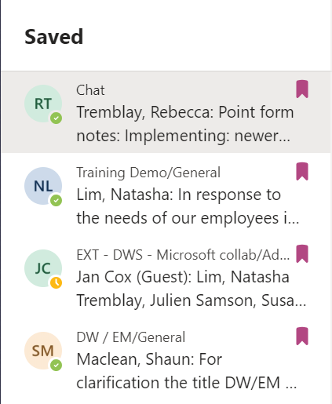
More Options for Posts
Save a Post/Message
Your saved messages can then be accessed from your Profile.
Click on the saved message to view it in the full context of the chat or channel post.
To un-save the message, click on the ribbon icon.

Slide 32
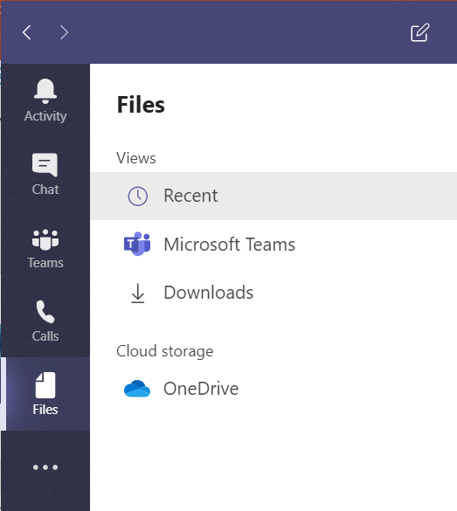
Collaborate on a File
Working on files with a colleague, or an entire team, is easy in Microsoft Teams.
Files can be shared in:
Channel posts (backed in SharePoint)
Channel files tab (backed in SharePoint)
Chat conversations (backed in OneDrive)

Slide 33
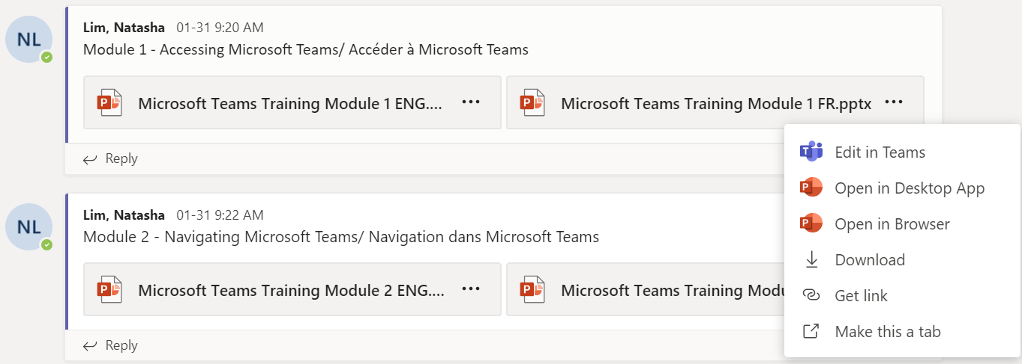
Collaborate on a File
To Open a File Shared in a Channel Post
Click on the file to open it directly in Teams OR click on the three dots for more options beside the file name to:
  Edit in Teams
  Open in Desktop App
  Open in Browser
  Download
  Get link
  Make this file a tab

Slide 34
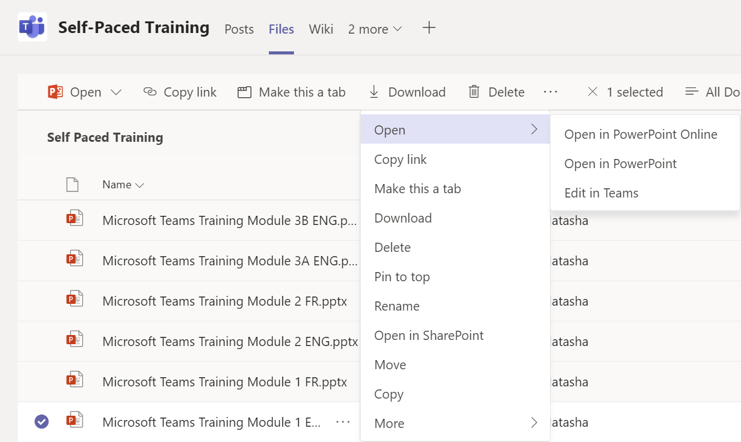
Collaborate on a File
To Open a File Shared in a Channel’s Files Tab
Click on the file to open it directly in Teams OR click on the three dots for more options beside the file name to open in:
  SharePoint
  Online Browser
  Desktop Application
  Teams

Slide 35
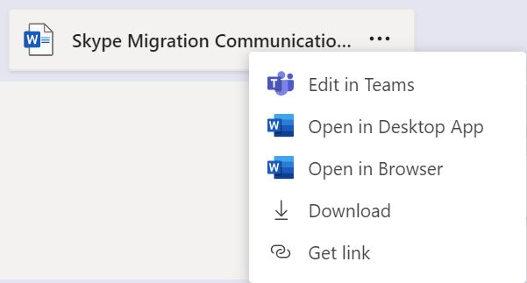
Collaborate on a File
To Open a File Shared in a Chat
Click on the file to open it directly in Teams OR click on the three dots for more options beside the file name to:
  Edit in Teams
  Open in Desktop App
  Open in Browser
  Download
  Get link

Slide 36
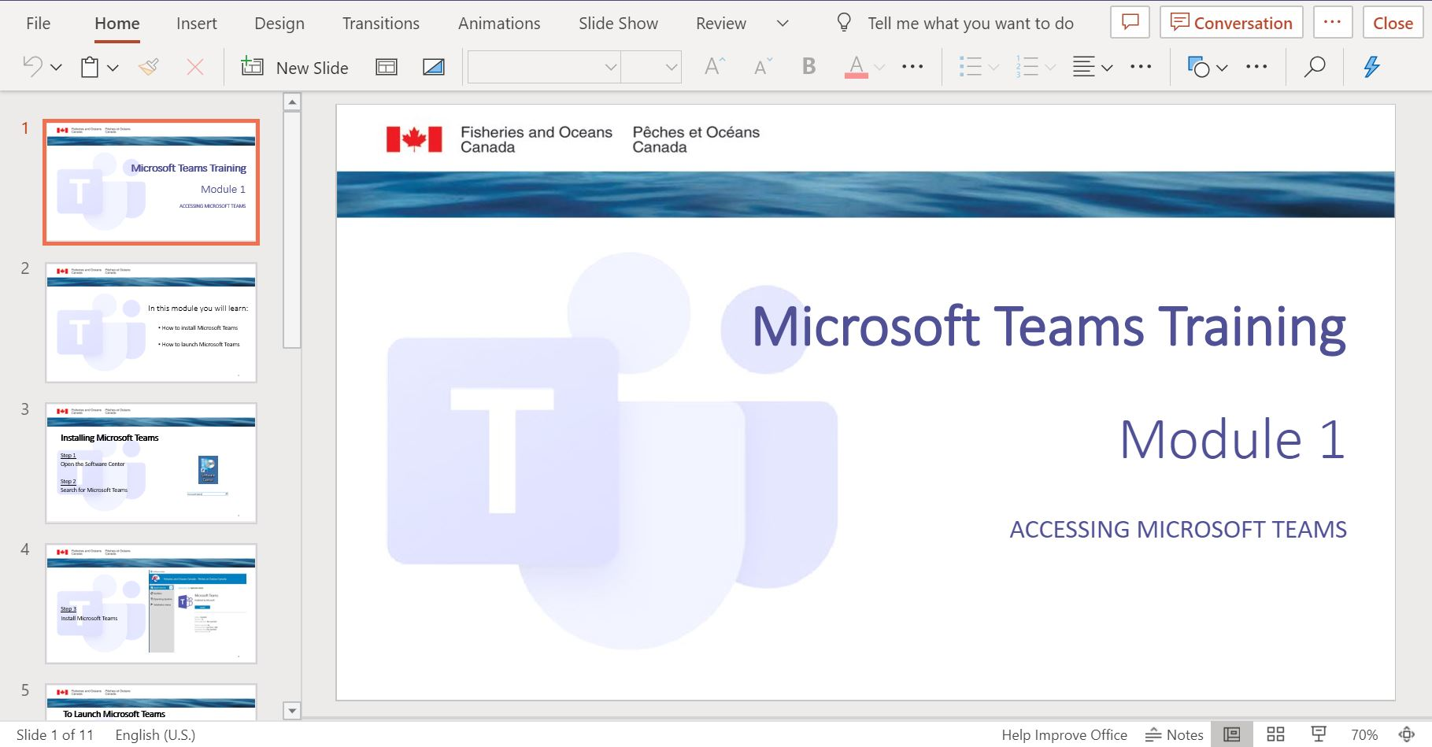
Collaborate on a File
To Collaborate on a File in Teams
You can also have a real-time discussion on the document while viewing/editing, without having to leave the file, by clicking on Conversation.
Make any additions or changes as desired, all updates will be automatically synced and saved in either SharePoint or OneDrive (depending on how the file was shared).

Slide 37
Congratulations!
You should now understand how to work effectively in Teams and Channels.
Start collaborating!
Join us in the next learning module Communicating in Teams
For questions or feedback please contact DFO.IMTS.DWS-SEN.GIST.MPO@dfo-mpo.gc.ca

