Slide 1
Digital Accelerator
Vik Pant, PhD, Chief Scientist and Chief Science Advisor, Natural Resources Canada

Slide 2
Our Objectives and Accomplishments
1
Recruit and Develop a Top Talent Team of Data Scientists Grow a data science team as well as mentor and coach team members
2
Accelerate value realization from advanced analytics Realize and deliver value propositions based on applications of data science
3
Nurture a Digital-Driven Culture Lead key initiatives to foster digital quotient and data acumen in the enterprise
4
Develop Strategic Partnerships Grow a partner ecosystem and value constellation based on win-win outcomes
5
Build Capability for AI governance Responsible integration of advanced analytics solutions & technologies

Slide 3
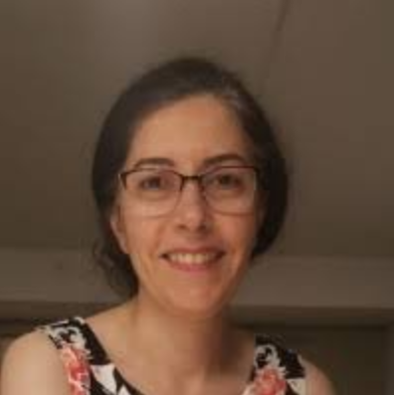
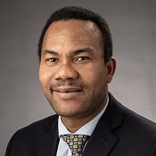
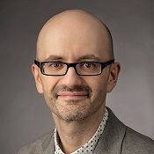
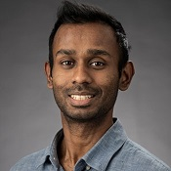
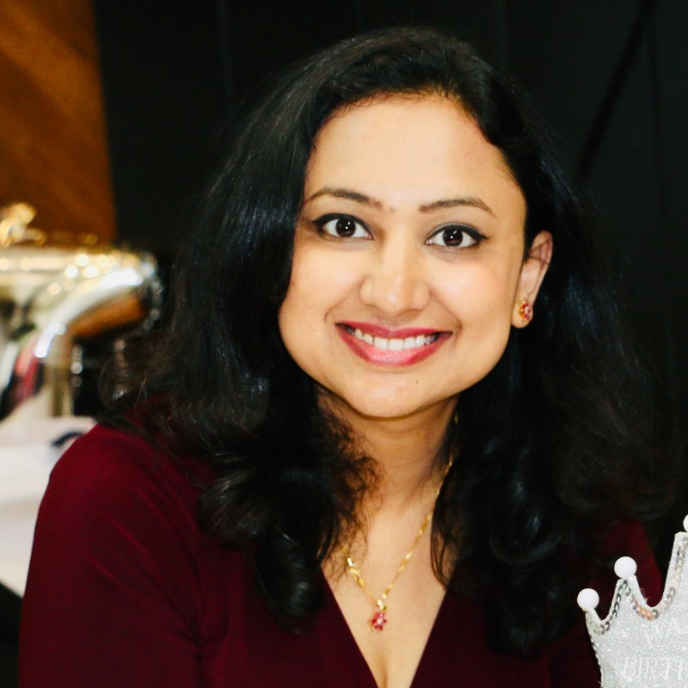
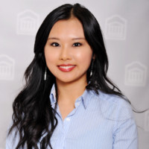
Our Data Scientists
Hospice Houngbo
PhD (CompSci)
Mitra Danesh
PhD (Engineering)
Alexei Lapouchnian
PhD (CompSci)
Krishan Rajaratnam
PhD (Math)
Mansi Jain
Human-centred Data Science
Lydia (Youjing) Li
Human-centred Data Science & UX
Lydia Jeong
Information Systems & Design
Ciara Zogheib
Knowledge & Information Management

Slide 4
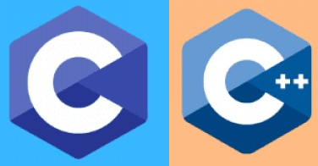
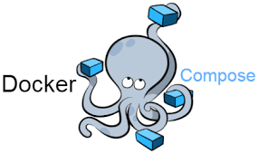
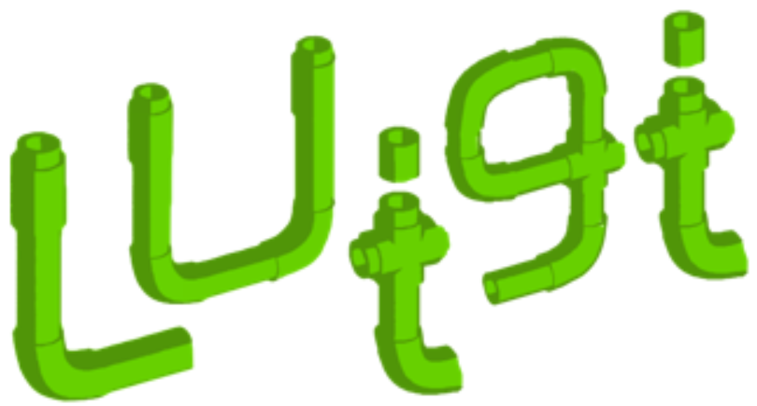
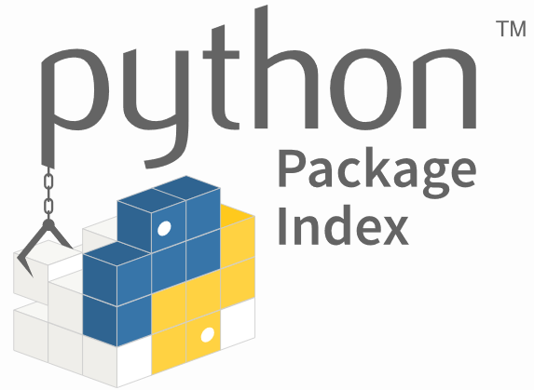
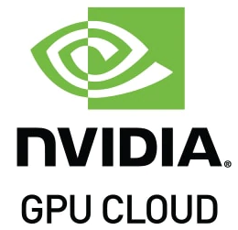
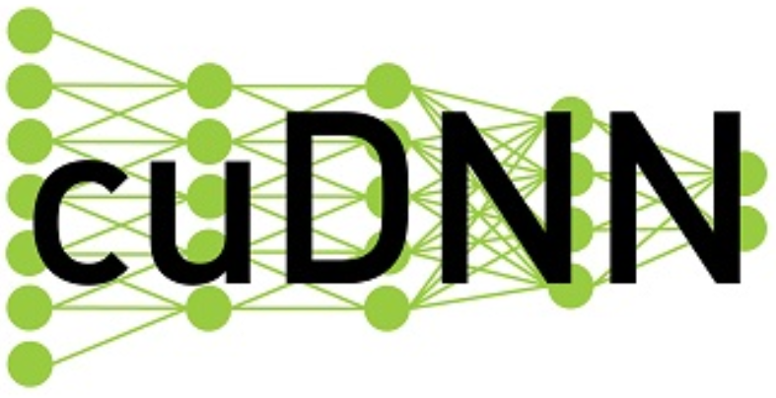
Code Repository
and
Runtime
Ship
Containers
Client Requirements
Local Development
Load
Containers
Artificial Intelligence Software
Tests
and
Experiments
Test
Containers
Visualization packages:
Package sources:

Slide 5
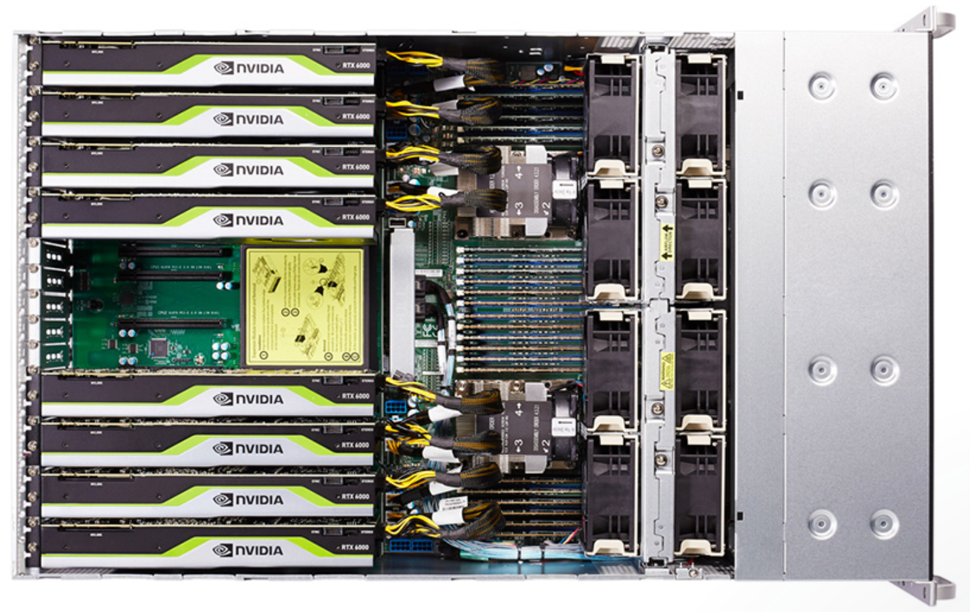
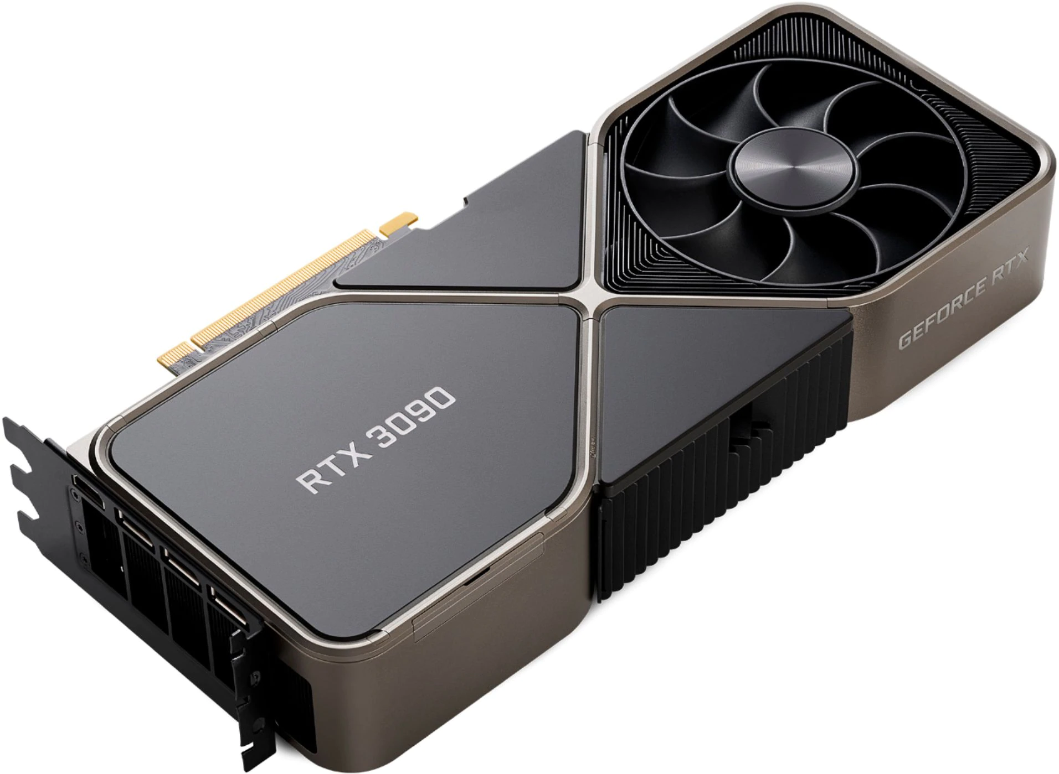
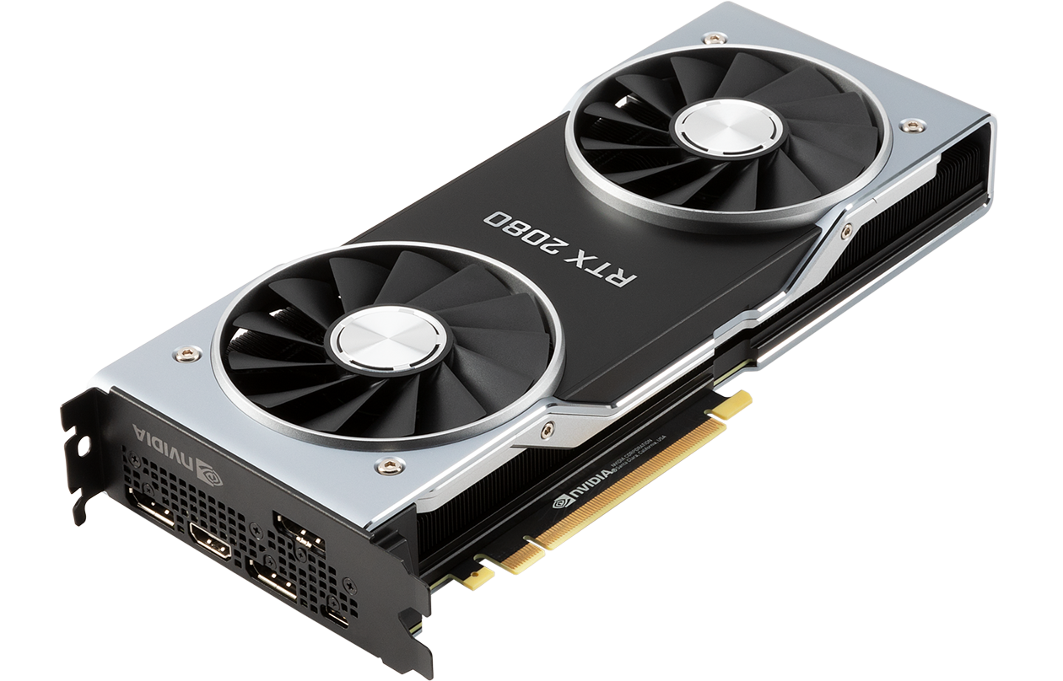
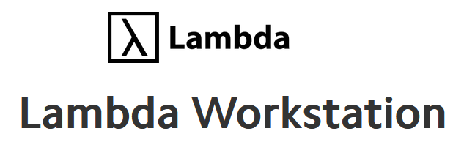
High Performance Computing

Slide 6
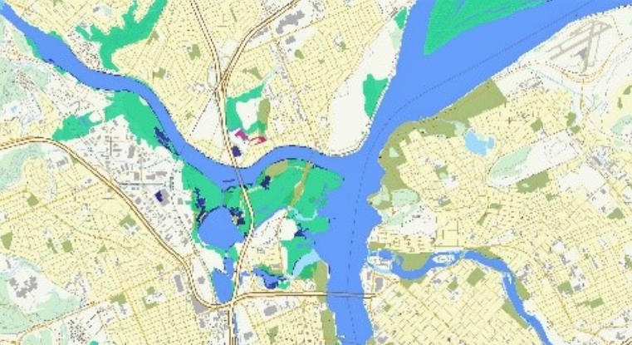
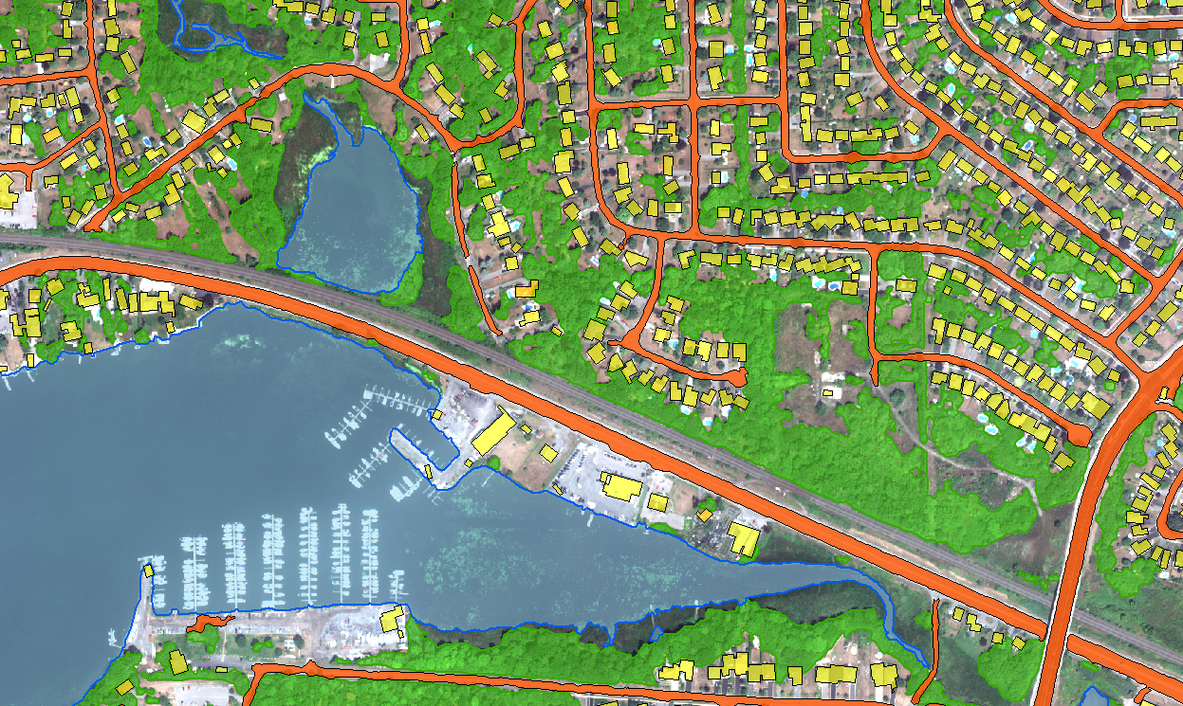
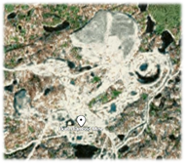
Space-based Earth Observation and
Location Intelligence
Flood Mapping
Goal: Segmentation of satellite imagery to assign land cover classes to pixels
Approach: Ensemble of Artificial Neural Networks for Semantic Segmentation and Instance Segmentation
Mining Risk Mitigation
Notes:
Mandate letter – flood plain mapping

Slide 7
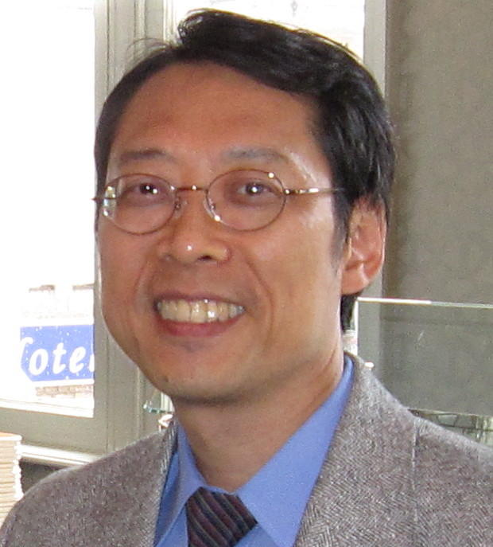
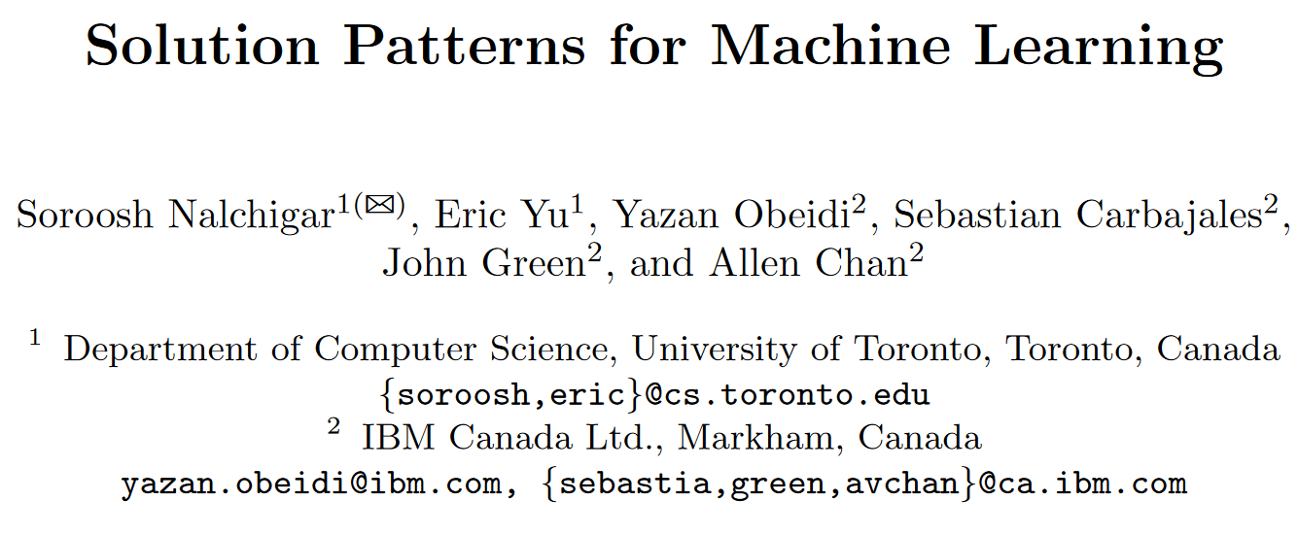
A Framework for Strategic Valuation of Data and Digital Assets
Soroosh Nalchigar, PhD
Eric Yu, PhD
Notes:
This brings me to the framework that I would like to showcase in this talk
It is a framework that has been purposefully designed for Aligning Organizational Strategies with AI Capabilities
We have starting applying this framework in NRCan to architect and design solutions that map technical decisions back to organizational goals and vice versa
This framework was developed by my PhD supervisor at the University of Toronto, Professor Eric Yu, and my research colleague, Soroosh Nalchigar, who is now working at Google
I will present a high level overview of this framework and would encourage you to contact use if you would details about our journey in NRCan as we adopt this framework
BTW, you will note from the affiliations of their co-authors on some these research papers that part of this research was done with the support and participation of IBM

Slide 8
Advancing a Digitally Driven Culture
Coordinated working sessions with over 20 federal departments and agencies to share the NRCan DA roadmap and blueprint
Built a Data Science Community of Practitioners
Lead or contributed to over 20 conference, webinars and other engagements to share insights with OGDs, stakeholders and external audiences
Convened over 30 sessions for knowledge sharing and collaborative learning with the Synthetic Intelligence Forum
Allowed to develop and grow an ecosystem of thought leaders, stakeholders, policy makers and other key actors, creating opportunities for new partnerships.

Slide 9
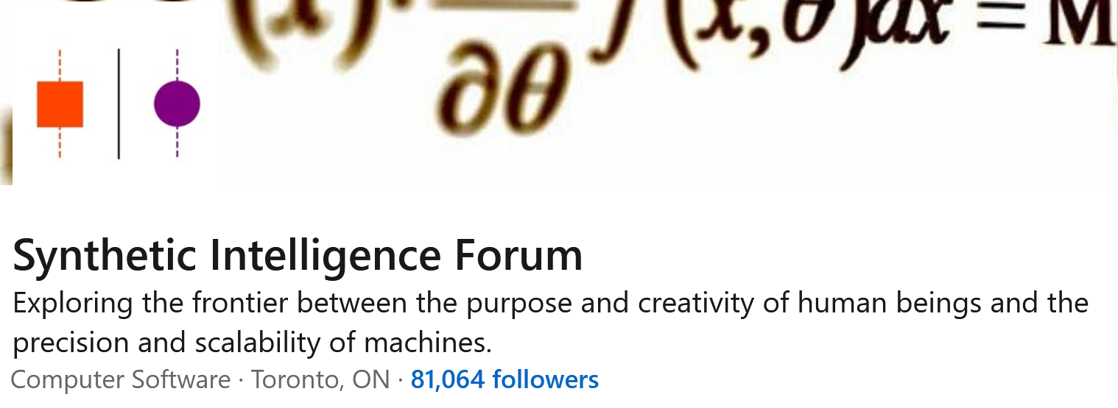

Slide 10
August 25th 2021
September 1st 2021

Slide 11
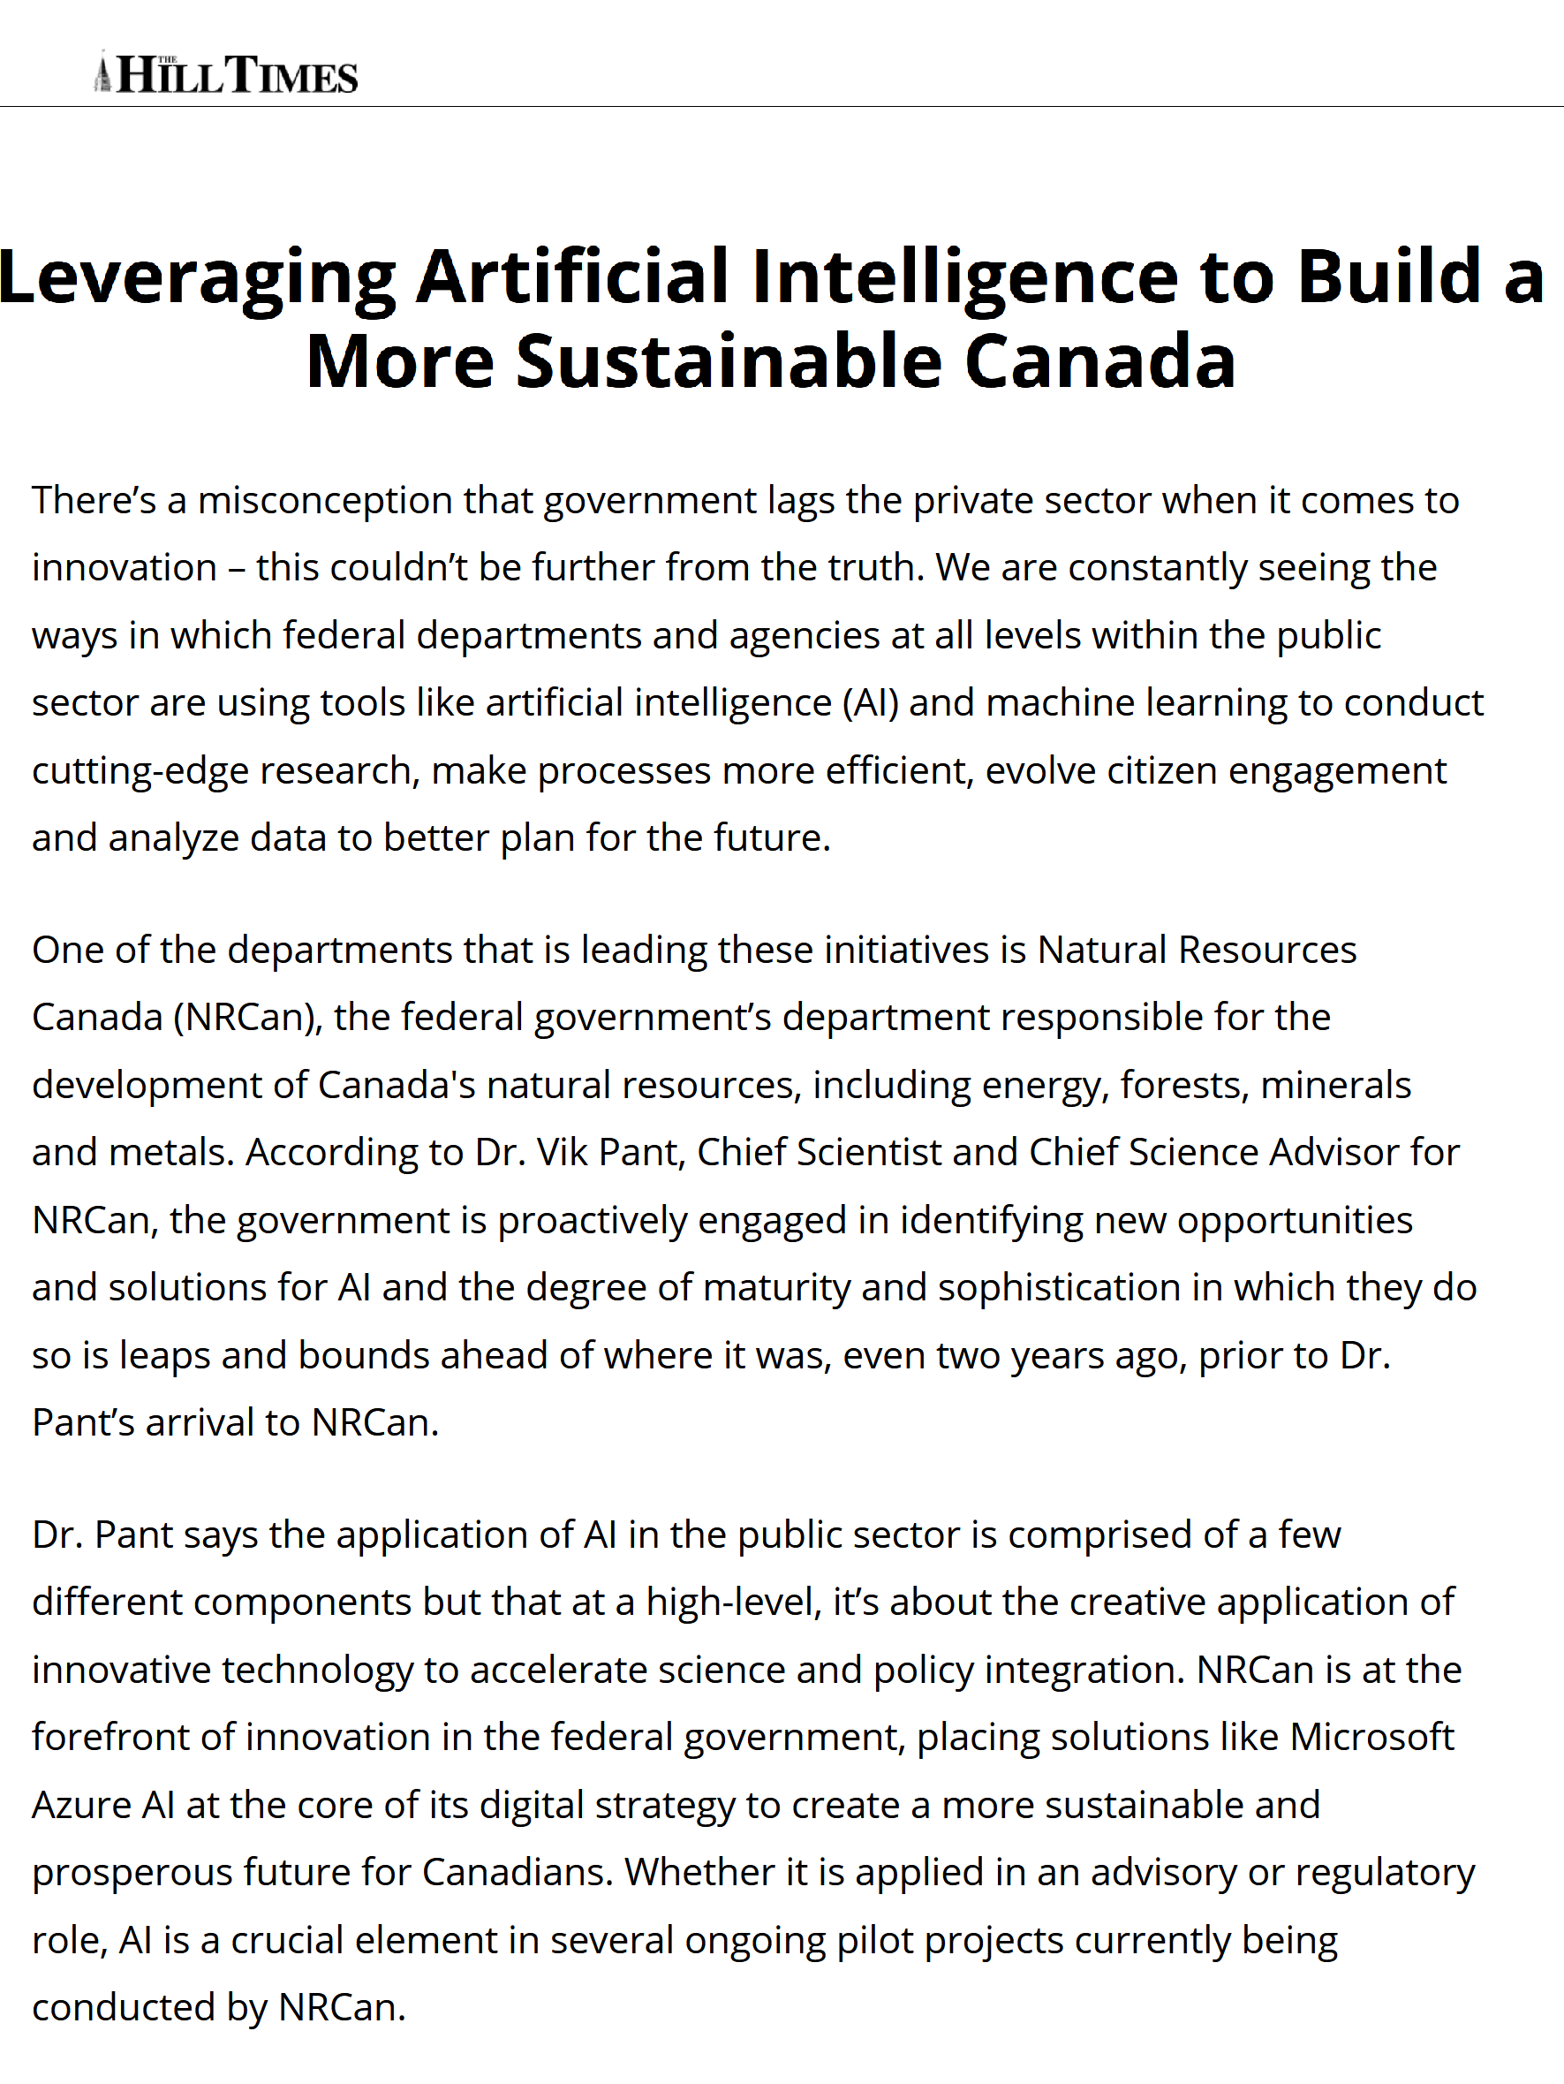
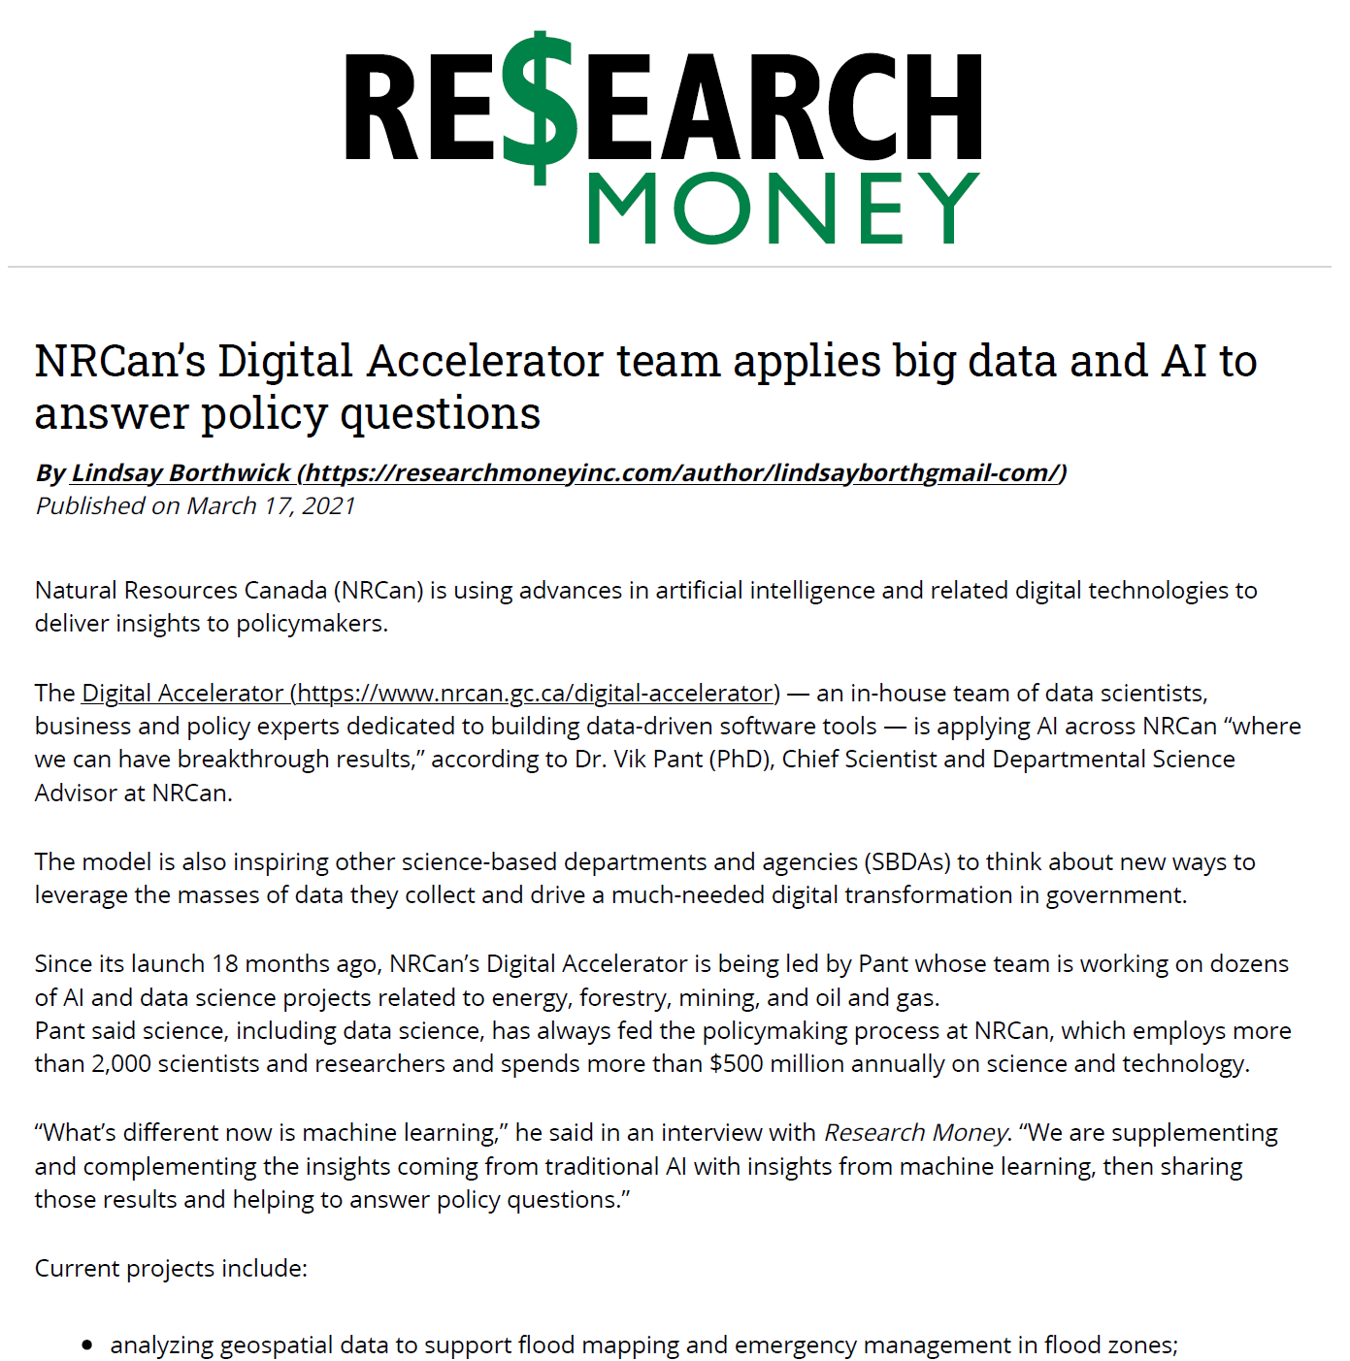
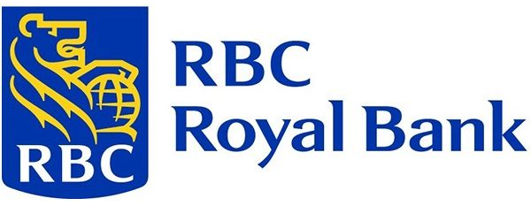
Digital Accelerator Strategic Partnerships

Slide 12
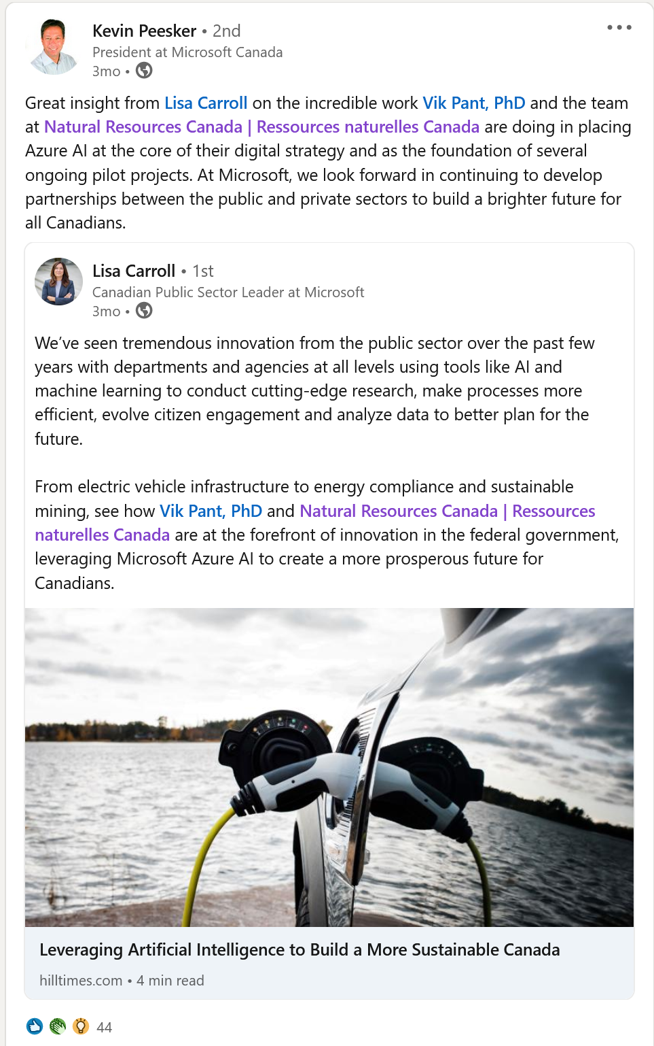
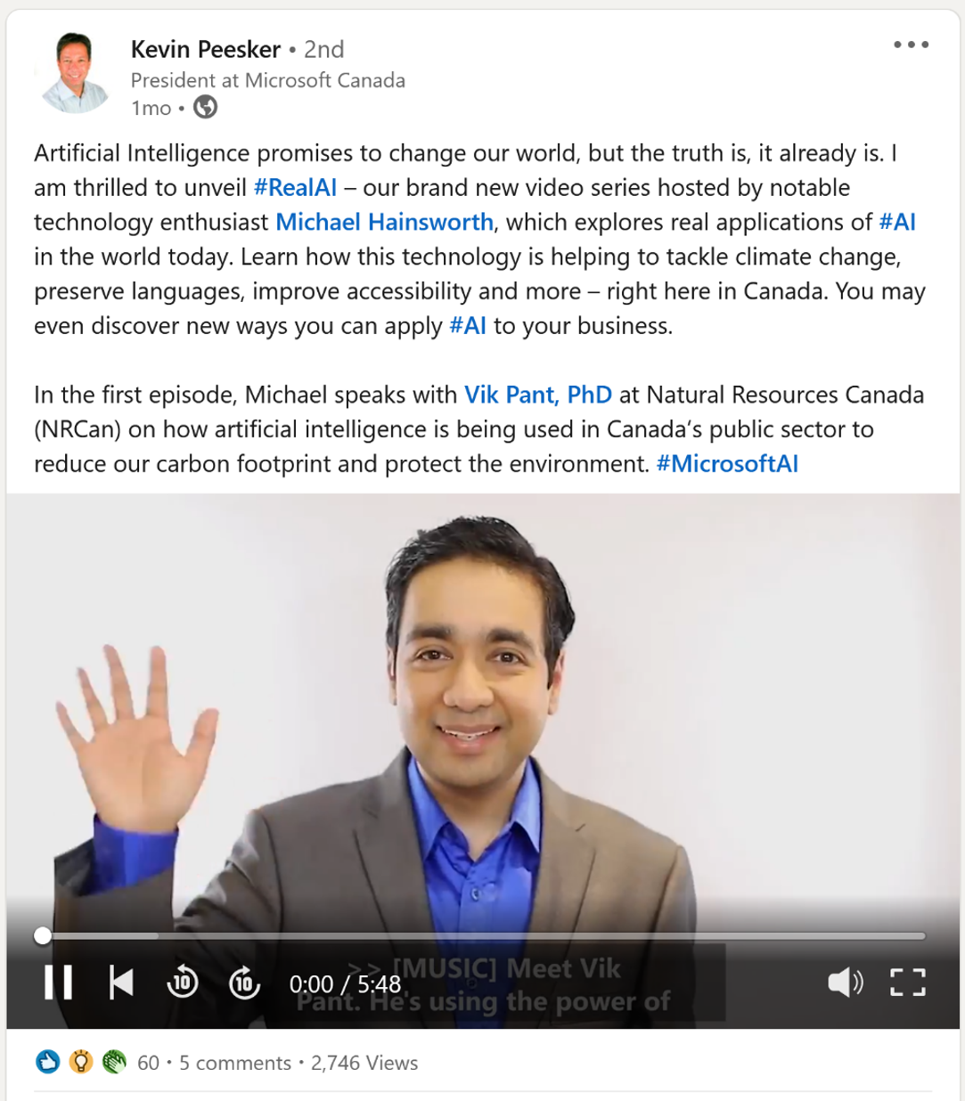

Slide 13
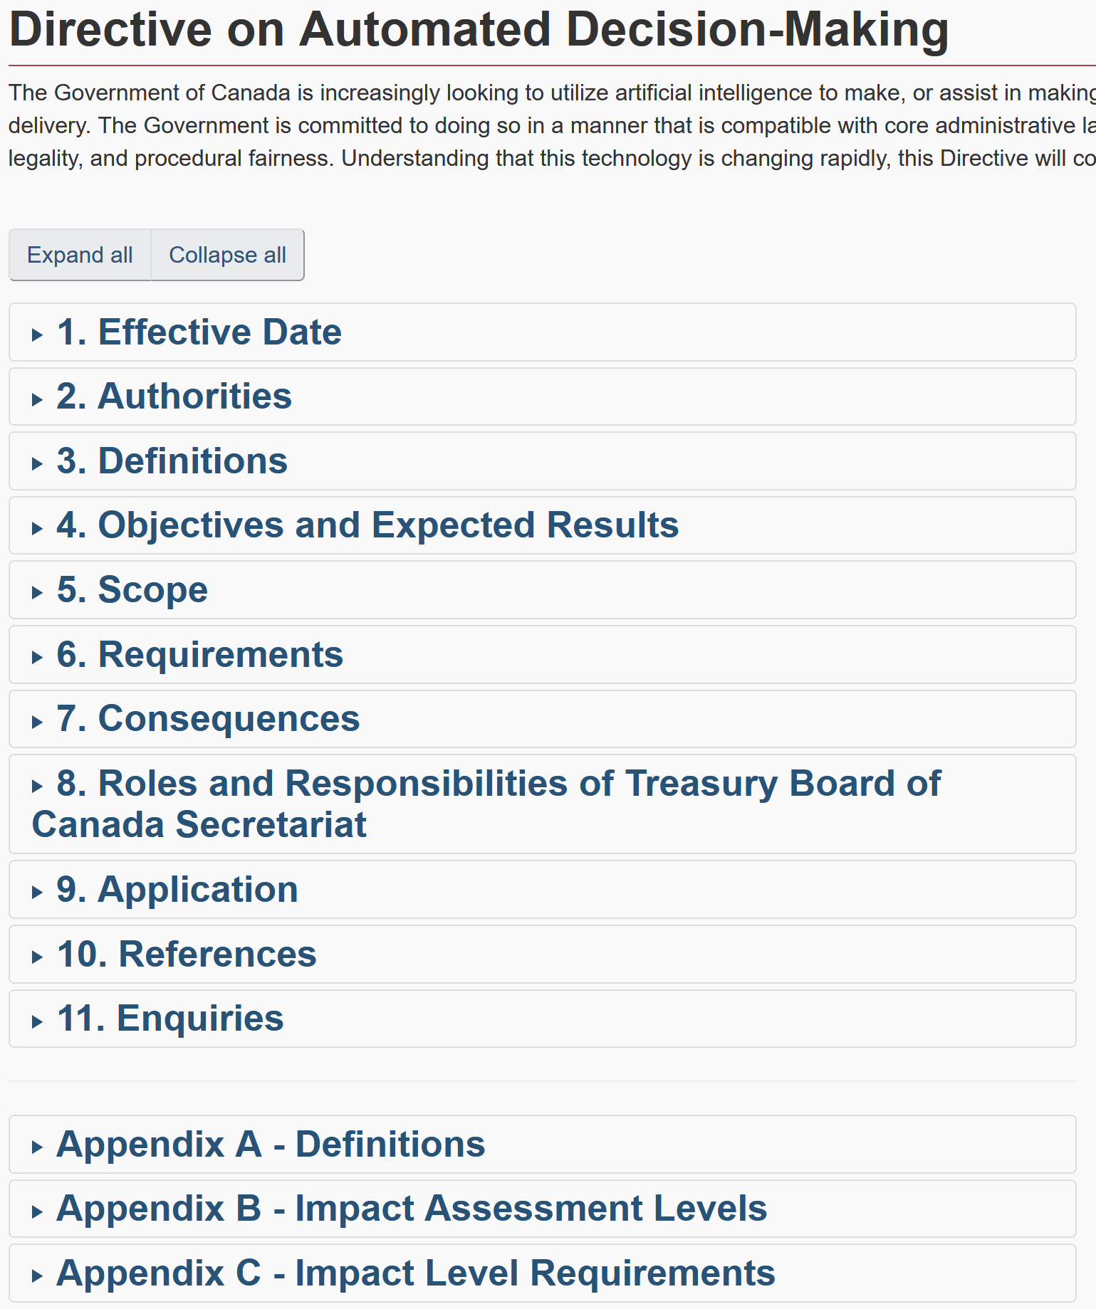
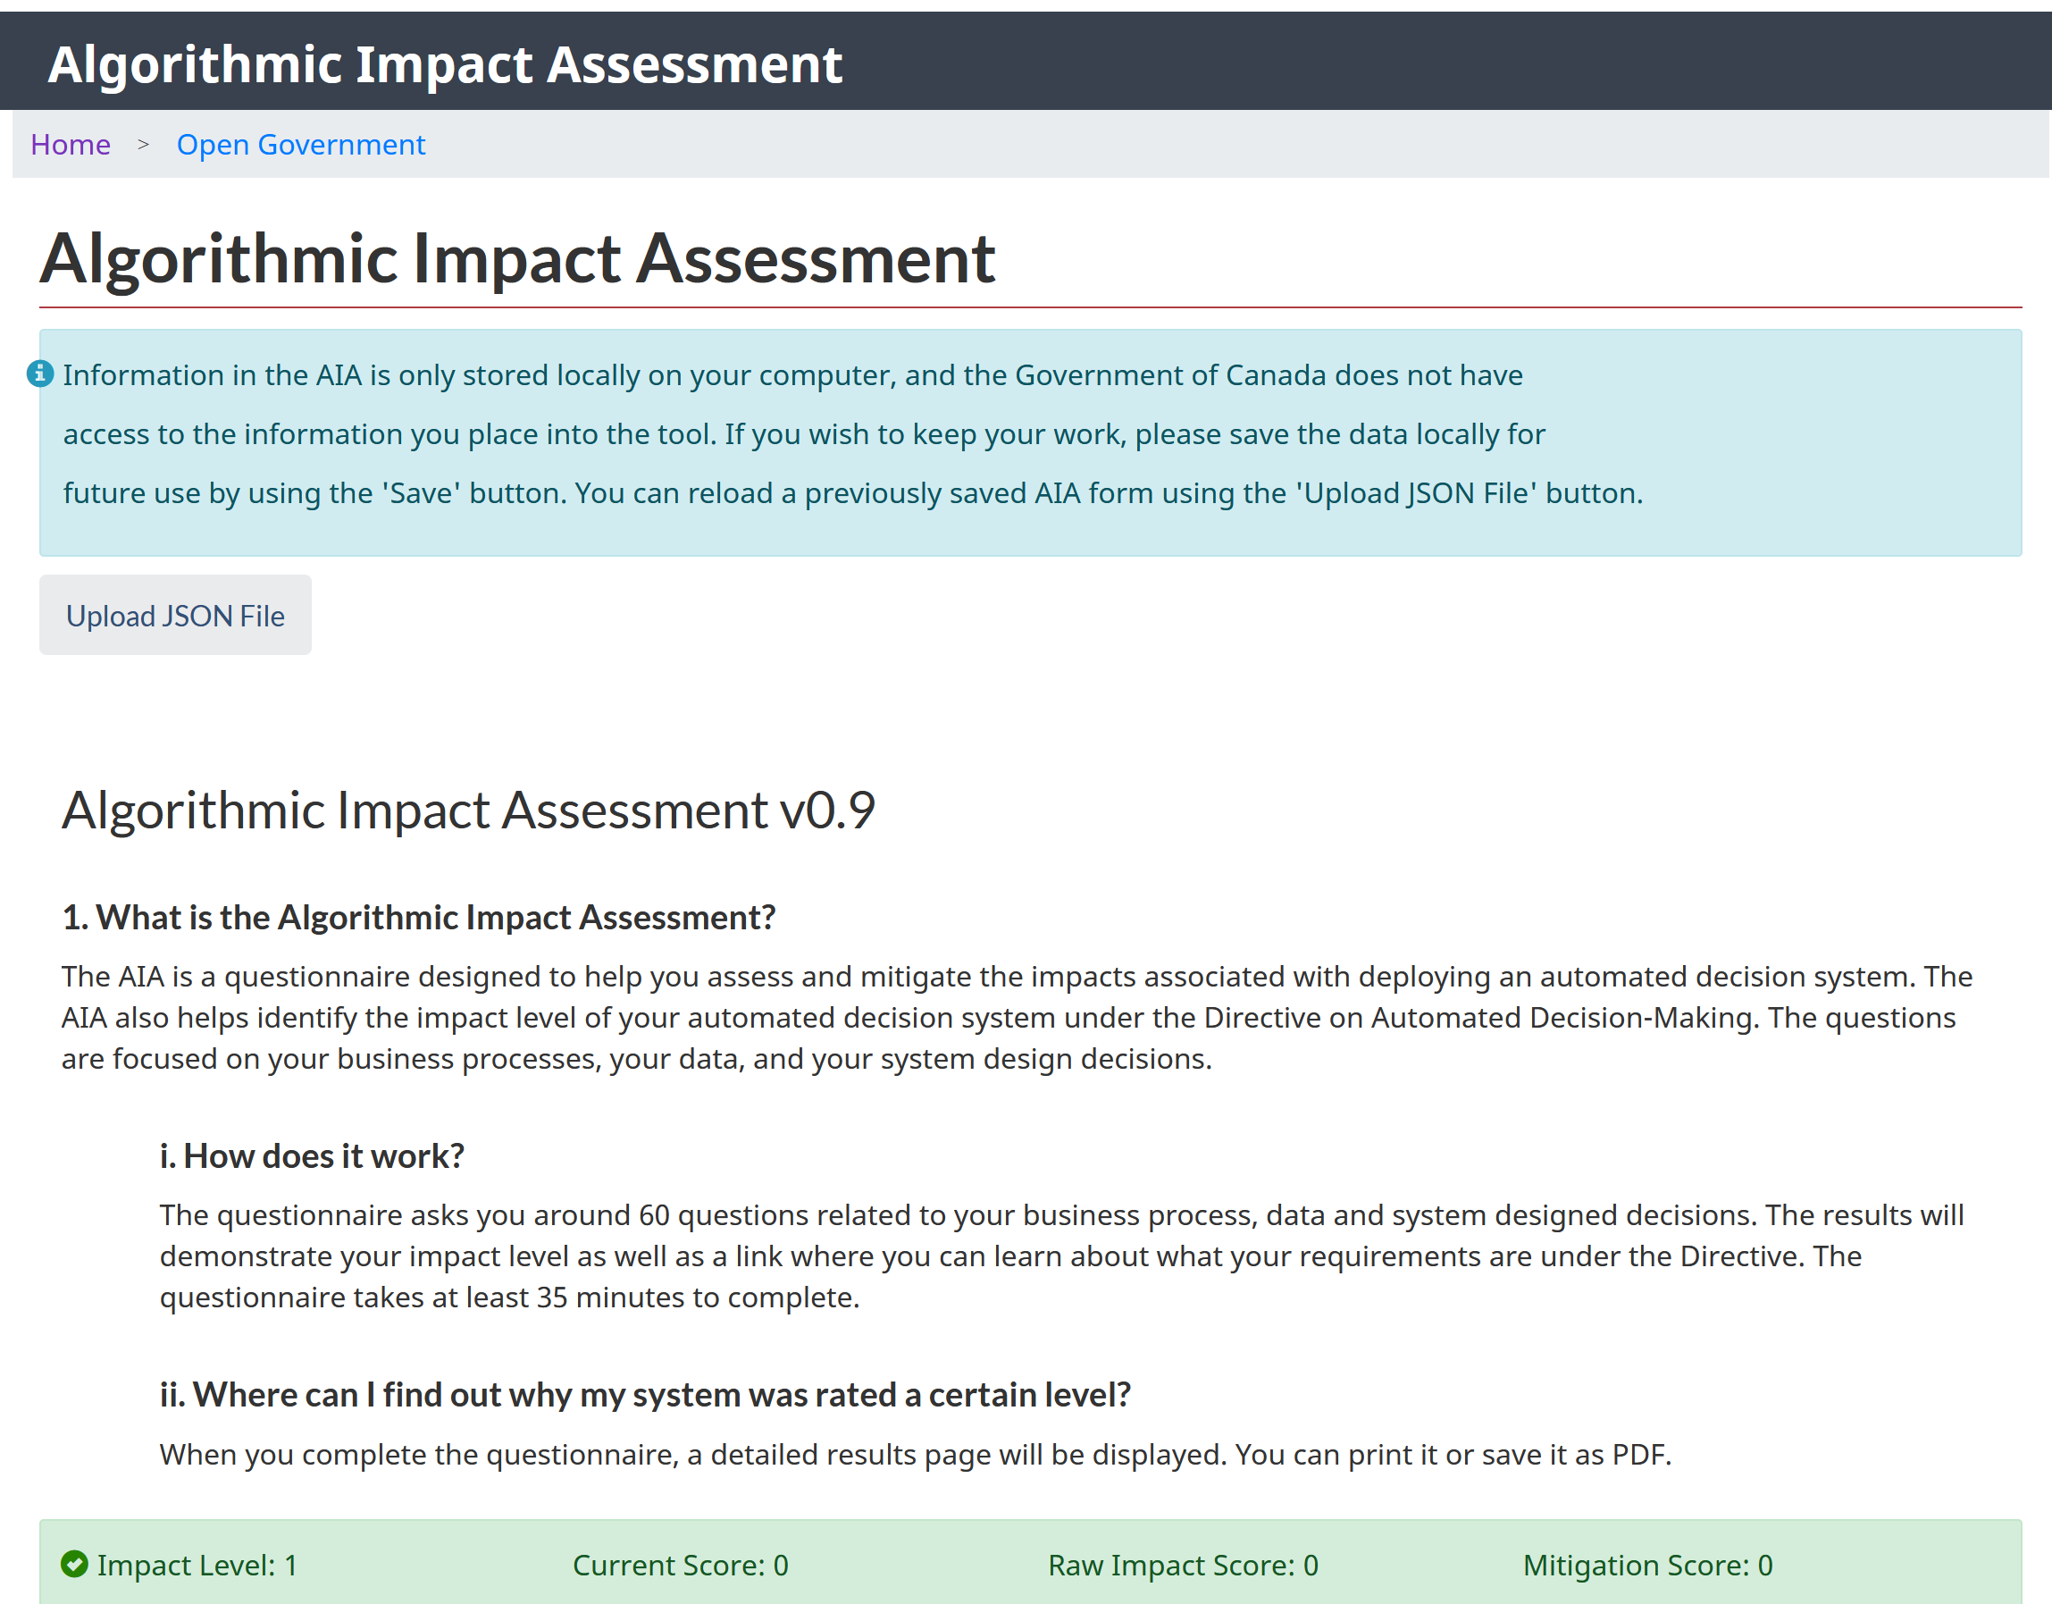
Digital Accelerator Governance

Slide 14
Thank you
Contact us at
https://www.nrcan.gc.ca/digital-accelerator
nrcan.digital-numerique.rncan@canada.ca

