Slide 1
Bill C-58 Implementation Workshop
Proactive Publication of Transition Binders
Case Study: TB Secretary Transition
June 19, 2018
GCDOCS#: 31243854

Slide 2
Proposed New Legislative Requirement
On behalf of Ministers’ offices, Departments and agencies to proactively publish:
Briefing packages prepared by the institution for new or incoming Ministers (s.74(a)) | Within 120 days after appointment
Departments and agencies to proactively publish:
Briefing packages for new or changing deputy heads (s.88(a)) | Within 120 days after appointment
Would not require the release of information that would normally be withheld in a response to an access to information request, such as personal and confidential information (sections 80 and 90)

Slide 3
Understanding the requirement
Make publicly available, within 120 calendar days following their appointment, the briefing materials used to enable a new minister or deputy head to assume their new responsibilities
Briefing materials for this purpose are required to be proactively published even if they are already publicly available
Example: Government appoints J. Doe as deputy head effective June 15, 2018. Briefing materials would need to be proactively published within 120 days after that date or
by October 13, 2018.

Slide 4
Understanding the requirement (cont’d)
The same exemptions and exclusions that would be applied in response to an access to information request would also apply to proactively published materials
Information provided under Part 2 can still be requested through a formal access to information request under Part 1
Not intended to change the information used to brief Ministers and deputy heads

Slide 5
Planning stage
Effective start date of new Secretary
Secretary announces retirement
TIP:
Analyse your needs with
the end product in mind
Jan 24,
2018
April 4,
2018
Immediately following Secretary’s announcement, work began to prepare transition binders with proactive publication in mind
The goal was to collectively develop a business process to deliver the proactive publication of briefing binders within the 120 days after new Secretary was in place
Business process considered:
  Volume of materials
  Content, structure, sensitive information, varying formats
  Coordination needs
  Roles and responsibilities
Notes:
June 7, 2018 meeting quote: ‘’Plan at the beginning; what’s in, what’s out’’
Planning and preparation
Identifying needs
Materials analysis
Volume - With three binders – so many materials to draft and review and approve, factoring in role of ATIP and web
Content – the importance of the format – alleviate redaction and web process – the importance of following templates
How are we going to build the briefing as well as alleviate challenges of proactive publication process
Coordination piece – coordinate, added proactive publication component and complexity added to regular transition process
All of this underlines roles and responsibilities – clear understanding of the respective roles and insuring deadlines expectations with a view – keeping track making sure things are not missed, no duplication of effort
Book 1 - This binder consisted of providing a snapshot of the department, mandate, current priorities, deputy head legal responsibilities; and introductory briefings of each sector in the department.
Book 2 - Geared towards briefing the Secretary on key files or issues of significance importance in his first 100 days.
Book 3 - additional background/supporting material to the Secretary related to the overall management of the department (Internal governance, Human Resource and Finance, etc.)

Slide 6
Production Stage
Effective start date of new Secretary
NOTE:
Content complete, locked down, publication production begins
120 days countdown to Proactive Publication required by date
April 4,
2018
Aug 2, 2018
The effective start date of the new Secretary triggered the proactive publication requirement
With the planning stage complete, the focus of the 120 day production stage was the ATIP review, translation and web coding
It soon became clear that it would be challenging to meet the 120 day deadline, given additional content that was not considered during the planning stage
Notes:
Book 1 - This binder consisted of providing a snapshot of the department, mandate, current priorities, deputy head legal responsibilities; and introductory briefings of each sector in the department.
Book 2 - Geared towards briefing the Secretary on key files or issues of significance importance in his first 100 days.
Book 3 - additional background/supporting material to the Secretary related to the overall management of the department (Internal governance, Human Resource and Finance, etc.)

Slide 7
Creating a Record on Open Government Portal
Once your briefing binder has been created (in HTML or PDF/UA) and is compliant with the Official Language Act and the Standard on Web Accessibility, we ask that you create a metadata record in the Open Government Registry (if you’re publishing the binder on your institutional page).
Creating a record on open.canada.ca ensures that your Briefing Binder will be searchable in one centralized location along with all other proactive publications.
The Open Government team is working to create templates and tools for new proactive publications, both standardized and non-standardized. We will be adding the Briefing Note Titles template to the Open Government Registry shortly.
For details on how to create a record in the Open Government Registry, please refer to the document “Creating a record for Ministerial Transition Binders” on the Proactive Publication GCpedia page.

Slide 8
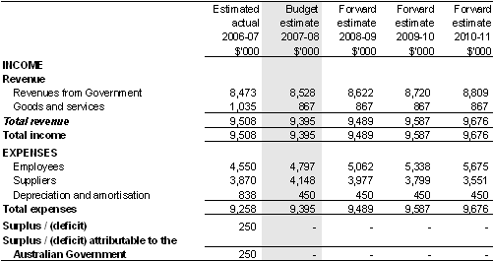
Lessons Learned
Bring the team together early
Strategic Policy
ATIP
Translation
Web
Determine roles and responsibilities
Consult web on use of graphics, diagrams and tables
Provide clear direction to those generating content
Be sensitive to privacy concerns
Grouping sensitive information facilitates more efficient coding and redaction

Slide 9
Annex: 7-Step Proactive Publication Process Map*
1) Production
Day 1 to 10
2) Pre-publication review
Day 11-19
3) Approval
Day 51-72
4) Translation
Day X
5) Web Coding
Day 73-99
7) Publication deadline
Day 100-120
Consolidate information from existing material
Identify publication content for transition binder(s)
identify information that may be subject to redaction
Develop material narratives
Consolidate material
Forward material to ATIP
Day 20 – 50
Consultations with related OPIs
ATIP Director to review/approve OPI recommendations
Ongoing effort
Material to Web Services
Web services to advise materials are ready for coding
Quality control review
6) Pre-publication notifications
Notification to DMO & Corp comms
Web Services posts
Advise org.
Corp. Sec.
*Inspired by draft process map provided by Transport Canada.
Don’t forget: You can access tools, support, model processes, learn from other departments, and share best practices on our GCTools page: http://www.gcpedia.gc.ca/wiki/ATI/PP

Slide 10
Annex: Writing for the Web

Slide 11

Annex: C-58 Proactive Publication Readiness Checklist
In order to be ready for the coming-into-force of Bill C-58, departments should:
Develop business processes for new publication requirements:
Titles of Briefing Notes for Deputy heads and Ministers
Reports Tabled in Parliament pursuant to a statutory requirement
Question Period Notes
Briefing Packages prepared for new Deputy heads and Ministers
Briefing Packages prepared for Deputy heads and Ministers for Parliamentary Committee Appearance
Amend business processes for where requirements have changed:
Travel and Hospitality
Grants and Contributions
Pre-Assessment:
ATIP - Timeline
Web experience
Translation
Contracts over $10,000
Report of Minister’s Office Expenses
Ensure readiness for publication:
Test business processes
Ready to publish to open.Canada.ca
(Travel & Hospitality, Grants & Contributions, Contracts over $10,000, Briefing Note Titles, Position Reclassification)
Realign transparency page on institutional website
Ready to publish to the institutional website
(QP Notes, Briefing materials, Parliamentary Committee Binders, Reports Tabled in Parliament)
Prepare to Publish! Institutions are encouraged to begin publishing in advance of Royal Assent.
Don’t forget: You can access tools, support, model processes, learn from other departments, and share best practices on our GCTools page: http://www.gcpedia.gc.ca/wiki/ATI/PP

Slide 12
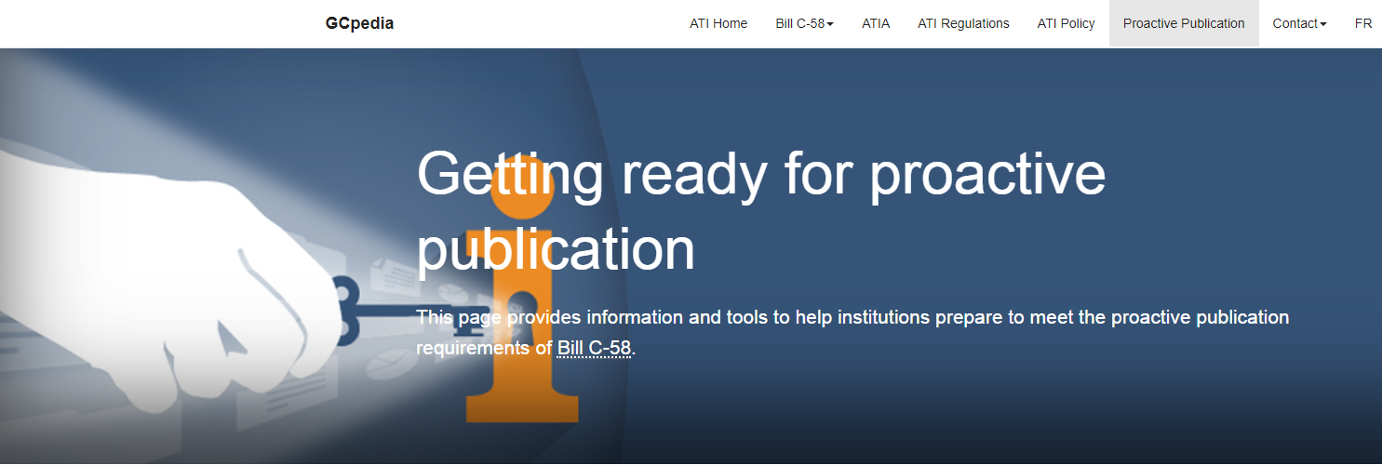
Questions?
http://www.gcpedia.gc.ca/wiki/ATI/PP
Treasury Board Secretariat
Information and Privacy Policy Division
ippd-dpiprp@tbs-sct.gc.ca

