Slide 1
A Beginner's Guide to A/B Testing on Canada.ca
April 2024

Slide 2
About Us: Impact Canada
Impact Canada is a whole-of-government framework for scaling up and mainstreaming “outcomes-based” policy/program methods to help bridge the gap between policy development and effective implementation. The Impact and Innovation Unit (IIU), housed in the Privy Council Office, was established in 2017 to implement the Impact Canada Initiative.
The IIU’s Behavioural Science Team applies the insights and methods of behavioural science to inform the design and implementation of priority programs, services, and initiatives across the Canadian government. At present, we are partnered with eight federal departments responsible for multiple areas: e.g., COVID-19 response and public health; environmental protection and climate change mitigation and adaptation; agriculture; government communications; and innovation in the Canadian economy.
Christine Kormos​ A/Lead Behavioural Science​ christine.kormos@pco-bcp.gc.ca ​
Kieran Findlater A/Sr Lead Behavioural Science​
kieran.findlater@pco-bcp.gc.ca ​
Notes:
Impact Canada is a whole of government framework for scaling up and mainstreaming “outcomes-based” policy/program methods to help bridge the gap between policy development and effective implementation.
The Impact and Innovation Unit (IIU), housed in the Privy Council Office, was established in 2017 to implement the Impact Canada Initiative.
The IIU is a specialized team with extensive experience in the development and execution of novel policy and program methods.
Through its Fellowship program, the IIU hires Behavioural Science Fellows who are embedded cross-departmentally to apply insights from Behavioural Science to inform the design and implementation of priority programs, services, and initiatives across government.
Behavioural Science is a multidisciplinary approach to the study of human behaviour and decision-making, combining the findings and methods from psychology, neuroscience, and other social sciences.

Slide 3
About Us: Our Partners and Collaborators
Environment and Climate Change Canada
Canadian Wildlife Services
Product Policy Section, Products Division
Plastics and Marine Litter Division
Marketing & Public Opinion Research Unit
Natural Resources Canada
Home Energy and Adaptation Labeling (HEAL), Office of Energy Efficiency
Policy, Innovation & Experimentation (PIE), Office of Energy Efficiency
Policy, Planning, Operations Division, Canadian Forestry Service
On-Road Transportation; Fuels Sector
Agriculture and Agrifoods Canada
Sustainable Development Policy Directorate
Canada Border Services Agency
Strategic Policy Branch
Public Health Agency of Canada
Behavioural Science Office
Public Health Measures Guidance Division
Mental Health Promotion and Wellbeing Division, Mental Health Promotion Team
Infectious Disease and Climate Change Program Implementation Team
Public Confidence Team
Antimicrobial Resistance Task Force
Health Canada
Tobacco Control Directorate
Cannabis, Strategic Policy Directorate
Immigration, Refugees and Citizenship Canada
Settlement and Integration Policy Branch
Office of the Secretary to the Governor General

Slide 4
Outline
1 | Introduction to A/B Testing
2 | Before you Begin
3 | Planning your Experiment
4 | Key Takeaways
5 | Additional Resources

Slide 5
Introduction to A/B Testing

Slide 6
What is A/B testing?
Much of website design is guided by top-down principles of usability, composition, and aesthetics.
A designer’s intuition about usability can go a long way, but some aspects of web design are better tested empirically.
A/B testing is a method of empirically testing two or more versions of a product to determine which produces better user engagement.
You can test anything on a page, including design, layout, titles/headings, images, calls-to-action, buttons, links, menus, forms, etc.
Variants (A or B) are randomly assigned to subjects as they arrive at the page.
Metrics are tracked for each variant and compared statistically to determine which performs better.

Slide 7
Considerations for a good A/B test
The Digital Transformation Office (DTO) provides a great deal of information on the design standards for Canada.ca, ongoing improvements, and experiences from other departments.
This can be a valuable source of inspiration for your test.
Canada.ca is mandated to provide clear and accurate information to viewers.
Changes to wording are more challenging to test than changes to layout and user interface, as they require a greater degree of approval and ethical consideration.
Ideally, an A/B test will focus on a single element of the page’s design.
Differences in outcome become impossible to attribute when multiple changes are tested at the same time. This can create more questions than answers.
Smaller, sequential tests with a single change at a time may be more impactful in the long run than a scattershot approach.
Some pages on Canada.ca experience seasonal variations in traffic. It is important to study these patterns, and try to schedule your test accordingly.
Source: https://design.canada.ca/

Slide 8
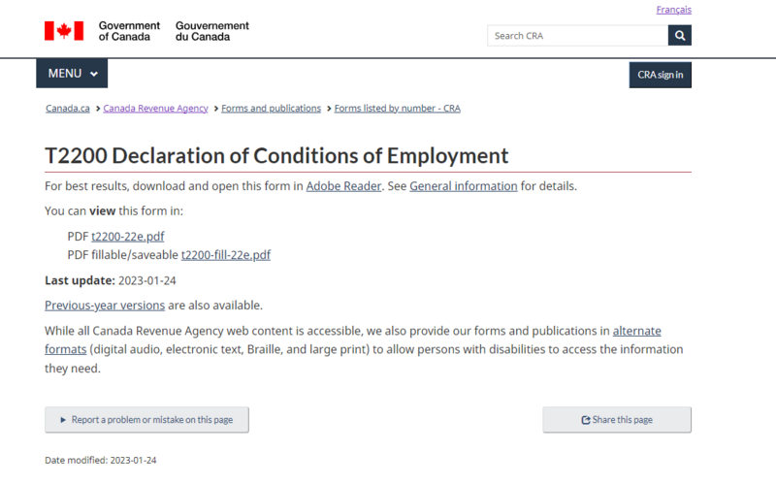
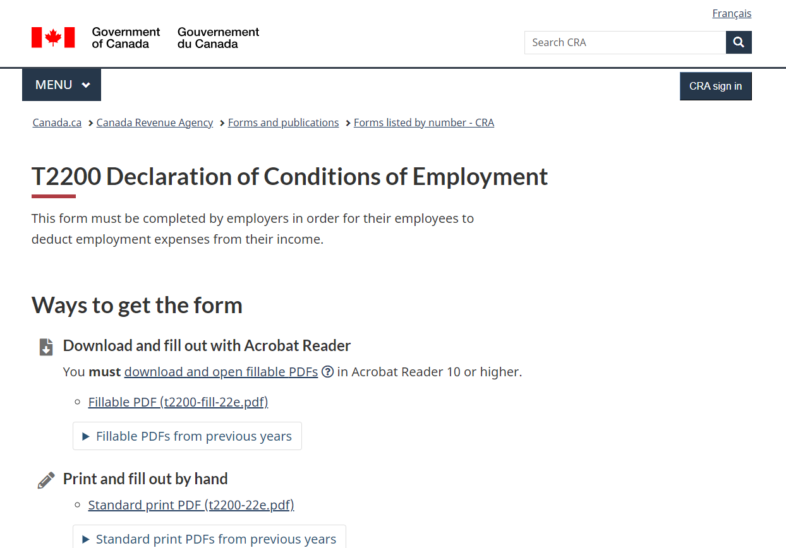
Examples of A/B testing on Canada.ca
Headers added to separate content
Previous versions in an expandable section
Control (A)
Test (B)
Institution: Canada Revenue Agency
Question: Can a change to the T2200 form page increase file downloads?
Results:
A: 14.5K unique visitors, 38.5% downloaded the T2200 form
B: 14.5K unique visitors, 58.6% downloaded the T2200 form
Conclusion: The test page produced better engagement.
Source: https://www.gcpedia.gc.ca/wiki/CRA:_T2200_form_(2023)

Slide 9
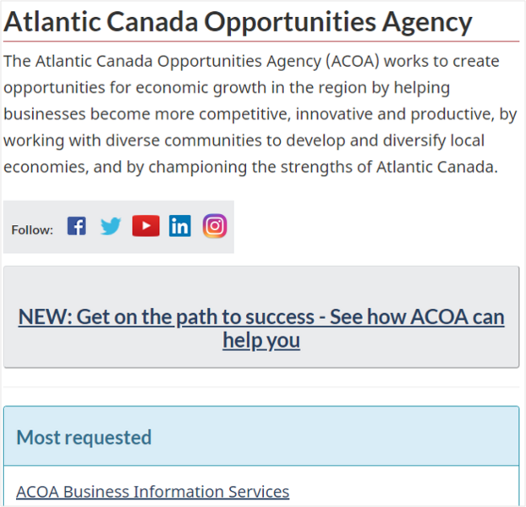
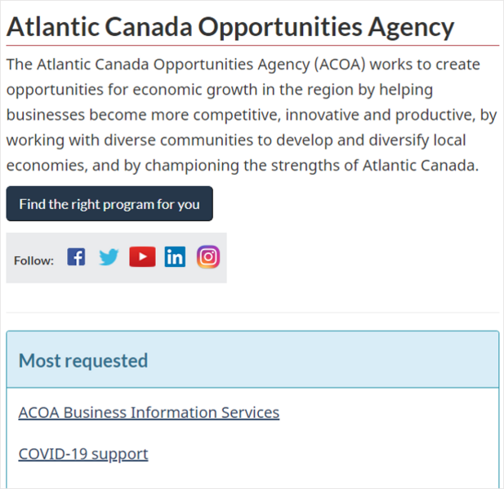
Examples of A/B testing on Canada.ca
New primary button style and wording
Control (A)
Test (B)
Institution: Atlantic Canada Opportunities Agency
Question: Will a button link increase traffic to “How can ACOA help me?” page?
Results:
A: 2.5K unique visitors, 3.7% click-through rate
B: 2.5K unique visitors, 8.9% click-through rate
Conclusion: The test page produced better engagement.
Source: https://www.gcpedia.gc.ca/wiki/ACOA:_Homepage,_A/B_test_(2022)

Slide 10
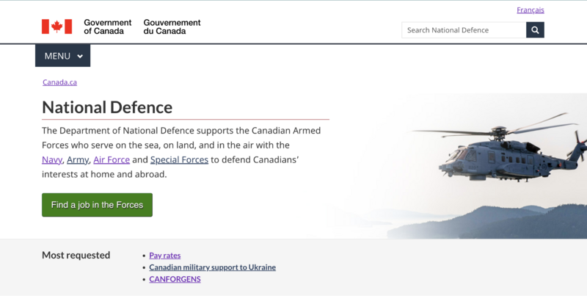
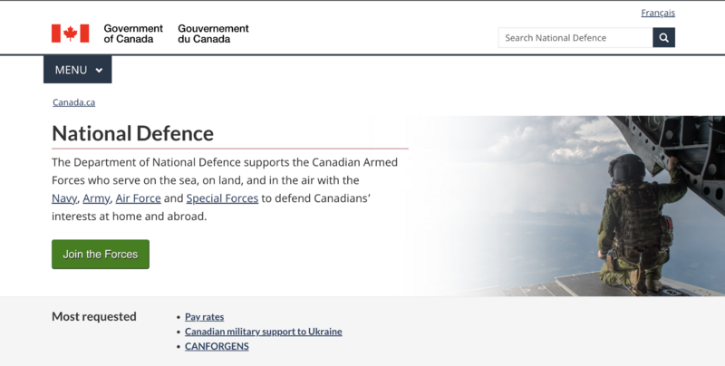
Examples of A/B testing on Canada.ca
Wording change on button
Control (A)
Test (B)
Institution: Department of National Defence
Question: Can changes to the text increase the click-through rate for the “Find a job in the Forces” button?
Results:
A: 45.9K unique visitors, 4.3% clicked the button
B: 45.9K unique visitors, 3.6% clicked the button
Conclusion: The control page had a higher conversion rate. Retain control page.
Source: https://www.gcpedia.gc.ca/wiki/DND:_Supertask_button_(May_2023)

Slide 11
Metrics used in A/B testing
Goals and testable hypotheses for A/B tests are stated using Key Performance Indicators (KPIs).
These metrics are automatically generated by the Adobe Analytics.
Conversion rate:
Proportion of users who complete a desired action (signing up, filling out a form, etc.,) relative to the total number of users.
Click-through rate:
Proportion of users who click on a specific link relative to the total number of visitors who were presented the link.
Bounce rate:
Percentage of visitors who navigate away from the site after viewing only one page.
Time on site:
Average duration that visitors spend on the website.
Unique page views:
The number of distinct individuals (as determined by IP address) who view the website.

Slide 12
Before you Begin

Slide 13
Considering statistical power
Before beginning an A/B test, it is important to calculate the sample size needed to reach acceptable levels of statistical power.
This ensures that you do not conduct an underpowered experiment or design an experiment that requires more subjects (page visitors) than you can possibly obtain.
Unlike traditional experiments, the sample size in an A/B test is determined by incoming page views.
In the absence of a marketing budget that could drive more traffic, the experimenter has no control over how many people view the page in a given period.
The only means for increasing sample size, therefore, is extending the duration of the experiment.
Knowing the average number of daily views your page receives is crucial to determining whether an A/B test will be adequately powered.

Slide 14
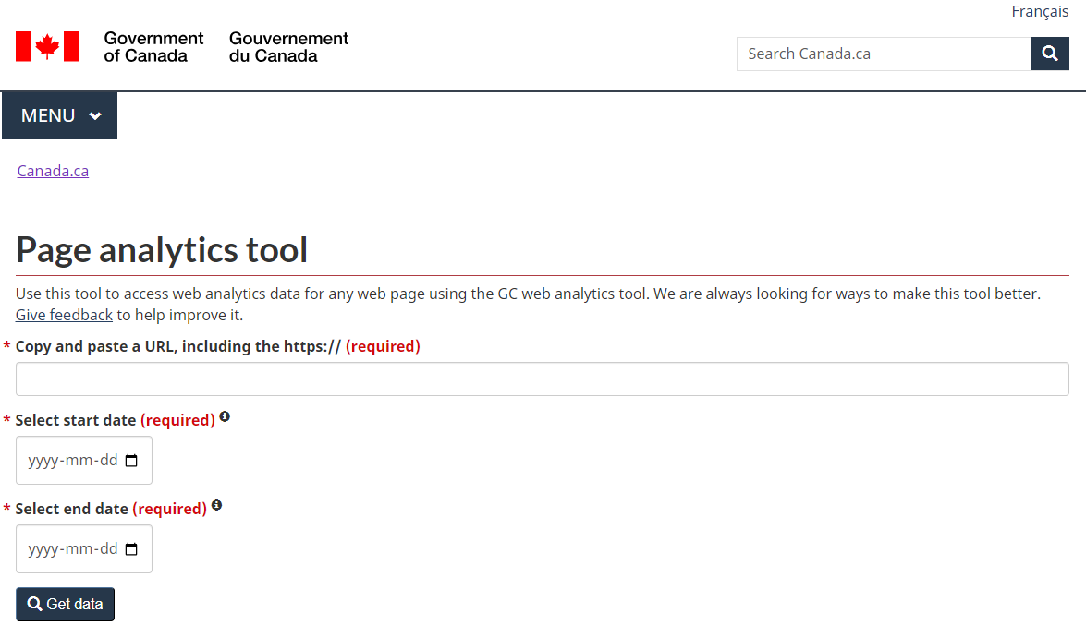
Finding page views and other analytics
The Government of Canada maintains a database of analytics for pages it hosts.
https://www.canada.ca/en/analytics.html
Longer time ranges take more time to retrieve, but a year-long snapshot is valuable for identifying seasonal trends and active marketing campaigns.

Slide 15
Example: Page view metrics
Daily page views in 2023 (English)
https://www.canada.ca/en/public-health/services/vaccination-children/when-to-vaccinate.html
Pre-campaign
Campaign
Key metrics
Beginning in Fall 2023, Canada’s Childhood Vaccine Schedule page was the subject of a marketing campaign to drive traffic from social media and search engines.
 | Pre-campaign | During campaign
Mean visits | 145 | 1,298
Click-through rate | 11.8% | 41%

Slide 16
Considering statistical power
Effect sizes in A/B tests are typically expressed as ‘lift rates’.
The lift rate is the percent increase in the rate of a measured KPI for a variant relative to a control.
This choice of units makes the baseline rate of the target behaviour crucial in determining statistical power.
An analysis of 1001 A/B tests found that the average lift rate is 2.08%*.
The effect size is highly dependent on the nature of the manipulation and the context of the target page.
Large effect sizes are possible, but publication bias makes it difficult to estimate how common these are.
Lift rate can be calculated as ((rate_{B}-rate_{A})/rate_{A})*100
For example, if the baseline rate is 50% and the rate in the variant page is 52%, the lift rate is 4%.
Checklist of information needed to estimate statistical power, and where to look:
Average number of daily visitors.
Canada.ca analytics
Baseline rate of target behaviour (i.e. current conversion rate).
Canada.ca analytics
Expected effect size of manipulation on target behaviour.
Past experiments
Pilot experiments
Or use 2% as a benchmark
Source: https://blog.analytics-toolkit.com/2022/what-can-be-learned-from-1001-a-b-tests/#outcomes

Slide 17
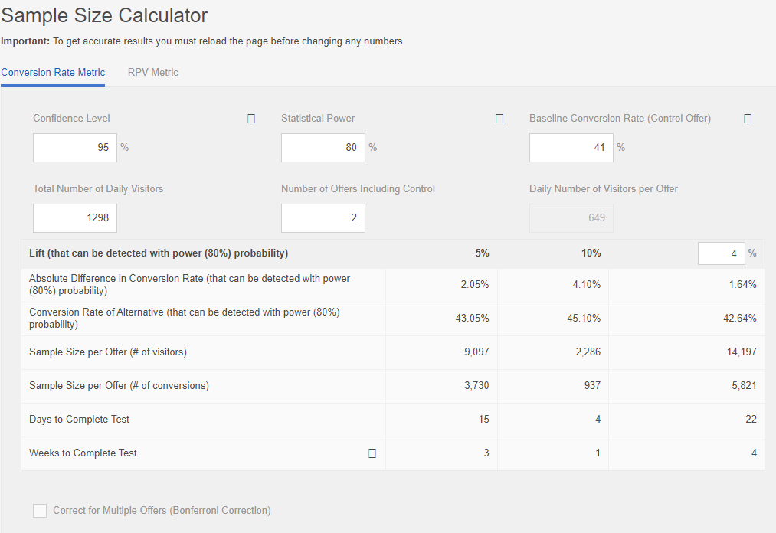
Setup: Adobe’s sample size calculator
Adobe provides a tool that can estimate how many visitors you will need to collect with a given lift rate and baseline conversion rate.
1
Enter the baseline conversion rate obtained from Canada.ca analytics.
Enter the average number of daily visitors obtained from Canada.ca analytics.
If running an A/B test, enter two offers. Change as needed if testing multiple variants.
This tool offers 5% and 10% lift rates as defaults. You can also enter your own benchmark lift rate.
2
3
4
Source: https://experienceleague.adobe.com/tools/calculator/testcalculator.html

Slide 18
Results: Adobe’s sample size calculator
The tool estimates the required sample size given your required statistical power and benchmark lift rates.
Accounting for the average number of daily visitors your page receives, the tool also calculates how long you will need to run the test.
1
2
Source: https://experienceleague.adobe.com/tools/calculator/testcalculator.html

Slide 19
Planning your Experiment

Slide 20
Introducing Adobe Target
Adobe Target is the software we use for A/B testing.
Target makes it very simple to create multiple versions of a page. This can be done without any coding or special web design skills.
Target is integrated with Adobe Analytics and Adobe Experience Manager to unify marketing and data collection efforts.
All Canada.ca pages use Adobe Experience Manager as their Content Management System (CMS).
This means that every page on Canada.ca is compatible with Target.
Target licences are department-specific.
Health Canada, PHAC and NRCan hold licences, but many others (i.e. ISED, ECCC, Agriculture and Agri-Food Canada) do not.

Slide 21
Who to contact about Adobe Target?
Adobe Target is the responsibility of the Principal Publisher, the authority that supports the Government of Canada’s online presence.
The GCpedia page for the Principal Publisher at Service Canada offers extensive resources for acquiring and learning to use Adobe Target and Adobe Analytics (VPN connection required).
If your department already has access to Target, you can begin by contacting your Institutional Representative.
A list of institutional representatives is available on GCpedia.
Source: https://www.gcpedia.gc.ca/wiki/Principal_Publisher_at_Service_Canada
Source: https://www.gcpedia.gc.ca/wiki/Institutional_Representatives_for_Adobe_Target

Slide 22
Privacy and ethical considerations
Compliance with privacy legislation:
A/B testing does not inherently violate user privacy, nor does Adobe Analytics collect personal information.
Institutions may rely on their own discretion when using Adobe Target in environments with Protected information.
Departments are mandated to provide clear, consistent information to Canadians.
This may limit your ability to change the wording/text of your page.
Departments may wish to submit A/B testing plans to an ethics review if they have access to a Research Ethics Board.
For pages displaying important information related to health, security, and other such topics, there may be ethical concerns about manipulations that reduce or impede user interaction.
You may need to adopt a Sequential Analysis approach, which has pre-defined stopping rules, to protect against the ethical implications of subjecting users to an under-performing version of a critical web page.
No matter what, it is a good idea to keep your department’s Research Ethics and Privacy teams in the loop about your project.

Slide 23
Alternatives to A/B testing
Intercept surveys
Canada.ca provides resources for performing intercept surveys, which directly prompt individuals to answer questions during or after their visit.
Intercept surveys can be highly targeted and context-specific,but can suffer from response bias.
Public Opinion Research (POR)
In some cases, it may be easier to run a survey or focus group study to gather the information you need.
POR platforms often allow for Randomized Controlled Trials (RCTs) that are well-suited to testing messaging and communications strategies.
RCTs allow for a much wider range of outcome variables, potentially making for a more informative study.
Guerilla testing
Involves approaching people in public settings where the target audience is likely to be found to gather immediate feedback on a website or service.
Guerilla testing tends to be unstructured making it useful for high-level feedback. As with intercept surveys, it can suffer from response bias.
A/B testing communications
Emails, social media, and advertising platforms also allow for A/B testing different variants of messages.

Slide 24
Key Takeaways
A/B testing is a powerful tool for improving the usability of pages on Canada.ca
Small, incremental changes can have a large impact on aggregate user experience.
Statistical power is the biggest concern when planning your project.
The average lift rate for A/B tests is around 2%. Not every page on Canada.ca will receive enough traffic to enable the sample sizes required for adequate power at that effect size.
Alternatives such as guerilla testing, intercept surveys, or public opinion research may substitute for A/B testing.
When statistical power is a limiting factor, consider alternative approaches.

Slide 25
Experiment planning checklist
Which page do you want to test?
Who owns this page?
Who is your target audience?
Is the site primarily used by the public or clients?
Do visitors to this site arrive primarily from a search engine, or are they arriving via links from another government page?
You can find this information at https://www.canada.ca/en/analytics.html
What does your audience hope to gain by visiting this page?
How can you change the page to help them better realize their goals?
What are this page’s baseline metrics?
How many visitors does the page receive in a month?
What are the baseline values for relevant metrics?
Are there any advertising campaigns planned that may change traffic dynamics to the site?
What are your objectives?
Consider the purpose of your target page and the goals of your department
Identify Key Performance Indicators (KPIs)
Formulate hypotheses in terms of quantitative differences in KPIs.
Does the amount of traffic normally received by this page yield adequate statistical power?

Slide 26
Contact Information
Impact Canada Privy Council Office | Behavioural Science Office Public Health Agency of Canada
General inquiries: iiu-uii@pco-bcp.gc.ca Harry MacKay Behavioural Science Fellow harry.mackay@pco-bcp.gc.ca | General inquiries: bescio-bsc@phac-aspc.gc.ca

Slide 27
Additional resources
https://design.canada.ca
Information on the Government of Canada’s digital presence.
https://www.gcpedia.gc.ca/wiki/GC_A/B_testing_tool:_Adobe_Target
Information on Adobe Target and the Principal Publisher’s A/B testing support.
https://www.gcpedia.gc.ca/wiki/Government_usability_research_index
A record of previous usability research done on Canada.ca

