Slide 1
BLACK HISTORY MONTH Introduction

Slide 2
Who Are We? What Do We Do?
FBEC-CEFN: Federal Black Employee Caucus/Caucus des employés fédéaux noirs
FBEC supports efforts at the national, regional, and local levels to address issues faced by Black federal public servants.
Notes:
https://gccollab.ca/profile/fbecbccefncb
https://gccollab.ca/groups/profile/3051375/enfederal-black-employee-caucus-fbec-u2013-british-columbia-chapterfrcaucus-des-employu00e9s-fu00e9du00e9raux-noirs-cefn-u2013-section-de-la-colombie-britannique

Slide 3
FBEC’s two objectives are to:
Collect disaggregated employment equity data to better understand where Black federal public servants are employed and what’s happening to them, and to
Support the mental health of Black employees by working together to reduce harassment and discrimination in the workplace.
Notes:
https://gccollab.ca/profile/fbecbccefncb
https://gccollab.ca/groups/profile/3051375/enfederal-black-employee-caucus-fbec-u2013-british-columbia-chapterfrcaucus-des-employu00e9s-fu00e9du00e9raux-noirs-cefn-u2013-section-de-la-colombie-britannique

Slide 5
Why do we need a Black History Month?
As the late Jack Layton wrote in his 2011 farewell letter to all Canadians, “Canada is a great country, one of the hopes of the world. We can be a better one – a country of greater equality, justice, and opportunity.”
The work we must do cannot begin until we reckon with the past, and the reckoning must begin with learning.
Please join us over the next few weeks, as we dive into the diversity and history of Canada’s African diaspora, and our contributions to Canada’s vibrant cultural mosaic.

Slide 6
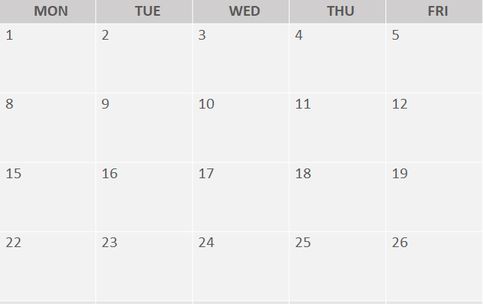
February
Agenda
Self-directed Slideshow: Introduction
Self-directed Slideshow: Diversity
Self-directed Slideshow:
Slavery
ZOOM Panel
11:00-13:00 pst
Career Discussions:
New Black Public Servants
ZOOM Panel
11:00-13:00 pst
Career Discussions:
Black Senior Leadership
Self-directed Slideshow:
Afro-Indigenous
Identity
ZOOM Workshop
10:00-12:00 pst
Anti-Black Racism & Systemic Bias Through the Black Lens
ZOOM Panel
11:00-13:00 pst
Mental Health Impacts of Anti-Black Racism
Open Door
11:00-12:30 pst
Managing the Mental Health of your Black Employees
Self-directed Slideshow:
Francophone
Diaspora
Notes:
© Copyright PresentationGO.com – The free PowerPoint and Google Slides template library

Slide 7
registration.
Career Discussions with Newer Black Public Servants
Hear about how newer black public servants’ navigate their career path. They will share their lived experiences, including obstacles that they faced and how they managed them and the impact to their career. Has mentoring, and networking helped them achieve success thus far? Moderator : Ingrid Coles
Panelists : Adwoa Gyasi-Nimako, Liz Martin, Imanzi Kayitare, TBA
February 16, 2021| Registration link
Career Discussions with Senior Black Leadership
Experienced black leaders share their journey on how they got where they are. They will talk about maximizing their skill sets, and how the colour of their skin affected their career path. The discussion will touch on the role of finding mentors, sponsors, networking and the importance of matching your interest with your career goals.
Moderator: Joyce Lawson
Panelists: Roxane Lee, Sena Paradis, Darren Ruck, Heather Hamilton
February 18, 2021 | Registration link

Slide 8
registration.
Anti-Black Racism and Systemic Bias Through the Black Lens
The Federal Black Employee Caucus BC Chapter (FBECBC-CEFNCB) presents a workshop on anti-Black racism and systemic bias from a Black perspective. Topics discussed will be: biases and their impacts on Black Canadians; history of Black Canadians and their lived experiences, particularly in BC; and allyship and systemic racism in the workplace.
February 22, 2021 | To register, please contact Carolyn Arthur.
10:00 am – 12:00 pm (PST) | The Zoom event link will be provided 24 hours before the event.
Anti-Black Racism: Impact on Mental Health
The latest events in United States reopened deep wounds for those around the world and those that our part of the Canadian public service. Our panel consisting of mental health experts and senior leadership, will discuss these impacts on black public servants, along with microaggressions /macroaggressions in the workplace, “othering” representation challenges the “concrete” ceiling, and what it means to work “within a psychologically safe environment”.
Moderator: Karla Backer
Panelists: Ayesha Sackey, Bohang Benedix, TBA
February 23, 2021 | Registration link

Slide 9
registration.
Open Door Event – Managing the Mental Health of your Black Employees
Open Door Workshop for Leaders in Mental Health, is an annual full-day series that offers awareness and practical tools to supervisors in the federal public service on mental health and wellness. The theme for 2021 is Diversity and Mental Health, exploring the ways that our unique backgrounds and identities impact our experience and needs to create mentally safe workplaces. This 90 mins workshop will explore how anti-black racism shows up in the workplace and how it can impact everyone and the organization. Participants will be provided with opportunities for discussion and reflection as well as practical tools which can be used upon their return to the workplace.
Workshop: Ayesha Sackey and Bohang Benedix
February 25, 2021 | Registration link TBC
11:00 – 12:30pm (PST) TBC

Slide 10
coming soon:
Introduction
Diversity
Slavery
Afro-indigenous identity
Francophone diaspora
FBEC British Columbia
Regional Representatives: Charlene Libert-Scott and Elizabeth (Liz) Martin
fbecbc.cefncb@gmail.com
https://fbec-cefn.ca/ (national website)
Thank you!
Notes:
https://gccollab.ca/profile/fbecbccefncb
https://gccollab.ca/groups/profile/3051375/enfederal-black-employee-caucus-fbec-u2013-british-columbia-chapterfrcaucus-des-employu00e9s-fu00e9du00e9raux-noirs-cefn-u2013-section-de-la-colombie-britannique

