Slide 1
Public Trust and Social Cohesion
January 2019
Kathryn Campbell CSC, Secretary,
Australian Department of Social Services
Stephanie Foster, Deputy Secretary, Governance, Australian Department of the Prime Minister and Cabinet
Marta Morgan, Deputy Minister, Immigration, Refugees and Citizenship Canada

Slide 2
Overview
1
What is social cohesion?
Social cohesion in Canada and Australia – at a glance
Public trust and perceptions: Public trust Economic security Diversity and immigration Discrimination Pride and national identity
Actions underway
Challenges and opportunities
Areas for government action
Discussion
2
Canada and Australia are well positioned to embark upon a joint discussion of emerging trends and 0pportunities for further government action
3
4
5
6
7

Slide 3
What is social cohesion?
Shared values
Safety
Access to opportunity
A community that sticks together, where people connect, share resources, support each other and work together to achieve collective goals
Pride and sense of belonging
Fairness and equality
Economic security
National symbols
Trust in institutions
Respecting diversity
Wellbeing
Inclusion for all
Building connections through sport and arts
Resilience
National identity
Appropriate infrastructure and access to services
Participation in employment, education and community life

Slide 4

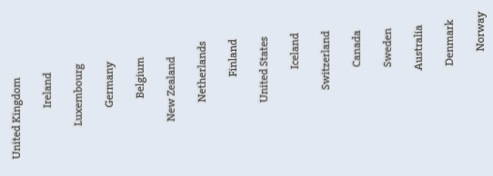
Social cohesion in Canada and Australia – at a glance
OECD 2017 Better Life Index
Both countries fare well on a range of aspects of well-being and social cohesion However, we are also affected by disruptive trends around the world
Risk | May lead to
Decreased sense of belonging | Lower participation Increased marginalization
Increase in fear of individuals/groups Discrimination and racism | More marginalized and segregated communities or ‘enclaves’
Continued decline of trust in government and other institutions | Lack of engagement in and with government and its services
Increase in perceptions that some are deserving/undeserving of government support | Grievances, disputes and divisions in community

Slide 5

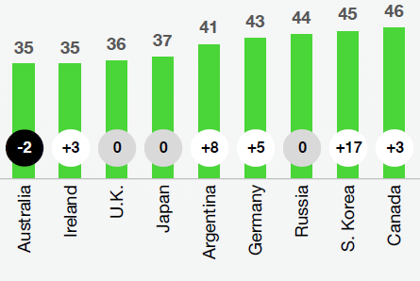

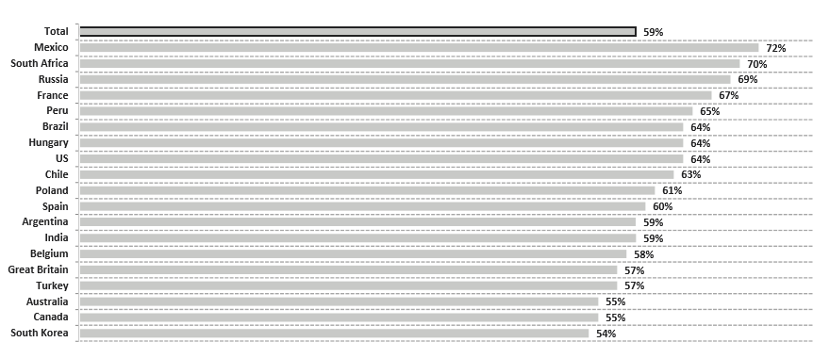

Public trust and perceptions
Public trust in government
Public trust
Canadians and Australians trust their governments and other institutions less than they did previously When governance is failing and people lose trust in institutions, the whole community feels the impact
Edelman, 2018
Ipsos,2018

Slide 6

Public trust and perceptions (cont.)
Economic security
58% of Canadians feel the next generation would have a lower standard of living than they presently do
Ekos, October 2017
60% of Australians agree that ‘getting ahead is becoming harder’
2017 Building and Fostering Community Cohesion
Canada and Australia rate well on the economic growth front However, some people are increasingly anxious about a comparable future and opportunities
88% of Canadians are concerned or somewhat concerned about the affordability of housing
2017 Nanos
1 in 4 Australians believes the great Australian dream of owning a home is over
2018 Salvation Army

Slide 7

Public trust and perceptions (cont.)
Diversity and immigration
80% of Canadians believe that immigration is good for the country’s economy 2018 Environics Institute
66% of Australians believe that ‘accepting immigrants from many different countries makes Australia stronger
2018 Scanlon Foundation
Public support for the value of immigration and the importance of diversity remain strong in both countries However, some negative trends have started to emerge
54% of Canadians agree ‘there are too many immigrants coming into this country who are not adopting Canadian values’
2017 Environics Institute
41% of Australians are questioning if Australia is too open to people from all over the world, and therefore, at risk of losing Australia’s identity as a nation
2018 Lowy Institute

Slide 8

Public trust and perceptions (cont.)
Discrimination
63% of visible minority respondents believed their experience was based on their race or skin colour, while 21% of visible minority females reported being a victim of discrimination
2014 General Social Survey
Proportion of Australians indicating experience of discrimination because of skin colour, ethnicity or religion has more than doubled, from 9% in 2007 to 19% in 2018
2018 Scanlon Foundation
Many Canadians and Australians still report that they have faced discrimination at some point in their life
Most Canadians believe there is on-going discrimination against ethnic and racial groups, especially Muslims and Indigenous People
2014 Environics
46% of Indigenous people reported experiencing prejudice, (39% two years before)
2016 Reconciliation Australia

Slide 9

Public trust and perceptions (cont.)
Pride and national identity
87% of Canadians are proud to be Canadians
90% of Canadians feel strong sense of belonging to Canada Canada 150 Surveys
85% of Australians have high sense of belonging, identification with Australia and hapiness
2018 Scanlon Foundation
Both Canada and Australia are fortunate to be countries rich in expressions of national pride, sense of belonging, and participation rates
6 in 10 Canadians and Australians have undertaken some voluntary work in the past 2013 General Social Survey
2016 Australian Bureau of Statistics

Slide 10
Actions underway
Whole-of-government sustained focus on gender equality
The Accessible Canada Act legislation
A new Federal Anti-Racism Strategy
The Poverty Reduction Strategy
The reconciliation agenda with Indigenous peoples
Canada and Australia each have wide-ranging foundation policies and frameworks to support cohesion
Reforms to strengthen the requirements for Australian residency and citizenship to support social cohesion
Developing a national policy framework on community cohesion
Multicultural Australia statement
Closing the Gap initiative
National Disability Insurance Scheme

Slide 11

Challenges and opportunities
External forces and actors such as disinformation and cyberattacks
The breadth of the concept makes it difficult to focus action
Lack of strategic coordinated national policy frameworks
Strong and consistent measurement frameworks have been elusive
Cohesion initiatives cut across all tiers of government and are ‘program rich and policy poor’
Several common challenges have begun to emerge

Slide 12






Areas for government action
Social cohesion = whole-of-community matter
Whole-of-government response
Engagement and partnership inside and outside of government
Long-term investment
Developing and collaborating on social cohesion frameworks
Collaboratively encouraging discussions in international fora
Canada and Australia are well-positioned to embark upon a joint discussion of emerging trends and opportunities for further government action

Slide 13
Discussion
What is the role of the national government in fostering social cohesion (as opposed to sub-national governments and other actors)?
1a. What is the role of other actors such as individuals, business, philanthropy, civil society in building social cohesion and how do we talk about it?
Could there be more focus on the role for public sector professionals in improving the trust relationship with citizens, for example, in the delivery of services?
How might countries further collaborate with each other (beyond exchanging assessments and experiences)?
What steps can be taken to formulate a bias-free social cohesion evidence base?

