Slide 1
Guide to assessing the sponsor and champions
To be used by the workplace modernization change manager
Date: TBD

Slide 2
About this guide
As a change manager, it is your role to ensure that the sponsor and champions are well equipped to lead the change. This guide, along with the Sponsorship assessment tool (Excel), will help you identify who they are and their level of competency, and create a sponsorship diagram. The analysis you conduct using this guide and tool will assist you later in developing a sponsorship plan that can then be shared with senior management.
This guide and the Sponsorship assessment tool (Excel) were adapted from PROSCI © and developed with information from the PROSCI© Sponsorship and the sponsor assessment diagram 2018.
Look for this symbol throughout the document for additional tips!
NOTE: This information you gather as part of this process is not intended to be shared with your organization. Maintain confidentiality: avoid embarrassing or surprising a senior leader—use this diagram with care!

Slide 3
Overview: Sponsorship tools and documents
1 Guide to assessing the sponsor and champions (PowerPoint)
Provides information on roles
Helps identify who the sponsor and champions are
Guides you in completing the Sponsorship assessment tool
2 Sponsorship assessment tool (Excel)
Helps identify the sponsor and champions’ positions towards the change and their competency level in their roles
3 Sponsorship roadmap (Word)
Template for the change manager to customize based on the results of the Sponsorship coalition assessment and the Sponsorship diagram
4 Sponsor Guide–Roles and Responsibilities (PowerPoint)
Part of the leadership toolkit
Guide that can be used to educate the sponsor and champions on their roles
Tools you create:
Sponsorship coalition assessment
Sponsorship diagram

Slide 4
About the sponsor and champions
The sponsor
“owns” and leads workplace change
participates actively and visibly
manages and oversees the change and approach
communicates expected benefits to employees
secures resources for the project ($+FTEs)
Ideal sponsor traits
Strong communication skills
Creates engagement through passion and enthusiasm
Engaged and involved
Visible and supportive
Approachable and available
Recognized leader with sponsorship experience
The champion
is the person employees of a group view as “in charge”
participates actively and visibly
adapts quickly and advocates for the change; early adopter
demonstrates commitment by building a coalition of support

Slide 5
Steps to assessing the sponsor and champions
Identify
the sponsor
Determine
the position of the sponsor and champions relative to the change
Assess
the change management (CM) competencies of the sponsor and champions
the impacted groups
the champions
Analyze
the results and create the Sponsorship diagram
Let’s start with the sponsor!

Slide 6
Identify… the sponsor
Open the Sponsorship assessment tool: On the “Assess the sponsor” tab, input the name of the sponsor in the appropriate cell.
Typically, the sponsor is the highest level executive that has control over the resources for the project.
Ask yourself, is my sponsor at the right level? There may be additional challenges if they are not; these can be addressed in the Sponsorship roadmap during the Plan phase of the WCM Playbook.

Slide 7
Determine the position of… the sponsor
On the “Assess the sponsor” tab, input the position of the sponsor in the appropriate cell.
In order to do so, choose between the two following options:
A
Openly supports the change
Openly opposes the change or is neutral
B

Slide 8
Assess the CM competencies of… the sponsor
On the “Assess the sponsor” tab, fill out the 20 grey cells in column “O” by ranking each factor on a scale of 1 to 5 (1 being the least and 5 being the most). This will generate: Assessment score Competency level Letter/number designation
Competency level of the sponsor:
High level of competency (score of 80-100) Moderate level of competency (score of 70-79) Low level of competency (score < 70)
1
2
3
Complete this assessment based on the sponsor’s behavior on the current project or on past projects.
Now let’s move on to the champions!

Slide 9
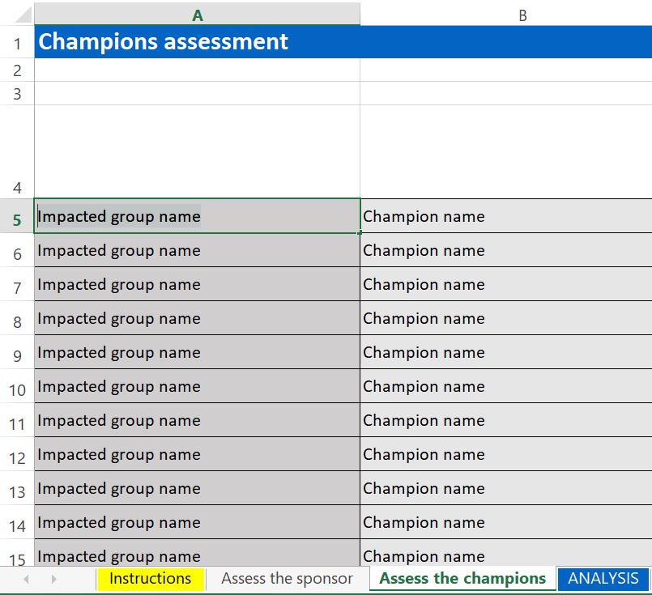
Identify… all impacted groups
On the “Assess the champions” tab, fill out the Impacted group name in column A.
In identifying impacted groups, keep in mind the following:
The size and complexity of your project will determine the impacted groups Example: on large projects, you may list high level groups at the branch level, and for smaller projects you may list smaller groups at the directorate level
Use information gathered during the stakeholder mapping (in the Strategize phase of the WCM playbook)

Slide 10
Identify… the champions
On the “Assess the champions” tab, input the name of the champion in column “B” for each impacted group.
Typically, a champion is the person employees of a group would view as “in charge”. The size and complexity of your project will determine the level and quantity of champions required.

Slide 11
Determine the position of… the champions
On the “Assess the champions” tab, input the position of each champion in column “C”.
In order to do so, choose between the two following options:
If unsure about a champion’s position towards the change, check with your sponsor or someone close to the champion (or ask the champion directly)
A
Openly supports the change
Openly opposes the change or is neutral
B

Slide 12
Assess the CM competencies of… the champions
On the “Assess the champions” tab, for each champion, fill out the 20 blue cells from columns “D” to “W” by ranking each factor on a scale of 1 to 5 (1 being the least and 5 being the most). This will generate: Assessment score Competency level Letter/number designation Note: these questions are abridged versions of the sponsor questions.
Competency level of the champions:
High level of competency (score of 80-100) Moderate level of competency (score of 70-79) Low level of competency (score < 70)
1
2
3
Complete this assessment based on the champions’ behaviors on the current project or on past projects.
If you do not have information for a particular individual, request an interview and ask them the questions in person.
On to Analyse!

Slide 13
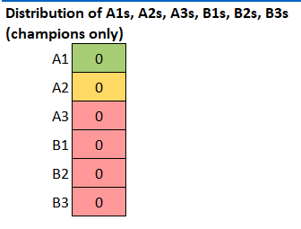
Analyze… the results of the assessment (1)
On the “ANALYSIS” tab, you will find a compilation of all the assessment results; the sponsor’s results separately on the left, and the champions results on the right that form the Sponsorship coalition assessment. The table below shows the quantity of letter/number designations for the champions.
Letter/number designation:
Green Supports the change and has demonstrated a high-level of sponsor competency Yellow Supports the change and has demonstrated a moderate level of sponsor competency Red Neutral or opposed to the change or has demonstrated a low level of sponsor competency
A1
A2
B1, B2, B3, A3
To see each individual’s result, you can refer to the “Assess the sponsor” or “Assess the champions” tabs

Slide 14
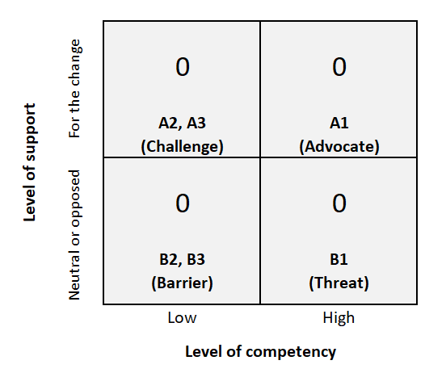
Analyze… the results of the assessment (2)
This table to the right shows how each letter/number designation might impact your project. A1 is your greatest advocate while B1 could be your greatest threat. The level 1 designation means that they completely understand how change sponsorship works, and could use that knowledge to support or undermine the change. B2 or B3 is your greatest barrier, but also an opportunity in terms of education and bringing them around to supporting the change. A2 or A3 will be your greatest educational challenge since they are supportive already but lack the skills and knowledge to be an effective champion.
Finally, let’s create the Sponsorship diagram!

Slide 15
Example of Sponsorship diagram
Analyze… and create the Sponsorship diagram (1)
Create the Sponsorship diagram: The diagram is a visual representation of the assessment results. You can start from an existing org chart; however, keep in mind that the champions may not follow the traditional org structure, depending on the complexity and scope of the project. Write the initials and letter/number designation for the sponsor and each champion; use the associated colour for a visual cue of the strengths and gaps.
Deputy Minister
A1
B.B. (sponsor)
A2
K.K.
B1
A.A.
A2
D.D.
A1
F.F.
A3
L.L.
B3
Senior ADM level
ADM level
NOTE: This information you gather as part of this process is not intended to be shared with your organization. Maintain confidentiality: avoid embarrassing or surprising a senior leader—use this diagram with care!

Slide 16
Example of Sponsorship diagram
Analyze… and create the Sponsorship diagram (2)
Next, show the relationship between the sponsor and any champions at a higher or same level, and identify the individual they all report to. Note: You should complete the competency assessment for that individual (in this example, the Deputy Minister) even if they are not directly impacted by the change; in certain cases, the sponsor may need their assistance with addressing resistance from higher level champions.
Deputy Minister
A1
B.B. (sponsor)
A2
K.K.
B1
A.A.
A2
D.D.
A1
F.F.
A3
L.L.
B3
Relationship between the sponsor and highest level champion
Senior ADM level
ADM level
This chart can be a great indicator of project success or failure.
NOTE: This information you gather as part of this process is not intended to be shared with your organization. Maintain confidentiality: avoid embarrassing or surprising a senior leader—use this diagram with care!

Slide 17
Next steps
Gain concurrence from your sponsor
Get commitment from your sponsor to address the most serious
challenges
Start a plan to address champions with yellow and red results; this
will form the base of the Sponsorship roadmap that you will develop
during the “Plan” phase of the WCM Playbook

