Slide 1
Unlocking the Potential of Cloud - CSPS
Canada Center for Mapping an Earth Observation (CCMEO) – Cloud-based Solutions Overview
Alexandre Tardif (alexandre.tardif@nrcan-rncan.gc.ca)
April 12th, 2022

Slide 2
DELIVERING ON OUTCOMES
CANADA CENTRE FOR MAPPING AND EARTH OBSERVATION (CCMEO)
CCMEO helps to deliver outcomes such as cumulative effects, open government, resource development consultations, major projects, clean energy, emergency and hazard management.
During the early days of the pandemic, we established a multi-jurisdictional cloud environment to maximize the effectiveness and efficiency of data sharing and analysis, data collection and reporting on COVID-19.
We work with multiple cloud providers, including most recently Google in establishing best-in-class geospatial technology, and are currently piloting the use of Google Earth Engine for advanced earth observation analysis, and a platform for scientific use.
With the second largest landmass on earth and the longest coastline in the world, the GC relies on satellite technology to support economic development of Canada's natural resources, the North, safety, security, sovereignty, and environmental monitoring.

Slide 3
GEO.CA
THE DEFINITIVE SOURCE FOR CANADA’S OPEN GEOSPATIAL RESOURCES
CCMEO actively works with organizations to publish and make discoverable over 7200 layers of from-the-source, interoperable geospatial data layers, supported by ISO standard metadata, available to federal employees and the public for analysis and decision support.
GEO.CA is a partnership between multiple jurisdictions, including Provinces and Territories through the Canadian Council of Geomatics (CCOG) to showcase our collection geospatial knowledge.
Building on years of development we maximize the value of Canada's geospatial assets, and make our open geospatial information even more accessible to everyone.
GEO.CA will be available publicly in the coming weeks.

Slide 4
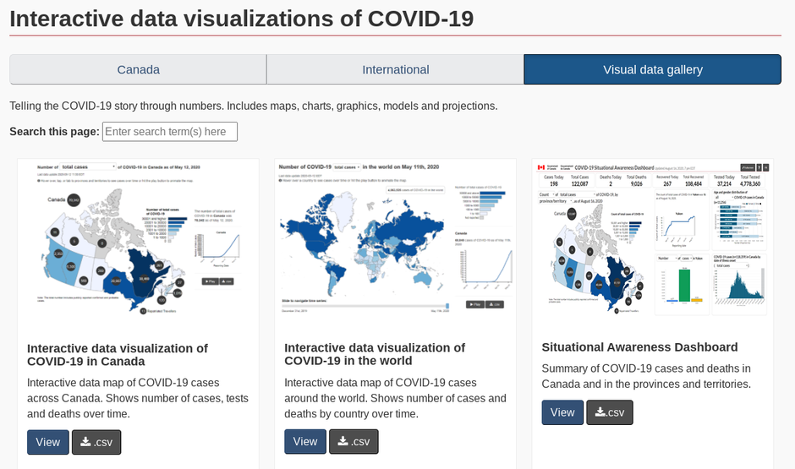
THE POWER OF THE CLOUD
GIVING CANADIANS AUTHORITATIVE INFORMATION ON COVID-19
On March 13th,2020 CCMEO FGP's assistance was requested by the Public Health Agency (PHAC), Statistics Canada (StatCan) and NRCan's Emergency Geomatics Services.
This required authoritative geospatial data from the source, for the country, accessed by multiple organizations, visualized in an epidemiologically-sound manner, and published for Canadians.
We created a multi-departmental, geospatially enabled cloud environment, with high availability and reliability, with the appropriate tools, accessible by many departments.
The next steps would include fully deploying a multi-jurisdictional geospatial infrastructure to enable more effective data collection, storage, access, and discovery for future emergencies.

Slide 5
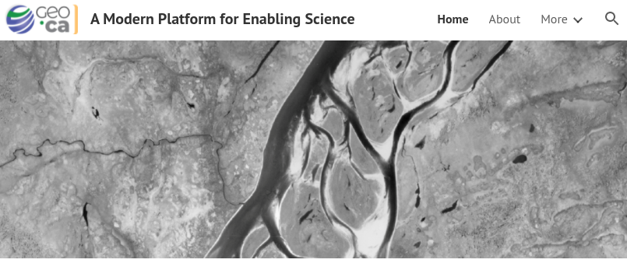
A MODERN PLATFORM FOR ENABLING SCIENCE
GOOGLE CLOUD ENVIRONMENT FOR SCIENTIFIC USE
Natural Resources Canada (NRCan), Agriculture and Agri-Food Canada (AAFC) and Google have launched the Google Cloud Environment for Scientific Use project.
This is a proof of concept that currently supports 17 pilot projects, as well as 12 new projects in the new fiscal year, designed to bridge the operational gap within NRCan’s scientific community.
The pilot tests a Geo-Solution Suite that combines innovation, security and high performance, providing an environment that enables NRCan’s scientific community to create breakthroughs and accelerate the progress in natural sciences.
The proof of concept (POC) demonstrates how Google Cloud technology can be leveraged to deploy a geospatial solution suite / scientific platform that supports evidence-based decision making and world-class research by providing integrated, on-demand, technological resources at a fixed cost.

Slide 6
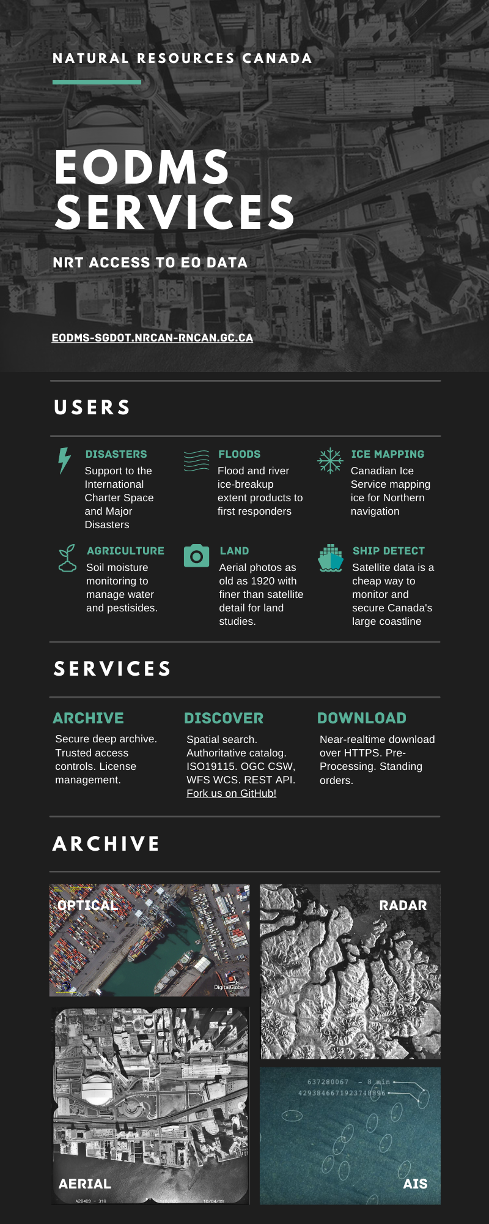
EARTH OBSERVATION
PROVIDING NEAR-REALTIME EO DATA FROM SPACE TO THE CLOUD IN MINUTES
EODMS is a site provided by NRCan open to the public to discover and download authoritative Canadian Earth Observation (EO) satellite data.
Current datasets include all RADARSAT data since 1995 including up-to-the-hour RCM and COGs on AWS: https://registry.opendata.aws/radarsat-1/, Canada Lands Air Photos and the National Air Photo Library, all commercial imagery procured by the GC.
AWS? So What? On April 01 2022, CCMEO EODMS migrated to AWS. This means EO data will get to decision makers faster, with more stability and consistency.

