Slide 1
Circle Discussion Guide #5
Self-Compassion & Neuroplasticity
Notes:
Welcome everyone to our last Circle session on Self-Compassion and Neuroplasticity.

Slide 2
Founders’ Message
“Thank you” doesn’t feel like enough to describe how happy we are, for you to have made the commitment to join the Lifting as you Lead Mentoring Circles program 4th edition, organized by the Diversity and Inclusion Office, Materiel Group, National Defence, and open to all Federal Public Service members.
What began as a simple idea from our consultations has grown into a thriving network, addressing the desire for meaningful networking and professional growth.
There’s Power in People Coming Together
You're now part of a diverse network of 1100+ inclusive-minded leaders, assigned to a Circle: a small, trusted group for goal achievement in a safe space. This Circle will facilitate learning from others' experiences and diverse perspectives, expanding your knowledge and tactical skills.
LLMC offers a unique opportunity for everyone to feel valued and respected for their contributions. The relationships you build will accelerate progress and drive accountability.
Nancy Tremblay
Assistant Deputy Minister, Materiel, National Defence
Samantha Moonsammy
Diversity and Inclusion Section Head,
Materiel, National Defence
Notes:
Here's a message from the program founders if you'd like to take a read through in your Discussion Guide PDFs [first of two slides]

Slide 3
Founders’ Message
By actively engaging with your Circle, sharing experiences, and fostering connections, you'll unlock personal and professional growth opportunities. This knowledge empowers you to advance in your career.
The Time to Act is Now!
Thank you for answering the call to action, committing to creating a psychologically safer workplace for all, especially those from equity-deserving groups.
We hope you will feel a real and fundamental shift throughout the program. And together we will celebrate all the hard work you put into this experience. Thank you for showing up for yourself, your family, your organization and the communities you’re called to serve.
Going forward, take advantage of all the networking that will take place, meet new LLMC members in MS Teams and on LinkedIn. Lean into the Masterclasses.
Choose to stay consistent with that next level version of you. We are rooting for you.
Nancy Tremblay
Assistant Deputy Minister, Materiel, National Defence
Samantha Moonsammy
Diversity and Inclusion Section Head,
Materiel, National Defence
Notes:
Here's a message from the program founders if you'd like to take a read through in your Discussion Guide PDFs [second of two slides]

Slide 4
Circle Ground Rules and Values
Equality: Everyone is an equal member
Substance: Share what's important
Openness: Listen and avoid judgements
Respect: Treat others as they would like to be treated
Notes:
Let's take a moment to review the Circle Ground Rules and Values:
Equality: Everyone is an equal member
Substance: Share what's important
Openness: Listen and avoid judgements
Respect: Treat others as they would like to be treated

Slide 5
Participant Ground Rules and Values
Confidentiality - trust is critical
Bring your full self and beginner’s mindset to each session
Come nourished and stay hydrated
Keep your camera on so everyone feels safe and connected
Be candid and honest - listen with empathy
Be ready to engage with your peers
Remove outside distractions
Keep your audio off, except when asking questions and contributing to the discussion
Be fully present and attend all five weeks - no multitasking
Notes:
Let's take a moment to review the Participant Ground Rules and Values:
Confidentiality - trust is critical
Bring your full self and beginner’s mindset to each session
Come nourished and stay hydrated
Keep your camera on so everyone feels safe and connected
Be candid and honest - listen with empathy
Be ready to engage with your peers
Remove outside distractions
Keep your audio off, except when asking questions and contributing to the discussion
Be fully present and attend all five weeks - no multitasking

Slide 6
Self-Compassion and
Neuroplasticity
“The ability to learn is the most important quality a leader can have.” Padmasree Warrior, Indian chemical engineer and business executive “Nature has given us a brain that survives in a changing world by changing itself.” Norman Doidge, Canadian author and psychiatrist
Notes:
Here are some quotes on self-compassion and neuroplasticity to get us started:
“The ability to learn is the most important quality a leader can have.”
Padmasree Warrior, Indian chemical engineer and business executive
“Nature has given us a brain that survives in a changing world by changing itself.”
Norman Doidge, Canadian author and psychiatrist

Slide 7
1. Check-In: Warm up and get going
(19 minutes)
1.1 Welcome
(1 minute)
Change is one of life's most constant elements, a reality that has been especially evident over the past few years.
Bonding Moment What do you like to do to adapt to change? (10 seconds each)
Notes:
Welcome, everyone, to our final Circle session. Today, we’ll explore how neuroplasticity and self-compassion can help us navigate our careers through change. Change is one of life's most constant elements, a reality that has been especially evident over the past few years. The COVID-19 Pandemic required considerable changes to how we lived our day-to-day lives and continues to impact how we live and work.
By understanding neuroplasticity, we can appreciate how our brains adapt to new situations, and with self-compassion, we can support ourselves kindly through these transitions.
Let's open with a bonding moment. What do you like to do to adapt to change?
(10 seconds each)

Slide 8
1.2 Your Health Comes First
(1 minute)
Hope for Wellness Helpline
1-855-242-3310
Employee Assistance Program (EAP)
Toll-free: 1-800-268-7708
For persons with hearing impairments:
1-800-567-5803
Notes:
Before we begin today’s Circle, an important reminder. The intent of these sessions is to have safer conversations about important subjects that will help transform the Federal Public Service by creating diverse and inclusive psychologically safer workplaces. The subjects may be difficult for some people to discuss. If at any point during this session you feel that you need to step away, you may leave the session in order to protect your mental health. There’s also a 5 minute break built in partway through the Circle.
Your health comes first.
If you need to talk to someone, whether before, during, or after a circle, there is support available to you 24/7. Please see the support section at the end of this guide for contact information.

Slide 9
1.3 Overview
(2 minutes)
Self-Compassion
Can help us see change as an opportunity for growth rather than a hurdle.
Neuroplasticity
Demonstrates how our brains are like flexible highways with constantly changing routes.
Notes:
Learning to navigate change effectively is a skill that benefits both our professional endeavours and personal lives.
This week's session focuses on how neuroplasticity and self-compassion can help us see change as an opportunity for growth rather than a hurdle. In today’s engaging and thoughtful discussions, we will explore how our brains can adapt to new situations and why being kind to ourselves is crucial during these transitions.
Neuroplasticity is a fascinating concept that demonstrates how our brains are like flexible highways with constantly changing routes. Unlike the old belief that our brains are set in stone after childhood, we now know that they are always reshaping and forming new connections based on our experiences, learning, and even after injuries. This ability to change allows us to acquire new skills, develop better different habits, and bounce back from challenges. It’s empowering to know that our brain can adapt and evolve as we develop new skills to advance our career.
Today we are talking about personal techniques to approach change through changing our brains. We will learn how to optimize our brain and our well-being through neuroplasticity and self-compassion. Let’s get started!

Slide 10
1.4 Icebreaker - Neuroplasticity in Everyday Life
(10 minutes)
Instructions: Read through these tangible examples of neuroplasticity in action in everyday work scenarios. Please choose one of the actions below that you have tried and share your experience: (2-3 minutes to read, then 1 minute per member)
Starting a new job Starting a new job or learning new tasks requires the brain to process a wealth of new information, from mastering unfamiliar procedures to understanding different workplace dynamics. Over time, as one becomes more accustomed to their role, the brain adapts, making these tasks feel more intuitive. | Figuring out how to use a new software or app When you start using a new software program or app at work, your brain begins to form new connections. Initially, you may find the interface and functions challenging to navigate. However, as you practice and become more proficient, specific areas of your brain associated with visual processing, problem-solving, and motor skills expand and strengthen, making the use of the software more intuitive and efficient.
Learning a new language When you start learning a new language for work, your brain begins to form new connections. As you practice and become more proficient, specific areas of your brain related to language comprehension, auditory processing, and memory expand and strengthen. | Becoming a new parent When you become a new parent, your brain undergoes significant changes as it adapts to new responsibilities and emotional bonds. As you care for your child and navigate new routines, areas of the brain associated with empathy, multitasking, and stress management grow and develop.
Want more info on Neuroplasticity? Watch this optional video: Intro to Neuroplasticity (2m 03s)
Notes:
Neuroplasticity isn’t just a scientific concept confined to research labs and academic discussions. It’s very much a part of our daily lives, influencing how we learn, adapt, and grow. From the skills we acquire to the challenges we overcome, our brain’s ability to adapt and evolve is nothing short of remarkable.
Instructions: Read through these tangible examples of neuroplasticity in action in everyday work scenarios. Please choose one of the actions below that you have tried and share your experience:
(2-3 minutes to read, then 1 minute per member)
Starting a new job
- Starting a new job or learning new tasks requires the brain to process a wealth of new information, from mastering unfamiliar procedures to understanding different workplace dynamics. Over time, as one becomes more accustomed to their role, the brain adapts, making these tasks feel more intuitive.
Figuring out how to use a new software or app
- When you start using a new software program or app at work, your brain begins to form new connections. Initially, you may find the interface and functions challenging to navigate. However, as you practice and become more proficient, specific areas of your brain associated with visual processing, problem-solving, and motor skills expand and strengthen, making the use of the software more intuitive and efficient.
Learning a new language
-When you start learning a new language for work, your brain begins to form new connections. As you practice and become more proficient, specific areas of your brain related to language comprehension, auditory processing, and memory expand and strengthen.
Becoming a new parent
- When you become a new parent, your brain undergoes significant changes as it adapts to new responsibilities and emotional bonds. As you
care for your child and navigate new routines, areas of the brain associated with empathy, multitasking, and stress management grow and develop.

Slide 11
1.5 One Action from the last meeting
(5 minutes)
Instructions: Once you’re warmed up, go around your Circle and have each member share their One Action update from week #4, Diversity, Equity, Inclusion, and Accessibility: A Non-Performative Approach. Your “One Action” is a concrete commitment you made during your previous Circle session. (1 minute per member)
Notes:
Now that we're warmed up, let's go around the Circle and have each of us share our One Action update from week #4: Diversity, Equity, Inclusion, and Accessibility: A Non-Performative Approach. Your One Action is a concrete commitment you made during your previous Circle session.
(1 minute or less per member)

Slide 12
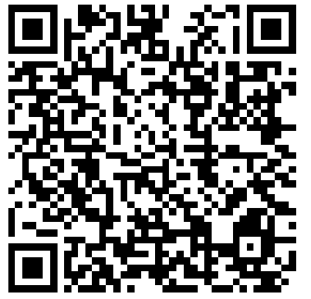
2. Educational Activity: Lean in, get inspired, and add to your toolkit
(30 minutes)
2.1 Video: Your Body Language May Shape Who You Are
(20 minutes)
Instructions: Watch the Amy Cuddy Ted Talk (edited) “Your Body Language May Shape Who You Are” (11m 33s).
Follow along with the transcript
Notes:
Instructions: As a group, watch Amy Cuddy’s “Your body language may shape who you are” video (10m), then share one key take-away with the group. Use the reflection questions on the slide following the video to guide the conversation if needed.
(1 minute per member to share)
[video on next slide, reflection questions on slide after that]

Slide 14
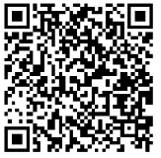
Reflection Questions: “Your Body Language May Shape Who You Are”
How did you feel before and after trying a power pose for a few minutes? Did you notice any changes in your mood or confidence levels?
Amy Cuddy discusses the concept of "fake it ‘til you become it." How does this idea relate to the principles of neuroplasticity? Can you think of other areas in your life where adopting this mindset might be beneficial?
How might practicing power poses regularly create long-term changes in your brain and behaviour? Consider how repeated behaviors and thoughts can shape neural pathways.
Link to the full video (20 minutes)
Notes:
Reflection Questions:
-How did you feel before and after trying a power pose for a few minutes? Did you notice any changes in your mood or confidence levels?
-Amy Cuddy discusses the concept of "fake it ‘til you become it." How does this idea relate to the principles of neuroplasticity? Can you think of other areas in your life where adopting this mindset might be beneficial?
-How might practicing power poses regularly create long-term changes in your brain and behaviour? Consider how repeated behaviors and thoughts can shape neural pathways.
-If you’re interested in watching the full video at a later time, you can scan the QR code here for the full link.

Slide 15
2.2 Group activity: Build an Intention Plan to Put Into Practice Neuroplasticity & Self-Compassion Concepts in Your Daily Life
(10 minutes)
Instructions: As a group, create a Circle Intention Plan of activities to bring neuroplasticity and self-compassion activities to your work and at home. Discuss what you would want to include in the following areas, then create the Intention Plan using the template on the next page (which includes examples to get you started!) (10 minutes)
Our Goal We strive to create supportive, mentally healthy environments. | At Home We will balance effort with rest, celebrating small victories.
At Work We view setbacks as essential steps toward self-improvement. | Our Commitment We pledge to treat ourselves with kindness, fostering self-compassion. We commit to lifelong learning and see every challenge as a growth opportunity.
Notes:
An Intention Plan is a declaration of an idea, belief, or mission. Sometimes it’s all three. An Intention Plan is an expression of the circle values that foster inclusion. An Intention Plan could be a written document (like a book) or spoken (Dr. Martin Luther King Jr.’s “I Have a Dream” speech is a good example!).
Instructions: As a group, create a Circle an Intention Plan of activities to bring neuroplasticity and self-compassion activities to your work and at home. Discuss what you would want to include in the following areas, then create the Intention Plan using the template on the next page (which includes examples to get you started!).
(10 minutes)
Intention Plan Areas
-Our Goal (We strive to create supportive, mentally healthy environments)
-At Home (We will balance effort with rest, celebrating small victories.)
-At Work (We view setbacks as essential steps toward self-improvement.)
-Our Commitments (We pledge to treat ourselves with kindness, fostering self-compassion. We commit to lifelong learning and see every challenge as a growth opportunity. )

Slide 16
Your Health Comes First!
Before the next activity, take a 5 minute mind & body
break. Grab some water, use the washroom, stretch—
whatever you need!
Notes:
Before the next activity, take a 5 minute mind & body break. Grab some water, use the washroom, stretch—whatever you need!
We'll be back together in 5 mins.

Slide 17
3. Group Activity: Storytelling and Networking - Share, Learn, and Connect
(40 minutes)
3.1 The Power of Celebration: Compliment Circle
(15 minutes)
Instructions: This is an opportunity for the Circle to practice giving and receiving compliments and celebrating wins. In this exercise, you will celebrate and compliment each other. Begin by writing down something you like or admire about every other person in your Circle. Then, go around the Circle and have everyone compliment a specific person, one by one, until everyone has gotten compliments from everyone else. (5 minutes writing & 10 minute discussion)
Notes:
Welcome back!
Celebrating achievements, no matter how small, plays a huge role in leadership. We acknowledge everyone is a leader at all levels. When we take a leader perspective and create the time to recognize and celebrate accomplishments, it helps to create a positive environment and strengthens resilience in the team.
Everyone at all levels can harness the power of celebration to foster a positive and resilient work environment. For instance, team members can acknowledge each other’s achievements in regular meetings, share a round of applause, or highlight successes during team huddles.
Not only does it acknowledge the hard work and effort of individuals, but it also triggers neuroplasticity—the brain’s ability to adapt and change. This means that when we celebrate, we’re encouraging our brains to reinforce positive patterns and outlooks, helping us to bounce back from setbacks more effectively.
It’s like nurturing a garden where each bloom represents not just a success but a fertile ground for new growth and potential.
A simple ‘thank you’ or a small, informal gathering to celebrate milestones can go a long way in strengthening team bonds and encouraging a growth mindset. By fostering a culture where recognition and celebration are part of the daily routine, everyone contributes to building a positive perspective and enhancing resilience in the workplace.
Instructions: This is an opportunity for the Circle to practice giving and receiving compliments and celebrating wins. In this exercise, you will celebrate and compliment each other.
Begin by writing down something you like or admire about every other person in your Circle. Then, go around the Circle and have everyone compliment a specific person, one by one, until everyone has gotten compliments from everyone else.
(5 minutes writing & 10 minute discussion)

Slide 18
3.2 Self-Reflection & Celebration
(25 minutes)
Instructions: This is an opportunity for the Circle to reflect on and share their learning, gratitude, and celebrations from the LLMC program. Begin by individually reflecting on the prompts below, then share as a group. (5 minutes individual reflection, then 2 minutes per member to share) What are the key lessons you’ve taken from the program? What’s one thing you’ve accomplished in this program? What’s something you’re grateful for as a result of this experience? How should we collectively celebrate our success?
Notes:
As we conclude our journey through the LLMC program, our objective is to celebrate the growth and insights we’ve gained while fostering an inclusive and psychologically safer workplace. By recognizing and appreciating these learnings, we strengthen individual capabilities and reinforce a culture of inclusion, sponsorship, and negotiation. By embracing inclusive leadership, diversity, accessibility, neuroplasticity, and more, we continue to promote a supportive environment where everyone feels valued and empowered.
Instructions: This is an opportunity for the Circle to reflect on and share their learning, gratitude, and celebrations from the LLMC program.
Begin by individually reflecting on the prompts below, then share as a group.
(5 minutes individual reflection, then 2 minutes per member to share)
-What are the key lessons you’ve taken from the program?
-What’s one thing you’ve accomplished in this program?
-What’s something you’re grateful for as a result of this experience?
-How should we collectively celebrate our success?

Slide 19
4. One Action: Apply yourself, pledge to grow, and inspire
others
(10 minutes)
Instructions: Each member declares their One Action commitment for this week. (1 minute per member)
Notes:
Your “One Action” is a concrete commitment you undertake related to the topics discussed during each Circle. The goal of a One Action is to step outside your comfort zone, practise a new skill, or try something new. Examples of one actions for this Circle can be found in the table that follows:
Instructions: Each member declares their One Action commitment for this week.
(1 minute per member)

Slide 20
Neuroplasticity & Self-Compassion |  | One Action
1 | Book a follow-up meeting 1 month from now with your circle. | Check out the Learning Library for some interesting ideas and inspiration.
2 | Share your final thoughts and accomplishments in the LLMC final evaluations.
3 | Continue to implement the new activities from the Intention Plan and LLMC learnings into your everyday life.
4 | Take your learning Beyond the Circle! | Explore the Learning Library Resources at the end of this guide
5 |  | Write down your One Action commitment in the table cell to the left.

Slide 21
5. Wrap-up: What’s next and a few final words
(5 minutes)
LLMC Written Component: Please share your comments by completing the
bi-weekly Written Component forms.
LLMC Lounge: Join this Friday’s LLMC Lounge if you would like to connect and
engage more on this week’s topic. This 60-minute session is facilitated by the LLMC
Program Team at Materiel Group’s Diversity and Inclusion Office (DIO) every Friday.
Notes:
Thank you everyone for your active participation in this week’s topic – Neuroplasticity & Self-Compassion. We hope you now can understand the power of intentionally changing our brains and supporting ongoing learning and change through neuroplasticity and self-compassion.
Recap: To recap today’s Circle, please review this discussion guide to help you reflect on this Circle session and implement your One Action for navigating change.
LLMC Written Component: Please share your comments by completing the bi-weekly Written Component forms. A link to the form can be found in your calendar. Completion of these forms is one of the commitments you made when you applied. The LLMC Program team relies upon your feedback to continue to grow the program.
LLMC Lounge: Join this Friday’s LLMC Lounge if you would like to connect and engage more on this week’s topic. This 60-minute session is facilitated by the LLMC Program Team at Materiel Group’s Diversity and Inclusion Office (DIO) every Friday.
[continue on next slide]

Slide 22
This is our final official week of the Lifting as you Lead Mentoring
Circles program. Everyone’s participation in this program is
appreciated and we hope that the experience has been a
positive and motivating one.
As mentioned last week, the conversation should not end with
the conclusion of the official LLMC program. The Diversity and
Inclusion Office (DIO) Team’s vision for all Circle members is to continue
to be inspired by this connection and to continue to grow your network, elevate your knowledge, and inspire others. The DIO team encourages you to continue to use the LLMC program-wide network. The DIO will post some topics and resources for possible future discussions on the LLMC Wiki page, but please feel free to find topics yourselves based upon the interests of the Circle members.
Thank you all for your participation in these Circles!
Be well, and take care.
Notes:
This is our final official week of the Lifting as you Lead Mentoring Circles program. Everyone’s participation in this program is appreciated and we hope that the experience has been a positive and motivating one. As mentioned last week, the conversation should not end with the conclusion of the official LLMC program. The Diversity and Inclusion Office (DIO) Team’s vision for all Circle members is to continue to be inspired by this connection and to continue to grow your network, elevate your knowledge, and inspire others. The DIO team encourages you to continue to use the LLMC program-wide network. The DIO will post some topics and resources for possible future discussions on the LLMC Wiki page, but please feel free to find topics yourselves based upon the interests of the Circle members.
Thank you all for your participation in these Circles! Be well, and take care.

Slide 23
To Do for Next Week & Into the Future
Consult the LLMC Program Overview Wiki
page for all checklist links
Attend the LLMC Lounge on Friday at 1:00pm Eastern (optional)
Join the LLMC LinkedIn group
Fill out the Reflection Questions (Discussion Guide PDF)
Check out the Beyond the Circle bonus content at the end of this guide & the LLMC Learning Library
Complete your One Action
Complete your Written Component forms
Make plans to (re)connect with your Circle
Make change!

Slide 24
Learning Library Resources
Government of Canada Resources
Mindfulness: Finding Peace in a Changing Environment (CSPS Job Aid)
Unleashing Resiliency During Change (CSPS Course)
Engagement and Empowerment Begin with Us (CSPS Course)
Fostering a Human-Centered Workplace (CSPS Course)
Audio
Self-Compassion Break (5 min)
Greater Good Podcast
Neuroplasticity Nerds on Apple Podcasts
How to Focus to Change Your Brain - Huberman Lab
Using Play to Rewire & Improve Your Brain - Huberman Lab
These resources are clickable links!

Slide 25
Learning Library Resources
Articles
The Five Myths of Self-Compassion
Success Gets into Your Head—and Changes It
The 4 Underlying Principles Of Changing Your Brain
Pourquoi et comment renforcer la flexibilité de votre cerveau ?
Want To Improve? Rewire Your Brain's Neural Pathways
L'auto-compassion : Une des clés de la santé mentale
How To Rewire Your Brain For Happiness
An Easy Grounding Technique For Times When You Feel Totally Overwhelmed
Peut-on apprendre la compassion?
De la peur à la confiance: les neurosciences comme soubassements d’une pratique méditative basée sur la pleine conscience et l’autocompassion
These resources are clickable links!

Slide 26
Learning Library Resources
Videos
Emotional Odyssey: Unraveling the Mystery of Change and Navigating the Emotional Journey - 2023 LLMC Masterclass #5 (1h 20m)
Intro to Neuroplasticity (2m 03s)
Your body language may shape who you are (20m 45s)
The Power of Habit (15m 58s)
The Three Components of Self-Compassion (6m 18s)
Neuroplasticity: Rick Hanson Explains How to Use Our Minds to Change Our Brains (7m 04s)
The Ten Principles Of Neuroplasticity Rehab (9m 25s)
Settle Down, Pay Attention, Say Thank You: A How-To (14m 43s)
How to Defeat Negative Thinking (2m 22s)
Changing Perspective (1m 11s)
Entraîner son esprit pour modeler son cerveau avec Matthieu Ricard (32m 16s)
These resources are clickable links!

Slide 27
Learning Library Resources
Books
Hardwiring Happiness by Rick Hanson PhD
The Power of Habit by Charles Duhigg
Atomic Habits: Tiny Changes, Remarkable Results by James Clear
The Brain That Changes Itself by Norman Doidge
The Tell-Tale Brain: A Neuroscientist’s Quest for What Makes Us Human by V. S. Ramachandran
Neuroplasticity: Your Brain's Superpower: Change Your Brain and Change Your Life by Philippe Douyon MD
Learned Optimism: How to Change Your Mind and Your Life by Martin E.P. Seligman

Slide 28
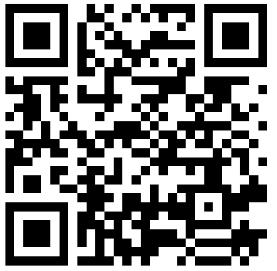
Contact Us
Contact us on the LLMC Support Form
The Lifting as you Lead Mentoring Circles Discussion Guide was created by the Diversity and Inclusion Office, Materiel Group, National Defence.

Slide 29
Support
Employee Assistance Program (EAP)
EAP provides free short-term counselling for personal or work-related problems as well as crisis
counselling.
Toll-free: 1-800-268-7708
TTY (for people with hearing impairments): 1-800-567-5803
https://www.canada.ca/en/government/publicservice/wellness-inclusion-diversity-public-service/
employee-assistance-program.html#E
Hope for Wellness Helpline
24/7 access to Indigenous Counsellors.
Available in French and English and, upon request, Ojibway, Cree and Inuktituk.
1-855-242-3310
Chat line via: https://www.hopeforwellness.ca/
Member and Family Assistance services (Canadian Armed Forces)
The Member and Family Assistance services is a 24 hour, 7 days a week bilingual telephone and face to face counselling service that is voluntary, confidential, and available to Canadian Armed Forces (CAF) members and their families who have personal concerns that affect their well-being and/or work performance.
https://www.canada.ca/en/department-national-defence/services/benefits-military/health-support/member-family-assistance-services.html

Slide 30
Support
Sexual Misconduct Support and Resource Centre (National Defence)
The Sexual Misconduct Support and Resource Centre (SMSRC) was created by the Department of
National Defence but is independent from the CAF chain of command and is not required to report
incidents of sexual misconduct to the CAF. Support services for CAF members, National Defence public
service employees, Cadets and Junior Canadian Rangers affected by sexual misconduct and their
families, aged 16 and older. Guidance and support for leaders and management on addressing sexual
misconduct.
https://www.canada.ca/en/department-national-defence/services/benefits-military/health-support/sexual-misconduct-response.html
The Canada Suicide Prevention Service
Talk Suicide Canada provides nationwide, 24-hour, bilingual support to anyone who is facing suicide.
Toll-free: 1-833-456-4566.
https://www.crisisservicescanada.ca/en/
Wellness Together Canada
Mental Health and Substance Abuse Support.
Toll free: 1-866-585-0445
https://wellnesstogether.ca

Slide 31
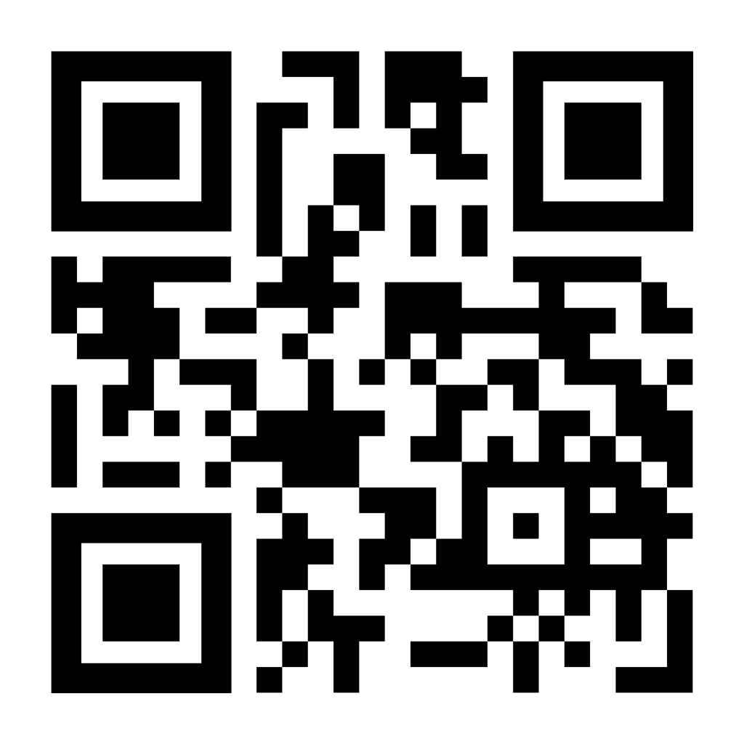
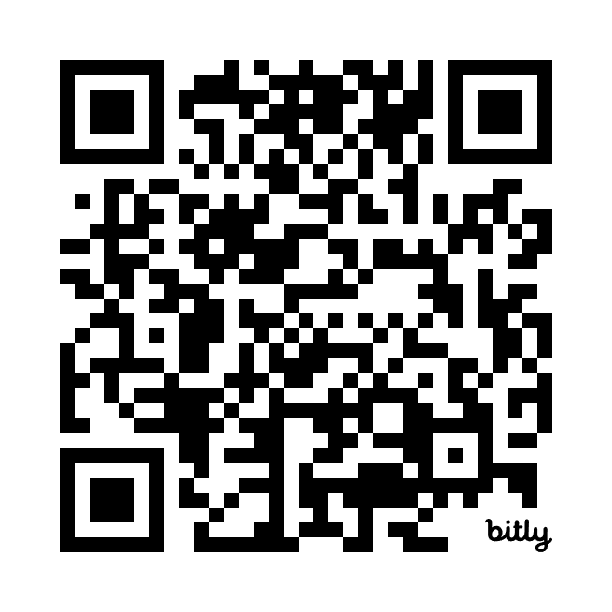
Keep the Conversation Going
Join the LLMC LinkedIn Group
Stay up to date on all Diversity and Inclusion Office Initiatives on our GC Wiki

Slide 32
Thank you all for your participation!
Be well, and take care.

